Slide 1
Anemia
Dr. Musa Alzahrani
Assistant Professor
Consultant Hematologist
MBBS, FRCPC, ABIM, MHSc

Slide 2
Objectives
Know how to read a CBC (complete blood count)
Approach to common causes of anemia
Understand the common terminologies
Brief overview of investigations and management

Slide 3
RBCs

Slide 4
What keep them biconcave?

Slide 5
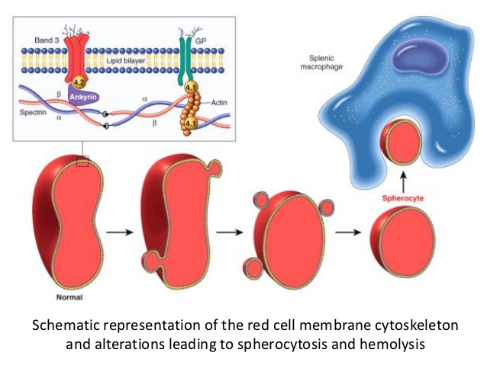
Terminology: spherocytosis
Loss of central pallor
Central pallor 1/3rd

Slide 6
elliptocytosis

Slide 7
Schistocytes (Helmet cells)

Slide 8
Thrombotic thrombocytopenic purpura (TTP)
A fatal disorder with mortality >90% if left untreated
Triad: Low plt, anemia, schistocytes
Pentad: (+/- neurological signs or symptoms, +/- renal failure, +/- fever)
Treatment is urgent PLasma EXchange (PLEX) and survival >85% if treated.
TTP is a true medical emergency!

Slide 9
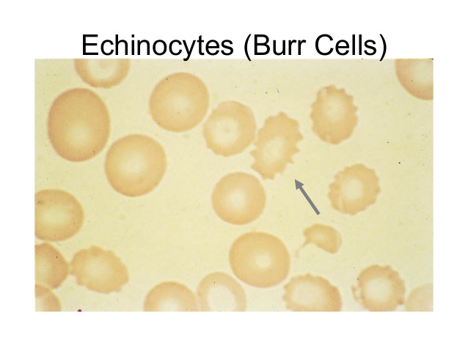
Spur and Burr cells
Liver disease
Renal disease

Slide 10
MCV
The mean corpuscular volume, or mean cell volume (MCV)
Is a measure of the average volume of a red blood corpuscle (or RBC).
MCV is calculated from the distribution of individual RBC volumes.

Slide 11
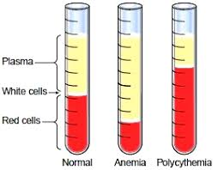
Hematocrit
Automated hematocrit (%) is calculated by multiplying the MCV by the RBC number
Hematocrit = MCV × red blood cells × 100.

Slide 12
MCH
The mean corpuscular hemoglobin (MCH)
Is expressed in picograms.
The MCH is calculated by dividing hemoglobin (g/L) by red blood cell count (10’12/L).

Slide 13
MCHC
The MCH concentration (MCHC)
Is expressed in grams of hemoglobin per deciliter of packed RBCs.
The MCHC is calculated by dividing the hemoglobin concentration (g/dL) by the hematocrit (%) × 100.

Slide 14
Red blood cell distribution width (RDW)
The RDW is the coefficient of variation of RBC size (anisocytosis).
The RDW is used in the evaluation of anemia.
The RDW is:
more frequently elevated with microcytic anemias due to iron deficiency anemia than to thalassemia or anemia of chronic disease
more frequently with macrocytic anemias due to vitamin B12 or folate deficiency than to liver disease, hypothyroidism.
Myelodysplastic syndromes, or RBC transfusions to pts with low/high MCV can produce a dimorphic RBC pattern with a very wide RDW.

Slide 15
Complete Blood Count

Slide 16
Complete Blood Count
Total WBC not the differential count.
Neutrophils, lymphocytes,
Monocytes,
Eosinophils and basophils

Slide 17
CBC with differential count

Slide 18
Complete Blood Count
<
leukopenia
>
Leukocytosis

Slide 19
Leukocytosis? Which cell line?
Neutrophilia ➔
Acute: bacterial infection, steroids.
Chronic: Chronic myeloid leukemia (CML)
Lymphocytosis ➔
Acute: viral infections
Chronic: chronic lymphocytic leukemia
Monocytosis ➔ fungal infection, TB
Eosinophilia ➔ allergic conditions, parasite, autoimmune diseases and eosinophilic leukemia
Basophilia ➔ very rare, CML

Slide 20
Leukopenia? Which cell line? What degree?
Neutropenia:
Mild: Absolute neutrophilic count (ANC) ➔ 1.5 - 1
Moderate: ANC ➔ 1 - 0.5
Severe: ANC ➔ < 0.5
Risk of infection not increased no need to investigate
Risk of infection not increased. But need to investigate
Risk of infection is increased. Must investigate

Slide 21
Complete Blood Count
Notes:
7

Slide 22
Complete Blood Count
Measures the absolute RBC count:
1- Low
2- Normal
3- High
Notes:
7

Slide 23
Complete Blood Count
Low ➔ anemia
High ➔ polycythemia
Notes:
7

Slide 24
Complete Blood Count
Low ➔ anemia
High ➔ polycythemia
Notes:
7

Slide 25
Complete Blood Count
Low ➔ microcytic
Normal ➔ normocytic
High ➔ macrocytic
Notes:
7

Slide 26
Complete Blood Count
Low ➔ hypochromic
Normal ➔ normochromic
Notes:
7

Slide 27
Complete Blood Count
High ➔ hereditary spherocytosis
Notes:
7

Slide 28
Complete Blood Count
High ➔ high variation in RBC sizes (anisocytosis)
Normal/Low ➔ low or no variation in sizes
Notes:
7

Slide 29
Approach to anemia
To start your approach with any case of anemia you need to look at three CBC parameters and one additional test.
The 3 CBC parameters are:
The hemoglobin (Hb)
MCV and
Reticulocyte count (retic count).
And the additional required test is the peripheral blood smear.

Slide 30
Approach to anemia
With the use of these 3 parameters your approach will be divided into 4 categories.
Low MCV (MCV < 80 fL), also called microcytic anemia.
Normal MCV (MCV 80-100 fL) with low retic count, also called normocytic anemia with inappropriately low bone marrow response.
Normal MCV (MCV80-100 fL) with high retic count, also called normocytic anemia with appropriate marrow response.
High MCV (MVC >100 fL), also called macrocytic anemia.

Slide 31
MCV < 80 fL (TAILS) | MCV N, low retic count | MCV N, high retic count | MCV > 100 fL
1) Thalassemia 2) Anemia of inflammation 3) Iron deficiency 4) Lead poisoning 5) Sideroblastic anemia | Bone marrow failure: Aplastic anemia 2) BM suppression: - Toxins, sepsis. - Organ failure: renal failure, liver failure, adrenal insufficiency Chronic inflammation chronic diseases 3) BM infiltration: - Lymphoma, leukemia metastatic solid tumour granulomatous disease (e.g. TB) | 1) bleeding 2) hemolysis 3) treated nutritional deficiency | 1) Megaloblastic: (impaired nucleic acid metabolism): - B12 deficiency - folate deficiency - drugs: such as methotrexate 2) Non megaloblastic: - liver disease - alcohol - Myelodysplasia - thyroid disease - myeloma - Congenital bone marrow failure syndromes
Iron deficiency or thalsemia

Slide 32
Microcytic anemia
Iron deficiency anemia vs thalassemia.
Both will have low Hb and low MCV. How to differentiate?
 | Iron deficiency anemia | Thalassemia
MCV | Low (80-70s) | Very low (70-60s)
RBC | Low | High or normal
RDW | High | normal
Ferritin/iron level | Low | High or normal

Slide 33
Read this CBC: case 1

Slide 34
Case 2

Slide 35
Case 3

Slide 36
Case 4

Slide 37
Case 5
Hb 5, MCV 85 (normal)? What’s next?

Slide 38
Retic count
Retic count can be reported as an absolute number or as a percentage.
A normal retic count/ percentage in the absence of anemia is 100 or 1%, respectively.
When someone with a healthy bone marrow (BM) develops anemia, the BM will automatically compensate for the anemia with production of more young red blood cells (reticulocytes)
Thus the retic count will increase and can go up to 1000 or 10% in some severe cases.
Therefore, a patient with anemia and a healthy bone marrow should have an appropriately elevated retic count.

Slide 39
Case 5
Hb 5, MCV 85 (normal)? What’s next?
Retic count was 300 (3%)

Slide 40
MCV < 80 fL (TAILS) | MCV N, low retic count | MCV N, high retic count | MCV > 100 fL
1) Thalassemia 2) Anemia of inflammation 3) Iron deficiency 4) Lead poisoning 5) Sideroblastic anemia | Bone marrow failure: Aplastic anemia 2) BM suppression: - Toxins, sepsis. - Organ failure: renal failure, liver failure, adrenal insufficiency Chronic inflammation chronic diseases 3) BM infiltration: - Lymphoma, leukemia metastatic solid tumour granulomatous disease (e.g. TB) | 1) bleeding 2) hemolysis 3) treated nutritional deficiency | 1) Megaloblastic: (impaired nucleic acid metabolism): - B12 deficiency - folate deficiency - drugs: such as methotrexate 2) Non megaloblastic: - liver disease - alcohol - Myelodysplasia - thyroid disease - myeloma - Congenital bone marrow failure syndromes

Slide 41
Acute or chronic drop in Hb?
Acute drop is either hemolysis or bleeding.
How to tell the difference?
 | Hemolysis | Bleeding
MCV | Normal or high | Normal or high
Retics | High | Normal or high
Bleeding | No | Yes, not always apparent
LDH | High | Normal
Haptoglobin | Low | Normal
Indirect bilirubin | High | Normal

Slide 42
Hemolytic anemia
Autoimmune hemolytic anemia
Hereditary spherocytosis or elleptocytosis
G6PD or pyruvate kinase deficiency
Sickle cell anemia
Thalassemia

Slide 43
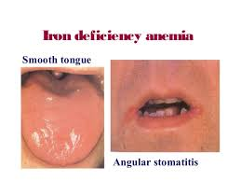
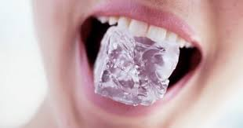
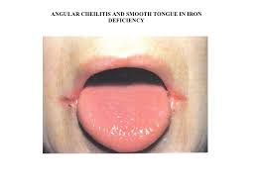
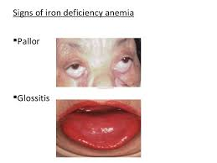
Iron deficiency anemia

Slide 44
Iron deficiency anemia
More common in female: heavy menses
In males: always investigate for GI causes: occult bleeding, colon cancer, malabsorption, celiac disease etc
Diet: a rare cause

Slide 45
Iron deficiency diagnosis
Diagnosis: iron studies:
Serum iron (Fe): measures the concentration of iron in the blood
Transferrin: is the main transport protein for iron
The body produces transferrin in relationship to the need for iron.
When iron stores are low, transferrin levels increase and vice versa.
TIBC:
is a measure of all the proteins in the blood that are available to bind with iron (including transferrin).
The TIBC test is a good indirect measurement of transferrin, as transferrin is the primary iron-binding protein
Transferrin saturation:
TSAT is a good marker of iron status.
TSAT < 20% indicates iron deficiency, a TSAT > 50% may indicate iron overload.
TSAT: is calculated with:
TSAT = (Fe/TIBC) × 100].
Ferritin level

Slide 46
FSG
Ferrous Fumarate: 325mg tablet contains 106mg elemental iron
Ferrous Sulfate: 325mg tablet contains 65mg elemental iron
Ferrous Gluconate: 325mg tablet contains 36mg elemental iron
More elemental = more effective = more GI side effects.
The recommended daily dose is between 150-200mg elemental iron per day.
IV iron (several formulations):
If not tolerant to oral iron
If blood loss exceeds the capacity of oral iron to meet the needs

Slide 47
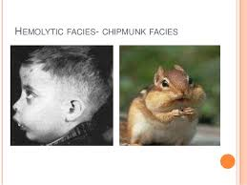
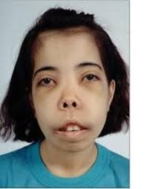
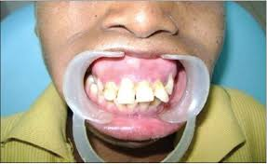
Thalassemia
Prominent malar eminences and mal-alignment of the teeth
Secondary to bone marrow hyperplasia

Slide 48
Alpha vs beta

Slide 49
Thalassemia
Hereditary disorders
Reduction in the synthesis of globin chains
Alpha thalassemia has reduced alpha globin chains
Beta thalassemia has reduced beta thalassemia chains

Slide 50
Anemia of chronic diseases

Slide 51
Anemia of chronic diseases
Serum iron is low.
TIBC is low.
Transferrin saturation is normal or low normal.

Slide 52
Macrocytic anemia (megaloblastic)

Slide 53
Macrocytic anemia (non-megaloblastic)
Liver disease
Alcohol
Myelodysplasia
Thyroid disease

Slide 54
Myelodysplastic syndromes (MDS)
A heterogeneous group of malignant hematopoietic stem cell disorders
Characterized by:
Dysplasia (abnormal morphology)
Varying degree of cytopenia
Variable risk of transformation to AML
A disease of the elderly (median age >65)
Treatment:
Supportive (transfusion, GCSF, antibiotics, EPO)
Hypomethylating agents (azacitidine)
Stem cell transplant (younger patients without comorbidities)

Slide 55
Thanks
Questions?

