Slide 1

Scleroderma Spectrum disease
Mohammed A. Omair MBBS, SF Rheum
Consultant Rheumatologist
Assistant Professor
King Saud University
President of the Charitable Association for Rheumatic Diseases

Slide 2
Agenda
Background
Scleroderma
Sjogren’s Syndrome
Inflammatory Myopathies

Slide 3
Background
Scleroderma spectrum diseases are a group of heterogeneous diseases that has a predominant feature and share other common features.
They are rare.
Difficult to treat.
Associated with significant morbidity and mortality.

Slide 4
Scleroderma or systemic sclerosis (SSc)

Slide 5
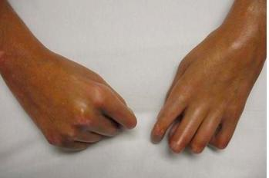
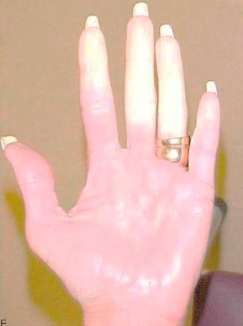
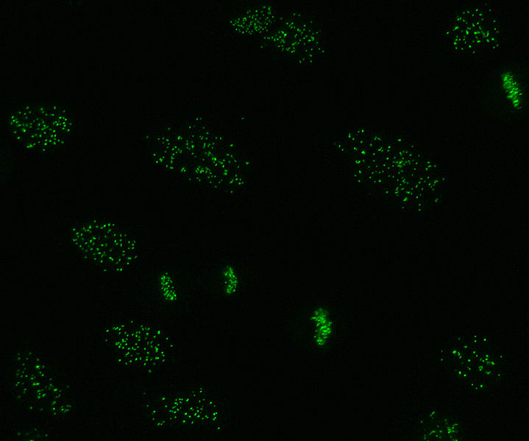
SSc
SSc is characterized by skin thickening, vasculopathy and autoantibody production.

Slide 6
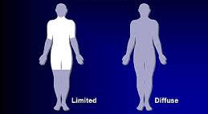
Types
Based on cutaneous involvement, it is classified to diffuse and limited.
Diffuse disease is associated with more internal organ involvement, Anti-topoisomerase/RNA polymerase III antibodies and a worse prognosis.
Limited form is often more indolent, has a higher risk of pulmonary hypertension, and anti-centromere antibodies

Slide 7
Autoantibodies
Scl-70 (topoisomerase): is associated with diffuse subset, ILD, and reduced risk of PAH.
Anti-centromere: limited subset, PAH and DU.
RNA polymerase III: associated with SRC, malignancy associated SSc, and mortality.
Scl-PM: associated with myositis overlap.

Slide 8
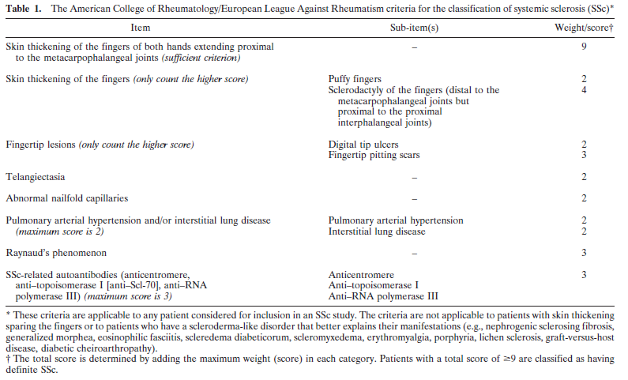
2013 Criteria for the Classification of Systemic Sclerosis

Slide 9
Organ Involvement in SSc
SSc is a disease that is difficult to evaluate, treat, and monitor (why is that ?)
It is very heterogeneous
Usually diagnosed late
Pathogenesis in each organ involved is not the same (Neurovascular/fibroproliferative/inflammatory).
There is no single drug that treats everything
A strategy should be adopted to evaluate each manifestation and organ involved on a regular basis.

Slide 10
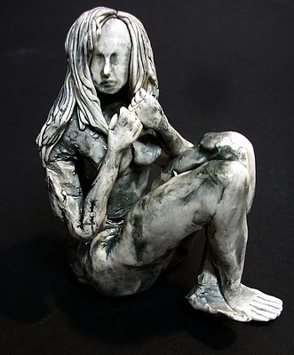
Skin the Largest and Most Important Organ in SSc (and all women)

Slide 11
Skin Involvement
Skin involvement has been considered a reflection of internal organ involvement.
The level of skin involvement predicts severe disease and mortality.
Skin loosening occurs 5 years after the onset of the disease.
Treatment is usually initiated when active skin inflammation is apparent or progressive skin thickening.

Slide 12
Skin Involvement
SKIN INVOLVEMENT ALWAYS STARTS IN THE FINGERS AND TOES AND EXTENDS PROXIMALLY.
Contractures of the fingers and disability are preventable with stretching exercise.
Patients should be advised to use emollients and creams at all time.

Slide 13
Treatment of skin involvement
Methotrexate (if no ILD or renal failure)
Mycophenolate mofetil
Cyclophosphamide
Rituximab
With some steroids

Slide 14
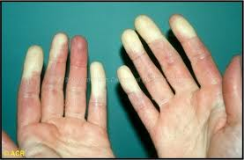
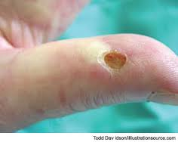
Raynaud’s Phenomenon and Digital Ulcers (Pain at the tip of your fingers)

Slide 15

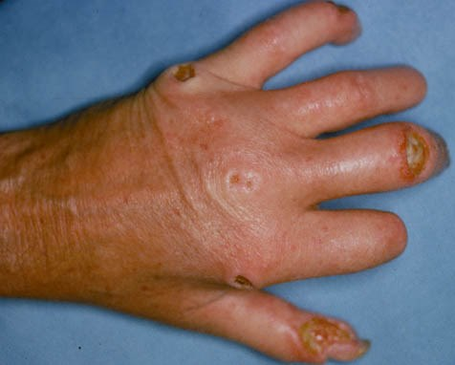
Raynaud’s Phenomenon (RP) and Digital Ulcers (DU)
RP and DU are 2 faces of the same coin.
There is some difference between the underlying pathogenesis of both conditions.
95% and 50% of SSc have RP and DU respectively, but RP tends to occur years before the diagnosis of SSc unlike DU that usually occur in the first 5 years after the development of the non-RP manifestation.

Slide 16
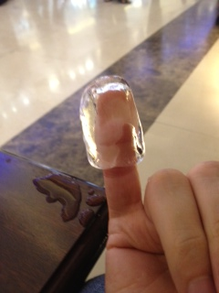
Treatment Modalities in Secondary RP
Never underestimate non-pharmacological treatment.
Treat pain adequately.
Calcium channel blockers are effective in treating RP with the cost of side effects and intolerance.
Prazocin not working well.
Efficacy of oral and IV prostaglandins.
IV iloprost better than nifedipine.

Slide 17
Treatment of DU
Aim of treatment includes: healing and prevention of new ulcers at the end of the study.
Calcium channel blockers are commonly used but no evidence in healing DU
Endothelin receptor antagonist (bosentan) has been shown to prevent new ulcers and is believed to be a disease modifying agent for SSc
Phosphodiesterase inhibitors has a positive effect on healing and preventing ulcers.
Prostacyclin has been shown to heal DU and prevent new ulcers.

Slide 18

Interstitial Lung Disease

Slide 19
ILD
ILD: is defined as a specific form of chronic, progressive fibrosing interstitial pneumonia leading to progressive loss of pulmonary function, and respiratory failure.
Who should be screened for ILD: EVERYBODY
It affects usually the bases of the lungs.
Diagnosis is made by a combination of imaging and pulmonary function test (PFT).

Slide 20
PFT in ILD
Clinical findings in ILD:
Tachypnea
Tachycardia
Cyanosis
Clubbing
Reduced chest expansion
Fine early inspiratory crackles
PFT in ILD shows
Low forced vital capacity (FVC)
Low forced expiratory volume in one second (FEV1)
Normal or high FVC/FEV1 ratio
Low diffusion capacity of carbon monoxide (DLCO)

Slide 21
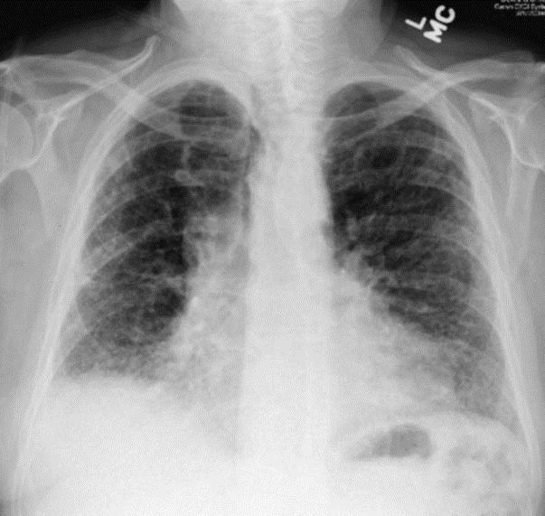
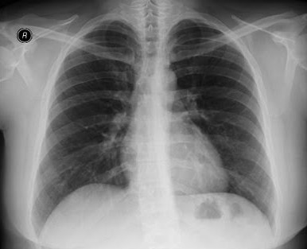
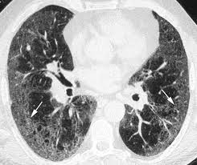
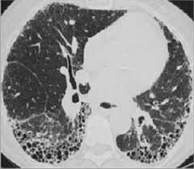

Slide 22
Treatment Options
Cyclophosphamide is up to today the standard of care used as treatment induction in ILD.
Alternative could be: MMF or rituximab.
Maintenance includes: MMF, AZA and RTX.
Steroids are a part of induction and maintenance.

Slide 23
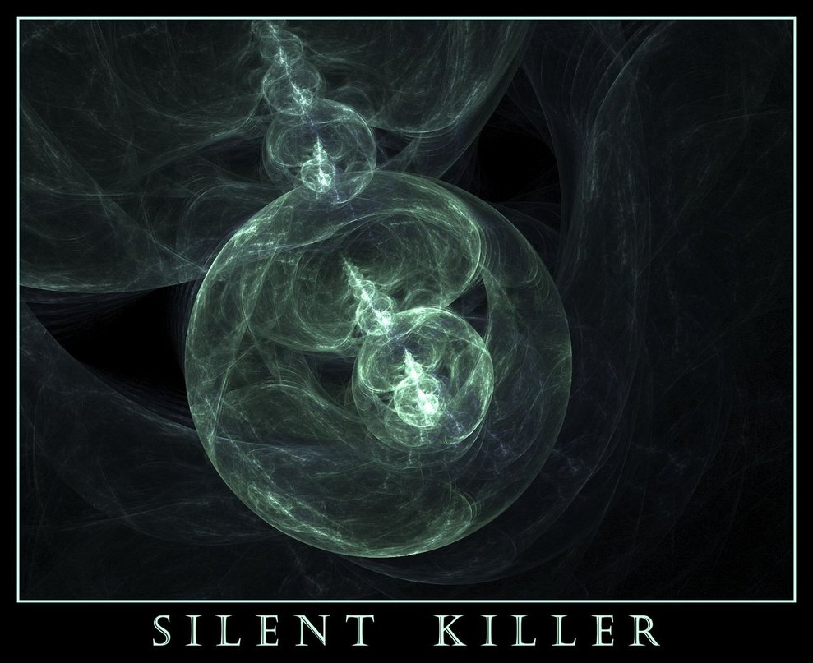
Pulmonary Arterial Hypertension

Slide 24
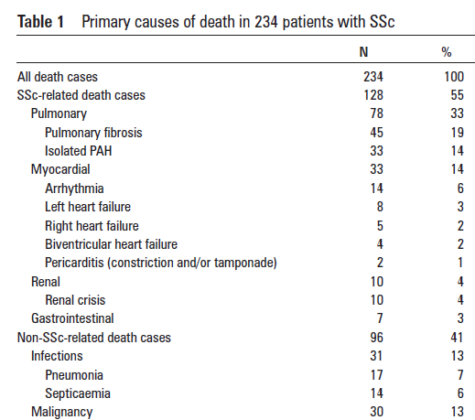


PAH in SSc
PAH is defined as PAP ≥ 25mmHg with a pulmonary wedge pressure ≤ 15 mmHg.
PAH has become a very important cause of mortality along with ILD they are the cause of 33% of death.
Affects 8-13% of SSc (RHC criteria)
PAH

Slide 25
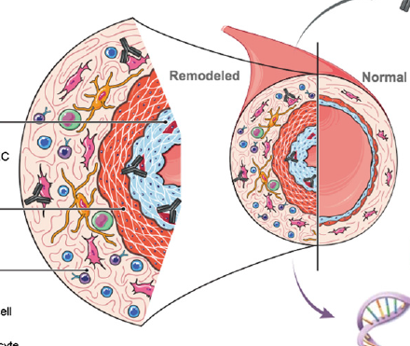
Solutions to Reduce PAH-related Mortality and Morbidity
Early Detection
Aggressive treatment
Early Referral for lung transplant

Slide 26
How to diagnose PAH in SSc
Clinical findings include:
Desaturation
Tachycardia
Palpable P2 and parasternal heave
Loud 2nd heart sound
Signs of right sided heart failure
The first investigation to order is echocardiography.
PFT may show isolated low DLCO
The gold diagnostic tool is right sided heart catheterization.

Slide 27
Remember you can have pulmonary hypertension secondary to ILD which makes diagnosis and management more complex.

Slide 28
Treatment of PAH
Endothelin Receptor Antagonists:
Bosentan
Ambrisentan
Macitentan
Phosphodiestrase Inhibitors
Prostacyclins

Slide 29
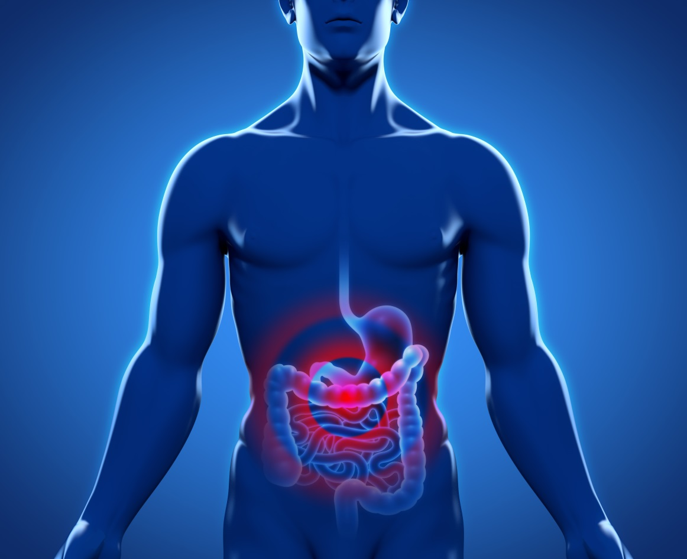
Gastrointestinal System

Slide 30
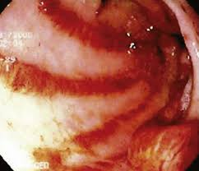
GIT Involvement
GIT is the most common internal organ to be involved (95-99%).
It affects the whole tract:
Esophagus: dysmotility and reflux leading to strictures
Stomach: gasrtoparesis, watermelon appearance with telagectasia.
Treatment of both includes: lifestyle modification, proton pump inhibitors and iron deficiency anemia treatment.

Slide 31
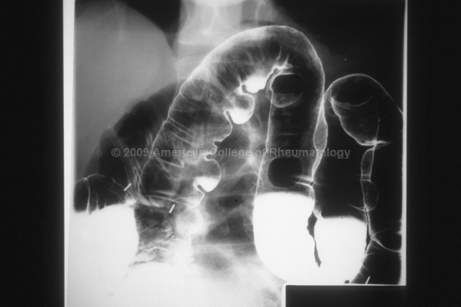
GIT Involvement
Small bowel: blind loop syndrome complicated by bacterial overgrowth manifesting as chronic diarrhea and malabsorption.
Primary treatment is sequential antibiotics but stomas and TPN can be offered in advanced case .
Large bowel: chronic constipation, fish mouth diverticulae.
Treatment includes laxatives
Anorectal: fecal incontinence is a devastating complication and difficult to manage but one option could be to clear bowel frequently before going out.

Slide 32
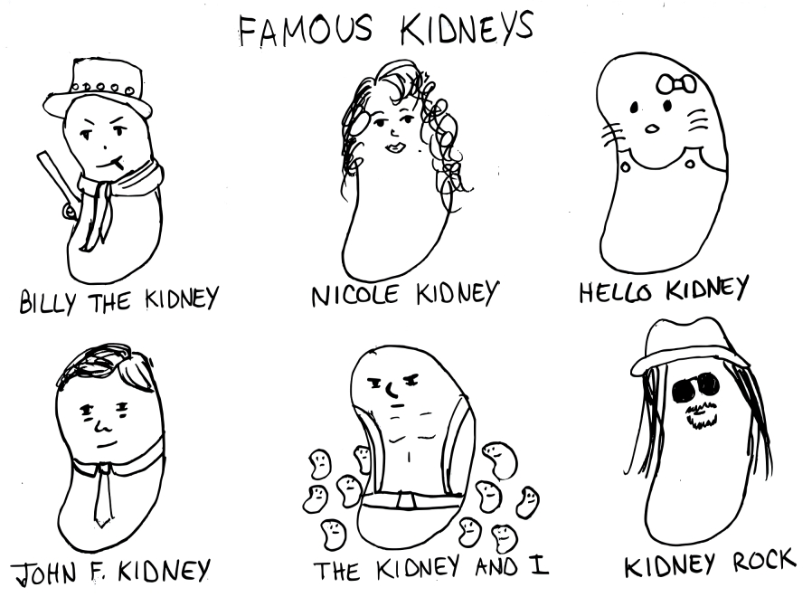
Kidney Involvement

Slide 33
Scleroderma Renal Crisis
Patients with SSc usually have low BP, once you see high BP suspect SRC.
The primary histopathologic changes in the kidney are localized in the small arcuate and interlobular arteries and the glomeruli.
The characteristic finding is intimal proliferation and thickening that leads to narrowing and obliteration of the vascular lumen, with concentric "onion-skin" hypertrophy.
This will lead to activation of the aldosterone-renin-angiotensin pathway.
Precipitating factors include: high dose steroids, cyclosporin, pregnancy.
Anemia in SSc is usually iron deficiency, once you see microangiopathic hemolytic anemia suspect SRC.

Slide 34
Clinical and Lab Findings
Any new onset HTN with a BP of >150/85 or 20mmHg increase from baseline is critical to recognize.
Normotensive renal crisis can occur
Urinalysis might show proteinuria and hematuria but no RBC cast.
High creatinine is almost universal
Anemia with positive hemolytic workup points to microangipathic hemolytic anemia

Slide 35
Treatment
Treatment is control of BP by reducing it 10mmHg every 24 hours
Best (and only) drug Angiotensin Converting Enzyme Inhibitors
Even if progress to ESKD 40% might recover and get back to near normal function.

Slide 36
Other manifestations
Cardiac: Myocardial fibrosis leading to conduction abnormalities, cardiomyopathy, and accelerated coronary artery disease.
Arthritis: similar to RA with erosions and joint destruction.
Myositis: manifested by weakness with no pain and high muscle enzymes.

Slide 37
Sjogren’s Syndrome (SS)

Slide 38
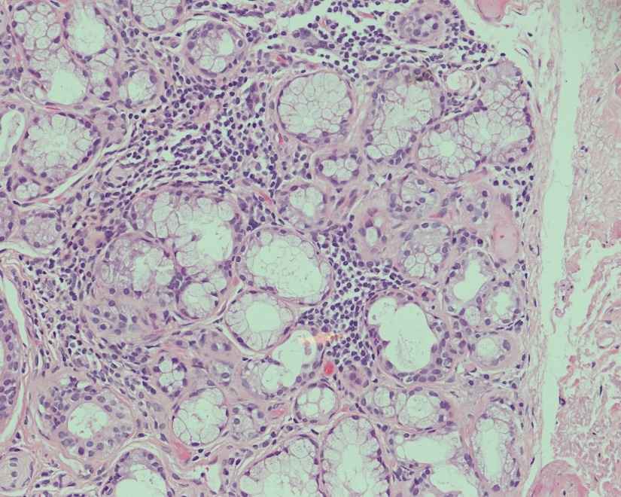
SS
is a systemic chronic inflammatory disorder characterized by lymphocytic infiltrates in exocrine organs.
Most individuals with Sjögren’s syndrome present with sicca symptoms, such as:
Xerophthalmia (dry eyes)
Xerostomia (dry mouth)
Vaginal dryness
Parotid gland enlargement

Slide 39
Criteria of SS
Diagnosis of primary SS requires at least 4 of the criteria listed below (you must have 5 or 6):
Ocular dryness
Oral dyness
Ocular signs (Schirmer test)
Oral signs (sialogram, scintigraphy or sialometry findings)
Positive minor salivary gland biopsy findings
Positive anti–SSA or anti–SSB antibody results

Slide 40
Treatment of glandular manifestations
Oral hygiene
Avoid sugars
Florid products
Parasympathomimetics (pilocarpine)
Artificial eye and mouth moisturizers
Creams and lotions
Vaginal lubricants

Slide 41
Extra-articular manifestations of SS
Arthritis
Myositis
Pancytopenia
Palpable purpura
ILD
Demyelinating disease
Renal tubular acidosis type 1
Interstitial nephritis
Fatigue

Slide 42
Treatment of extra-glandular manifestations
Treatment of all include immunosuppressive agents:
Steroids
MTX (except for ILD)
Azathioprine
Cyclophosphamide
Rituxmiab
For RTA you just need to give NaHCO3

Slide 43
Complications
SS patients are at risk of developing lymphoma 20 times more than the general population
Look for persistent LAP or disappearance of RF

Slide 44
Idiopathic inflammatory Myopathies (IIM)

Slide 45
IIM
Are a group of autoimmune myopathies that are characterized by muscle weakness mainly in the proximal muscles.
It is insidious and progressive.
Pharyngeal muscle involvement can present as dysphagia and can lead to aspiration pneumonia.
Chest wall weakness can present as dyspnea and lead to type II respiratory failure.
Can affect the heart and lead to cardiomyopathy

Slide 46
Types of IIM
Primary idiopathic polymyositis (PM)
Primary idiopathic dermatomyositis (DM)
Polymyositis or dermatomyositis associated with malignancy
Childhood polymyositis or dermatomyositis
Polymyositis or dermatomyositis associated with another connective-tissue disease
Inclusion body myositis
Miscellaneous (eg, eosinophilic myositis, myositis ossificans, focal myositis, giant cell myositis)

Slide 47
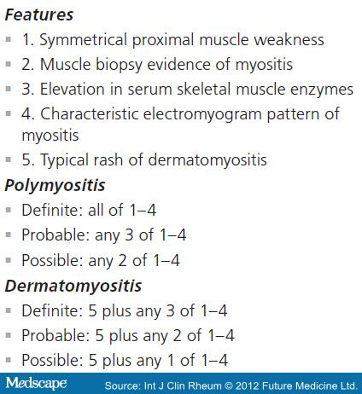
Criteria for PM and DM

Slide 48
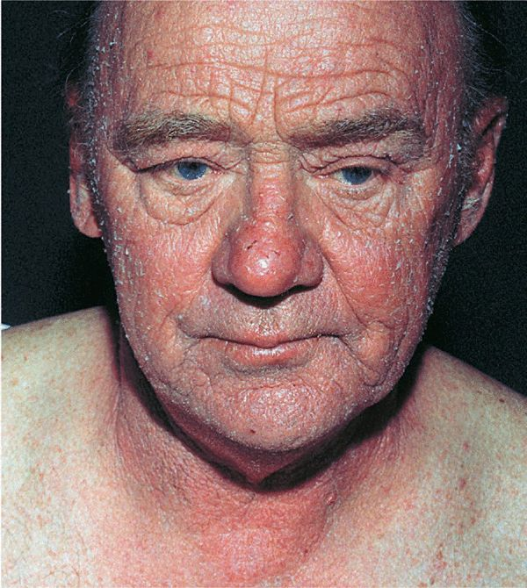
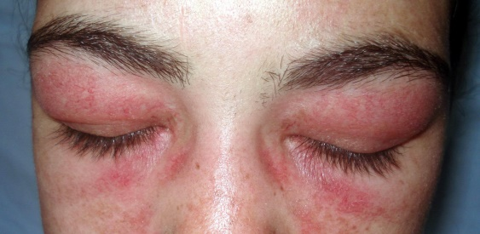
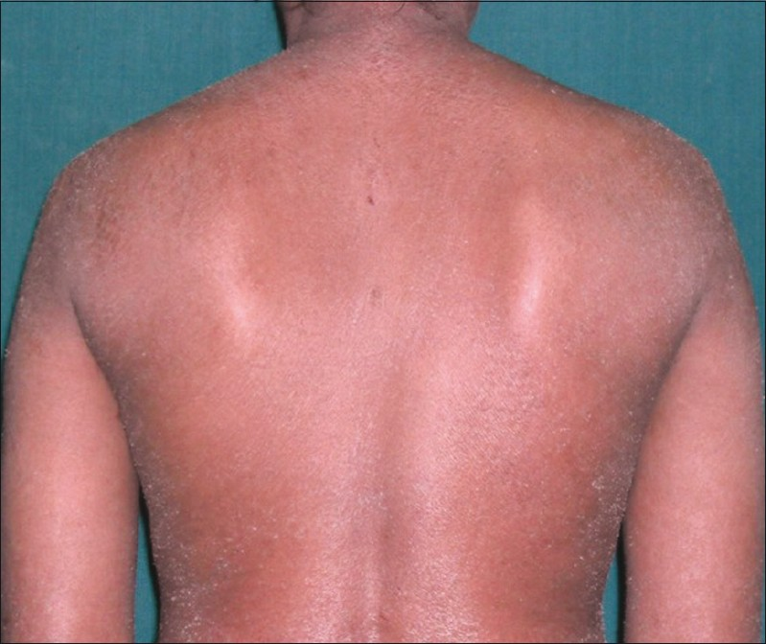
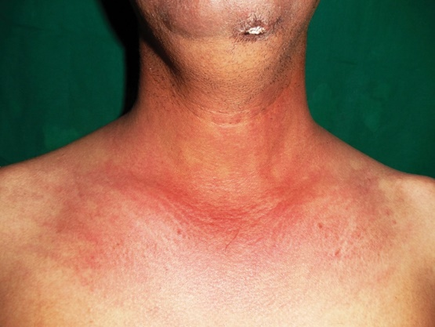
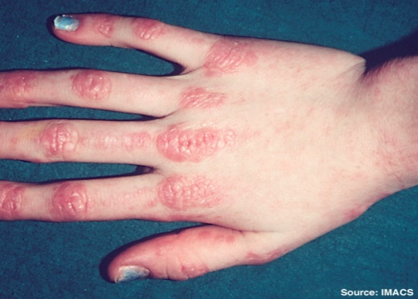
Rashes of DM
Photosensitivity
Heliotrope rash
Gottron’s papules/sign
Shawl rash
Erythroderma

Slide 49
Investigation
Muscle enzymes
CK
LD
AST
ALT
Aldolase
MRI muscle: showing muscle edema
Muscle biopsy: lymphocytic infiltration
EMG: myopathic changes
MOST IMPORTANT: RULE OUT OTHER CAUSES OF MYOPATHIES.

Slide 50
Extra-muscular manifestations
Arthritis
RP
ILD (antisynthetase syndrome)

Slide 51
Treatment of all manifestations
Steroids
Methotrextae
Mycophenolate mofetil
Azathioprine
Rituximab
Intravenous immunoglobulins

Slide 52
Conclusion
Scleroderma spectrum diseases are rare but serious diseases that are characterized by a specific organ involvement and many other common features.
Therapies used to treat inflammatory manifestations are similar for all conditions.
Morbidity and mortality are due to internal organ damage.

Slide 53
Thank you for your attention

