Slide 1

Approach to Headache
Yousef Mohammad MD., MSc., FAHA
Associate Professor of Neurology
King Saud University

Slide 2
Approach to Headache
Primary Headache: always benign
Secondary headache: is serious and sometimes life-threatning

Slide 3
Approach to Headache
Red flags’ include:
1. Sudden or worst headache (thunderclap
headache)
2. New-onset headache after age 50
3. Increasing headache frequency and severity
4. Chronic daily headaches unresponsive to medications

Slide 4
Approach to Headache
Red flags’ include:
5. Headaches always on the same side
6. Headaches following head trauma
7. Headaches with systemic illness (fever, stiff
neck, rash)
8. Headaches associated with seizures
9. Headaches associated with atypical aura

Slide 5
Approach to Headache
Red flags’ include:
10. Headaches associated with abnormal neurologic examination
11. New onset of headache in a human immunodeficiency virus (HIV) or cancer patient
12. Headaches in patients with neurocutaneous
syndromes
13. Headaches precipitated by exertion, strain or
positional changes

Slide 6
Secondary Headache disorder
HEADACHES DUE TO HEAD AND NECK TRAUMA, including hematoma (SDH & EDH)
HEADACHES DUE TO CRANIAL OR CERVICAL VASCULAR DISORDER
HEADACHES FROM ALTERED INTRACRANIAL PRESSURE AND NEOPLASTIC
INFLAMMTORY,, AND INFECTIOUS ETIOLOGIES
HEADACHES FROM SUBSTANCE ABUSE, METABOLIC DISORDERS,
EENT CAUSES, AND NEURALGIAS

Slide 7
HEADACHES DUE TO HEAD AND NECK TRAUMA
After head and neck trauma, patients often develop headache and the post–head trauma syndrome consisting of dizziness, depression, other psychological symptoms, cognitive changes, and insomnia
Performing a brain CT is considered routine after head trauma
At times, very mild trauma causes severe symptoms
The headache is usually tension-type and occasionally migraine and sometimes even cluster headache: post traumatic headache
Treatment include NSAID prn, Amitriptyline, and physical therapy, biofeedback/relaxation therapy, nerve stimulators, and cognitive behavioral therapy

Slide 8
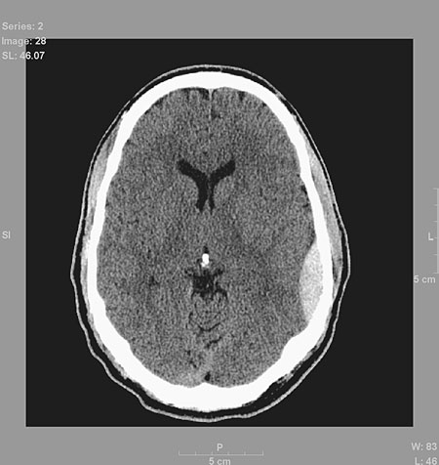
Post Traumatic EDH
Post-traumatic epidural hematoma usually occurs shortly after direct skull trauma and is related to tearing of a middle meningeal artery
There is often a lucid period followed by deterioration in the level of consciousness
The focal signs and symptoms may be more signifi- cant than the headache
Emergency surgery is usually indicated

Slide 9
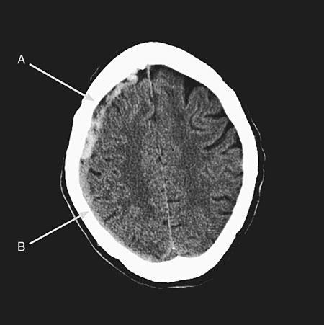
Post Traumatic SDH
Acute subdural hematoma produces a headache that is usually minor compared to the neurologic signs and symptoms the patient develops
the patient often does not recall the mild head trauma that may have caused it
Older person, with or without a history of trauma, has increasing headache a chronic subdural hematoma should be considered

Slide 10
HEADACHES DUE TO CRANIAL OR CERVICAL VASCULAR DISORDER
Headache from ischemic stroke
Headache from ICH
Headache from AVM
Headache from SAH
Headache from Giant Cell Arteritis
Headache from vasculitis

Slide 11
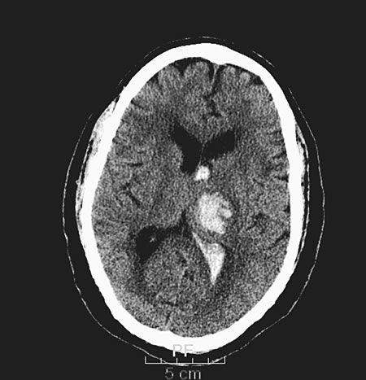
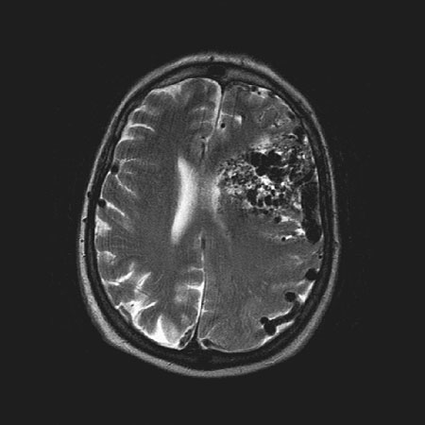
HEADACHES DUE TO CRANIAL OR CERVICAL VASCULAR DISORDER
Headache from ischemic stroke: onset is concurrent with acute focal neurological deficit and usually migrainous in quality
Headache from intracerebral hemorrhage
Headache from AVM

Slide 12
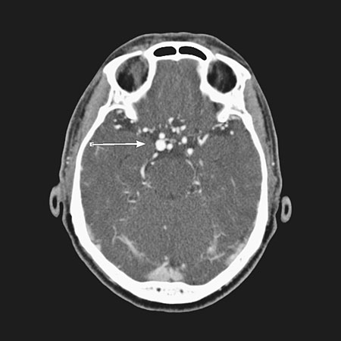
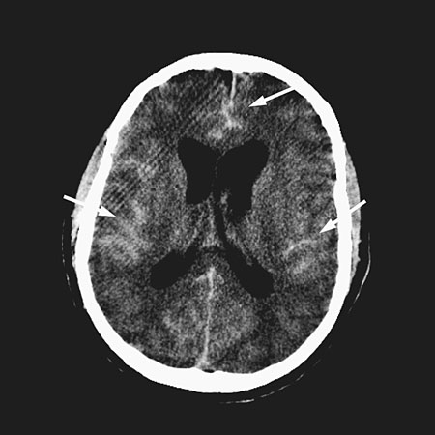
Headache Attributed to Subarachnoid Hemorrhage:
Sudden severe headache (thunderclap)
A very serious condition with a 50% mortality rate within hours
Caused by ruptured saccular aneurysms
Associated with nausea, vomiting, nuchal rigidity, and cardiac arrhythmias
The diagnosis is easily confirmed by a CT scan (if negative then spinal tap)
Treatment is urgent aneurysm coiling

Slide 13
Headache Attributed to Giant Cell Arteritis
Affects only elderly population >65 years
Cause irreversible blindness
Temporal area pain, tenderness of one or both temporal arteries
Protruding temporal artery and Pulseless temporal artery
Jaw claudication,fatigue, anemia
Elevated ESR and/or CRP
Start high dose prednisone and Biopsy within 1 week

Slide 14
Headache from CNS Vasculitis
Headache is usually of migrainous quality
Stroke
Seizures
Altered Mental Status
Evaluation include MRI, CT angiogram, sometimes biopsy
Treatment include steroid and other immuno-suppressive agents

Slide 15
HEADACHES FROM ALTERED INTRACRANIAL PRESSURE AND NEOPLASTIC
IDIOPATHIC INTRACRANIAL HYPERTENSION
POSTURAL (POST-LUMBAR) PUNCTURE HEADACHE
HEADACHE ATTRIBUTED TO SPONTANEOUS (OR IDIOPATHIC) LOW CSF PRESSURE
HEADACHE ATTRIBUTED TO INTRACRANIAL NEOPLASM

Slide 16
IDIOPATHIC INTRACRANIAL HYPERTENSION
It is a disorder of abnormal cerebrospinal fluid (CSF) mechanics
It is associated with the use of tetracyclines, vitamin A and retinoids, nalidixic acid, and the withdrawal of Corticosteroids
Usually affects young overweight females
Usually presents with headache, Transient visual obscurations, papilledema, and pulsating tinnitus

Slide 17
IDIOPATHIC INTRACRANIAL HYPERTENSION
Visual loss can be permanent
Evaluation include MRI/MRV of brain. If normal, then spinal tap to measure the OP (>25 cm)
Treatment include weight loss and Acetazolamide
Fenestration of the optic nerve sheath and VP shunt for refractory patients

Slide 18
POSTURAL (POST-LUMBAR) PUNCTURE HEADACHE
Headache occurs in as many as 60% of patients who undergo LP
Headache is orthostatic in nature
Risk factors include headache before LP, patients with a lower body mass index, and younger female patients
Small-gauge a traumatic needles do appear to reduce the risk of post-LP headache
Treatment include lying in a supine position
Rehydration, simple analgesics, opioids and anti‐emetics
Blood patch for refractory cases

Slide 19
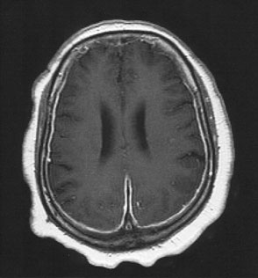
HEADACHE ATTRIBUTED TO SPONTANEOUS LOW CSF PRESSURE
Idiopathic low-pressure headache typically results from a CSF leak, usually from trauma
Headache is orthostatic and bilateral
Other symptoms include changes in vision, hearing, dizziness, and diplopia
MR imaging shows diffuse enhancement of the pachymeninges
Treatment options include bed rest, analgesics, caffeine
hydration, epidural saline infusion
Epidural blood patch is effective and act by sealing the dural defect

Slide 20
HEADACHE ATTRIBUTED TO INTRACRANIAL NEOPLASM
Headache occurs in 50% to 70% of those with brain tumors
Localized or diffuse non-pulsating headache
Progressive
Associated with nausea and/or vomiting
Worse in the morning
Aggravated by coughing or bending forward
Might be associated with focal neurological deficits, papilledema, seizure, or visual symptoms
Brain imaging is a must
Headache responds to surgical removal of tumor or steroids

Slide 21
INFLAMMTORY, AND INFECTIOUS ETIOLOGIES
HEADACHE ATTRIBUTED TO ASEPTIC (Non-infectious) MENINGITIS: NSAIDS, IMMUNOGLOBULINS, ANTIBIOTICS
HEADACHE ATTRIBUTED TO INTRACRANIAL INFECTION

Slide 22
HEADACHE ATTRIBUTED TO ASEPTIC (Non-infectious) MENINGITIS
NSAIDS (Ibuprofen), IMMUNOGLOBULINS, Abs (penicillin or trimethoprim)
The clinical presentation is similar to infectious meningitis, with headache, meningismus, and mental status changes
The CSF picture is of elevated protein values, normal-low glucose values, and several hundred to several thousand white cells
Headache resolves within 3 months after withdrawal of the offending substance

Slide 23
HEADACHE ATTRIBUTED TO INTRACRANIAL INFECTION
Headache increasing in intensity
Associated fever, nuchal rigidity, nausea, photophobia and/or phonophobia
Urgent CT of brain. If normal proceed urgently with spinal tap
Start broad spectrum Abs (Ceftriaxone and Vancomycin) pending CSF results
If altered mental status is present indicating encephalitis, then add Acyclovir pending HSV PCR in the CSF

Slide 24
HEADACHES FROM SUBSTANCE ABUSE, METABOLIC DISORDERS
HEADACHE ATTRIBUTED TO A SUBSTANCE OR ITS WITHDRAWAL
Headache Attributed to Pre-eclampsia and Eclampsia
Medication Overuse Headache
High-Altitude Headache
Sleep Apnea Headache
Headache Attributed to Hypertensive Encephalopathy

Slide 25
HEADACHE ATTRIBUTED TO A SUBSTANCE OR ITS WITHDRAWAL
Nitric Oxide Donor–Induced Headache (nitroglycerin, sodium nitroprusside, isosorbide)
Phosphodiesterase (sildenafil and dipyridamole)
Alcohol-Induced Headache
Monosodium glutamate (tomato, cheese, Chinese food, canned vegetables, soups and processed meat
Cocaine
Cannabis
Caffeine withdrawal, opioid withdrawal, estrogen
withdrawal

Slide 26
HEADACHE ATTRIBUTED TO A SUBSTANCE OR ITS WITHDRAWAL
Nonsteroidal antiinfl amatory Indomethacin, diclofenac
Beta-blocker Atenolol
Calcium channel blocker Nifedipine
Histamine receptor blocker Cimetidine, ranitidine
Antibiotics Tetracyclines, trimethaprim-sulfamethoxazole
Vasodilators Isosorbide dinitrate, glyceryl trinitrate
Hormones Danazol, ethinylestradiol, oral contraceptives
Others Angiotensin-converting enzyme inhibitors, monoamine, oxidase inhibitors, selective serotonin receptor inhibitors

Slide 27
Headache Attributed to Pre-eclampsia and Eclampsia
Pre-eclampsia consists of hypertension, edema, and proteinuria
Eclampsia is characterized by all of the above plus the presence of seizures
Both disorders can occur up to 4 weeks postpartum
The headache may be bilateral, pulsatile, or worse with exertion
The headache should develop during periods of high blood pressure and resolve within 7 days after effective treatment of the hypertension.

Slide 28
Medication Overuse Headache
Patients who develop a new type of headache or whose migraine or tension-type headache is made markedly worse during medication overuse should be given both the diagnosis of the preexisting headache and the diagnosis of medication overuse headache
Excess consumption of ergotamine, triptan, analgesic, opioid, combination medications, can all cause overuse headache
Treatment is gradual withdrawal of the incriminated agent
Tricyclic anti-depressant or SSRI can be added during he withdrawal process

Slide 29
High-Altitude Headache
Headache commonly occurs when climbing to altitudes greater than 2,500 meters
The disorder affects women more often than men and affects younger people
Usually dull or pressing in nature and mild to moderate in intensity
Headache develop within 24 hours of ascent and will resolve within 8 hours of descent
The headache may awaken the sufferer from sleep or be present upon awakening in the morning

Slide 30
Sleep Apnea Headache
These recurrent headaches occur on more than 15 days per month and are bilateral and pressing
Individual headaches are present upon awakening and resolve within 30 minutes
Overnight polysomnography is mandatory
Headache resolves within 72 hours and does not recur after effective treatment of the sleep apnea

Slide 31
Headache Attributed to Hypertensive Encephalopathy
Sudden and severe increases in blood pressure may produce an acute encephalopathy with headache, reduced level of consciousness, visual disturbances, and seizures
In normotensive patients this syndrome may develop when the blood pressure reaches 160/100
The headache should resolve following the control of the elevated blood pressure
MRI shows white matter abnormality that resolves within few weeks

Slide 32
Primary Headache

Slide 33
Approach to the Patient with Headache
A 28 year old lady was referred to the neurology clinic for recurrent headaches. She been having headache since age 19 years of age.
She described the headache as throbbing and localized at the bilateral temporal area.
The headache is usually associated with photophobia, phonophobia, nausea and vomiting and usually lasts 24 hours.

Slide 34
Approach to the Patient with Headache
She avoid moving during the headache attack because it makes the headache worse. The intensity of the headache is mostly severe
She has been having 7 attacks a month
Chinese food usually triggers headache attack. No change in the headache since the onset

Slide 35
Approach to the Patient with Headache
Social history: works as a secretary
Family history: negative for migraine headache
Medications: simple analgesics prn
Normal neurological examination

Slide 36
Approach to the Patient with Headache
What is your diagnosis

Slide 37
Approach to the Patient with Headache
Answer: Migraine without aura

Slide 38
Approach to the Patient with Headache
Migraine epidemiology
Migraine diagnosis
Migraine pathophysiology
Migraine treatment
Migraine prevention

Slide 39
Notes:
Migraine is a highly prevalent medical disorder, afflicting nearly 28 million people in the United States. The overall 1-year prevalence of migraine among individuals 12 years of age and older is 12.6%. Nearly 3 times as many females as males are affected. Approximately 1 out of every 5 women in the United States suffers from migraine versus 1 in 15 men.¹
1. Lipton RB, Stewart WF, Diamond S, Diamond ML, Reed M. Prevalence and burden of migraine in the United States: data from the American Migraine Study II. Headache. 2001;41:646-657.

Slide 40
Migraine Prevalence Is Highest at Ages of Peak Productivity
25-30 Million Americans Suffer from Migraine
Women
Men
Migraine
Prevalence (%)
20
30
40
50
60
70
80
90
100
Age (Years)
Lipton RB et al. Headache. 2001;41:646-657.
*
Notes:
SLIDE 6. Migraine Prevalence Is Highest at Ages of Peak Productivity
Each year approximately 18 million patients visit physicians for headache (Cypress BK, 1981)
Migraine is a common, chronic disorder. From a prevalence study using a questionnaire in the general population, it can be estimated that migraine affects approximately 25-30 million people in the United States (Lipton RB, Stewart WF, 1993)
The prevalence of migraine has remained stable over the past decade. The number of migraine sufferers in the United States increased from 23.6 million in 1989 to 27.9 million in 1999. This growth is commensurate with the growth of the population (Lipton RB et al, 2001b)
A survey of almost 14,000 US households using questionnaires found that migraine affects approximately 6.5% of men and 18.2% of women each year (Lipton RB et al, 2001b)
Although the prevalence of migraine varies with age, it is highest during the ages of peak productivity, primarily between the ages of 30 and 49 years (Stewart WF et al, 1992)
At its peak prevalence (age 30-39 years), migraine affects approximately 1 out of 4 women and approximately 1 out of 10 men (Lipton RB et al, 2001b)

Slide 41
Migraine Prevalence Comparable to
Many Other Chronic Illnesses
30
26.4
25
21.4
20
18.2
Percentage of Population
15
8.9
10.0
10
8.3
8.0
6.5
5
0
Diabetes*
Hypertension†
Asthma‡
Migraine§
*Ages ≥ 20 years. †Ages 20-74 years. ‡Ages ≥ 18 years. §Ages ≥ 12 years.
Centers for Disease Control. Available at: http://www.cdc.gov. Accessed October 28, 2002.
Lipton RB et al. Headache. 2001;41:646-657.
Notes:
SLIDE 7. Migraine Prevalence Comparable to Many Other Chronic Illnesses
Migraine is a chronic illness characterized by potentially debilitating acute attacks
The overall prevalence of migraine is comparable to other common chronic illnesses, specifically diabetes, hypertension, and asthma (CDC statistics, 2002; Lipton RB et al, 2001b)

Slide 42
Notes:
Most migraine sufferers experience severe migraine pain. In AMS II, affected individuals were asked to rate the severity of their headaches on a scale that ranged from mild to extremely severe. More than 89% reported experiencing severe to extremely severe migraine pain.¹ Only 9.7% reported moderately severe pain and fewer than 1% described their migraine pain as mild.
1. Lipton RB, Diamond S, Reed M, Diamond ML, Stewart WF. Migraine diagnosis and treatment: results from the American Migraine Study II. Headache. 2001;41:638-645.

Slide 43
Notes:
Lipton et al conducted a population-based survey in 1999—the American Migraine Study II (AMS II). The survey was mailed to 20,000 United States households to identify individuals with severe headache meeting a case definition of migraine based upon the IHS criteria.^{1*}
In the American Migraine Study II affected individuals were asked to rate the severity of their headaches on a scale that ranged from mild to extremely severe. Ninety-nine percent of migraine sufferers experienced moderate to severe pain, of which, more than 75% experienced severe to extremely severe migraine pain.¹ The majority of patients also experienced other debilitating symptoms in association with migraines. Over three quarters of sufferers experience light and/or sound sensitivity. Many also experience nausea (74%) and vomiting (30%).¹
Although migraine headaches are acute in nature, they are typically long in duration if left untreated, ranging from 4 hours to 72 hours.²
*Both migraine sufferers with and without a physician diagnosis of migraine were included in the survey.
1. Lipton RB, Diamond S, Reed M, Diamond ML, Stewart WF. Migraine diagnosis and treatment: results from the American Migraine Study II. Headache. 2001;41:638-645.
2. Headache Classification Committee of the International Headache Society. Classification and diagnostic criteria for headache disorders, cranial neuralgias and facial pain. Cephalalgia. 1988;8(suppl 7):1-96.

Slide 44
Most Migraine Sufferers
Have ≤ 3 Attacks Per Month
Monthly Frequency of Migraine Headaches
> 5 Attacks
4-5 Attacks
14%
11%
75%
≤ 3 Attacks
N = 3738 self-reported migraine sufferers.
Lipton RB et al. Headache. 2001;41:646-657.
Notes:
SLIDE 29. Most Migraine Sufferers Have ≤ 3 Attacks Per Month
Lipton et al reported that approximately 75% of self-reported migraine sufferers experience 3 or fewer headache attacks per month (Lipton RB et al, 2001b)
Studies indicate women tend to experience migraine headache attacks more frequently than men (Stewart WF et al, 1994)

Slide 45
Migraine Headache
Attacks Last Most of the Day
Duration of Untreated or Unsuccessfully Treated Migraine Headache Attacks
> 2 Days
4
1-2 Days
8
5-24 Hours
49
≤ 4 Hours
39
0
10
20
30
40
50
Percentage of Migraine Sufferers
N = 1638 self-reported migraine sufferers.
Lipton RB et al. Headache. 1998;38:87-96.
Notes:
SLIDE 30. Migraine Headache Attacks Last Most of the Day
Untreated or unsuccessfully treated, migraine headache attacks typically last 4 hours to 3 days in adults (Olesen J, 1988)
Sixty-one percent of self-reported migraine sufferers experience headache attacks that last 5 hours or longer (Lipton RB et al, 1998)
Strict IHS criteria for headache duration (4 to 72 hours untreated) was used in this study
The median duration for migraine headache attacks is 9 to 24 hours in adults (Stewart WF et al, 1994)

Slide 46
Migraine Is Disabling
Percentage of Migraine Sufferers Reporting Impairment
Unable to Do Household Work
75%
Household Productivity
Reduced ≥ 50%
67%
Missed Family/Social Activity
59%
Work/School
Productivity Reduced ≥ 50%
51%
0 10 20 30 40 50 60 70 80
Lipton RB et al. Headache. 2001;41:646-657.
Notes:
SLIDE 32. Migraine Is Disabling
As a result of their headache pain and associated symptoms, most migraine sufferers are not able to function normally
The functional impairments associated with migraine headaches interfere with patients’ work, school, family lives, and social activities
Lipton et al (2001b) reported that three quarters of migraine sufferers reported being unable to perform any household work when stricken
Two thirds of respondents stated that their overall household productivity was reduced by 50% or more
Fifty-nine percent of subjects missed family or social activities because of migraines
More than half of subjects with migraine noted that their work or school productivity was reduced by 50% or more (Smith R, 1998)
As demonstrated in a separate study by Smith, the negative impact of migraine on families is considerable. In this telephone survey of 350 migraine sufferers, 61% reported negative family effects due to migraine, including the inability to care for young children, poor spousal relationships, and separation and divorce (Smith R, 1998)

Slide 47
Notes:
Despite the significant clinical, social, and economic impact of migraine, diagnosis and treatment rates remain low.
In AMS II, only 48% of subjects who met IHS criteria for a diagnosis of migraine had, in fact, ever been diagnosed by a physician.¹ The majority of migraine sufferers in the United States do not currently consult a physician about their headaches, including many who experience severe, disabling pain.¹
This slide also shows the treatment patterns for the migraine sufferers who responded to the survey. Forty-six percent of sufferers used prescription medications, half of whom (23%) combined it with over-the-counter pain relievers. Forty-nine percent received OTC medications only and a small portion of patients—5%—use no medication at all.¹
1. Lipton RB, Scher AI, Kolodner K, Liberman J, Steiner TJ, Stewart WF. Migraine in the United States: epidemiology and patterns of health care use. Neurology. 2002;58:885-894.

Slide 48
Notes:
Hu and colleagues estimated the economic costs of migraine in 1998. They correlated data from medical claims for migraine-related treatments, prevalence and disability data from published studies, and information from both the US Census Bureau and the Bureau of Labor Statistics.¹ The direct medical costs of migraine, which include inpatient, outpatient, and prescription-drug costs, were estimated at more than $1 billion.¹ Indirect costs of migraine, attributable to missed workdays and to lost worker productivity, were estimated at $13 billion annually, with the majority of costs, almost $8 billion, attributable to migraine-related missed workdays.¹
It should be noted that the $1 billion in direct medical costs estimated by Hu et al probably underestimates current medical expenditures for migraine. This study did not include over-the-counter medications, nor did it include the majority of preventive medications, most of which are also used to treat conditions other than migraine.¹ Lastly, since prescription-medication estimates were based on data from 1994, the only triptan represented in the estimate is Imitrex.¹
1. Hu XH, Markson LE, Lipton RB, Stewart WF, Berger ML. Burden of migraine in the United States: disability and economic costs. Arch Intern Med. 1999;159:813-818.

Slide 49
Approach to the Patient with Headache
Migraine epidemiology
Migraine diagnosis
Migraine pathophysiology
Migraine treatment
Migraine prevention

Slide 50
Migraine without aura
A. At least 5 attacks fulfilling criteria B-D
B. Headache attacks lasting 4-72 h (untreated or unsuccessfully treated)
C. Headache has ≥2 of the following characteristics:
  1. unilateral location
  2. pulsating quality
  3. moderate or severe pain intensity
  4. aggravation by or causing avoidance of routine physical activity (eg, walking, climbing stairs)
D. During headache ≥1 of the following:
  1. nausea and/or vomiting
  2. photophobia and phonophobia
E. Not better accounted for by another ICHD-3 diagnosis

Slide 51
Migraine with aura
A. At least 2 attacks fulfilling criteria B and C
B. ≥1 of the following fully reversible aura symptoms:
1. visual; 2. sensory; 3. speech and/or language; 4. motor ; 5. brainstem; 6. retinal
C. ≥2 of the following 4 characteristics:
1. ≥1 aura symptom spreads gradually over ≥5 min, and/or ≥2 symptoms occur in succession
2. each individual aura symptom lasts 5-60 min
3. ≥1 aura symptom is unilateral
4. aura accompanied or followed in <60 min by headache
D. Not better accounted for by another ICHD-3 diagnosis, and TIA excluded

Slide 52
Approach to the Patient with Headache
Migraine epidemiology
Migraine diagnosis
Migraine pathophysiology
Migraine treatment
Migraine prevention

Slide 53
Migraine Pathophysiology
    Multi-Mechanism
    Neurogenic Inflammation
    Pain Neuropeptides
    Central processing of trigemiovascular pain (Trigeminal Nucleus generator).
    Central sensitization
    Cortical Spreading Depression.
    Throbbing/Pulsating pain (vasodilation)

Slide 54
Migraine: Pathophysiology
Vascular Theory (Harold Wolff)
Migraine starts with intracerebral vasoconstriction that sometimes leads to an aura, due to significant reduction in blood flow. This is followed by reactive vasodilation, to increase blood flow, with the consequence of throbbing/pulsating headache.

Slide 55
Migraine Pathophysiology
Vascular Theory (Harold Wolff)
He also demonstrated that Ergotamine worked by constricting blood vessels and used this as proof of the vascular theory.

Slide 56
Migraine: Pathophysiology
Drawbacks of the Vascular Theory
Some of the drugs used to treat migraine have no effect on blood vessels.
Most patients have no aura
The evidence from some studies to support the theory was inconsistent
This indicates that the mechanism of migraine is not purely vascular.

Slide 57
Migraine: Pathophysiology
Neurovascular Theory:
Migraine is not caused by a primary vascular event. It is a disorder in which neural events precedes the development of headache.

Slide 58
Migraine: Pathophysiology
Based on the concept that Serotonin can relieve migraine. Humphrey and his colleagues clarified the 5-HT receptor responsible for selective cranial vasoconstriction, and this led to the development of Sumatriptan

Slide 59
Migraine: Pathophysiology
Sumatriptan passed well the clinical trials and was FDA approved for the treatment of migraine headaches.
This was followed by the development of a number of new Serotonin agonists (Triptans).
All Triptans share the same mechanism of action: promote vasoconstriction and block pain pathways at Brainstem level.

Slide 60
Migraine: Pathophysiology
excessive indulgence in sensual pleasures.
A long weekend at the seaside means drinking, drugging & general debauchery , yes?
excessive indulgence in sensual pleasures.
A long weekend at the seaside means drinking, drugging & general debauchery , yes?
Cortical Spreading depression

Slide 61
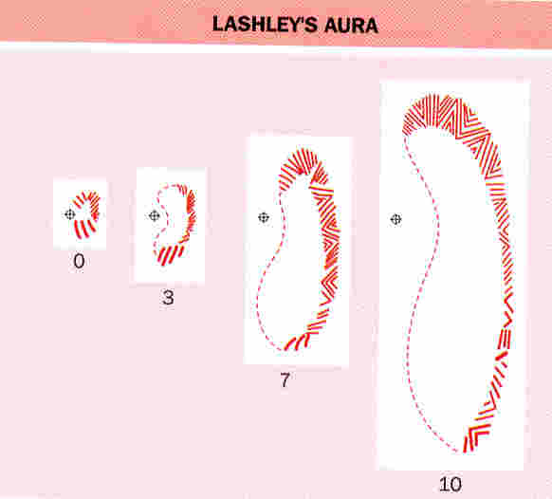
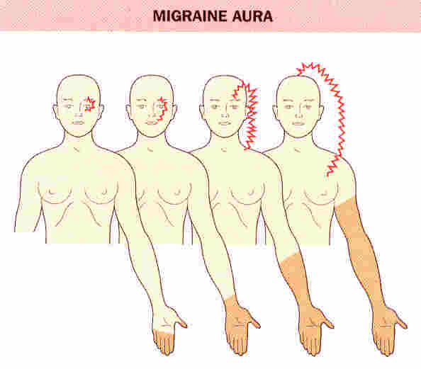
Migraine Aura (25%)

Slide 62
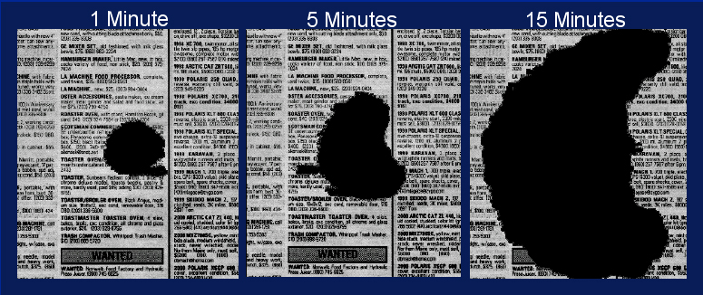
Visual Aura
1 Minute
5 Minutes
15 Minutes
Adapted from Lashley KS. Arch Neurol Psychiatry. 1941;46:331-339.
Notes:
SLIDE 27. Visual Aura
A visual aura, such as this representation of a scotoma, is the most common form of aura experienced by migraine sufferers
A visual aura may take different manifestations (MacGregor A, 1999)

Slide 63
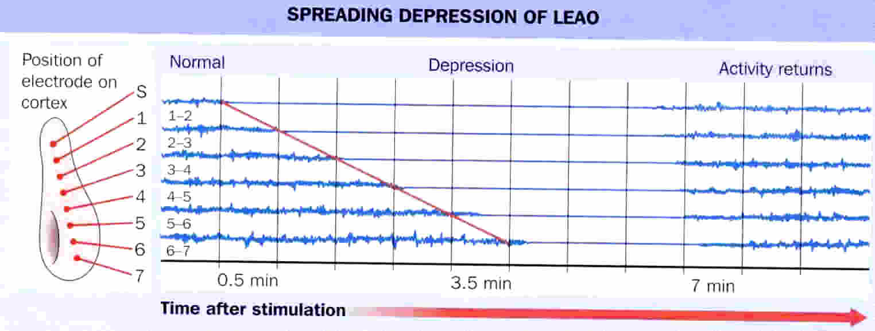
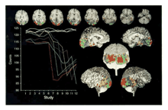
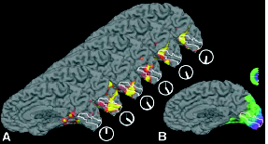
Cortical Spreading Depression & Migraine
Woods, R. P., M. Iacoboni, et al. (1994). "Brief report: bilateral spreading cerebral hypoperfusion during spontaneous migraine headache." N Engl J Med 331(25): 1689-92.
Hadjikhani, N., M. Sanchez Del Rio, et al. (2001). "Mechanisms of migraine aura revealed by functional MRI in human visual cortex." Proc Natl Acad Sci U S A 98(8): 4687-92.

Slide 64
Migraine: Pathophysiology
Migraine with aura may begin with a state of neuronal hyper excitability followed by depression (spreading depression of Leao): Neuronal dysfunction.
Most clinicians now believe that neuronal dysfunction (spreading depression) is the neuronal basis for the migraine aura.

Slide 65
Approach to the Patient with Headache
Migraine epidemiology
Migraine diagnosis
Migraine pathophysiology
Migraine treatment
Migraine prevention

Slide 66
Nausea
Treatment Options
Metochlopramide
Prochorperazine

Slide 67
Treatment of Acute Migraine Attacks
US Headache Consortium Guidelines:
Non-steroidal Anti-inflammatory Agents and non-opiate analgesics (Ibuprofen, Naproxen, and Aspirin) for patients with mild to moderate migraine pain [Grade A]

Slide 68
Treatment of Acute Migraine Attacks
US Headache Consortium Guidelines:
Serotonin Receptor Agonists (Triptans) are useful choices for patients who have moderate to severe migraine or no relief from NSAIDS [Grade A]
All Triptans share the same mechanism of action: promote vasoconstriction and block pain pathways at Brainstem level.

Slide 69
Treatment of Acute Migraine Attacks
Triptans
Sumatriptan (Imitrex)
Zolmitriptan (Zomig)
Naratriptan (Amerge)
Rizatriptan (Maxalt)
Eletriptan (Relpax)
Almotriptan (Axert)
Frovatriptan (Frova)

Slide 70
Efficacy of Eletriptan:
Headache Response at 2 Hours
Sandrini et al
Mathew et al
67%
*
70%
64%
70%
†
*
†
59%*
60%
60%
50%*
53%*
50%
50%
40%
40%
31%
Patients with response (%)
Patients with response (%)
26%
30%
30%
20%
20%
10%
10%
0%
0%
Placebo
Imitrex
Imitrex
Relpax
Placebo
Imitrex
Relpax
50 mg
100 mg
40 mg
100 mg
40 mg
(n= 80)
(n=176)
(n=160)
(n=169)
(n=404)
(n= 799)
(n= 779)
Imitrex
was blinded using encapsulation. Encapsulated
Imitrex
was bioequivalent to commercial tablets.
†
*P
<.05 vs placebo.
P
<.05 vs Imitrex.
*
†
P
<.0001 vs placebo.
P
<.0001 vs Imitrex.
Sandrini et al.
Neurology
. 2002.
Mathew et al.
Headache
. 2003.
Notes:
The results in the study by Sandrini et al show that both active drugs were superior to placebo for headache response at 2 hours postdose. The 40-mg dose of Relpax had a headache response of 64% compared to the headache response of 50% for Imitrex 50 mg and 53% for Imitrex 100 mg.¹ Active treatment comparisons demonstrated a statistically significant difference between the 40-mg dose of Relpax and the 50-mg and 100-mg doses of Imitrex (P<.05).¹
In the study by Mathew et al, comparisons between active treatments showed a statistically significant difference between the 40-mg dose of Relpax and the 100-mg dose of Imitrex. Both active treatments were superior to placebo. The 40-mg dose of Relpax had a headache response of 67% compared to the headache response of 59% for Imitrex 100 mg (P<.0001).¹
Sandrini G, Färkkilä M, Burgess G, Forster E, Haughie S, for the Eletriptan Steering Committee. Eletriptan vs sumatriptan: a double-blind, placebo-controlled, multiple migraine attack study. Neurology. 2002; 59:1210-1217.
Mathew NT, Schoenen J, Winner P, Muirhead N, Sikes CR. Comparative efficacy of eletriptan
40 mg versus sumatriptan 100 mg. Headache. 2003;43:214-222.

Slide 71
Notes:
These charts show the clinical success (efficacy) and clinical failure (return of headache) rates from the Ferrari meta-analysis for all the triptans. The chart on the left is for 2-hour pain-free sustained response. The highest success rates were seen with Imitrex 50 mg and 100 mg, Zomig 5 mg, Axert 12.5 mg, Maxalt 10 mg, and Relpax 40 and 80 mg.¹
The bars on the right indicate the failure (return of headache) rate within 24 hours of the initial response at 2 hours. The lowest failure (return of headache) rates were seen with Amerge 2.5 mg and Relpax 40 and 80 mg.¹
Ferrari M, Roon K, Lipton R, Goadsby P. Oral triptans (serotonin 5-HT_{1B/1D} agonists) in acute migraine treatment: a meta-analysis of 53 trials. Lancet. 2001;358:1668-1675.

Slide 72
Other Treatment Options for Acute Migraine Attacks
Ergot Alkaloids and Deratives: DHE and Ergotamine for patients with severe to moderate migraine pain [Grade B and C].
Opioid Analgesics: For patients with moderate to severe attacks. Efficacy must be balanced against the risks of sedation and dependency [Grade A and B]
Barbiturate Hypnotics: Same as Opioids. [Grade B].

Slide 73
Treatment of Acute Migraine Attacks
Combinations Acetaminophen/aspirin/caffeine 500/500/130 mg or Sumatriptan/naproxen 85/500 mg are effective
Antiemetics: Intravenous Metoclopramide and IV or IM Prochlorperazine have pain relieving properties [Grade B]
Other Agents:
- Isometheptene for mild to moderate pain [Grade B]
- Corticosteroids for status migrainous

Slide 74
Migraine Treatment
New and novel treatment of migraine:
Transcranial Magnetic Stimulation (TMS)
CGRP Receptor Blocker

Slide 75
TMS Rationale
Neurovascular Theory III
Lashley, who suffered from migraine, calculated that the growth of his own migrainous fortification spectrum corresponded to an event moving across the cortex at a rate of 2-3mm/min

Slide 76
TMS Rationale
Leao found that noxious stimulation of the exposed cerebral cortex of a rabbit produced a spreading decrease in electrical activity that moved at a rate of 2-3mm/min (spreading depression of Leao).

Slide 77
Cortical Spreading Depression & Migraine
Lashley’s Aura
Spreading Depression of LEAO
Position of electrode on cortex
Normal Activity Returns
Depression
0
3
7
0.5 min
3.5 min
7 min
10
Time after stimulation
Woods, R. P., M. Iacoboni, et al. (1994). "Brief report: bilateral spreading cerebral hypoperfusion during spontaneous migraine headache." N Engl J Med 331(25): 1689-92.
Hadjikhani, N., M. Sanchez Del Rio, et al. (2001). "Mechanisms of migraine aura revealed by functional MRI in human visual cortex." Proc Natl Acad Sci U S A 98(8): 4687-92.

Slide 78
TMS Rationale
Neurovascular Theory III:
Recent magnetoencephalography studies suggested that changes consistent with spreading depression exists in migraine patients
Recently, Welch et al, suggested that migraine aura may be associated with a state of neuronal hyper excitability.

Slide 79
TMS Rationale
Cortical spreading Depression (CSD):
Migraine starts with neuronal hyper excitability which is manifested as flashing light, zigzag light, bright spots etc.
The neuronal hyper excitability is followed by neuronal depression which is manifested as the aura
This process spreads out and is followed by the throbbing/pounding headache
Currently, most migraine experts believe that cortical spreading depression is likely to be the neurobiological basis for the migraine

Slide 80
TMS Rationale
Neurovascular Theory:
Based on the trigeminal autonomic dysfunction theory, applying TMS pulses at the onset of migraine attack can deactivate the sensitization of the trigeminovascular afferents and hence relieve the headache
Based on the CSD theory, applying TMS pulses during the aura phase can depolarize/deactivate the neurons and hence interrupt the cortical spreading depression activity and the headache

Slide 81
TMS Rationale
We hypothesized that TMS might be effective in the acute treatment of migraine perhaps by disrupting cortical spreading depression or deactivating trigeminal vascular afferents

Slide 82
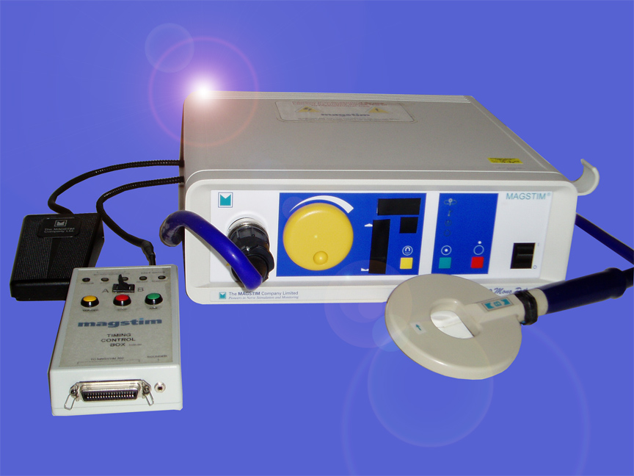
TMS Background
The magnetic stimulator will be applied by the subject over the area of maximal headache or over the occipital area (visual aura)
Modified Magstim 200
Mohammad et al...

Slide 83
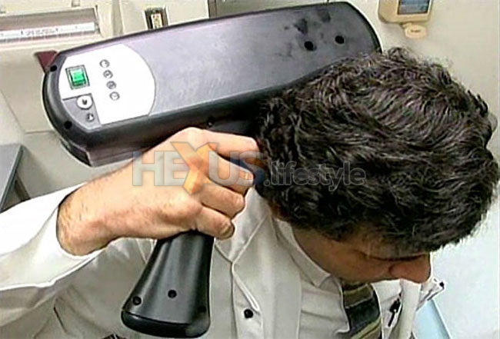

Slide 84
CONCLUSIONS
In this small randomized Pilot trial:
For the primary endpoint, 2 hour headache response differences were not significant but the trend was encouraging (74% vs. 45%, p =.0531)
There were statistically significant differences in photophobia and phonophobia free
Trends favored TMS for 2 hour pain free, nausea free, work function, and the global assessment but were not significant
Mohammad et al.

Slide 85
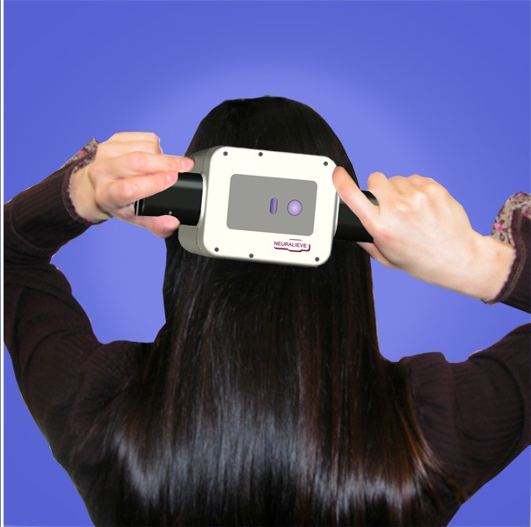
An adequately powered randomized trial focusing on treatment during the aura phase was conducted
Future studies may focus on treatment during the premonitory or headache phase of migraine without aura.
Mohammad et al

Slide 86
TMS: Phase III Trial
Phase III Randomized, Double-Blind, Parallel Group, Sham-Controlled Study Evaluating the Efficacy and Safety of Nin-Repetitive TMS for the Acute Preemptive of the Aura Phase of Migraine Headache.

Slide 87
TMS: Phase III Trial
Primary Outcome Measures
Percentage of patients experiencing no pain at two hours post-treatment of the first episode.
Percentage of patients who have symptoms of nausea, vomiting, photophobia, and phonophobia two hours post treatment of the first episode.

Slide 88
TMS: Phase III Trial
METHODS
18-65 years
Fulfills the ICDD-II criteria for Migraine with aura.
30% of the migraine attacks have a visual aura preceding the headache.
90% of the time have moderate or severe headaches following their aura.
1-8 migraine attacks per month.
Prolonged aura (> 60 minutes) are excluded.

Slide 89
TMS: Phase III Trial
METHODS
A Multi-center study (16 centers)
Patients randomized to either the
Portable TMS device or the sham device
0.9 Tesla vs 0 Tesla (x 2 application)
During the aura phase of the first three
Attacks or for three months.
Patients will record their response electronically
Through PDA.

Slide 90
TMS: Phase III Trial
RESULTS
A total of 267 subjects were enrolled in 16 sites.
201 subjects entered the migraine treatment phase.
82 TMS subjects and 82 Sham subjects reported at least one treatment of an aura episode and 37 subjects did not report a treatment.

Slide 91
TMS: Phase III Trial
 | TMS N =82 | Sham N =82
Pain free at 2 hours | 39% | 22% P=0.018
Sustained pain free at 24 hours | 29.3% | 15% P=0.040
Sustained pain free at 48 hours | 26.8% | 13.4% P=0.033

Slide 92
TMS: Phase III Trial
The safety of TMS has been demonstrated
The FDA, in 2014, approved TMS for migraine treatment

Slide 93
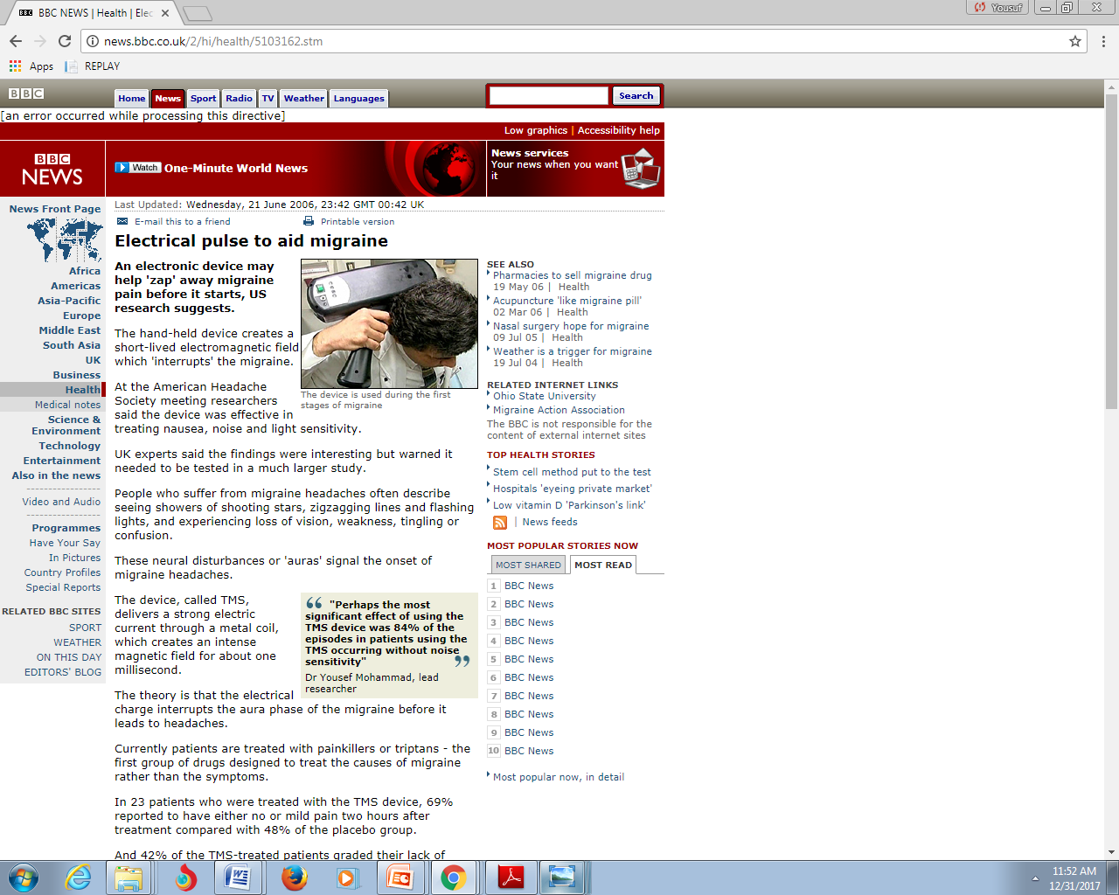

Slide 94
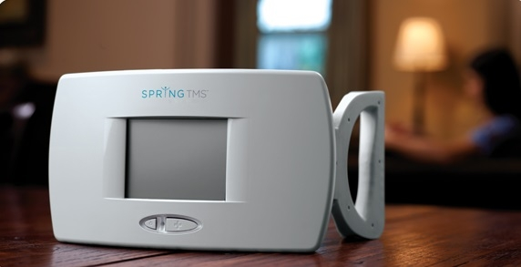

Slide 95
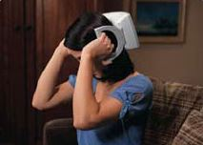
In 2014 TMS, the first transcranial magnetic stimulation device for migraine that will be available to U.S. patients, has received FDA approval

Slide 96
Emerging New Treatments for Acute Migraine Attacks
Calcitonin Gene-Related Peptide (CGRP) Receptor Blocker: MK-0974

Slide 97
Migraine Pathophysiology
    Multi-Mechanism
    Neurogenic Inflammation
    Pain Neuropeptides
    Central processing of trigemiovascular pain (Trigeminal Nucleus generator).
    Central sensitization
    Cortical Spreading Depression
    Throbbing/Pulsating pain (vasodilation)

Slide 98
CGRP Receptor Blocker: MK-0974
Rationale
The pain-producing trigeminal neurons that innervate the cranial circulation and dura mater release a number of Neuropeptides (CGRP).
Stimulation of the trigeminal ganglion in humans results in elevated levels of CGRP in the cranial circulation.

Slide 99
CGRP Receptor Blocker: MK-0974
Rationale
CGRP levels are also increased during acute attacks of migraine
Migraine patients infused with CGRP developed a delayed headache.
Treatment of migraine attacks with Rizatriptan or Sumatriptan reduces the elevated CGRP levels.

Slide 100
CGRP Receptor Blocker: MK-0974
Rationale
Migraine is triggered by CSD or brainstem (Generator).
This is followed by activation of trigeminal nociceptive neurons which release CGRP at their central and peripheral nerve endings.
CGRP release in the periphery leads to pronounced vasodilatation and centrally (brain stem) it facilitate pain transmission.

Slide 101
CGRP Receptor Blocker: MK-0974
Rationale
CGRP Receptor Antagonist (MK-0974) relieves headache when administered during a migraine attack.

Slide 102
CGRP Receptor Blocker: MK-0974
Ho et al. Headache 47 (2007).
 | MK-0974 25-300 mg | MK-0974 300-600 | Rizat | Placeb
2 hr pain relief | No efficacy | 68.1% | 69.5% | 46.3%
2 hr pain free | No efficacy | 45% | 33.4% | 14.3%
Sustain pain free | No efficacy | 39.6% | 18.4% | 11%

Slide 103
CGRP Receptor Blocker (MK-0974) Trial
Total n= 1380
 | MK 150mg n=333 | Tel 300mg n=354 | Zolm n=345 | Placebo n=348
Pain free | 17% | 26% | 31% | 9.6%
Pain relief | 49% | 55% | 56% | 27%
Photo free | 53% | 57% | 55% | 36%
Phono free | 45% | 51% | 50% | 28%
Nau free | 67% | 65% | 71% | 55%

Slide 104
CGRP Receptor Blocker (MK-0974) Phase III Trial
Conclusion
Telcagepant 300mg is effective as an acute treatment for migraine with efficacy comparable to that of Zolmitriptan, but with fewer associated adverse effects.

Slide 105
Approach to the Patient with Headache
Migraine epidemiology
Migraine diagnosis
Migraine pathophysiology
Migraine treatment
Migraine prevention

Slide 106
Migraine Prevention

Slide 107
Migraine Prevention
Migraine Hygiene
Avoid triggers (red wine, aged cheese, preserved meat etc.)
Regular meals
Regular and adequate sleep
Avoid over the counter medications
Exercise
Education
Relaxation Technique
Biofeedback Technique

Slide 108
What Can You Do to Manage
Your Migraines?
Lifestyle
  Identify and then avoid your triggers
    Write down what you were eating, drinking, and doing as well as what was happening around you when a migraine attack began
  Follow a regular sleep routine
  Eat meals at regular times each day
  Avoid eating foods and beverages that may trigger migraine
    Foods containing nitrites or monosodium glutamate (MSG)
    Foods and beverages containing the artificial sweetener aspartame
    Chocolate
    Aged cheeses
    Alcohol
  Exercise often
108
Notes:
The first step to managing migraines is to look at your lifestyle and see if there are any changes you can make that might help you prevent or minimize your migraines.
First of all, try to identify your triggers. The next time you have a migraine, write down everything you were doing when it came on, like what you ate or drank before you got the migraine, or what was happening around you.^{12,17,18} Were there any loud noises, such as during a loud movie?
You should also try to keep a regular schedule. Try to get the same amount of sleep each night, going to bed and getting up at about the same time. Also, it’s helpful to eat at regular times during the day.^{17,18}
Speaking of eating, as we discussed before, some foods and beverages are notorious migraine triggers. If you’re keeping track of your migraines and find you often get them after consuming certain foods or beverages, try avoiding those items. As a reminder, typical food and beverage triggers include chocolate, aged cheeses, and alcohol, as well as foods containing nitrites or monosodium glutamate, or MSG, or aspartame, an artificial sweetener. However, every individual is different. You may discover a completely different set of triggers for your migraines.^{12,17,18}
Finally, like with most medical conditions, exercising regularly can really help, in this case because exercise helps reduce stress hormones in the body.¹⁹
SLIDE 108
108

Slide 109
Migraine Prevention
Preventive treatment can be
preemptive (ex. Migraine induced by exercise:Indomethacin 25mg or 50mg 1-2 hours prior to exercise)
Short term prevention (ex. Menstrual related: NSAID or Naratriptan)
Long term prevention

Slide 110
Migraine Prevention
Recommendations for Long-Term Prevention
    Recurring migraine that significantly interferes with the patient’s daily routine despite acute treatment
    Failure of, contraindication to, or troublesome side effects from acute medications
    Presence of uncommon migraine conditions (Basilar migraine)
    Overuse of acute medications

Slide 111
Migraine Prevention
US Headache Consortium Guidelines
Non-Pharmacologic Interventions may be provided before or in conjunction with traditional anti-migraine prophylaxis:
  Behavioral Treatment
  Physical Treatment

Slide 112
Migraine Prevention
Behavioral Treatments (Grade A and B)
    Relaxation Training
    Biofeedback Therapy
    Cognitive-Behavioral
    Stress Management training

Slide 113
What Can You Do to Manage
Your Migraines?
Reduce stress
Relaxation exercise
  Tense muscles are a sign of stress, which can trigger a migraine. Progressive relaxation:
    Relax the muscles in each part of your body step-by-step and note the difference in how it feels
    Knowing the difference between tense and relaxed muscles allows control over stress reaction
  Deep-breathing exercise
    Sit in a quiet place
    Close your eyes and inhale slowly and deeply through the nose to the count of 10
    Expand your stomach and abdomen but do not let your chest rise
    Exhale through the nose to the count of 10
    Focus on your breathing and counting; clear your mind of other thoughts
    Repeat 5-10 times
113
Notes:
Remember this exercise from the beginning of this seminar? This is another exercise you can do when you feel yourself getting stressed out. Try to repeat it about 5-10 times when you do it.¹
SLIDE 113
113

Slide 114
Preventive Treatment of Migraine
Physical Treatments
(No recommendation by the US Headache Consortium)
    Acupuncture
    Transcutanuos electrical nerve stimulation
    Cervical Manipulation
    Mobilization Therapy

Slide 115
Migraine Prevention
The major medication groups for migraine prevention include:
    ß-adrenergic blockers
    Anti-depressants (TCA’s and SSRI’s)
    Calcium channel antagonist
    Serotonin antagonist (Methysergide)
    Anti-Epileptics

Slide 116
Migraine Prevention
Preventive medications should be considered for frequent , impairing or prolonged attacks
The agent should be chosen from one of the major categories based on side effects profile, and coexistent co-morbid conditions
Preventive medications should be started at a low dose and increased slowly until therapeutic effect develop, side effects develop, or the ceiling dose for the agent is reached

Slide 117
Migraine Prevention
A full trial may take 2-6 months
Avoid interfering, contraindicated, or overused medications
Involve patients in their care to improve adherence

Slide 118
Migraine Prevention
Migraine headache may improve with time. A drug holiday should be attempted every few months
A woman of childbearing potential should be on adequate contraception before starting migraine medications
Choose a drug based on efficacy, patient’s preferences, headache profile, the drug’s side effects, and the presence of coexisting or co-morbid conditions

Slide 119
Migraine Prevention
Drugs with documented high efficacy and mild to moderate adverse effects (AEs) include Topiramate, ß-blockers, Amitriptyline, and Divalproex
Drugs with lower documented efficacy and mild to moderate AEs include SSRIs, Calcium channel antagonists, Gabapentin, and Riboflavin
Drug use based on opinion include many antidepressant medications like Doxepin, Sertraline, Trazodone etc.

Slide 120
Migraine Prevention
Drugs with documented high efficacy that have significant AEs include Methysergide
Drugs with proven limited or no efficacy include Cyproheptadine, Lithium and Phenytoin

Slide 121
Migraine Prevention
Choose a drug based on its proven efficacy, drug’s side effects and the presence or absence of coexisting or co-morbid disease
    An underweight patient would be a candidate for TCA. In contrast, one would try to avoid these drugs in the overweight patient
    An obese or overweight patient would be a good candidate for Topiramate because weight loss is a common adverse reaction for this agent

Slide 122
Migraine Prevention
The older patient with cardiac disease or patients with significant hypotension may not be able to use TCAs or calcium channel or ß-blockers but could easily use Divalproex
In the athletic patient, ß-blockers should be used with caution
Tertiary TCAs that have a sedating effect would be useful at bedtime for patients with insomnia

Slide 123
Migraine Prevention
When migraine and hypertension and/or angina occur together, ß-blockers or calcium-channel blockers is effective for all conditions
For patients with migraine and depression, TCAs or SSRIs may be especially useful
For the patient with migraine and epilepsy or migraine and manic depressive illness, Divalproex sodium, Gabapentin, or Topiramate are the drugs of choice

Slide 124
AHS/AAN Migraine Prevention Guidelines
Level A: established as effective
Divalproex: 400-1000 mg/day
Topiramate: 25-200 mg/day
Propranolol: 120-240 mg/day
Metoprolol: 47.5-200 mg/day
Timolol: 10-15 BID
Petasites: 50-75 BID

Slide 125
AHS/AAN Migraine Prevention Guidelines
Level B: probably effective
Amitriptyline: 25-150 mg/day
Fenoprofen: 200-600 TID
Feverfew: 50-300 mg BID
Naproxen 500-1100 mg/day
Magnesium 600 mg QD
Riboflavin 400 mg/day

Slide 126
AHS/AAN Migraine Prevention Guidelines
Level C: possibly effective
Candesartan: 150 mg ER/day
Clonidine 0.75-0.15 mg/day
Carbamazepine: 600 mg/day
Cyproheptadine
Guafacine: 0.5-1 mg/day
Pindolol: 10 mg/day

Slide 127
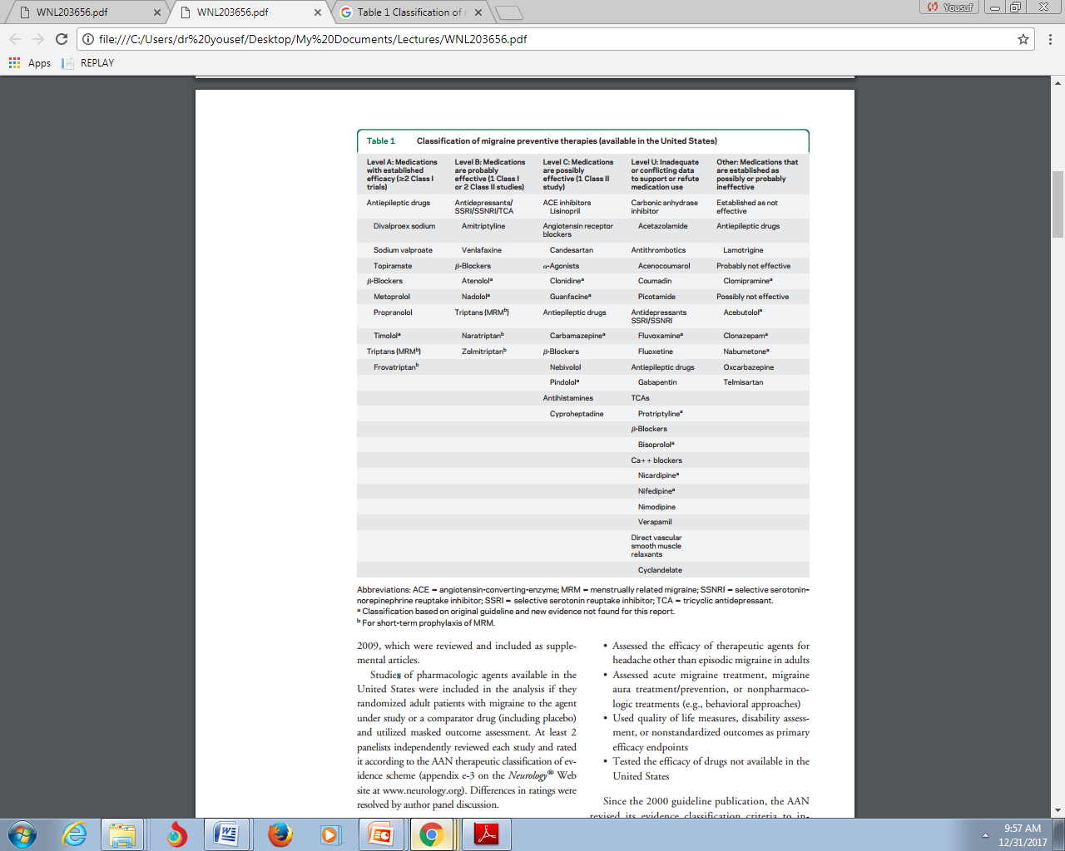

Slide 128
Based on the quality of studies, a level of evidence was assigned for each drug, as follows:
Level A: Established as effective (or ineffective) for acute migraine (supported by at least 2 Class I studies)
Level B: Probably effective (or ineffective) for acute migraine (supported by 1 Class I study or 2 Class II studies)
Level C: Possibly effective (or ineffective) for acute migraine (supported by 1 Class II study or 2 Class III studies)
Level U: Evidence is conflicting or inadequate to support or refute the use of the medication(s) for acute migraine

Slide 129
Approach to the Patient with Headache
A 31 year old male referred to the neurology clinic for recurrent headache. He has been having headache since age 25 years
He described the headache as very intense and localized to only the left side
Each attack will last for only 45 minutes
The headache is associated with tearing and nasal congestion on the left side

Slide 130
Approach to the Patient with Headache
The headache occurs daily, usually at night, for three weeks then resolve spontaneously. However, it reoccurs every 2 years
Red wine can trigger an attack
Past medical history, social history, family histories are unrevealing
Neurological examination is normal
CT scan is normal

Slide 131
Approach to the Patient with Headache
What is your diagnosis

Slide 132
Approach to the Patient with Headache
Cluster headache

Slide 133
Approach to the Patient with Headache
Cluster headache epidemiology
Cluster headache diagnosis
Cluster headache pathophysiology
Cluster headache treatment
Cluster headache prevention

Slide 134
Epidemiology of Cluster headache
Cluster headache has a prevalence of around 0.1% of the general population
The onset of the disease can occur at almost any age but typical age of onset being about 30 years
Duration in most patients it can exceed 15 years but declines with age
Male to female ratio of about 3:1

Slide 135
Epidemiology of Cluster headache
85% of patients with cluster headache are cigarette smokers. However, the link between nicotine consumption and cluster headache is unclear
Alcohol intake is a trigger of single attacks, most patients tend to avoid alcohol consumption completely

Slide 136
Approach to the Patient with Headache
Cluster headache epidemiology
Cluster headache diagnosis
Cluster headache pathophysiology
Cluster headache treatment
Cluster headache prevention

Slide 137
Cluster headache diagnosis
Cluster headache is a trigeminal autonomic cephalalgia characterized by extremely painful, strictly unilateral, short-lasting headache attacks accompanied by ipsilateral autonomic symptoms or the sense of restlessness and agitation, or both
Strictly unilateral headache that comes in attacks of 15–180 min duration and is commonly localized within or above the orbit

Slide 138
Cluster headache diagnosis
The attacks are accompanied by at least one autonomic symptom (eg, eyelid edemma, or forehead and facial sweating) that occurs ipsilateral to the pain side or a sense of agitation or restlessness
Attack frequency is usually once daily

Slide 139
Cluster headache diagnosis
85–90% of patients with cluster headache have is the episodic form in which attacks appear as a series of daily attacks lasting for weeks or months, followed by a complete remission for months or years
If the episode does not remit within 12 months, which is the case in 10–15% of patients with cluster headache, the disease is classified as chronic cluster headache
Cluster headache is frequently associated with psychiatric co morbidities

Slide 140
Approach to the Patient with Headache
Cluster headache epidemiology
Cluster headache diagnosis
Cluster headache pathophysiology
Cluster headache treatment
Cluster headache prevention

Slide 141
Cluster Headache Pathophysiology
For a sequence of attacks to take place, three key structures need to interact:
The trigeminovascular system
The parasympathetic nerve fibers (trigeminal autonomic reflex)
Hypothalamus (circadian pattern)

Slide 142
Approach to the Patient with Headache
Cluster headache epidemiology
Cluster headache diagnosis
Cluster headache pathophysiology
Cluster headache treatment
Cluster headache prevention

Slide 143
Cluster headache treatment
In all patients, triptans (5-HT1B/1D-receptor agonists) are the most effective treatment to abort an acute cluster attack
Subcutaneously administered sumatriptan (6 mg single dose)
Zolmitriptan and sumatriptan nasal spray have been effective within 30 minutes

Slide 144
Cluster headache treatment
About two thirds of all patients with cluster headache respond to inhalation of 100% oxygen within 15-20 minutes—a feature that is unique to this primary headache
Lidocaine drip or nail spray in the ipsilateral nostril is effective in aborting acute attacks in about a third of all patients with cluster headache

Slide 145
Approach to the Patient with Headache
Cluster headache epidemiology
Cluster headache diagnosis
Cluster headache pathophysiology
Cluster headache treatment
Cluster headache prevention

Slide 146
Cluster Headache Prevention
Verapamil is effective and the most widely
prescribed in doses that are between 360 and 560 mg/day
Lithium has also been proven effective in reducing attack frequency in patients with cluster headache (the dose needs to be adjusted to achieve a plasma concentration ranging between 0.6 and 0.8 mmol/L
Topiramate might be effective as a preventive treatment for patients with cluster headache

Slide 147
Approach to the Patient with Headache
A 35 year old female was referred to the neurology clinic for the evaluation and treatment of intractable headache
She has been having almost daily headache for the last 5 years
The headache is localized to the bilateral frontal area and is pressure in nature

Slide 148
Approach to the Patient with Headache
The headache has been mild in intensity and without any associated symptoms
Multiple medications were tried, including analgesics, Triptans, Propranolol, Amitriptyline, Topamax, and Gabapentin but all failed
Review of System: She feels sad and cries many times but no suicidal ideation

Slide 149
Approach to the Patient with Headache
Social history: Married but her marital life has been tumultuous
Neurological examination is normal except for flat affect
MRI of brain is normal

Slide 150
Approach to the Patient with Headache
What is your diagnosis

Slide 151
Approach to the Patient with Headache
Tension headache

Slide 152
Approach to the Patient with Headache
Tension headache epidemiology
Tension headache diagnosis
Tension headache pathophysiology
Tension headache treatment
Tension headache Prevention

Slide 153
Tension headache epidemiology
Tension-type headache (TTH) is the most prevalent of the primary headaches
It is much more common than migraine, although less disabling
The 1-year prevalence of episodic TTH was 38.3%
The male/female ratio was 4:5
Prevalence increased with increasing educational levels
in both sexes, peaking in subjects with graduate school educations (48.5% for men and 48.9% for women)

Slide 154
Tension headache epidemiology
The 1-year period prevalence of chronic TTH was 2.2%; the prevalence was higher in women and declined with increasing education
Of subjects with episodic TTH, 8.3% reported lost workdays because of their headaches, while 43.6% reported decreased effectiveness at work, home,
or school
Subjects with chronic TTH reported more lost workdays and reduced effectiveness days compared with subjects with episodic TTH.

Slide 155
Approach to the Patient with Headache
Tension headache epidemiology
Tension headache diagnosis
Tension headache pathophysiology
Tension headache treatment
Tension headache Prevention

Slide 156
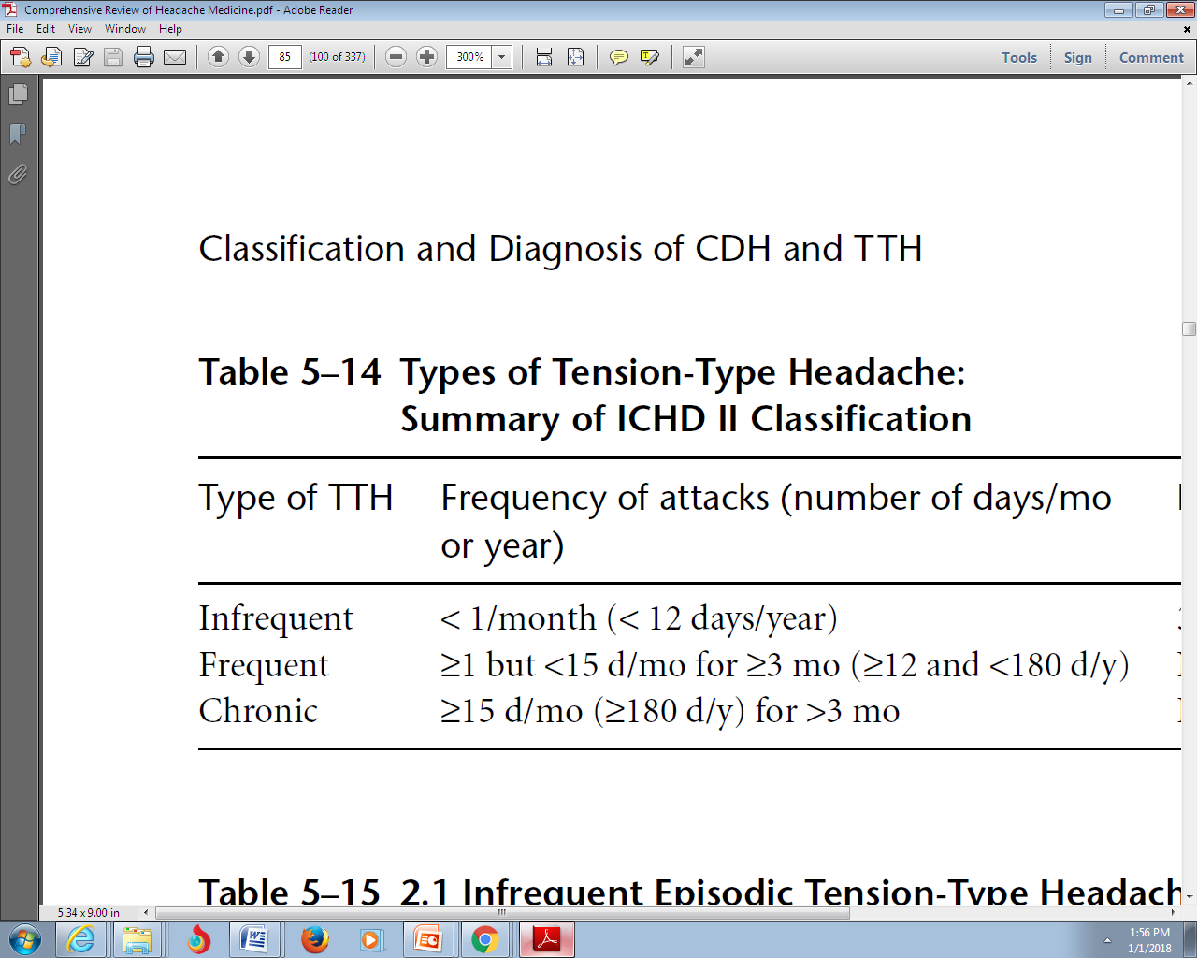
Tension headache diagnosis

Slide 157
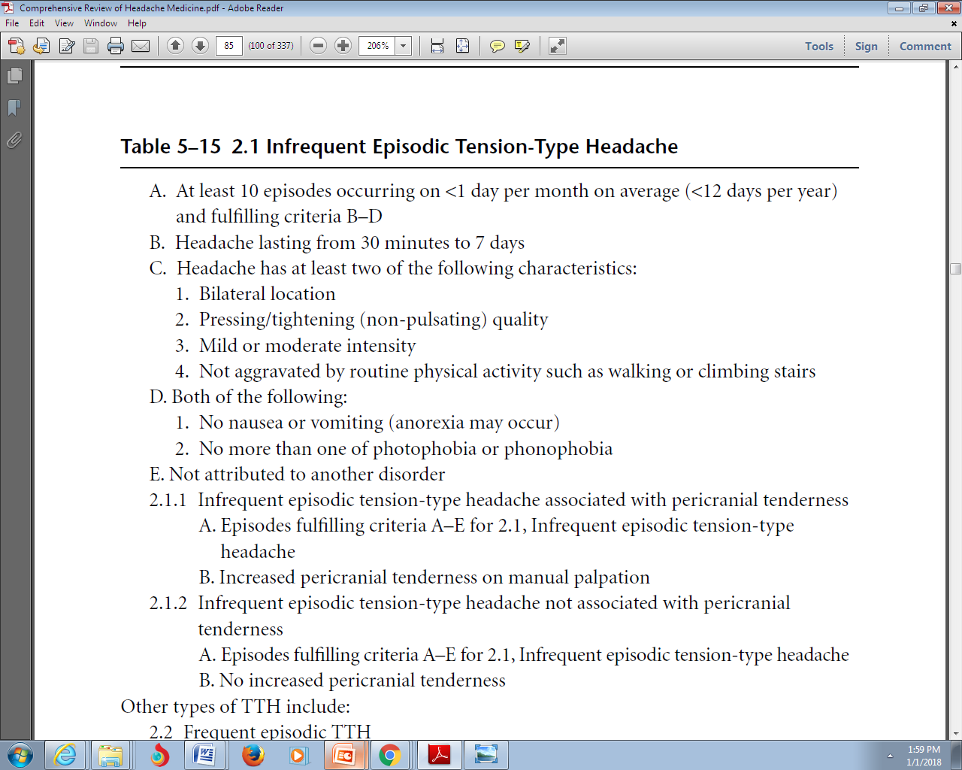
Tension headache diagnosis

Slide 158
Tension headache diagnosis
Other types of TTH include:
Frequent episodic TTH
Frequent episodic tension-type headache associated with pericranial tenderness
Frequent episodic tension-type headache not associated with pericranial tenderness
Chronic TTH
Chronic tension-type headache associated with pericranial tenderness
Chronic tension-type headache not associated with pericranial tenderness

Slide 159
Approach to the Patient with Headache
Tension headache epidemiology
Tension headache diagnosis
Tension headache pathophysiology
Tension headache treatment
Tension headache Prevention

Slide 160
Tension headache pathophysiology
Its name does not reflect causation by muscular tension (migraine without aura produces more), nor causation by emotional tension (comorbidity of anxiety and depression is higher in migraine)
A number of studies done after the ICHD-I strongly suggest a neurobiological basis: both a peripheral pain mechanism and central pain mechanisms

Slide 161
Approach to the Patient with Headache
Tension headache epidemiology
Tension headache diagnosis
Tension headache pathophysiology
Tension headache treatment
Tension headache Prevention

Slide 162
Tension headache treatment
Solid evidence is lacking
Amitriptyline, Fluvoxamine, topiramate, 5-hydroxytryptophan, venlafaxine, protriptyline, and have shown possible efficacy in chronic tension-type headache in small studies
Given the high incidence of comorbid depression and anxiety with this disorder, look for the comorbidity and treat it.

Slide 163
Tension headache treatment
The combined therapy combining Amitriptyline with stress management may be better than monotherapy
Biofeedback therapy, cognitive-behavioral therapy, stress management, nutritional interventions, exercise, and so forth were helpful in this disorder
physiotherapy, were best for chronic tension-type
Complementary/alternative medicine was found to be helpful in 41% of patients with chronic tension-type headache

Slide 164
Approach to the Patient with Headache
Tension headache epidemiology
Tension headache diagnosis
Tension headache pathophysiology
Tension headache treatment
Tension headache Prevention

Slide 165
Tension headache Prevention
There is limited positive evidence as to the effectiveness of Amitriptyline
Clomipramine has a single positive RCT for chronic tension-type headache
Gabapentin has a single positive RCT for chronic daily headache
Careful Review of the SSRI data suggests uniformly negative studies

Slide 166
Primary Stabbing Headache
Brief, localized stabs of pain in various places in the head that occur spontaneously
Sharp stabbing pains usually last less than 10 seconds
Most patients have multiple attacks per day, not producing disability
The bulk of the stabs usually occur in the territory of the first trigeminal division
About a third of the patients continue to have the pains for many months, another third have spontaneous remission, and the remainder develops more typical primary headaches
Treatment with indomethacin and others to antineuralgia drugs such as topiramate or gabapentin,

Slide 167
Hypnic Headache
Awakens the patient from sleep, usually at about the same time every night
The pain is usually mild to moderate
Attacks usually begin after age fifty
Two thirds of patients report bilateral pain for 15 to 180 minutes
Melatonin, Indomethacine, caffeine and lithium may be effective

Slide 168
Hemicrania Continua
Unilateral pain without side shift
Daily and continuous, without pain-free periods
Moderate intensity, with exacerbations of severe pain
Sometines associated with conjunctival injection and/or lacrimation, nasal congestion and/or rhinorrhea, ptosis and/or miosis
Complete response to therapeutic doses of indomethacin

Slide 169
A diabetic patient who has had a myocardial infarction and has a history of kidney stones wants migraine prevention. Which medication
would be optimal?
a. Amitriptyline
b. Topiramate
c. Divalproex
d. Methylergonovine

Slide 170
A young, obese patient with high-frequency headaches desires daily prevention. Which choice is optimal?
a. Amitriptyline
b. Topiramate
c. Divalproex
d. Propranolol

Slide 171
A very anxious patient with no history of depression wants daily prevention for migraine. Name two potential choices that optimally
treat both disorders.
a. Amitriptyline, topiramate
b. Divalproex, propranolol
c. Propranolol, venlafaxine
d. Fluoxetine, venlafaxine

Slide 172
A healthy young patient has depression, sleep disorder, and both migraine and chronic tension-type headache. What is the best
choice?
a. Amitriptyline
b. Topiramate
c. Divalproex
d. Timolol

Slide 173
Which of the following statements is true?
a. The incidence of migraine is higher in the female gender at all ages
b. The incidence of migraine peaks earlier in boys than in girls
c. The incidence of migraine with aura is higher than the incidence of migraine without aura
d. None of the above

Slide 174
Which of the following statements is false?
a. Cluster headache is a rare disease that is associated with extremely severe pain
b. Cluster headache is considered to be the most severe of the primary headache disorders
c. Cluster headache affects more women than men
d. None of the above

Slide 175
Which of the following statements is true?
a. The 1-year prevalence of cluster headache is lower than 1%
b. Episodic cluster headache is more common than chronic cluster headache.
c. Cluster headache is more common in men than women.
d. All of the above

