Slide 1
Lecture Title:
ANATOMY AND INVESTIGATIONS OF NERVOUS SYSTEM ..
(RAD 366, Radiology)
Lecturer name: Dr. HAMDY HASSAN
Lecture Date:

Slide 2
Lecture Objectives..
Students at the end of the lecture will be able to:
Identify the different radiological modalities used for evaluation of CNS
Identify the indication and contraindication for each modality
Identify the radiological anatomy of brain and its vasculatures in different modalities.

Slide 3
The Radiological Investigation Used For Evaluation of The Brain and Skull
1.Plain x-ray Skull
2.CT Scan
3.MRI
4.MRA , MRV & CTA
5.Catheter angiogram
6.Duplex U/S of carotid arteries
7.Ultrasound for neonatal brain

Slide 4
The Radiological Investigation Used For Evaluation of The Brain and Skull
The newer imaging modalities have had a great impact on the diagnosis of diseases of the central nervous system.
CT and MRI have become the standard investigations for disorders of the brain.
Plain films are still the initial investigation for disorders of the bones of the skull – particularly fractures, but otherwise have limited uses.

Slide 5
Plain x-ray skull
Indications:
trauma
congenital
calcification: normal or abnormal (vascular ,neoplasm)
metastasis: lytic /sclerotic
multiple myeloma
metabolic disorders

Slide 6
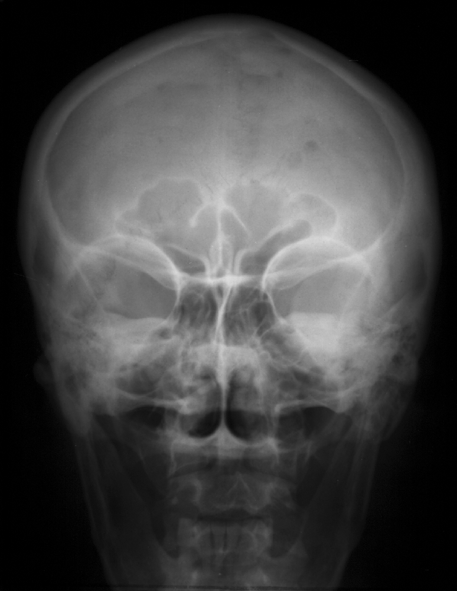
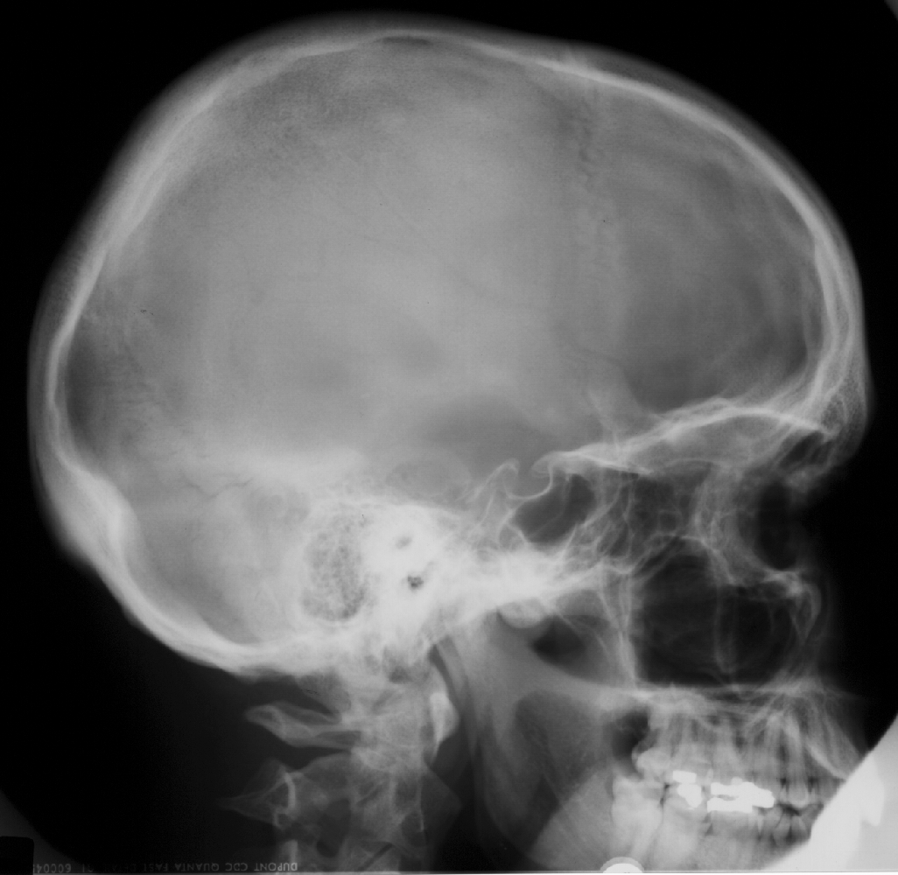
Skull X-RAY LAT. VIEW
Plain x-ray skull
GROOVE FOR MCA
Coronal suture
Frontal sinus
Ethmoid sinuses
SELLA TURCICA
Petrous bone
orbit
EXT.AUD MEATUS
ORBITAL GROOVE
mandible
Mastoid air cells
L
SKULL PA VIEW

Slide 7
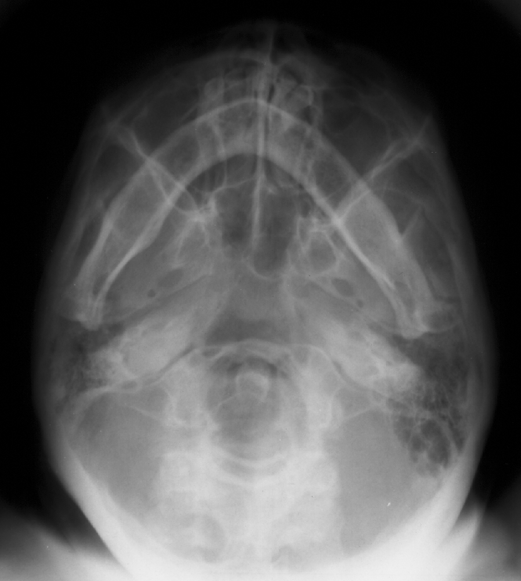
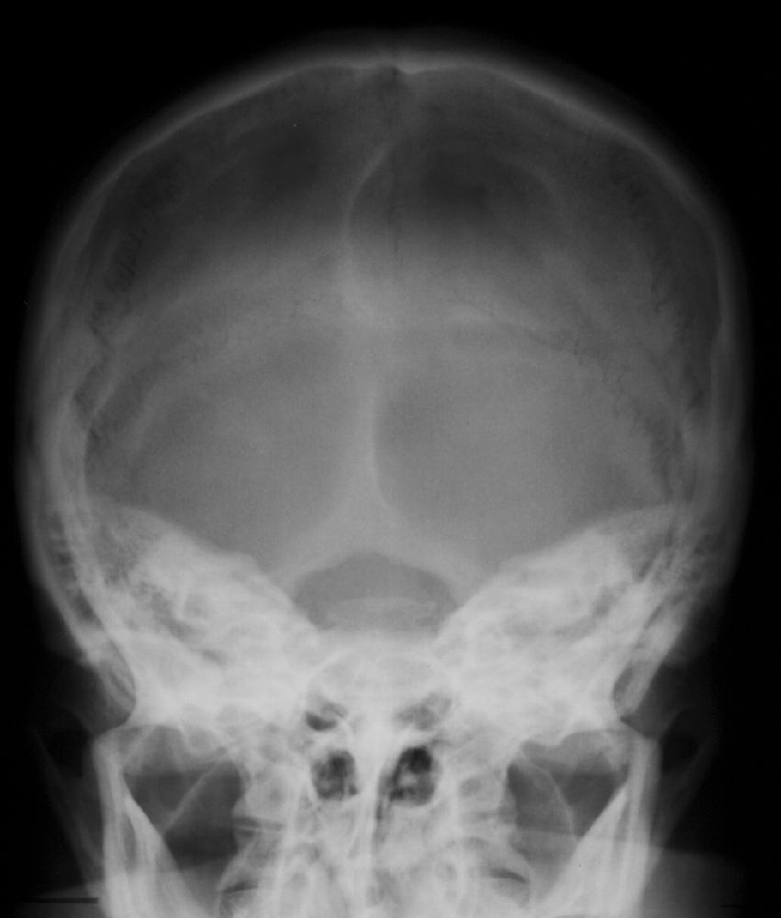
Plain x-ray skull
Foramen ovale
Foramen spinosum
LAMBDOID SUTURE
Mandible
Carotid canal
IAMs
F.MAGNUM
Ant. arch C1
Occipital condyle
Odontoid
Dorsum sellae
submentovertical VIEW
TOWENS VIEW (AP)

Slide 8
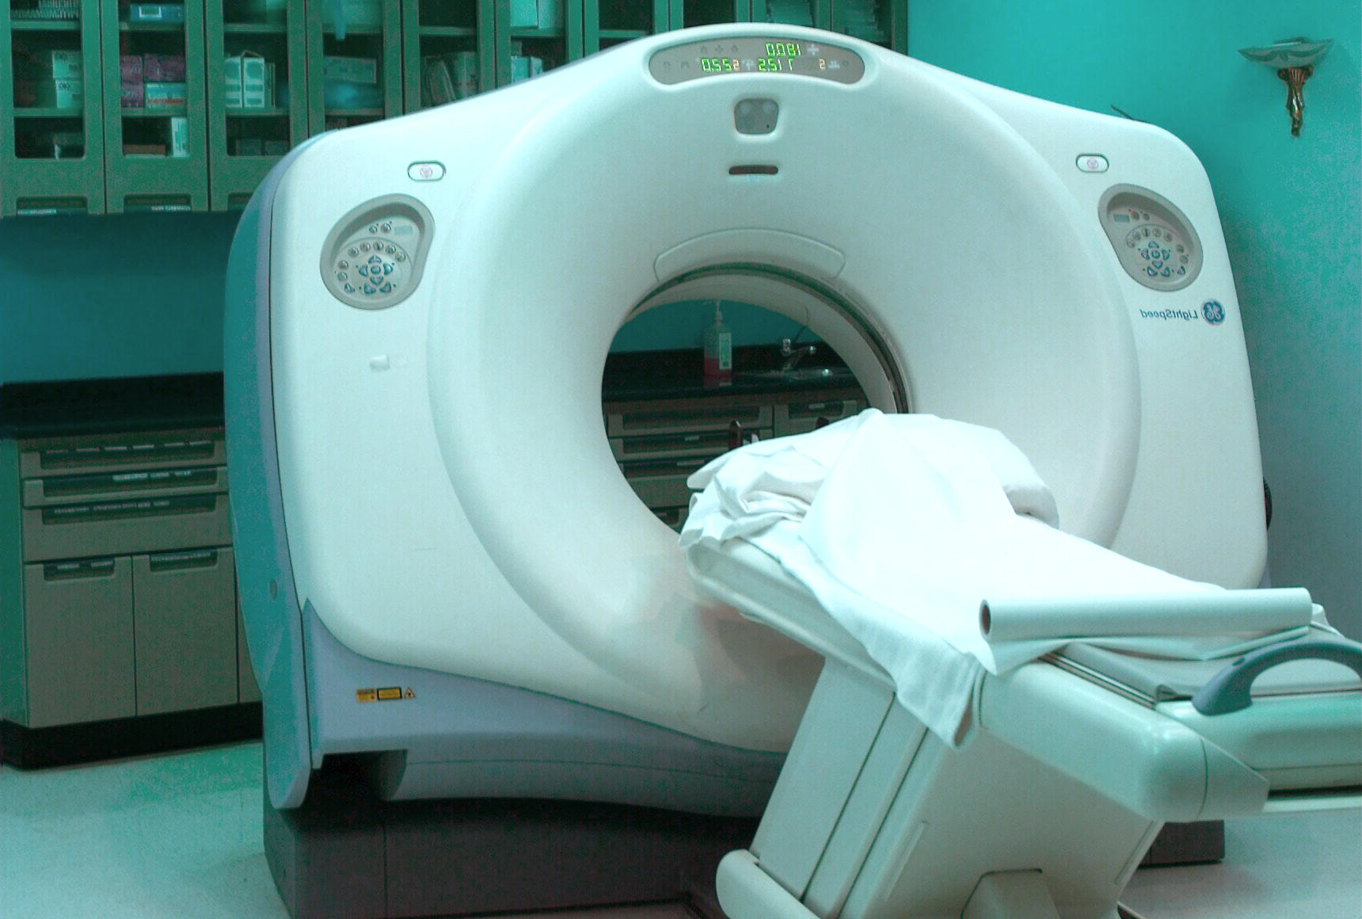
CT SCAN ..

Slide 9
CT SCAN..
Using ionizing radiation
Spiral CT can perform a head scan in 15 minutes pre
&post contrast scans.
The scan itself can take as little as 10 seconds.
Patient preparation: nil
Type of the contrast medium: iodinated contrast
(non ionic L.O.C.M)

Slide 10
CT SCAN..
Indications:
Trauma
detection of blood
strokes
tumours
infection
Vascular disorders
Contraindications
Disadvantages

Slide 11
CT SCAN..
The axial plane is the routine projection but it is sometimes possible to obtain direct coronal scans.
The window settings are selected for the brain, but may be altered to show the bones.

Slide 12
CT SCAN..
NORMAL CT BRAIN
CSF is seen as water density (black) within ventricular system and subarachnoid space.
Grey matter is differentiated from white matter (white matter is relatively darker than grey matter).
The falx is denser than the brain.
Large arteries and venous sinuses can be recognized when opacified by contrast medium.
Posterior fossa may be obscured by artifacts from overlying temporal and occipital bone.

Slide 13
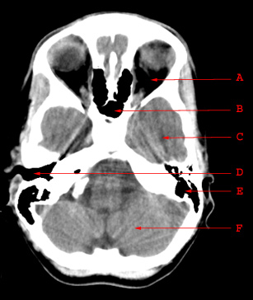
CT SCAN..
A. Orbit
B. Sphenoid Sinus
C. Temporal Lobe
D.Externa Auditory Canal
E. Mastoid Air Cells
F. Cerebellar Hemisphere

Slide 14
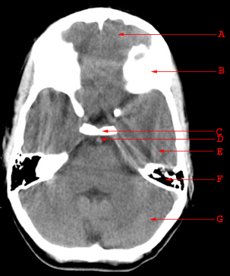
CT SCAN..
A. Frontal Lobe
B. Frontal Bone (Superior Surface of Orbital Part)
C. Dorsum Sellae
D. Basilar Artery
E. Temporal Lobe
F. Mastoid Air Cells
G. Cerebellar Hemisphere

Slide 15
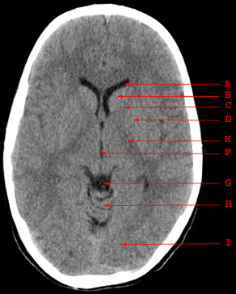
CT SCAN..
A. Anterior Horn of the Lateral Ventricle
B. Caudate Nucleus
C. Anterior Limb of the Internal Capsule
D. Putamen and Globus Pallidus
E. Posterior Limb of the Internal Capsule
F. Third Ventricle
G. Quadrigeminal Plate Cistern
H. Cerebellar Vermis
I. Occipital Lobe

Slide 16
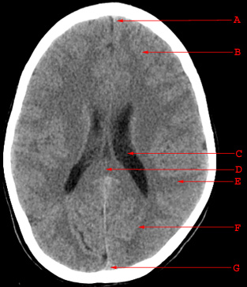
CT SCAN..
A. Falx Cerebri
B. Frontal Lobe
C. Body of the Lateral Ventricle
D. Splenium of the Corpus Callosum
E. Parietal Lobe
F. Occipital Lobe
G. Superior Sagittal Sinus

Slide 17
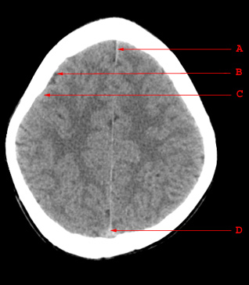
CT SCAN..
A. Falx Cerebri
B. Sulcus
C. Gyrus
D. Superior Sagittal Sinus

Slide 18
CT SCAN..
Contrast enhanced CT:
IV injection of contrast medium is often given because the abnormality not seen in pre contrast scans may be rendered visible following contrast enhancement (consequence of breakdown of blood brain barrier allowing contrast to enter the lesion particularly in neoplasm, infection, inflammation and certain stage of ischemia).
Also it is helpful in demonstrating blood vessels
ACA
MCA
Basilar artery
Straight sinus
Superior sagittal sinus
Contrast enhanced CT

Slide 19
CT SCAN..
Computer reconstructions
can in selected circumstances be made from the axial sections which then provide images in coronal or sagittal planes.
Sagittal reconstruction
Coronal reconstruction

Slide 20
CT SCAN..
Bone window
Brain window
fracture
Acute extradural hemorrhage
The window settings are selected for the brain, but may be altered to shows the bones.

Slide 21
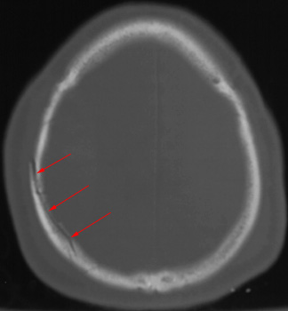
CT SCAN..
Bone window
fracture

Slide 22
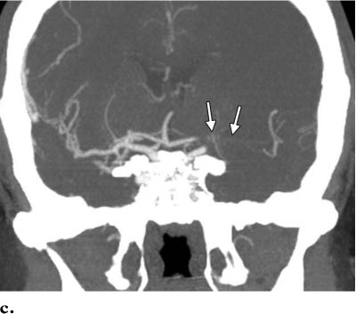
CT SCAN..
CTA
CT angiography is helpful in diagnosis of vascular diseases and abnormalities such as stenosis, occlusion or vascular malformation
Occlusion of left middle cerebral artery

Slide 23
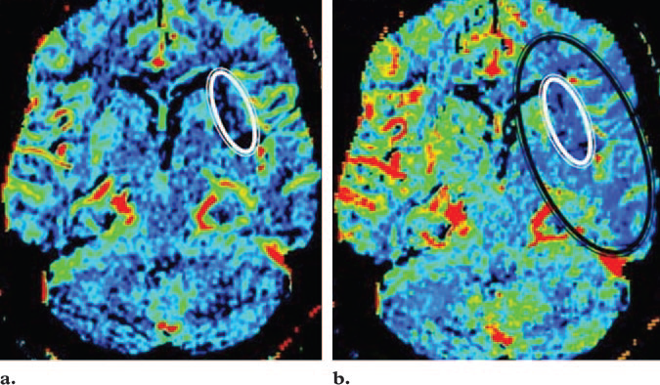
CT SCAN..
CT PERFUSION
cerebral blood volume
cerebral blood flow

Slide 24
CT SCAN..
CT PERFUSION
In acute stroke, very early cranial CT may be normal. Perfusion CT shows great promise in refining the selection of patients suitable for thrombolysis, as it can accurately determine infarct core from potentially salvageable ischaemic penumbra.
Some cerebral tumours are associated with angiogenesis and a breakdown of the blood-brain barrier. Angiogenesis can be detected as an increase in flow and volume parameters, and blood-brain barrier breakdown can be quantified as contrast accumulates in the interstitial space. Such aggressive features can distinguish malignant from benign tumours when standard imaging may not.

Slide 25
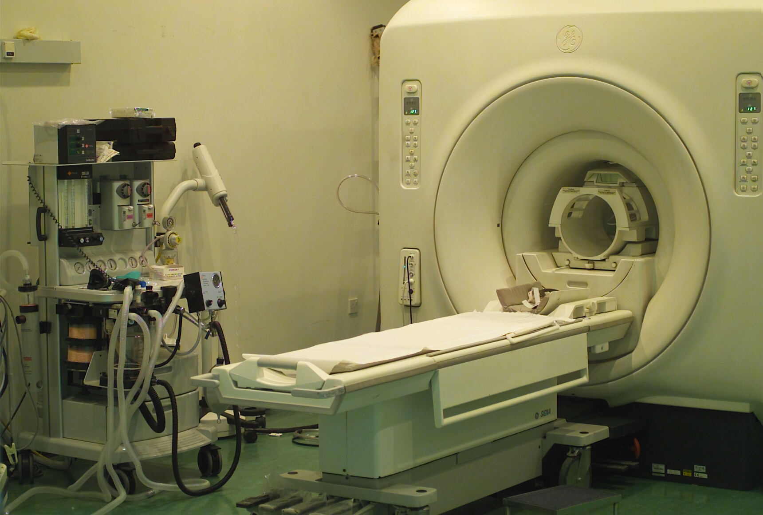
MRI..

Slide 26
MRI..
No ionizing radiation
Patient preparation: Nil unless fasting for general
anaesthesia.
Contrast medium: Gadolinium
Indications:
strokes
tumours
infection
Vascular disorders
white matter disease
some cases of trauma

Slide 27
MRI..
Contraindications
cardiac pacemaker
cochlear implants
ocular prostheses
intraocular ferrous foreign body
neurostimulators
pregnancy (1st trimester)
claustrophobia

Slide 28
MRI..
MRI is a multi planar technique (can produce images in Sagittal, axial and coronal planes) which is useful for assessment of extent of brain tumors and for better visualization of structures of posterior fossa and cranio-cervical junction.
MRI is a multi sequential technique (can create images in T1WI, T2WI, FLAIR, gradient and other sequences).
It is possible to recognize flowing blood and therefore large arteries and veins stand out clearly without the need for contrast medium injection.

Slide 29
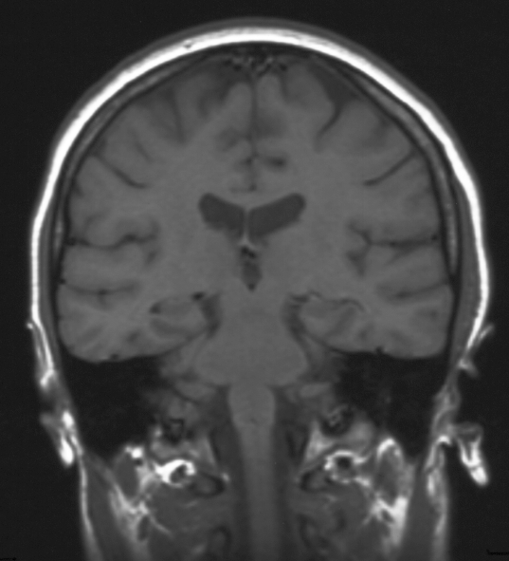
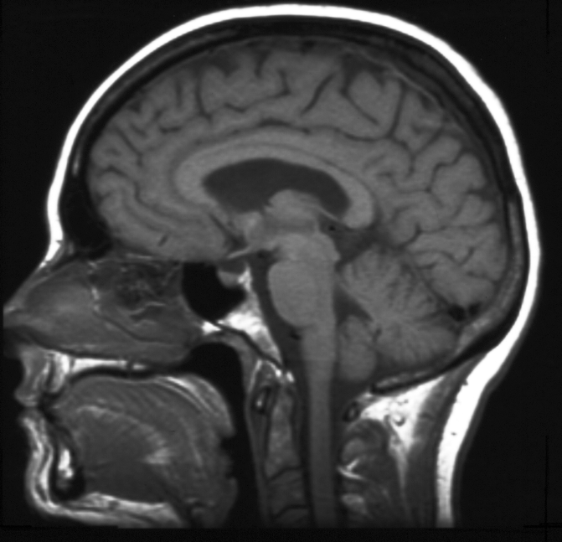
MRI BRAIN (SAGITTAL T1WI)
MRI..
Cerebral peduncle
CC
PITUTARY
CEREBELLUM
3rd v
Sphenoid sinus
PONS
Pons
MEDULLA
Medulla
clivus
Spinal cord
cord
MRI BRAIN (CORONAL T1WI)

Slide 30
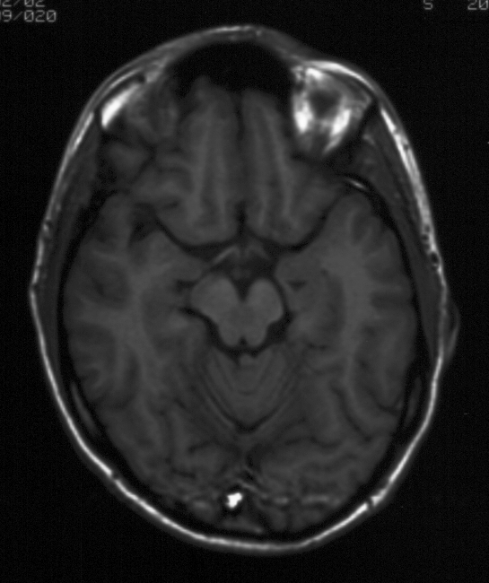
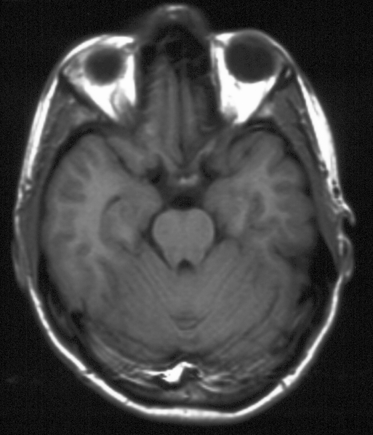
MRI BRAIN (AXIAL T1WI)
MRI..
MCA
OPTIC TRACT
OPTIC CHIASM
Temporal horn lateral ventricle
CEREBRAL PEDUNCLE
Aquiduct of sylvius
Mid brain
VERMIS
CEREBELLAR FOLIA

Slide 31
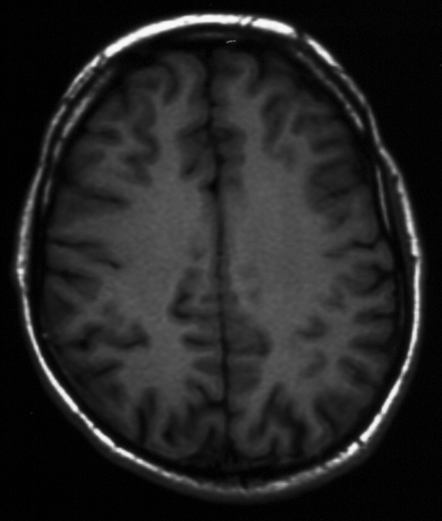
MRI BRAIN (AXIAL T1WI)
MRI..
GREY MATTER
WHITE MATTER

Slide 32
MRI..
T2WI
FLAIR

Slide 33
MRI..
The Characteristic signal intensity of brain structures in different MRI sequences:
 | Grey matter | White matter | CSF
T1WI | grey | light | dark
T2WI | light | dark | white
FLAIR | light | dark | dark

Slide 34
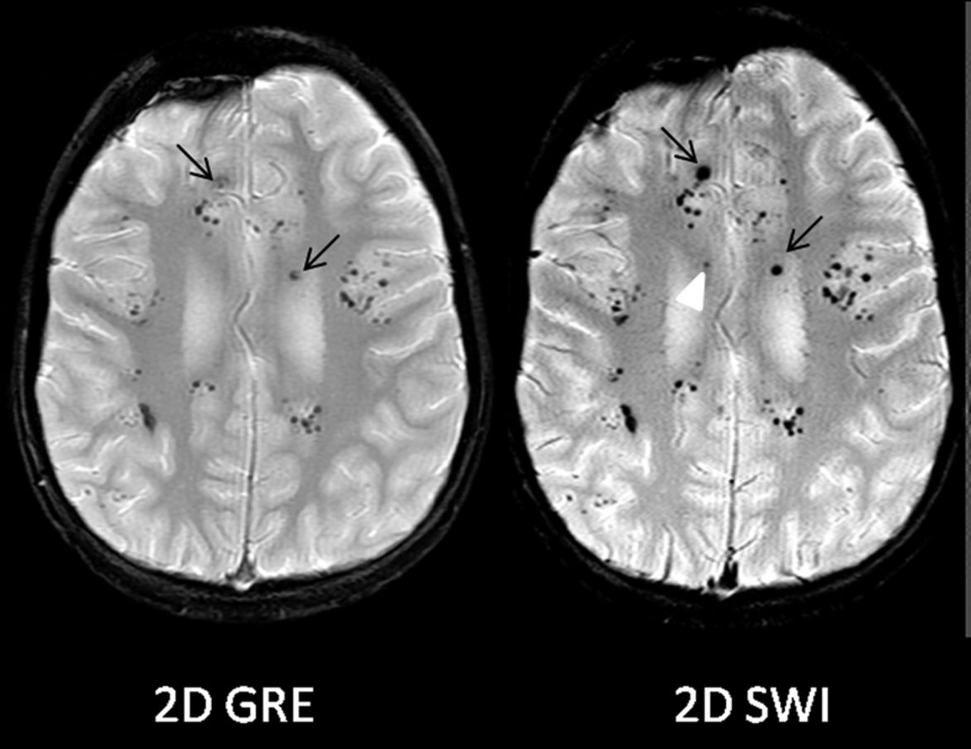
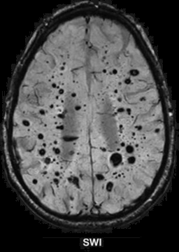
MRI..
Susceptibility
Weighted Sequence
Signal loss due to
Paramagnetic
Diamagnetic
Calcium
Blood

Slide 35
MRI..
Patient post RTA with diminished level of consciousness the SWI shows multiple foci of dark signal intensity (blooming) at grey-white matter interface (not seen in T2WI and FLAIR) representing hemorrhagic diffuse axonal injuries.

Slide 36
MR Angiography..
MRA
Can be done without injection of contrast medium using time of flight technique.
Can be used to assess intra and extra cranial arteries for any vascular abnormalities such as stenosis, occlusion or vascular malformation.
MRA

Slide 37
MR Venography..
MRV
Can be done either with or without injection of contrast medium.
Assess venous dural sinuses superficial and deep venous system.
Can confirm presence of venous thrombosis
MRV

Slide 38
MRI Diffusion..
MR diffusion
Very helpful in assessment of:
Early brain infarction.
Brain abscess.
Certain types of brain tumor.
DWI
ADC map

Slide 39
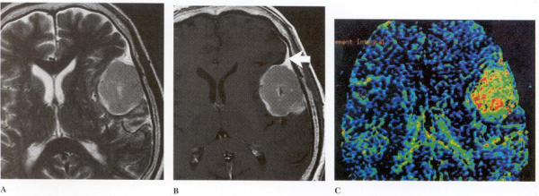
MRI..
Meningioma
T2 Contrasted T1 Perfusion-Weighted

Slide 40
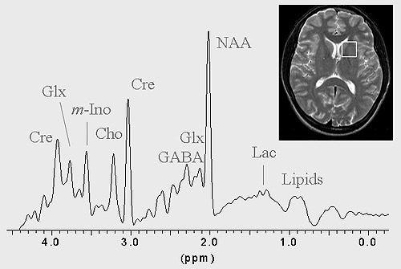
MR Spectroscopy..
Unlike MRI, the technique of MRS does not generally produce images, instead creating spectra (see figure). Each peak in the spectrum arises from different brain metabolite (NAA, N-acetylaspartate; Cre, Creatine; Cho, Choline; myoI, myo-Inositol; Lac, lactate; Glx, Glutamate and Glutamine; GABA, gamma amino butyric acid). The height of each peak is an indication of metabolite concentrations. The NAA peak arises from the neurons in the brain. Loss of this metabolite indicates damage or loss of neurons.
Investigations of brain injury by magnetic resonance imaging (MRI) and spectroscopy (MRS)
Prof Andrew M. Blamire
Newcastle Magnetic Resonance Centre Newcastle University, Campus for Ageing & Vitality Newcastle upon Tyne, NE4 5PL United Kingdom.

Slide 41
MR Spectroscopy..
MR Spectroscopy
Very helpful in:
Differentiating neoplastic from non neoplastic processes.
Differentiating benign from malignant tumors.
Determination of certain types of tumors.
Assessment of white matter diseases
Assessment of neurodegeneartive diseases

Slide 42
MR Spectroscopy..
MR Spectroscopy in GBM

Slide 43
CEREBRAL ANGIOGRAM..
It is the gold standard technique for assessment of intra and extra cranial vessels.
It can demonstrate different vascular diseases (stenosis, occlusion, vascular malformation and blood supply of brain tumors.
It is an invasive technique.
Recently its main role for intervention purposes such as treatment of vascular malformaion (aneurysm/arterovenous malformation) or pre operative embolization of vascular supply of tumor.

Slide 44
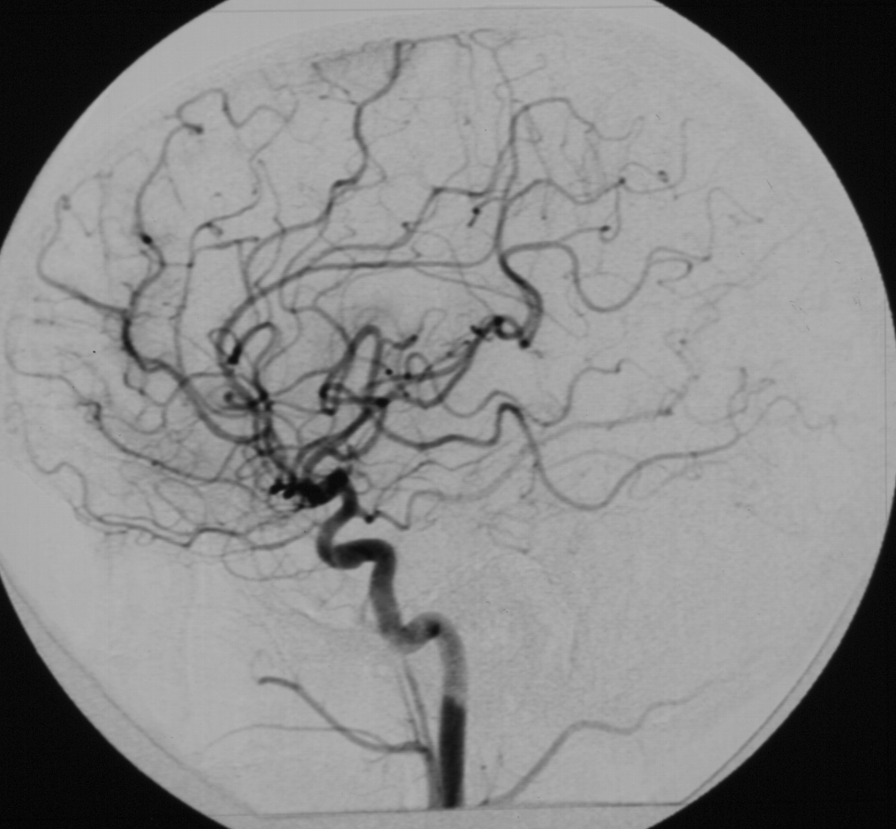
Internal carotid angiogram AP
CEREBRAL ANGIOGRAM..
ACA MCA
middle cerebral artery
Anterior cerebral artery
Internal carotid artery
Cavern.
Pterous
cervical
ICA
CAVERNOUS
PTEROUS
CERVICAL
CERVICAL
Internal carotid angiogram lateral view

Slide 45
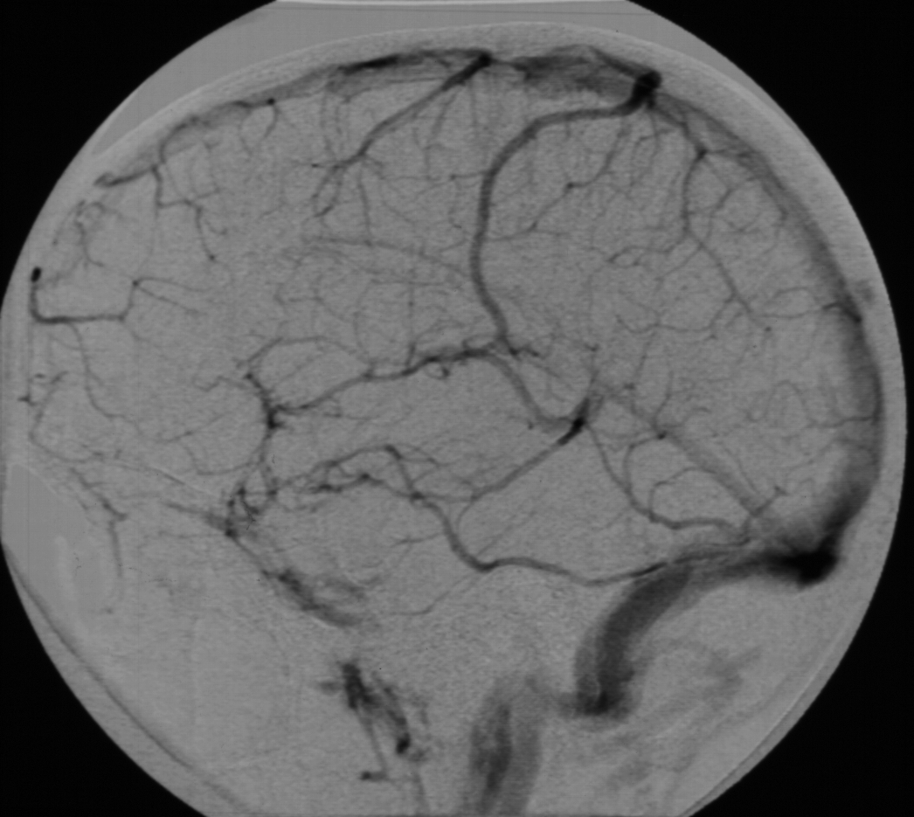
VENOUS PHASE CEREBRAL ANGIOGRAM..
SSS
Straight sinus
Transverse sinus
Sigmoid sinus
IJV

Slide 46
CAROTID DOPPLER..

Slide 47
ULTRASOUND NEONATAL BRAIN..
It is a simple and easy way to scan the head of neonates and young babies.
Not using ionizing radiation
Scanning is best done through an open fontanelle.
Little discomfort to the baby.
Readily carried out even on ill babies in intensive care units.
It has proved particular useful in detecting ventricular dilatation (hydrocephalus), intracerebral hemorrhage and congenital abnormality of the brain

Slide 48
ULTRASOUND NEONATAL BRAIN..
CORONAL
SAGITTAL

Slide 49
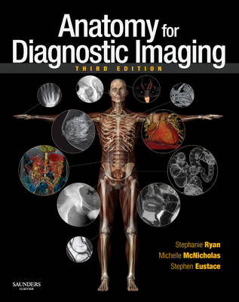
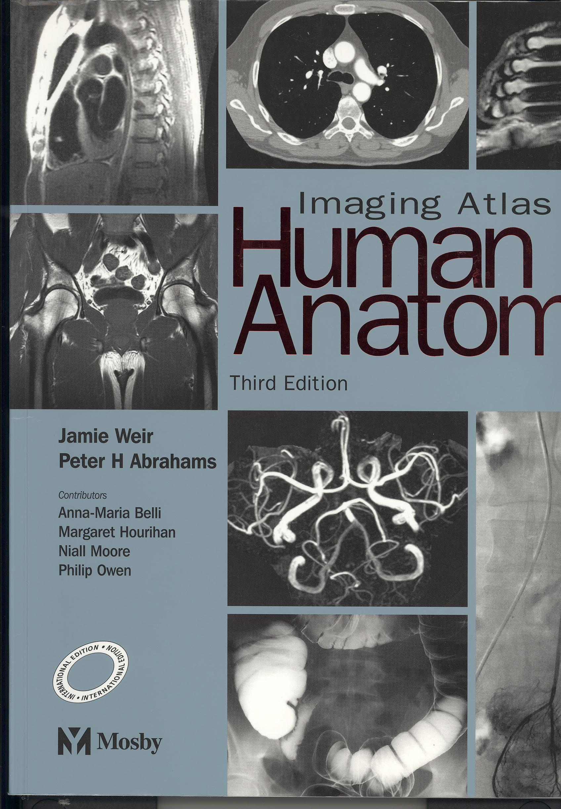
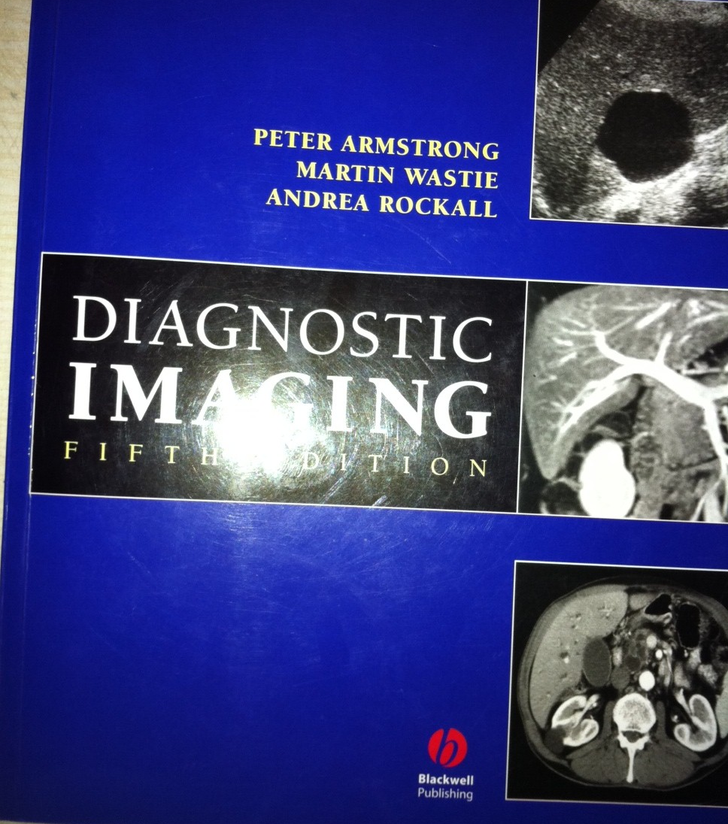
Reference book and the relevant page numbers..
Stephanie Ryan, “Anatomy for Diagnostic imaging”, 2nd Edition, Pages 61-66
Jamie Weir, Peter Abraham, “Imaging Atlas of Human Anatomy” 3rd Edition, Pages 34-41
Peter Armstrong, “diagnostic imaging ”,
5th Edition, Pages (396-404)

Slide 50
Thank You ☺
(Rad 366, Radiology)
Dr. HAMDY HASSAN

