Slide 1
Congenital Neurosurgical Diseases
Abdulrazag Ajlan MD, MSc, FRCSC, UCNS(D)
Neurosurgery Residency Training Central Region Program Director, Riyadh
Neurosurgery Residency Training program Director, KSU, Riyadh
Skull-base fellowship Training Program Director
Vice-President Saudi Association of Neurological Surgery (SANS)
Head of Neuro-oncology and Skull Base Program, KKUH, KSU
Neurosurgery Consultant & Assistant Professor, King Saud University, Riyadh, KSA
Adjunct Assistant Professor, Neurosurgery Department, Stanford University, US
Modified from Dr. Essam Elgamal

Slide 3
Learning Objectives
Introduction to Neurosurgery
Approaching neurological symptoms
Congenital diseases
Hydrocephalus
Neural Tube Defect
Chiari Malformation
Dandy-Walker Malformation
Craniosynostosis
Arachnoid Cyst

Slide 4
Neurosciences
Vascular
Oncology
Skull-Base
Spine
Pediatrics
Functional
Epilepsy
Peripheral Nerves
Critical Care
Trauma
-Basic science
Clinical
→Neurosurgery
→Neurology
→Psychiatry
→Others

Slide 5
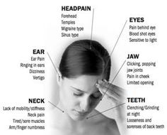
Approaching Neurological Symptoms
? →
Headache or facial pain

Slide 6
Headache
Primary vs. secondary headaches
Primary headaches
Are benign, recurrent headaches not caused by underlying disease or structural problems
Examples: Migraines, tension-type headaches, cluster headaches
Secondary headaches
Are caused by an underlying disease
→International Headache Society (IHS) classification
→Certain "red flags" indicate a secondary headache

Slide 7
Is the headache serious?
Headache
The American College for Emergency Physicians published criteria for low-risk headaches.
-Age younger than 30 years
-Features typical of primary headache
-History of similar headache
-No abnormal findings on neurologic exam
-No concerning change in normal headache pattern
-No high-risk comorbid conditions (for example, HIV)
-No new concerning history or physical examination findings

Slide 8
Red Flags:
Headache
-In general
→People complaining of their "first" or "worst" headache
→Progressively worsening
The American Headache Society recommends using "SSNOOP", a mnemonic to remember the red flags for identifying a secondary headache:
Systemic symptoms (fever or weight loss)
Systemic disease (HIV infection, malignancy)
Neurologic symptoms or signs
Onset sudden (thunderclap headache)
Onset after age 40 years
Previous headache history (first, worst, or different headache)

Slide 9
Headache
Primary vs. secondary headaches
Primary headaches
Are benign, recurrent headaches not caused by underlying disease or structural problems
Examples: Migraines, tension-type headaches, cluster headaches
Secondary headaches
Are caused by an underlying disease
→International Headache Society (IHS) classification
→Certain "red flags" indicate a secondary headache

Slide 10
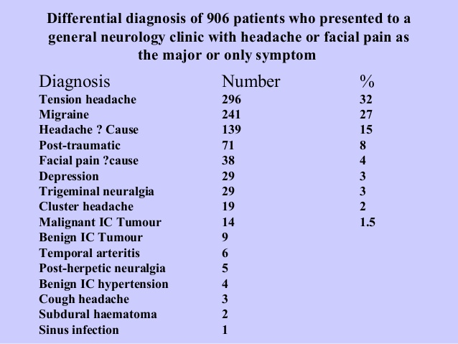
Headache
Vascular
Inflammatory/Infectious
Neoplastic
Degenerative/Deficiency/Drugs
Idiopathic/Intoxication/Iatrogenic
Congenital
Autoimmune/Allergic/Anatomic
Traumatic
Endocrine/Environmental
Metabolic
http://www.slideshare.net/oxfordshireloc/headache-dr-paul-davies

Slide 12
Differential Diagnosis of CNS space-occupying
Vascular
Inflammatory/Infectious
Neoplastic
Degenerative/Deficiency/Drugs
Idiopathic/Intoxication/Iatrogenic
Congenital
Autoimmune/Allergic/Anatomic
Traumatic
Endocrine/Environmental
Metabolic
Neoplastic
Vascular
Congenital
Inflammatory
Infectious

Slide 13
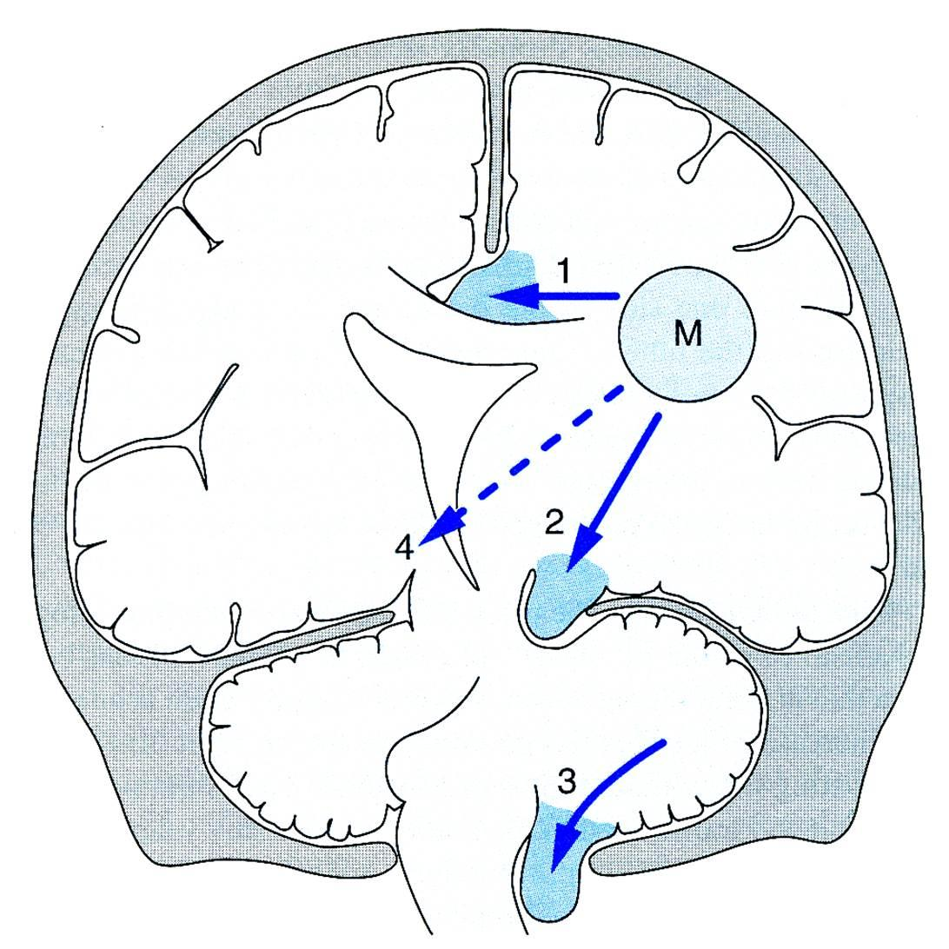
1- Local compression 2- Mass effect & Herniation 3- High ICP

Slide 15
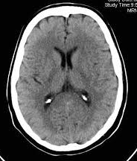
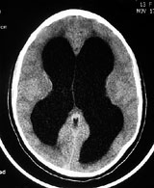
Hydrocephalus
Hydrocephalus is an increase in the CSF volume, associated with increased ventricular size
Not the same as Ventriculomegaly
Essam Elgamal

Slide 16
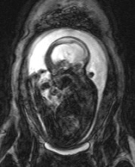
Causes of hydrocephalus
Overproduction of CSF
Obstruction of CSF flow
Under absorption of CSF
Common Congenital Neurosurgical Diseases
Essam Elgamal

Slide 17
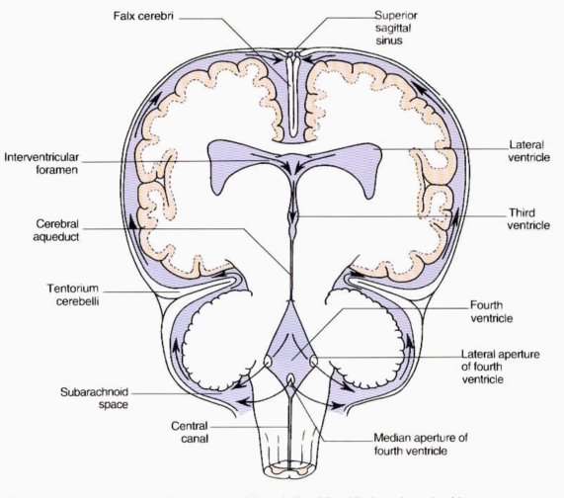
Physiology
Total volume of CSF in the ventricles varies from 5-15 ml in neonates to 150 ml in adults.
Produced mainly by choroid plexus.
Rate of production is 0.3-0.4 ml/minute.
Common Congenital Neurosurgical Diseases
Essam Elgamal

Slide 18
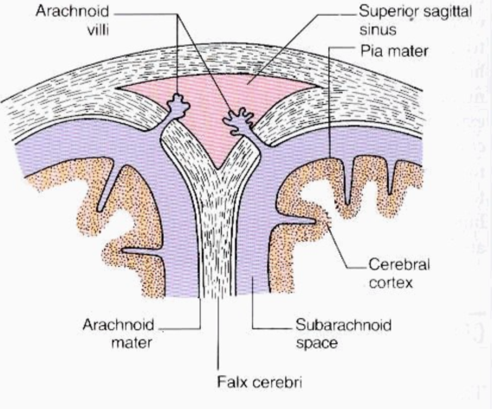
Common Congenital Neurosurgical Diseases
Essam Elgamal

Slide 19
Types of hydrocephalus
Communicating:
Overproduction or under absorption of CSF
Non-Communicating:
blockage of the flow of CSF
→ Congenital, since birth
→ Acquired, develops after birth
Common Congenital Neurosurgical Diseases
Essam Elgamal

Slide 20
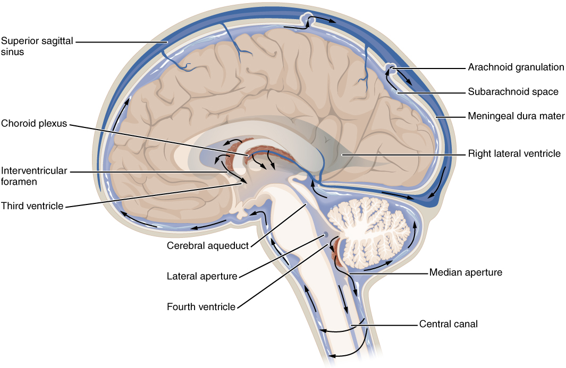
Types of hydrocephalus
Common Congenital Neurosurgical Diseases

Slide 21
Etiology
Congenital
Aqueductal anomalies
Dandy Walker malformation Chiari II malformation Myleomeningocele Intrauterine viral infection (CMV, mumps, rubella, varicella) Toxoplasmosis Congenital tumors Vein of Galen aneurysms Chromosomal anomalies (trisomy 13 and 18) Congenital or primary hydrocephalus.
Common Congenital Neurosurgical Diseases
Essam Elgamal

Slide 22
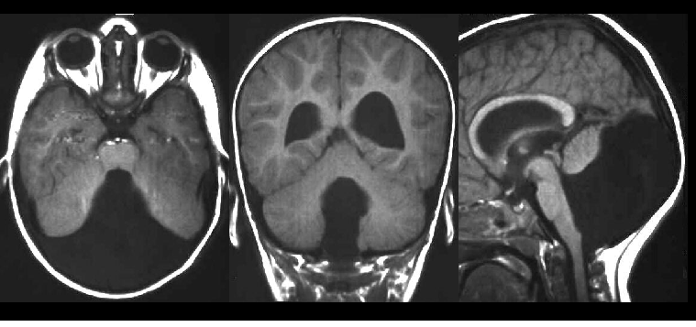
Etiology
Congenital
Dandy Walker malformation
Common Congenital Neurosurgical Diseases
Essam Elgamal

Slide 23
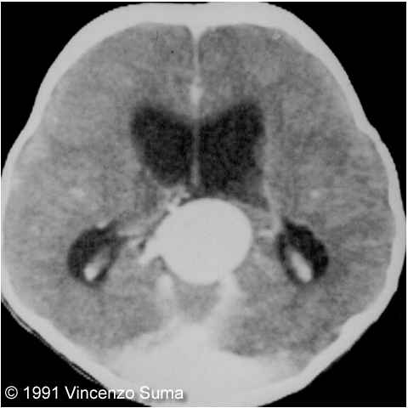
Etiology
Congenital
Aqueductal anomalies Dandy Walker malformation Chiari II malformation Myleomeningocele Intrauterine viral infection Toxoplasmosis Congenital tumors Vein of Galen aneurysms Chromosomal anomalies (trisomy 13 and 18) Congenital or primary hydrocephalus.
Common Congenital Neurosurgical Diseases
Essam Elgamal

Slide 24
Etiology
Acquired
Germinal plate hemorrhage:
in premature babies <1500 gm (30%-40%)
Post-meningitis
Tumors
SAH
Severe TBI
Common Congenital Neurosurgical Diseases
Essam Elgamal

Slide 25
Clinical features
Infants & young children:
1. Increasing head circumference. 2. Irritability, lethargy, poor feeding, and vomiting. 3. Bulging anterior fontanelle. 4. Widened cranial sutures. 5. McEwen's (cracked-pot) sign with cranial percussion. 6. Scalp vein dilation (collateral venous drainage). 7. Sunset sign (downward deviation of the eyes). 8. Episodic bradycardia and apnea.
Common Congenital Neurosurgical Diseases
Essam Elgamal

Slide 26
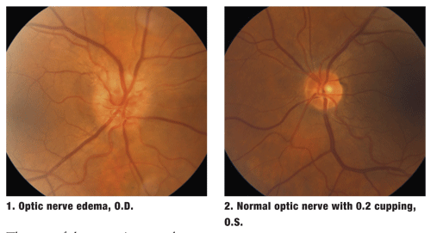
Clinical features
Juvenile & adult:
Headaches Nausea
Vomiting
Decreased level of consciousness Focal neurological deficit (rare) Papilledema

Slide 27
Investigations
CT or MRI:
The pattern of ventricular enlargement can help delineate the cause:
Lateral & 3rd ventricle dilatation
→ normal 4th ventricle: suggests aqueduct stenosis
→ deviated or absent 4th ventricle: suggests posterior fossa tumor
Generalized dilatation: suggests a communicating hydrocephalus.
Common Congenital Neurosurgical Diseases
Essam Elgamal

Slide 28
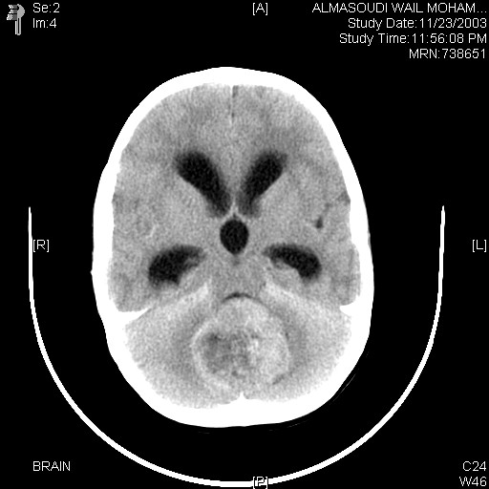
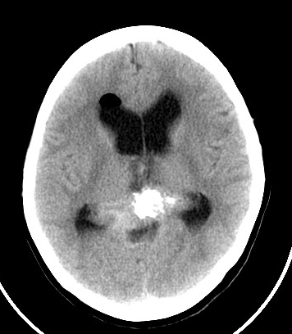
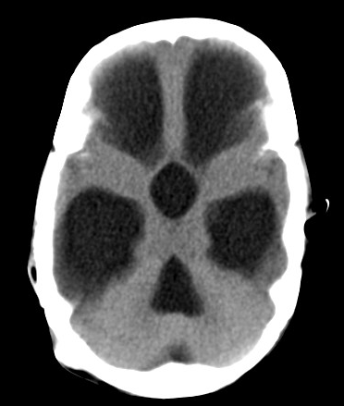
Investigations
Essam Elgamal

Slide 29
Treatment
Communicating: Medical or surgical
Obstructive: SURGICAL TREATMENT
Common Congenital Neurosurgical Diseases
Essam Elgamal

Slide 30
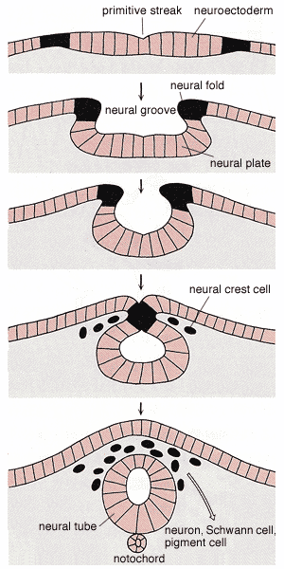
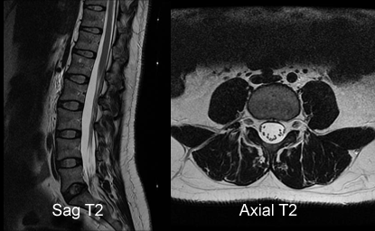
Neural Tube Defect
Spinal Dysraphism
Failure of closure of posterior neural arch
Two major types: Open or Closed
Essam Elgamal

Slide 31
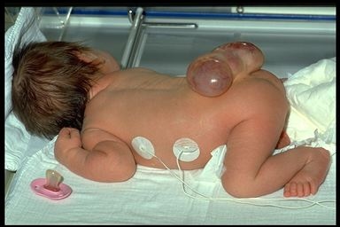
Essam Elgamal

Slide 32
Types of Myelodysplasia
Spina bifida occulta
Meningocele
Myelomeningocele
Essam Elgamal

Slide 33
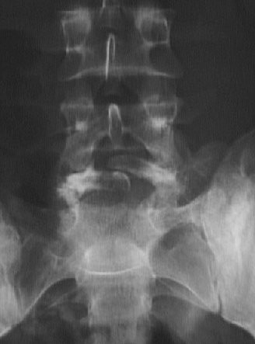
NTD
Spina bifida occulta
5-10% of population
not clinically significant
tuft of hair, dimple sinus or port wine stain
high incidence of underlying defect
no treatment required
Common Congenital Neurosurgical Diseases
Essam Elgamal

Slide 34
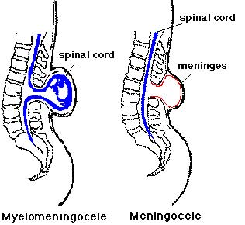
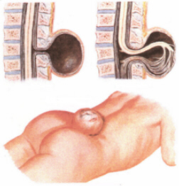
NTD
Meningocele
-Cystic CSF-filled cavity lined by meninges
-no neural tissue
-communicates with spinal canal
-look for other cong. Anomalies
-seldom any neurological deficit
-U/S or MRI
Common Congenital Neurosurgical Diseases
Essam Elgamal

Slide 35
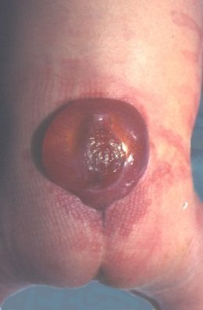
NTD
Meningomyelocele
Spinal cord and roots protrude through the bony defect,
lie within cystic cavity
observe limb movements (degree & level of neurological damage)
note dilated bladder & patulous annual sphincter
U/S or MRI
gross hydrocephalus, multiple serious cong. anomalies
Common Congenital Neurosurgical Diseases
Essam Elgamal

Slide 36
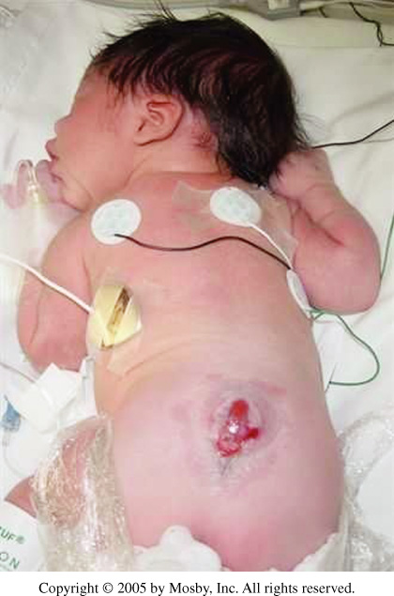

Slide 37
NTD
Incidence
2/1000 birth
Risk increase to 5% if a sibling is affected
Teratogens
How to prevent?
Common Congenital Neurosurgical Diseases
Essam Elgamal

Slide 38
NTD
Antenatal diagnosis
Maternal U/S,
MRI
Serum/amniotic fluid for alpha-fetoprotein & acetylcholinesterase
Contrast enhancing amniography
possibility of therapeutic abortion
Common Congenital Neurosurgical Diseases
Essam Elgamal

Slide 39
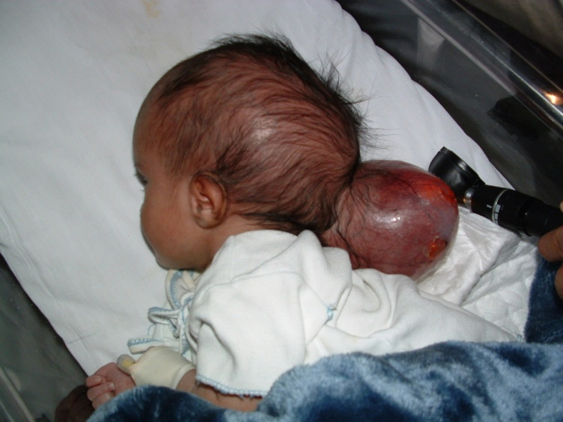
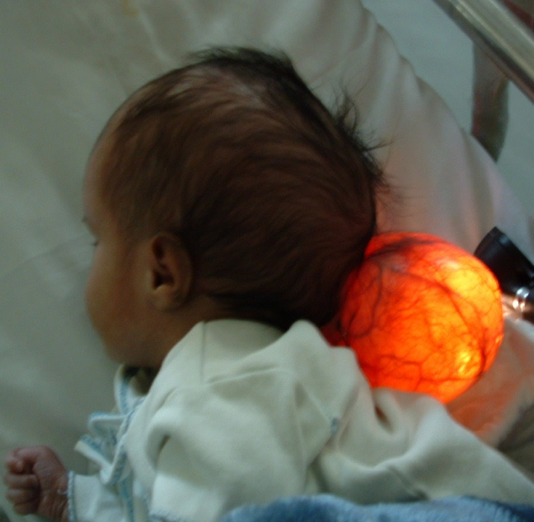
Other congenital anomalies
Encephalocele
Usually occipital
may contain occipital lobe, or cerebellum
often associated with hydrocephalus
Immediate treatment if ruptured
outcome depends upon contents
Common Congenital Neurosurgical Diseases
Essam Elgamal

Slide 40
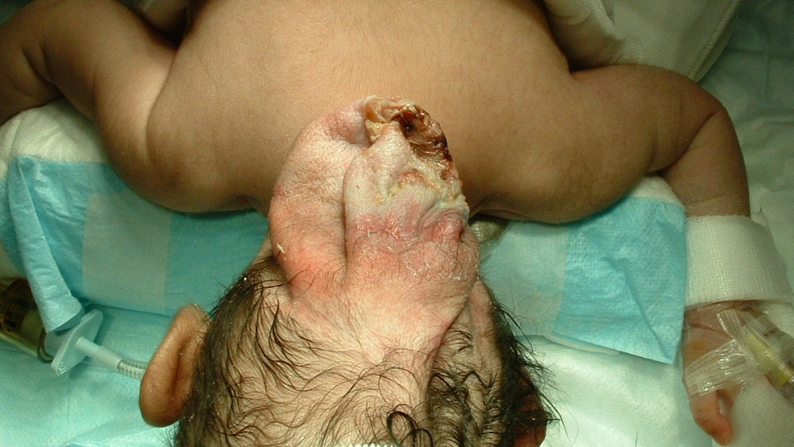
Other congenital anomalies
Common Congenital Neurosurgical Diseases
Essam Elgamal

Slide 41
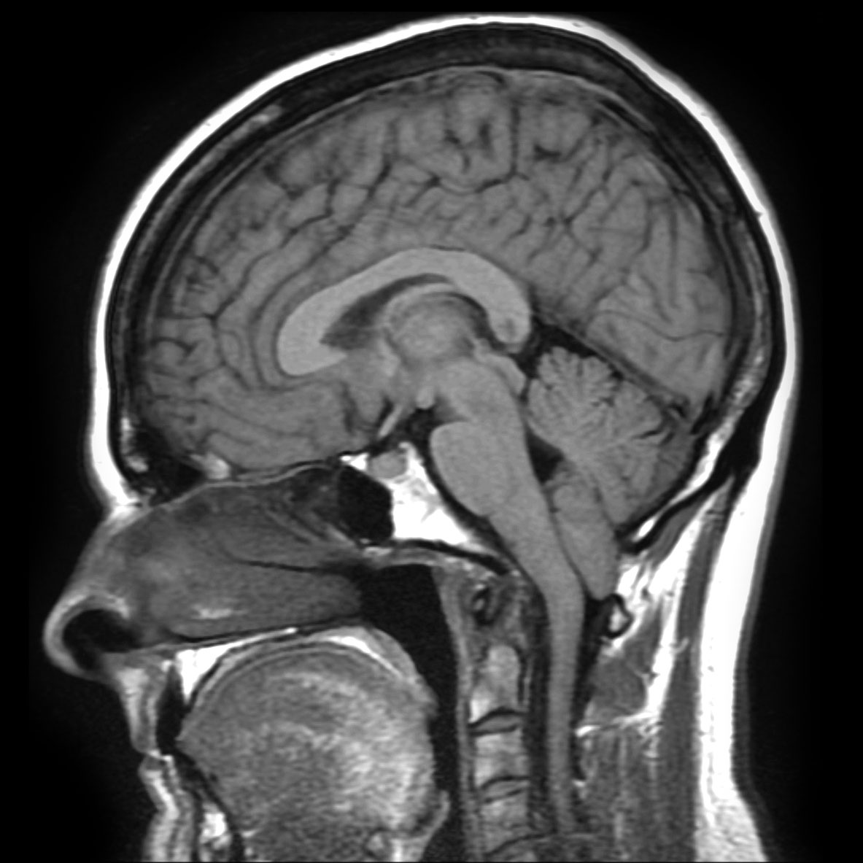
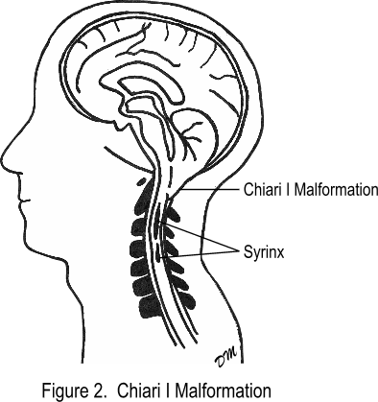
Chiari Malformation
When part of the cerebellum is located below the foramen magnum, it is called a Chiari malformation. http://www.ninds.nih.gov/disorders/chiari/detail_chiari.htm
Common Congenital Neurosurgical Diseases

Slide 42
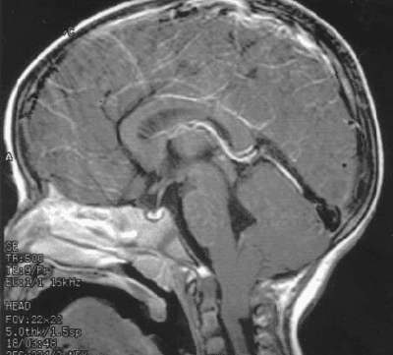
Chiari Malformation (Types)
Type I
-Extension of the cerebellar tonsils into the foramen magnum, without involving the brain stem
Type II
-Extension of both cerebellar and brain stem tissue into the foramen magnum
-Myelomeningocele
-Hydrocephalus
Type III
Type IV

Slide 43
Learning Objectives
Introduction to Neurosurgery
Approaching neurological symptoms
Congenital diseases
Hydrocephalus
Neural Tube Defect
Chiari Malformation
Dandy-Walker Malformation
Craniosynostosis
Arachnoid Cyst

Slide 44
-4 y/o
-No past medical history
-Worsening headache, occipital area x 7 weeks
-His headache worsened last night
-Dizziness
-loss of balance
-N/V twice over the last 3 weeks

Slide 45
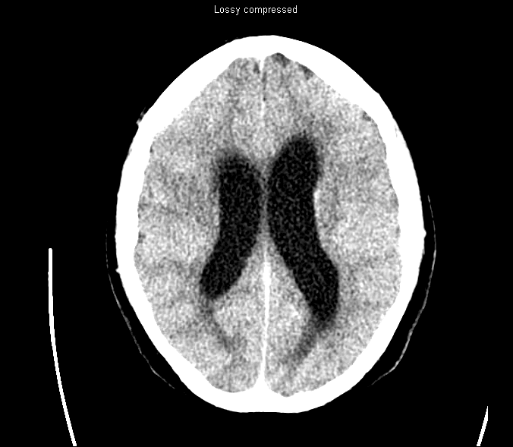

Slide 46
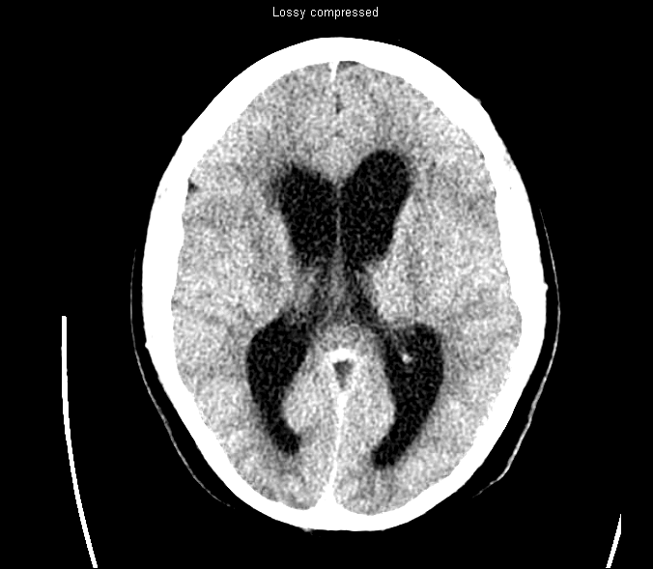

Slide 47
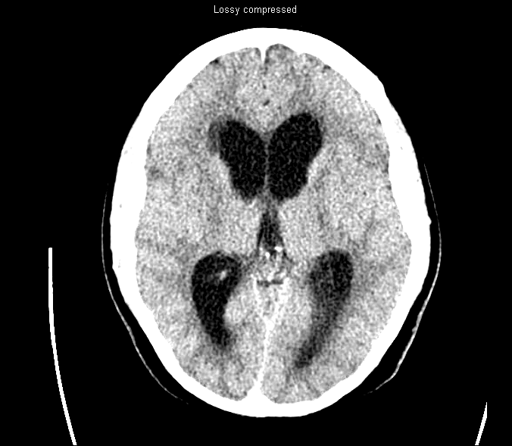

Slide 48
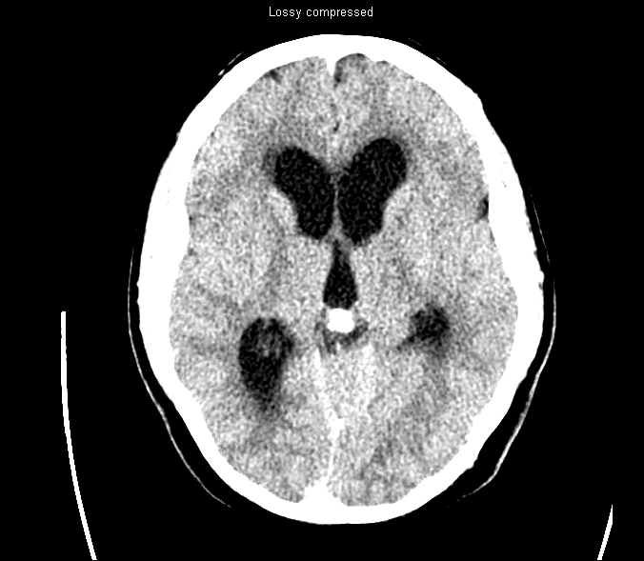

Slide 49
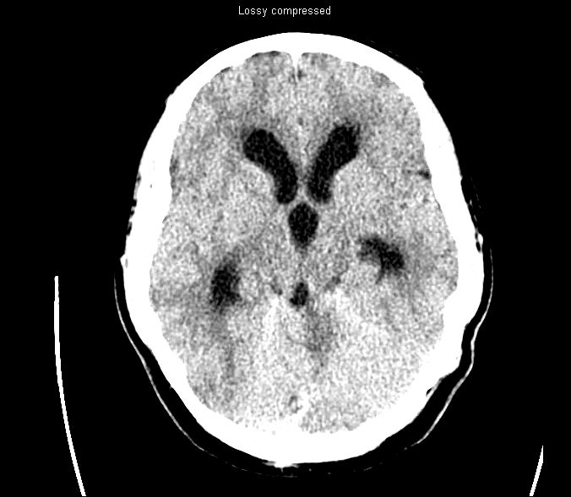

Slide 50
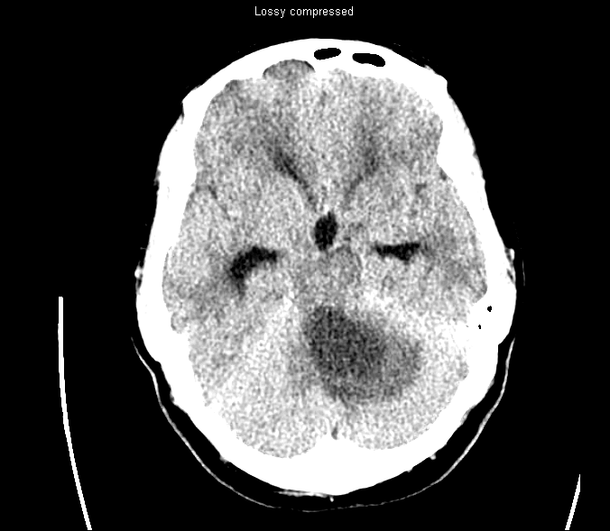

Slide 51
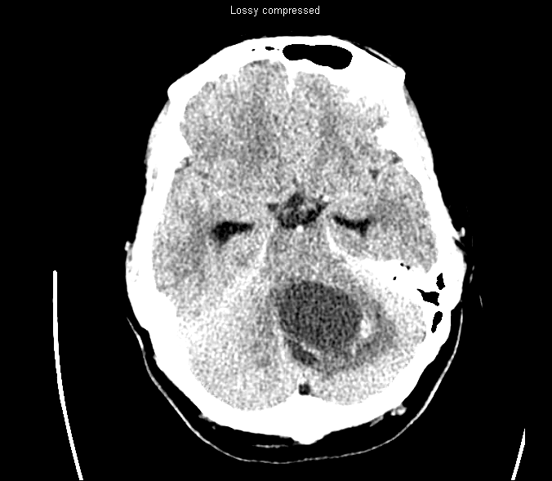

Slide 52
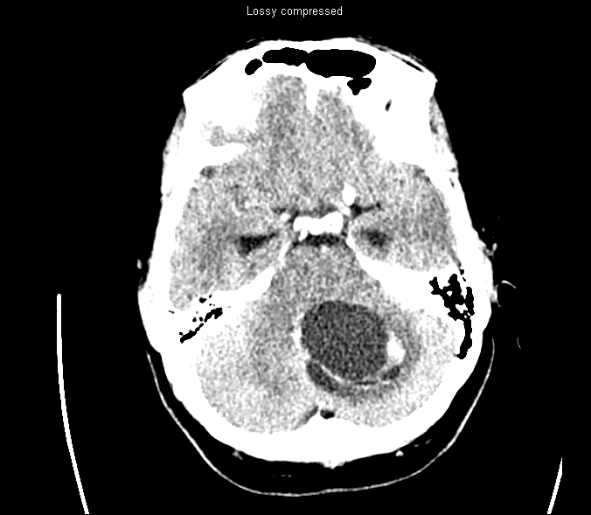

Slide 53
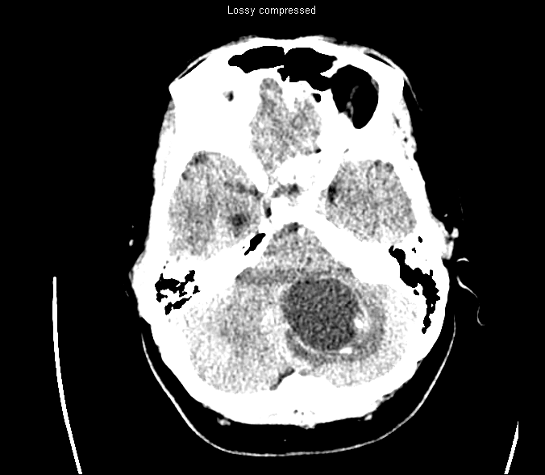

Slide 54
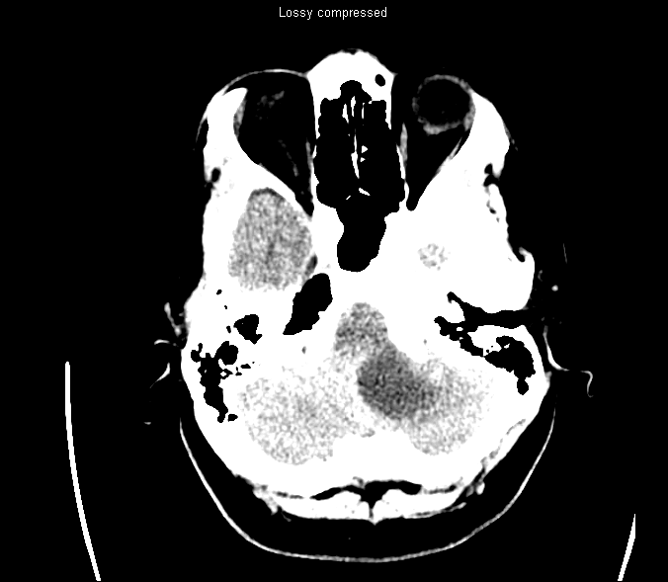

Slide 55
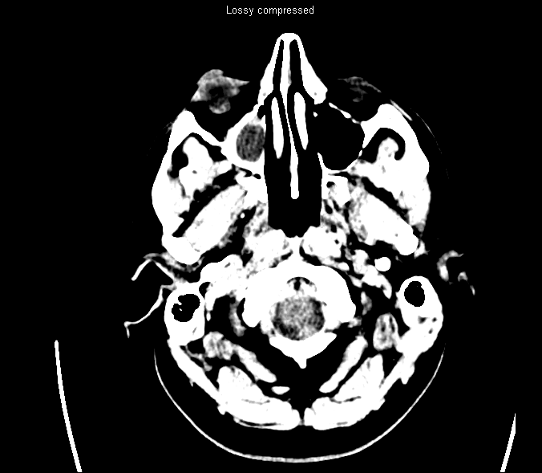

Slide 56
- Other exam findings?
D/D?
What do u want to do?

Slide 57
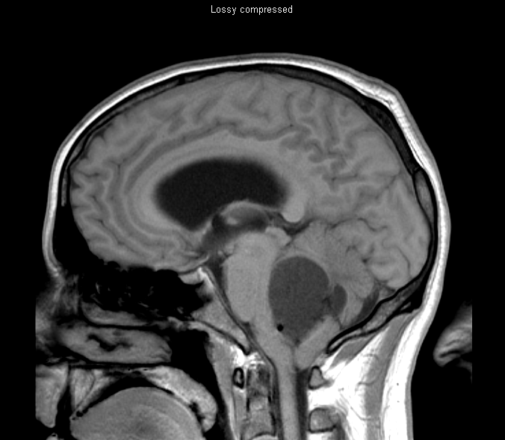
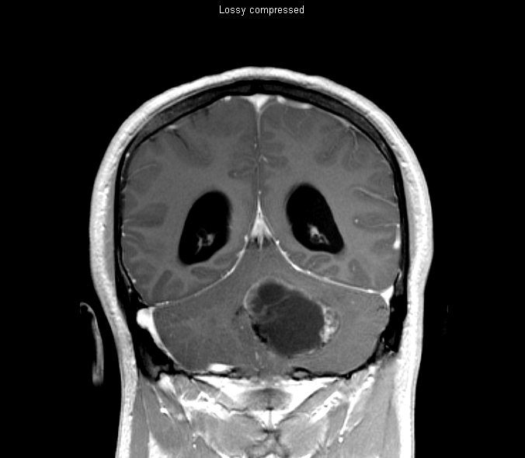
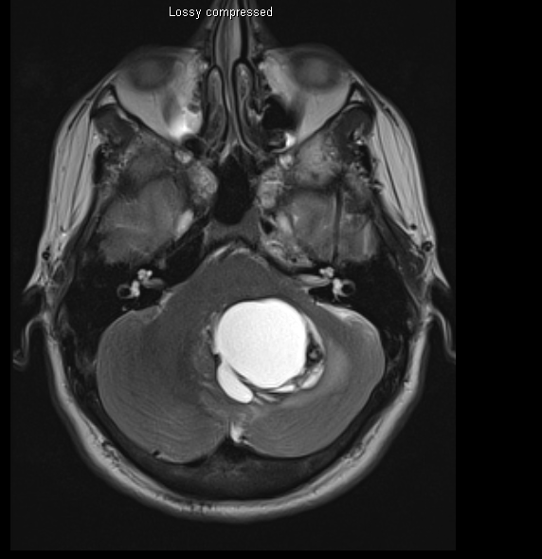
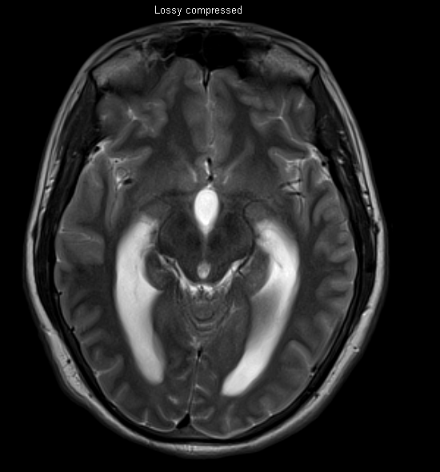
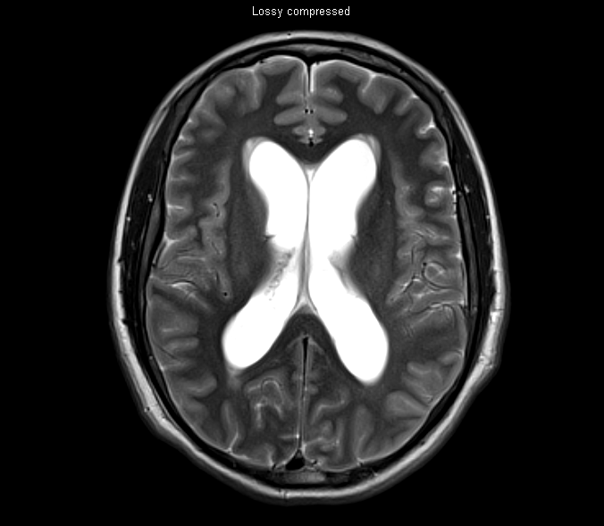

Slide 58
What do you want to do?

Slide 59
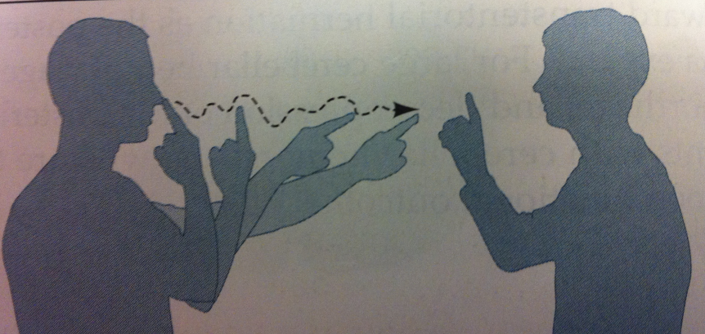
Cerebellar sign
-Gait ataxia
-Truncal ataxia
-Limb ataxia Finger-nose and heel-knee-shin
→ intention tremor , dysmetria (past pointing) &dysrhythmia
-Cerebellar dysarthria
-Hypotonia
-Rapid alternating movements (dysdiadochokinesia)
-Tremor
-Nystagmus gaze-evoked, horizontal drift followed by a fast correction

Slide 60
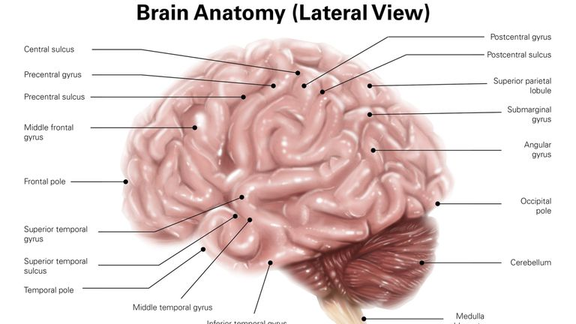
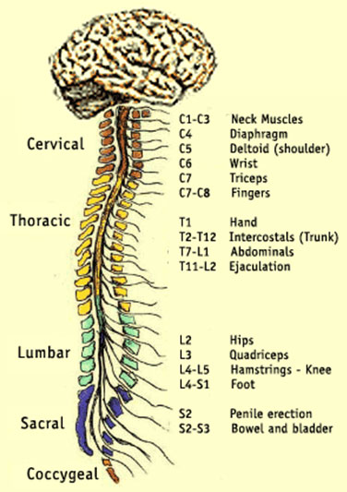
Localize lesions
Clinical presentation
Most common Pathology
-Frontal/motor cortex
(Dominant vs none-dominate hemispheres
-Parietal/sensory cortex
-Cerebellum
-Spinal cord (Cervical/Thoracic/lumbar)
-Cervical roots
-Lumbar roots

Slide 61
Thank You
Dr_ajlan79@hotmail.com
Common Congenital Neurosurgical Diseases

