Slide 1
Geriatric health in Saudi
King Saud University, College of Medicine,
Community medicine, 2018
Supervisor,
Dr. Khawater H. Bahkali
Done by G9:
Amjad Alduhaish 435202324
Lina Ismael 435202143
Luluh Alzeghayer 435202142
Rayanh Ababtain 435202250
Hadeel alghurair 435202256
Malak Alyahya 435202132
Maryam MA Majeed-Saidan 435202165
Shahad aldakhyil 435202086
Munira Alhussaini 435202146
Lina Al Bawardi 435202265

Slide 2
Outlines
Define and classify the elderly population
Study: The health of Saudi older adults; results from the Saudi National Survey for Elderly Health (SNSEH) 2006–2015 & issues of geriatric health in KSA
Explain the demographic changes associated with ageing of the population
List the health and social problems associated with ageing,
Describe the interaction between physical ill-health, social problems, psychological problems and functional limitations
State the top ten causes of years lived with disability, disability adjusted life years lost and death among elderly 70+ years in KSA
Outline the aims and aspect of elderly care

Slide 3
Definition & classification
Amjad Alduhaish
435202324

Slide 4
Definition Of Elderly Population:
To define someone as "elderly" just based on chronological age, as most of the official bodies do, seems inappropriate when the heterogeneity in this sub-population is considered. The theory of "deficit accumulation" better defines this process, whereby ageing is considered as the accumulation of various deficits over the time.
Researchgate.net/post/Who_is_elderly
The elderly population is defined as people aged 65 and over.
Data.oecd.org
Notes:
Organisation for Economic Co-operation and Development (OECD)

Slide 5
Life Expectancy:
In recent years, there has been a sharp increase in the number of older persons worldwide and more old people are alive nowadays than at any time in history.
The proportion of the population aged 60 and over, is also growing each year. By the year 2025, the world will host 1.2 billion people aged 60 and over and rising to 1.9 billion in 2050.
Morbidity profile of elderly attended / admitted in Jeddah, health facilities, Saudi Arabia
Ibrahim NK, Ghabrah TM, Qadi M

Slide 6
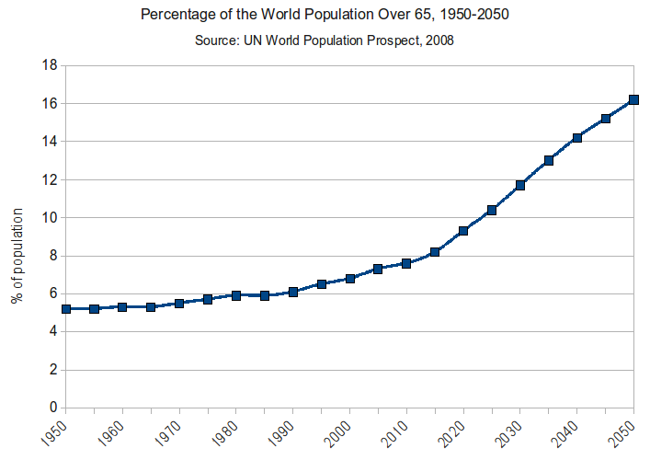
Source: United Nation (UN) World Population Prospect, 2008.

Slide 7
Classification Of Elderly Population:
Young old (60 to less than 75 years)
Old (75 years to less than 85 years)
Oldest old (85 years and above)
Frail elderly (above 60 years with cognitive impairment or a disability)

Slide 8
The health of Saudi older adults
Luluh Alzeghayer
435202142

Slide 9
Study: The health of Saudi older adults; results from the Saudi National Survey for Elderly Health (SNSEH) 2006–2015
Study sample: 2,946 SOA. The mean age was 70.1 years. ~ 70% were illiterate.
Study results:
The most reported diseases were:
hypertension,
diabetes and
joints pain.
The most reported medications were:
over the counter,
antidiabetics and
antihypertensive.
The nine-years age-adjusted death hazard was 42% higher in SOA males.

Slide 10
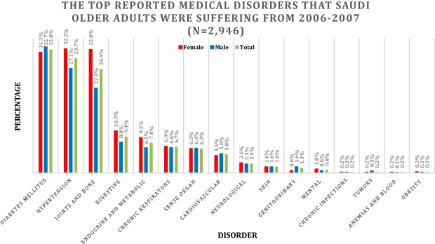
Study: The health of Saudi older adults; results from the Saudi National Survey for Elderly Health (SNSEH) 2006–2015

Slide 11
Issues of geriatric health in KSA
We don’t have enough comprehensive geriatric health centres
Employees aren’t well aware of elderly culture and requirement in SA
Nursery homes are overcrowded and understaffed.
Hospitals are overcrowded, making physical performance and psychological care for elderly not a priority
Not many Saudi older adults follow-up for their regular check-ups
Many Older adults and their caregivers prefer herbal remedies over medical treatment.

Slide 12
Issues of geriatric health in KSA cont.
6. Caregivers take most decisions regarding their elderly family-members, as many are illiterate and dependant on caregivers.
7. Homes and public places aren’t well designed for disabled/elderly populations, hence predisposing them to falls and injuries.
8. Many older adults can’t afford medical treatment and ancillary tools, like glasses and denture.
9. Sedentary lifestyle and lack of practices for healthy diet and exercise.

Slide 13
Strandgården - Sweden

Slide 14
Health and social problems associated with ageing
Rayanh Ababtain, Hadeel alghurair
435202250 , 435202256

Slide 15
Physical problems:
Chronic diseases
Nutrition problems
Impairment of special senses
Polypharmacy
Unintentional injuries
Deterioration of functional abilities

Slide 16
Chronic diseases:
Prevalent chronic and degenerative diseases among elderly are:
•Hypertension
•Diabetes
•Heart diseases
•Stroke
•Joint problems (arthritis)
•Incontinence and urgency (BPH)

Slide 17
Nutrition problems:
Primary malnutrition:
Reduced intake due to social or economic reasons
Secondary malnutrition:
Excess loss and reduced absorption
Overweight and obesity:
Imbalance between intake and expenditure of energy

Slide 18
Polypharmacy:
Polypharmacy is defined as: taking more than 5 drugs at a time including:
•Prescribed medications
•Over the counter medications
•Herbal treatment
Polypharmacy is the result of:
•Presence of multitude of diseases
•Physician’s aim to control physical problems

Slide 19
Impaired special senses:
Vision impairment:
•Cataract
•Corneal opacity
•Macular degeneration
Hearing impairment:
•Deterioration of smell
Dependence on others
Psychological problems
Rate of unintentional injuries

Slide 20
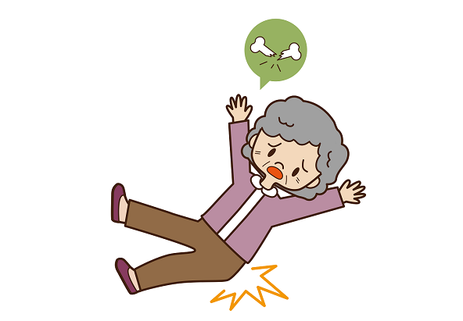
unintentional injuries:
mostly falls in the elderly own home
Less likely falls outside the home
Fractures
Being bed bound
Slow recovery
Unable to regain their status
Increase dependency

Slide 21
deterioration of functional abilities:
Reflects the abilities of the elderly to live independently
Housekeeping
Shopping
Cooking
Use of transportation
Use of Telephone
Dealing with money
Taking medications

Slide 22
deterioration of functional abilities:
Reflects the abilities of the elderly for self care
Bathing
Dressing
Grooming
Feeding
Continence
Ambulating
Transfer

Slide 23
Social problems :
Decrease income
Poverty has a negative impact on all age groups, and studies show it tends to impact the oldest generations the hardest.
Limits access to food
Limits access to healthcare
Healthcare costs seem to constantly be on the rise, and people over the age of 55 often have more health issues
Restricts Access to Transportation

Slide 24
Social problems :
Low social contact
Getting older means that our friends are aging, as well.
It is common for seniors to lose their friends to Alzheimer’s disease
or even death. Spending time with remaining friends
and family members becomes all the more important.

Slide 25
The interaction between physical ill-health, social problems, psychological problems and functional limitations.
Lina Ismael 435202143
Malak Alyahya 435202132

Slide 26
Health related quality of life in chronic diseases
Due to the medical care and treatment improvement, the life expectancy of elderly has become longer, Therefore, an increasing number of people live with chronic diseases that can adversely affect their quality of life.
Most of the chronic diseases have the potential to worsen the overall health of the person, affecting many aspects of their life like:
1- daily activities.
2- social activities.
3- economic status.

Slide 27
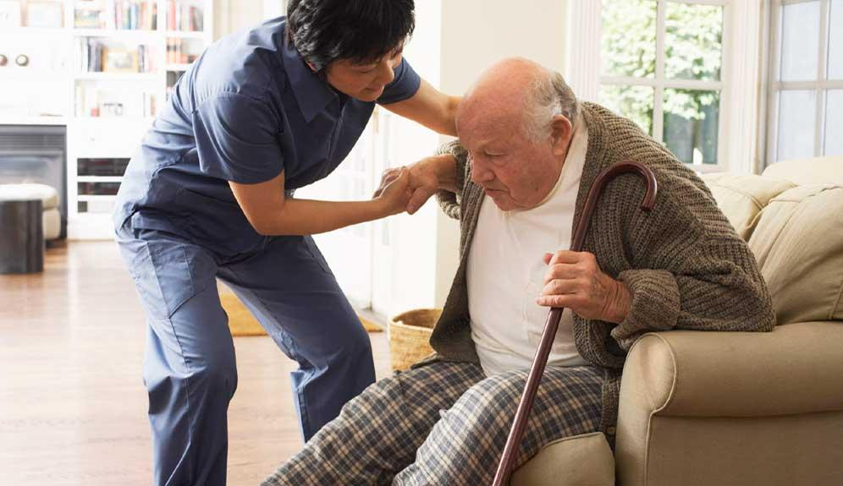
ACTIVITIES OF DAILY LIVING
“I’m 80 years old, and I can’t do what I used to. I don’t want people to help or hurry me. I want to do it on my own so please be patient.” – Frederick, age 80
Reflects the abilities of the elderly for self-care, such as:
•Bathing. •Dressing. •Grooming.
•Feeding. •Continence.
•Ambulating.
•Transfer.

Slide 28
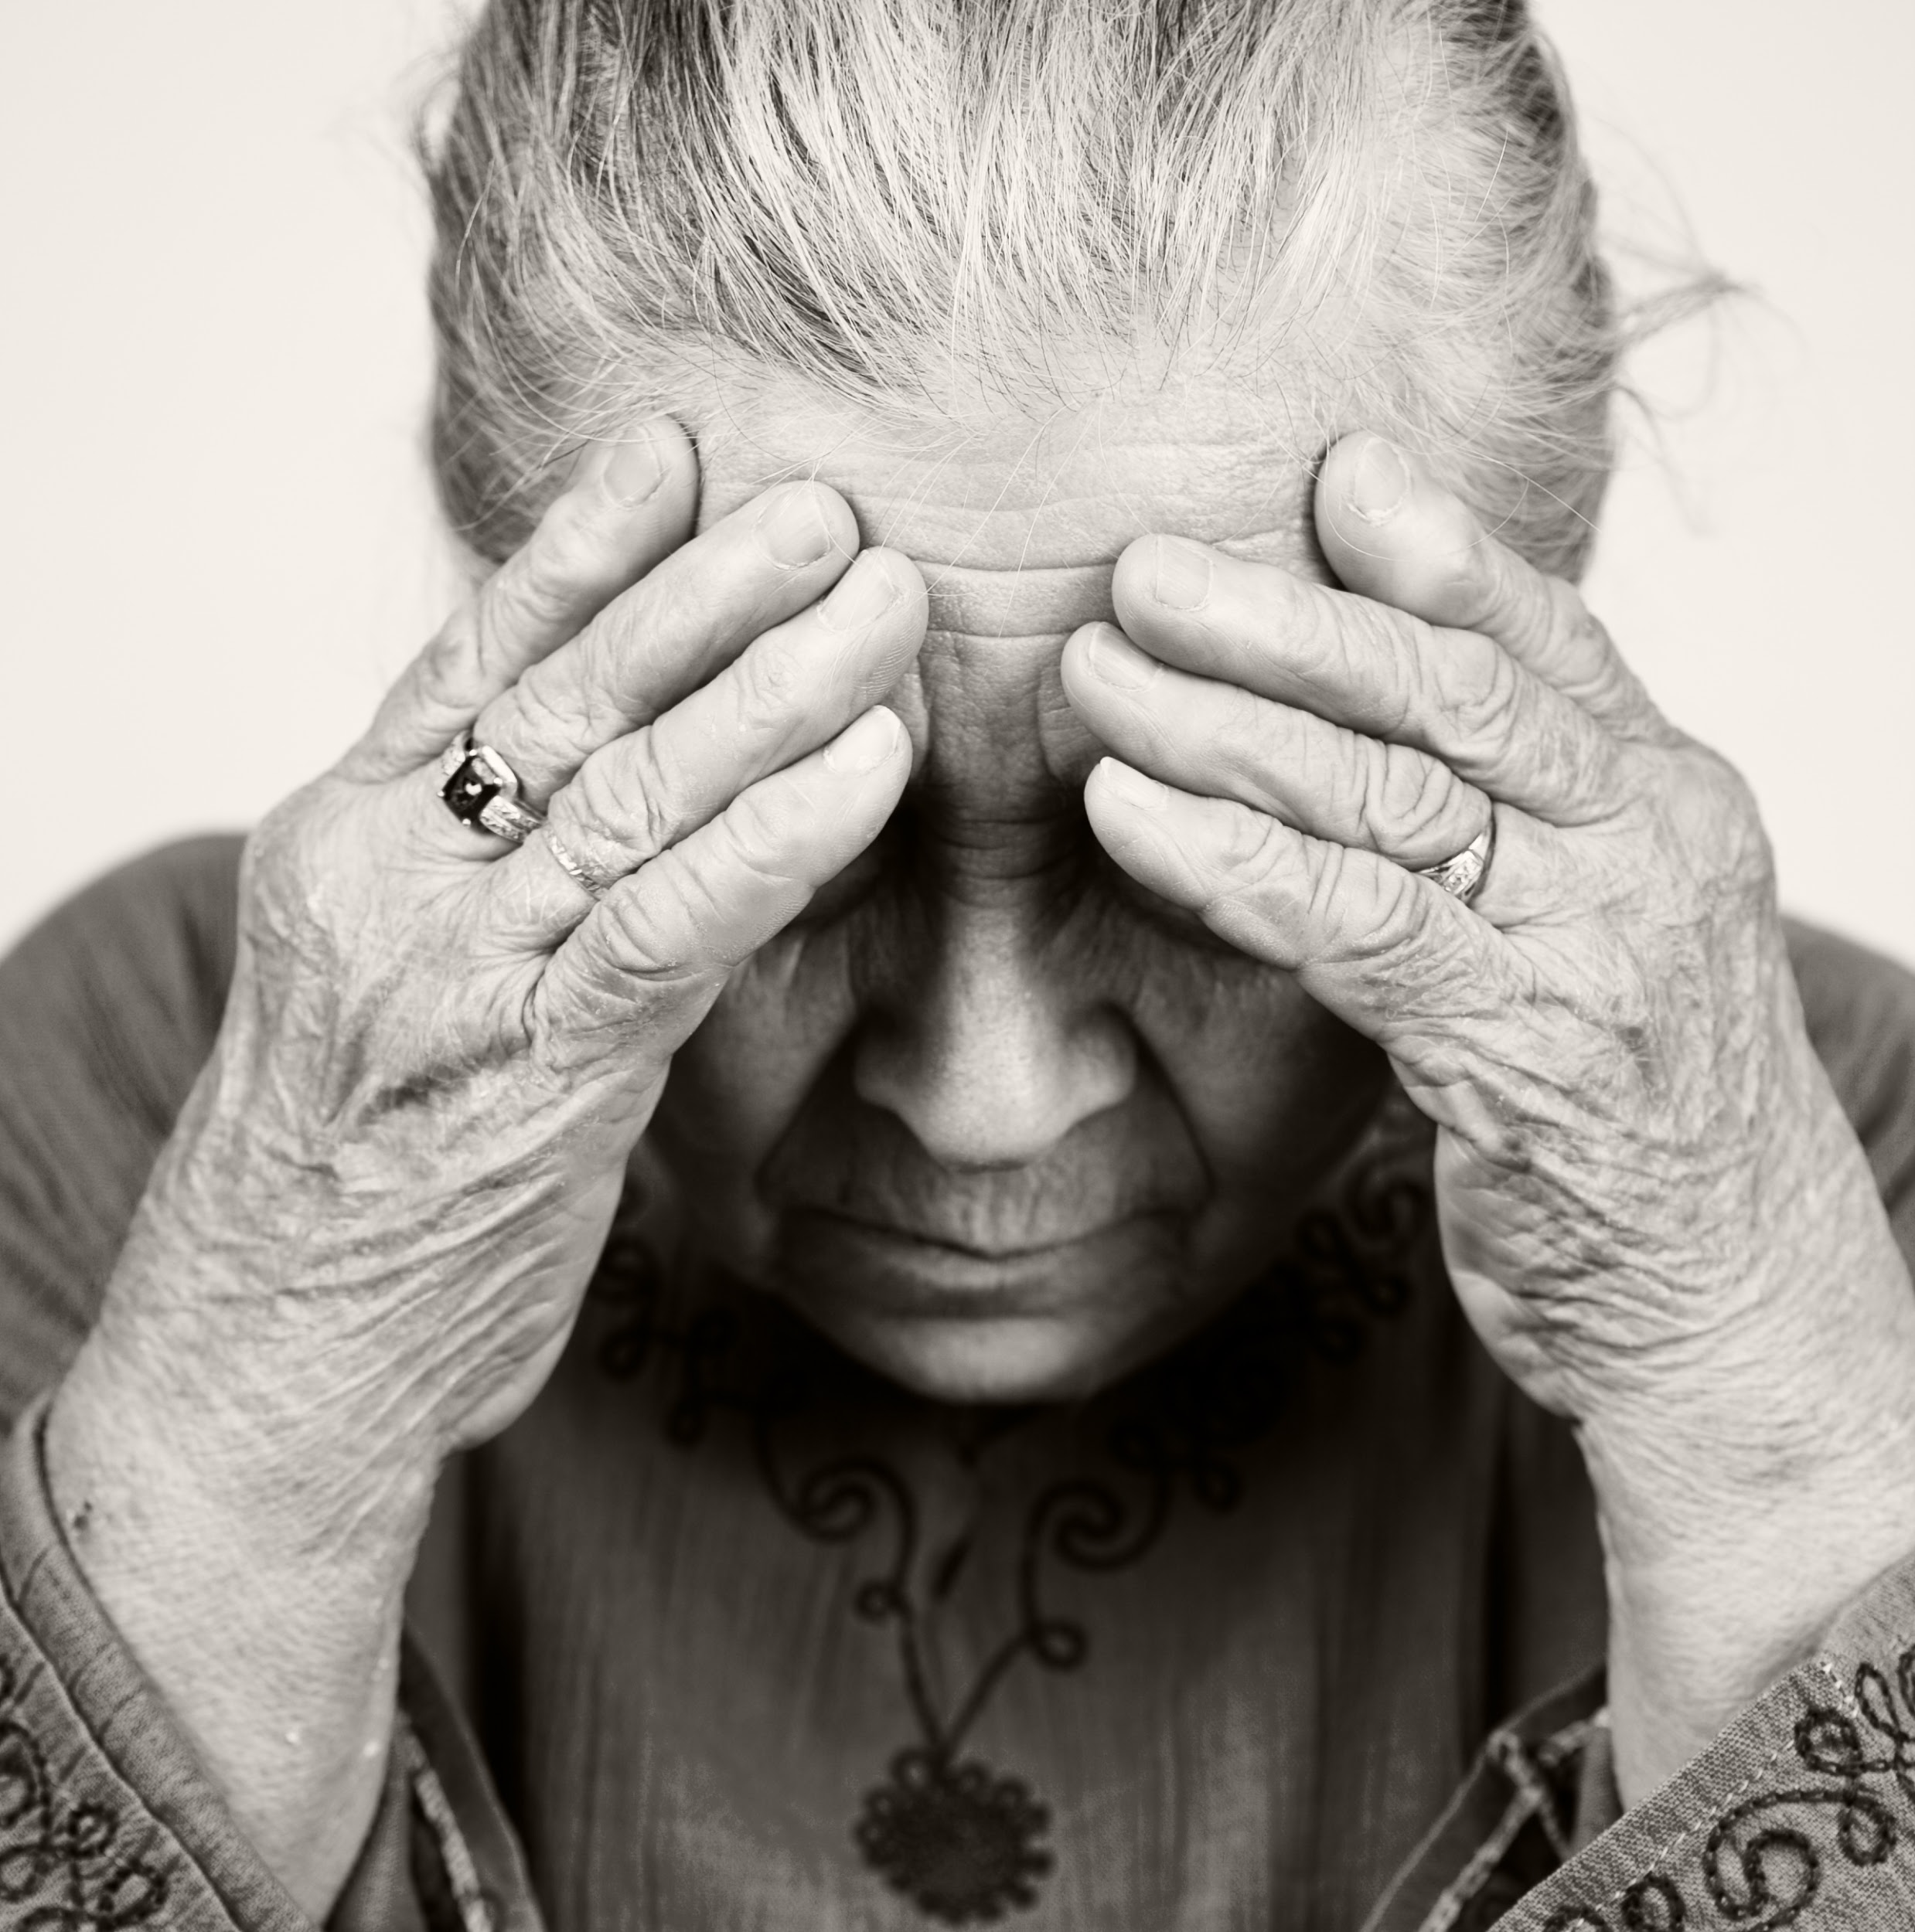
Psychological problems of elderly:
Elderly have high risk of psychiatric diseases because:
They are usually alone.
Losing a loved one.
Have been ill, or have a progressive chronic disease.
Disabling illness.
Recent surgery.
Use some medication.

Slide 29
DEPRESSION
Commonest psychological disorder among the elderly is depression.
Community-based mental health studies have revealed that the point prevalence of depressive disorders in the elderly population of the world varies between 10% and 20%, depending on cultural situations.
Gradual onset and progressive course.
Often not recognized by the elderly or the caregivers.
Manifested by executive dysfunction.

Slide 30
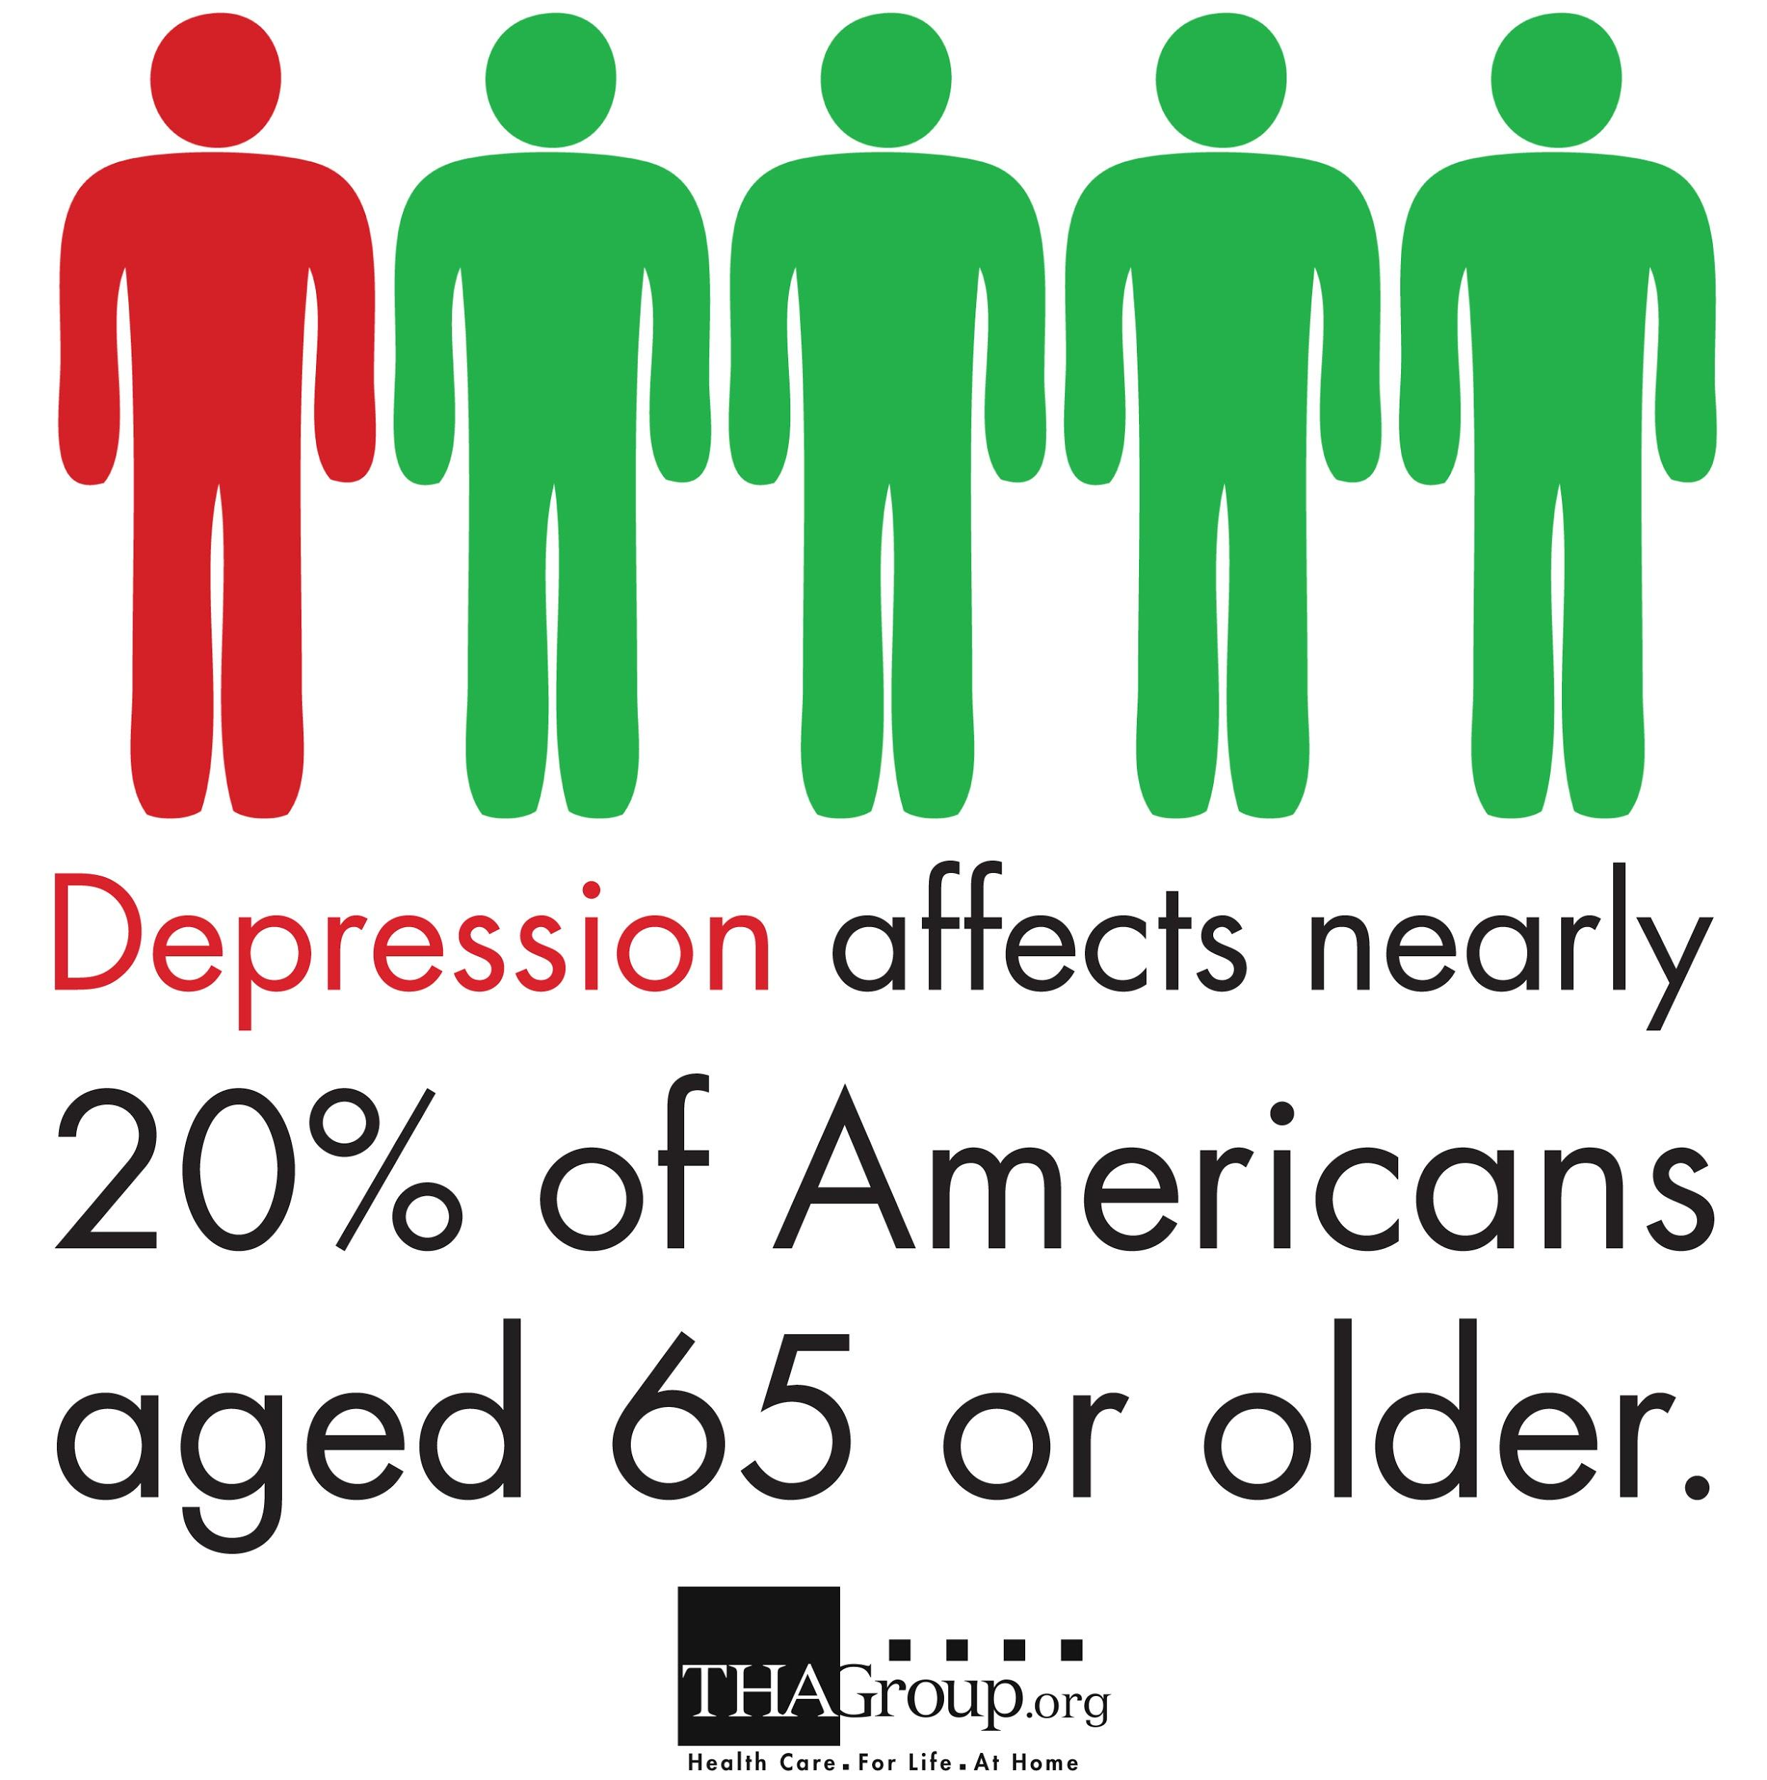
Treatment of depression:
Emotional support e.g. spend time together, and make them feel loved and wanted.
Encourage them to talk with their doctor.
Taking antidepressant drugs.

Slide 31
Long-term disability causes
-Munira alhussaini 435202146
Lina Al Bawardi 435202265

Slide 32
Leading causes of disability in elderly:
Arthritis:
Arthritis and other musculoskeletal problems.These are the most common causes of long-term disability. They make up as much as a third of all disability cases. Arthritis is probably the biggest single cause. About 1 in 3 people say arthritis affects their ability to do their jobs in some way
Heart disease and stroke:
People may live with heart disease for years or decades. It can severely limit their ability to work. Studies estimate that heart disease is now the reason for 17% of all health costs in the U.S.
Notes:
Reference: https://www.webmd.com/healthy-aging/features/top-causes-disability#1

Slide 33
Leading causes of disability in elderly:
Cancer:
cancer incidence increases exponentially with advancing age. the incidence of cancer in those over 65 is 10 times greater than in those younger than 65 and the cancer death rate is 16 times greater in patients over 65 compared to younger patients While cancer itself can be disabling, treatments such as surgery, radiation, and chemotherapy can also make it difficult to work.
Mental health problems.
You might think of disability as physical, but mental health problems can make work difficult or impossible. Depression, bipolar disorder, and other conditions can be as disabling as any physical illness.
Notes:
https://www.webmd.com/healthy-aging/features/top-causes-disability#1

Slide 34
Leading causes of disability in elderly:
Diabetes:
Diabetes is associated with a strong increase in the risk of physical disability. There are several hypotheses as to why diabetes has such a broad effect on physical functioning. Diabetes has many associated risks, comorbidities, and complications that lead to multiple impairments and a broad impact on functioning.
Nervous system disorders. These include a number of conditions that affect the brain or nerves, such as:
Parkinson's disease
Alzheimer's disease
Notes:
https://academic.oup.com/biomedgerontology/article/59/2/M148/610283

Slide 35
Leading causes of disability in elderly:
Lower respiratory infection
allergic rhinitis, influenza, lung cancer
lower respiratory infections in adults, including pneumonia
Asthma
chronic obstructive pulmonary disease (COPD)
Tuberculosis
cystic fibrosis
Chronic kidney disease:
Heart disease is the major cause of death for all people with CKD.
treatment with dialysis or kidney transplantation creates a huge financial burden for the majority of the people who need it
Notes:
https://www.kidney.org/kidneydisease/global-facts-about-kidney-disease

Slide 36
Leading causes of disability in elderly:
Refraction disorder:
Poor vision can have many adverse effects, such as depression, car accidents, and medication errors, but none of these are more concerning than falls. Falls are among the leading cause of death in age 65+
Back pain:
A person's back pain is not the cause of death, however back pain have been linked to increased symptoms of anxiety and depression, and reduced social activity, decreased physical activity may lead to weight gain, which, in turn, increases a person's risk for a number of diseases,
Notes:
https://www.theeyeassociates.com/vision-loss-and-falls/
https://www.livescience.com/58019-back-pain-risk-of-death.html

Slide 37
The Demographic Changes Associated with Aging of the Population
Maryam MA Majeed-Saidan
435202165

Slide 38
Elderly Population
Over 600 million people are aged over 65 in 2015
Over 1.5 billion people will be aged over 65 in 2050
People aged over 80 will increase by 6 folds from 125 million to 700 million
This can be attributed to advances in healthcare and interventional therapy and infection control
Also, total fertility rate is decreasing while the lifespan is increasing
Notes:
Cancer survival
Vaccines
Healthcare
Fertility rate is lower
Given the natural disasters

Slide 39
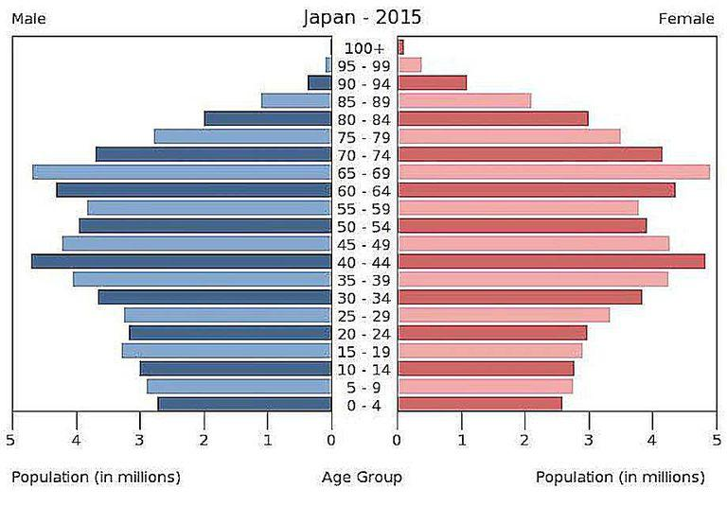
Aging on the Population Pyramid
60+ years is wide
Size of the dependant old is large
Large portion of population with a longer lifespan
Old dependency ratio will increase
Notes:
https://academic.oup.com/biomedgerontology/article/59/2/M148/610283

Slide 40
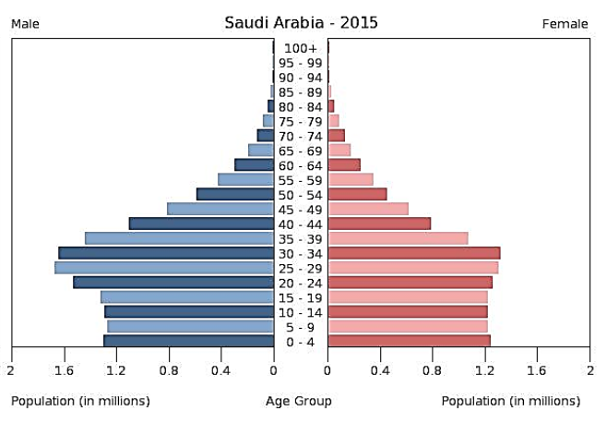
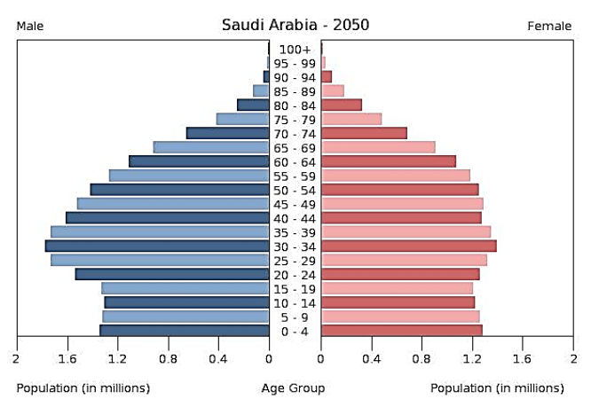
Population Pyramid of Saudi Arabia
2015
2050
Notes:
https://academic.oup.com/biomedgerontology/article/59/2/M148/610283

Slide 41
Effect on the Economy
Increased demand on healthcare
Increased need for healthcare workers
Increased old dependency ratio
Decrease in the workforce
Increase in retirement costs
Notes:
Dependency ratio in the US will increase from 59% in 2005 to 72% in 2050

Slide 42
CARE FOR THE ELDERLY
Shahad aldakhyil
435202086

Slide 43
The aim of the elderly care is :
Promote healthy ageing; growing old and delaying ill-health
early detection of aging at PHC ( help in treatment of physical and mental health problems early )
Provide a social support to ensure a decent and safe living
Establish long and short term community based services to provide care for the elderly and alleviate tension on the family

Slide 44
PROMOTE HEALTHY AGEING
Promoting healthy ageing has its roots in adopting a healthy lifestyle through the lifespan including
•Maintaining acceptable level of physical activity
•Adherence to a healthy diet
•Avoid the use of any tobacco products
•Avoid the use of alcohol

Slide 45
Comprehensive health assessment of the elderly at PHC to screen for major health problems through:
•History
•Medical problems
•Unintentional injuries
•Medications
EARLY DETECTION AND MANAGEMENT
•Use of standardized tools for the screening for
•Nutrition problems •Depression
•Hearing impairment •Dementia
•Incontinence
•Functional abilities

Slide 46
•Social contact (living in a family, presence of caregiver, frequency of contact with caregiver, nature of relation with caregiver)
•Social activities (having a profession, friends, hobbies, special interest, outing and extent of satisfaction with social activities)
•Living conditions (comfort and safety in the house and extent of satisfaction with living conditions)
•Economic status (tangible wealth, monthly income, extent of coverage of needs)
SOCIAL EVALUATION AND SUPPORT

Slide 47
COMMUNITY-BASED SERVICES
•Elderly day care centers: Elderly clubs to maintain social interaction
•Elderly day health centers: Day hospitals for elderly who need nursing care
•Home services: Provide social and nursing services to elderly in their own homes

Slide 48
References:
Study: The health of Saudi older adults; results from the Saudi National Survey for Elderly Health (SNSEH) 2006–2015
https://www.sciencedirect.com/science/article/pii/S1319016417302037#s0045
https://www.ncbi.nlm.nih.gov/pubmed/22048509
http://www.thagroup.org
http://www.abc.net.au/news/2015-10-22/curson-the-demographics-that-will-change-our-world/6875200
Notes:
https://academic.oup.com/biomedgerontology/article/59/2/M148/610283

Slide 49
Thank u !

