Slide 1


Clinical Data
Amr Jamal, MD, SBFM, ABFM, MRCGP, GCMI, MBI
Assistant Professor and Consultant Family Physician and Clinical Informatician
Head of Medical Informatics & e-Learning Unit (MIELU)
King Saud University, College of Medicine
Nasriah Zakaria
Assistant Professor
Medical Informatics & e-Learning Unit (MIELU)
King Saud University, College of Medicine

Slide 2
What are clinical data? [1]
A datum is a single observation of a patient
Clinical data are a collection of observations about a patient
Each datum has five elements:
  the patient (Amr Jamal)
  the attribute (heart rate)
  the value of the attribute (52 beats per minute)
  the time of the observation (1:00 pm on 1/1/2015)
  the method by which the attribute was obtained (heart monitor)

Slide 3
Types of clinical data [1]
Narrative: recording by clinician- maternity history
Numerical measurements: blood pressure, temperature
Coded data: selection from a controlled terminology system example being the term MI that may mean myocardial infarction or mitral insufficiency
Textual data: other results reported as text
Recorded signals: EKG, EEG
Pictures: radiographs, photographs, and other images

Slide 4
Use of clinical data [1]
Form basis of historical record
Support communication among providers
Anticipate future health problems
Record standard preventive measures
Identify deviations from expected trends example being a growth chart
Coding and billing
Provide a legal record
Support clinical research

Slide 5
Types of clinical data documents [1]
History and physical examination:
 by a clinician
Progress notes
 update of progress by primary, consulting, and ancillary providers
Reports
 by specialists, ancillary providers
Typical paper chart maintains all patient notes in chronological order, sometimes separated into different components

Slide 6
Chief complaint
History of the present illness
Assessment of a stable patient [1]
Past medical history
Social history
Family history
Review of systems
Physical examination
Investigations –lab, x‐ray, other
Assessment plan

Slide 7
Some complications of data [1]
Circumstances of observation
e.g., how was heart rate taken? pulse? EKG?
Uncertainty
how accurate is patient reporting, measurement, device?
Time
what level of specificity do we need?

Slide 8
Some complications of data[2]
Duplication
 e.g., multiple records in different departments
Outdated
e.g. missing values
Incorrectly formatted
does not follow standards

Slide 9
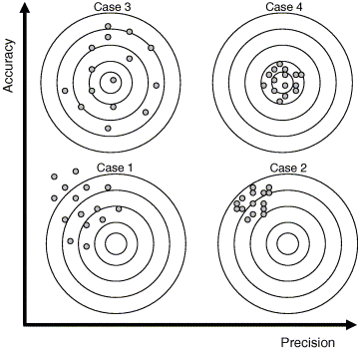
Imprecision vs. Inaccuracy [5]

Slide 10
Structure of clinical data [1]
Medicine lacks uniform structured vocabulary and nomenclature as does Physics and Chemistry
Standardization and computerization of data is
benefited by standard representations (Cimino, 2007)
Counter‐arguments are “freedom of expression” and
“art of medicine”
Narrative information when expressed in
many ways can be ambiguous

Slide 11
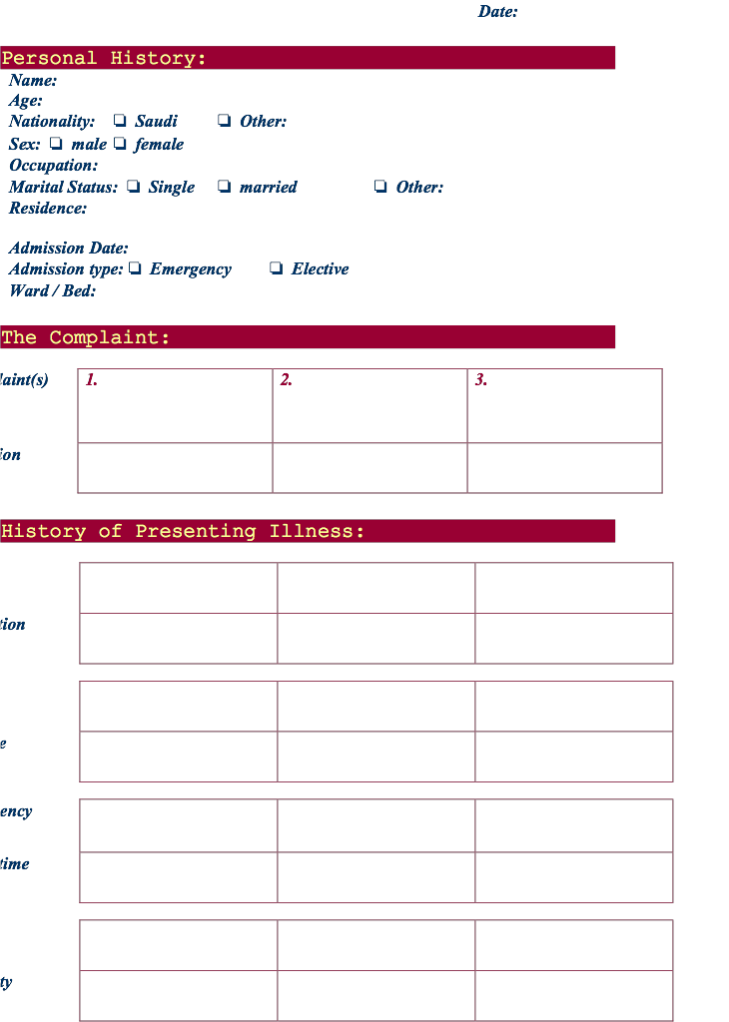


Slide 12
We need better access to clinical data [1]
Missing clinical information during primary care visits (Smith, 2005)
 Information reported missing in 13.6% of clinical visits
 Available but outside system in 52% of instances
 Estimated to adversely effect patients 44% of time
 Unsuccessful searching for it took >5 minutes 35% of time
Physicians have two unmet information needs for every three
patients (Gorman, 1995; Ely, 1999)
Secondary use of clinical data (Safran, 2007)

Slide 13

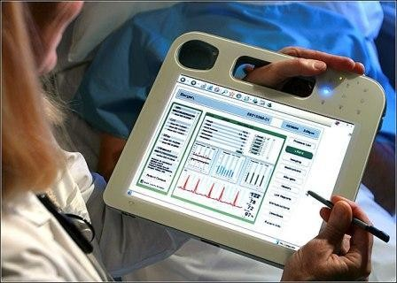
Data entry [1]
General categories of data entry:
 Free-form entry by historical
methods:
 writing
 dictation
 typing
 Structured (menu-driven) data
entry by mouse or pen
 Speech recognition for either of above

Slide 14
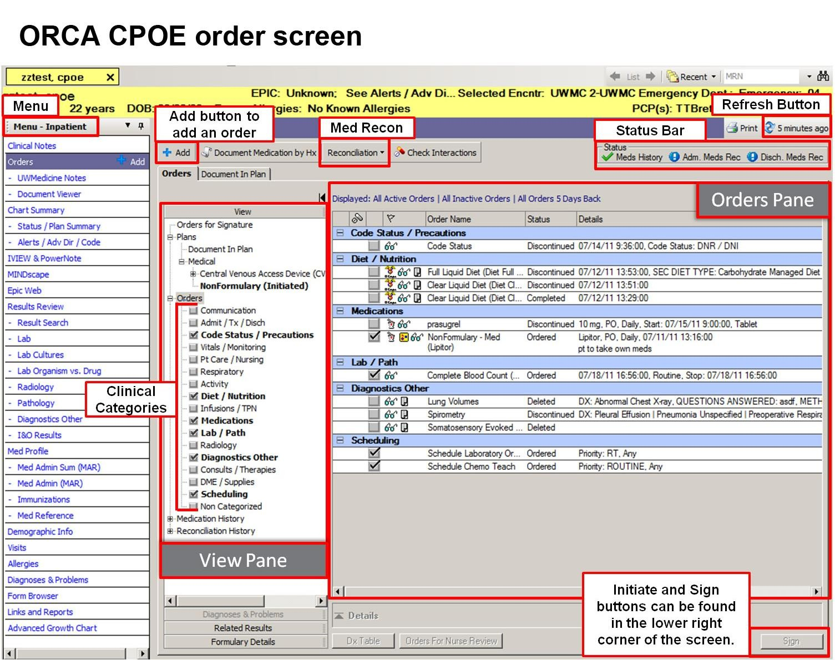

Slide 15
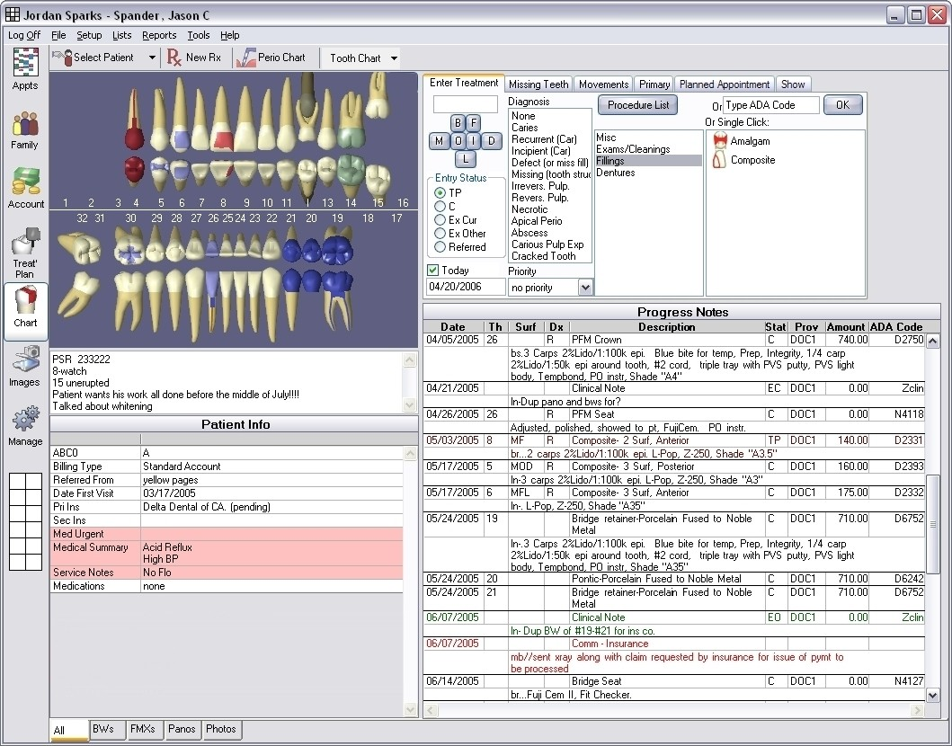

Slide 16
Structured or menu‐driven data entry
Many attempts from old (Greenes, 1970;
Cimino, 1987; Bell, 1994) to new (Oceania; OpenSDE – Los, 2005)
Can be done via mouse or pen, with typing
Benefits
 Data codified for easier retrieval and analysis
 Reduces ambiguity if language used consistently
Drawbacks
 In general, more time‐consuming
 Requires exhaustive vocabulary
 Requires dedication to use by clinicians

Slide 17

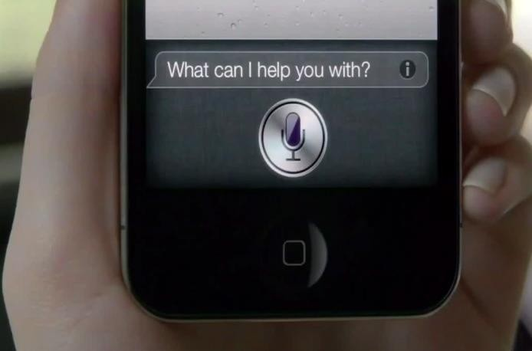
Speech recognition for data entry [1]
Most common use is for narration
 e.g., computer dictation of clinical notes
An advantage is instant availability of dictated content
Continuous speech recognition now is commercial reality
 Speaker‐dependent systems require user training
 Speaker-independent are systems less accurate
Many established systems on the market that operate on:
 front-end (used by clinician) or
 back-end (process dictations) (Brown, 2008)

Slide 18
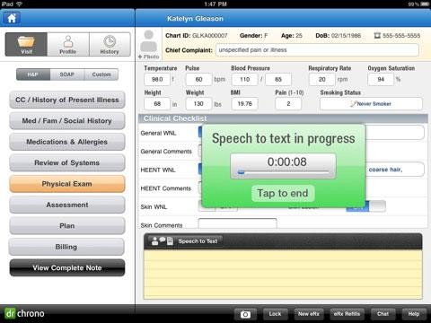
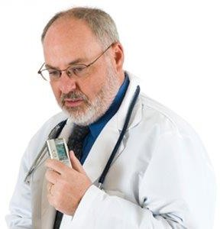

Slide 19
Coded vs. free-text data [1]
Coded data:
Documentation of discrete data from controlled
vocabulary
Free text:
Alphanumeric data that are unstructured, typically in narrative form

Slide 20
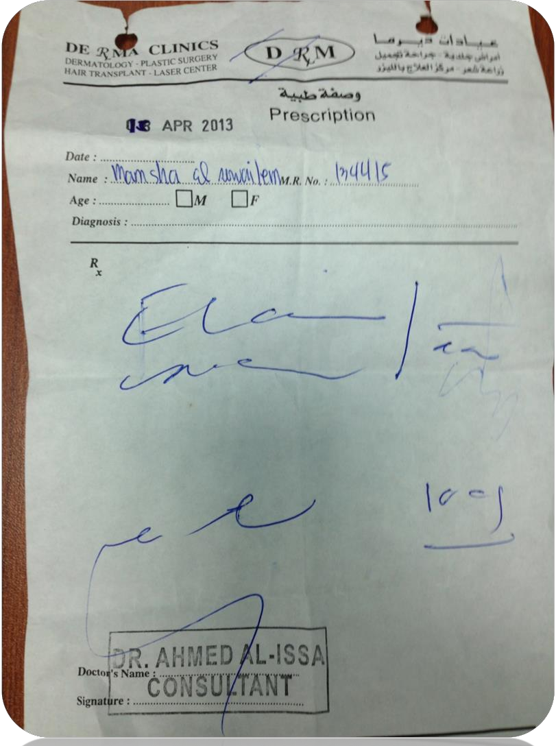



Slide 21
Narratives tell a story.
A narrative tells a story
 See the patient through a description
 Complicated events are easier to describe in text
Undifferentiated problems
 Interpretation.
 “only a human can prioritize and determine what the chief
complaint really is”

Slide 22
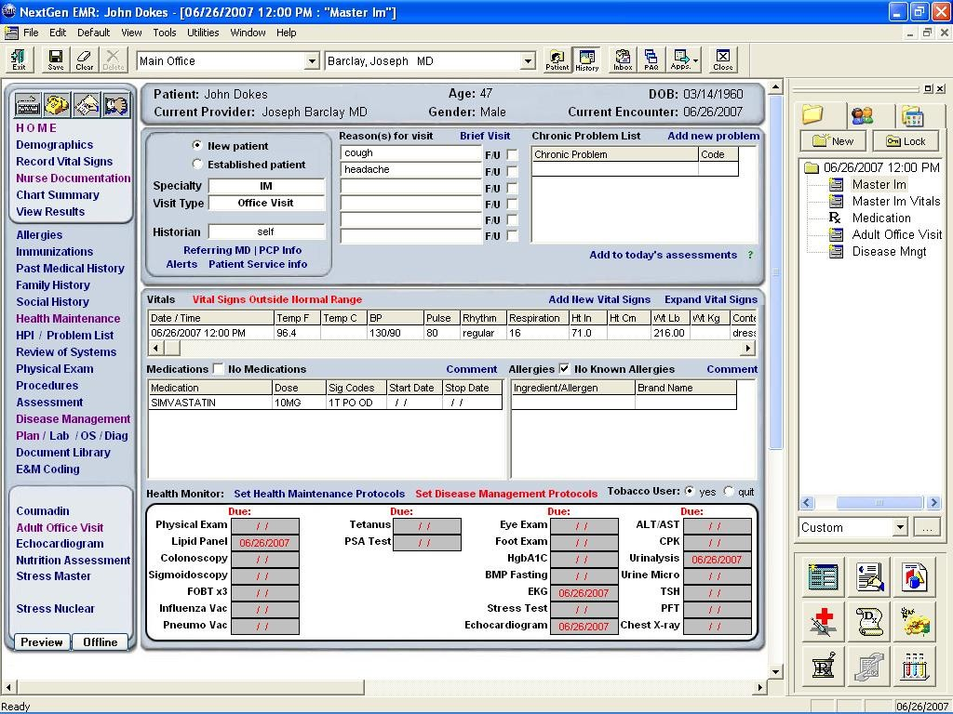

Slide 23
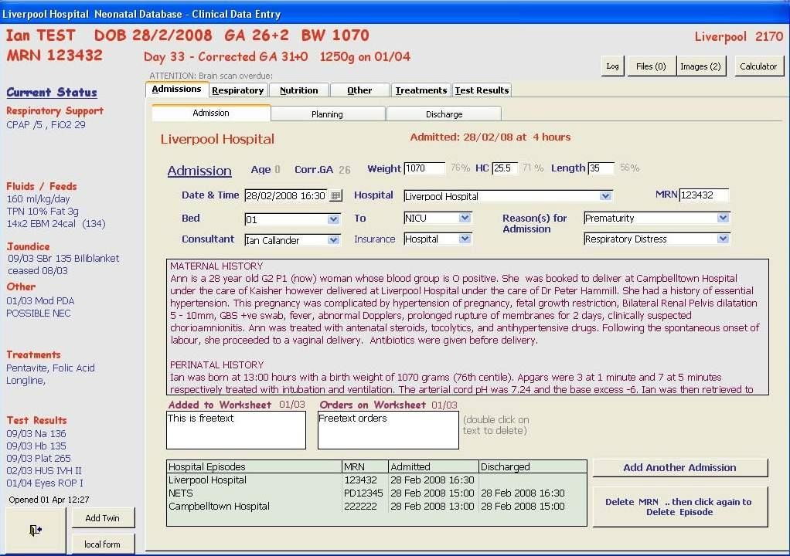

Slide 24


Issues with coded data
“pick from a list” allows wrong selection
compliance concerns
over documentation for care
cloning

Slide 25
Data Management [2]
File Organization concepts
Database: A set of related files
File: Collection of records of same type
Record: A set of related field
Field: Words and numbers
26

Slide 26
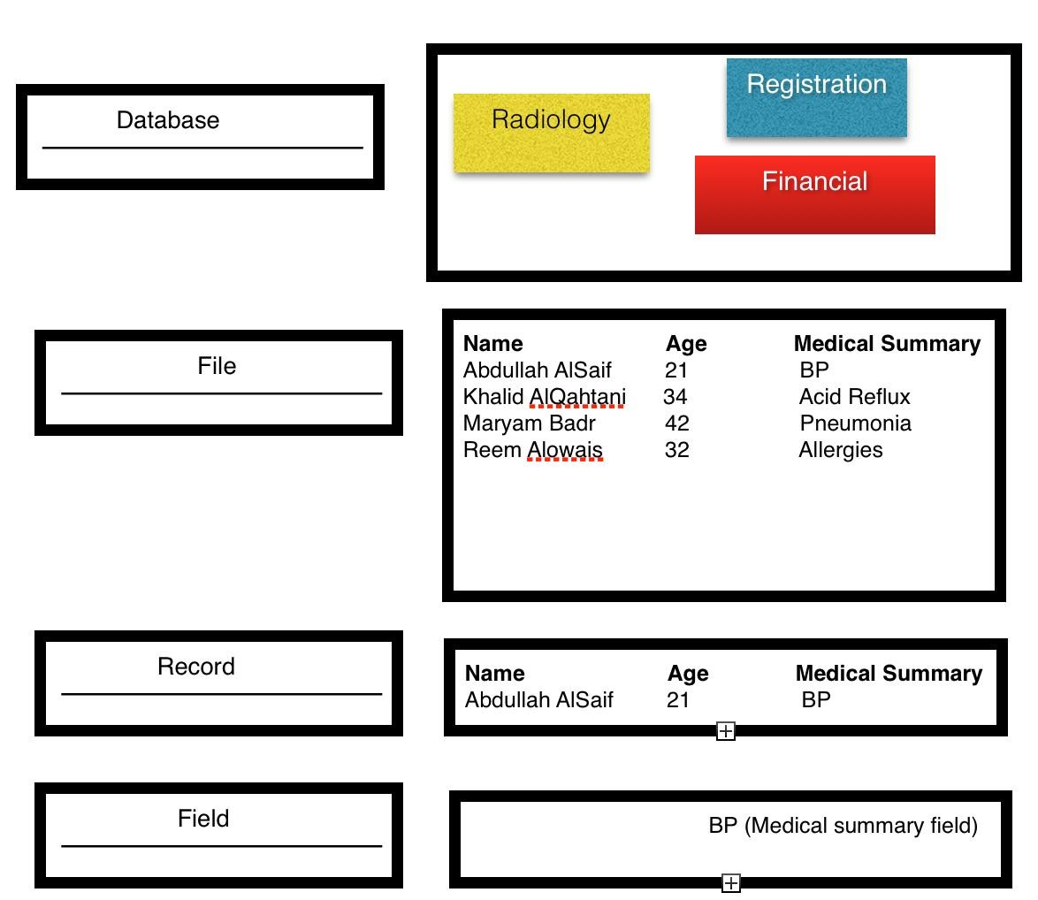
27

Slide 27
Relational DBMS [1]
Relational model links records to tables
Allows efficiencies
One-time information (e.g., demographics) stored only once
Complex queries easier to construct and carry out
Most query capabilities are based on Structured Query Language (SQL)- special language in relational database
28

Slide 28
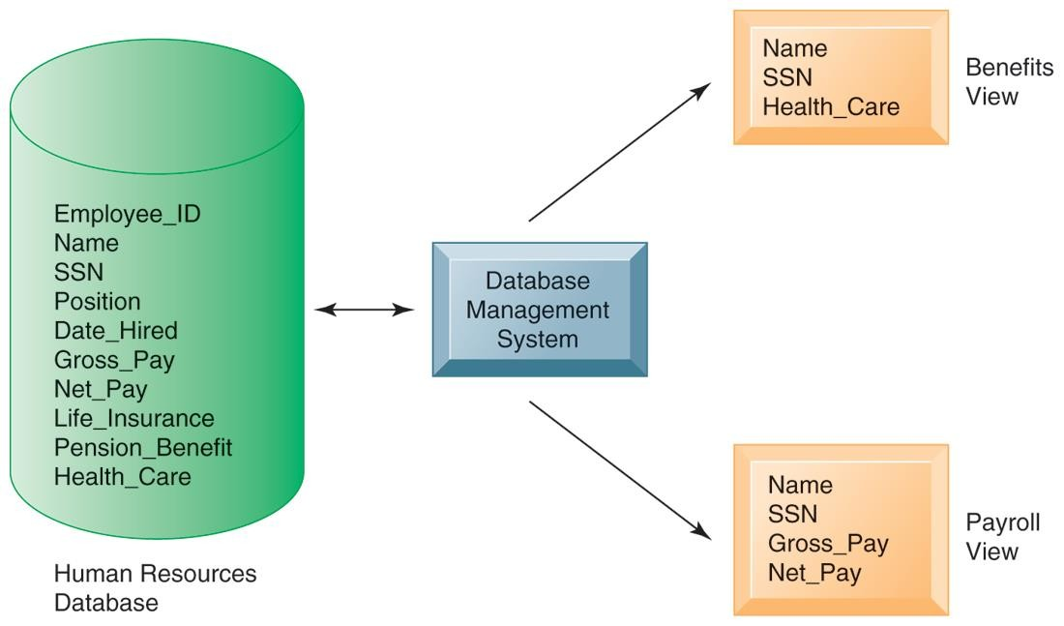
Relational DBMS [2]
29

Slide 29
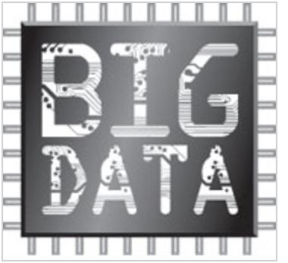
Big Data [3]
Science of Data Management & analysis
“to convert Vast information and knowledge in organisation to achieve their objectives” (Murdoch et al, 2013*)
What is BIG/VAST ? Zettabytes (10^21 gigabytes) to Yottabytes (10^24 gigabytes)
Used in Astronomy, Search Engines, Financial, Politics and now in
Biomedicine
Example of Big Data is Bioinformatics (genome, proteomic)
*Murdoch, T. , Detsky, A. (2013) The Inevitable Application of Big Data to Health Care
JAMA. 2013;309(13):1351-1352. doi:10.1001/jama.2013.393.

Slide 30
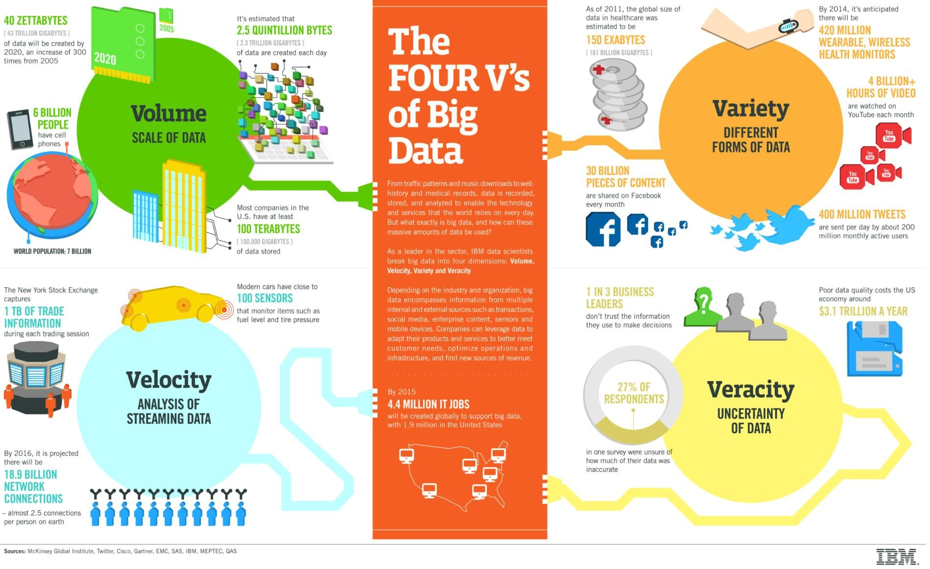
The FOUR V’s of Big Data [3]

Slide 31
Big Data in healthcare [3]
“80% of medical data is unstructured and is clinically
relevant.
The data reside in multiple places like individual EMRs, lab and imaging systems, physician notes, medical correspondence, claims, customer relations
management systems and finance.”

Slide 32
Sources of BIG DATA [4]
Clinical Data from CPOE
Clinical decision support systems (Written notes &
prescriptions)
Imaging systems: PACS, Radiology Information systems
Sensor data (monitoring vital signs)
Social media data- Tweets from Twitter, wall and status updates on Facebook
Emergency care data
Literature from medical journal
33

Slide 33
Healthcare BIG data problems to be solved [4]
Patient profiles and the health outcomes- identify the effective treatments
For public health- identify individuals who would get preventive care or lifestyle changes
Analysing literature on medical procedure to determining which
care protocols work best
Creating mobile apps to manage diabetes. Via Data analytics, we are able to monitor the healthcare outcomes improvements
Analysing social network communication among support group members- to understand how non-profit organization can interact and provide help
34

Slide 34
In summary,
Types of clinical data
Types of clinical data documents
Use of clinical data
Access to clinical data
Data entry
Coded vs. free-form data
Speech recognition
Big Data
Database Management

Slide 35

Acknowledgement
Notes are adapted with permission from Professor Hersh, Oregon Health and Science University (OHSU), Oregon, USA

Slide 36
References
Hersh, W. (2014). Notes from 10x10 Medical Informatics certificate, Oregon Health & Science University
Laudon & Laudon (2011), Management Information Systems, Prentice Hall
IBM website:http://www-01.ibm.com/software/data/bigdata/what-is-big-
data.html
Ragupathi W. & Ragupathi V. (2014). Big Data Analytics in Healthcare: Promise and Potential. Health Information Science and Systems http://www.hissjournal.com/content/2/1/3
http://www.sophia.org/tutorials/accuracy-and-precision--3

