Slide 1
Paper Medical Record and Electronic Health Record (EHR)
PROF. AHMED ALBARRAK
1

Slide 2
Traditional Paper-based Medical Record
Purpose: to record observations and could be reminded of patients'
details.
Input sources:
  History
  Notes
  Lab
  Radiology
  Reports
  Coding
  Other
1

Slide 3

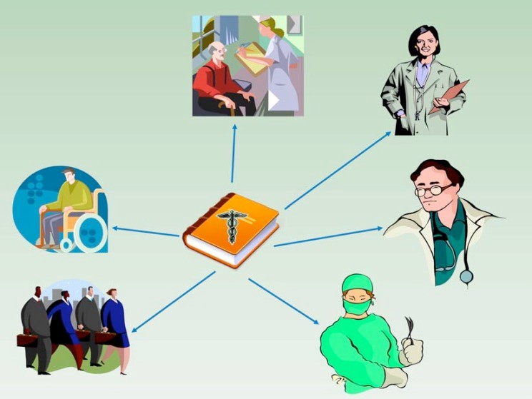
Traditional Paper-based Medical Record
Outputs:
1

Slide 4
Paper based medical records dis(advantages)
Find the record (lost, being used elsewhere)
Find data within the record (poorly organized, missing)
Read data (legibility)
Update data (manual)
Record fragmentation
Moving records
Redundancy (re-enter data in multiple forms)
Statistics and Research (can not search across patients)
Passive (no automated decision support)
1

Slide 5
Main Purpose of Documentation
Remembering what you did and why; form basis for historical record
Conveying information to Medical Team members; Support communication among providers
Coding and Billing
Legal issues
1

Slide 6
Main Purpose of Documentation
Anticipate future health problems
Record standard preventive measures
Identify deviations from expected trends example; growth chart
Support clinical research
1

Slide 7
Remembering what was done and why
  Legibility
  Ease of search
  Granularity of information
  Miss filings
  Lost charts
1

Slide 8
Disadvantages
Learning curve
Slower-time
Security/privacy concerns
Cost, initial cost,running and maintenance
Upgrades and depreciation
1

Slide 9
Role of medical records
Transcription Coding Quality check Security administration Training Research

Slide 10
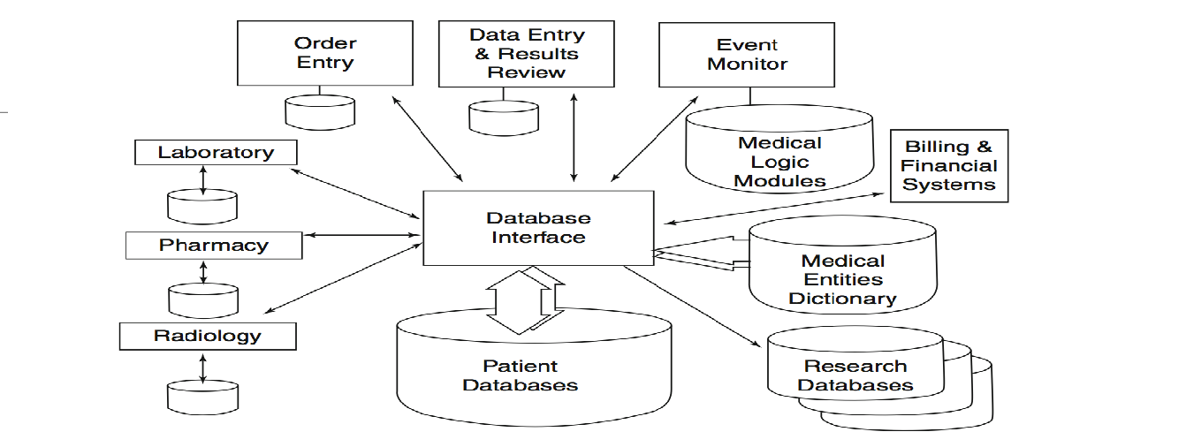
Block Diagram showing multiple systems feeding into patient database. The Database Interface or Interface Engine may perform intelligent filtering, translating and alert functions (page 396, Shortliffe)
10

Slide 11
Medical records…
Medical records serves a variety of functions for organizations not involved directly in care:
Insurers (government and private) to justify payment for medical services rendered, and to detect fraud.
Quality reviews, administrative reviews, and utilization studies to manage the business aspects of health care.
Used for societal purposes, such as, social service and welfare system management, law enforcement, screening and licensing and determining life insurance eligibility.
Medical research, public health management
Education and medical training

Slide 12
EMR
A general term describing computer-based patient record systems. It is sometimes extended to include other functions like order entry for medications and tests, amongst other common functions.
EMR (Electronic Medical Record) – the set of databases (lab, pharmacy, radiology, clinical notes, etc.) that contains the health information for patients within a given institution or organization

Slide 13

*EMR Components*
Results reporting
Data repository
Decision support
Clinical messaging and communications; i.e. e-mail
Documentation
Order entry

Slide 14

Electronic Health Records (EHR)
Definition: a repository of electronically maintained information about an individual’s
health status and health care, stored such that it can serve the multiple legitimate uses
and users of the record.
Other definition: Longitudinal electronic record of patient health information generated
by one or more encounters in any care delivery setting
Electronic Health Record System: includes the active tools that are used to manage the
information.
Interoperability standards to exchange info outside a single healthcare delivery system.
Supports other care-related activities directly or indirectly—evidence-based decision support, quality management, and outcomes reporting

Slide 15



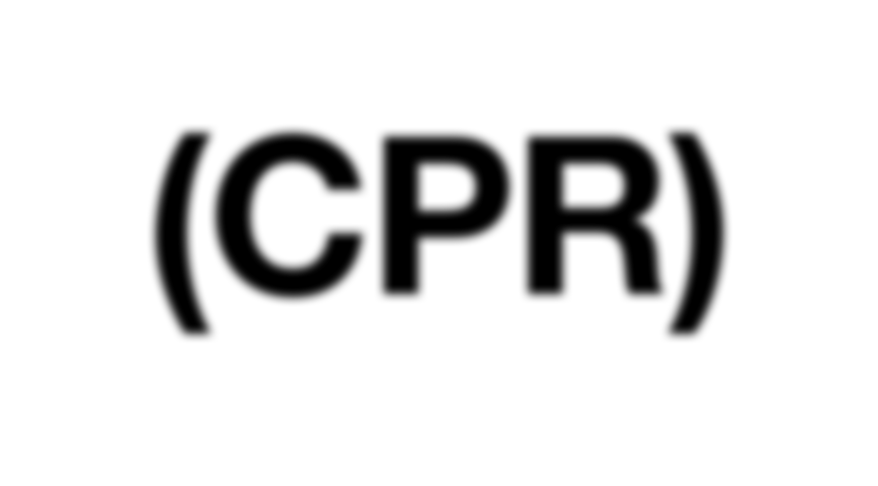
Computer-Based Patient Record (CPR)
Comprehensive lifetime record
Attributes identified by the Institute of Medicine (IOM) provide the basis for today’s understanding of the EHR

Slide 16
Electronic Medical Record vs. Paper-Based
Record
Function | Paper record | EMR
Availability and accessibility | One location | Multiple
Display | One format | Several format
Security | Low | High
Data | Difficult to extract | Should be easy to extract
Legibility | Low | More
Duplication of records | Yes | No – can all be linked
Duplication of tests | Yes | Rare
Patient interaction | None | Full – if desired

Slide 17
Functional Components of an Electronic Medical Record System
An EHR is not simply an electronic version of the paper record.
Integrated view of patient data
Clinician order entry
Clinical decision support
Access to knowledge resources
Integrated communication and reporting support

Slide 18
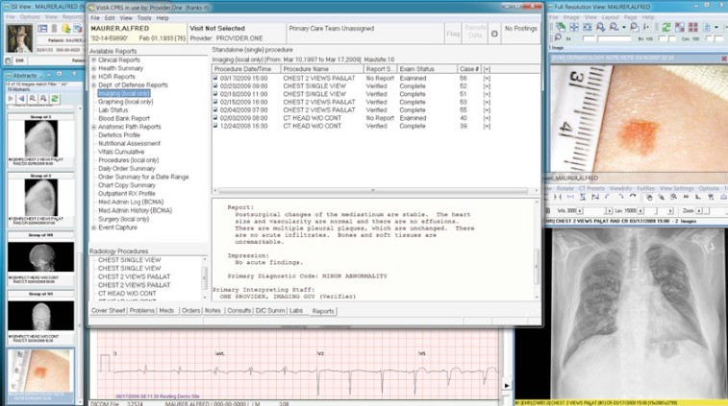
Integrated View of Patient Data
Available at anytime anywhere
Clinical Data has complexity and diversity
Clinical Data requires different format and terminology
Requires standards like HL7 to integrate the clinical data
Local terminologies needs to be translated into standardized terminologies
(Source: Courtesy of WorldVistA (worldvista. org) and ISI Group ( www.isigp.com ), 2012)

Slide 19
Integrated View of Patient Data
Interface Engine helps to become mediator for EHR to be connected to other vendor systems( Tracking system, Imaging system, Medication dispenser etc)
Various views: Flowsheet, Chronological views, Summary Views

Slide 20

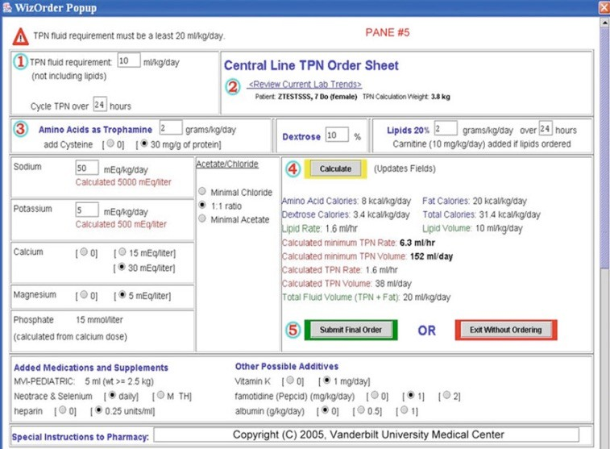
Clinician Order Entry
Electronic order entry can improve health care at several levels
(computerized physician order entry (CPOE)):
-Reduce errors and costs.
-Deliver decision support at the point where clinical decisions are being made.

Slide 21

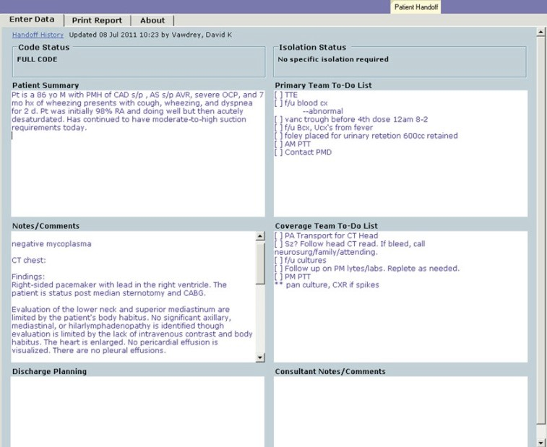
Integrated Communication and Reporting Support
Communication tools could be an integrated part of the EHR system.
Patient handoffs.
Health Information Exchanges ( HIE )

Slide 22
Patient Benefits
Decreased wait time for treatment
Increased access/control over health information
Increased use of best practices/decision support
Increased ability to ask informed questions
Quicker turnaround time for ordered treatments

Slide 23
Patient Benefits
Greater clarity to discharge instruction
Increased responsibility for own care
Alerts and reminders for appointments and scheduled tests
Increased satisfaction and understanding of choices
Issue: When a patient could access his/her own health information like in other online services ? (Pros, Cons)

Slide 24
* Data Ownership *
Paper medical records are the property of the creators with full responsibilities: storage, accuracy
Many providers share / update the same electronic data in many sites, who is the responsible owner in EHR?

Slide 25
Caregiver Resistance
EHRs are perceived as lacking essential features and awkward/inconvenience to use
Some people have been unable /unwilling to use computers !
Professionals don’t want to change their “familiar”, “traditional” practices
Rather pay penalties than bear EHR implementing cost
May even refuse patients
Need “incentives”

Slide 26
Enabling Factors:
Comprehensiveness of information.
Duration of use and retention of data.
Degree of structure of data.
Ubiquity of access .

Slide 27
Fundamental Issues:
Data Validation:
Range checks (out of range value)
Pattern checks
Computed checks(values have the correct mathematical relationship )
Consistency checks
Delta checks (large and unlikely differences between the values )
Spelling checks

Slide 28
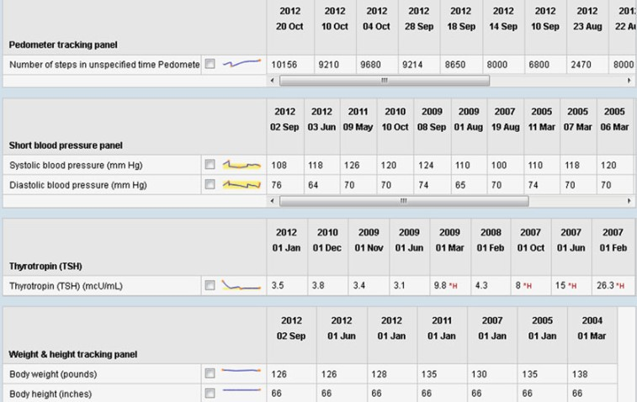
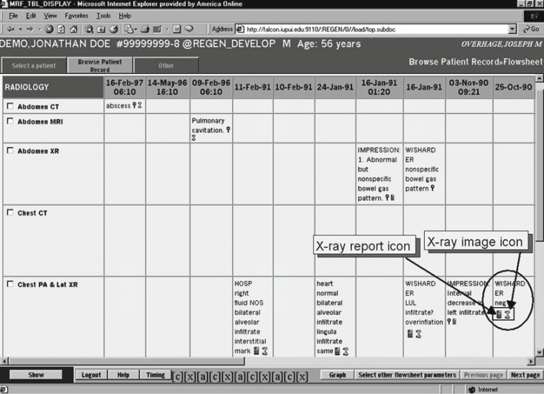
Fundamental Issues:
Data display: Once stored in the computer, data can be presented in numerous formats for different purposes without further entry work
TIMELINE GRAPHS
TIMELINE FLOWSHEETS

Slide 29
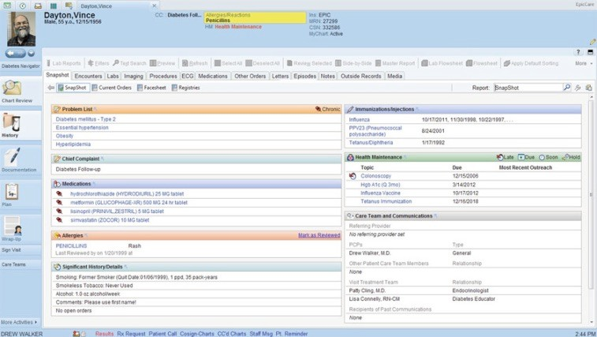
Data Display
Summaries and Snapshots
Dynamic Search
Search tools help the physician to locate relevant data.
The EHR can then display these data as specialized presentation formats (e.g., flowsheets or graphics).

Slide 30
Fundamental issues:
Query and Surveillance Systems
Find records of patients that satisfy pre-specified criteria and export selected data.
Clinical care
Clinical research
Quality reporting
Retrospective studies
Administration (e.g. resource consumption)

Slide 31




EHR Adoption in Saudi Arabia
Eastern Province study (Bah, Alharthi, El Mhalli, 2011).
•
EHR
Paper_ based .85
60%
50%
40%
30%
20%
10%
0%
50%
15%
36%
14%
fully-functioning EHR
in progress
No
85%
level of EHR functions (Mahalli ,2015).

Slide 32
Barriers of EHR in Saudi Arabia:
Human Barriers:
  Lack of
    awareness of the importance and benefits of EHR,
    knowledge and experience of using EHRs,
    experience of computer applications .
  Negative beliefs and impressions about EHRs and about their ability to use EHRs
Financial Barriers:
  High initial cost of EHRs implementation.
  High operation and maintenance costs of EHRs.
  Lack of feasibility studies that show the benefits versus costs of implementing and using EHRs.

Slide 33
Barriers of EHR in Saudi Arabia:
Legal and regulatory barriers:
  Lack of policies that govern EHRs on both hospital and national levels.
  Using EHRs may threaten confidentiality of health information.
Organizational barriers:
  Workflow needs redesign to match with EHRs.
  Hospital management doesn’t have the necessary experience to choose & implement the best EHRs.
  Hospital management doesn’t provide the necessary training for the staff on using EHRs.

Slide 34
Barriers of EHR in Saudi Arabia:
Technical barriers:
  Computers and networks have a lot of maintenance problems.
  EHRs are not satisfying different users’ needs.
  The main difficulty with EHRs is data entry and data retrieval.
Professional barriers:
  Lack of motivation to learn and train on using EHRs.
  EHRs slows down work/decreases productivity.

Slide 35
Future Trends of EHR:
Patient access will increase, Cloud technology for EHR.
Movement toward a nationalized database. Mobile accessibility.

Slide 36
Suggested Readings:
Shortliffe, E. H., & Cimino, J. J. (Eds.). (2013). Biomedical informatics: computer applications in health care and biomedicine. Springer Science & Business Media.
Menachemi, N., & Collum, T. H. (2011). Benefits and drawbacks of electronic health record systems. Risk Manag Healthc Policy, 4, 47-55.
Bah, S., Alharthi, H., & El Mahalli, A. A. (2011). Annual survey on the level and extent of usage of electronic health records in government-related hospitals in Eastern Province, Saudi Arabia.Perspectives in Health Information Management,8(1), 102-153.
Mahalli, A. E. (2015). Adoption and Barriers to Adoption of Electronic Health Records by Nurses in Three Governmental Hospitals in Eastern Province, Saudi Arabia. Perspectives in Health Information Management, 12(Fall).
Khalifa, M. (2013). Barriers to health information systems and electronic medical records implementation. A field study of Saudi Arabian hospitals. Procedia Computer Science, 21, 335-342.

Slide 37
Best wishes
Albarrak@ksu.edu.sa

