Slide 1
CPOE
Medication errors resulting in preventable ADEs most commonly occur at the prescribing stage. Bobb A, et al. The epidemiology of prescribing errors: The potential impact of CPOE. Arch Intern Med 2004;164:785 – 792.
Out of 1111 prescribing errors were identified (6.2% errors), most occurring on admission (64%). Of these, 30.8% were rated clinically significant and were most frequently related to; 1)anti-infective medication orders, 2)incorrect dose, and 3)medication knowledge deficiency.
64.4% were rated as likely to be prevented with CPOE,
13.2% unlikely to be prevented with CPOE, and
22.4% possibly prevented with CPOE depending on specific CPOE system characteristics.

Slide 2
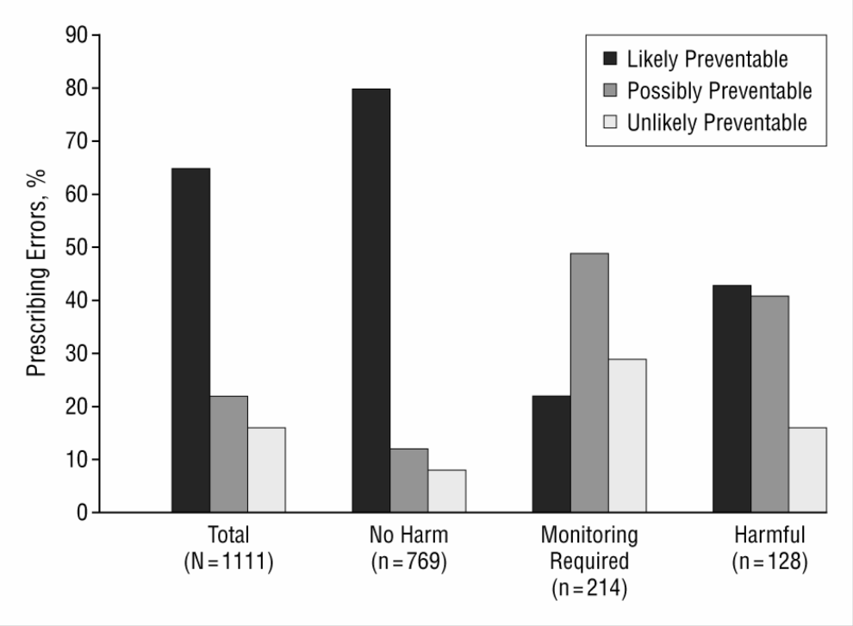
From: The Epidemiology of Prescribing Errors: The Potential Impact of Computerized Prescriber Order Entry
Arch Intern Med. 2004;164(7):785-792. doi:10.1001/archinte.164.7.785
Severity of prescribing errors and rated preventability by use of a computerized prescriber order entry system.
Copyright © 2016 American Medical Association. All rights reserved.

Slide 3
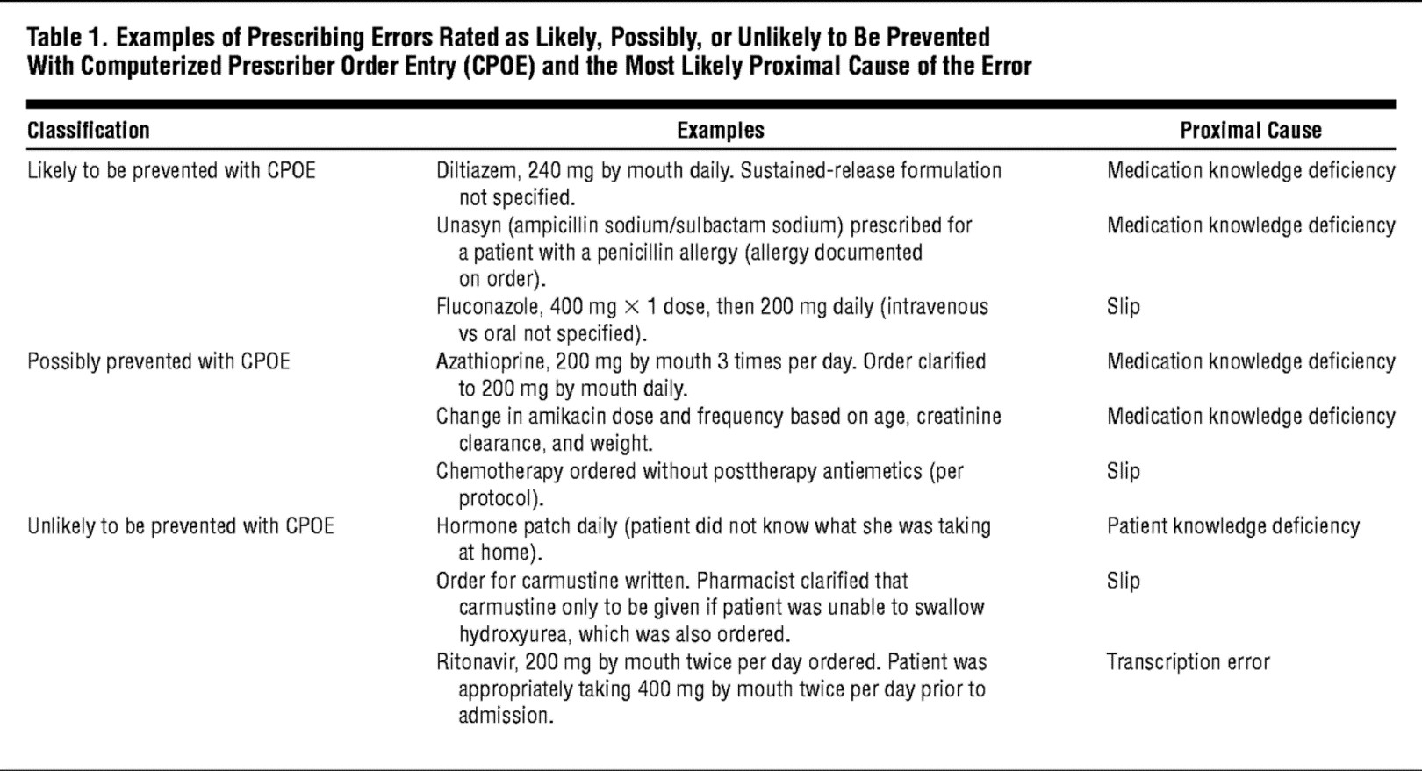
From: The Epidemiology of Prescribing Errors: The Potential Impact of Computerized Prescriber Order Entry
Arch Intern Med. 2004;164(7):785-792. doi:10.1001/archinte.164.7.785
Examples of Prescribing Errors Rated as Likely, Possibly, or Unlikely to Be Prevented With Computerized Prescriber Order Entry
(CPOE) and the Most Likely Proximal Cause of the Error
Copyright © 2016 American Medical Association. All rights reserved.

Slide 4
Adverse drug events (ADEs) are the most common cause of injury to hospitalized patients and are often preventable.
A CPOE with an advanced level of CDS is needed to prevent many of the prescribing errors with the greatest potential to lead to patient harm.
Basic = drug-allergy, drug-drug interaction & duplicate therapy checking,
basic dosing guidance, formulary decision support
Advanced = dosing for renal insufficiency and geriatric patients, guidance for medication-related lab testing, drug-pregnancy and drug- disease contraindication checking

Slide 5
Reasons for CPOE
Order Communication
Clarity of Orders
Ease of Identifying the Ordering Physician
Standardization of Care
Clinically validated order sets for
Clinical diagnoses
Procedures
Situations (post-op order sets)
Alerts and Reminders (Real Time Decision Support)
Drug Safety Database (Conflict Checking)
Clinically validated rules

Slide 6
Adverse Drug Reaction (ADE’s)
Several studies have found a serious medication error in 3.4%- 5.3% of inpatients
The cost of a single preventable ADE is $4,685
$1.3 million annually for an average 300 bed hospital
Bates et al. JAMA 1997;277:307-311 Bates et al. JAMA 1998;280:1311-1316
Bates et al. J Am Med Informat Assoc 1999;6:313-321
Lesar et al. Arch Intern Med 1997;157:1569-1576

Slide 7
Medication Errors
Two recent Harvard studies found that physician ordering errors accounted for 56%-78% of all preventable Adverse Drug Events
Bates et al. JAMA 1997;277:307-311 Kaushal et al. JAMA 2001;285:2114-2120

Slide 8
Medication Errors
Physician drug ordering errors are most often due to one of two causes:
Lack of knowledge about the drug
•
•
•
Wrong dose Wrong frequency
Drug-drug interaction
2. Incomplete patient information
Documented allergies Recent lab results
•
•

Slide 9
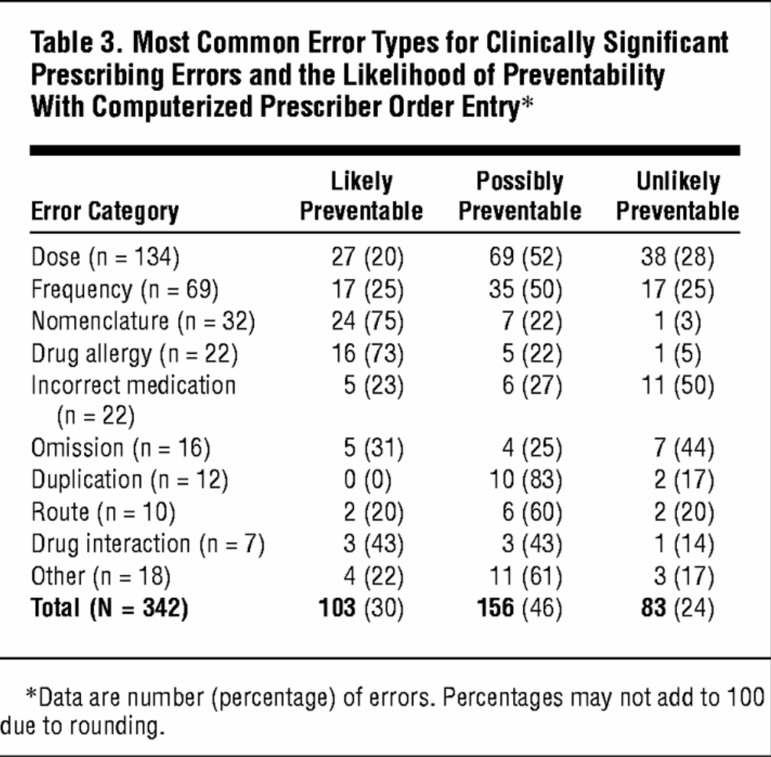
From: The Epidemiology of Prescribing Errors: The Potential Impact of Computerized Prescriber Order Entry
Arch Intern Med. 2004;164(7):785-792. doi:10.1001/archinte.164.7.785
Most Common Error Types for Clinically Significant Prescribing Errors and the Likelihood of Preventability With Computerized
Prescriber Order Entry*
Copyright © 2016 American Medical Association. All rights reserved.

Slide 10
CPOE Can Help Reduce Errors
Brigham and Women’s Hospital launched its first CPOE in 1993
Since then, they have documented a 54% reduction in serious medication errors
Resulted in 62% reduction in preventable ADE’s

Slide 11
Improved Quality
CPOE allows for physician reminders of best practice or evidence-based guidelines
Indiana University study
Pneumococcal vaccine in eligible patients
0.8%
Heparin prophylaxis
18.9%
36.0%
32%

Slide 12
Improved Efficiency
Maimonides Medical Center (Bronx, NY)
700 bed teaching hospital
After CPOE, found substantial reduction in order processing time
Physician order to receipt by pharmacy
3.4 hours 0.5 hours
Physician order to Delivery to Patient Care Area
4.6 hours
Estimate 12%
1.4 hours
in LOS following CPOE

Slide 13
IOM
“the science and technologies involved in healthcare -- the knowledge, skills, care interventions, devices and drugs – have advanced more rapidly than our ability to deliver them safely, effectively, and efficiently”
IOM. 2001. Crossing the Quality Chasm: A New Health
System for the 21st Century.

Slide 14
THANK YOU
Professor Ahmed Al Barrak Mohammed Al Hajjy

