Slide 1
Action
Endorsement of CPOE
Establish CPOE as an Institutional Commitment and Goal
Identify CPOE as a Quality and Safety Improvement Initiative

Slide 2
Definitions
EMR (Electronic Medical Record) – the set of databases (lab, pharmacy, radiology, clinical notes, etc.) that contains the health information for patients within a given institution or organization
CDS (Clinical Decision Support) component - software that makes relevant information available for clinical decision-making (clinical data, references, clinical guidelines, situation-specific advice)
CPOE (Computerized Physician Order Entry) component – enables
clinicians to enter orders (tests, meds, dietary, etc.)
CCR (Computerized Clinical Reminder) – just-in-time reminders at the point of care that reflect evidence-based medicine guidelines

Slide 3
Advantages
Improve communication
Make knowledge more readily accessible
Assist with calculations
Perform checks in real time
Assist with monitoring
Provide decision support
Require key pieces of information (dose, e.g.)

Slide 4
CPOE
In 2005, only 4% of hospitals are in full compliance with CPOE; 17% have made good progress.
Government and larger teaching hospitals are more likely to have implemented CPOE.
Source: Cutler EM, Feldman NE, Hurwitz JR. US Adoption of Computerized Physician Order Entry Systems. Health Affairs 2005 Nov/Dec;24(6):1654 – 1655.

Slide 5
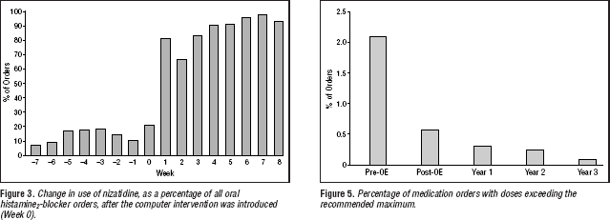
Example CPOE improves adherence to guideline
Teich JM et al. Arch Intern Med. 2000 Oct 9;160(18):2713-4.

Slide 6
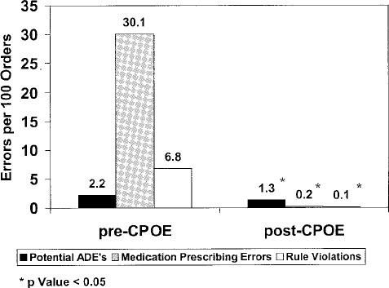
Example CPOE reduce errors
Potts studied ADE rates in 13,828 medication orders
before/after CPOE implementation at Vanderbilt Children’s PICU:
Potts AL, Barr FE, et al. Pediatrics. 2004 Jan;113(1 Pt 1):59-63.

Slide 7
CPOE
Effective in reducing the rate of serious medication errors.
Reduction in antibiotic-related ADEs after implementation of decision support for these drug.
Length of stay at Wishard Memorial Hospital in Indianapolis fell by 0.9 days, and hospital charges decreased by 13% after implementation of CPOE.
A study at Ohio State University also identified substantial reductions in pharmacy, radiology and laboratory turn- around times, and there was a reduction in length of stay in one of the two hospitals studied.
Research estimates that implementation of CPOE systems at all non-rural U.S. hospitals could prevent three million adverse drug events each year.

Slide 8
Example CPOE introduces errors
Brigham and Womens' Hospital, Boston introduced a
CPOE
 | pre | period1 | period2 | period3
Potential ADEs/1000 pt-days | 15.8 | 31.3 | 59.4 | 0.5
After implementation, the rate of intercepted Adverse Drug Events (ADE) doubled!
Reason: The system allowed to easily order much too large dosages of potassium chloride without clear indicating that it be given in divided doses.
•
Bates et al The impact of computerized physician order entry on medication error prevention. JAMIA 1999, 6(4), 313-21.

Slide 9
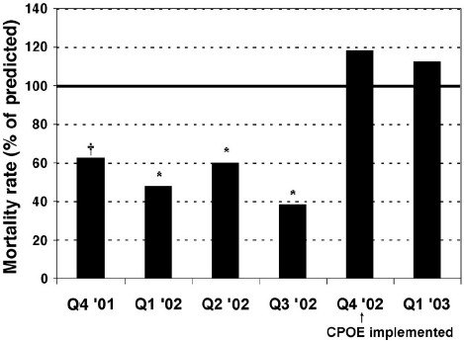
Example CPOE introduces errors
Association with increased PICU mortality:
2.8% 14 months before CPOE
6.4% 5 months after CPOE
Han YY, Carcillo JA, et al. Pediatrics. 2005 Dec;116(6):1506-12.

Slide 10
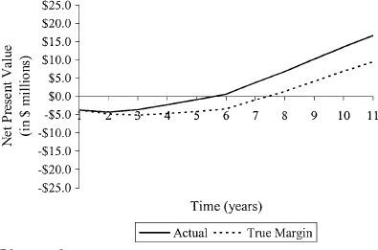
Example CPOE reduce costs
Brigham and Women’s Experience: Cost-Effective
$3.7 million implementation
$ 600,000 to $1.1 million
operational costs
Results:
Decreased drug costs
ADE cost is approximately
$4,700
The return on initial investment has been $5 to $10 million in annual savings.
Kausal R et al. J Am Med Inform Assoc. 2006; 13(3): 365-7

Slide 11
Full implementation of computerized physician order entry and medication related quality outcomes: a study of 3364 hospitals in 2013
Only 8% of US hospitals have fully implemented CPOE systems.

Slide 12
Challenges
The upfront cost of implementing CPOE is one major obstacle for hospitals. At Brigham and Women’s Hospital, the cost of developing and implementing CPOE was approximately $1.9 million, with $500,000 maintenance costs per year since.
Installation of even “off the shelf” CPOE packages requires a significant amount of customization for each hospital and can be very expensive.
Integration with other systems, cost, time, technical
Cultural obstacles to CPOE implementation. For example, some physicians resist utilizing computerized decision- support tools, relying instead on practice experience

Slide 13
CPOE:
Lessons From Other Institutions
Leadership
Physicians need to lead the effort as the primary users
However, CPOE is an interdisciplinary project that requires input and coordination with all clinical groups (nursing, PT/OT, Case Management, Pharmacy, Lab, Radiology, etc.) and I.T.
Commitment
CPOE affects the workflow and process of all caregivers and ancillary departments, not just physicians
Success requires commitment to change at all levels
Support
Responsiveness and Flexibility are key
Must be ongoing, not just at rollout

Slide 14
The Need for CPOE
Improved patient safety
Improved quality
Improved efficiency
Reducing operating costs

Slide 15
CPOE
Physicians are concerned that CPOE will take too much time

Slide 16
Does CPOE Take More Time?
Time Spent/Patient Encounter— Duplicate Tasks Removed (minutes)
Time Spent/Patient Encounter (minutes)
40
35
30
25
20
15
10
5
0
40
35
30
25
20
15
10
5
0
36.3
34.2
35.1
34.2
Paper
CPOE
Paper
CPOE
6.2
6.9
6.2 5.7
Writing Tasks
Overall Writing Tasks
Overall
Evidence shows that CPOE adds less than one minute to the time physicians spent writing orders and overall only added 1-2 minutes per patient encounter. As physicians gained experience with the system, the time for orders actually decreased.
(Overhage JM, et al J Am Med Informatics Associ 2001;8:361-371)

Slide 17
CPOE
The clinical benefits for improved patient care clearly outweigh the perceived concerns.

Slide 18
What Is Needed For Success?
Clinicians
End-users (clinicians) must be willing to champion the implementation of
CPOE
Clinicians must be involved in design and implementation of the system
Clinicians must be flexible and willing to change workflow processes

Slide 19
What Is Needed For Success?
Information Technology (I.T. Department)
Ensure fast, reliable, and easily accessible system
Provide ongoing support
Train, educate users
Institution
Commitment to workflow changes

Slide 20
CPOE--Summary
CPOE is a key component to improve Patient Safety and Quality of Care
The focus needs to be on workflow and process of care changes that are necessary for optimal patient care, Not on implementing a new computer system
Commitment from clinicians to help with process design and
implementation is critical for success.

Slide 21
CPOE--Summary
CPOE is a clinical based process development to improve patient care, not an I.T. project

Slide 22
THANK YOU
Professor Ahmed Al Barrak

