Slide 1
RESEARCH FOCUS IN MEDICAL INFORMATICS IN SAUDI ARABIA
1
Ahmed Albarrak, PhD, MSc. Professor of Medical Informatics
Founding Chairman, Medical Informatics and e-learning,
College of Medicine, King Saud University
Founding Former Dean of Health Sciences College, and Vice Rector for Planning Quality and Development, SEU albarrak@ksu.edu.sa
@aalbarrak2

Slide 2
Outline
2
Definition
Knowledge management
Why Knowledge management in Healthcare
Examples of research in medical informatics:
Evidence based medicine
Medical records
Tele-health
Students
Public health
What is next?
Facts and conclusions

Slide 3
Medical informatics
"Medical informatics is a rapidly developing scientific field that deals with the storage, retrieval, and optimal use of biomedical information, data, and knowledge for problem solving and decision making."
Blois, M.S., and E.H. Shortliffe. in Medical Informatics: Computer Applications
in Health Care, 1990, p. 20.
"Medical informatics is the application of computers, communications and information technology and systems to all fields of medicine - medical care, medical education and medical research.“ definition by MF Collen (MEDINFO '80, Tokyo, later extended).

Slide 4
Knowledge
4
Data, information and knowledge are often used interchangeably, however, they are not the same
Data, in itself is not knowledge, nor is information. Data is without a meaningful relation to anything else” (Bellinger, 2004).
“Knowledge is the full utilization of information and data, with the potential of people's skills, competencies,….. (Grey, 2009*7)

Slide 5
Knowledge
5
Knowledge Involves interpreting information received, adding relevance and context to clarify the insights the information contains” (Audit Commission, 2007)
Knowledge: is the understanding and interpretation of information and its settings within a meaningful context
There are numerous theories existence regarding not only the creation of knowledge, but also the different types of knowledge that exist.
Cook and Brown (1999) define four types of knowledge: individual/explicit; individual/tacit; group/explicit; group/tacit.

Slide 6
Data?
6
Data: “data are numbers, words or images that have yet to be organised or analysed to answer a specific question” (Audit Commission, 2007).
What makes numbers, words and images all data? rawness. No exact meaning or context.
Information: Information is the result of processing, manipulating and/or organising data or combinations of data to answer question.
•

Slide 7
Environment public health KM
7

Slide 8
8

Slide 9
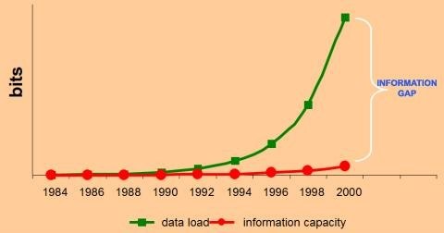
Flood of Information
9
Huge gap in data acquisition and information €  knowledge capacity

Slide 10
Data – knowledge - utilization
10
60000
50000
40000
data knowledge utilization
30000
20000
10000
0

Slide 11
11
Institute of Medicine (IOM) estimated that around 98,000 patients die each year as a consequence of preventable errors. Likewise, a study of two UK hospitals found that 11% of admitted patients experienced adverse events of which 48% of these events were most likely preventable if the right knowledge was applied.
The under-utilization of healthcare knowledge contributes to improper clinical decisions, medical errors, under-utilization of resources and raise in healthcare delivery costs

Slide 12
12

Slide 13
13

Slide 14
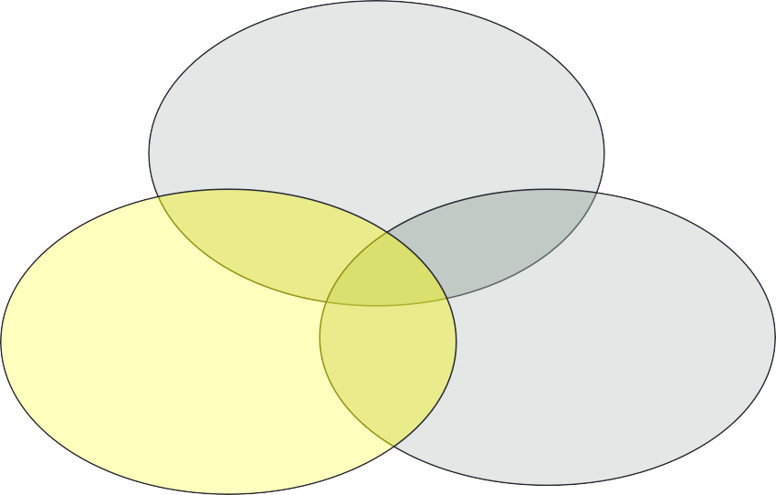
Evidence based medicine definition:
14
Evidence based medicine (EBM) is the integration of best research evidence with clinical expertise and patient values.
Patient Concerns
Best researc^{E}h^{BM} evidence
Clinical Expertise

Slide 15
History of EBM
15
The name of EBM appeared in 1992 by group led by
Gordon Guyatt at McMaster University in Canada.
Since then the number of articles about evidence based practice has grown exponentially from one publication in 1992 to about 1000 in 1998 and international interest has led to the development of six evidence based journals that summarize the most relevant studies in clinical practice and have a combined worldwide circulation of over 175000.

