Slide 1
History of EBM
1
The name of EBM appeared in 1992 by group led by
Gordon Guyatt at McMaster University in Canada.
Since then the number of articles about evidence based practice has grown exponentially from one publication in 1992 to about 1000 in 1998 and international interest has led to the development of six evidence based journals that summarize the most relevant studies in clinical practice and have a combined worldwide circulation of over 175000.

Slide 2
EBM Feb 17 2012
2

Slide 3
Literature Searching
3
Can improve the treatment of medical inpatients, even those already receiving evidence-based treatment.
Random sample of 146 inpatients cared for by 33 internal medicine attending physicians.
After physicians committed to a specific diagnosis and treatment plan,
investigators performed standardized literature searches and provided the search results to the attending physicians.
Attending physicians changed treatment for 23 (18%) of the 130 eligible
patients as a result of the literature searches.*
*. Lucas BP, Evans AT, et al. The impact of evidence on physician’s inpatient treatment decisions. J Gen Intern Med 2004;19:402-409.

Slide 4
4

Slide 5
The Accenture study
5
The Accenture survey asked physicians about the extent to which they used 12 different “functions” of EMR and HIS such as electronic entry of patient notes, electronic referrals, electronic ordering and prescribing and communicating with other physicians or patients via secure email.
By Jim Burke, Managing Director, Accenture UK Health
Industry Published Friday, 3 February 2012 –
Research among more than 3,700 doctors in eight countries reveals ripe opportunities to accelerate broad healthcare IT initiatives, according to a new survey from Accenture

Slide 6
The Accenture study
6
The findings clearly show that the broadest, fastest path to integrated, effective health practices requires outreach, education and changing mindsets.
Results showed that physicians who are routine users of a wider range of healthcare IT functions have a more positive attitude towards the these technologies. On average across all the countries, as physicians start to use more “functions” the more positive they are about the benefits

Slide 7
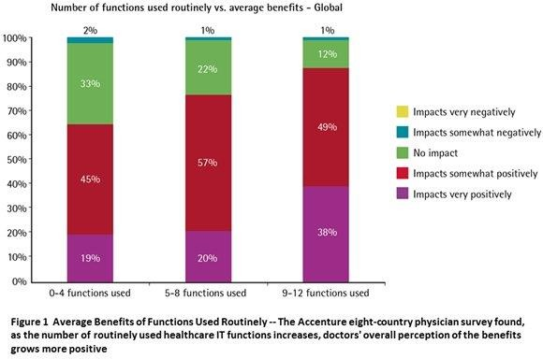
7

Slide 8
The Accenture study
8
Majority of doctors surveyed believe that healthcare IT does provide some common top benefits, including;
better access, quality data for clinical research (70.9%),
improved coordination of care (69.1 %)
reduction in medical errors (66 %).
average score of 61 %,
In England, physicians perceived other healthcare IT benefits to include: increased speed of access to health services to patients (55.3 %), reduced number of unnecessary interventions and procedures (52 %).

Slide 9
Veterans Health
9
Veterans Health, which runs the largest and one of the most cost-effective healthcare systems in the United States. The VA has been employing tele-health tools for more than 11 years. “The VA is absolutely a pioneer in the use of telehealth,” They published a study linking telehealth and 17,000 VA patients with chronic disease that showed a tremendous impact – nearly a 20 % reduction in hospital admissions.”.

Slide 10
10

Slide 11
11

Slide 12
12

Slide 13
13

Slide 14
14

Slide 15
15

Slide 16
16

Slide 17
17

Slide 18
18

