Slide 1


CDSS – Part II
Clinical Decision Support
Amr Jamal, MD, SBFM, ABFM, MRCGP, MBI
Assistant professor and consultant Family physician and clinical informatician
Nasriah Zakaria , Ph.D.
Assistant Professor
Medical informatics and e-learning unit (MIELU)

Slide 2
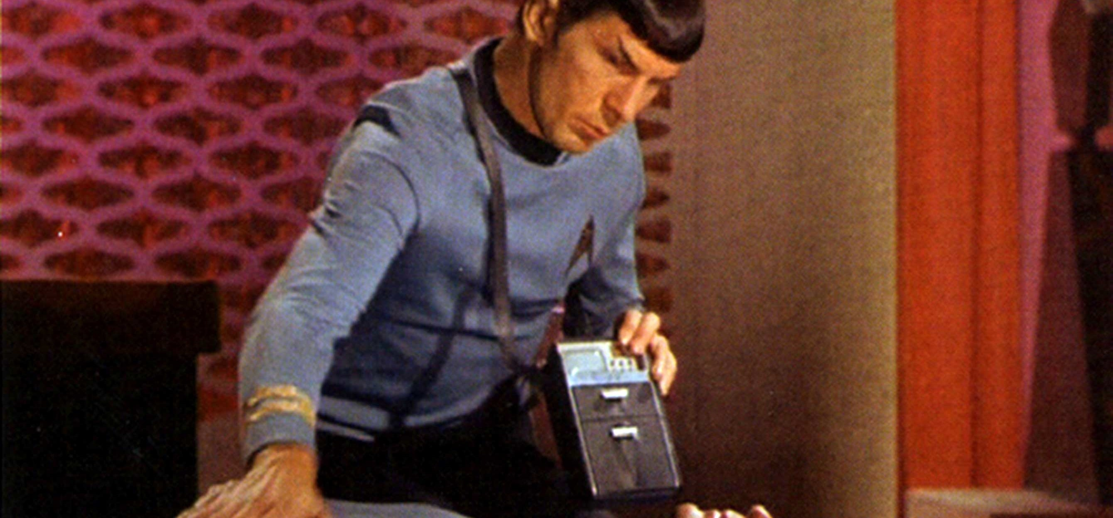
Star Trek & Diagnostic Device

Slide 3
Futuristic ….
In Star Trek- point diagnostic device to patients and device determine
  What is the problem ?
  How serious damage is?
In Star Trek- Diagnostic device is the “Clinical Decision Support”
Societal Concerns
  Can computers replace doctors in making decisions?
  What kinds of decisions can computers make?
  How good will computers be?
  What will the effects be on the practice of medicine, on medical education and on relationship among colleagues or between physicians and patients?

Slide 4

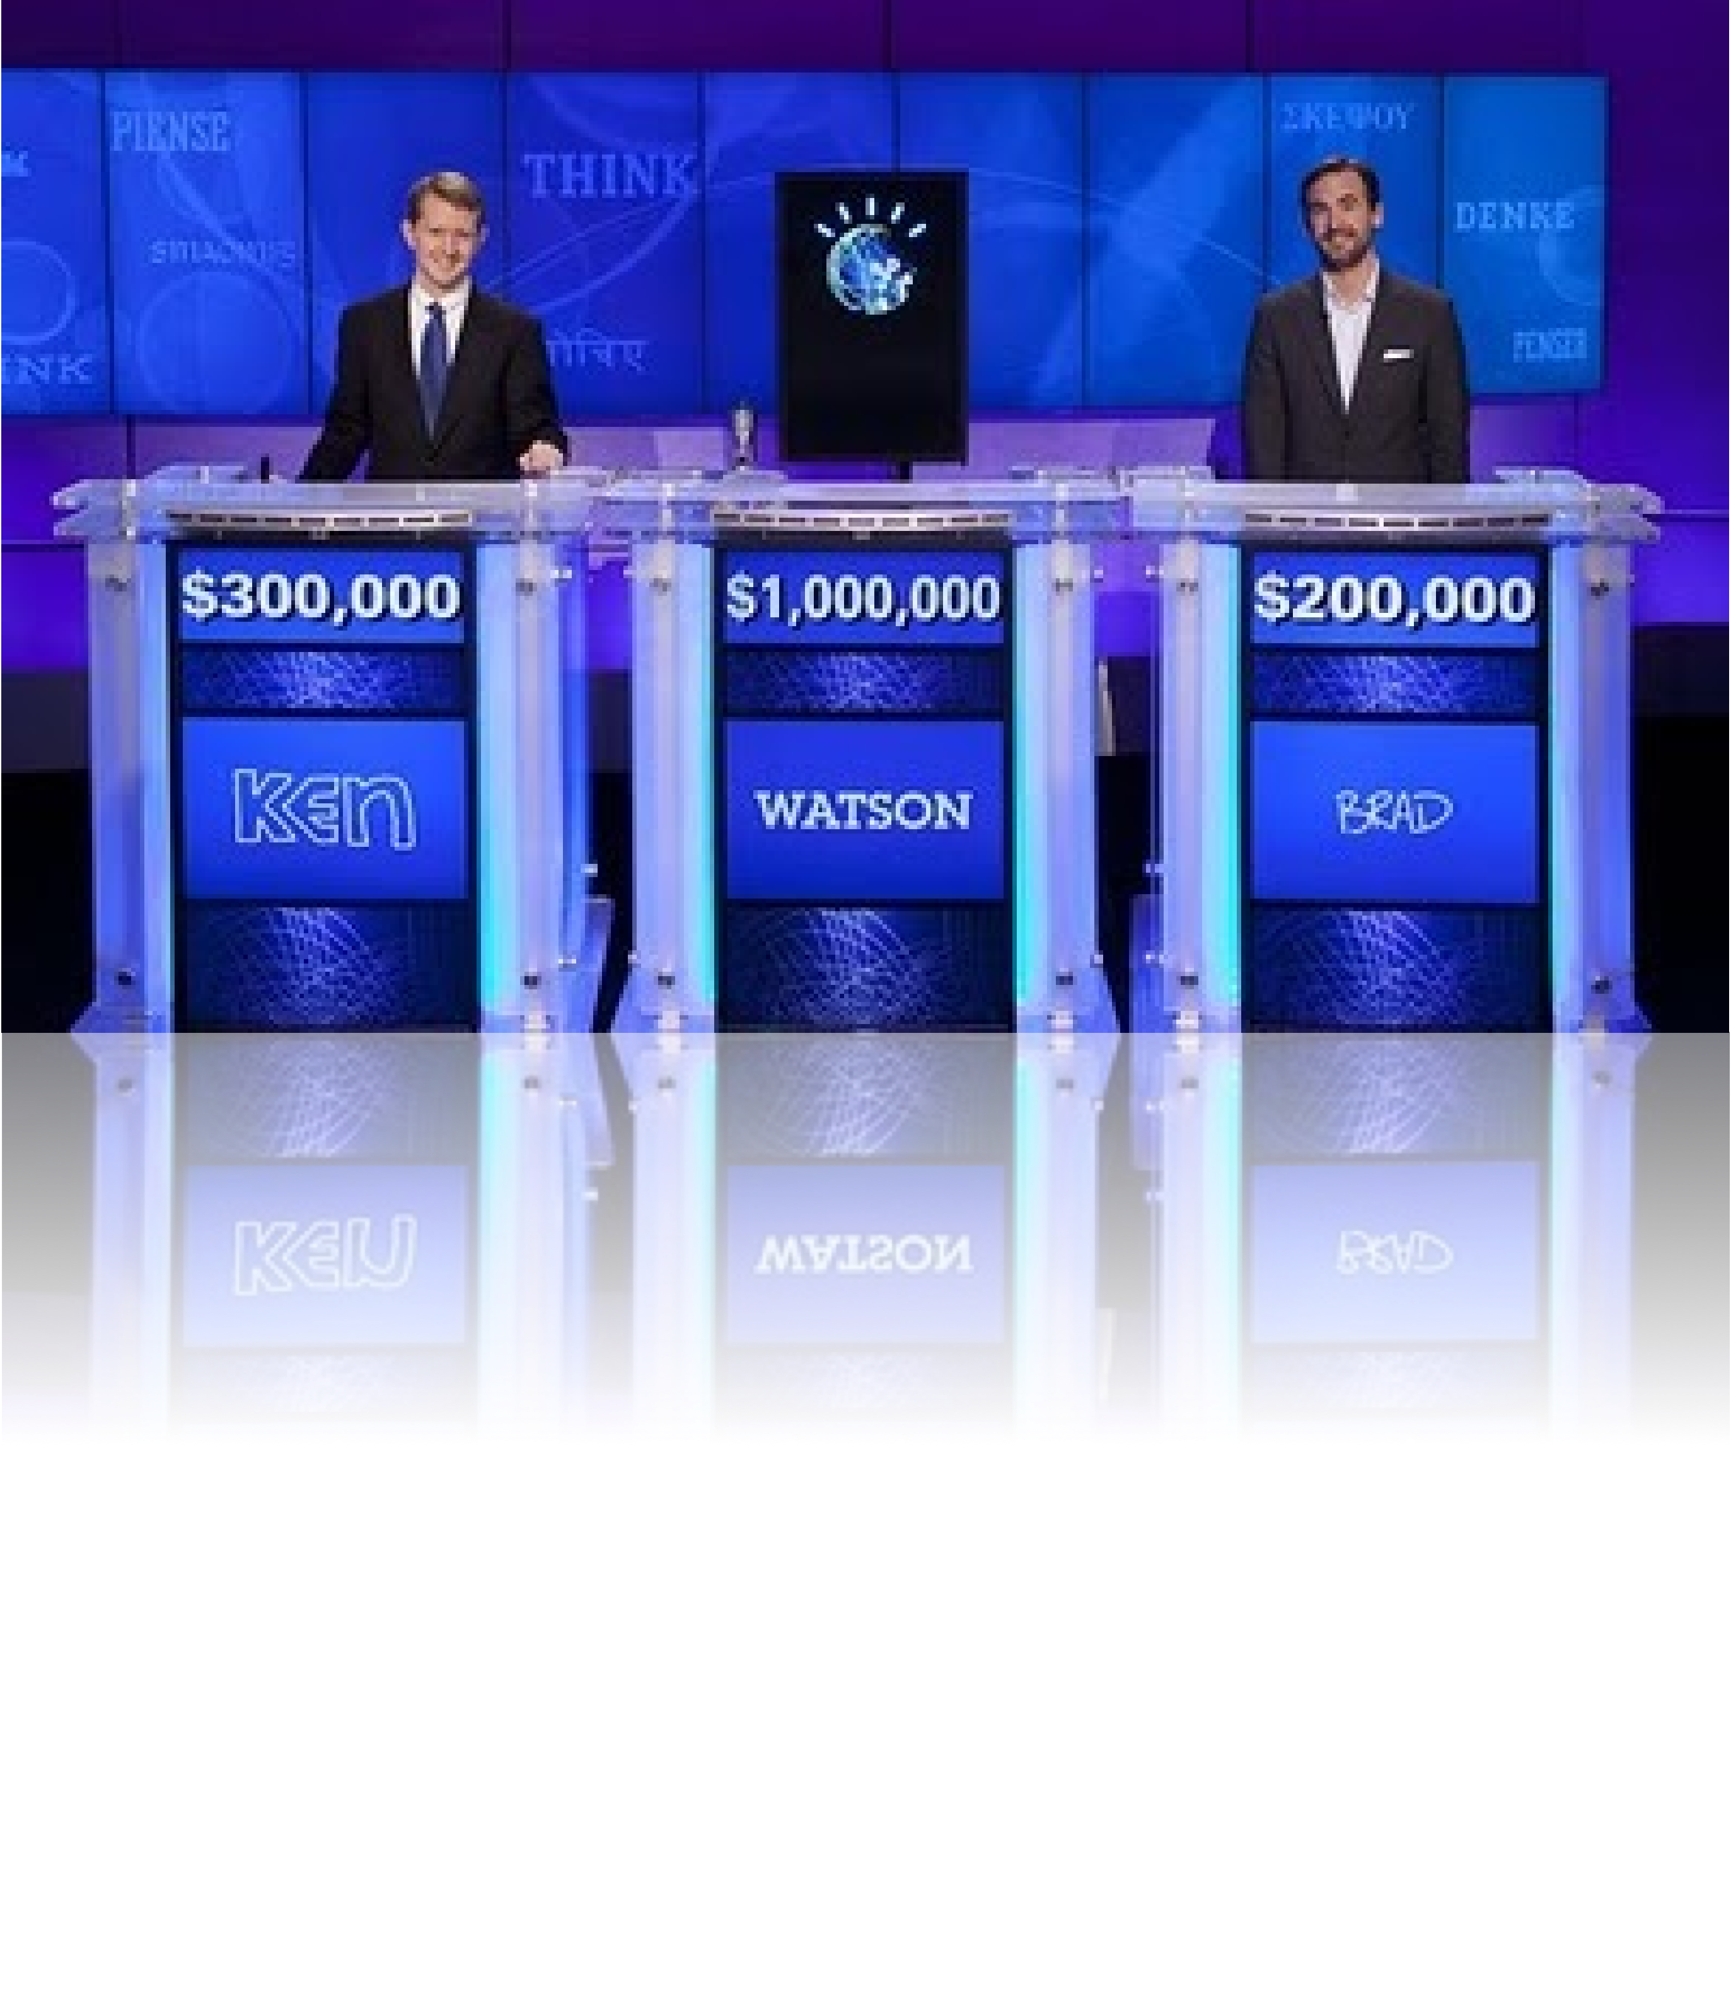



On February 14, 2011, IBM Watson changed history introducing a system that rivaled a human’s ability to answer questions posed in natural language with speed, accuracy and confidence.
Watson Wins!
Largest Jeopardy! in 5 years
  34.5M Jeopardy! Viewers
  1.3B+ Impressions
Over 10,000 Media Stories
11,000 attend watch events
2.5M+ Videos Views (top 10 only)
10,897 Twitter
23,647 Facebook Fans
‹#›
© 2011 IBM Corporation

Slide 5



The World is Getting Smarter
+
Instrumented
+
Interconnected Intelligent
=
An opportunity to think and act in new ways— economically, socially and technically.
‹#› ⁵
© 2011 IBM Corporation

Slide 6





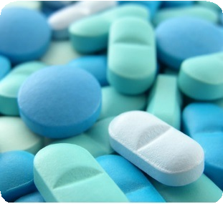


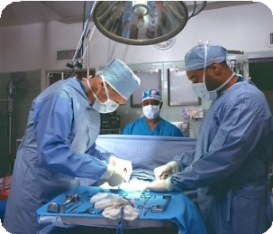
Healthcare Industry is beset with some of the most complex information challenges we collectively face
Medical information is doubling every 5 years, much of which is unstructured
81% of physicians report spending 5 hours or less per month reading medical journals
1 in 5
diagnosis that are estimated to be inaccurate or i₁n.c₅om_{m}p_{i}l_{l}e_{li}t_{o}e_{n}
errors in the way medications are prescribed, delivered and taken in the U.S. every year
44,000 -98,000
# of Americans who die each year from preventable medical errors in hospitals alone
“Medicine has become too complex (and only) about 20 percent of the knowledge clinicians use today is evidence-based.”
Steven Shapiro, Chief Medical and Scientific Officer, UPMC
© 2011 IBM Corporation
‹#›

Slide 7
IBM Smarter Healthcare
A smarter health system improves visibility and collaboration across all health system participants making best use of resources to prevent and treat diseases, reduce overall healthcare costs, and keep people healthy.
+ +
Instrumented Interconnected Intelligent
Capture accurate, real-time information from devices & systems
Enable seamless information sharing across groups
Use advanced analytics to improve research, diagnosis and treatment
‹#›
© 2011 IBM Corporation

Slide 8


Why is Watson Technology ideal for Healthcare?
What condition has red eye, pain, inflammation,
Understands natural language
³
blurred vision, floating spots and sensitivity to
questions
light?
Physician Notes, Medical Journals, Clinical Trials, Pathology Results, Blogs, Wikipedia
Analyzes large volumes of unstructured data
Generates and evaluates hypothesis
Presents responses with confidence
Supports iterative dialogue to refine results
Learns from results over time
³
³
Possible Diagnosis | Confidence
Uveitis | 91%
Iritis | 48%
Keratitis | 29%
³
³
³
Family History, Patient Interview, Physical Exam,
Current Medications
What actions were taken? What treatments were prescribed? What was the outcome?
‹#›
© 2011 IBM Corporation

Slide 9

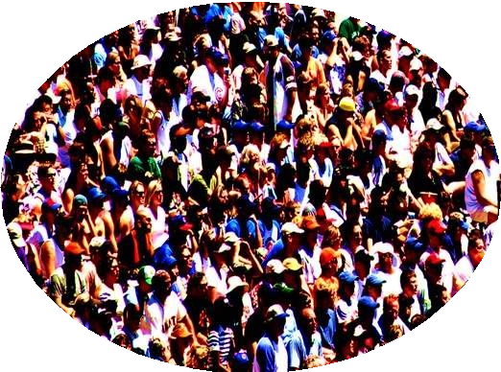

IBM and WellPoint are working together to put Watson
to work in healthcare
Leverage medical records
TO
diagnose and identify treatment options
TO
enhance the quality of medical care delivered
+
=
IBM Watson
WellPoint
Serving 1 in 9 insured Americans
IBM Watson
"Imagine having the ability within three seconds to look through all of that (medical) information….at the moment you're caring for that patient."
Dr. Sam Nussbaum, WellPoint's Chief Medical Officer, WellPoint
© 2011 IBM Corporation
‹#›

Slide 10
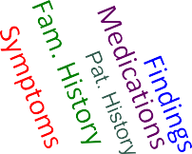






































































Putting the pieces together at point of impact can
be life changing
difficulty swallowing fever
dry mouth thirst anorexia
frequent urination
dizziness
no abdominal pain no back pain
no cough no diarrhea
Oral cancer Bladder cancer Hemochromatosis Purpura
Graves’ Disease
(Thyroid Autoimmune)
cutaneous lupus osteoporosis hyperlipidemia
frequent UTI hypothyroidism
Alendronate
pravastatin
levothyroxine hydroxychloroquine
urine dipstick:
leukocyte esterase supine 120/80 mm HG heart rate: 88 bpm urine culture: E. Coli
AA 5588--yyeeaarr--oolldldwwoommaananprperseesnetendtetdod htoerhperrimparirmy acaaryrecare
pphhyyysssicicicaiananafateftrtesresveevrvaelrdaalydsaoyfsdoizfzdinizezszsin, easnso,reaxniao,rederxyia,
Diagnosis Models
Confidence
^{m}drºry^{ut}m^{h,}o^{in}u^{c}th^{re},ªin^{se}c^{d}re^{t}a^{h}s^{i}s^{r}e^{s}e^{t}d^{, a}th^{n}i^{d}irs^{fr}t,^{e}, ^{q}a^{u}n^{e}d^{n}f^{t}fr^{u}e^{r}q^{in}uªe^{ti}nºt^{n}u^{. S}rin^{h}n^{e}at^{h}ioªn^{d}.
Symptoms
a_{S}ls_{h}o_{e}h_{h}a_{a}d_{d}a_{a}fe_{ls}v_{o}er_{h}a_{a}n_{d}d _{a}re_{ff}p_{e}o_{v}r_{e}te_{r}d_{a}t_{n}h_{d}at_{r}f_{e}o_{p}o_{o}d_{r}w_{te}o_{d}ul_{t}d_{ha}“g_{t}e_{f}t_{o}s_{o}t_{d}uck”
Renal failure
w_{w}h_{o}e_{u}n_{ld}sh“e_{ge}w_{t}a_{s}s_{tu}s_{cc}w_{ck}a”llo_{w}w_{h}i_{e}n_{n}g_{n}. _{s}S_{h}h_{e}e _{w}re_{a}p_{s}or_{s}te_{w}d_{a}n_{ll}o_{ow}pa_{in}in_{g.}i.n_{S}h_{h}e_{e}r
ªr^{b}e^{d}pºo^{m}rt^{e}e^{n}d, n^{b}oªo^{c}pp^{k}aa,aºin^{r f}in^{l}n^{an}h^{k}eªr^{n}a^{d}bd^{n}dºom^{co}e^{u}n^{g},^{h}b, a^{sh}cºk^{r},^{tn}o^{e}r^{s}f^{s}laºn^{f}k and
breath, diarrhea, or dysuria. Her family history included
o^{n}rºal ^{c}aºn^{u}d^{g}b^{h}la,d^{s}d^{h}eºr^{r}c^{tn}a^{e}n^{s}c^{s}e^{s}rºin^{f b}h^{r}e^{e}rªm^{th}o,th^{d}e^{ia}rª,^{r}G^{rh}r^{e}avªe, sº' ^{r}d^{d}is^{y}e^{s}a^{u}s^{rr}e^{ia}in.
UTI
t^{H}wo^{er}si^{f}sªt^{m}er^{i}s^{ly}, h^{h}e^{i}m^{st}oºc^{ry}hr^{i}o^{n}m^{cl}a^{u}t^{d}os^{e}i^{d}s iºn^{ra}on^{l} e^{an}s^{d}ist^{b}e^{l}rª, ^{d}a^{d}n^{e}d^{er}id^{c}ioªp^{n}a^{c}t^{e}h^{r}ic
t^{i}h^{n}ro^{h}m^{e}b^{r}o^{m}cyºt^{t}o^{h}p^{e}e^{r}n,i^{G}c p^{ra}u^{vv}rp^{e}u^{s}r'a^{d}i^{i}n^{se}oªn^{s}e^{se}si^{i}s^{n}te^{t}r^{w}. ºH^{s}e^{i}r^{s}h^{te}is^{r}t^{s}o,ry was
nhoetamboolecfhorrocmutaatnoesoisusinluopnues,shiyspteerr,lipainddemidiaio, poasttehoicporosis,
Diabetes
ftrheqroumenbtoucriyntaorpyetrnaicctpinufrepcutioransin, thorneee suinscteormr. pHliceartehdistory
Family History
cwesaasrenaontasbelcetiofonrsc,cautlaenfteoooupsholurepcutosm, hyyfporearlibpeidneigmnicay,st,
aonsdteporipmoarroyshisy,,pfortehqyuuroeidnitsmur,inwahriychtrhaacdt ibnefeenctdioiangsn,otsheredeea
Influenza
y_{u}e_{n}a_{c}r _{o}e_{m}ar_{p}lie_{li}r_{c}._{a}H_{te}e_{d}r m_{ce}ed_{s}i_{a}c_{rr}a_{e}ti_{a}o_{n}ns_{s}w_{ec}e_{t}r_{i}e_{on}le_{s}v,o_{a}th_{l}y_{e}r_{f}o_{t}xine,
h_{o}y_{o}d_{p}ro_{h}x_{o}y_{r}c_{e}h_{c}lo_{to}ro_{m}q_{y}ui_{f}n_{fo}e_{r}, _{a}pr_{b}av_{e}a_{n}s_{ig}ta_{n}tin_{c},_{y}a_{s}n_{t,}d_{a}a_{n}le_{d}n_{pp}d_{rr}ro_{im}na_{a}t_{r}e_{y}. A urine
d_{h}ip_{y}s_{p}t_{o}ic_{t}k_{hy}w_{r}a_{o}s_{id}p_{is}o_{s}s_{m}it,iv_{w}e_{h}fo_{ic}r_{h}le_{h}u_{a}ko_{d}c_{bb}yt_{e}e_{e}e_{n}st_{d}e_{i}r_{a}a_{g}s_{nn}e_{o}a_{s}n_{e}d_{d}n_{a}itr_{y}ite_{e}s_{a}._{r}
The patient was given a prescription for ciprofloxacin for a
Medications Patient History
hypokalemia
u^{e}rªin^{r}a^{li}r^{e}y^{r}t.r^{H}ac^{e}t^{r}in^{m}fe^{e}c^{d}tio^{ic}nªa^{ti}nºd^{ns}wa^{w}s^{e}a^{re}dv^{l}i^{e}s^{v}eºd^{t}t^{h}o^{y}d^{ro}ri^{x}n^{i}k^{n}p^{e}l,enty of
f^{h}lu^{y}id^{d}s^{r}.ºO^{xy}n^{c}a^{hl}fºol^{r}lºo^{q}w^{u}-u^{in}p^{e}v,is^{p}it^{ra}w^{v}itªh^{s}h^{ta}e^{t}r^{in}p,hªys^{n}i^{d}ciaªn^{le}3^{n}d^{d}a^{ro}ys^{na}la^{t}t^{e}e.r,
her fever had resolved, but she reported continued
Esophagitis
weakness and dizziness despite drinking a lot of fluids.
Her supine blood pressure was 120/80 mm Hg, and her
pulse was 88 beats per minute; on standing, her systolic
blood pressure was 84 mm Hg, and her pulse was 92
•E
Patient History
beats per minute. A urine specimen obtained at her initial
CSoymnfpidtomts Dig
Es:soDUIpnhiTfaaluIgbeitiens tzeas
presentation had been cultured and grew more than
100,000 colonies of Escherichia coli, which is sensitive to
FMaemdilcyaHtioisnStsoyrmy ptoms
ciprofloxacin.
Findings
Findings
‹#›
present
© 2011 IBM Corporation

Slide 11
Clinical Decision Support System (CDSS)
* Definition:
Provide clinicians or patients with computer- generated clinical knowledge and patient-related information, intelligently filtered or presented at appropriate times, to enhance patient care” [1]

Slide 12
Elements of CDS [1]
Knowledge
  Provide evidence to meet physician information needs
  Meta-analysis of Randomized Controlled trials as evidences
Patient-specific Information
  Medication List
  Problem Lists
  Lab results and other clinical data

Slide 13
Elements of CDS [1]
Filtered
  Gathering and presenting pertinent data
Presented at appropriate time
  Provider able and ready to act on the information
Enhance Patient Care
  Error prevention
  Quality improvement
  Lab results and other clinical data

Slide 14
MYCIN [2]
Gives ADVICE to clinicians
Used Artificial Intelligence
Production Rules– knowledge gathered from discussions among experts
Example: Rule 507
Comprised of conditional statement (IF-THEN)

Slide 15
Decision Making in Medicine [2]
Uncertainty
  What is the diagnosis?
  What should the intervention be?
  What is the latest research that gives evidence the intervention really works?
Examples:
  Should John gets another chemotherapy?
  Should Mr. James undergo a third operation?
  Should Mrs. Blackwood be given hepatitis B vaccination as an intervention?
To ensure specificity and sensitivity

Slide 16
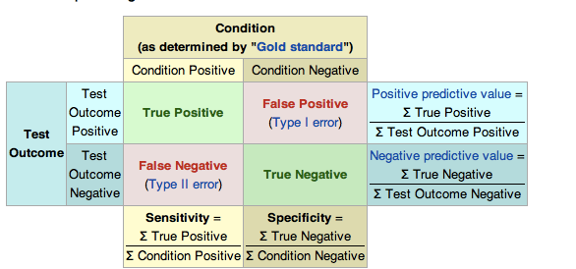
Sensitivity & Specificity- Wikipedia

Slide 17
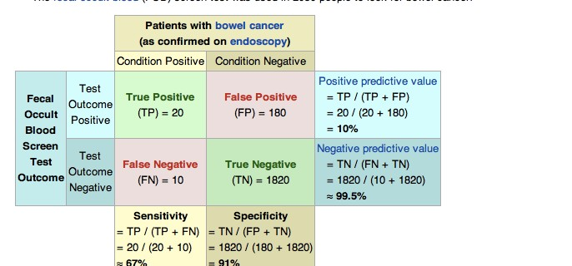
Sensitivity & Specificity- Wikipedia

Slide 18
Why CDS?[1]
1. Questions
Unanswered Questions
Some doubts

Slide 19
Why CDS?[1]
2. Information
Unmet information need
Cannot process information
Lack of time
Unsatisfied information need
Unrecognized information need

Slide 20
Why CDS? [1]
Inquiry
  Needs time
  Resource Intensive (Evidence, Literature, Knowledge)
Solutions are needed…. CDS can help provide ALERTS and REMINDERS
  To avoid errors and increase patient safety– new knowledge discovery – average 17 years to take evidence into clinical practice
  CDS embedded in EMR to improve patient safety and reduce medical error

Slide 22
Clinical Decision Support System (CDSS) [3]
CDSS in Patient Monitoring Systems
* Example: ECG that gives out warning
CDSS embed in Electronic Medical Record (EMR) and Computerized Patient Order Entry (CPOE)
Example: Send reminders/warnings in test results, drug-drug interaction, dosage errors etc.
Formulating Diagnosis
Formulating Treatment

Slide 23
Roles of Computer in Decision Support or Clinical Decision Support (CDS)
CDSS in Prescription [4]
Guiding prescribing practices
Flagging adverse drug reactions
Identify duplication of therapy

Slide 24
Constructing DSS[1]
Elicitation of Medical Knowledge
Reasoning and Representation
Validation of System Performance
Integration of CDSS Tools

Slide 25
Types of CDSS [1]
Documentation Tool
  Provide complete documentation
*Well-designed order form
  Required fields & Proper information
  Reduce error of Omission by providing selection
  Provide coded data for CDSS

Slide 26
Types of CDSS [1]
Types | Sub-types | Examples
1. Documentation Tool
 | 1.1 Patient Assessment Form | Pre-visit questionnaires
 | 1.2 Nursing Patient Assessment Form | Inpatient admission assessment

Slide 27
Types of CDSS [1]
Types | Sub-types | Examples
1. Documentation Tool
 | 1.3 Clinical Encounter Patient Form | Intelligent Referral Form
 | 1.4 Departmental/multidisciplin ary clinical documentation forms | Emergency department documentation
 | 1.5 Data Flowsheets | Immunization flowsheet

Slide 28
Types of CDSS [1]
2) Relevant Data Presentation
*Display relevant data –including costs
*Pertinent Data are displayed
*Complex Data – to show overall picture
*To highlight needed ACTIONS

Slide 29
Types of CDSS [1]
Types | Sub-types | Examples
2. Relevant Data Presentation
 | 2.1 Relevant data for | Display of relevant
 | ordering | lab tests when
 |  | ordering a
 |  | medication
 | 2.2 Choice list | Suggest dose choice lists

Slide 30
Types of CDSS [1]
Types | Sub-types | Examples
2. Relevant Data Presentation
 | 2.3 Practice status display | ED tracking display
 | 2.4 Retrospective/aggregate reporting/filtering | Physician “report cards”
 | 2.5 Environment parameter report | Recent antibiotic sensitivities

Slide 31
Types of CDSS [1]
Types | Sub-types | Examples
3. Order Creation Facilitators
 | 3.1 Single-order completers- consequent orders | Prompt Order Consequent Order Suggestions
 | 3.2 Order sets | General Order Set Post Op Order Set
 | 3.3 Tools for complex ordering | Guided Dose Active Guidelines

Slide 32
Types of CDSS [1]
Types | Sub-types | Examples
4. Time-based checking & protocol/pathway support
 | 4.1 Stepwise processing of multi-step protocol | Tools for Monitoring and supporting patient clinical pathway
 | 4.2 Support for managing clinical problems | Computer assistant management algo

Slide 33
Types of CDSS [1]
Types | Sub-types | Examples
5. Reference Information and guidance
 | 5.1 Context-insensitive | General Link from EMR to a reference program
 | 5.2 Context-sensitive | Direct link to a specific reference program

Slide 34
Types of CDSS [1]
Types | Sub-types | Examples
6. Reactive Alerts & Reminders
 | Alerts to prevent potential errors | Drug Allergy Alerts Drug Interaction aler Under/Overdose Alert

Slide 35
Summary
* CDS
Provide clinicians or patients with computer- generated clinical knowledge and patient-related information, intelligently filtered or presented at appropriate times, to enhance patient care” [1]

Slide 36
References
Carter, J.H. (2008) . Electronic Health Records, 2nd edition, American College of Medicine.
Shortliffe, E.H., Cimino, J.J. (2006).Biomedical informatics: computer applications in health care and biomedicine, 3rd Edition, Springer.

Slide 37
References
[3] Jaspers , M.N.W, Smeulers, M., Vermuelen, H., Peute, L.W. (2010).
Effects of clinical decision-support systems on practitioner performance
and patient outcomes: a synthesis of high-quality systematic review
findings. Journal of American Medical Informatics Association, No 18, pp.
327-334.
[4] Moxey, A., Robertson, J., Newby, D., Hains, I. , Williamson, M., Pearson, S.A. (2008). Computerized clinical decision support for prescribing: provision does not guarantee uptake. Journal of American Medical Informatics Association, No 17, pp. 25-33.

