Slide 1


Patient Safety and Health Informatics
Ahmed Albarrak, PhD, MSc.
Professor of Medical Informatics
Founding Chairman, Medical Informatics and e-learning, College of Medicine, King Saud University
Founding Former Dean of Health Sciences College, and Vice Rector for Planning
Quality and Development, SEU
albarrak@ksu.edu.sa

Slide 2
Content
Medical informatics,
Patient safety definitions, imperatives and current issues
Medical errors and adverse events
Error types
Human errors
The impact of health informatics on patient safety
CPOE Benefits
Take Home Messages
5/12/2016
Professor Ahmed Al Barrak

Slide 3
Medical informatics
"Medical informatics is a rapidly developing scientific field that deals with the storage, retrieval, and optimal use of biomedical information, data, and knowledge for problem solving and decision making."
Blois, M.S., and E.H. Shortliffe. in Medical Informatics: Computer Applications in Health Care, 1990, p. 20.
"Medical informatics is the application of computers, communications and information technology and systems to all fields of medicine - medical care, medical education and medical research.“ definition by MF Collen (MEDINFO '80, Tokyo, later extended).

Slide 4
Define SAFETY in healthcare?
In 2-3 minutes, define patient safety, what does it mean to you? And how would you think we can enhance it?
Write down your notes

Slide 5
Freedom from accidental injury due to medical care, or medical errors.
IOM, 2000

Slide 6

The avoidance, prevention and amelioration of adverse outcomes or injuries stemming from the process of healthcare.
Vincent, 2011

Slide 7

Patient Safety defined as;
The prevention of errors and adverse effects to patients associated with health care.

Slide 8
Errors vs. Adverse Effects
A 67 year old patient is prescribed Nonsteroidal anti-inflammatory drugs – NSAID for osteoarthritis pain, and is admitted 4 weeks later with GI hemorrhage.
This is an adverse event, even though the prescribing decision was not erroneous. Recording it as a patient safety issue is honest, as the patient was harmed by medical care.
Being less tolerant of threats to patient safety such as this may lead to more recommendations to take precautionary action (such as guidance regarding co-prescription of proton pump inhibitors - PPIs for all older people given an NSAID).

Slide 9
Errors vs. Adverse Effects
Errors: prescribing Nonsteroidal anti- inflammatory drugs – NSAID without considering patient condition (age) which require co-prescription of proton pump inhibitors – PPIs.
Adverse Effects: GI hemorrhage

Slide 10

The magnitude
98,000/365 = 268.49

Slide 11

Equal to one plane crashes every day!

Slide 12

Death Rate (US)
120000
100000
80000
60000
40000
20000
0
Medical Errors
Motor Accidents
Medical Errors Motor Accidents
Breast Cancer
Breast Cancer AIDS
AIDS

Slide 13
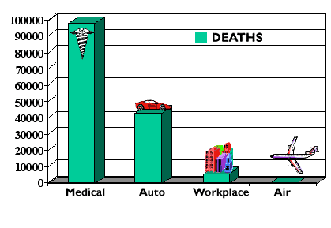
Annual Accidental Deaths
13
©copyright 2008 by the Trustees of Columbia University in the City of New
York Rights Reserved

Slide 14
Status quo
One in 5 patients discharged from hospitals end up sicker within 30 days and half are medication related
One of 10 inpatients suffers as a result of a mistake with medications cause significant injury or death
Source: Safe Practices for Better Healthcare Why Implement Practices to Improve Safety at http://www.qualityforum.org/News_And_Resources/Press_Kits/Safe_Practices_for_Better_Healthcare.aspx

Slide 15
Over 7,000 deaths annually. Resulted by medication errors
alone, occurring either in or out of the hospital.

Slide 16
Between $17B and $29B
Cost of errors estimated

