Slide 1
A study of two UK hospitals found that 11% of admitted patients experienced adverse events of which 48% of these events were most likely preventable if the right knowledge was applied.
The under-utilization of healthcare data- information- knowledge contributes to improper clinical decisions, medical errors, under-utilization of resources and raise in healthcare delivery costs

Slide 2
How safe is your hospital?
Take 3 to 5 minutes to think about safety in your hospital or organization
List 3-5 risk process or areas
5/12/2016
Professor Ahmed Al Barrak

Slide 3
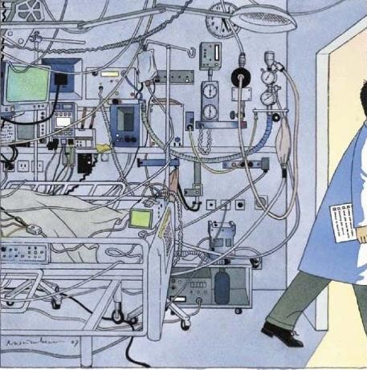
Aircraft Vs. ICU
5/12/2016
Professor Ahmed Al Barrak

Slide 4
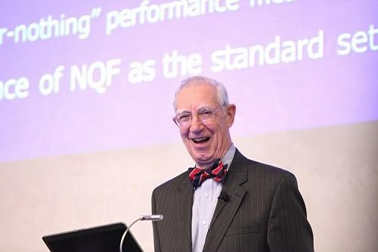
“Modern healthcare is the most complex human activity there is, due to interpersonal relationships
between many different clinicians with
different expertise and interests, and we haven’t figured out
how to make that work well.
We have come to a full stop against a complex environment that resists accepting change on the scale clearly required”
Lucian Leape, MD
Founder of the Modern Patient Safety Movement Adjunct professor of health policy at Harvard University "Error in Medicine," published in JAMA, 1994

Slide 5
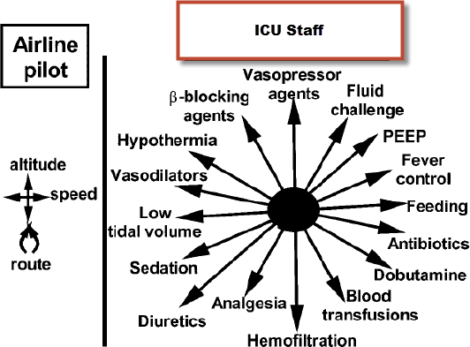
Parameters
5/12/2016
Professor Ahmed Al Barrak

Slide 6
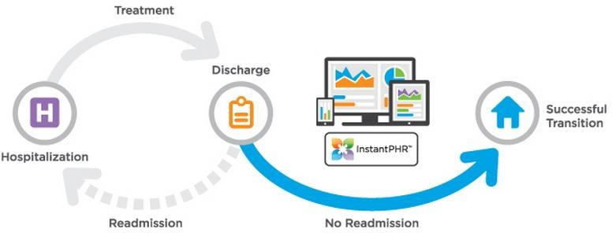
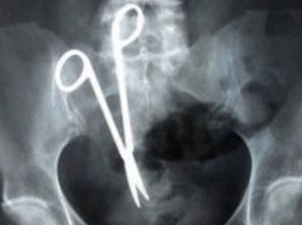
Safety Issues
Medication errors
Failure to rescue
Readmissions
Falls
Pressure ulcer
Sentinel events
Hospital acquired infections
Under reported incidents
5/12/2016
Professor Ahmed Al Barrak

Slide 7
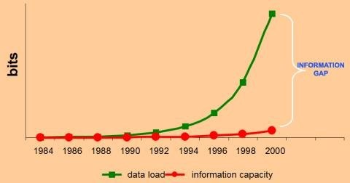
Flood of Information
Huge gap in data acquisition and information € knowledge capacity

Slide 8
Data – knowledge - utilization
60000
50000
40000
data knowledge utilization
30000
20000
10000
0

Slide 9
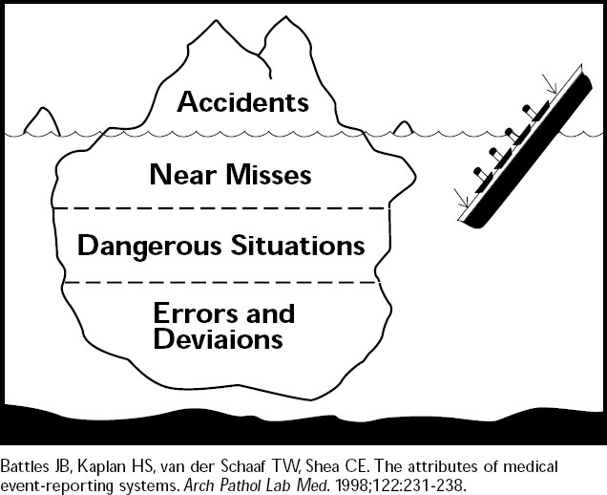

Slide 10
i.e. Medication process
Prescribing Dispensing Administrating Monitoring
Medication errors (MEs) are common and considered one of the highest risk factors that threaten patients in hospitals. The majority of these errors are considered common during prescribing medication stage
(Shulman et al, 2005).
5/12/2016

Slide 11
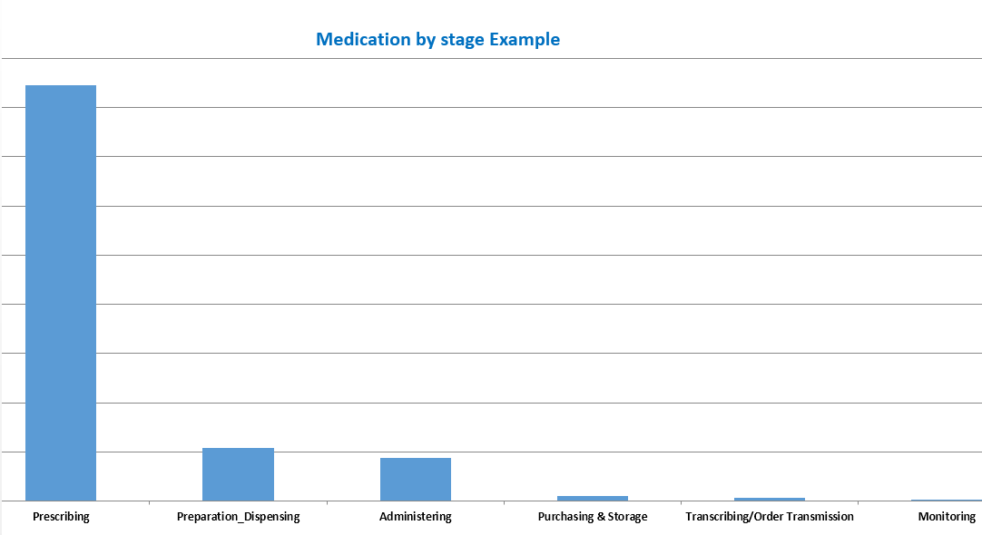
Where did it happened?

Slide 12
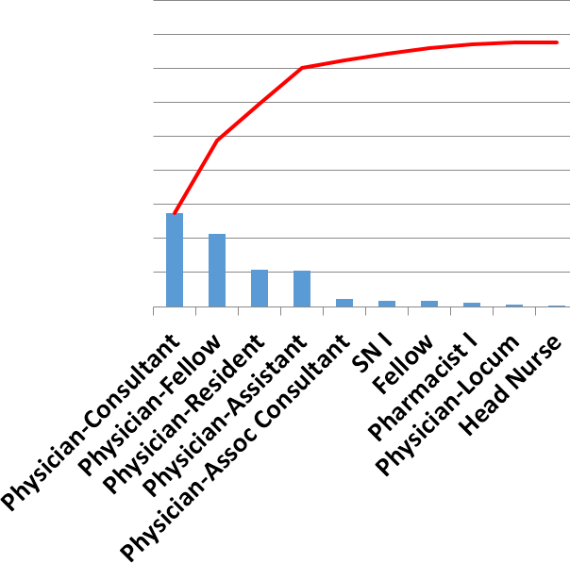
Who did it?
5/12/2016

Slide 13
Prof. Lucian Leape MD
Incompetent people are, at most, 1%
of the problem.
The other 99% are good people trying to do a good job who make very simple mistakes
It's the processes that set them up to make these mistakes.
5/12/2016

Slide 14
Error types
Others
Failure of communication
Treatment
Wrong medication administration
Diagnostic
Delay in diagnosis
Prevention
Failure to provide prophylactic
5/12/2016

Slide 15
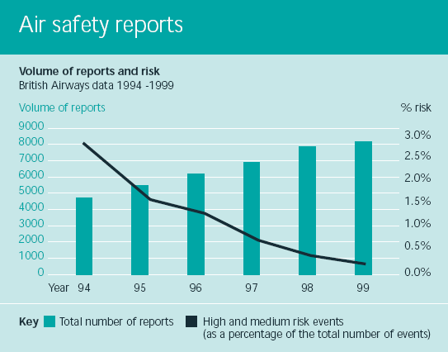
5/12/2016

