Slide 1
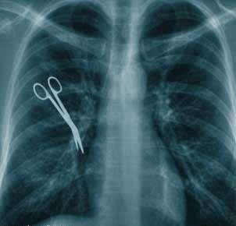
Contributing factors
Lack of communication
Lack of coordination
Inadequate staffing
IPP / standards not followed
Insecure access of patient information
Lack of knowledge
Failure to follow up
Lack of proper check
Improper assessment / reassessment
No / inadequate resources or supplies
Look alike medications
Illegible handwriting
5/12/2016

Slide 2
CPOE Benefits
≥50% of none-intercepted serious MEs rate decreased significantly (Bates et al, 1998).
81% reduction of medication errors (Bates et al, 1999).
Decreased patients LOS (Rothschild, 2004).
Improves medication reconciliation process ( Vira et al, 2006).
Improves the prescribers’ compliance (Cunningham et al , 2008).
Decreases mortality rate by 20% per month (Longhurst et al, 2010).
Improves patients satisfaction (Spalding et al, 2011).
5/12/2016

Slide 3
CPOE Impact
Facilitates 22 new types of medication errors (Koppel et al, 2005).
Lack of information systems compatibility, configuration and usability with end users (Colpaert and Decruyenaere, 2009; Rothschild, 2004).
A significant increase of mortality rates post CPOE (Han et al, 2005).
5/12/2016

Slide 4
Informatics Benefits
Tracking system
Effective communication and coordination
Prompt alerts and notifications
Decision support system
Manage data and store information
Secured access and defined privileges
Protocol guided and standardized practices
Accessible documentations
Legible orders, requests, and reports
Integrated care delivery
Support Lean processes toward more efficient workflows
Facilitate productivity measurements and monitoring
Reduce medication errors
Shortened length of patients’ hospitalisation due to
effective enhancement of antimicrobial management .
Reinforce clinicians compliance on evidence-based practices.
5/12/2016

Slide 5
Contributing factors
Lack of communication
Lack of coordination
Inadequate staffing
IPP / standards not followed
Insecure access of patient information
Lack of knowledge
Failure to follow up
Lack of proper check
Improper assessment / reassessment
No / inadequate resources or supplies
Look alike medications
Illegible handwriting
5/12/2016

Slide 6
Barriers to technology implementation
Cost (36%)
Difficulties in proving quantifiable benefits and ROI (32%)
Vendors inability to provide satisfactory products or services (27%)
Lack of standardization with integration and interfaces. (HL7, NAHIT)
Level of system evolution needed to meet growing demand on technology advancements
People
5/12/2016

Slide 7
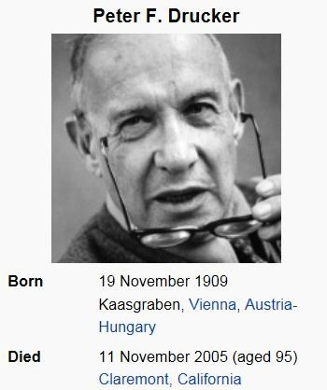
Benefits
You can’t manage what you can’t measure!
5/12/2016

Slide 8
Take Home Messages for Safer Health System

Slide 9
What Medical Informatics tools can?…
Improve communication
Make knowledge more readily accessible
Assist with calculations
Perform checks in real time
Assist with monitoring
Provide decision support
Require key pieces of information (dose, e.g.)
9

Slide 10
The Accenture study
The Accenture survey asked physicians about the extent to which they used 12 different “functions” of EMR and HIS— such as electronic entry of patient notes, electronic referrals, electronic ordering and prescribing and communicating with other physicians or patients via secure email.
The results showed that physicians who are routine users of a wider range of healthcare IT functions have a more positive attitude towards the these technologies. On average across all the countries, as physicians start to use more “functions” —the more positive they are about the benefits

Slide 11
The Accenture study
Majority of doctors surveyed believe that healthcare IT does provide some common top benefits, including:
better access, quality data for clinical research (70.9%),
improved coordination of care (69.1 %)
reduction in medical errors (66 %).
average score of 61 %,
In England, physicians perceived other healthcare IT benefits to include: increased speed of access to health services to patients (55.3
%), reduced number of unnecessary interventions and procedures (52
%).

Slide 12
Table 1: Assessment of Handwritten Prescriptions completeness
Information assessed | No. of prescription with omission (%)
Patient name | 0 (0.0%)
Hospital no. | 0 (0.0%)
Sex | 64 (32.2%)
Age | 132 (66.3%)
National ID | 171 (85.9%)
Diagnosis | 39 (19.6%)
Generic name | 85 (42.7%)
Frequency | 3 (1.5%)
Dose | 20 (10.1%)
Duration | 2 (1.0%)
Route of administration | 29 (14.6%)
physician's name | 12 (6.0%)
Extension and bleep | 25 (12.6%)
physician's signature | 7 (3.5%)
Date | 12 (6.0%)
Clinic name | 1 (0.5%)
Total of prescriptions were evaluated: 199 (100%)

Slide 13
Table 2: Assessment of Handwritten Prescriptions Legibility
Scale* | No. of prescription (%) Pharmacist B Pharmacist A |  |  |  | % of average scale
1 | 195 (98.0%) |  | 156 (78.4%) |  | 88.2
2 | 3 | (1.5%) | 27 | (13.6%) | 7.5
3 | 1 | (0.5%) | 16 | (8.0%) | 4.3
Total | 199 (100%) |  | 199 (100%) |  | 100%
Total of illegible and partially illegible ! | 4 | (2.0%) | 43 | (21.6%) | 11.8%
ـــــــــــــــــــــــــــــــــــــــــــــــــــــــــــــــــــــــــــــــــــــــــــــــــــــــ
*1= Legible, 2= legible with effort, 3= illegible
^ pharmacist 1= expert
~ pharmacist2= new
! scale of 2 and 3

Slide 14
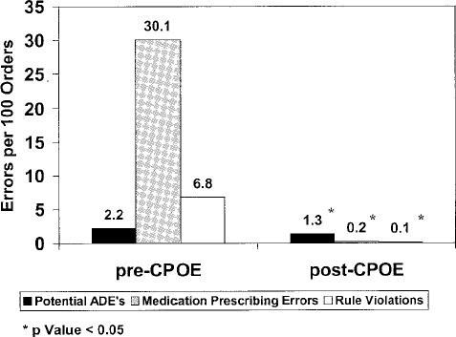
Example CPOE reduce errors
Potts studied ADE rates in 13,828 medication orders before/after
CPOE implementation at Vanderbilt Children’s PICU:
Potts AL, Barr FE, et al. Pediatrics. 2004 Jan;113(1 Pt 1):59-63.

Slide 15
Does CPOE Take More Time?
Time Spent/Patient Encounter— Duplicate Tasks Removed (minutes)
Time Spent/Patient Encounter (minutes)
40
35
30
25
20
15
10
5
0
40
35
30
25
20
15
10
5
0
34.2
36.3
34.2
35.1
Paper
CPOE
Paper
CPOE
6.2
6.9
6.2
5.7
Overall Writing Tasks
Overall Writing Tasks
Evidence shows that CPOE adds less than one minute to the time physicians spent writing orders and overall only added 1-2 minutes per patient encounter. As physicians gained experience with the system, the time for orders actually decreased.
(Overhage JM, et al J Am Med Informatics Associ 2001;8:361-371)

Slide 16
Healthcare
The healthcare industry is different from, other industries. We are talking about healing and dealing with human,
NOT a process based, and can’t just apply systems and global optimization techniques in the traditional, industrial engineering sense to the healthcare industry,
Health is something that is very difficult to measure nor to quantify.

