Slide 1
CONSUMER HEALTH
INFORMATICS (CHI)
Ahmed Albarrak, PhD, MSc.
Professor of Medical Informatics College of Medicine Chairman Health Informatics and E=learning
Chairman, Health Informatics Research Chair Chairman Public Health Program
King Saud University
Albarrak@ksu.edu.sa

Slide 2
What is Consumer Health Informatics?
A branch of health informatics that:
  Analyzes information needs of consumers
  Studies and implements methods of making health information and services accessible to consumers
  Integrates consumer preferences into health
care information systems

Slide 3
In this view, informatics analyzes consumers' needs for information; studies and implements methods for making information and services accessible to consumers; and models and integrates consumers' preferences into health information systems.
Consumer informatics stands at the crossroads of other disciplines, such as nursing informatics, public health, health promotion, health education, library science, and communication science.

Slide 4
Consumer Health Informatics
Integration of consumer health information and information technology in an environment of shared healthcare decision-making that supports effective self-health action.
Lewis, D. & Friedman, C. (2002). Consumer health informatics. In M.J. Ball, K.J. Hannah,
S.K. Newbold, & J.V.Douglas (Eds.). Nursing informatics: Where caring and technology meet (3rd
ed.). New York; Springer-Verlag.

Slide 5
Consumers?
More broader than “patient “ it may include the well and caregivers
It is a very diverse group
Brennan&Safran.Chapter 2 Empowered consumers. In: Lewis, Eysenbach, Kukafka, Stavri, Jimison. Consumer Health Informatics
Springer, 2005

Slide 6
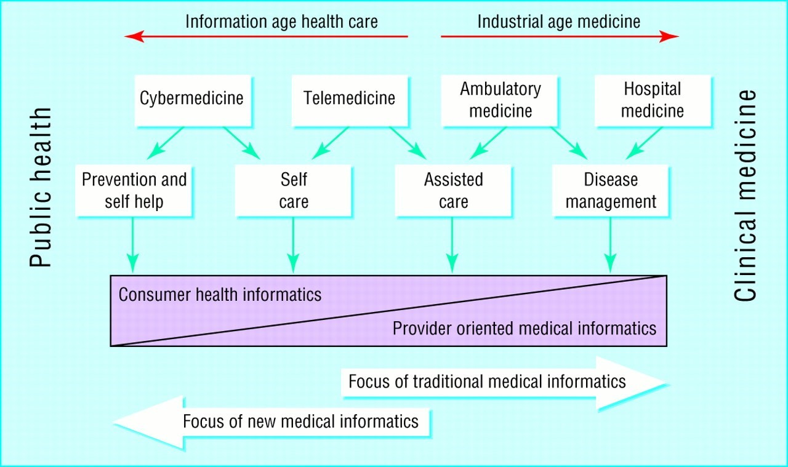
The focus of traditional health care and medical informatics
is shifting from health professionals to consumers

Slide 7
Empowered Consumers
Empowerment: Granting of power to a dependent group or enhancing an individual's ability for self determination
“a social process of recognizing, promoting and enhancing people’ abilities to meet their own needs, to solve their own problems, and mobilize the necessary resources in order to feel in control of their lives” (Gibson, 1991)
Brennan&Safran.Chapter 2 Empowered consumers. In: Lewis, Eysenbach, Kukafka, Stavri, Jimison. Consumer Health Informatics
Springer, 2005

Slide 8
Empowering Consumers
Consumers Health Informatics applications support the empowered consumers concept (a power balance in the patient-health professional relationship) by e.g.:
  Providing Informing about health concerns
  Assisting in finding others with similar concerns
  Assisting in navigating the health care system and services
  Access to clinical records and personal care management tools.

Slide 9
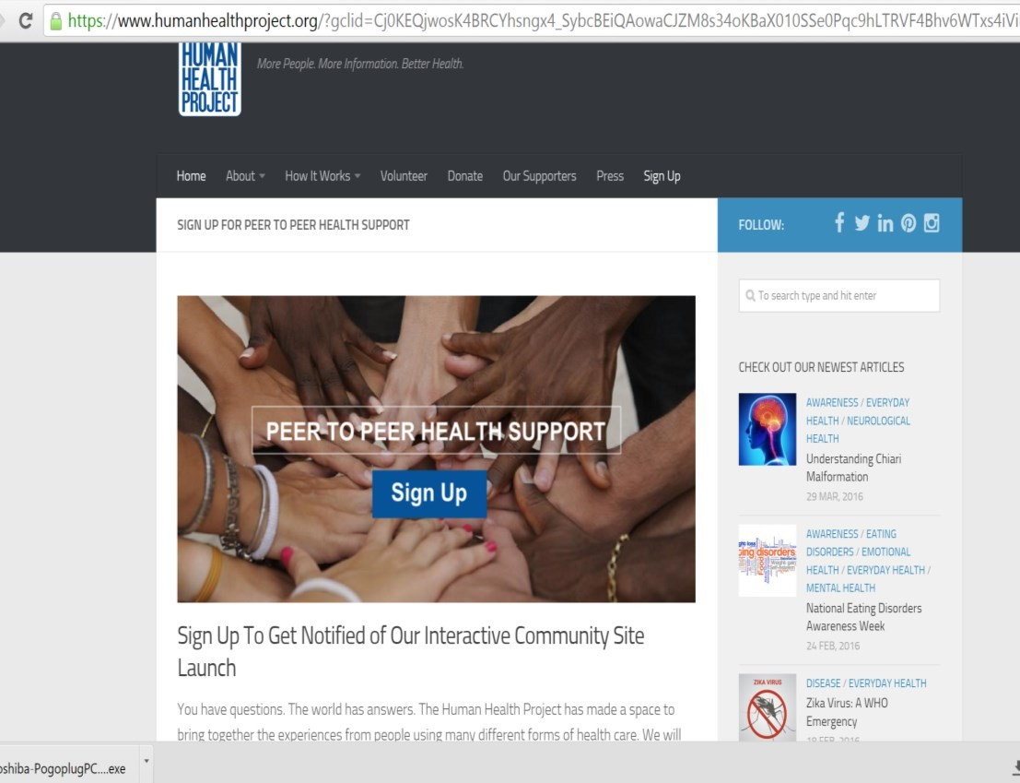

Slide 10
History of CHI
Consumer movement of 1970s
  Increased demand for information
  Greater participation in “medical” decision making
Prominence of “self-help” phenomenon of 1980s
  Huge increase in health information for lay audience
Widespread use of the Internet
  Increased dramatically throughout 1990s

Slide 11
CHI Continuum
Give/receive support
Obtain education/ information/treatment
Communicate with
Access to personal ^{providers} medical information
Provide information
Degree of Consumer Autonomy

Slide 12
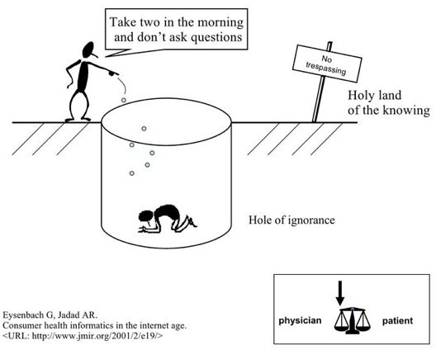

Slide 13
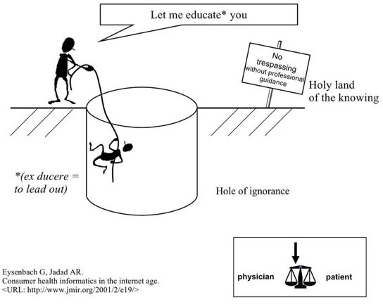

Slide 14
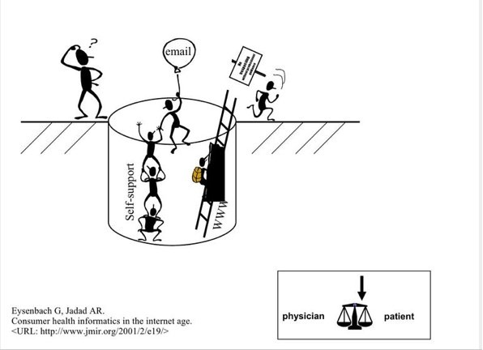

Slide 15
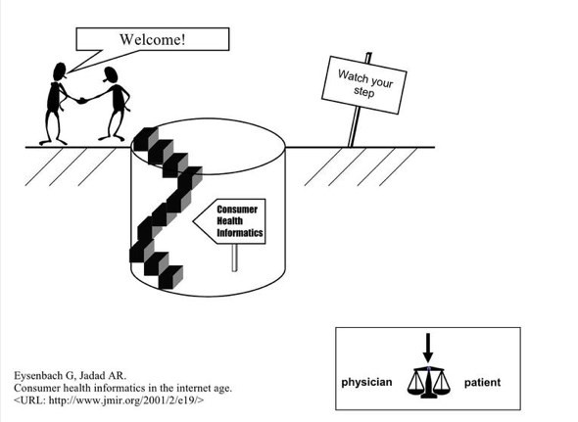

Slide 16
https://youtu.be/8BKN7RFhdq4
patient centered care
http://www.internetworldstats.com/me/sa.htm

Slide 17
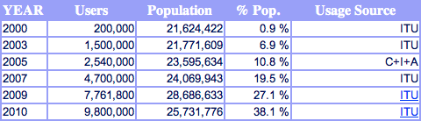
Saudi Arabia: Internet Growth and Population
Statistics
http://www.internetworldstats.com/me/sa.htm

Slide 18
Mobile health
M-health or Mobile health is a term used for the practice of medicine and public health, supported by mobile devices. The term is mainly used in reference to using mobile communication devices, such as mobile phones, tablets and PDAs, for health services and information. The mobile Health is a sub-segment of eHealth,
The mHealth market earned revenues of $230 million in 2010 and is estimated to reach $392 million in 2015 in USA, according to a new report from research firm Frost & Sullivan.

Slide 19
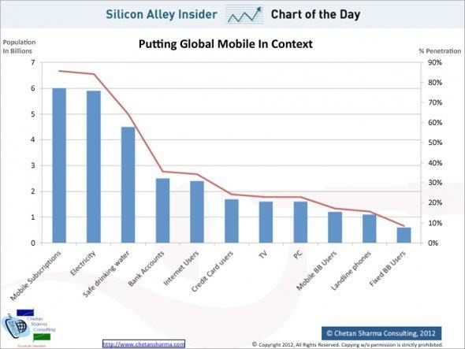
mHealth
Mobile is the most Pervasive technology ever invented

Slide 20


The mHealth Opportunity
7 Billion
People
By 2014
More mobile phones than people
Expanding the coverage and reach of critical health information and services and moving towards citizen-centered health and well-being

Slide 21
Consumer Health Informatics
Consumer Health Informatics
consumer or patient views.
patient-focused informatics,
health literacy and consumer education.
health information literacy,
consumer-friendly language,
personal health records, and Internet-based strategies and resources.

Slide 22
Where clinical IS and Consumer health informatics meet
Patient Portals: Patient interface to clinical information systems
Personal Health Record: Internet based- set of tools that allows people to access and coordinate their life-long health information and make appropriate parts of it available to those who need it
http://ww.webcitation.org

Slide 23
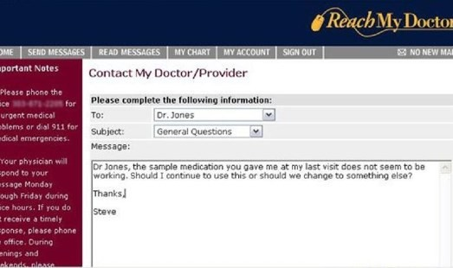

Slide 24
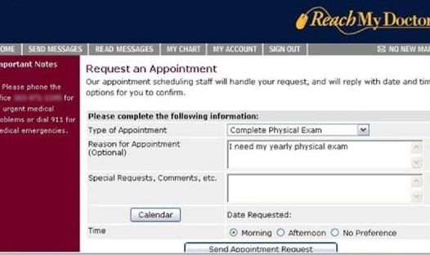

Slide 25
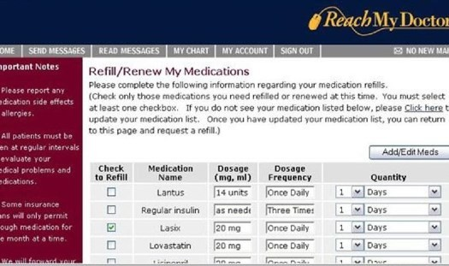

Slide 26
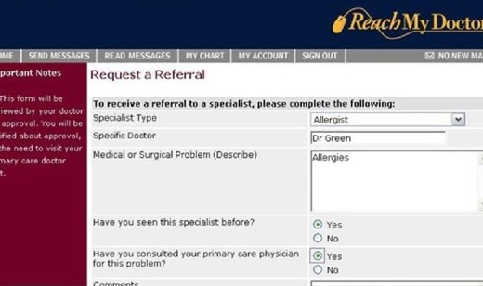

Slide 27
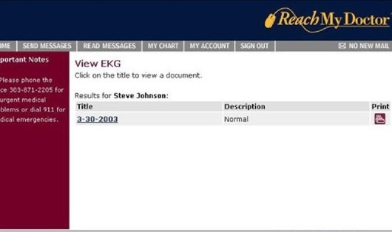

Slide 28
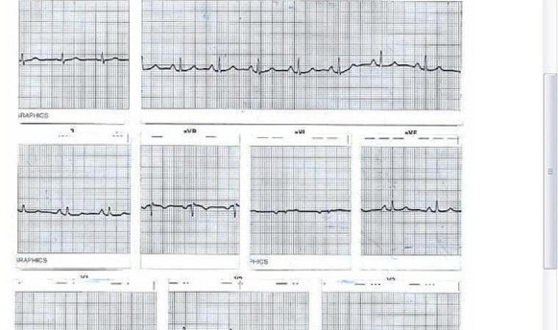

Slide 29
Consumer Health Informatics Systems
Consumer health informatics can be organized into three general systems that:
  provide health information to the user (one-way communication)
  tailor specific information to the user’s unique situation
(customized communication)
  allow the user to communicate and interact with health care providers or other users (two-way communication)

Slide 30
Consumer Health Informatics Systems
One-way communication: CD-ROMs, on-line health articles
Tailor: automated systems that obtain information from the consumer about his or her general health or other health-related factors (such as family disease histories and smoking habits) and, on the basis of this information, suggest a need for preventive health procedures (such as mammograms), or identify actions to curb high-risk behaviors.
Two-way communication: electronic mail, electronic bulletin boards, on-line discussion groups.

Slide 31
Roles of Health Professionals in CHI
Professionals serve as sources of content
Professionals provide important guidance in moderating public electronic discussion groups and responding to patients’ electronic messages
Clinicians become information brokers and interpreters for patients.

Slide 32
Quality control of health information on the internet
The quality control of health information on the internet rests on four pillars:
  educating the consumer
  encouraging the self regulation of providers of health information
  having third parties evaluate the information
  enforcing consents in cases of dissemination of fraudulent or harmful information.

Slide 33
Credibility Criteria
The FA4CT Algorithm: A New Model and Tool for Consumers to Assess and Filter Health Information on the Internet
CREDIBLE Criterion
Current and frequently updated
Reference cited
Explicit purpose
Disclosure of sponsors
Interest disclosed and no conflicts found (e.g financial)
Balanced
Level of Evidence
  Eysenbach G, Thomson M. The FA4CT Algorithm: A New Model and Tool for Consumers to Assess and Filter Health
Information on the Internet. In: Kuhn K (ed.) Medinfo 2007 Proceedings (in press)

Slide 34
Patient Centric Healthcare
“care that is respectful of, and responsive to, individual patient preferences, needs, and values” and that ensures
“that patient values guide all clinical decisions.”
This definition highlights the importance of clinicians and patients working together to produce the best outcomes possible.
Crossing the Quality Chasm, IOM

Slide 35
Patient / People Engagement
WHO defines People Centered Care as:
“Care that is focused & organized around the health needs & expectations of people & communities rather than on disease”

Slide 36
Characteristics of Patient Centered
Care
Respect for patients values, preferences & needs
Coordinated and integrated care
Information, Communication & Education
Physical Comfort
Emotional Support
Involvement of family & friends
Continuity of care
Access to care
Picker Institute-Multiyear Research Project
“Through the Patient’s Eyes: Understanding and Promoting Patient-Centered Care”

Slide 37
It’s a Different Ball game
In an eHealth environment, Information Moves
rather than the Physician or the Patient
eHealth
ePhysician - eConsumer
!

Slide 38





Is “At the Point of Care” Too Late?
Health Status
Health care spending
Healthy / Low Risk
At Risk
Early High Risk Clinical
Sympto
ms
20% of people generate
80% of costs
Early detection of at-risk patients
Provide personalized evidence to enable pro- active decisions

Slide 39
Actions
Technology victories and chronic disease,
e-Health takes a prominent role in the management of healthcare
To aggregate rather than segregate healthcare system
Consumer health education and empowerment
Preventive medicine takes precedence over treating the
sick
Focus on vulnerable members of society
The European study for future of health

Slide 40
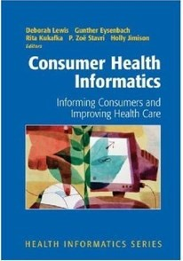
Further Reading

Slide 41
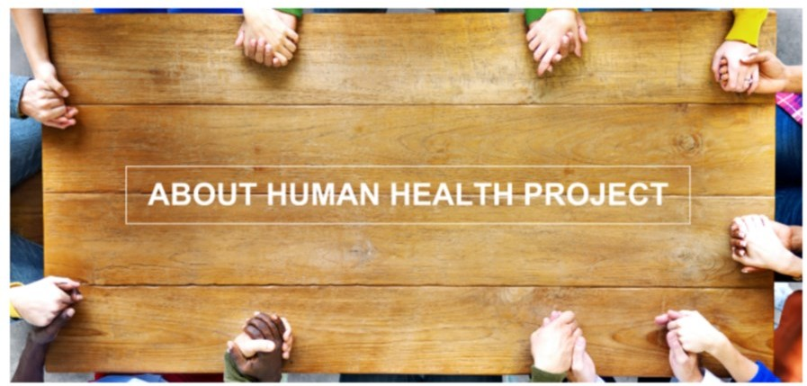

Slide 42
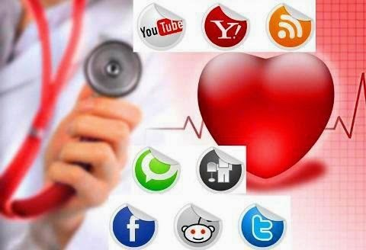
https://youtu.be/kp-5Jo1qHw8

Slide 43
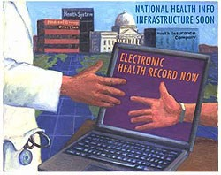
The Future: Trends
Is for Consumer Health Informatics
Thank you
Prof Ahmed Albarrak

