Slide 1
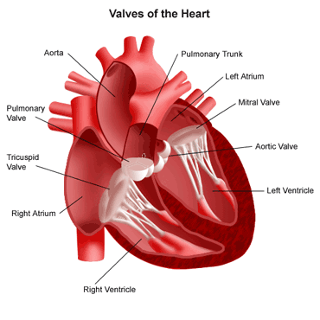
Valvular Heart Diseases
Prof. Mohammed Arafah
MB,BS FACP FRCPC FACC

Slide 2
Objectives
Etiology of valve diseases
Pathogenesis .
Clinical presentation .
Clinical findings .
Investigation .
Management .

Slide 3
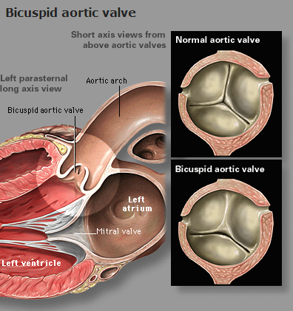
Etiology
Congenital :
- Bicuspid or unicuspid .
- Subvalvular or supravalvular .

Slide 4
Etiology - continue
Acquired :
- Rheumatic .
- Degeneration .
- myxomatous
- calcification
- Ischaemic .
- Infective Endocarditis .
- Valve ring dilatation .

Slide 5
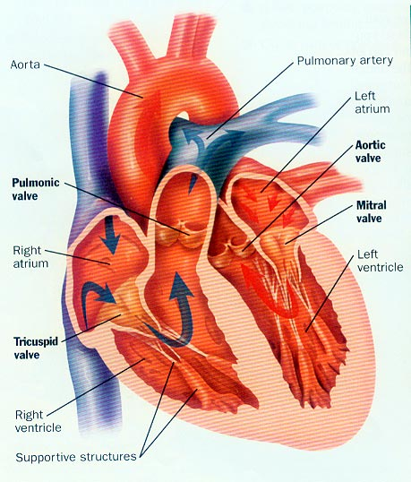
TYPES of Presentations
Acute Presentation :
- Acute mitral regurgitation due to
eg acute myocardial infarction
acute chordea tendineae rupture

Slide 6
TYPES of Presentations
Chronic Presentation :
- Chronic mitral regurgitation due to
eg RHRUMATIC fever .
Mitral valve Prolapse .
- Chronic aortic regurgitation due to
eg Bicuspid Aortic valve .

Slide 7
HEAMODYNAMICS Consequences
Pressure Overload :
- Aortic stenosis
Left Ventricular hypertrophy
- Mitral stenosis
Left Atriarl hypertrophy & dilatation

Slide 8
HEAMODYNAMICS Consequences
Volume Overload :
- chronic mitral regurgitation
dilated left ventricle & left atria
- chronic tricuspid regurgitation
dilated right ventricle & right atria

Slide 9
SYMPTOMS
Dyspnea , paroxysmal nocturnal dyspnea
orthopnea .
Palpitation .
Chest pain .
Dizziness , prefainting ,syncope .
Oedema , Ascites
Cough .
Fatigue
Hemoptysis
Symptoms of thromboembolic complication .

Slide 10
Signs of Valvular Diseases
Abnormal look ( mitral facies ) .
Abnormal pulse ( Atrial fibrillation ) .
Abnormal JVP
Apex beat abnormality .
Sternal or parasternal heave .
Thrill .
Abnormal heart sound .
MURMURS .
Systolic or Diastolic .

Slide 13
INVESTIGATION
ECG .
CXR .
Echo cardiology .
M mode , 2D ,3D . 4 D . TEE .
Doppler .
24 hours monitor for heart rhythm .
MRI .
Cardiac catheterization .

Slide 14
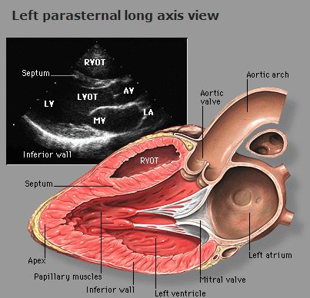

Slide 16
MITRAL STENOSIS

Slide 20
MITRAL STENOSIS results in several changes to the integrity of the valves:
CUSPS THICKEN
COMMISSURES FUSED TOGETHER
CHORDAE TENDINAE BECOMES
THICKENED & SHORTENED
CALCIUM DEPOSITS FORM

Slide 28
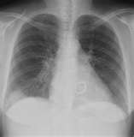

Slide 29
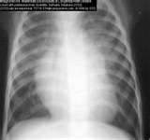

Slide 30
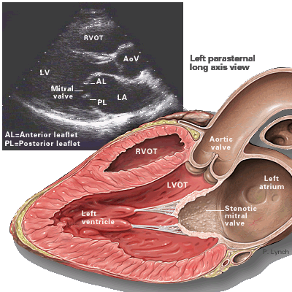
LEFT PARASTERNAL, LONG AXIS VIEW
STENOTIC MITRAL VALVE

Slide 32
COMPLICATIONS OF MITRAL STENOSIS
ATRIAL FIBRILLATION
LUNG CONGESTION
BLOOD CLOTS with SYSTEMIC EMBOLIZATION
PULMOARY HYPERTENSION
CONGESTIVE HEART FAILURE

Slide 33
MEDICAL MANAGEMENT
DIURETICS
DIGITALIS
ANTI-ARRYHTHMICS
ANTICOAGULANTS
ANTIBIOTICS

Slide 34
Intervention
PERCUTANEOUS TRANSVENOUS MITRAL COMMISSUROTOMY (PTMC)
SURGICAL COMMISSUROTOMY
MITRAL VALVE Replacement .

Slide 36
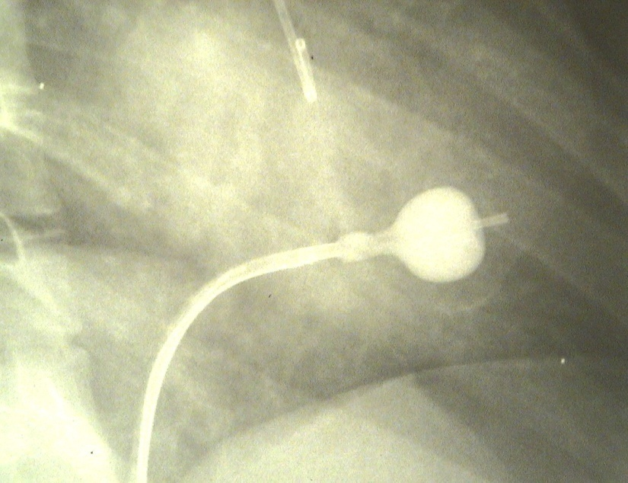
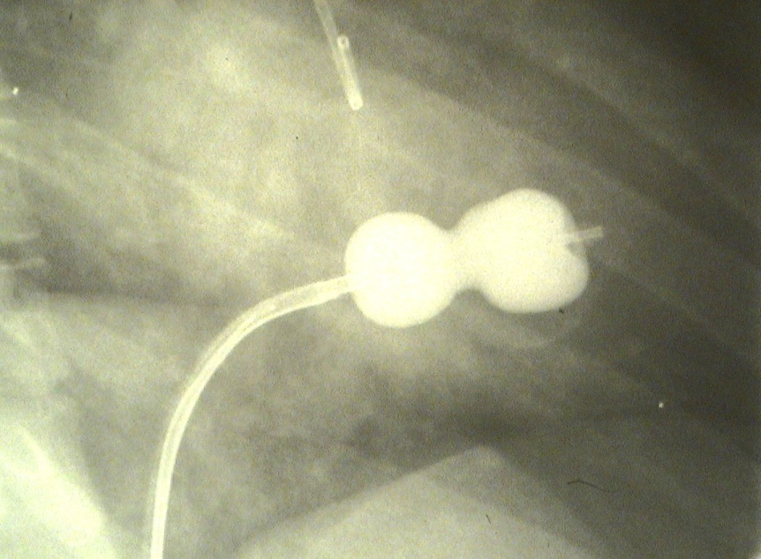
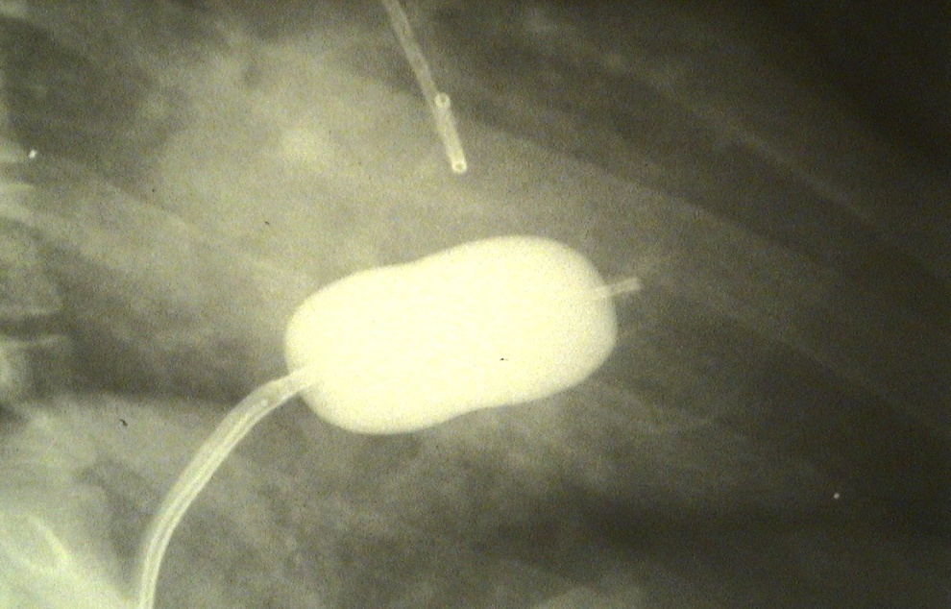

Slide 37
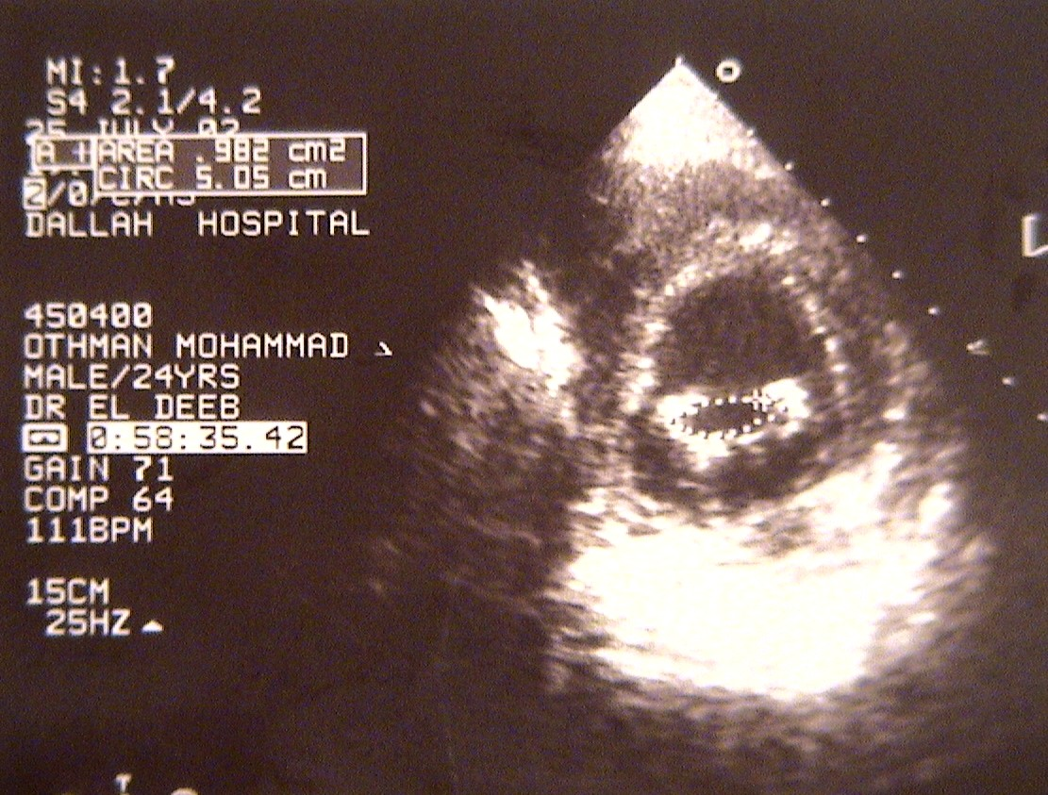
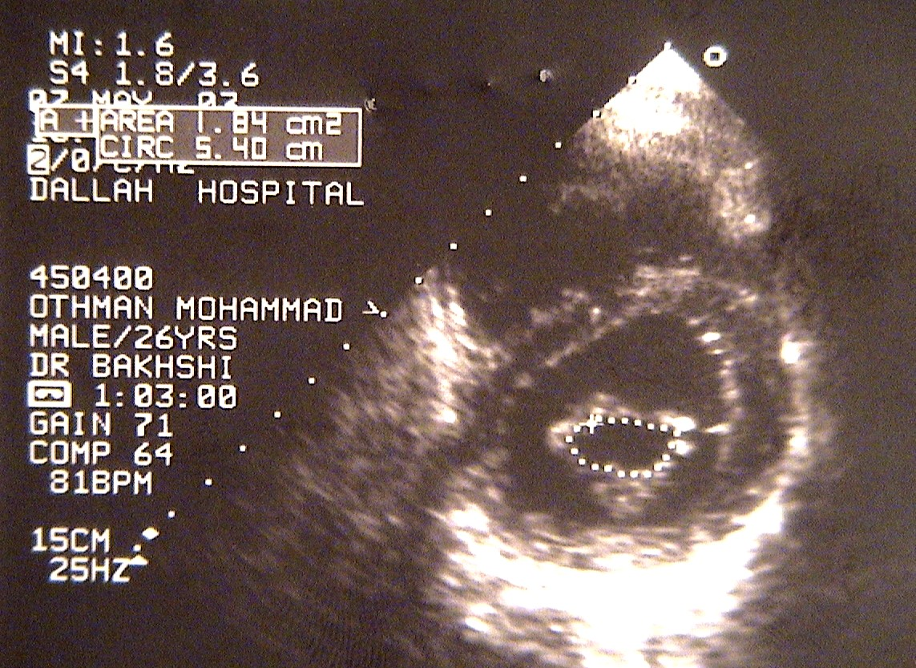
MVA = .982 cm²
MVA = 1.84 cm²
PRE-PROCEDURE
POST-PROCEDURE

Slide 38
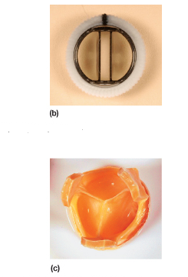

Slide 39
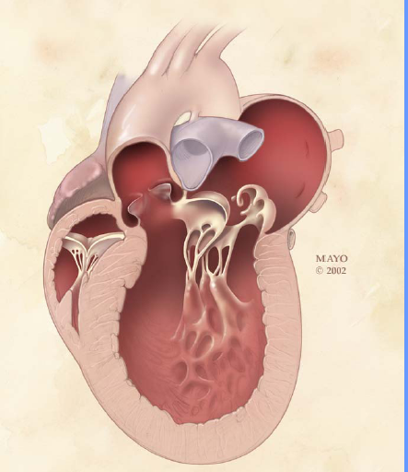
MITRAL REGURGITATION

Slide 40
ETIOLOGY
RHEUMATIC HEART disease .
MITRAL Valve Prolapse .
Others
- IHD
- Cardiomyopathy ( dilated , hypertrophic )
- Hypertensive heart disease
- infective endocarditis
- Myocarditis
- connective tissue disorders - (SLE)
- collagen abnormalities - Marfan's syndrome

Slide 41
SIGNS
Laterally displaced (forceful) diffuse apex beat and a systolic thrill .
Soft first heart sound .
Pansystolic murmur .
Prominent third heart sound .

Slide 44
Management of mitral regurgitation
Evidence of progressive cardiac enlargement generally warrants early surgical intervention by either mitral valve repair or replacement .
Treatment with ACE inhibitors, diuretics and possibly anticoagulants .

Slide 45
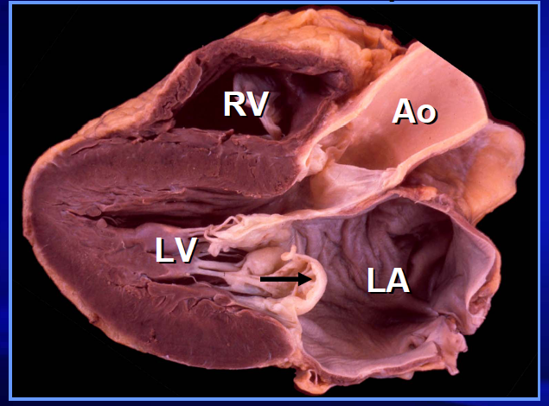
Mitral Valve Prolapse

Slide 46
Pathology
Large mitral valve leaflets, an enlarged mitral annulus, abnormally long chordae or disordered papillary muscle contraction .
Demonstrate myxomatous degeneration of the mitral valve leaflets .
Associated with Marfan's syndrome, thyrotoxicosis, rheumatic or ischaemic heart disease .

Slide 47
Symptoms
Atypical chest pain is the most common symptom .
Palpitations may be experienced because of the abnormal ventricular contraction or because of the atrial and ventricular arrhythmias .
Sudden cardiac death due to fatal ventricular arrhythmias is a very rare but recognized complication.

Slide 48
SIGNS
The most common sign is a mid-systolic click .
Produced by the sudden prolapse of the valve and the tensing of the chordae tendineae that occurs during systole .
A late systolic murmur owing to some regurgitation

Slide 49
Treatment
Beta-blockade is effective for the treatment of the atypical chest pain and palpitations .
Mitral valve prolapse associated with significant mitral regurgitation and atrial fibrillation, anticoagulation is advised to prevent thromboembolism .
Mitral valve prolapse associated with severe mitral regurgitation has a risk of sudden cardiac death.

Slide 50
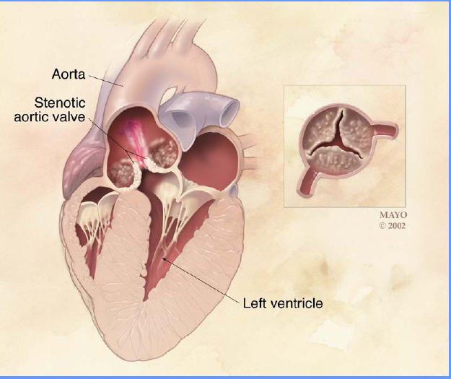
AORTIC STENOSIS

Slide 52
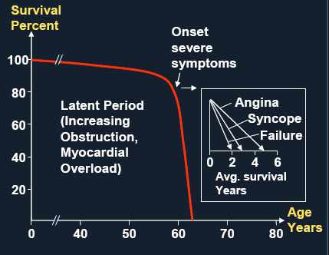

Slide 54
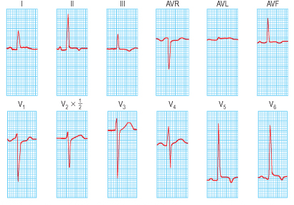

Slide 57
Treatment
In patients with aortic stenosis, symptoms are a good index of severity and all symptomatic patients should have aortic valve replacement.
Asymptomatic patients should be under regular review for assessment of symptoms and echocardiography .

Slide 58
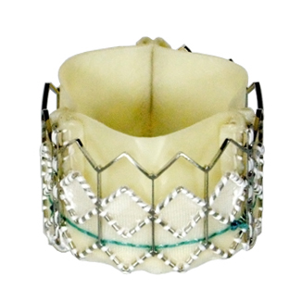
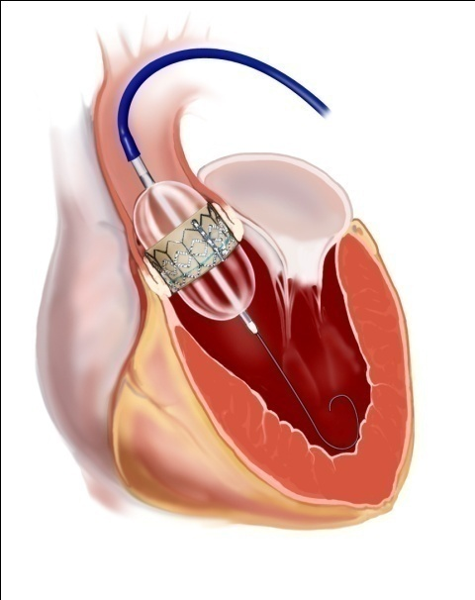
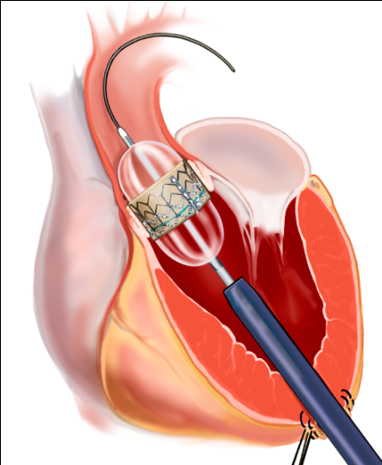
TAVR
Transfemoral (TF) and Transapical (TA)
Transfemoral
Transapical

Slide 59
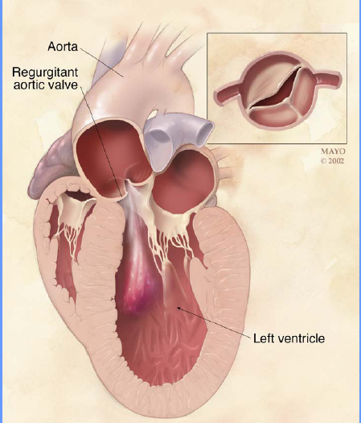
AORTIC REGURGITATION

Slide 65
Acute aortic regurgitation
Acute rheumatic fever
Infective endocarditis
Dissection of the aorta
Ruptured sinus of Valsalva aneurysm
Failure of prosthetic heart valve

Slide 66
Chronic aortic regurgitation
Rheumatic heart disease
Syphilis Arthritides:
Reiter's syndrome
Ankylosing spondylitis
Rheumatoid arthritis
Hypertension (severe)
Bicuspid aortic valve
Aortic endocarditis
Marfan's syndrome
Osteogenesis imperfecta

Slide 67
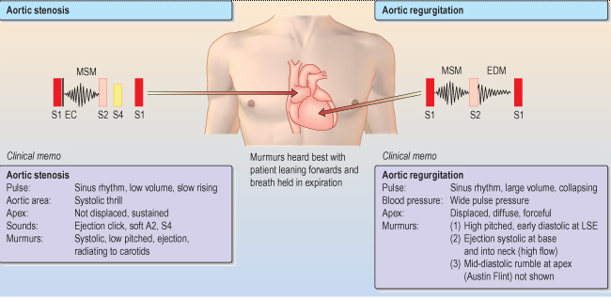

Slide 68
Treatment : Aortic valve replacement
Because symptoms do not develop until the myocardium fails and because the myocardium does not recover fully after surgery, operation is performed before significant symptoms occur.
The timing of the operation is best determined according to haemodynamic, echocardiographic or angiographic criteria

Slide 69
PULMONIC Valve Diseases
PULMONIC Valve stenosis
PULMONIC Valve Rergurgitation

Slide 70
TRICUSPID Valve Diseases
TRICUSPID Valve Regurgitation
TRICUSPID Valve stenosis

Slide 71
Thank You ☺
Valvular Heart Diseases
Prof. Mohammed Arafah

