Slide 1
Qualitative Research
Dr. Afnan Younis, MBBS, MPH, SBCM
Assistant Professor, Community Medicine
ayounis@ksu.edu.sa
Afnan.younis@gmail.com

Slide 2
Objectives:
To understand the basic concepts of qualitative study design
To differentiate between qualitative and quantitative study designs
To understand the basic design features of qualitative design

Slide 3
Types of research
Quantitative
Observational
Experimental
Qualitative

Slide 4
Quantitative research

Slide 5
Qualitative research

Slide 6
Qualitative research
Naturalistic approach
Holistic: no single reality – reality is based on perceptions – it is different for each person – changes over time
Words rather than numbers to describe findings
Depth and richness of information
Emphasizes seeing the world from the perspective of the participants
Notes:
no single reality – reality is based on perceptions – it is different for each person – changes over tim

Slide 7
Qualitative research
Interpretive: goal is understanding rather than prediction
Reflexivity / active use of researcher as research instrument
Emphasizes the subjective dimensions of human experiences
Assumes a dynamic reality
Inductive in nature

Slide 8
Qualitative research question: (Why/ How)
Answers the WHY question:
Why do young girls continue to smoke? Eg. Hilary Graham’s research
Why do young men engage in many high-risk activities?
Why are some health care services inequitable provided?
Why has a clinical trial failed...? Why has it worked?

Slide 9
Qualitative research question: (Why/ How)
Answers the HOW question:
How opinions and attitudes are formed
How people are affected by the events that go on around them
How and why cultures have developed in the way they have

Slide 10
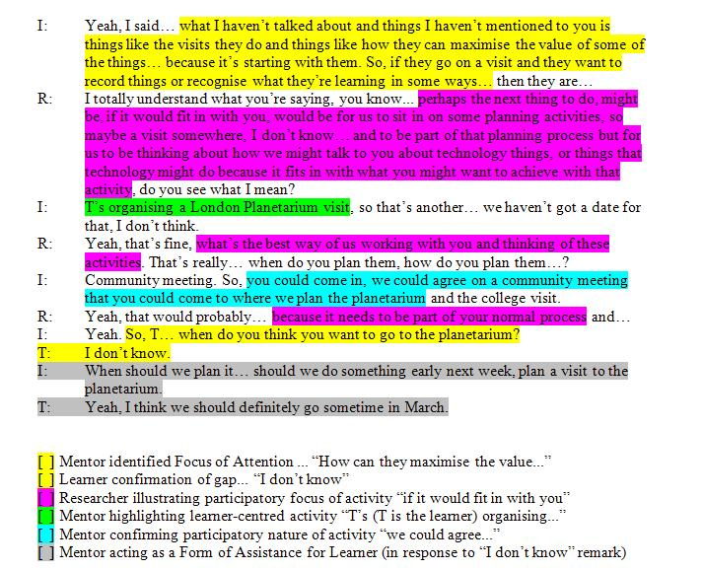
Qualitative data:
Text/story
No numbers
Statistical inference has no role in qualitative research

Slide 11
Sampling techniques:
Non-random sampling
Purposive
Snowballing
Quota
Convenient
Saturation: a situation in data collection in which participants’ descriptions become repetitive & confirm previously collected data
Notes:
Goal is not generalization of findings but rich descriptions of phenomenon by those who have experienced it
An indication that data collection is complete
Similar to adequate sample size in quantitative research

Slide 12
Purposive sampling: Researcher seeks out elements that meet specific criteria.

Slide 13
Snowball: Researcher relies on participant referrals to recruit new participants.

Slide 14
Quota sampling: Researcher selects cases from within several different subgroups.

Slide 15
Convenient: Researcher gathers data from whatever cases happen to be convenient.

Slide 16
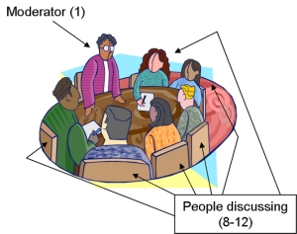
Data collection methods:
Interviews
Focus groups
Observations
Documents

Slide 17
Face-to-face interviews
Semi-structured interviews
Open-ended questions
Flexible in probing, expanding, question order.
Researcher can elicit more in-depth response or fill in information if participant doesn’t understand the question
Certainty about who answered the questions
Cost time and money

Slide 18
Focus group
A number of respondents to be brought together to discuss an issue.
Ideal size: 6 – 12 people
To generate a broad ranging output
Homogeneity and anonymity in selection of groups
Notes:
people may open up with others who are perceived to think along similar lines AND whom they may never see again

Slide 19
Dealing with data and data analysis:
During data collection interviews are usually recorded (audio/visually).
Transcribed verbatim.
Field notes and journals
Reading, rereading, analyzing, synthesizing & reporting
Cyclical
Extensive amount of time
Data similar in meaning are clustered together
CAQDAS
Notes:
Field notes and journals

Slide 20
Notes:
Tapes are usually transcribed verbatim
Text is sorted into emergent themes by at least 2 researchers to ensure validity using pile-sort method or computerized version such as CDC’s EasyText (free!)
Themes are compared with field notes taken by second researcher

Slide 23
Research trustworthiness (evaluation)
Quantitative | Qualitative
Internal validity | Credibility | Are the findings believable?
External validity | Transferability | Are the findings applicable elsewhere?
Instrument reliability | Dependability | If the study were repeated, would the same findings emerge?
Intra-observer reliability | Confirmability | Has the researcher biased the findings?
Notes:
Credibility : accurate description of participants’ responses: Member check, triangulation
Transferability – refers to the extent to which the findings from the data can be transferred to other settings or groups = similar to the concept of generalizability. THICK DESCRIPTION
Dependability – refers to data stability over time and over conditions complete and transparent description of methods
Confirmability –refers to the objectivity or neutrality of the data – what does that mean? Researcher's characteristics :

Slide 24
Which is better?
Qualitative research is not intrinsically better or worse than quantitative research.
Research design should be selected depending on research question.
Qualitative research is complementary to quantitative research. Both processes produce different kinds of knowledge that are valued by the profession and both are needed to promote excellence in practice
Notes:
qualitative methodology is not intrinsically better or worse than a quantitative alternative. The appropriateness of any methodology can be judged only in relation to the research question that needs to be answered. No methodology, from a randomised controlled trial to an ethnographic study, should be selected for its own sake:

Slide 25
Mixed method study design:
Detailed description and inductive reasoning provided by a qualitative study can be a stepping stone to a quantitative study that gathers detailed measurements of phenomena in a range of settings.
Quantitative survey may pose questions that require the in-depth interpretation by an interview or focus group.
Combining the two methodologies is known as mixed-methods research.

Slide 26
Comparison of Qualitative and Quantitative approaches
Quantitative | Qualitative
Deductive (theory testing) | Inductive (develop theory)
Large, random samples | Small, purposive samples
Generalizability, representativeness | May, or may not, be representative
‘Objective’ instruments (attitude/ outcome scales) | Less structured instruments (interviews)
Results as number and statistics | Results as words and concepts
Infer to population | Do not infer to population
‘Distance’ between researcher and subjects | Reflexivity and attention to individual participants
Emphasis on following original research plan | Flexibility of approach

Slide 27
References:
Bryman A (2001) Social Research Methods. Oxford University Press.

