Slide 1
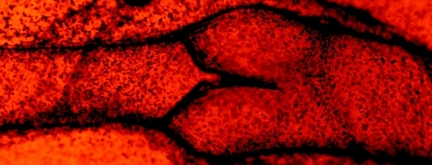
Chronic Venous Insufficiency
Dr. Talal A. Altuwaijri

Slide 2
Anatomy

Slide 3
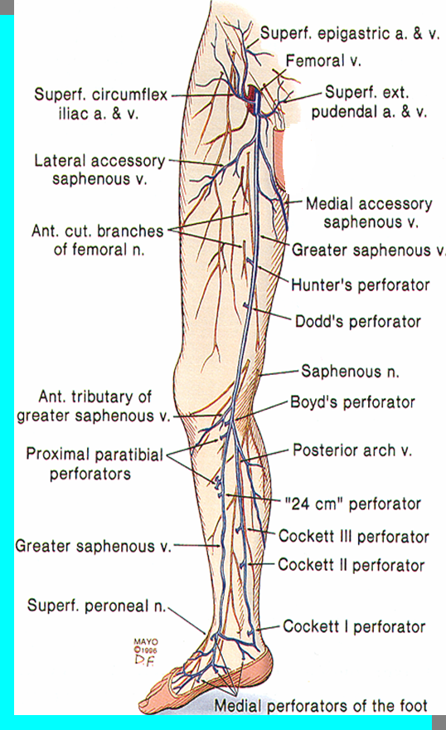
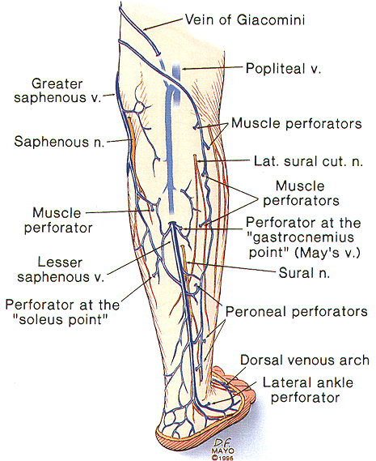
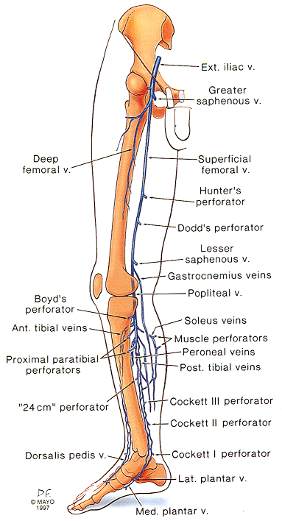

Slide 4
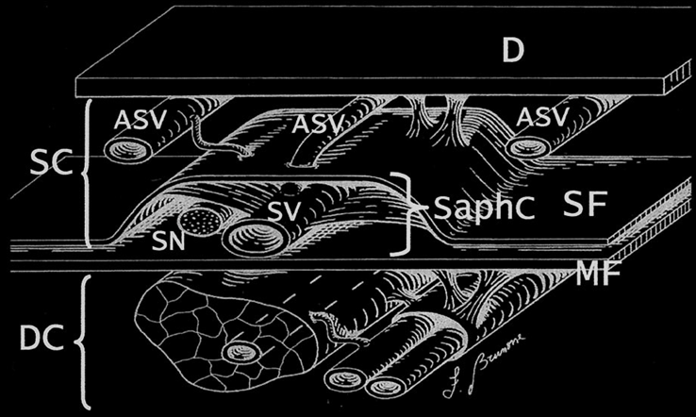
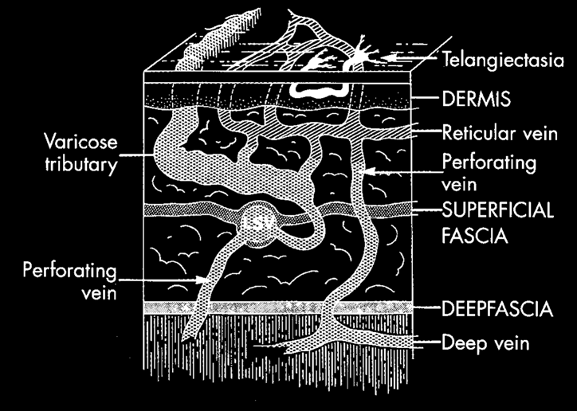

Slide 5
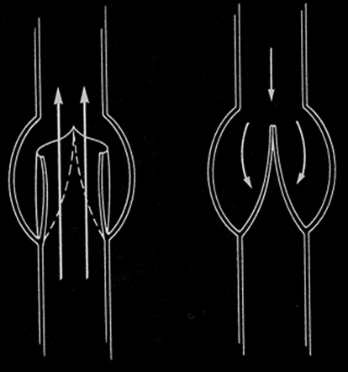
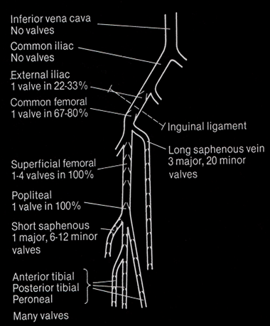

Slide 8
Physiology

Slide 9
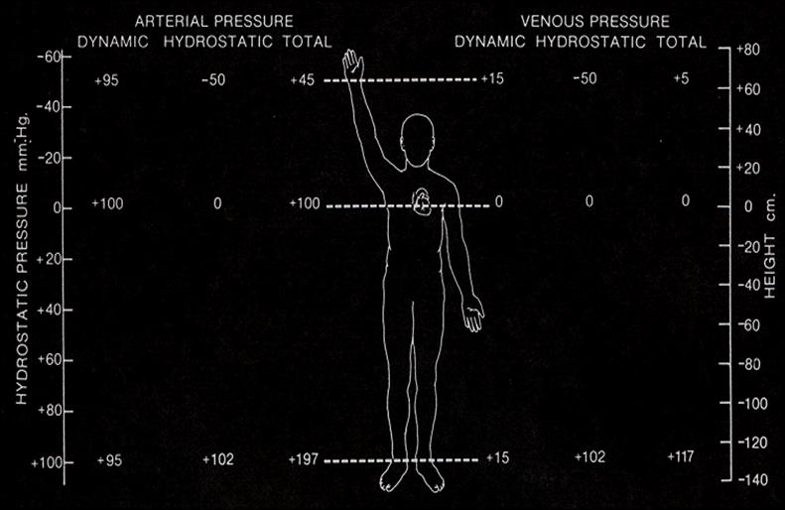

Slide 10
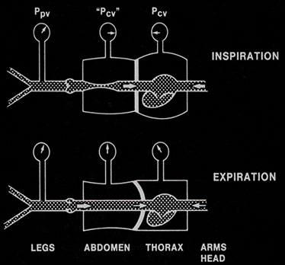
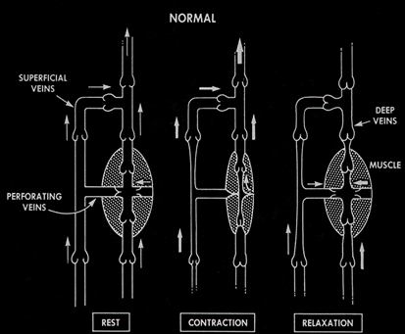

Slide 11
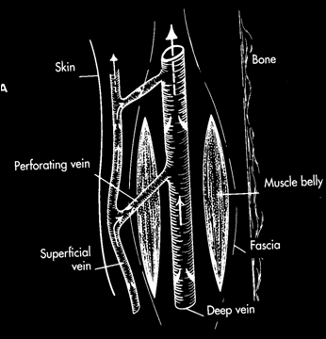
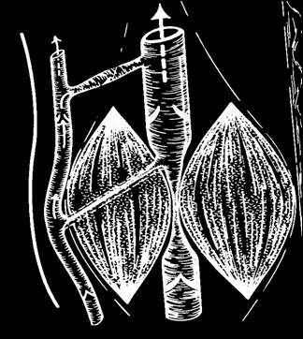
Calf Muscle Pump
Rest
Contraction

Slide 12
Ambulatory Venous Pressure
Position mm Hg
Supine 10
Standing 90
Walking* 25
* 7 steps = maximum effect
Notes:
IN REVIEW! If you understand normal you will be able to advise and guide regarding therapy for the abnormal.

Slide 13
What is Chronic venous insufficiency?
Notes:
The presence of (irreversible) skin damage in the lower leg as a result of sustained venous hypertension.

Slide 14
Pathophysiology

Slide 15
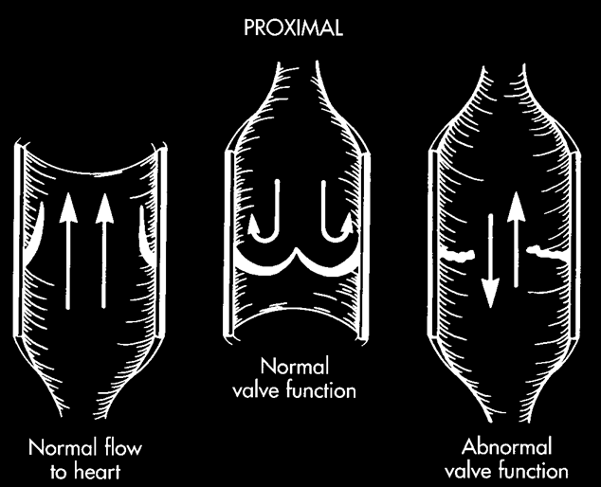
Reflux (90%) Obstruction (10%)

Slide 17
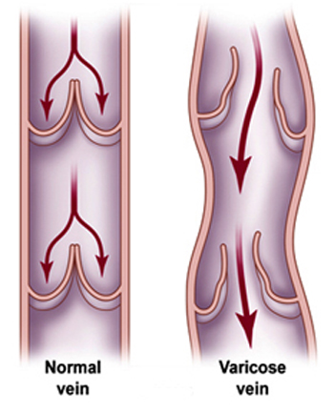

Slide 18
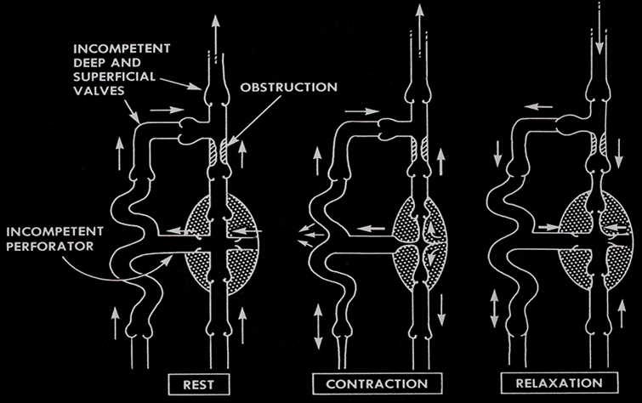
Primary Valvular Incompetence
“ floppy valve ”
Secondary Valvular Incompetence

Slide 19
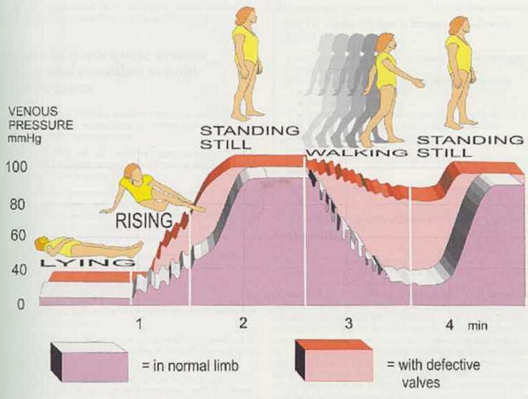
SO, Waht happens to the Venous Pressure?
Notes:
This slide depicts the pressures in a healthy limb, in mauve, while lying, rising, standing still and walking compared with the pressures present in a limb with defective valves.
The mauve depicts the normal rise and fall of venous pressure according to body positioning and gravitational effect.

Slide 20
Evaluation
History
Physical Examination
Investigations:
Non-invasive (Doppler/Duplex)
Invasive (AVP/ Venography)

Slide 21
Clinical Presentation

Slide 22
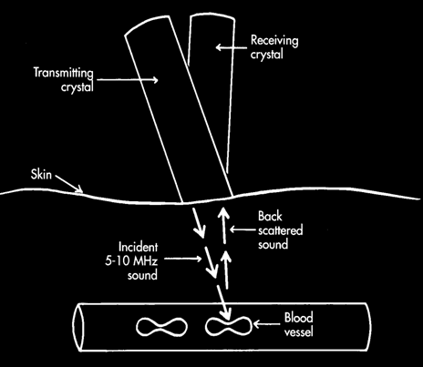
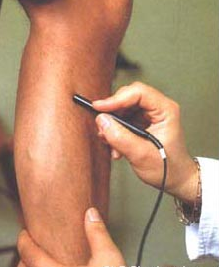
Doppler

Slide 23
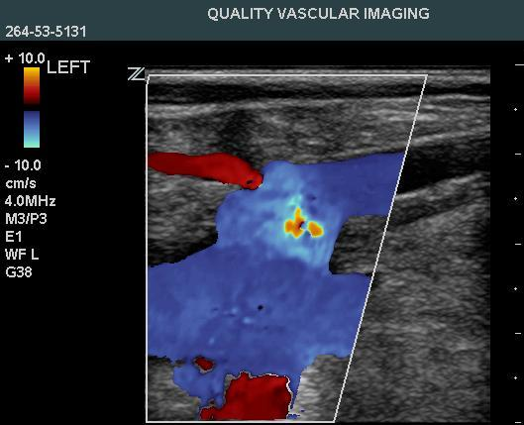
Duplex-Scanning

Slide 24
Duplex-Scanning

Slide 27
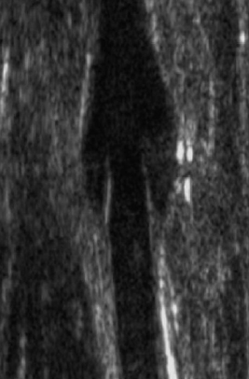
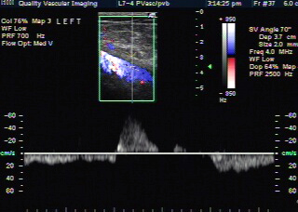
Duplex-Scanning

Slide 28
Duplex-Scanning

Slide 29
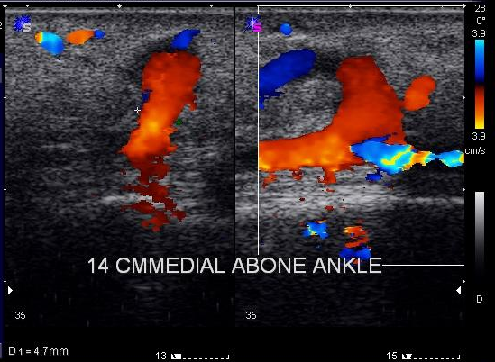
Incompetent Perforator Vein

Slide 30
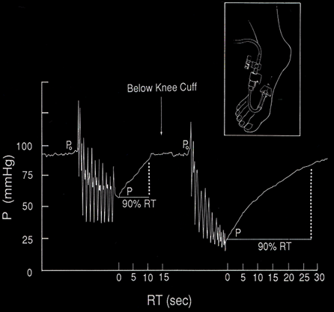
Ambulatory Venous Pressure
Reflux
20-21gauge Butterfly Needle
Superficial Dorsal Vein (Foot)
or Ankle Vein
Standing
Heal Raised
Measurements

Slide 31
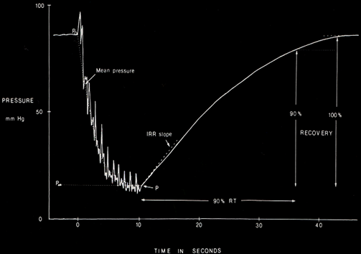
Ambulatory Venous Pressure
Interpretation
Normal :
Pressure 80 - 90mm Hg
to 20-30 mm Hg
or > 50% drop
Venous RF Time: ≥20 SEC

Slide 32
Abnormal AVP
I
Lack of sufficient drop in pressure with ambulation
P < 50%
II
Short Venous Refill Time
VRT < 20 sec

Slide 33
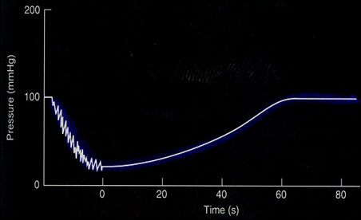
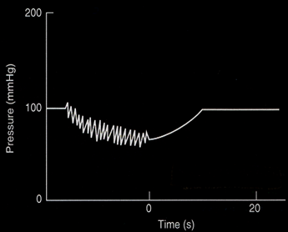
AVP
Deep venous incompetence
Normal

Slide 34
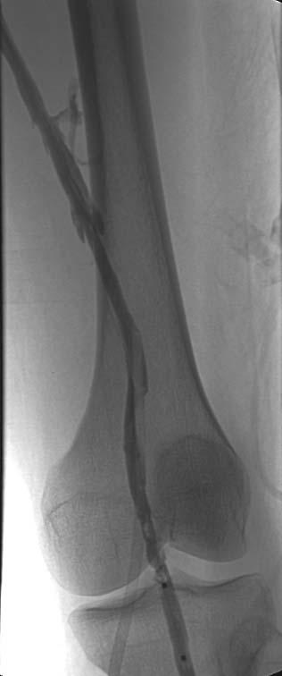
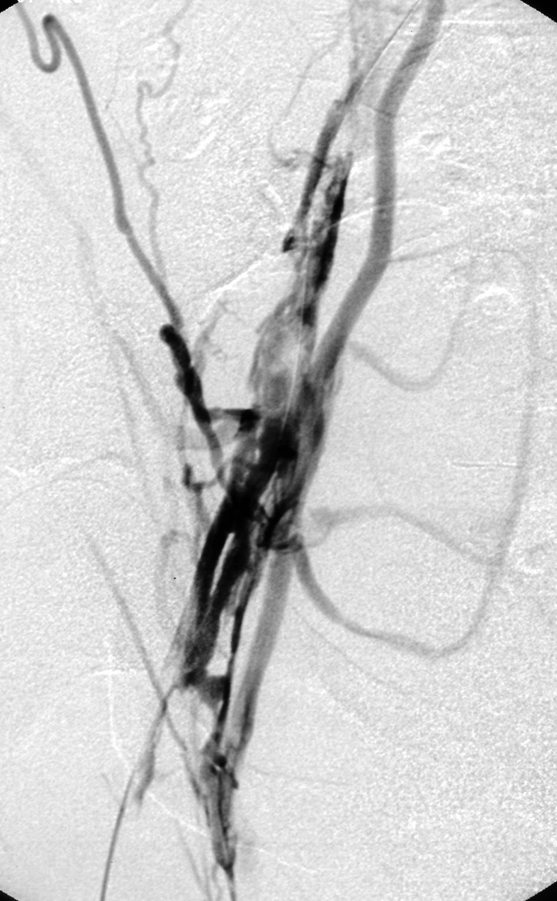
Phlebography

Slide 35
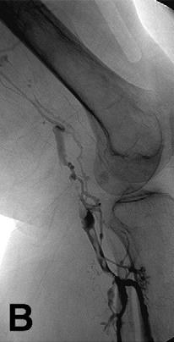
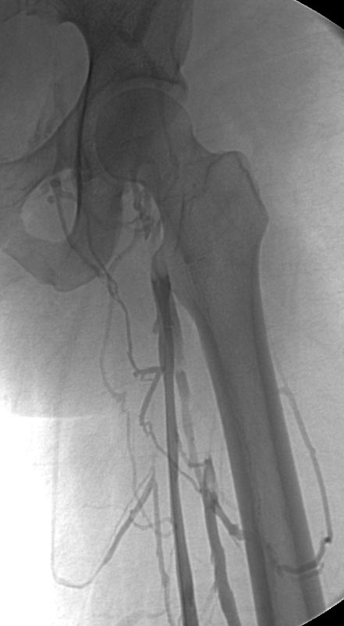
Phlebography

Slide 36
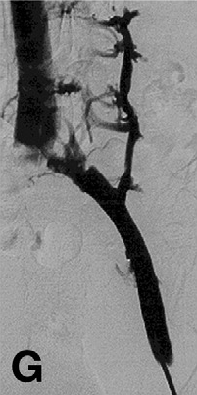
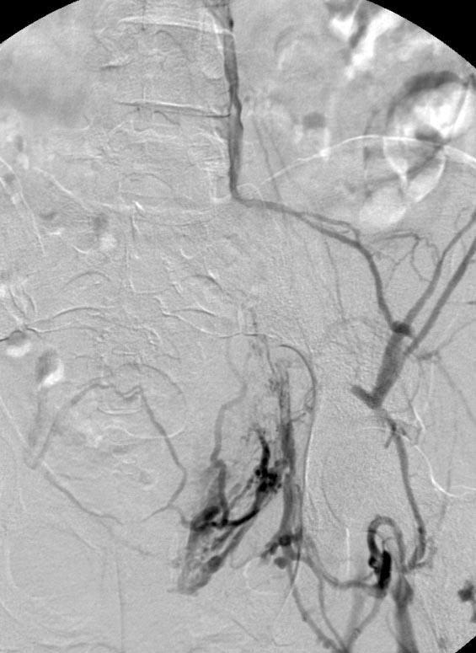
Phlebography

Slide 37
Treatment

Slide 38
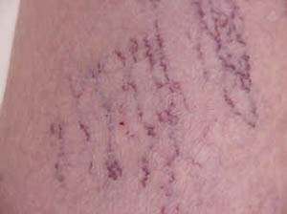
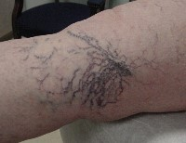
Treatment
Telangiectasias
& Reticular veins
Stocking and/or Sclero-Rx

Slide 39
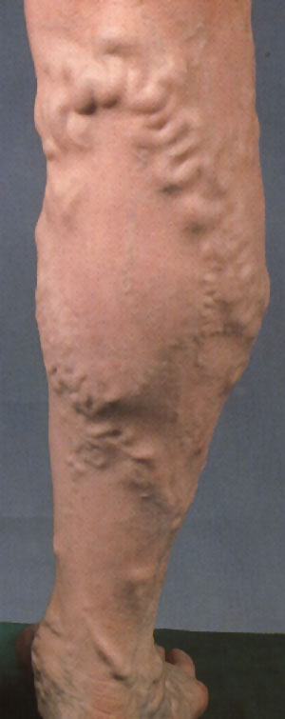
Treatment
Varicose Veins
Stocking
USG-Sclero-Rx
EVLT/Surgery

Slide 40
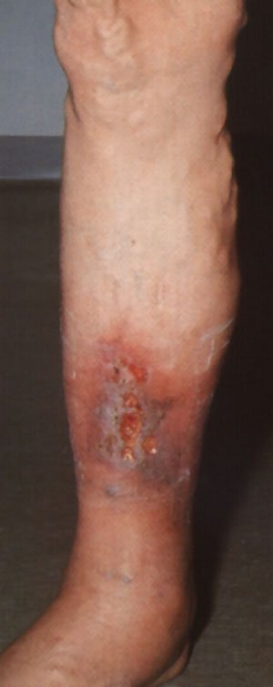
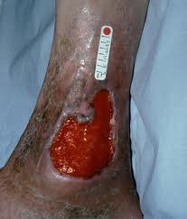
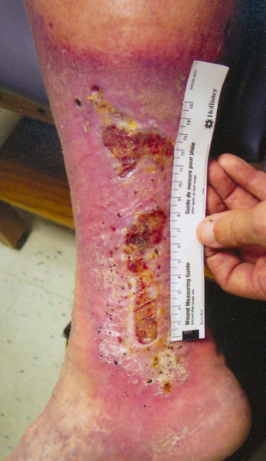
Edema
Cutaneous Ulcer
Local Wound
Stocking
USG-Sclero
ELVT/Surgery

Slide 41
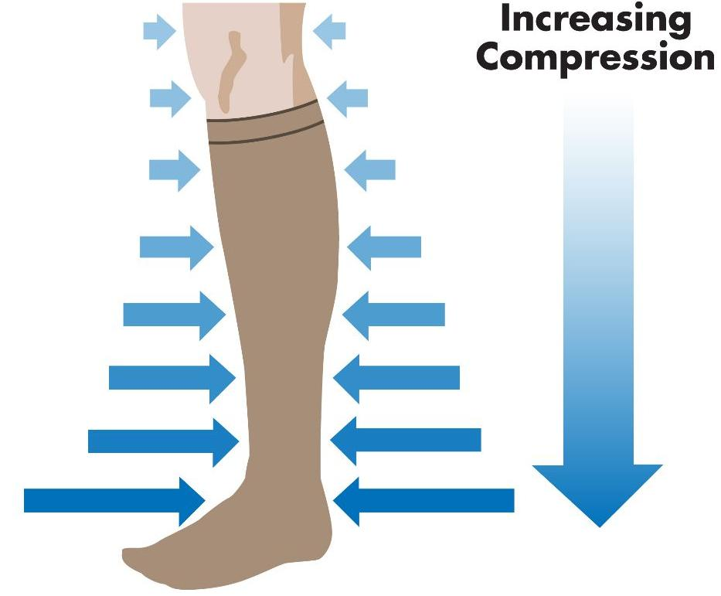
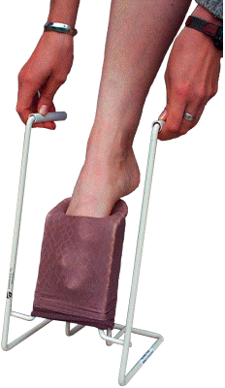
Compression Stockings

Slide 42
Compression Stockings

Slide 43
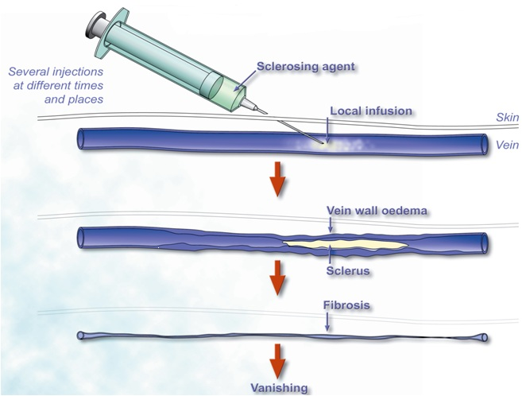
Sclerotherapy
Notes:
Sclerotherapy is the injection of a sclerosing agent into a vein, causing an inflammatory reaction in the endothelium of the vein wall. The vein walls adhere together under compression and form a scar (fibrotic tissue) that is absorbed by the body.

Slide 44
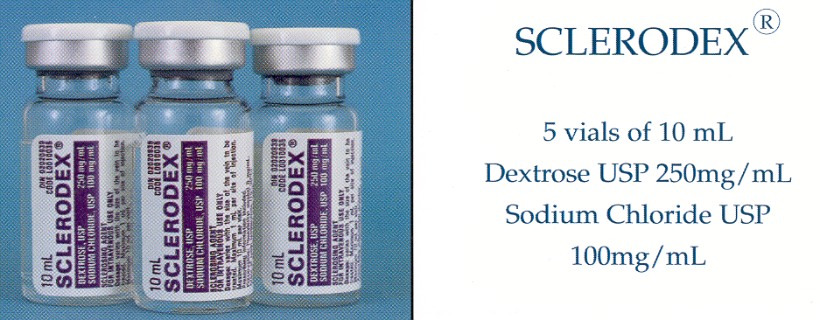
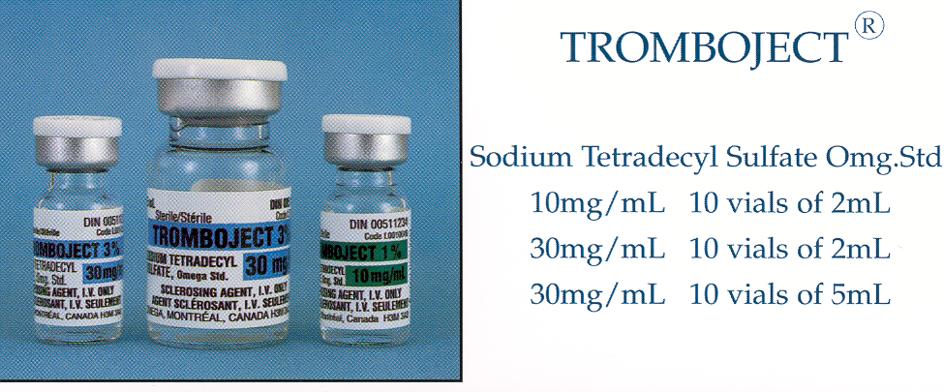
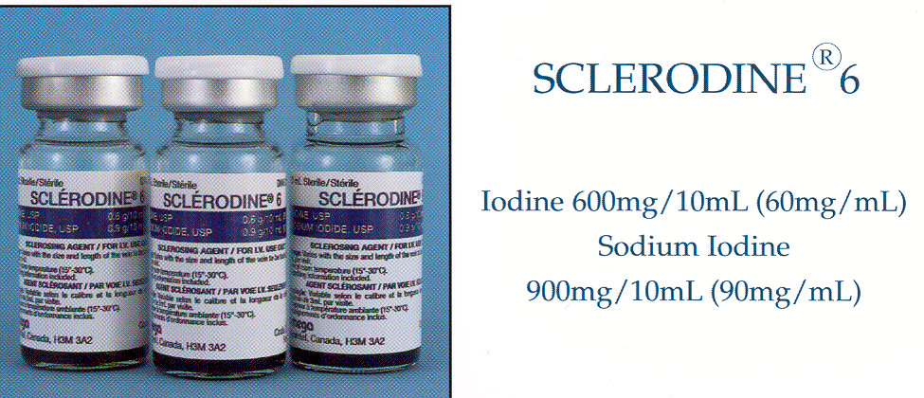
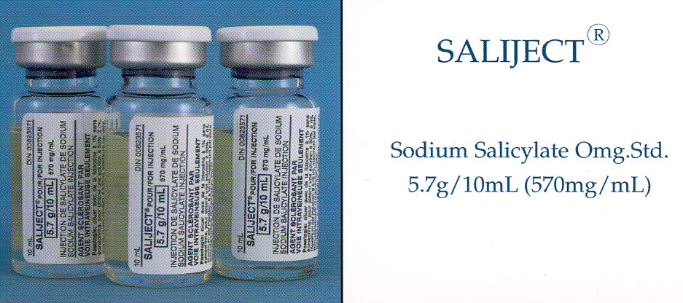
Sclerotherapy

Slide 45
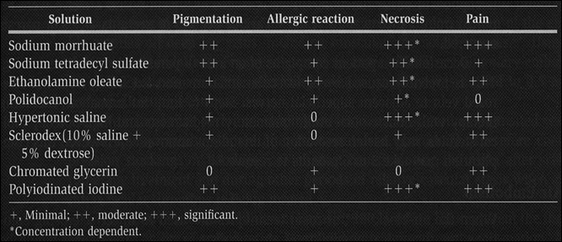
Sclero-Rx - Complications

Slide 46
Endovenous Ablation Techniques
Denaturation of vein wall collagen
Contraction
Fibrous obliteration

Slide 47
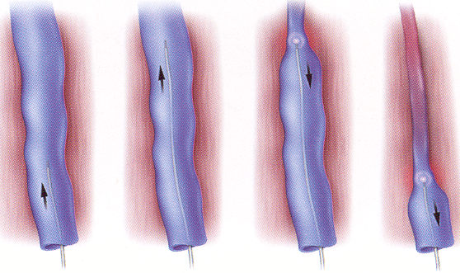
EndoVenous Laser Therapy(EVLT)

Slide 48
EndoVenous Laser Therapy(EVLT)

Slide 49
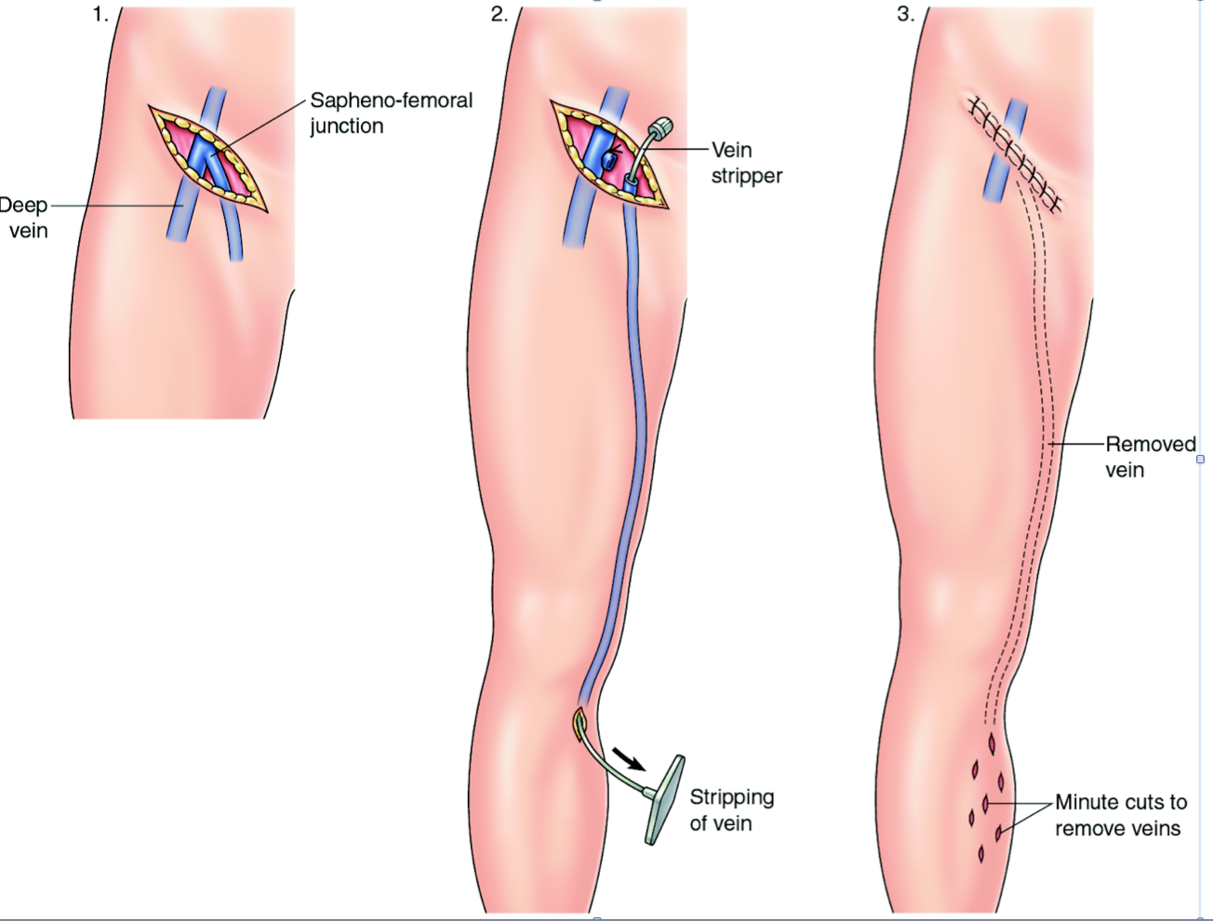
Surgery

Slide 50
Thank You

