Slide 1
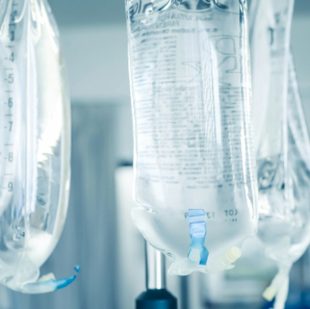
Intravenous Fluid & Acid-base Balance for Surgical Patients
Dr. Abdullah F Alshehri, MBBS, FRCSC, MSc
Assistant professor, consultant pediatric surgeon

Slide 2
What is Intravenous fluid?

Slide 3
Why is understanding IV fluid important for you?
The commonest order prescribed in every hospital
Needed for almost every patient
Always done by the junior doctors
Considered basic medical knowledge
Everyone expect you to know it
Incorrect prescription can be very dangerous
Usually the fluid is available in the floor, so no pharmacist to double check your orders

Slide 4
Objectives
Review basics of fluid & electrolytes physiology in surgical patient
Be familiar with different types of commonly used IV fluids
Be able to calculate fluid & electrolytes requirement for a patient and choose the appropriate type of fluid
Understand different types of electrolytes and fluid disturbance and its management
Understand basics of acid-base physiology and common disorders

Slide 5
What are we discussing?
Intravenous fluids
Electrolytes
Acid-base balance

Slide 6
Water & electrolyte balance

Slide 7
Electrolyte composition of the body compartments
Notes:
Extracellular Osmolality 275-295 mosmol/kg

Slide 8
Distribution of fluid between intravascular and extravascular spaces depends on:
Oncotic pressure: albumin
Endothelial permeability
Aldosteron & ADH-> Na & water retention
ANP -> Na & water excretion

Slide 9
Normal water loss
Notes:
200–300 ml of water is provided endogenously
every 24 hours by the oxidation of carbohydrate
and fat.

Slide 10
Normal daily fluid requirement (maintenance)
3 methods:
4,2,1 formula (most commonly used)- ml/hr
35 ml/kg/day (rough estimate)
Weight + 40 ml/hr

Slide 11
Normal daily fluid requirement (maintenance)
Method 1: 4,2,1 formula: based on body weight
First 10 kg | 4ml/kg/hr
Next 10kg | 2ml/kg/hr
Each kg over 20kg | 1ml/kg /hr
Example: Calculate the fluid requirement of a 100kg- man
First 10 kg: 4x10= 40
Next 10kg: 2x10= 20
Last 80kg: 1x80= 80
Total: 40+20+80= 140ml/hr =3360ml/day

Slide 12
Normal daily fluid requirement (maintenance)
Method 2:
35 x 100= 3500 ml/kg/day = 145 ml/hr
Method 3:
100 + 40= 140 ml/hr

Slide 13
Assessing fluid/electrolytes in surgical patient
Fever:
-200ml/day for each 1 degree Celsius
Sweating:
Up to -1L/hr
Na>K loss

Slide 14
Assessing fluid/electrolytes in surgical patient
Effect of Surgery:
Stress response:
Increased ADH, Aldosteron >> urinary retention + oliguria
Third space loss:
Surgical manipulation resulting in fluid sequestration within the tissues (extravascular)
Loss of fluid from gastrointestinal tract:
Bowel obstruction: no fluid absorption
Paralytic ileus: loss of GI function after abdominal surgery for 2-3 days
Nasogastric tube fluid loss
Stoma or intestinal fistula fluid loss
Diarrhea

Slide 15
Volume + Electrolytes in GI fluid

Slide 16
IVF administration
Before ordering IVF, you should ask yourself:
How much maintenance fluid does the patient need?
4,2,1 formula
Is there any fluid deficit I should add?
Dehydrated patient!
What fluid compartment I want to replace?
Does the patient have any electrolytes disturbance?
Na, K, Cl
What is the type of fluid appropriate for my patient?
Crystalloid vs. colloid
Does the patient need bolus or continuous fluid?

Slide 17
Types of IV fluids
Crystalloids:
Dextrose solutions
NaCl solutions
0.9% normal saline
½ normal saline
¼ normal saline
Hypertonic saline
Ringer’s Lactate (Hartmann’s solution)
Colloids:
Natural: albumin
Synthetic: Gelatins, Hetastarch, Dextran

Slide 18
Crystalloids
Dextrose fluids:
Different concentration: 5%, 10%, 20%, 50%
5% Dextrose contain 5gm of glucose in every 100ml of water (50g/L)
No electrolytes
After administration:
60% will go to intarcellular compartment
30% will go to extracellular compartment (80% Interstitial , 20% intravascular)
Not good option for fluid resuscitation
> 12% dextrose can not be administered in peripheral vein (central venous line is needed)
Never bolus any dextrose containing solution !!! (hypotonic)
Which patient could benefit from this type of fluid?

Slide 19
Crystalloids
Electrolytes solutions:
NaCl solutions (0.9% NS, ½ NS, ¼ NS)
LR solution (Hartmann’s)
Hypotonic fluid: 1/2NS, ¼ NS
Never bolus a hypotonic solution!!!
Isotonic fluids:
0.9%NS, LR (similar osmolality to plasma)
25% will remain in the IVC
75% will go to EVC
Best option for fluid resuscitation e.g. dehydration, trauma, perioperative
Can be given as bolus or continuous fluid
Hypertonic solutions
E.g. 3% NS
Rarely used ( for cerebral edema and management of brain injuries)
Notes:
Ringer's saline solution was invented in the early 1880s by Sydney Ringer,^{[4]} a British physician and physiologist. Ringer was studying the beating of an isolated frog heart outside of the body. He hoped to identify the substances in blood that would allow the isolated heart to beat normally for a time.^{[17]} The use of Ringer's original solution of inorganic salts slowly became more popular.^{[4]} In the 1930s, the original solution was further modified by American pediatrician Alexis Hartmann for the purpose of treating acidosis. Hartmann added lactate, which mitigates changes in pH by acting as a buffer for acid. Thus the solution became known as "Ringer's lactate solution" or "Hartmann's solution"

Slide 20
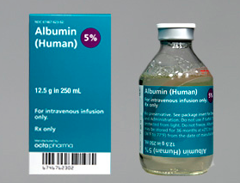
Colloids
Examples:
Natural: albumin 5%, 20%
Synthetic: Gelatins, Hetastarch, Dextran
Contain protein particles that exert oncotic pressure and cause fluid to remain in the intravascular compartment for ~ 6-24hrs
Disadvantages of colloid:
Not widely available
Take time to prepare and administer
Albumin is a blood product (stored in the blood bank)
Expensive
Can cause allergic reactions, pruritus, coagulopathy

Slide 21
Composition of IV fluid

Slide 22
Composition of IV fluid

Slide 23
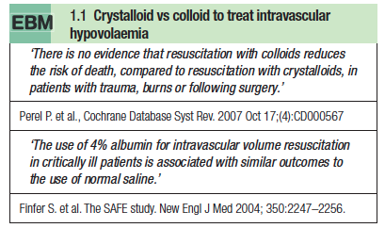
Is colloid better than crystalloid for fluid resuscitation?

Slide 24
Which goes to which?

Slide 25
Electrolyte requirement
Adult:
Na: 1-2 mEq/kg/day
K: 1mEq/kg/day
Cl 1-2mEq/kg/day
Children:
Na: 2-3 mEq/kg/day
K: 2-3 mEq/kg/day
Cl: 2-3 mEq/kg/day

Slide 26
Calculating fluid requirement for 70kg adult
Assuming normal, well hydrated patient, normal electrolytes
Volume: 4,2,1 formula
(4x10) + (2x10) + (1x50) = 110 ml/hr
2640 ml/day
Electrolytes:
Na: 1-2 x 70= 70-140 mEq/day
K: 1x70= 70 mEq/day
Type of fluid:
D5 1/2 NS is the best solution
Why:
If you give 0.9NS only = 400mEq/day of Na (too much)
If you give ½ NS only = 200mEq/day of Na (acceptable)
But 1/2NS is hypotonic (150mOsmol/L) >> add D5 will raise osmolality to 400 mOsm (acceptable) also will prevent muscle catabolism
You should add 20mEq KCL/L to the solution = 52 mEq/day
Avoid Dextrose in diabetic patient (use ½ NS)

Slide 27
Your final order: Start IV fluid D51/2 NS + 20mEq KCL/L @ 110ml/hr

Slide 29
Water depletion/ Dehydration
Very common in surgical patients
Usually water + Na
Commonly caused by:
Decreased intake
Increased GI loss (diarrhea, vomiting, NGT loss, high stoma output)m;987
Signs of dehydration:
Decreases skin turgor
Dry mucous membranes
Tachycardia
Oliguria <500ml/day (normal 0.5-1ml/kg/hr)
Hypotension
Decreased level of consciousness
Treatment:
Rapid IV bolus of isotonic solution (0.9% NS or LR)
250-1000ml over 30-60min
Monitor response to rehydration

Slide 30
Water excess
Due to excessive fluid administration (especially hypotonic fluid e.g. Dextrose solutions
Can cause hyponatremia (dilutional)
Water accumulate in ECC
Difficult to detect clinically (edema, basal chest crackles, elevated JVP)
Later stages >> tissue edema
High risk patients:
Cardiac failure
Renal failure

Slide 31
Hypernatremia (Na >145mmol/l)
Causes
Treatment
Hypovolemic hyponatremia is treated with isotonic saline
Avoid rapid lowering Na (cerebral edema, permanent brain damage)

Slide 32
Hyponatremia (Na <135 mmol/L)
Causes
Treatment
Depends of extracellular fluid volume status:
Normal or high: reduce water intake> Na will correct
Low: isotonic fluid administration
Avoid rapid correction >> brain damage

Slide 33
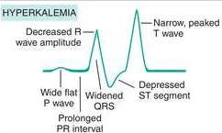
Hyperkalemia K>5mmol/l
Can be life threatening

Slide 34
Hyperkalemia K>5mmol/l

Slide 35
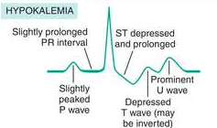
Hypokalemia K< 3mmol/l
Very common in surgical patients
Most K is lost via kidneys
Rx:
Oral K
IV K for severe cases
Avoid K IV bolus (arrhythmia)

Slide 36
Acid-base balance

Slide 37
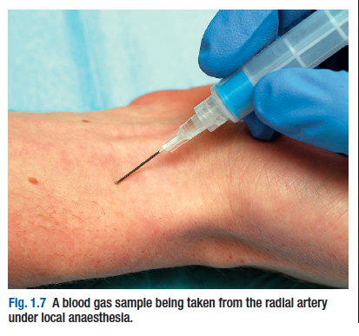
Introduction
pH: measure of fluid acidity
Normal plasma values:
pH: 7.35-7.45
PCo2: 35-45 mmHg
HCo3: 22-26
Acidosis:
pH <7.35
Can be respiratory or metabolic
Alkalosis:
pH >7.45
Can be respiratory or metabolic
Arterial blood gas (ABG) is the method to analyze acid-base status through arterial blood sample from the radial artery

Slide 38
ABG result

Slide 39
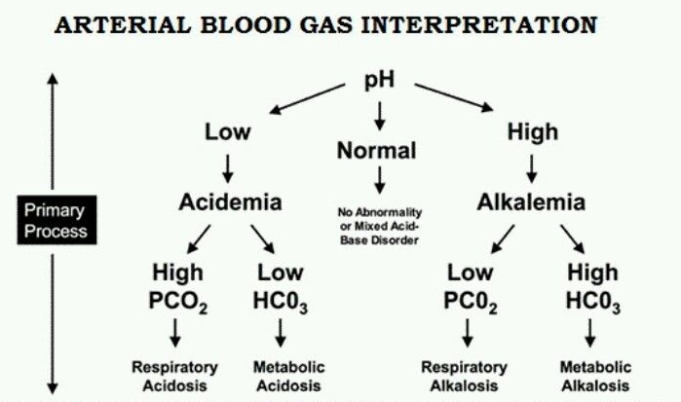
How to read blood gas?

Slide 41
Metabolic Acidosis

Slide 42
Metabolic alkalosis

Slide 43
Respiratory Acidosis

Slide 44
Respiratory alkalosis

Slide 45
THANK YOU
REMEMBER:
Formula to calculate fluid requirement
Comparing different types of fluid
Identifying and managing dehydrated patient
Composition of different intravenous solutions

