Slide 1

Congenital Pediatric Urinary Disorders
Dr. Hamdan ALHAZMI
Associated Professor and Consultant Pediatric Urologist
drhamdan@ksu.edu.sa

Slide 2

Learning Objectives:
 Identify the common congenital anomalies.
 How to detect this anomaly on radiological investigations.
 Important steps in management.

Slide 3

Congenital Urinary Disorders
 Anomalies of the Upper Urinary Tract
 Kidney
 Ureter
 Anomalies of the Lower Urinary Tract
 Urinary Bladder
 Urethra

Slide 4
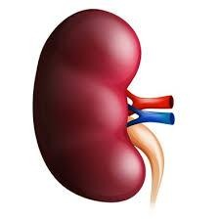

Anomalies of the kidney
 Anomalies of:
 Number
 Ascent
 Form and Fusion
 Rotation

Slide 5
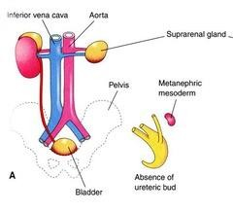
1- Unilateral Renal Agenesis
 1 in 1100 births.
 Male: Female of 1.8 : 1
 The left side is absent more frequently .
 The ipsilateral ureter is
completely absent in 50%.

Slide 6
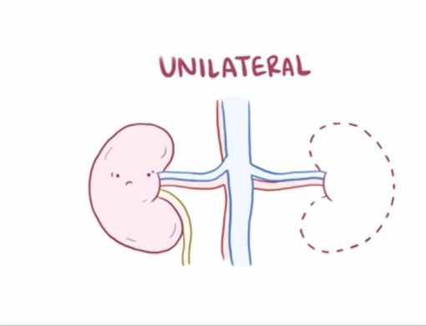
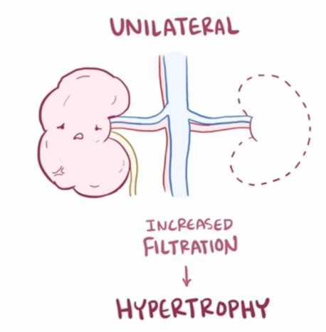
Unilateral Renal Agenesis…

Slide 7
Unilateral Renal Agenesis….
 Associated anomalies:
 Anomalies of other organ systems are found frequently in affected individuals
CVS,GIT,MSC
 Müllerian duct abnormalities
 25% to 50% of females
 10% to 15% of males
 Approximately one fourth to one third of women with Mullerian duct anomalies are found to have URA.

Slide 8
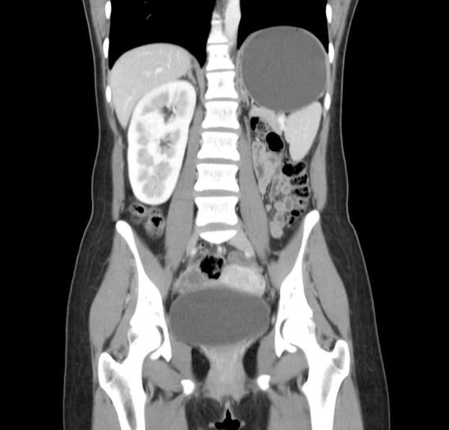
Unilateral Renal Agenesis…
 Presentation
 Prenatal US
 Incidentally
 Abdominal US
 Abdominal CT

Slide 9
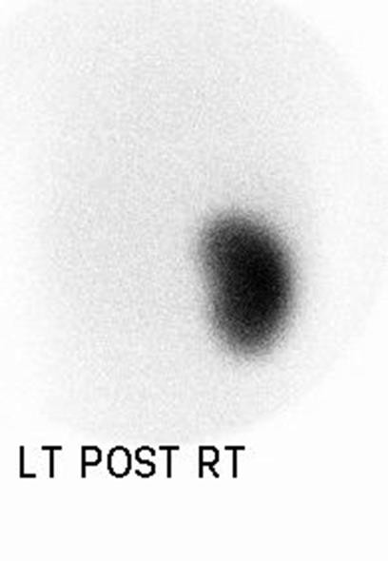
Unilateral Renal Agenesis…
 Diagnosis
 Confirmed
 Nuclear study (DMSA)

Slide 10
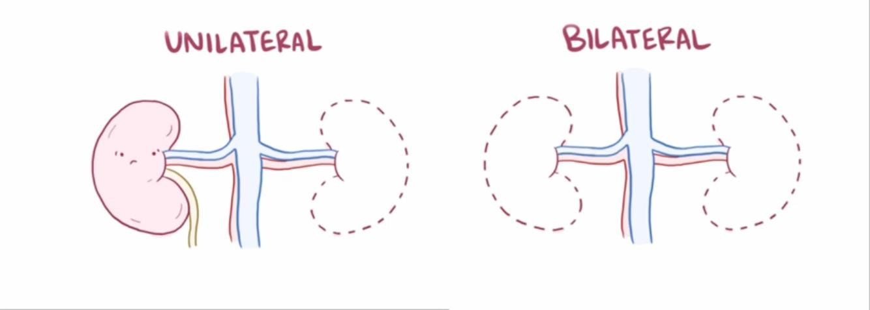
2- Bilateral Renal Agenesis

Slide 11
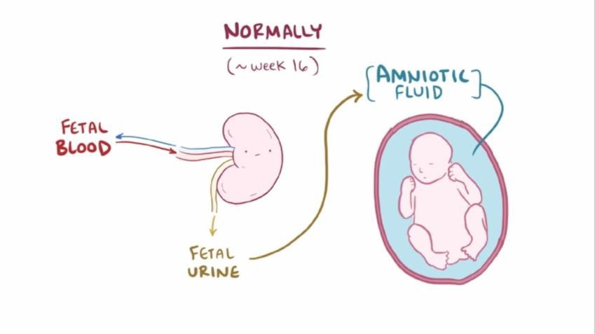
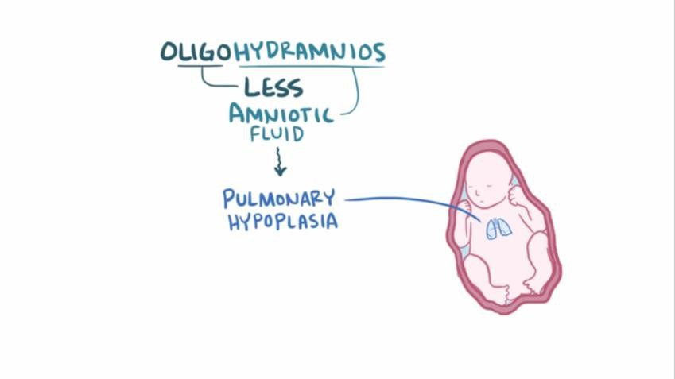
Bilateral Renal Agenesis…

Slide 12
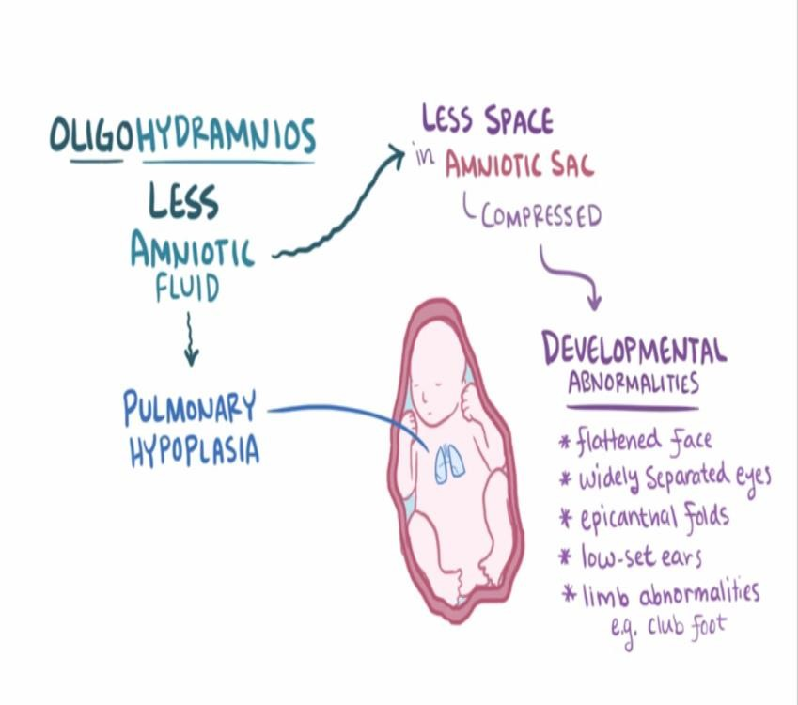
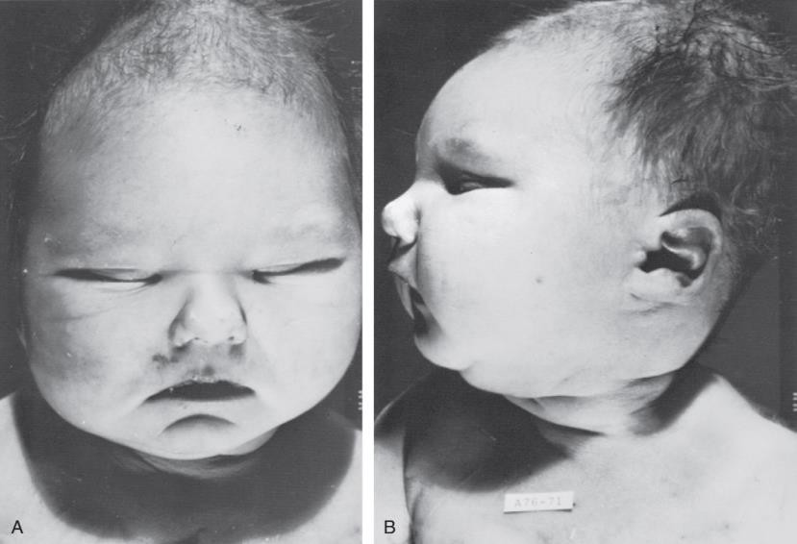
Bilateral Renal Agenesis…

Slide 13
Bilateral Renal Agenesis
 Ureters are almost always absent.
 Bladder is either absent or hypoplastic.
 Adrenal glands are usually positioned normally.
 Müllerian duct anomalies are commonly observed.

Slide 14
Bilateral Renal Agenesis…
 Prognosis
 40% are stillborn.
 Do not survive beyond 48
 hours due to respiratory distress associated with pulmonary hypoplasia.

Slide 15
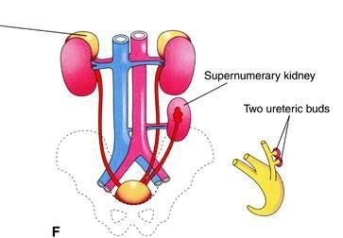
3- Supernumerary Kidney
 Definitive accessory organ with its own collecting system, blood supply, and distinct encapsulated parenchyma.
 Either completely separate or loosely attached to the kidney on the ipsilateral side.
 The ureteral inter-relationships on the side of the supernumerary kidney can be variable.

Slide 16
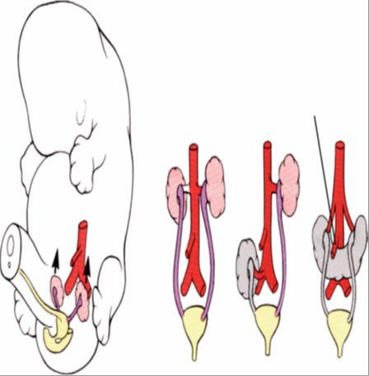
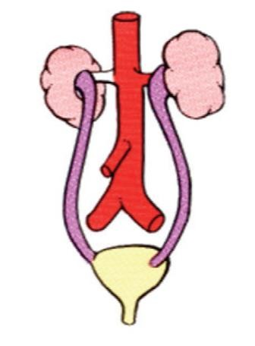
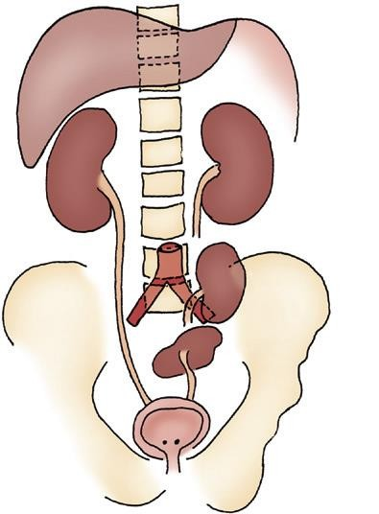
4- Simple Renal Ectopia

Slide 17
4- Simple Renal Ectopia
 Left more than the right.
 1 of 2100 to 3000 autopsies.
 Most ectopic kidneys are clinically asymptomatic.

Slide 18
4- Simple Renal Ectopia…
 Associated Anomalies:
 50% have a hydronephrosis:
Obstruction: UPJO and
UVJO
Reflux (VUR): grade III or greater
Malrotation
 Genital anomalies in the patient with ectopia is about 15%.

Slide 19
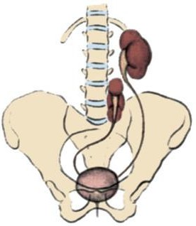
5- Crossed Renal Ectopia
Crossed ectopia: kidney is located on the side opposite from that in which its ureter inserts into the bladder.
The ureter from each kidney is usually orthotopic.

Slide 20
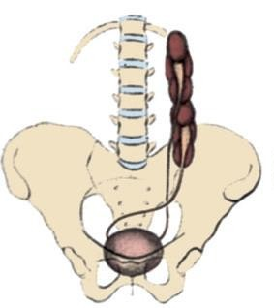
Crossed Renal Ectopia…
with Fusion
without Fusion
90% are fused
the superior pole of the ectopic kidney usually joins with the
inferior aspect of the normal kidney.

Slide 21
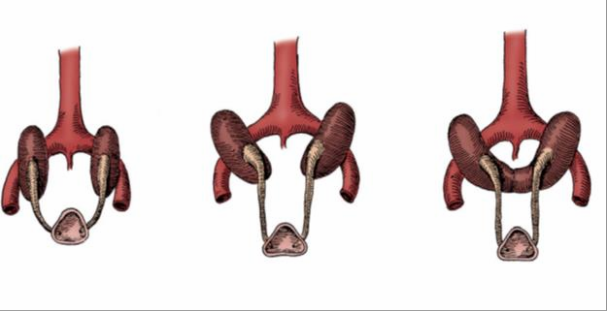

6- Horseshoe Kidney
The isthmus is bulky and consists of parenchymatous tissue.

Slide 22
Horseshoe Kidney
 Occurs 1 in 400 persons.
 The calyces:
normal in number
atypical in orientation.
pelvis remains in the vertical or obliquely lateral plane
 Horseshoe kidney is frequently found in association with other congenital anomalies.
 UPJ obstruction in one third.
 60 % asymptomatic.

Slide 23





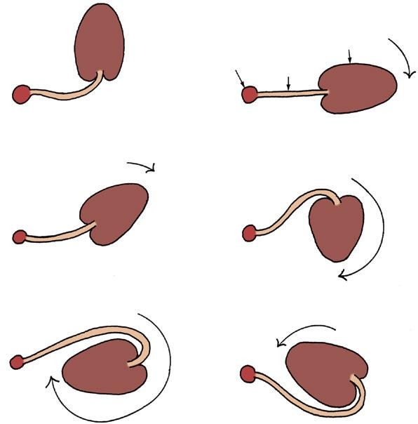
7- Anomalies of Rotation
 The kidney and renal pelvis normally rotate 90 degrees ventromedially during ascent
the calyces point laterally.
the pelvis faces medially.
 When this alignment is not exact, the condition is known as malrotation.
 Frequently associated with Turner
syndrome.

Slide 24


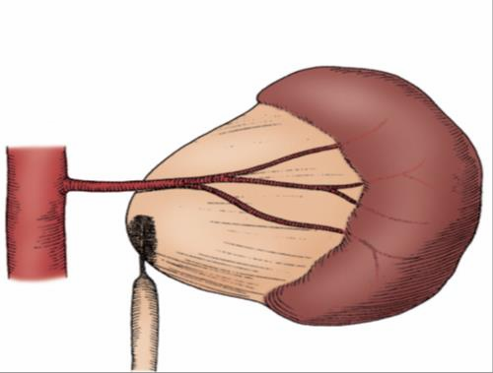
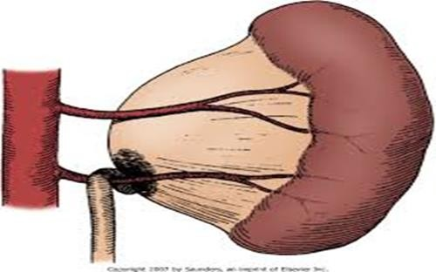
8-Ureteropelvic junction (UPJ) obstruction

Slide 25

UPJ…
Presentation:
 Prenatal US
 Incidental in Neonates/Children
 Symptomatic:
UTI
Pain
Mass
Hematuria
Stone

Slide 26

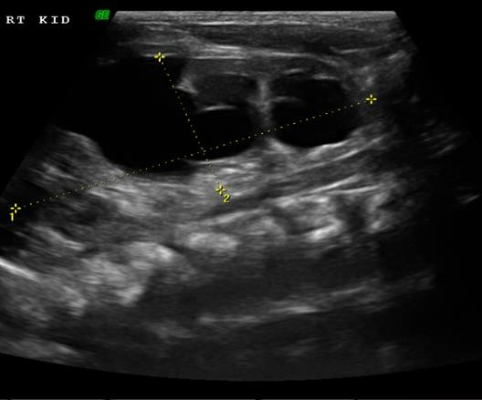
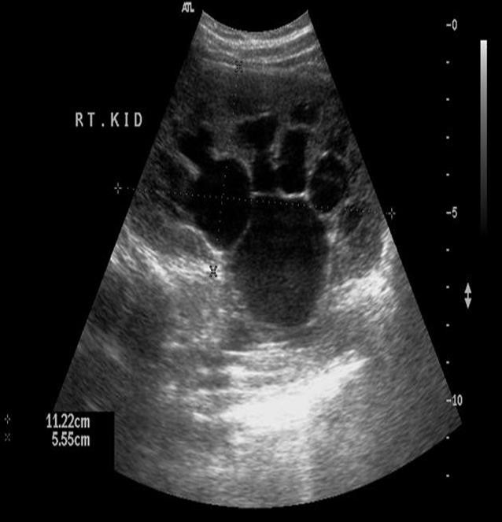
UPJO…

Slide 27


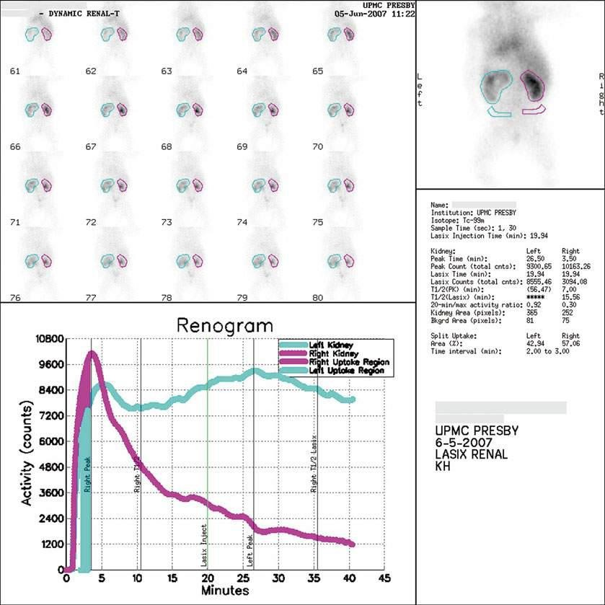
UPJO…
 Dynamic renogram

Slide 28
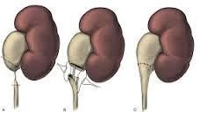
UPJO…
 Dismembered Pyeloplasty

Slide 29





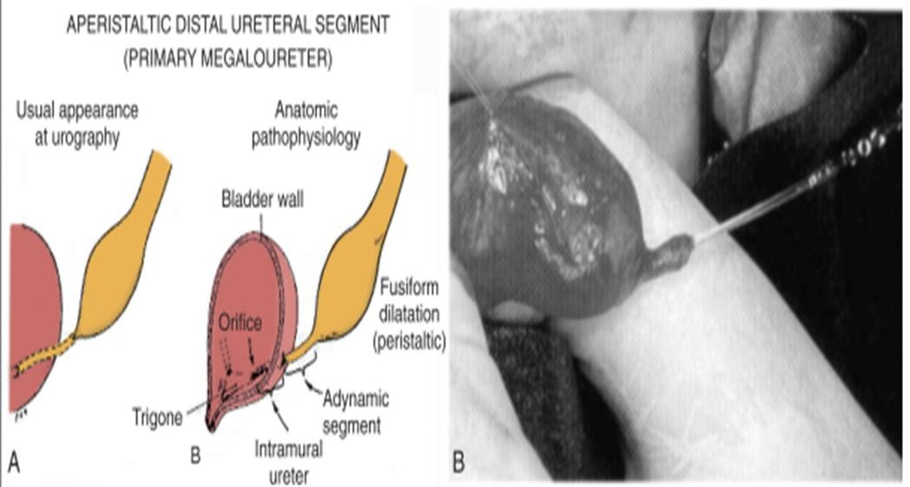
9-Ureterovesical junction (UVJ) obstruction (Megaureters)

Slide 30
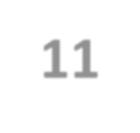

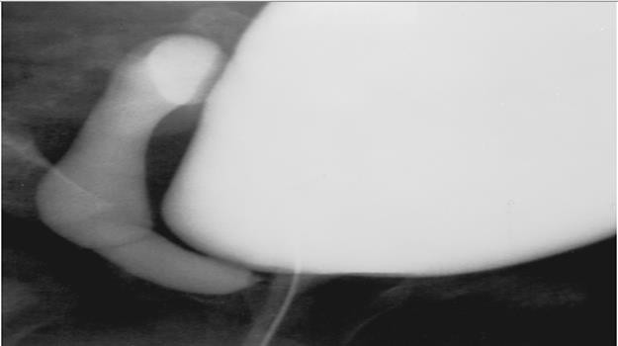
11- Ectopic Ureter
 An ectopic ureter is any ureter, single or duplex, that doesn't enter the trigonal area of the bladder.

Slide 31

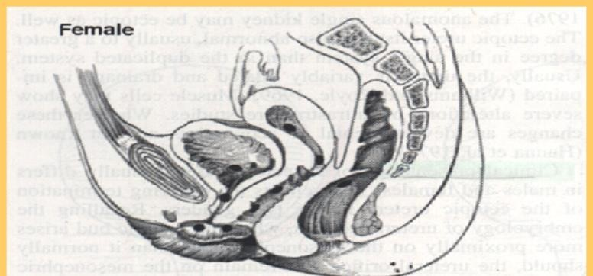
Ectopic Ureter…
 In females the ectopic ureter may enter anywhere from the bladder neck to the perineum and into the vagina, uterus,and even rectum.
 One of the classic symptoms is
continuous wetting.

Slide 32

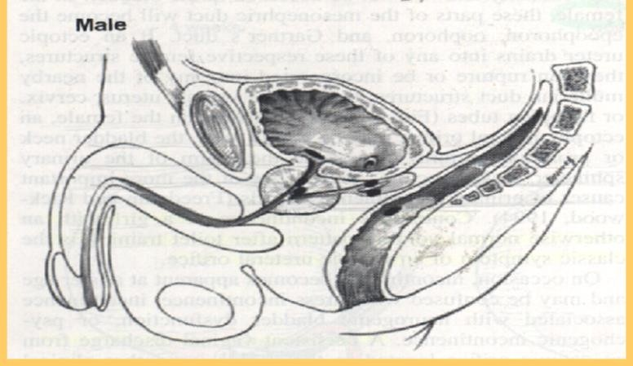
Ectopic Ureter
 In males the ectopic ureter always enters the urogenital system above the external sphincter or pelvic floor, and usually into the wolffian structures including vas deferens, seminal vesicles, or ejaculatory duct.

Slide 33
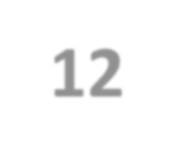

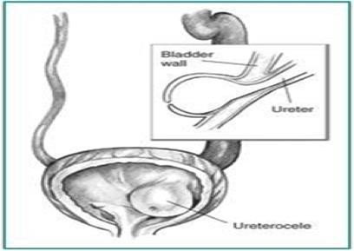
12- Ureterocele
 A cystic dilation of the distal aspect of the ureter
 Located either within the bladder or spanning the bladder neck and urethra.
 Presentation:
 Antenatal (U/S)
 Urine retention
 Infection
 Calculus formation

Slide 34

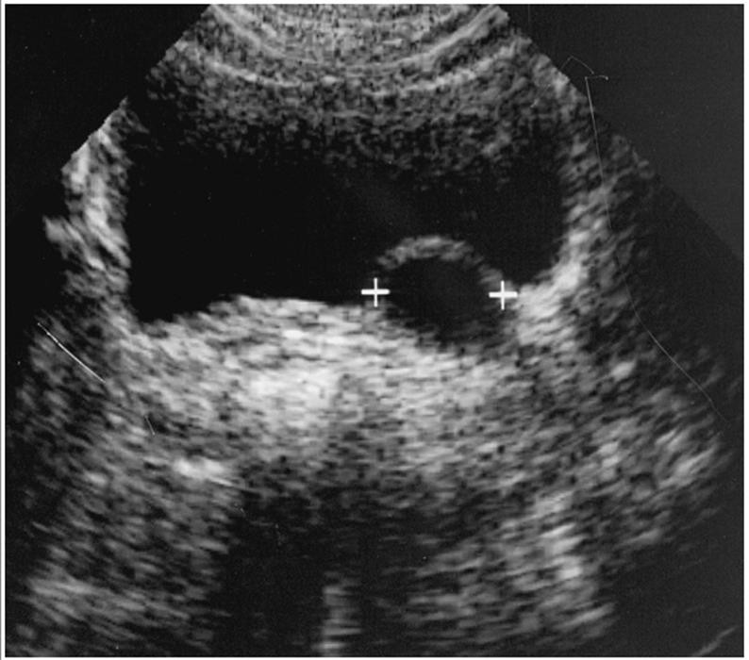
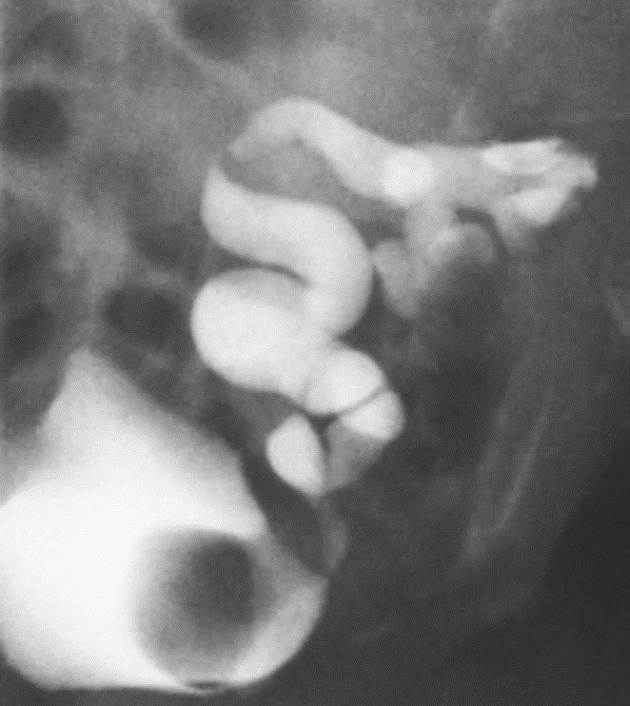
Ureterocele…

Slide 35
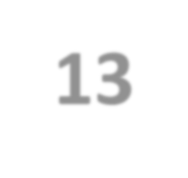

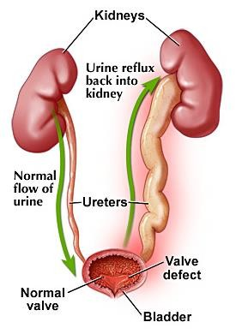
13-Vesicoureteral Reflux (VUR)

Slide 36

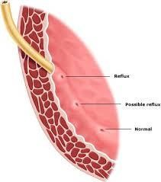
Vesicoureteral Reflux (VUR)…
Normal anti-reflux mechanism “Flap valve”
Oblique course as it enters the bladder.
Proper muscular attachments
to provide fixation.
Posterior support to enable its occlusion.
Adequate submucosal length.

Slide 37

VUR…
 Presentation
 Asymptomatic
 Prenatal
 Fluctuated dilatation
 Febrile UTIs

Slide 38
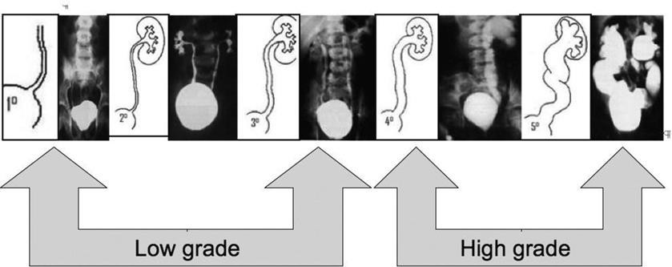
VUR…
 Diagnosis:
 MCUG (VCUG)

Slide 39
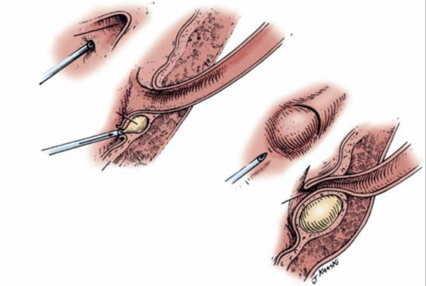
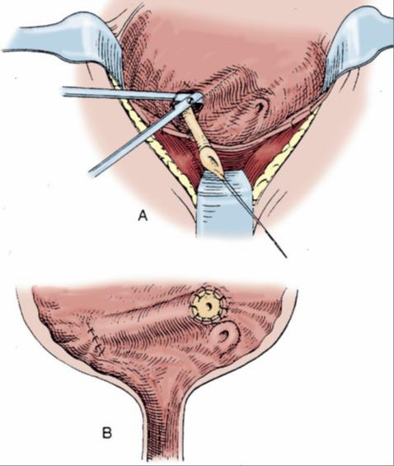
VUR…
 Management:
 Prophylactic antibiotic
 Surgical treatment
 Endoscopic treatment
 Ureteral reimplantation

Slide 40
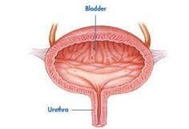
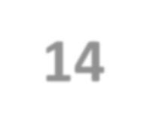


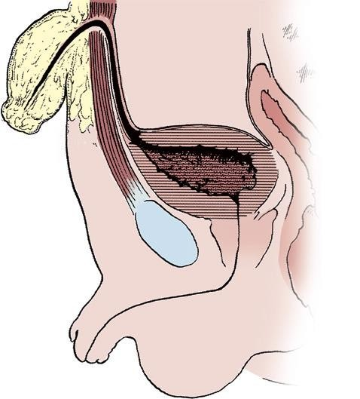
14-Urachal abnormalities
 Urachal anomalies are usually detected postnatally due to umbilical drainage.
 Imaging possibilities include
ultrasound, CT, and VCUG.

Slide 41

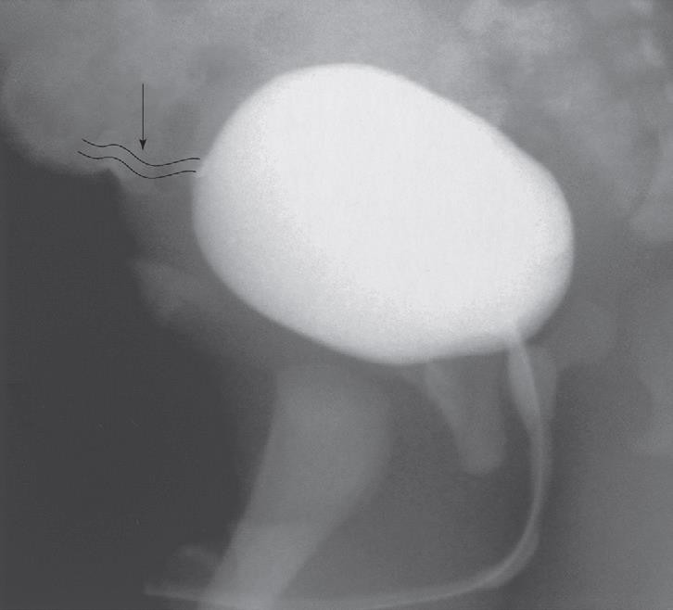
14-Urachal abnormalities…
 Conservative treatment with observation is justified in asymptomatic cases due to possible spontaneous resolution
 Infected urachal remnants are initially treated with drainage and antibiotics, followed by surgical excision.
 Nonresolved urachal remnants should be excised due to theincreased risk of later adenocarcinoma formation

Slide 42
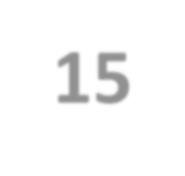


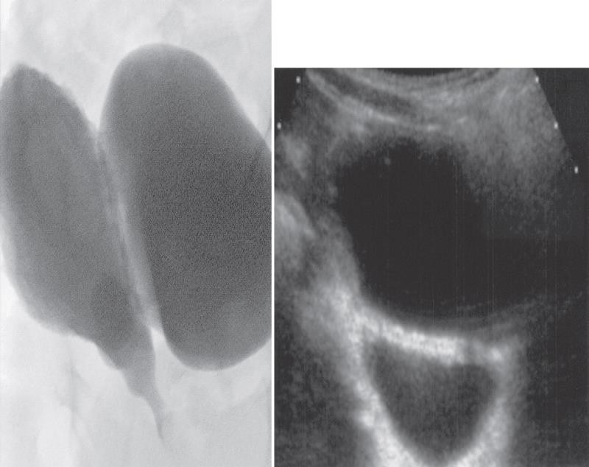
15-Bladder Diverticulum
 Bladder diverticula can be detected on prenatal ultrasound, but the gold standard remains VCUG, which will reveal possible accompanying VUR.

Slide 43

Bladder Diverticulum…
 Types:
 Primary diverticula
 arise as a localized herniation of bladder mucosa at the ureteral hiatus and are most likely caused by a congenitally deficient bladder wall.
 Secondary para-ureteral diverticula
 are acquired and develop due to existing infra- vesical obstruction.
 Symptomatic diverticula, especially in conjunction with VUR, should be treated surgically.

Slide 44
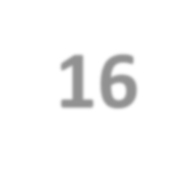

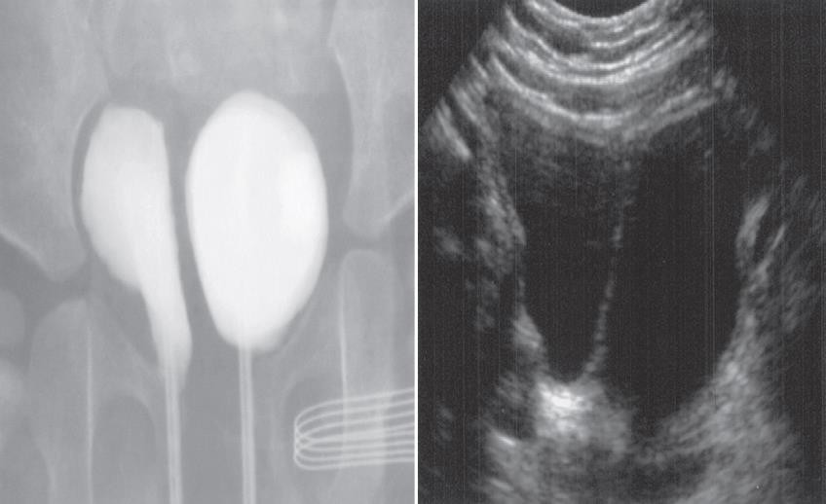
16- Bladder Duplication
 Often associated with duplication anomalies of the external genitalia and lower gastrointestinal tract.
 Initial treatment is directed toward
 renal preservation.
 prevention of infections.

Slide 45

Bladder Duplication…
 Long-term goals include achieving continence and reconstructing the internal and external genitalia.
 Due to the rarity of the disease and the large variety of presentations, the surgeries must be individualized

Slide 46
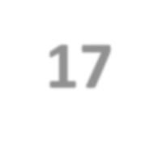

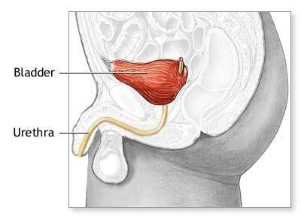

17- Bladder Exstrophy
The incidence of bladder exstrophy has been estimated as between 1 in 10,000 and 1 in 50,000.

Slide 47




Bladder Exstrophy…

Slide 48






18-Posterior Urethral Valves (PUV)
The bladder and the kidneys developed under high pressure and resistance.

Slide 49


PUV…
 1 in 8000 to 25,000 live births.
 Make up 10% of urinary obstructions diagnosed in utero.
 Most common cause of urine retention in male infants.
 50% have renal impairment.

Slide 50


PUV…

Slide 51
PUV…
 Presentation:
Antenatal
Urine retention
UTI
Poor urinary stream
Urinary incontinence
CRF (ESRD)
Associated findings:
  Oligohydramnios
  Bilateral renal dilatation 3. VUR: 40%
Valve bladder
Renal impairment

Slide 52
PUV…
 Initial treatment
 Feeding tube insertion
 Start antibiotic prophylactic
 Ultrasound
 MCUG

Slide 53



PUV…
Endoscopic valve ablation
Cutaneous vesicostomy

Slide 54



19-Hypospadias
 Abnormal position of the EUM on the ventral surface.
 Types:
Distal hypospadias.
Proximal hypospadias.
 NO Circumcision
 6 to 9 months repair.

Slide 55





20- Epispadias
Male
Female

Slide 56



21-Cloacal Exstrophy

Slide 57




22- Prune-Belly Syndrome
 The incidence :1 in29,000 to 1 in 40,000 live births
 The three major findings are
 deficiency of the abdominal musculature,
 bilateral intra-abdominal testes,
 anomalous urinary tract
 Other names
 Triad syndrome
 Eagle-Barrett syndrome
 abdominal musculation
syndrome

Slide 58



23-NEUROSPINAL DYSRAPHISMS
 The most common cause of neurogenic bladder dysfunction in children is abnormal development of the spinal canal and internecine spinal cord.

Slide 59


NEUROSPINAL DYSRAPHISMS…
 Cutaneous lesions occur in 90% of children with various occult dysraphicstates.
 These lesions vary from
 small lipomeningocele
 hair patch
 dermal vascular malformation
 sacral dimple
 abnormal gluteal cleft.

Slide 60
Antenatal Hydronephrosis(ANH)

Slide 61


Antenatal Hydronephrosis(ANH)
Causes:
 Pelviureteric junction obstruction (41%)
 Ureterovesical junction obstruction (23%)
 Vesicoureteric reflux(7%)
 Duplication anomalies (13%)
 Posterior urethral valves (10 %)
 MCDK
 Others (6%)

