Slide 1
Shock and Metabolic Response to Injury
Ahmed Alburakan, MD, FRCSC, FRCPC Assistant professor & consultant Trauma surgery & Critical care
King Saud University

Slide 2
SHOCK

Slide 3
Shock
What is Shock?

Slide 4
Shock
Inadequate oxygen delivery to meet metabolic demand.
Results in global tissue hypoperfusion and metabolic acidosis
Shock can occur with a normal blood pressure, and hypotension can occur without shock

Slide 5
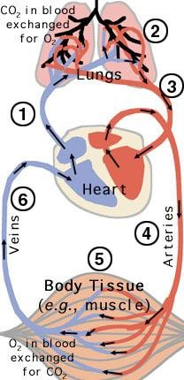
Shock
Oxygen delivery is the function of the circulatory system.
This system is basically:
Pump (heart)
Pipes (vessels)
Solution (blood)
Needs to function at adequate pressure, volume and carrying capacity.

Slide 6
Understanding Shock
Inadequate systemic oxygen delivery activates autonomic responses to maintain systemic oxygen delivery
Sympathetic nervous system
NE, epinephrine, dopamine, and cortisol release
Causes vasoconstriction, increase in HR, and increase of cardiac contractility (cardiac output)
Renin-angiotensin axis
Water and sodium conservation and vasoconstriction
Increase in blood volume and blood pressure

Slide 7
Understanding Shock
Cellular responses to decreased systemic oxygen delivery
ATP depletion → ion pump dysfunction
Cellular edema
Hydrolysis of cellular membranes and cellular death
The body tries to maintain cerebral and cardiac perfusion
Vasoconstriction of splanchnic, musculoskeletal, and renal blood flow
Global cellular reliance on anerobic glycolysis and increased lactate production.
Systemic metabolic lactic acidosis

Slide 8
Multiorgan Dysfunction Syndrome (MODS)
Progression of physiologic effects as shock ensues
Cardiac depression
Respiratory distress
Renal failure
DIC
Result is end organ failure

Slide 9
Types Of Shock
Low Cardiac Output states
Hypovolemic shock (↓↓ solution)
bleeding
Dehydration
Cardiogenic shock (↓↓ pump)
Impaired inflow
Primary pump dysfunction
Impaired outflow
Low peripheral resistance states
(↑↑pipes)
Neurogenic shock
Loss of sympathetic tone
Vasogenic Shock
Septic
Anaphylactic

Slide 10
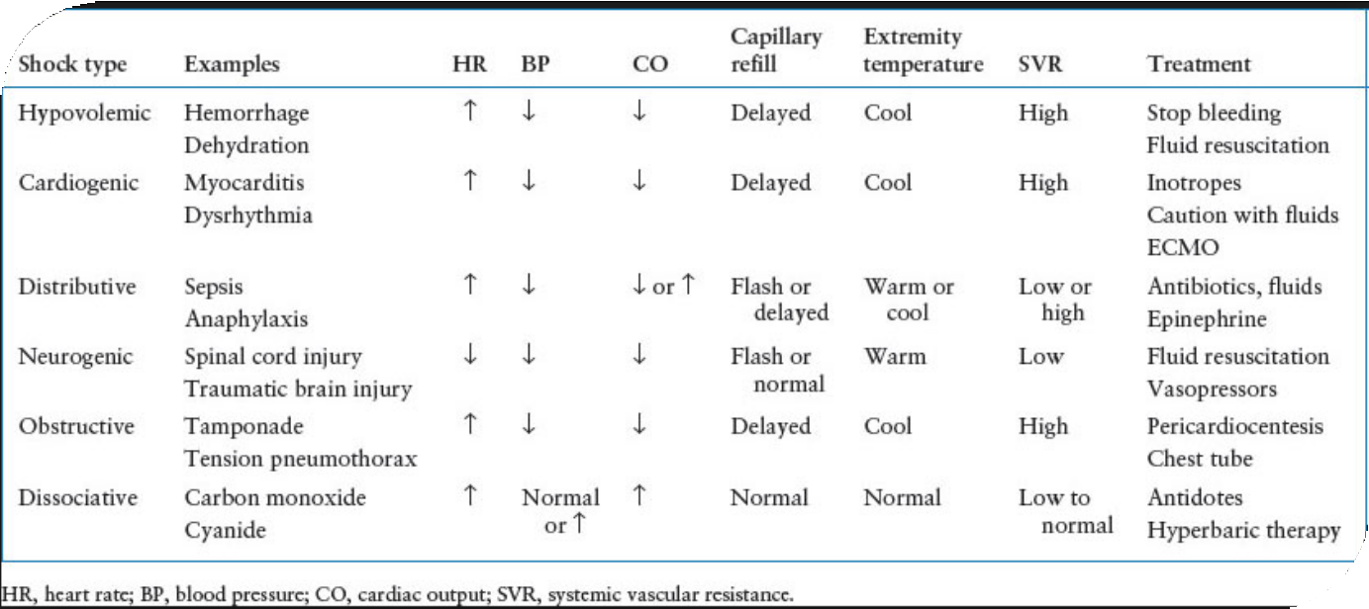
Types Of
Shock

Slide 11
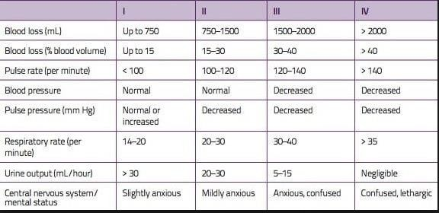
Classes of Hypovolemic Shock

Slide 12
Treatment of Shock
Goal: Restore perfusion
Method: Depends on type of Shock
Reverse the cause.

Slide 13
End Points of Resuscitation in Shock management
Normal vital signs ( can be misleading)
Normal serum lactate levels
Evidence of adequate tissue perfusion!!
normal mental status.
normal urine output.
- normal liver function. etc.

Slide 14
What Type of Shock is This?
68 yo M with hx of HTN and DM presents to the ER with abrupt onset of diffuse abdominal pain with radiation to his low back. The pt is hypotensive, tachycardic, afebrile, with cool but dry skin.

Slide 15
What Type of Shock is This?
68M with hx of HTN and DM presents to the ER with abrupt onset of diffuse abdominal pain with radiation to his low back. The pt is hypotensive, tachycardic, afebrile, with cool but dry skin.
Hypovolemic shock

Slide 16
What Type of Shock is This?
A 34F presents to the ER after dining at a restaurant where shortly after eating the first few bites of her meal, became anxious, diaphoretic, began wheezing, noted diffuse pruritic rash, nausea, and a sensation of her “throat closing off”. She is currently hypotensive, tachycardic and ill appearing.

Slide 17
What Type of Shock is This?
A 34F presents to the ER after dining at a restaurant where shortly after eating the first few bites of her meal, became anxious, diaphoretic, began wheezing, noted diffuse pruritic rash, nausea, and a sensation of her “throat closing off”. She is currently hypotensive, tachycardic and ill appearing.
Anaphylactic

Slide 18
Metabolic Response to Injury

Slide 19
Mediating the Response
The Acute Inflammatory Response
Cellular activation
Inflammatory mediators (TNF, IL1, etc)
Paracrine Vs endocrine effects

Slide 20
Mediating the Response
The Endothelium
Selectins, Integrins, and ICAMs
Nitric Oxide
Tissue Factor

Slide 21
Mediating the Response
Afferent Nerve Stimulation
Sympathetic Nervous System
Adrenal Gland Medulla

Slide 22
Mediating the Response
The Endocrine System
Pituitary Gland (GH, ACTH, ADP)
Adrenal Gland (Cortisol, Aldosterone)
Pancreatic (Glucagon, ↓ Insulin)
Others (Renin, Angiotensin, ↓ Sex hormones, ↓ T4)

Slide 23
Consequences of the Response
Limiting injury
Initiation of repair processes
Mobilization of substrates
Prevention of infection
Distant organ damage

Slide 24
Metabolic Response to Fasting
I
II
III
IV
V
GLUCOSE UTILIZED (g/hora)
40
Exogenous
The carbohydrate deposits of the body last about 18 to 20 hours and new glucose is produced through gluconeogenesis of amino acids from the lean body mass
Glycogen
30
Gluconeogenesis
20
10
LEGEND
I
II
III
IV
V
FUEL FOR BRAIN
GLUCOSE
GLUCOSE
GLUCOSE
GLUCOSE,
KETONES
GLUCOSE,
KETONES
Ruderman NB. Annu Rev Med 1975;26:248

Slide 25
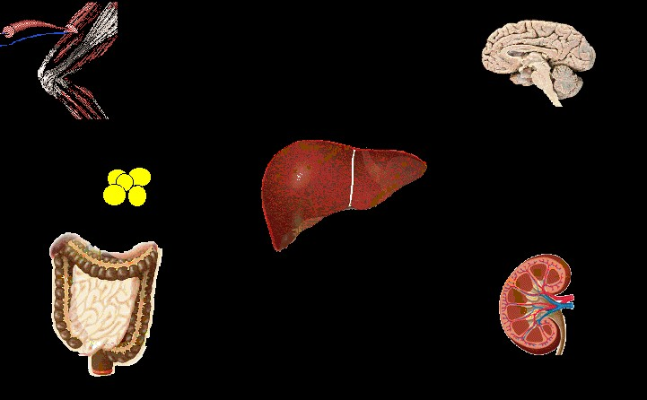
Starvation – Early Stage
Muscle
Alanine / Pyruvate
Brain
Glucose
Glutamine
Glycerol
Gluconeogenesis
Fat
Ketogenesis
Ketones
AGL
Liver
Ureagenesis
Ketones
Urea
NH₃
Kidney
Intestine

Slide 26
Starvation – Late Stage
Muscle
Alanine / Pyruvate
Brain
Glucose
Glutamine
Glycerol
Gluconeogenesis
Fat
Ketogenesis
Ketones
AGL
Liver
Ureagenesis
Ketones
Urea
NH₃
Kidney
Intestine

Slide 27
Metabolic Response to Starvation
•
Hormone Norepinephrine Norepinephrine Epinephrine
Thyroid Hormone T4
Source
Sympathetic Nervous System
Adrenal Gland Adrenal Gland
Thyroid Gland (changes to T3
peripherally)
Change in Secretion
↓ ↓ ↓
↑
↑
↓ ↓ ↓

Slide 28
Energy Expenditure in Starvation
12
•
Normal Range
4
Partial Starvation
Total Starvation
Days
Long CL et al. JPEN 1979;3:452-456

Slide 29
Metabolic Response to Injury
•
Time
Ebb Phase
Flow Phase
Energy Expenditure
Cutherbertson DP, et al. Adv Clin Chem 1969;12:1-55

Slide 30
Metabolic Response to Injury: Ebb Phase
Characterized by hypovolemic shock
Priority is to maintain life/homeostasis
•
•
•
•
•
•
↓ Cardiac output
↓ Oxygen consumption
↓ Blood pressure
↓ Tissue perfusion
↓ Body temperature
↓ Metabolic rate

Slide 31
Metabolic Response to Injury: Flow Phase
↑ Catecholamines
↑ Glucocorticoids
↑ Glucagon
Release of cytokines, lipid mediators
Acute phase protein production

Slide 32
Metabolic Response to Injury
Fatty Deposits
Liver & Muscle (glycogen)
Muscle (amino acids)
Fatty Acids
Endocrine
Response
Glucose
Amino Acids

Slide 33
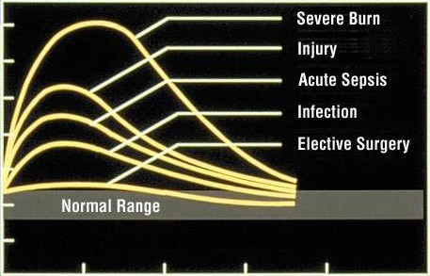
Metabolic Response to Injury
•
28
24
20
16
12
8
4
0
Nitrogen Excretion (g/day)
10
20
30
40
Days
Long CL, et al. JPEN 1979;3:452-456

Slide 34
Severity of Injury: Effects on Nitrogen Losses and Metabolic Rate
•
Major Surgery
Nitrogen Loss in Urine
Moderate to Severe Burn
Severe Sepsis
Infection
Elective Surgery
Basal Metabolic Rate
Adapted from Long CL, et al. JPEN 1979;3:452-456

Slide 35
Comparing Starvation and Injury
•
Starvation
Trauma or Disease
Metabolic rate Body fuels Body protein Urinary nitrogen Weight loss
conserved conserved
wasted wasted
slow rapid
The body adapts to starvation, but not in the presence of critical injury or disease.
Popp MB, et al. In: Fischer JF, ed. Surgical Nutrition. 1983.

Slide 36
Modifying the Response
Medication (before or after injury)
Nutritional status
Severity of injury
Temperature
Anesthetic technique

Slide 37
Summary
Injury (Trauma or Surgery) leads to a metabolic response
Metabolic response to injury is an adaptive response
Metabolic response could overwhelm the body and lead to increased morbidity and mortality
We can modify the metabolic response before and sometimes after injury

Slide 38
Metabolic Response to Injury
Questions

