Slide 1


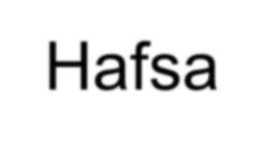

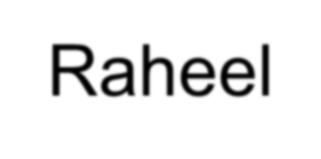
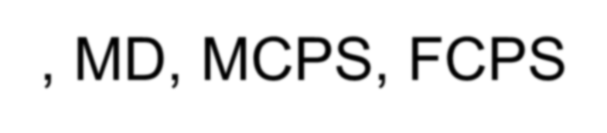
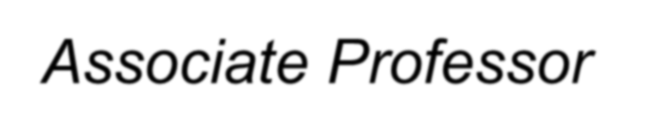


Tuberculosis
Hafsa Raheel, MD, MCPS, FCPS
Associate Professor
Department of Family and Community Medicine KSU

Slide 2
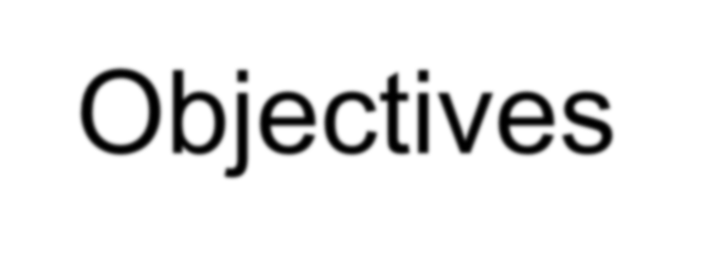


Objectives
Understand the epidemiology and global burden of TB
List the sign and symptoms and risk factors of different types of TB, with particular emphasis
on pulmonary TB
Describe trends and state reasons for resurgence of pulmonary TB
List population subgroups at risk for pulmonary TB Draw the cycle of infection of pulmonary TB
Outline procedures for community diagnosis of pulmonary TB with emphasis on the limitation of each procedure
Describe measures for prevention and control for pulmonary TB
Describe the role of WHO to address the global burden of TB, particularly directly observed therapy short course (DOTS) for pulmonary TB

Slide 3
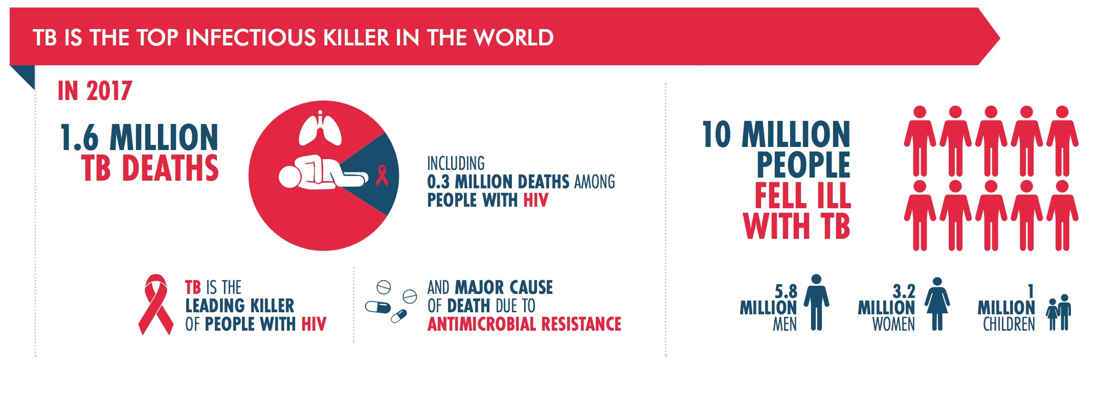

Slide 4
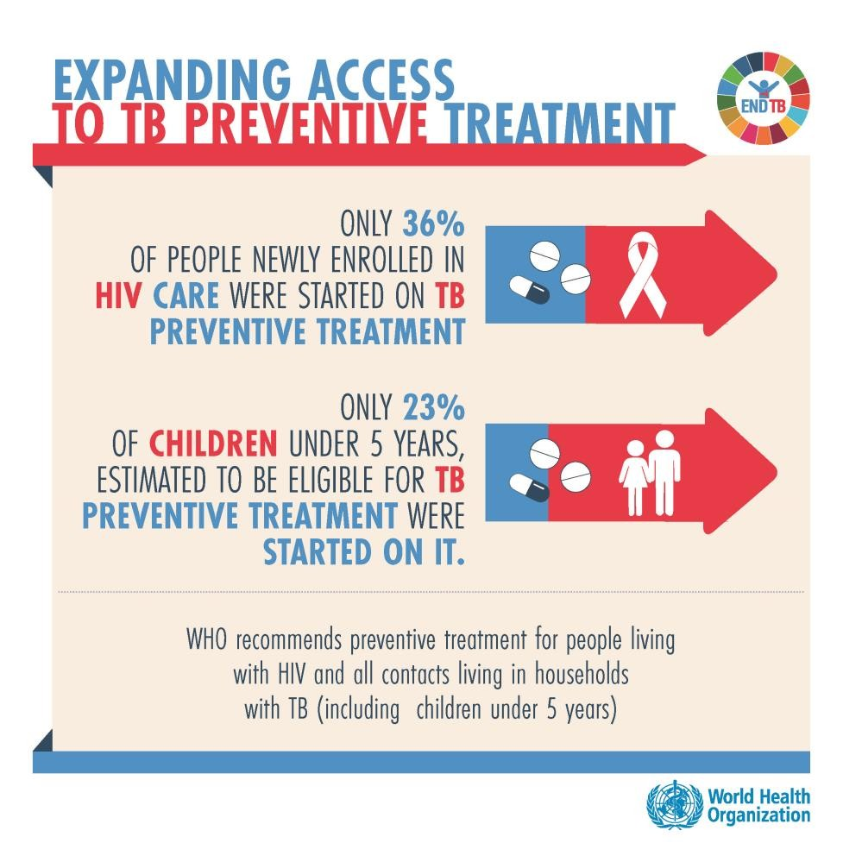
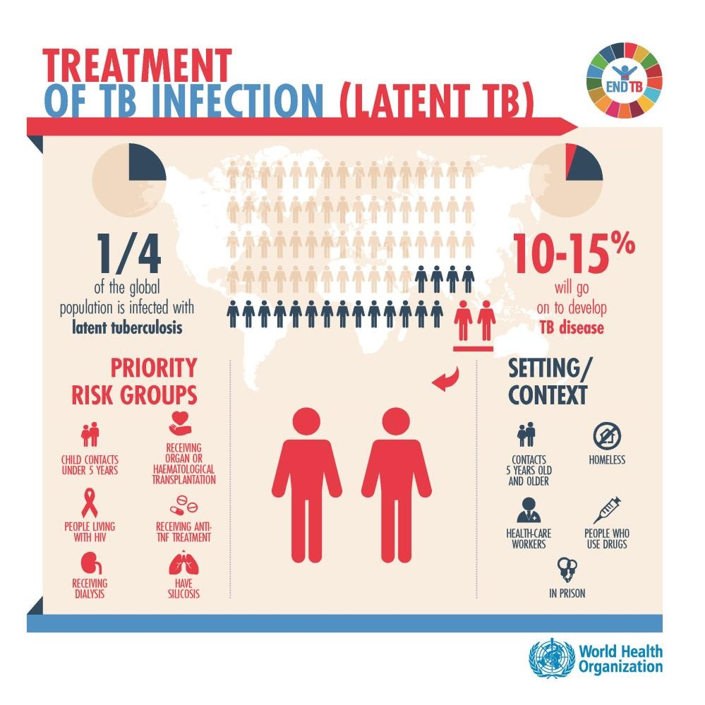

Slide 5
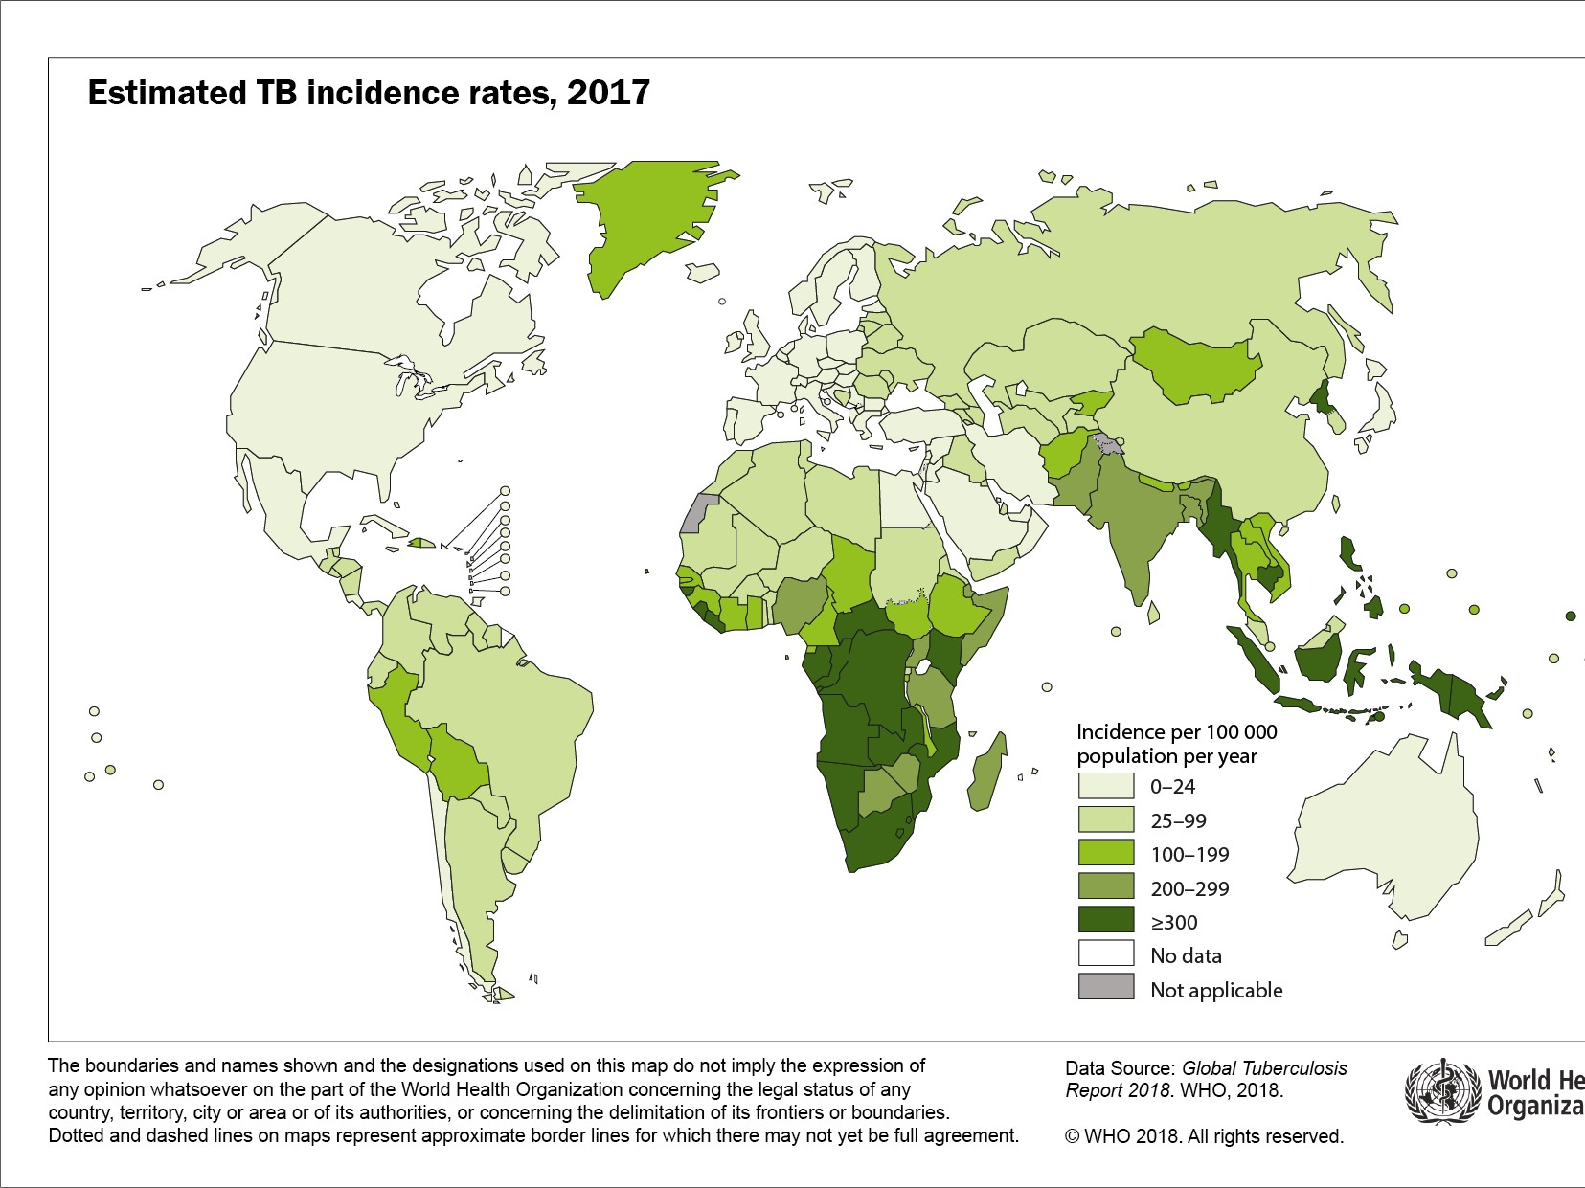





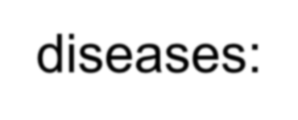
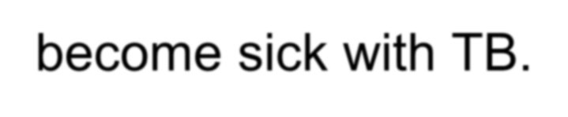
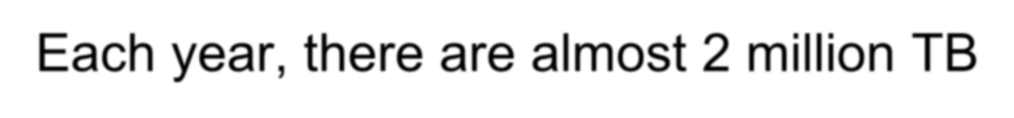

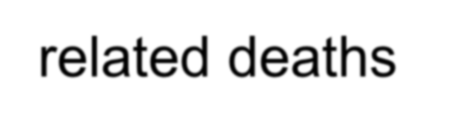
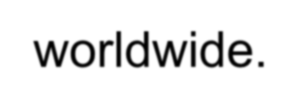
A Global Perspective on
Tuberculosis
TB Elimination: Now is the Time!
Tuberculosis (TB) is one of the world’s deadliest diseases:
One third of the world’s population are infected with TB.
Each year, nearly 9 million people around the world
become sick with TB.
Each year, there are almost 2 million TB-related deaths worldwide.
TB is the leading killer of people who are HIV infected.

Slide 6
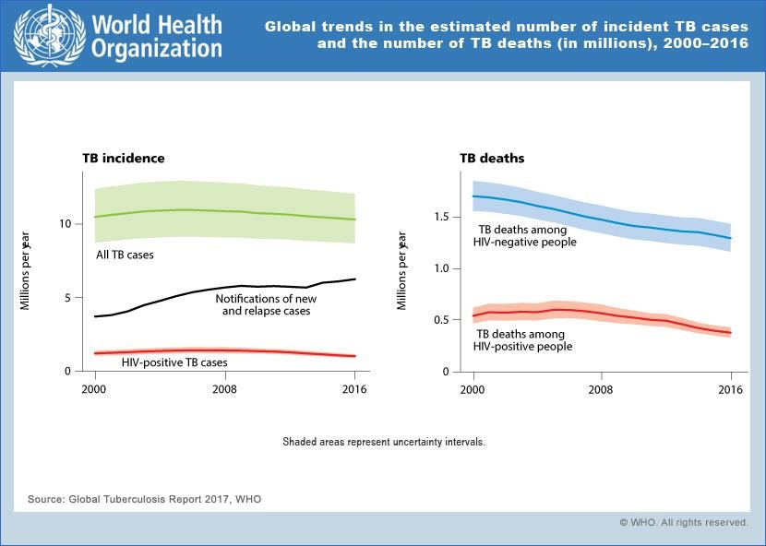

Slide 7
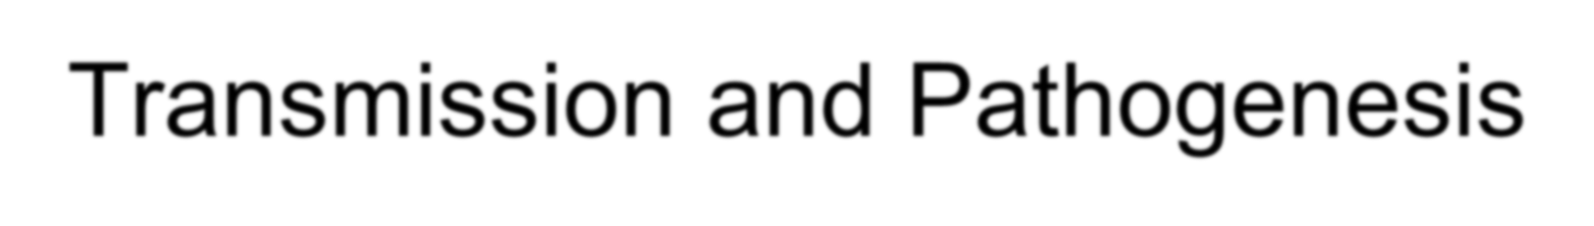
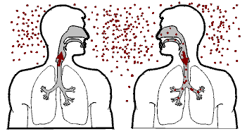
Transmission and Pathogenesis

Slide 8
Transmission of M. tuberculosis
Spread by droplet nuclei
Expelled when person with infectious TB coughs, sneezes, speaks, or sings
Close contacts at highest risk of becoming infected
Transmission occurs from person with infectious TB disease (not latent TB infection)

Slide 9



CYCLE OF INFECTION OF PULMONARY TUBERCULOSIS
Susceptible host:
Low standard of livings, malnutrition, alcoholism, HIV/AIDS
Agent: Mycobacterium tuberculosis
Portal of entry (inlet): Respiratory tract
Incubation period=4-12 weeks
Transmission:
Contact: Direct, indirect& droplet
Air borne: droplet nuclei & dust
transmission
Reservoir Man in the form
of a case
Portal of exit: Respiratory tract Source of infection: Sputum an contaminated articles, dust

Slide 10
Probability TB Will Be Transmitted
Infectiousness of person with TB
Environment in which exposure occurred Duration of exposure
Virulence of the organism

Slide 11
Conditions That Increase the Risk of Progression to TB Disease
HIV infection
Substance abuse
Recent infection
Chest radiograph findings suggestive of previous TB Diabetes mellitus
Silicosis
Prolonged corticosteriod therapy
Other immunosuppressive therapy

Slide 12
Common Sites of TB Disease
Lungs
Pleura
Central nervous system Lymphatic system Genitourinary systems
Bones and joints
Disseminated (miliary TB)

Slide 13
Persons at Higher Risk for Exposure to or Infection with TB
Close contacts of persons known or suspected to have TB
Residents and employees of high-risk congregate settings
Health care workers (HCWs) who serve high-risk Clients
Medically underserved, low-income populations Children exposed to adults in high-risk categories Persons who inject illicit drugs

Slide 14
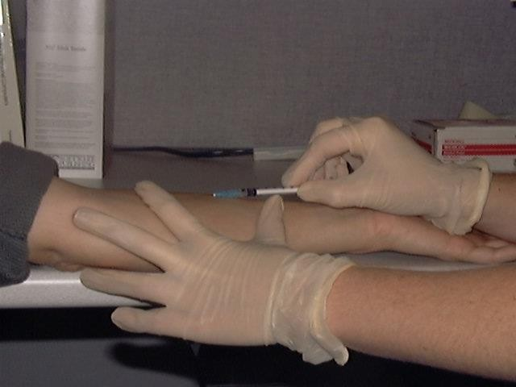
Testing for
TB Disease and Infection

Slide 15
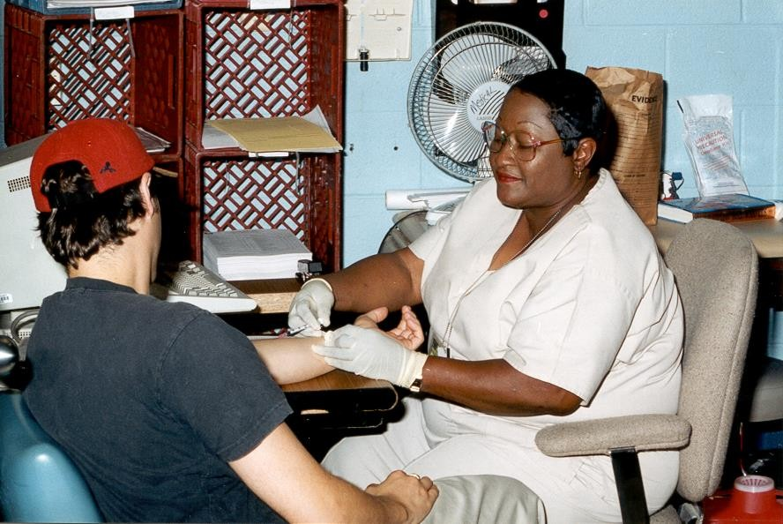
All testing activities should be accompanied
by a plan for follow-up care

Slide 16
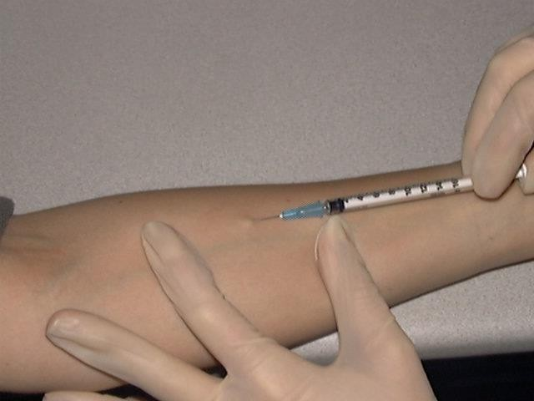
Administering the Tuberculin Skin Test
Inject intradermally 0.1 ml of 5 TU PPD tuberculin
Produce wheal 6 mm to 10 mm in diameter
Do not recap, bend, or break
needles, or remove needles from syringes
Follow universal precautions for infection control

Slide 17

Reading the Tuberculin Skin Test
Read reaction 48-72 hours after injection
Measure only induration Record reaction in millimeters

Slide 18
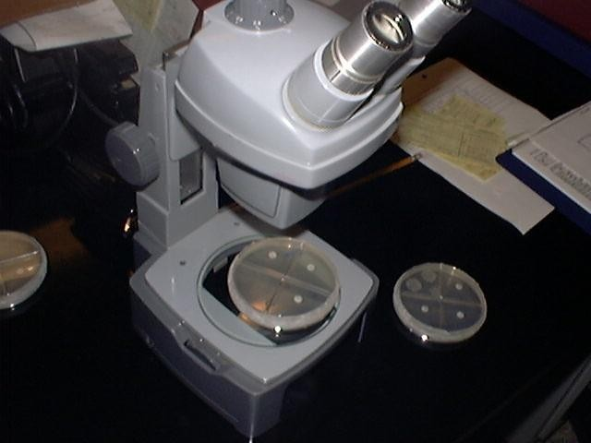
Diagnosis of TB

Slide 19
Evaluation for TB
Medical history
Physical examination Mantoux tuberculin skin test Chest radiograph
Bacteriologic or histologic exam

Slide 20
Symptoms of Pulmonary TB
Productive, prolonged cough (duration of >3 weeks)
Chest pain Hemoptysis

Slide 21
Systemic Symptoms of TB
Fever
Chills
Night sweats Appetite loss Weight loss
Easy fatigability

Slide 22
Medical History
Symptoms of disease
History of TB exposure, infection, or disease Past TB treatment
Demographic risk factors for TB
Medical conditions that increase risk for TB disease

Slide 23
Factors that May Affect the Skin Test Reaction
Type of Reaction Possible Cause
False-positive
Nontuberculous mycobacteria BCG vaccination
False-negative
Recent TB infection
Very young age (< 6 months old) Live-virus vaccination Overwhelming TB disease

Slide 24
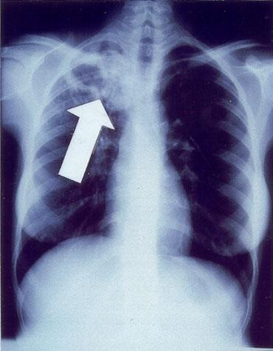
Chest Radiograph
Abnormalities often seen in apical or posterior segments of upper
lobe or superior segments of lower lobe
May have unusual appearance in HIV-positive persons
Arrow points to cavity in patient's right upper lobe.
Cannot confirm diagnosis of TB

Slide 25
Sputum Specimen Collection
Obtain 3 sputum specimens for smear examination and culture
Persons unable to cough up sputum, induce sputum, bronchoscopy or gastric aspiration
Follow infection control precautions during specimen collection

Slide 26
Smear Examination
Strongly consider TB in patients with smears containing acid-fast bacilli (AFB)
Results should be available within 24 hours of specimen collection
Presumptive diagnosis of TB

Slide 27
Cultures
Use to confirm diagnosis of TB
Culture all specimens, even if smear negative
Results in 4 to 14 days when liquid medium systems used

Slide 28
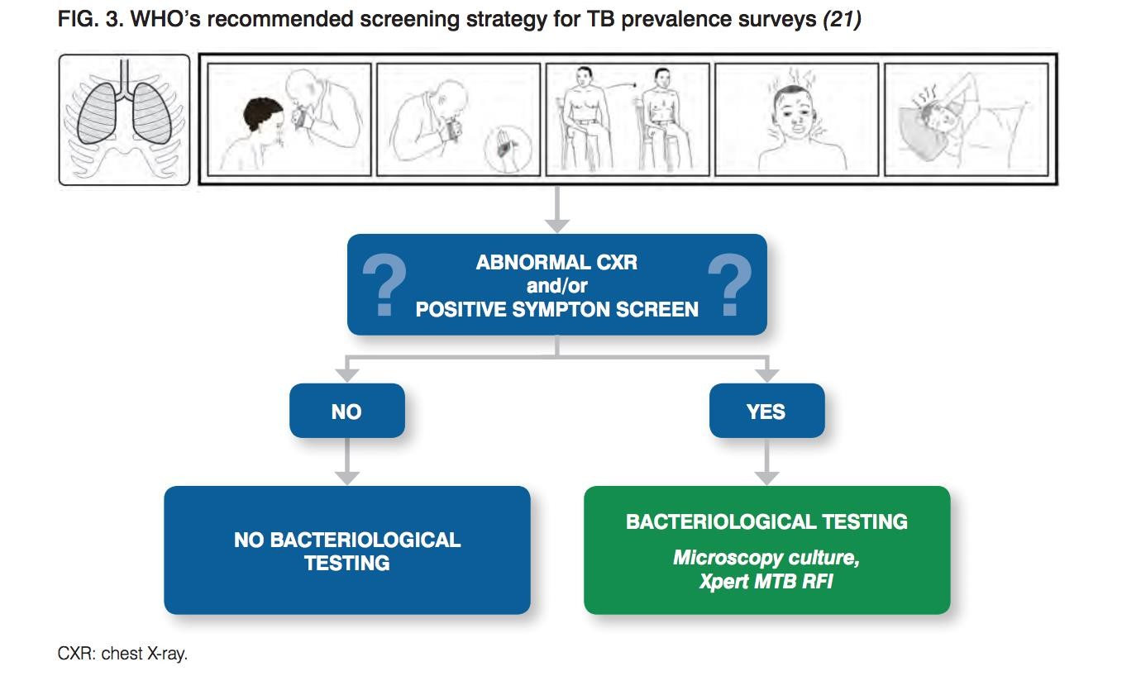

Slide 29
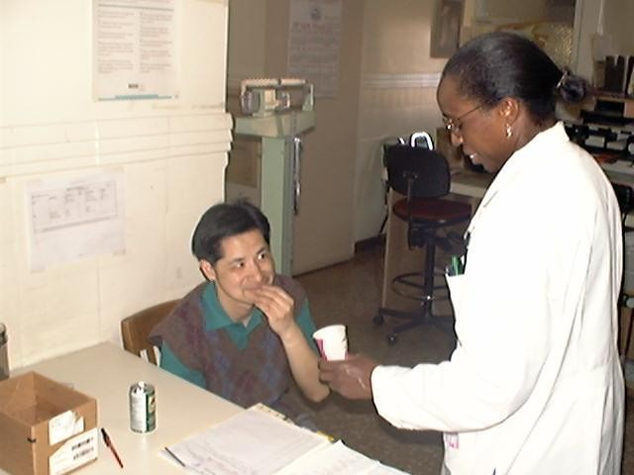
Treatment of TB Infection

Slide 30
Directly Observed Therapy (DOTs)
Health care worker watches patient swallow each dose of medication
Consider DOT for all patients
DOT can lead to reductions in relapse and acquired
drug resistance
Use DOT with other measures to promote adherence

Slide 31



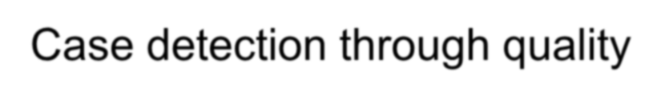

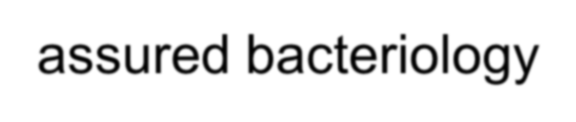
The five elements of DOTS
Political commitment with increased and sustained financing
Case detection through quality-assured bacteriology Standardized treatment, with supervision and patient support An effective drug supply and management system Monitoring and evaluation system, and impact measurement

Slide 32
Treatment of TB for HIV-Negative Persons
Include four drugs in initial regimen
Isoniazid (INH)
Rifampin (RIF)
Pyrazinamide (PZA)
Ethambutol (EMB) or streptomycin (SM)
Adjust regimen when drug susceptibility results are known

Slide 33
Extrapulmonary TB
In most cases, treat with same regimens used for pulmonary TB
Bone and Joint TB, Miliary TB, or TB Meningitis in Children
Treat for a minimum of 12 months

Slide 34
Multidrug-Resistant TB (MDR TB)
Presents difficult treatment problems
Treatment must be individualized
Clinicians unfamiliar with treatment of MDR TB should seek expert consultation
Always use DOT to ensure adherence

Slide 35
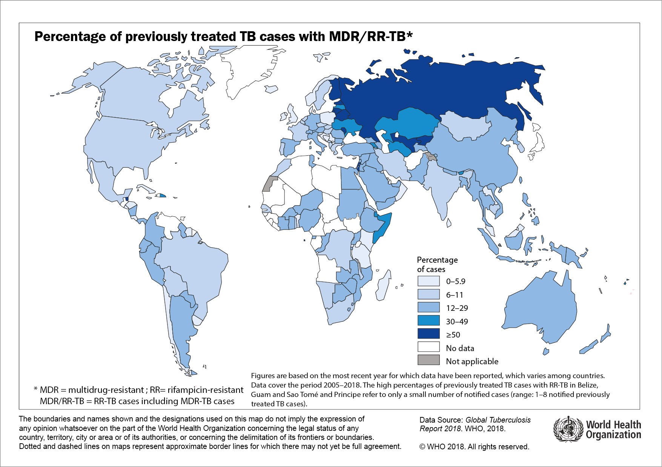

Slide 36

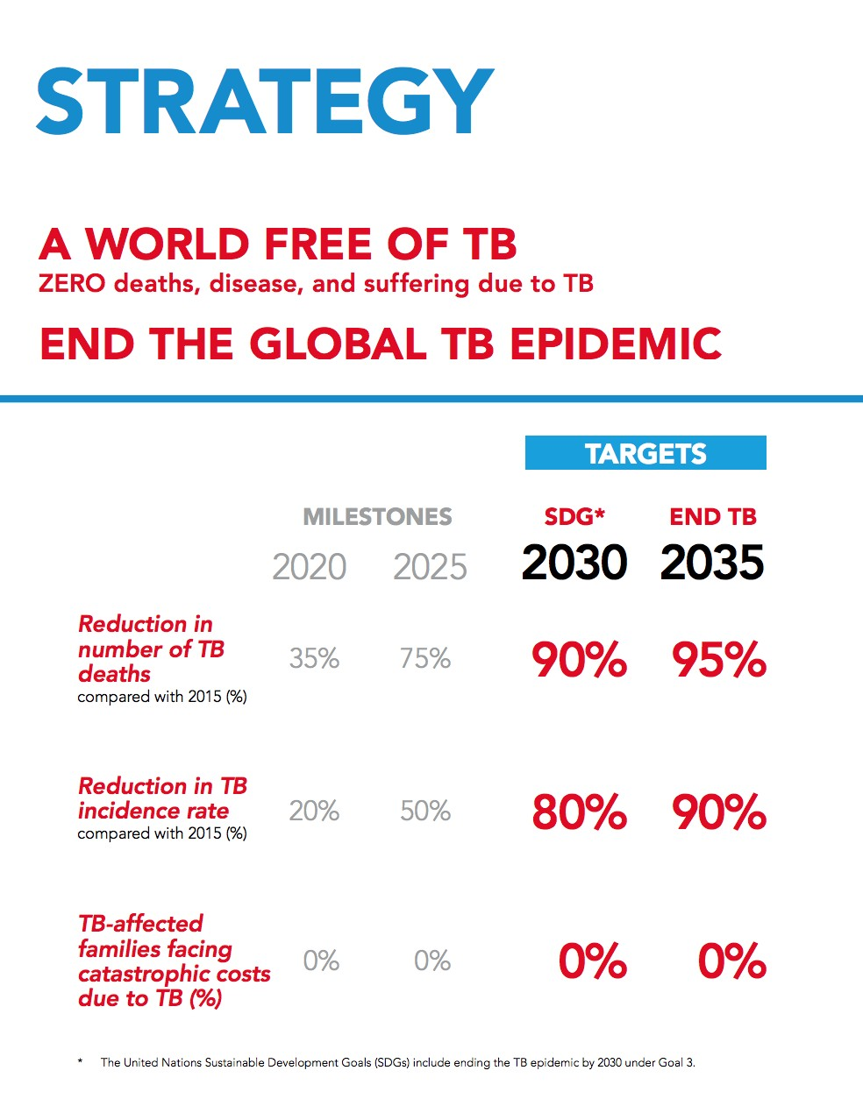
WHO EFFORTS

Slide 37
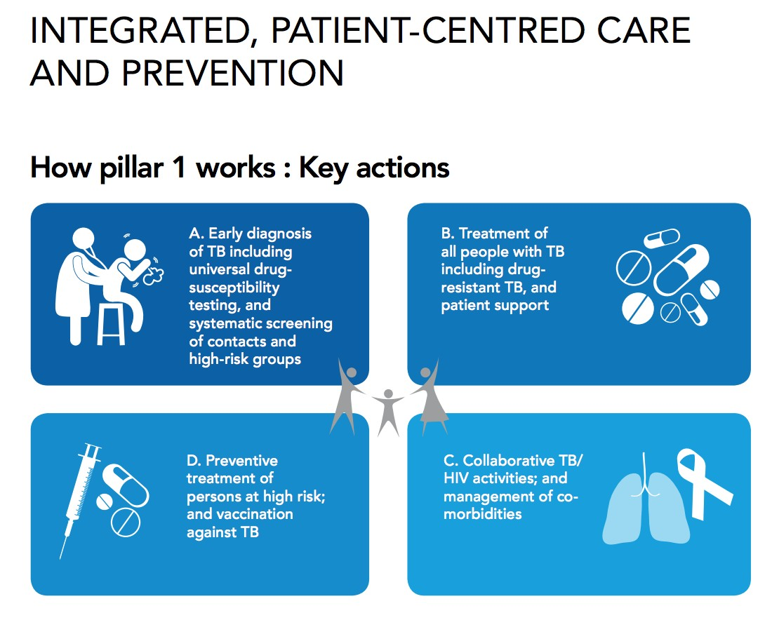

Slide 38
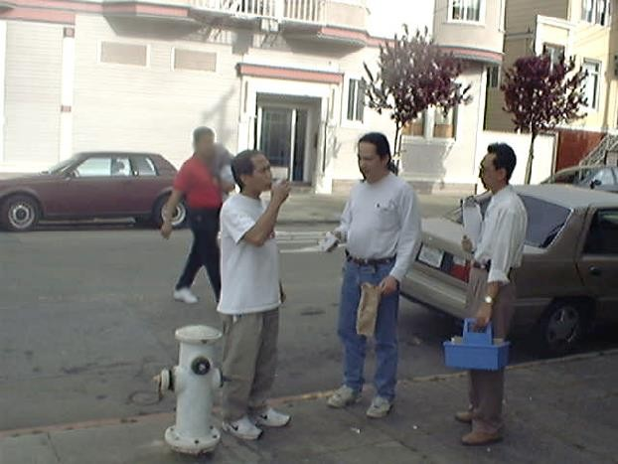
Community TB Control

Slide 39
Preventing and Controlling TB
Three priority strategies:
Identify and treat all persons with TB disease
Identify contacts to persons with infectious TB; evaluate and offer therapy
Test high-risk groups for LTBI; offer therapy as appropriate

Slide 40
Health care providers should work with health department in the following areas
Overall planning and policy development
Identification of persons with clinically active TB
Management of persons with disease or TB suspects
Identification and management of persons with TB
Laboratory and diagnostic services
Data collection and analysis
Training and education

Slide 41
Data Collection and Analysis
TB reporting required in every state
All new cases and suspected cases promptly reported to health department
All drug susceptibility results sent to health department

Slide 42
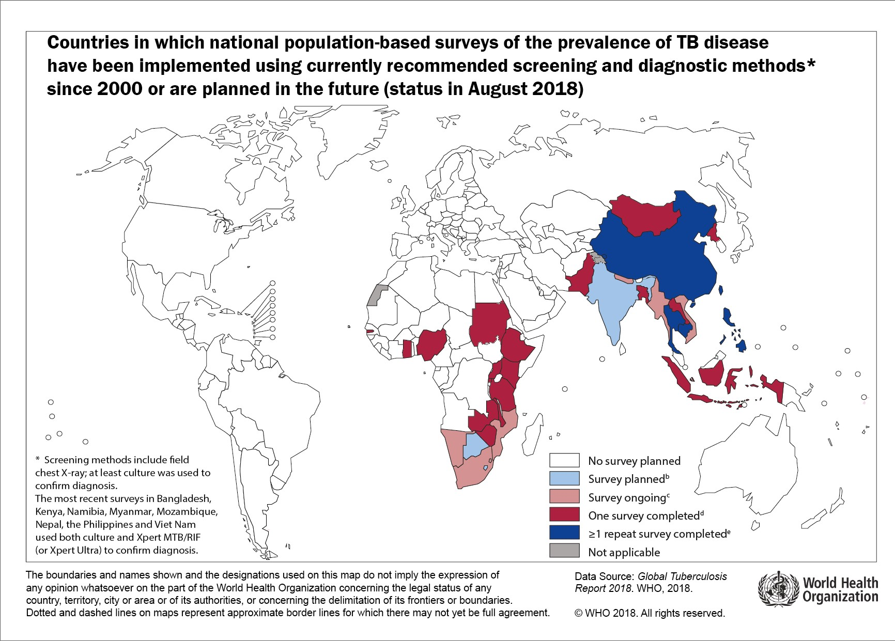

Slide 43
Training and Education
TB control programs should
Provide training for program staff
Provide leadership in TB education to the community Ensure community leaders, clinicians, and
policymakers are knowledgeable about TB
Educate the public

Slide 44


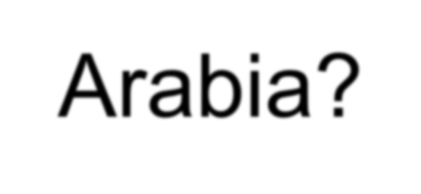
Why is it a concern for Saudi Arabia?

Slide 45
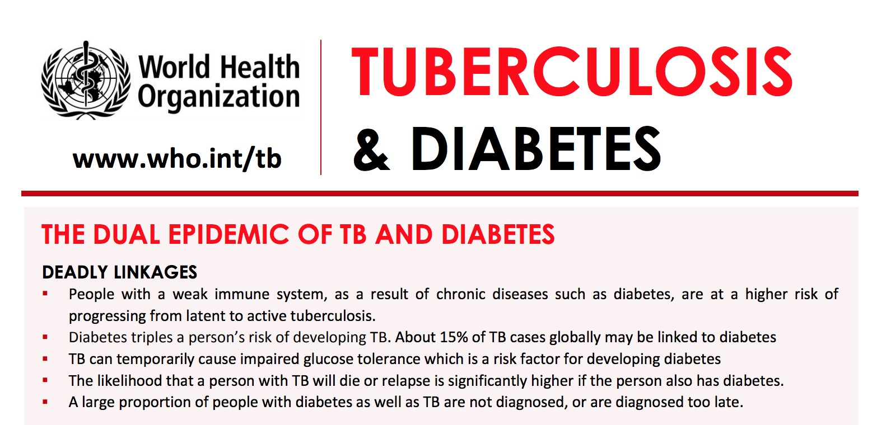

Slide 46
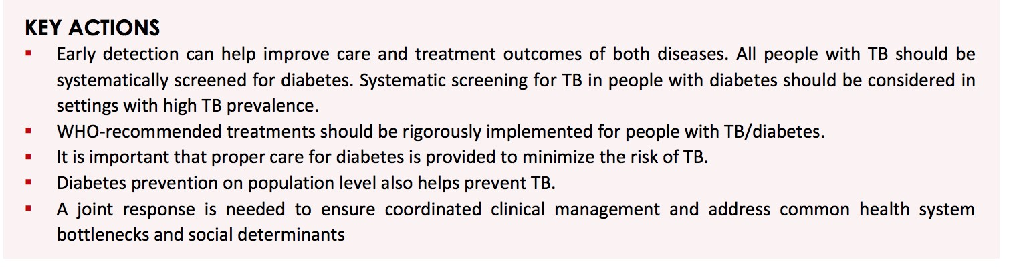

Slide 47
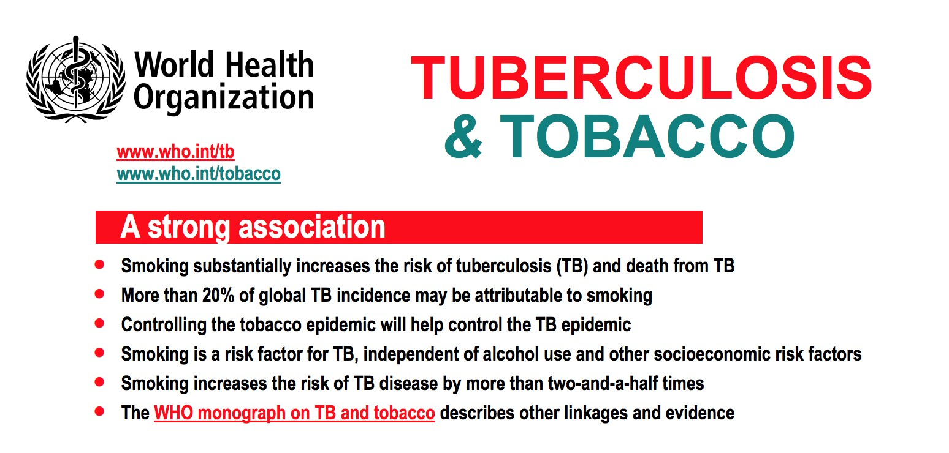

Slide 48
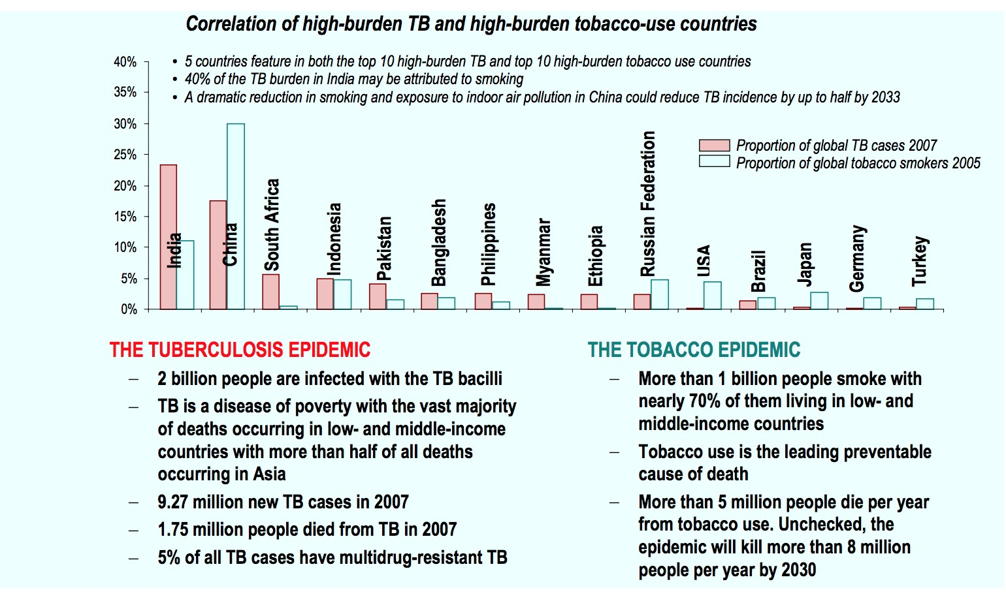

Slide 49



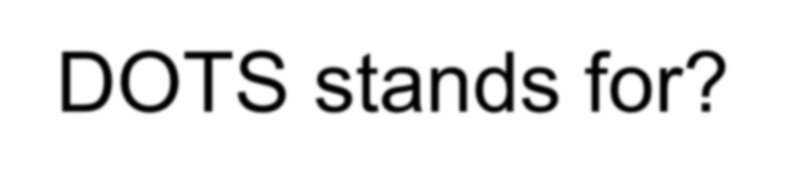
Quizz
Enlist the drugs used to treat TB
DOTS stands for?

