Slide 1
Determinants of Health
Marwah Hassounah MPH-HCOM, MBBS
Community Medicine Unit Faculty
Family and Community Medicine Department- King Saud University
COMM 311 - Community Medicine Course
September 16th, 2018 1-2 p.m.
Notes:
Salam
Excited to teach this lct, first time to be taught in the course.
It is very relevant as we enter the era of vision 2030 and health care reform,
it is important for you to be able to be part of the global conversation on health
And it is important because it makes you better physicians as you adopt a wholistic approach to your patients

Slide 2
Objectives
By the end of this lecture, students should be able to:
Explain the spectrum of health in relation to health and sickness
Define: health, disease, illness, and wellbeing
Define the term “ determinants of health”
Recognize different types of determinants of health [ biological, behavioral, socio and cultural, environmental, socioeconomic, health services, aging, and gender]
Recognize the terms “right to health “ and “health for all”

Slide 3
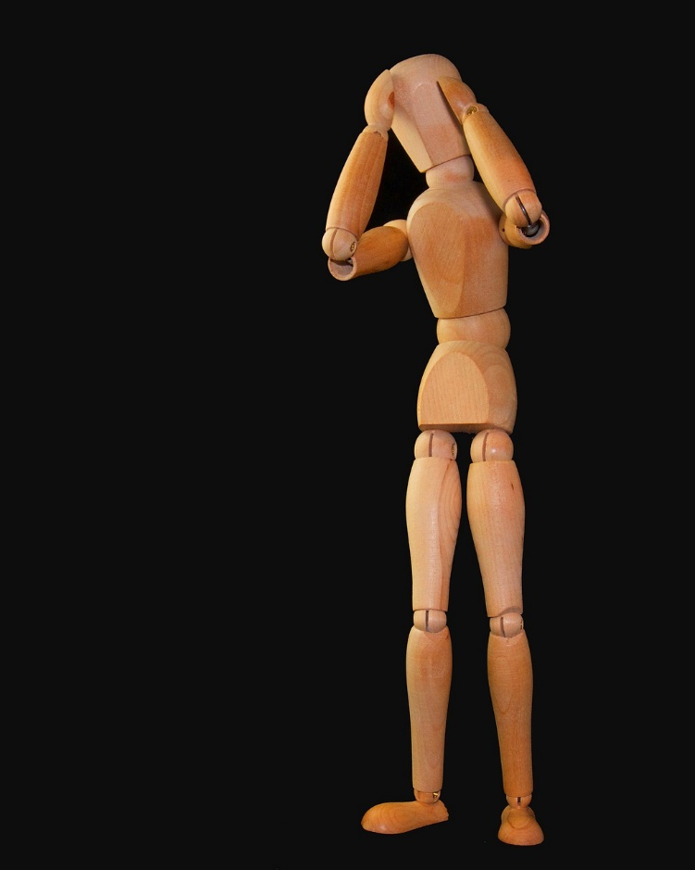
Notes:
Who has a headache right now?
Can we have a quick interview with you?
Since when did your headache start?

Slide 4
Spectrum of Health
Health and disease lie along a continuum, and there is no single cut-off point
The lowest point on the health-disease spectrum is death and the highest point corresponds to the WHO definition of positive health
The health of an individual is not static; it is a dynamic phenomenon and a process of continuous change
There are degrees or "levels of health" as there are degrees or severity of illness. As long as we are alive there is some degree of health in us.
Notes:
????

Slide 5
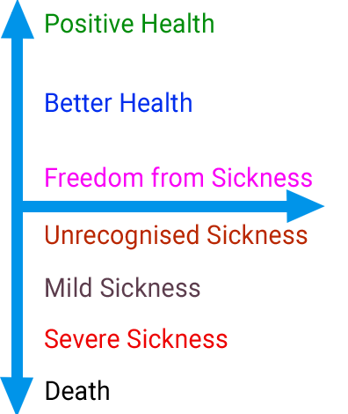
Spectrum of Health cnt’
[Fig.2 The health sickness spectrum. Park’s textbook. pg:18]
Notes:
???

Slide 6
Objectives
By the end of this lecture, students should be able to:
Explain the spectrum of health in relation to health and sickness
Define: health, disease, illness, and wellbeing
Define the term “ determinants of health”
Recognize different types of determinants of health [ biological, behavioral, socio and cultural, environmental, socioeconomic, health services, aging, and gender]
Recognize the terms “right to health “ and “health for all”

Slide 7
Is this person in good health?
Notes:
This is Am Mohammad. He is sitting in the renal hemodialysis unit- غسيل كلى
is he in good health?
No
What if I say it depends?
Can you give me an example in which this person being on dialysis is considered good health?
-maybe he was deteriorating, becoming disoriented and his body is full of fluids ( edema) and he just recently got a chance to get dialysis.
Image credit: FELESTEEN [ website] 5 November 2013. [ Accessed 13 September 2018] URL: http://felesteen.ps/details/news/103380/%D8%A7%D9%86%D9%82%D8%B7%D8%A7%D8%B9-%D8%A7%D9%84%D8%AA%D9%8A%D8%A7%D8%B1-%D8%A7%D9%84%D9%83%D9%87%D8%B1%D8%A8%D8%A7%D8%A6%D9%8A-%D9%8A%D9%87%D8%AF%D8%AF-%D9%85%D8%B1%D8%B6%D9%89-%D8%BA%D8%B2%D8%A9-%D8%A8%D9%80%D8%A7%D9%84%D9%85%D9%88%D8%AA.html

Slide 8
Health- A relative concept
It is relative to
where on the spectrum of health this patient is.
the health dimensions (physical, mental, social, spiritual, emotional, vocational dimensions)
local conditions and health standards.
For ex: a newborn baby in India weighs 2.8 kg on an average compared to 3.5 kg in the developed countries, and yet compares favorably in health.
Notes:
نسبي ، يعني ‘الصحة‘ نقدر نقول إنها كويسة أولا نسبة لعوامل أخرى و هي ليست عبارة مطلقة

Slide 9
Defining Health
Communities have their concepts of health, as part of their culture.
The oldest definition is that health is the "absence of disease".
World Health Organization ( 1948)
"Health is a state of complete physical, mental and social well-being and not merely an absence of disease or infirmity"
In recent years, this statement has been amplified to include the ability to lead a "socially and economically productive life"
Notes:
For ex: in Saudi a chubby baby is considered a healthy baby. A chubby adult is malyana or mateen but not obese or sick.
---
The widely accepted definition of health. / The WHO has an operational definition that can be used more practically in research for example, you can find it in the book.

Slide 10
Defining Disease and Illness (2)
Disease
“A condition in which the body health is impaired”
Illness
“A phenomenon in which one or more natural functions of the body are so disturbed that the affected individual cannot meet the natural requirements of everyday life.”
if disturbance is severe+ short duration >> acute illness
Long duration+ without disability >> chronic illness

Slide 11
Defining Wellbeing
There is no satisfactory definition of the term
well-being!

Slide 12
Notes:
-I searched google images for the word well-being and a this si a screenshot of what I got.
-As you can see these top images are about you doing something: read a book, be active, etc.
-And this is how psychologists define wellbeing. It is the presence of positive attributes like active pursuit of well-being, pro social behavior and so on. (reference 2)

Slide 13
Well being components
Objective components | Subjective components
1- Standard of living The scale of our expenditure, the goods we consume, and the services we enjoy. comparison can be made using the per capita GNP (gross national product) | Quality of life A composite measure of physical, mental, and social well-being as perceived by each individual or by a group of individuals. Difficult to measure. Possible measures are the physical quality of life index (PQLI) and the Human development Index (HDI)
2- Level of living Parallel term used by the United Nations
Notes:
Standard of living: Includes level of education, employment status, food, dress, house, amusements
GNP: economic indicator- it is the total value of all the goods and services produced by a country in a year including income from foreign investments, divided by the number of people living there

Slide 14
Recap
Wellbeing
Objectives components
Subjective components
Standard of living
Level of living
Quality of life
PQLI
HDI
Notes:
To recap

Slide 15
Measures of Quality of Life
 | physical quality of life index (PQLI) | Human development Index (HDI)
Indicators used in calculating this index | Infant mortality Life expectancy at age one literacy | Life expectancy at birth (longevity) Mean years of schooling (knowledge) Expected years of schooling (knowledge) GNI, gross national income, per capita (income/ decent standard of living)
scale | From 0-100 0 is worst performance and 100 is best performance | Values from 0 to 1
It measures | The results of social, economic, and political policies. Does NOT measure economic growth | It reflects achievements in the most basic human capabilities
Both allow for national and international comparison
Notes:
???

Slide 16
Objectives
By the end of this lecture, students should be able to:
Explain the spectrum of health in relation to health and sickness
Define: health, disease, illness, and wellbeing
Define the term “ determinants of health”
Recognize different types of determinants of health [ biological, behavioral, socio and cultural, environmental, socioeconomic, health services, aging, and gender]
Recognize the terms “right to health “ and “health for all”

Slide 17
Notes:
In class Stretching break!!!!!

Slide 18
Determinants of Health
Notes:
Now listen well
The core of det. Of hx is that hx is multifactorial.

Slide 19
“Many factors combine together to affect the health of individuals and communities.” (3)

Slide 20
Objectives
By the end of this lecture, students should be able to:
Explain the spectrum of health in relation to health and sickness
Define: health, disease, illness, and wellbeing
Define the term “ determinants of health”
Recognize different types of determinants of health [ biological, behavioral, socio and cultural, environmental, socioeconomic, health services, aging, and gender]
Recognize the terms “right to health “ and “health for all”

Slide 21
Types of determinants of health
Biological: genetic predisposition
Behavioral and socio-cultural: cultural and behavior patterns, life long habits developed from socialization (eg: smoking), lifestyle
Environment: internal, external (macro-environment: things you’re exposed to after conception.)
Socio-economic: this determinant encompasses
Economic status: per capita GNP
Education
Occupation
Political system
Notes:
Environment: exposed to could be medications in your mom’s womb, could be chemicals in something you eat or drink, and so on. Env. could be your built environment, what you live in, the pavements on the street, so on.
SE status:
a)Economic status: imp. Factor in seeking health care
b)illiteracy goes hand in hand with poverty, malnutrition, high infant and child mortality
d)Political system:
-Decisions concerning resource allocation, manpower policy, choice of technology and the degree to which health services are made available and accessible
-The percentage of GNP spent on health is a quantitative indicator of political commitment. The WHO has set the target of at least 5 per cent expenditure of each country's GNP on health care

Slide 22
Types of determinants of health cnt’
5. Health services: services for treatment of disease, prevention of illness and promotion of health.
To be effective, the health services must:
reach the social periphery,
equitably distributed,
accessible at a cost the country and community can afford,
and socially acceptable
6. Aging
7. Gender
8. Other: information technology, health related systems like agriculture and food
Notes:
5. For example, immunization of children, provision of safe water , the care of pregnant women.
6.Aging of the population: older people are living longer due to advances in medicine and other factors. For that there is an increased prevalence of chronic diseases and disabilities, both being conditions that tend to accompany the ageing process and deserve special attention.
7. gender:
-The 1990s have witnessed an increased concentration on women's issues
-women's health covering nutrition, reproductive health, the health consequences of violence, ageing, lifestyle related conditions and the occupational environment.
8.
-revolutions, in information and in communication. offers tremendous opportunities in providing an easy and instant access to medical information once difficult to retrieve.
-Other contributions to the health of population derive from systems outside the formal health care system, i.e., health related systems (e.g., food and agriculture, education, industry, social welfare, rural development)

Slide 23
Notes:
Meet leen.
Leen is a 22 year old medical student . She has top grades and helps in preparing studying material for her colleagues. Sounds familiar?!
But don’t be deceived by this smile. Leen has a secret. Leen is diagnosed with depression. She has been working hard to hide it but it is exhausting her.
Let’s look at the different types of determinants of health and see how they contributed in this diagnosis.

Slide 24
Types of determinants of health
Biological
Behavioral and socio-cultural
Environment
Socio-economic
Health services
Aging
Gender
Other: information technology, health related systems like agriculture and food
Notes:
Mental illness runs in the family [genetic predisposition], has chronic illness
Lack of sleep and physical activity [lifestyle]
Maybe she lives in a place where it is always raining,
Maybe she lives in a crowded low income neighborhood where there isn’t space to walk outside or it is not safe to do so alone.
Lack of student psychologist or mental health services for students
N/A
Females are more predisposed to depression, also being a female in the medical field in Saudi arabia might feel lke a lot of pressure to prove yourself in a male dominant field.
This is at an individual level, let’s see another example at the community level and try to understand that community’s detemrinants of health.

Slide 25
Notes:
Brief about the story

Slide 26
Notes:
This is the list of problems that people of el-tal el-kebir where initially suffering from. This is a prioritized list that they finalized with input from the community, the MOH, and college.
Go through the list, notice the problems.
Schistosomiasis بلهارسيا
http://www.who.int/news-room/fact-sheets/detail/schistosomiasis
Image is part of a table in the article ( reference 4)

Slide 27
Some of what they did with this community (4)
Created inter-sectoral sustainable partnerships
Notes:
Some of what they did to address the determinanats of health
ex: veterenarians, MOH, including the community itself, etc.

Slide 28
Some of what they did with this community (4)
Training of community health workers (CHW)
Notes:
CHW are well documented as an effective method in enhancing health in rural and underserved communities.

Slide 29
Some of what they did with this community (4)
Involving women in small industries

Slide 30
Some of what they did with this community (4)
communication skills training for informal leaders and CHW >> lead to acquiring a large water pump for clean water

Slide 31
Some of what they did with this community (4)
waste collection and sorting >>organic waste was turned into fertilizer and sold to nearby farmers.
Notes:
You might think, that some of these things are not exactly the concern of a health practitioner. You don’t see the grand opening of a primary care center. This is because they worked with the community to understand their true needs and to find feasible and sustainable solutions. These are determinants of health. Waste management, representation, income, health services,, etc.

Slide 32
Notes:
Now lets see that list of health issues 15 years later, in 2011. what are the health priorities of the community, have they changed.
1-Notice that the no. one concern has gone down to 9
2-Notice how more of the non-communicable illnesses have shifted up the list
3-Some of the determinants of Hx haven’t changed much. Like water sanitation and sewage.
This is an amazing case study, I love it a lot. It inspired me when I was a student when I first read it, and it still does till this day, and I use it frequently for different topics. I really hope you will read it and see the student’s experience and how they where able to b=make some change in their neighboring community.

Slide 33
Objectives
By the end of this lecture, students should be able to:
Explain the spectrum of health in relation to health and sickness
Define: health, disease, illness, and wellbeing
Define the term “ determinants of health”
Recognize different types of determinants of health [ biological, behavioral, socio and cultural, environmental, socioeconomic, health services, aging, and gender]
Recognize the terms “right to health “ and “health for all”

Slide 34
Right to Health
Historically, the right to health was one of the last to be proclaimed in the Constitutions of most countries
Universal Declaration of Human Rights 1948: "Everyone has the right to a standard of living adequate for the health and well-being of himself and his family ..... ".
WHO Constitution introduction affirms that it is one of the fundamental rights of every human being to enjoy "the highest attainable standard of health".

Slide 35
Health for all
Decided by the 30th World Health Assembly in year 1977
They decided that the main social target of governments and WHO in the coming decades should be "the attainment by all citizens of the world by the year 2000 of a level of health that will permit them to lead a socially and economically productive life"

Slide 36
Objectives
By the end of this lecture, students should be able to:
Explain the spectrum of health in relation to health and sickness
Define: health, disease, illness, and wellbeing
Define the term “ determinants of health”
Recognize different types of determinants of health [ biological, behavioral, socio and cultural, environmental, socioeconomic, health services, aging, and gender]
Recognize the terms “right to health “ and “health for all”

Slide 37
References
Park’s Textbook of Preventive and Social Medicine. 23rd edition. CH2 (p 13-21).*
Public Health and Community Medicine [textbook]. 8th edition. (p.4). Muhammad Irfanullah Siddiqui
The determinants of health [webpage]. World Health Organization. [Accessed 13. sept. 2018] URL: http://www.who.int/hia/evidence/doh/en/
Talaat W, El-Wazir Y. The El-Tal El-Kebir story: an example of social accountability from Egypt. Medical teacher. 2012 May 1;34(5):354-60.

Slide 38
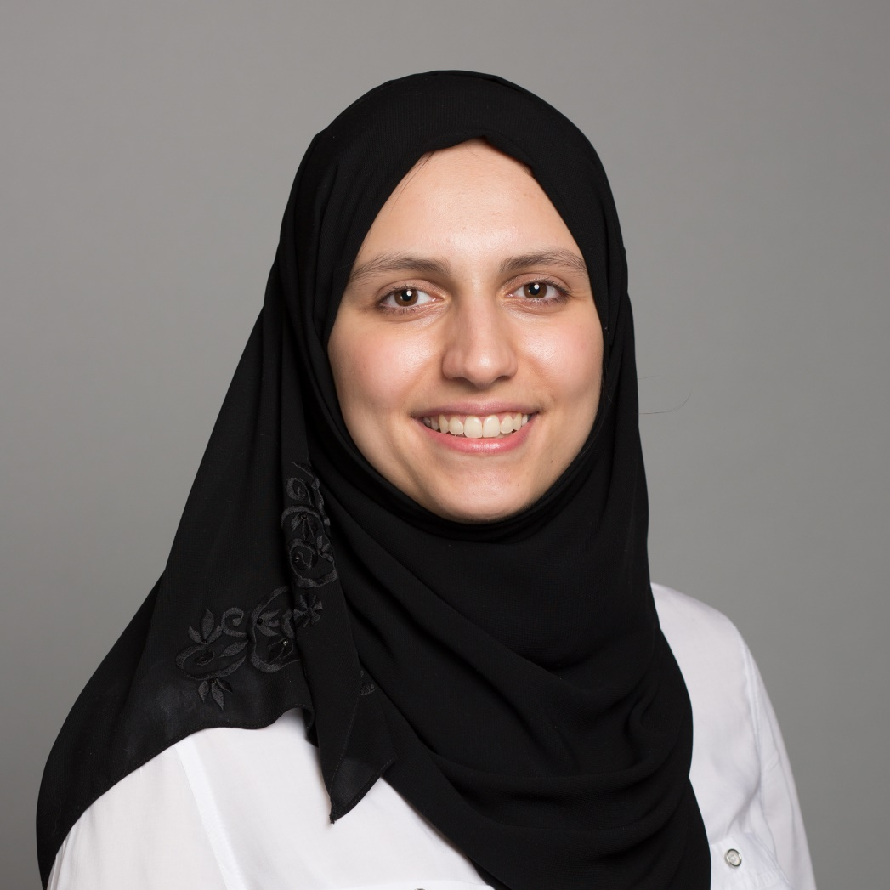
Marwah.m.i.h@gmail.com
Marwah Hassounah
Marwah Hassounah

Slide 39
Thank You

