Slide 1


Natural History of Disease and Concepts of Prevention and Control
Dr. Shatha Alduraywish, MBBS; MEpi; PhD
Assistant Professor, Epidemiologist Department of Family and Community Medicine
College of Medicine - King Saud University Email: salduraywish@ksu.edu.sa September 2018

Slide 2
Session Objectives
To describe theories postulated for the development of diseases
Explain the concepts of iceberg phenomenon of diseases
Understand the relationship between host, environment and agent in disease causation
Define the term prevention
Identify the level of prevention in relation to stage of disease development
Identify the measures applied at each level of prevention.

Slide 3
Session Overview
Theories of Disease Causation.
Natural History of Disease
Spectrum of Disease
Iceberg of Disease
Concept of Prevention
Modes of Intervention

Slide 4






Diagnostic measures
Etiology
Therapeutic measures
Risk Factors
Preventive measures

Slide 5

Theories Of Disease Causation

Slide 6
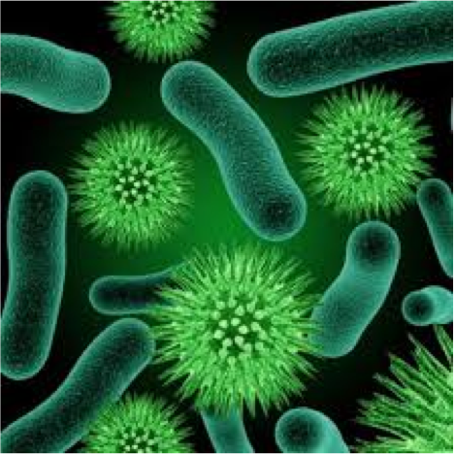
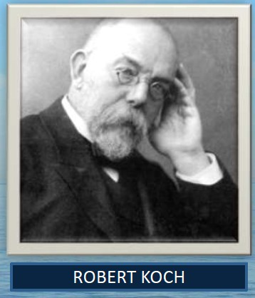
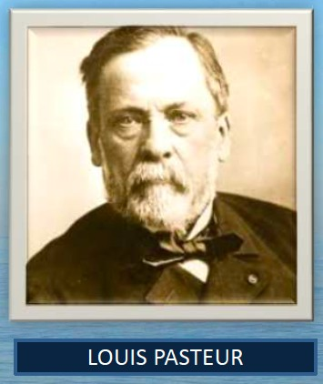
Germ Theory
In the second half of 19th century
Proposed by Robert Koch and Louis Pasteur (discovery of bacteria).

Slide 7
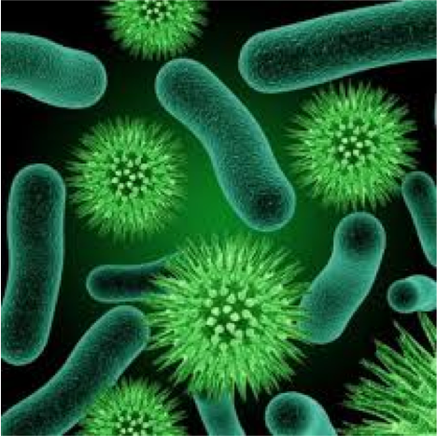
Germ Theory
Every human disease is caused by a microbe or germ, which is specific for that disease and one must be able to isolate the microbe from the diseased human being.

Slide 8




Germ Theory
One to one relationship between causal agent and disease.
Disease agent
Man
Disease

Slide 9
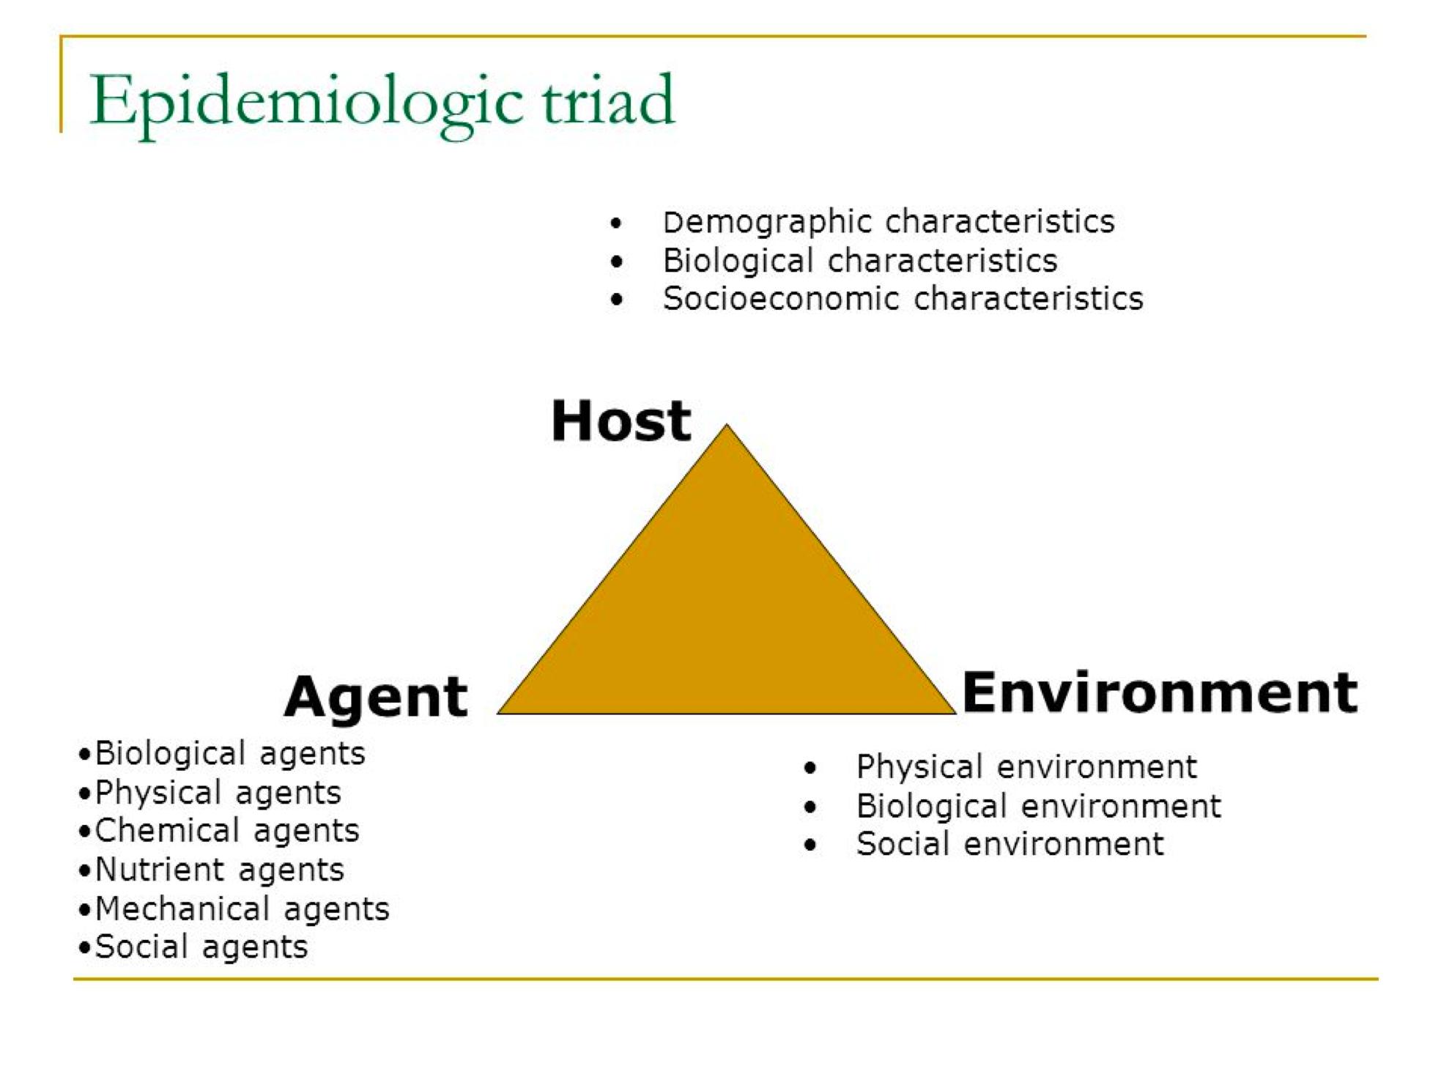
The Epidemiological Triad

Slide 10
The Epidemiological Triad
Example
Not everyone exposed to tubercle bacteria develops tuberculosis but the same exposure in an undernourished or immunocompromised person may result in clinical disease and exposure occurs more in overcrowding.

Slide 11
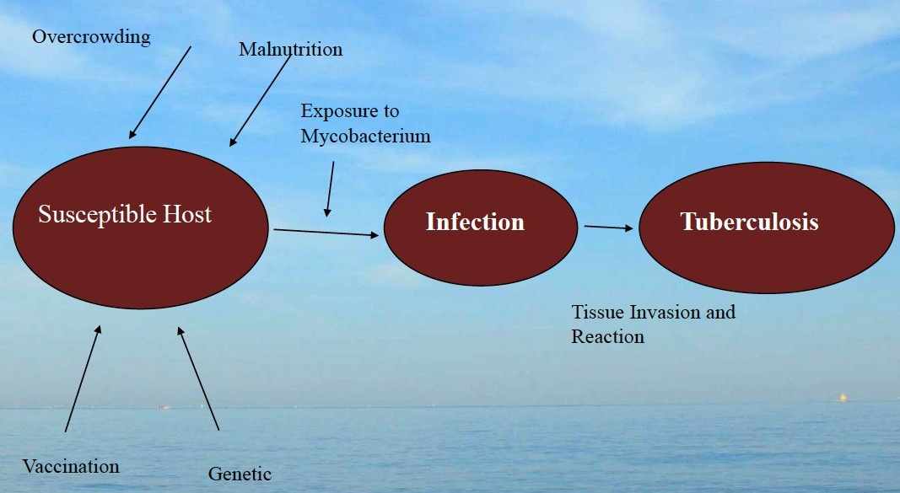
The Epidemiological Triad

Slide 12
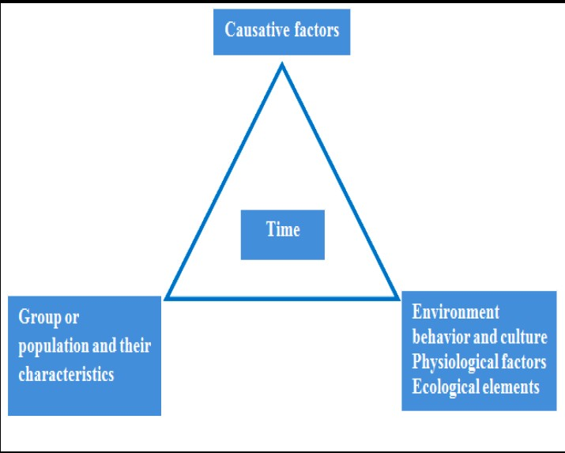
Epidemiological Tetrad
In addition to HOST, AGENT and ENVIRONMENT, one more factor TIME factor is added.
TIME accounts for incubation periods, life expectancy of the host or pathogen, duration of the course of illness .

Slide 13
The “BEINGS” Model of Disease Causation
A complex interplay of nine different factors
Biological factors innate in a human being,
Behavioural factors concerned with individual lifestyles,
Environmental factors as physical, chemical and biological aspects of environment,
Immunological factors,
Nutritional factors,
Genetic factors,
Social factors,
Spiritual factors and
Services factors, related to the various aspects of health care services.

Slide 14
The Theory of “Web of Causation”
Suggested by MacMohan and Pugh.
The various factors (e.g. hypercholesterolemia, smoking, hypertension) are like an interacting web of a spider.
Each factor has its own relative importance in causing the final departure from the state of health, as well as interacts with others, modifying the effect of each other.

Slide 15
The Theory of “Web of Causation”
Ideally suited in the study of chronic disease, where the agent is often not known and disease is the outcome of interaction of multiple factors.
This model of disease causation considers all predisposing factors of any type and their complex interrelationship with each other.

Slide 16
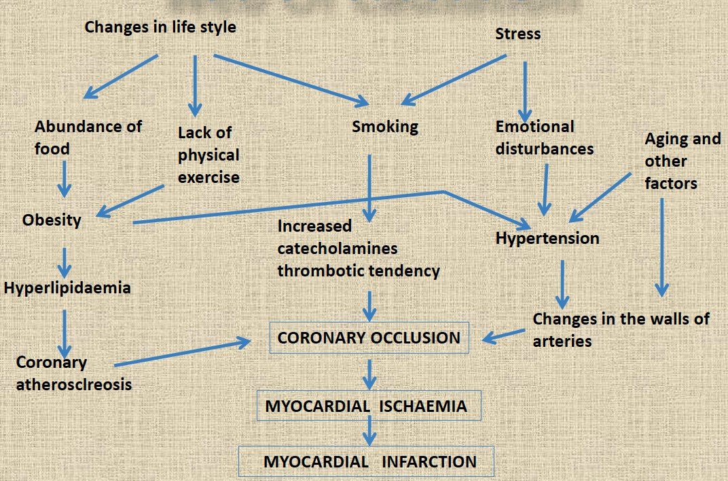
The Theory of “Web of Causation”

Slide 17
Wheel theory
As medical knowledge advanced, an additional aspect of interest that came into play is the comparative role of “genetic” and the “environmental” (i.e. extrinsic factors outside the host) factors in causation of disease.
The “triad” as well as the “web” theory does not adequately cover up this differential.
To explain such relative contribution of genetic and environmental factors, the “wheel” theory has been postulated.

Slide 18
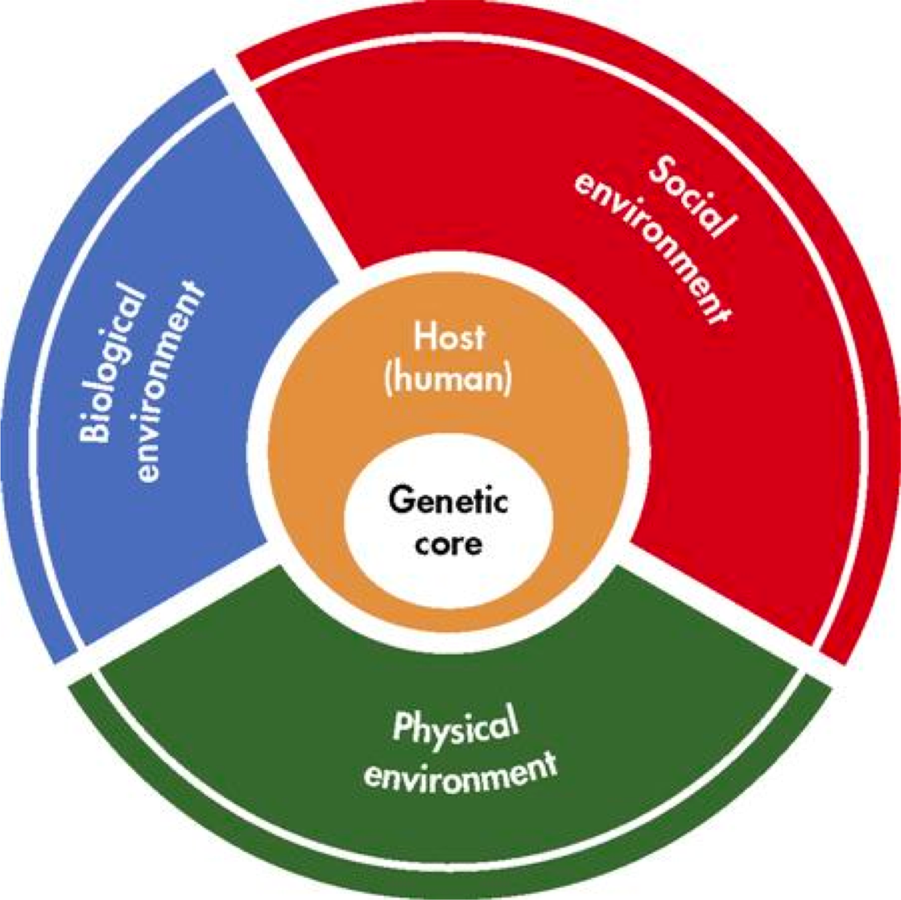
Wheel theory

Slide 19
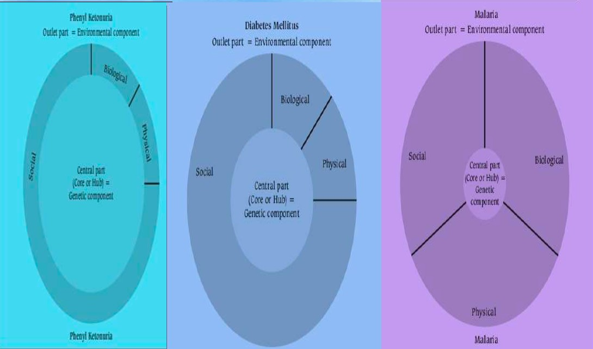
Wheel theory

Slide 20
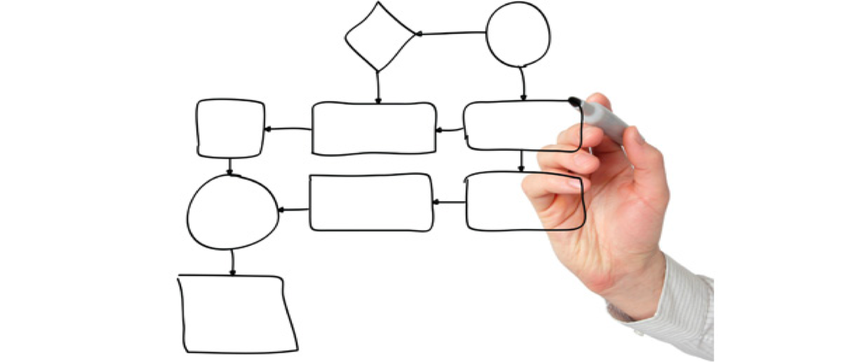
Natural History of Disease

Slide 21
Definition
Natural history of disease refers to the progress of a disease process in an individual over time, in the absence of intervention.
The process begins with exposure to or accumulation of factors capable of causing disease

Slide 22







Without medical intervention, the process ends with:
Recovery
Disability
Death
Recovery
Exposure
Host
Disease
Disability
Death

Slide 23

Why it is important?

Slide 24
Why it is important?
It is one of the major elements of descriptive epidemiology.
Understanding the progress of disease process and its pathogenetic chain of events is must for the application of preventive measures.

Slide 25

Which Design is the Best
The natural history of disease is best established by cohort studies.
As these studies are costly, understanding of the natural history of disease is largely based on other epidemiological studies, such as cross-sectional and retrospective studies, undertaken in different population settings.

Slide 26


What the physician sees in the hospital is just an "episode" in the natural history of disease.
The epidemiologist, by studying the natural history of disease in the community setting is in a unique position to fill the gaps in the knowledge about the natural history of disease.

Slide 27
Schematic Diagram of The Natural history of disease in a patient
Why ?
It is framework to understand the pathogenic chain of events for a particular disease, and for the application of preventive measures.

Slide 28
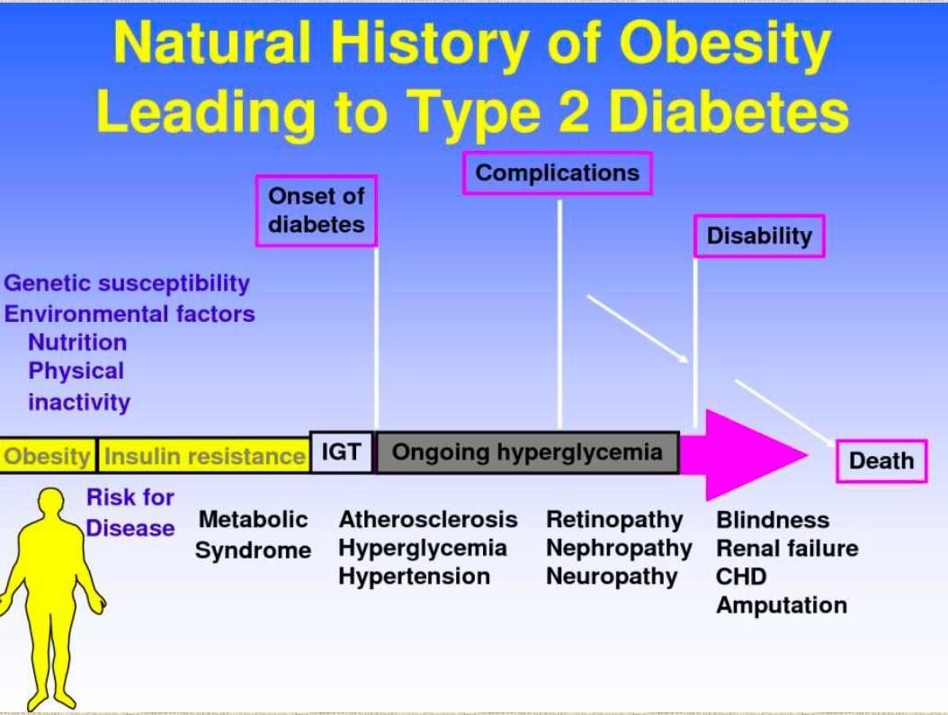

Slide 29






Schematic Diagram of The Natural history of disease in a patient
Consists of two phases
PRE-PATHOGENESIS
PATHOGENESIS
The process in the environment
The process in the man

Slide 30
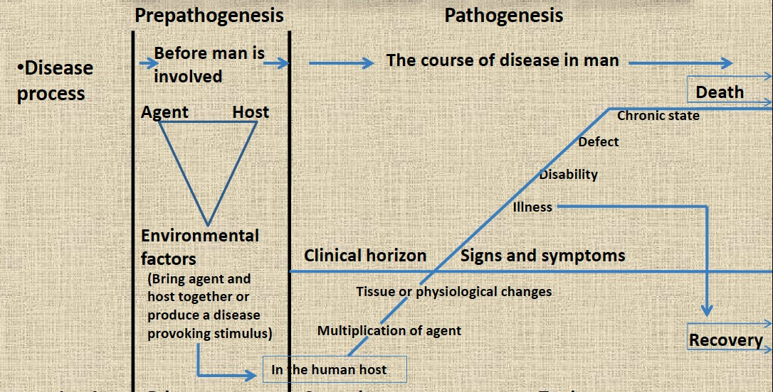
Schematic Diagram of The Natural history of disease in a patient

Slide 31
Pre-pathogenesis phase
This refers to the period preliminary to the onset of disease in man.
The disease agent has not yet entered man, but the factors which favor its interaction with the human host are already existing in the environment.
This situation is frequently referred to as “man exposed to the risk of disease”.

Slide 32
Pathogenesis phase
This phase begins with entry of the disease “agent” in the susceptible human host.
After the entry, agent multiplies and induces tissue and physiological changes, the disease progresses through the period of incubation and later through the period of early and late pathogenesis.
The final outcome of the disease may be recovery, disability or death.

Slide 33
Pathogenesis phase
In chronic diseases, the early pathogenesis phase is less dramatic and is also called as pre-symptomatic phase.
During pre-symptomatic stage, there is no manifest disease. The pathological changes are essentially below the level of the “clinical horizon”.
The clinical stage begins when recognizable signs or symptoms appear.
By the time signs and symptoms appear, the disease phase is already well advanced into the late pathogenesis phase.

Slide 34
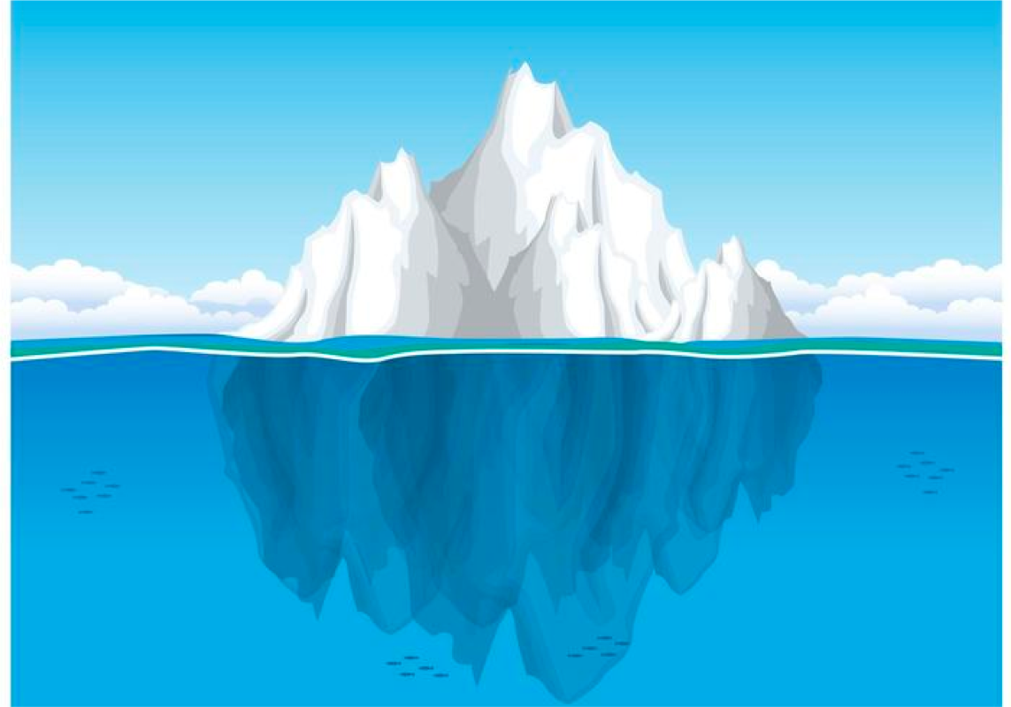
Spectrum of Disease and Iceberg Phenomenon

Slide 35
Spectrum of disease
It is a graphic representation of variations in the manifestations of disease.
At the one end of disease spectrum are sub-clinical infections which are not ordinarily identified, and at the other end are fatal illnesses.
In the middle of spectrum lie illnesses ranging in severity from mild to severe.
These different manifestations are the result of individuals’ different states of immunity and receptivity.

Slide 36

Iceberg of disease
The floating tip
Waterline
The submerged portion

Slide 37
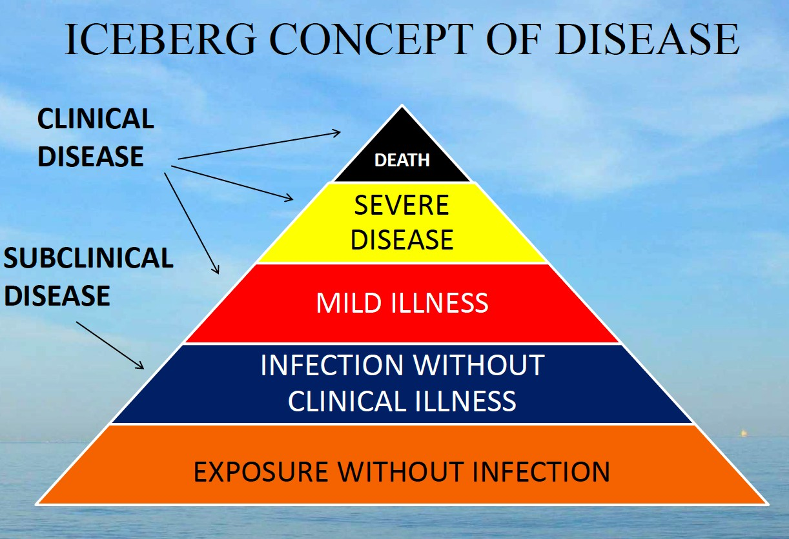

Slide 38
Spectrum of disease
Spectrum of disease presents challenges to the clinician and to the public health worker.
WHY?
Because of the clinical spectrum, cases of illness diagnosed by clinicians in the community often represent only the “tip of the iceberg.” Many additional cases may be too early to diagnose or may remain asymptomatic.
For the public health worker, the challenge is that persons with undiagnosed infections may be able to transmit them to others.

Slide 39
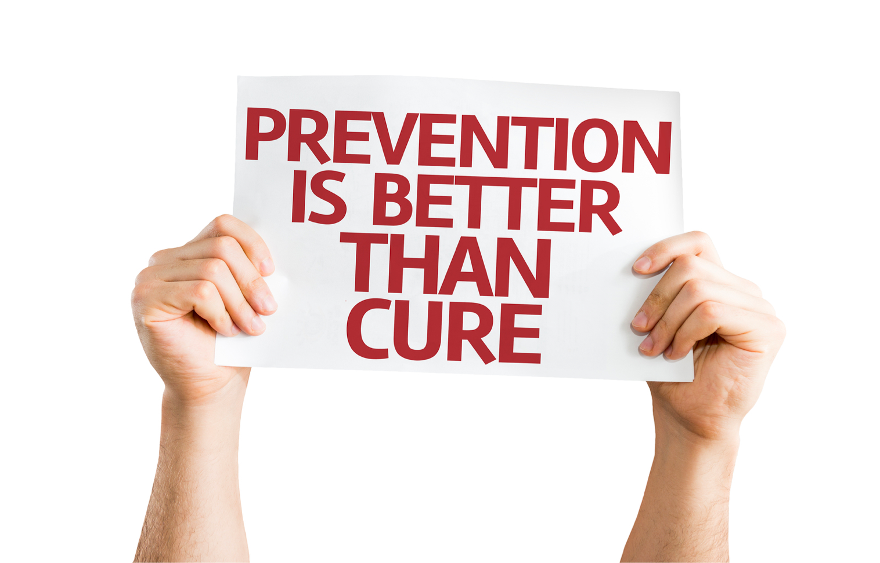
Concept of Prevention

Slide 40
Prevention of disease
Prevention is the process of intercepting or opposing the “cause” of a disease and thereby the disease process.
Successful prevention depends on:
Knowledge of causation
Dynamics of transmission
Identification of risk factors and risk groups
Availability of prophylactic or early detection and treatment measures
Organization to apply these measures
Continuous evaluation

Slide 41
Prevention of disease
Levels Of Prevention
Primordial prevention
Primary prevention
Secondary prevention
Tertiary prevention

Slide 42
Primordial prevention
It is the prevention of the emergence or development of risk factors in population groups in which they HAVE NOT yet appeared.
For example, many adult health problems (e.g., obesity and hypertension) have their early origin in childhood, so efforts are directed towards encouraging children to adopt healthy lifestyles ( e.g, physical exercise, healthy dietary habits etc.)
The main intervention in primordial prevention is through
individual and mass education.

Slide 43
Primary Prevention
It can be defined as “ action taken prior to the onset of disease, which removes the possibility that a disease will ever occur.
It signifies intervention in the pre-pathogenesis phase of a disease.

Slide 44
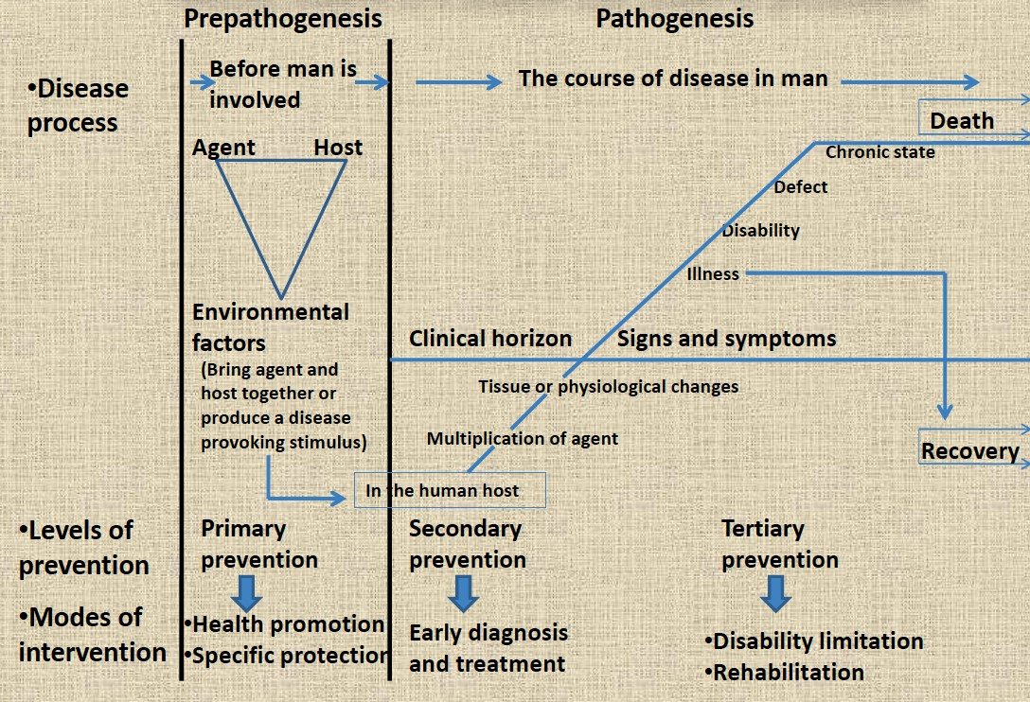


Slide 45
Primary Prevention
Two types of strategies
Population( mass ) strategy
High risk strategy

Slide 46
Primary Prevention
Population strategy
directed at whole population irrespective of the individual risk levels.
directed towards socio-economic, behavioral and lifestyle changes.
High risk strategy
Includes identification of “High risk groups” in the population and bring preventive care to these risk group.
e.g., People having the family history of Hypertension, allergic disease, Diabetes .

Slide 47
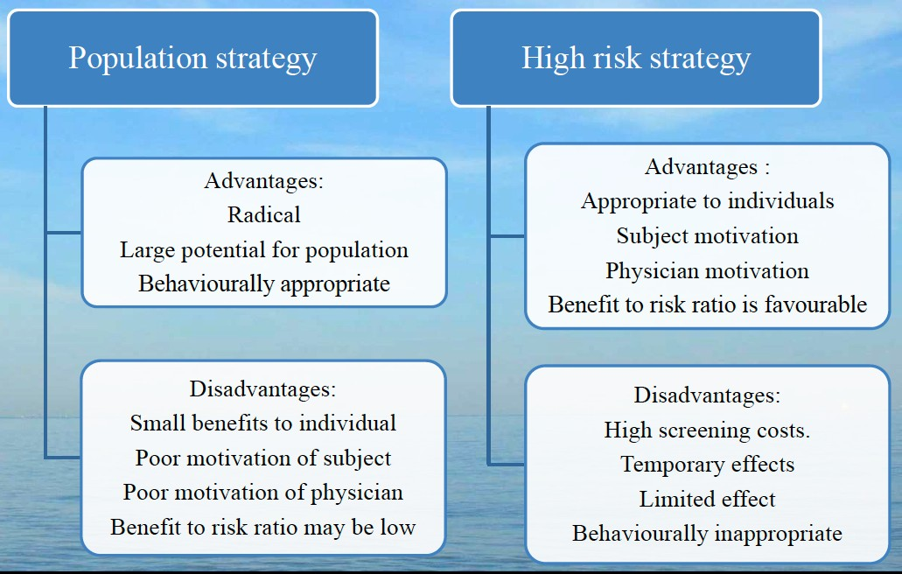
Primary Prevention

Slide 48
Secondary prevention
Defined as “action which stop the progress of a disease at its initial stage and prevents complications”.
It is applied in the early pathogenesis stage of disease.
It reduce the prevalence of the disease by shortening its duration.
It may also protect others in the community from acquiring the infection and thus provide, at once, secondary prevention for the infected individuals and primary prevention for their potential contacts.

Slide 50
Secondary prevention
The specific interventions used is :
  Early diagnosis and treatment.
Early detection of health impairment is defined as “ the detection of disturbances of homoeostatic and compensatory mechanism while biochemical, morphological and functional changes are still reversible.
e.g. , screening for disease for breast cancer (using mammography) and cervical cancer (using pap smear).
Medical examinations of school children, of industrial workers and various disease screening camps.

Slide 51
Tertiary prevention
These include all measures undertaken when the disease has become clinically manifest or advanced, with a view to
  prevent or delay death,
  reduce or limit the impairments and disabilities,
  minimize suffering and
  promote the subject’s adjustment to incurable conditions.
Tertiary prevention has two types of approaches
  disability limitation
  rehabilitation.

Slide 53
Tertiary prevention
Disability Limitation
These include all measures to prevent the occurrence of further complications, impairments, disabilities and handicaps or even death.
Examples
Complete rest, morphine, oxygen and streptokinase is given to a patient of Acute MI, to prevent death or complications like arrhythmias / CHF.
Application of plaster cast to a patient who has suffered Colle’s fracture, is done to prevent complications and further disability like mal-union or non-union.

Slide 54
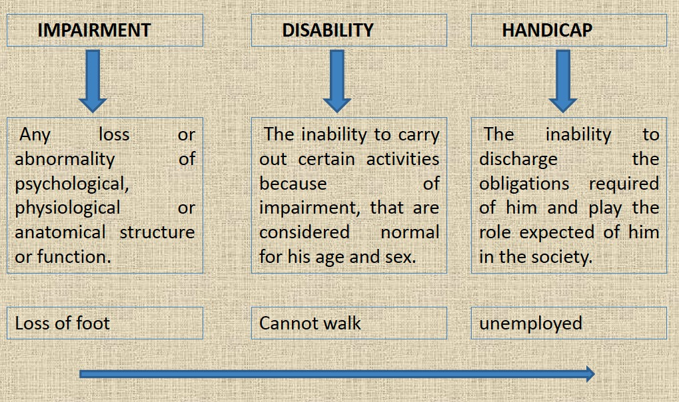
Tertiary prevention

Slide 55
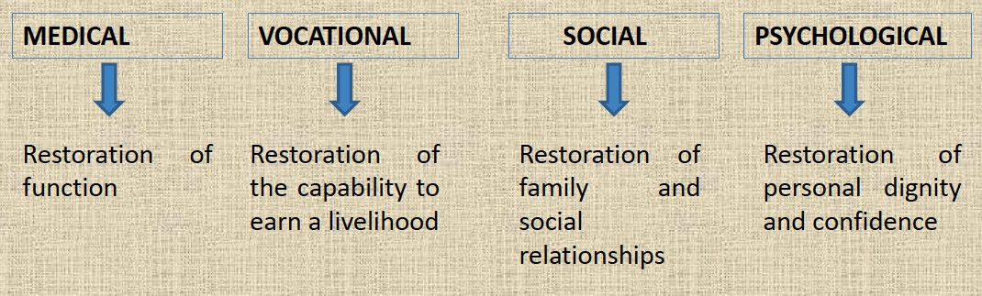
Tertiary prevention
Rehabilitation
It is defined as the combined and coordinated use of medical, social, educational and occupational measures for training and retraining the individual to the highest possible level of functional ability.

Slide 56
Tertiary prevention
Examples of Rehabilitation
  Establishing schools for blinds
  Provision of aids for the handicapped
  Reconstructive surgery in leprosy
  Muscle re-education and graded exercises in neurological disorders

Slide 57
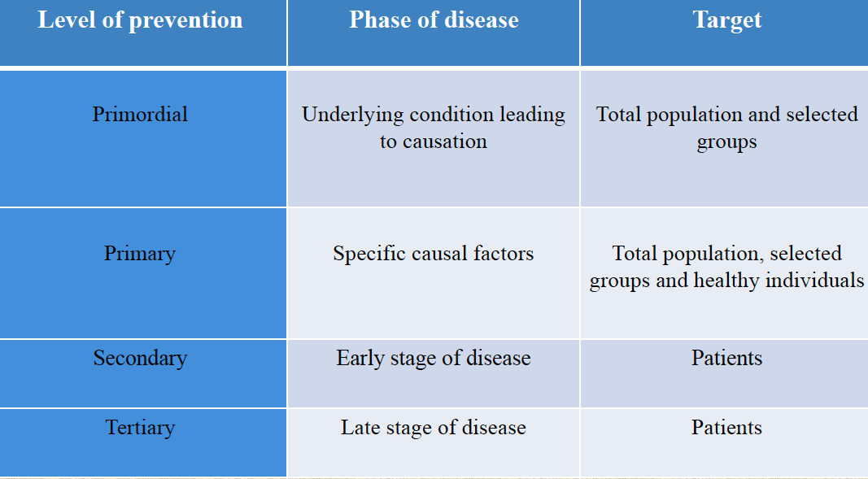
Levels of prevention

Slide 58


