Slide 1
Health Indicators (ch.2, 3)
Dr. Afnan Younis, MPH, SBCM
Assistant Professor, Community Medicine
ayounis@ksu.edu.sa
Afnan.younis@gmail.com

Slide 2
Is it a health problem in Saudi Arabia?
Diabetes
Breast cancer
Teenage pregnancy
Thalassemia

Slide 3
At the end of the lecture students should be able to:
Explain the need to use “indicators” to measure “health” status
State the characteristics of health indicators
List the uses of health indicators
State with examples the types of health indicators

Slide 4
What is health indicator?
Is an indication of a given situation.
Variables that help to measure change.
When change cannot be measured directly.

Slide 5
Uses of Health Indicators
Measure health status in a community.
Compare health status between countries or over time.
Assessment of health care needs.
Allocation of resources according to needs.
Monitoring and evaluation of health services.

Slide 6
Characteristics of a good indicator:
Valid
Reliable
Sensitive
Specific
Relevant
Feasible
Notes:
Valid – measures what it is supposed to measure.
Reliable – provides same information under
different observations, conditions
Sensitive – sensitive to changes in the situation
Specific – reflects changes only in that situation
Relevant: relevant to the community needs &
problems.
Feasible: the ability to obtain data when needed

Slide 7
Types of Health Indicators
Mortality indicators
Morbidity indicators
Disability indicators
Nutritional status indicators
Health care delivery indicators
Utilization rates
Notes:
Mortality indicators (crude mortality rate, cause-specific mortality rate, age specific mortality rate,……)
Morbidity indicators (incidence, prevalence)
Disability indicators (DALY, QALY,….)
Nutritional status indicators (anthropometric measurements,…)
Health care delivery indicators (doctor-population ratio, population-bed ratio,……)
Utilization rates (bed turnover ratio, vaccine coverage ratio,…)

Slide 8
Types of Health Indicators
Social and mental health indicators
Environmental indicators
Socioeconomic indicators
Health policy indicators
Indicators of quality of life
Other indicators
Notes:
Social and mental health indicators (tobacco use, substance Abuse, responsible sexual behavior, mental health)
Environmental indicators (Environmental Quality)
Socioeconomic indicators (rate of population increase, dependency ratio, literacy rate,….)
Health policy indicators (GNP spent on healthcare,…)
Indicators of quality of life
Other indicators (health for all, MDG, SDG,….)
(rate of population increase, dependency ratio, literacy rate,….)
(GNP spent on healthcare,…)

Slide 9
Morbidity rates
Incidence
Prevalence

Slide 10
Incidence
It measures the new cases.
Incidence rate =
No. of new cases in the population during a specific period of time X 10^{n}
Population at risk in the population during same period of time
Notes:
Useful for taking action
Control disease
Research for etiology and pathogenesis
Efficacy of therapeutic and preventive measures

Slide 11
Example
In 1426 the number of colon cancer cases reported to the cancer registry in Riyadh region was 200. The midyear population of Riyadh region was four million.
Calculate the incidence of colon cancer in Riyadh.

Slide 12
Incidence rate =
No. of new cases in the population during a specific period of time X 10^{n}
Population at risk in the population during same period of time
= 200/4,000,000 X 1000
= 0.05 /1000 population

Slide 13
Attack rate
Acute recurrent diseases e.g. ARTI, food poisoning.
No. of episodes during specified period
AR= x 10^{n}
Population at risk during same
Notes:
Person may catch the disease more than one time.

Slide 14
Secondary attack rate

Slide 15
Prevalence
Point prevalence:
Total cases (old + new) at fixed point of time in place
x 10 ^{n}
total population at risk in the same place and time

Slide 16
example
MOH conducted a survey for RVF among workers in slaughterhouses in Makkah. 224 seropositive workers were identified among 6000 workers.
Calculate the prevalence of RVF.

Slide 17
MOH conducted a survey for RVF among workers in slaughterhouses in Makkah. 224 seropositive workers were identified among 6000 workers.
Calculate the prevalence of RVF.
Prevalence= Total cases (old + new) at fixed point of time in place x 10 ^{n}
total population at risk in the same place and time
=224 / 6,000 X 1,000 = 37 per 1,000

Slide 18
Period prevalence
No. of existing cases (old+new) of a specified
disease during a given period of time interval
X100
Estimated mid-interval population at risk

Slide 19
Incidence, point prevalence and period prevalence
Case 1
Case 2
Case 3
Case 4
Case 5
Case 6
Case 7
Case 8
Jan1
Dec 31
Notes:
Incidence: 3, 4, 5, 8
Point prevalence jan1: 1, 2, 7
Point prevalence dec 31: 1, 3, 5, 8
Period prevalence: 1, 2, 3, 4, 5, 7, 8

Slide 20
Case 1
Case 2
Case 3
Case 4
Case 5
Case 6
Case 7
Case 8
Jan1
Dec 31
Incidence: 3, 4, 5, 8
Point prevalence dec 31: 1, 3, 5, 8
Point prevalence jan1: 1, 2, 7
Period prevalence: 1, 2, 3, 4, 5, 7, 8
Notes:
Incidence: 3, 4, 5, 8
Point prevalence jan1: 1, 2, 7
Point prevalence dec 31: 1, 3, 5, 8
Period prevalence: 1, 2, 3, 4, 5, 7, 8

Slide 21
Incidence vs. prevalence
Incidence: causality
Prevalence: magnitude of health problem

Slide 22
Mortality rates

Slide 23
Rate
Ratio
Proportion

Slide 24
Mortality Rates
No. of deaths in one year
Death rate= X1000
Mid-year population
Notes:
A mortality rate is a measure of the frequency of occurrence of death in a defined population during a specified period of time.
mid-year population=
It is important to use the population size at the midpoint of the time interval as an estimate of the average population at risk especially if:
a denominator population is growing or shrinking during the period of time for which a rate is to be computed.
e.g. If a death rate is to be calculated for the year 2012, then the population of July 1, 2012 is used for the denominator.

Slide 25
Mortality rates
Crude death rates
Specific death rates
Standardized death rates

Slide 26
Crude Death Rate (CDR)
Notes:
All causes of death
entire population.
= … Deaths/1000 individual in the specified year and locality.

Slide 27
Specific mortality rate
Specific mortality rate
Age
Cause
Race
Gender

Slide 28
Cause-specific mortality rate
Notes:
The number of deaths attributed to a specific cause divided by the population at the midpoint of the time period multiply by 100,000.

Slide 29
Example

Slide 30
Specific mortality rate
Age
Cause
Race
Gender

Slide 31
Age-specific mortality rates
Examples: neonatal, post-neonatal, infant and under 5-years mortality rates.
Notes:
limited to a particular age group.

Slide 33
Adult mortality rate (per 1000 population)
Adulthood: between 15- 60 years of age
Notes:
Probability that a 15 year old person will die before reaching his/her 60th birthday.

Slide 34
Mortality rates related to maternal and child health:
Notes:
Denominator: no. of live birth

Slide 35
Maternal mortality ratio (MMR) (per 100 000 live births)
The number of maternal deaths per 100 000 live births during a specified time period, usually 1 year.
Maternal death is the death of a woman while pregnant or within 42 days after termination of pregnancy, irrespective of the duration and site of the pregnancy, from any cause related to or aggravated by the pregnancy or its management, but not from accidental or incidental causes.

Slide 36
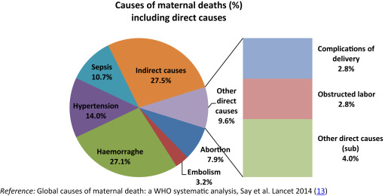

Slide 38
Period of Infancy
28 weeks pregnancy
birth
7 days
28 days
1 year
stillbirth
Peri-natal period
neonatal period
Post natal period
Infancy period
Notes:
Infancy period

Slide 39
Infant mortality rate (per 1 000 live births)
Infant mortality rate is the probability of a child born in a specific year or period dying before reaching the age of one.

Slide 40
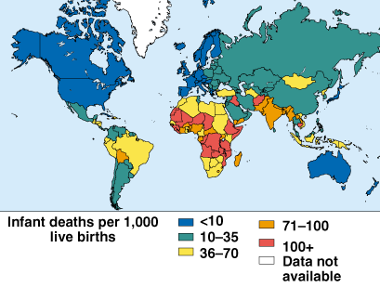
Infant Mortality Rate

Slide 41
Neonatal mortality rate (per 1 000Neonatal live births)
Notes:
Neonatal m

Slide 42
Post-Neonatal mortality rate (per 1 000 live births)

Slide 43
Stillbirth rate (per 1000 total births)

Slide 44
Stillbirths: are defined as third trimester fetal deaths (> or = 1000 grams or > or = 28 weeks of gestation).
Total births : Total births is defined as the sum of live births and still births.

Slide 45
Perinatal Mortality Rate
It is expressed as the sum number of still births and early neonatal deaths (less than 7 days of life) per 1000 total births (still births plus live births).
It the best indicator of Maternal and Child Health services

Slide 46
Under-5 mortality rate(per 1 000 live births)
Under-five mortality rate is the probability of a child born in a specific year or period dying before reaching the age of five.

Slide 47
Proportionate mortality ratio
Notes:
Proportionate mortality rate

Slide 48
Proportionate mortality ratio

Slide 49
Causes of child deaths in sub-Saharan Africa, 2010
https://doi.org/10.1371/journal.pmed.1000294.g004

Slide 50
Proportionate mortality ratio, KSA 2010
Cause | %
Injury, Poisoning and External Causes | 18.5
Dis. Circulatory System | 16.74
Cond. Orig..Perinatal Period | 9.05
Dis. Respiratory System | 4.09
Neoplasms | 4.75
Infect & Parasitic Diseases | 3.31
Dis. Genitourinary System | 3.09
Congenital Anomalies | 2.66
Endocrine. Nutr. Metab Diseases | 2.46
Dis.Digestive System | 1.93

Slide 51
Case fatality rate (Death to case ratio)
It reflects severity and virulence of diseases

Slide 52
Standardized (adjusted) death rates
Removes confounding effect
Direct comparison

Slide 53
Age group | Mid-year pop. | Deaths in the year | Age-specific death rate
0 | 4,000 | 60 | 15
1-4 | 4,500 | 20 | 4.4
5-14 | 4,000 | 12 | 3
15-19 | 5,000 | 15 | 3
20-24 | 4,000 | 16 | 4
25-34 | 8,000 | 25 | 3.1
35-44 | 9,000 | 48 | 5.3
45-54 | 8,000 | 100 | 12.5
55-64 | 7,000 | 150 | 21.4
Crude death rate |  | 8.30 per 1000 population
Standardized death rate |  | 6.56 per 1000 population
Notes:
Standard population
Expected deaths

Slide 54
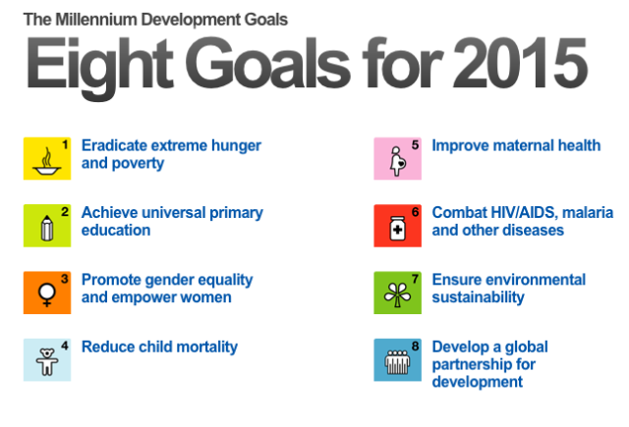

Slide 56
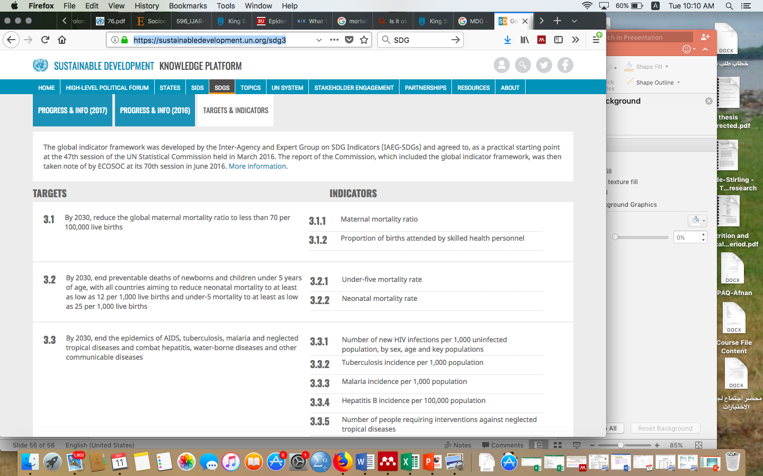
https://sustainabledevelopment.un.org/sdg3

Slide 57
Reference book Park,s Textbook of Preventive and Social Medicine

