Slide 1
Screening
Dr Leena Baghdadi
MBBS, Master CliEpi, PhD ClinEpi
Assistant Professor| Family & Community Medicine| College of Medicine | KSU

Slide 2
Objectives
Definition of screening
Concept of screening and the lead time
Difference between “screening”, “case finding”, “periodic examination” and “diagnosis”
Uses of screening programs
Criteria of health problems amenable for screening
Differences between screening and diagnostic test
Distinguish between “mass screening” and “high risk screening”
Criteria of an ideal screening test

Slide 3
Cont. objectives
Validity of screening test and its calculations:
Sensitivity
Specificity
Positive predictive value
Negative predictive value
False Positive Rate
False Negative Rate

Slide 4
1. Definition of screening
Screening: actively searching for unrecognized disease or defect by means of rapidly applied tools in apparently healthy individuals not seeking medical care

Slide 5
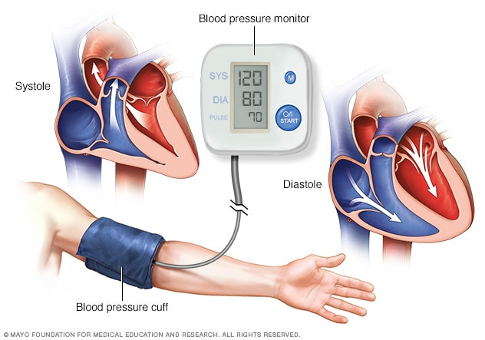
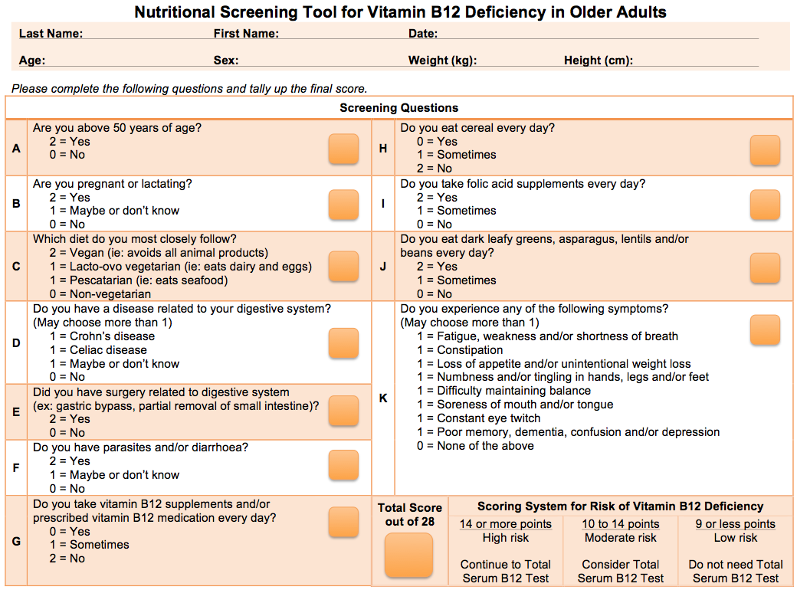
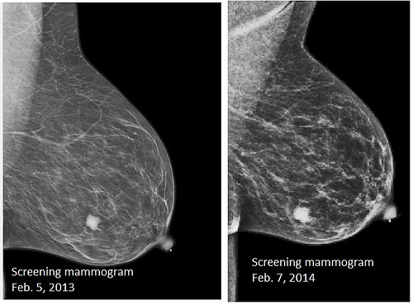
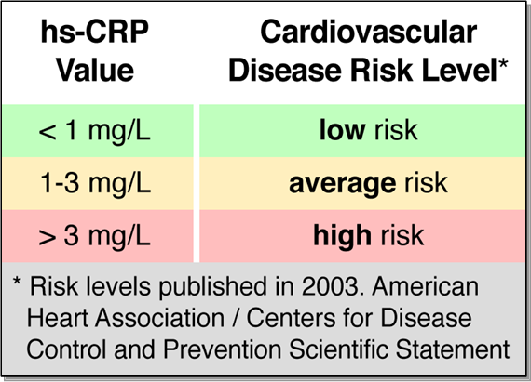
Tools and examples of screening

Slide 6
2. Concept of Screening
Table 1. Natural history of disease and levels of prevention

Slide 7
3. Concept of Lead Time
Figure 1. Model for early detection program

Slide 8
4.
Table 2. Difference between screening, case finding, periodic examination and diagnosis
Screening | Periodic examination | Case finding | Diagnosis
The search for unrecognized disease or defect by means of rapidly applied tools in apparently healthy individuals not seeking medical care. | Seeking of medical care at intervals to evaluate health status and to detect any health problem without the presence of any complaint. In periodic examination, different systems are looked at and a series of investigations are applied. | The use of a clinical, laboratory or non laboratory test to detect disease in individuals seeking health care for other reasons. The aim of identifying diabetes among pregnant women is an example of case finding. | A procedure to confirm or refute the existence of a disease or abnormality among those seeking medical care with a specific complaint. Achieved by obtaining medical history, clinical examination and the application of laboratory or non laboratory tests.

Slide 9
5. Uses of screening programs
Table 3. Uses of screening tests
No. | Use of screening program | Definition | Example
1 | Case detection | Prescriptive screening Identification of unrecognized disease or defect that doesn’t arise from patients’ request | Neonatal screening
2 | Control of diseases | Prospective screening Prevention of the transmission of the disease to healthy community members | Screening of immigrants from infectious diseases such as tuberculosis and syphilis
3 | Research purposes | Initial screening is conducted to estimate the prevalence of a disease and subsequent screening will provide data on the incidence | Screening of chronic diseases whose natural history is not fully known (e.g. cancer)

Slide 10
6. Types of screening programs
Mass screening:
Applied to the whole population or population subgroups as adults, school children, industrial’s workers irrespective of their risk.

Slide 11
2. High risk or selective screening:
Applied to a selective population subgroups who are at a high risk. Among high risk population, the disease is more likely to be prevalent and the screening will result in a better yield.

Slide 12
7. Criteria of screening
It is related to:
The disease
The screening test

Slide 13
A. The disease
The disease to be screened should fulfil the following criteria before it is considered suitable for screening:
1. The condition sought should be an important health (in general, prevalence should be high)

Slide 14
2. There should be a recognizable latent or early
asymptomatic stage

Slide 15
3. The natural history of the condition, including
development from latent to declared disease, should
be adequately understood (so that we can know at
what stage the process ceases to be reversible)

Slide 16
4. There is a test that can detect the disease prior to the
onset of signs and symptoms

Slide 17
5. Facilities should be available for confirmation of the
diagnosis

Slide 18
6. There is an effective treatment

Slide 19
7. There is good evidence that early detection and treatment reduces morbidity and mortality

Slide 20
8. The expected benefits (e.g., the number of lives saved) of early detection exceed the risks and costs

Slide 21
Screening and diagnostic test
Table 4. Difference between screening and diagnostic test
No. | Screening test | Diagnostic test
1 | Done on apparently healthy | Done on those with indications or sick
2 | Applied to groups | Applied to single patients, all diseases are considered
3 | Test results are arbitrary and final | Diagnosis is not final but modified in light of new evidence, diagnosis is the sum of all evidence
4 | Based on one criterion or cut-off point | Based on evaluation of a number of symptoms, signs (e.g., diabetes) and laboratory findings
5 | Less accurate | More accurate
6 | Less expensive | More expensive
7 | Not a basis for treatment | Used as a basis for treatment
8 | The initiative comes from the investigator or agency providing care | The initiative comes from a patient with a complaint

Slide 22
7. Cont. Criteria of screening
It is related to:
The disease
The screening test

Slide 23
B. The Screening Test
1. Feasibility: Simple, inexpensive, capable of wide application
2. Acceptability: Acceptable by the people to whom it is intend to be applied
3. Reliability (precision): Consistent results on repeated application on the same individual under same circumstances
4. Validity (accuracy): Ability to distinguish between those who have and those who don’t have the disease as confirmed by a gold standard

Slide 24
8. Validity of screening test
Sensitivity: ability of the test to detect correctly those who truly have the condition (true positive)
2. Specificity: ability of the test to detect correctly those who truly do not have the condition (true negative)

Slide 25
1. Sensitivity
It is called as true positive rate.
True Positive Rate
Percentage of patients who have a disease that test positive on the test.
Sensitivity= True positive/T _{Disease} × 100

Slide 26
2. Specificity
It is called the true negative rate.
True Negative Rate
Percentage of patients who do not have the disease who test negative on the test.
Specificity= True Negative/ T _{Non-Disease} × 100

Slide 27
3. False Positive Rate
Percentage of patients who have a positive test result but do not have the disease.

Slide 28
4. False Negative Rate
Percentage of patients who have negative test results but have the disease.

Slide 29
False positive result
False negative result
is referred to as adverse effect or errors of screening is not desirable
is a waste of resources; incurring the cost of the screening and the confirmation of the diagnosis
leads to unnecessary exposure of subjects to the hazards of the tests
causes emotional strain of being a probable case
is not desirable
gives a false re-assurance that they are free from the condition

Slide 30
Truth
 | Disease (number) | Non-Disease (number) | Total (number)
Positive (number) | A (True Positive) | B (False Positive) | T _{Test Positive}
Negative (number) | C (False Negative) | D (True Negative) | T _{Test Negative}
 | T _{Disease} | T _{Non-Disease} | Total
Sensitivity= A/(A+C) × 100
Specificity= D/(D+B) × 100
False Positive Rate=
B /(B+D) × 100
False Negative Rate=
C /(A+C) × 100
Test Result

Slide 31
Example
Test | Breast cancer |  | Total
 | Positive | Negative
Positive | 900 | 1980 | 2880
Negative | 100 | 97020 | 97120
Total | 1000 | 99000 | 100000
Sensitivity= A/(A+C) × 100
(900/1000)x 100 = 90.00%
Specificity= D/(D+B) × 100
(97020/99000) x 100 = 98.00%
False Positive Rate= B /(B+D) × 100
(1980/99000) x100= 2%
False Negative Rate= C /(A+C) × 100
(100/1000) x100= 10%

Slide 32
Interpretations of sensitivity and specificity:
Breast cancer screening test was capable to identify correctly 90% of the those who have the cancer
Breast cancer screening test was capable to identify correctly 98% of the those who don’t have the condition

Slide 33
5. Positive predictive value
Percentage of the time that a positive test correctly identifies people who have the disease.
Positive Predictive Value= True Positive/ T _{Test Positive} × 100

Slide 34
6. Negative predictive value
Percentage of time that a negative test correctly identifies people without the disease.
Negative Predictive Value= True Negative/ T _{Test Negative}× 100

Slide 35
Meaning of positive predictive value
Reflects the diagnostic power of the test.
The predictive accuracy depends upon sensitivity, specificity and disease prevalence
Low value is a waste of resources; very few of those who tested positive will be found to have the condition
High value is desirable in screening program; detecting and bringing into care subjects with the condition at a pre-clinical stage

Slide 36
Truth
 | Disease (number) | Non-Disease (number) | Total (number)
Positive (number) | A (True Positive) | B (False Positive) | T _{Test Positive}
Negative (number) | C (False Negative) | D (True Negative) | T _{Test Negative}
 | T _{Disease} | T _{Non-Disease} | Total
Positive Predictive Value= A/(A+B) × 100
Negative Predictive Value= D/(D+C) × 100
Test Result

Slide 37
Example
Test | Breast cancer |  | Total
 | Positive | Negative
Positive | 900 | 1980 | 2880
Negative | 100 | 97020 | 97120
Total | 1000 | 99000 | 100000
Positive Predictive Value= A/(A+B) × 100
(900/2880) x 100 = 31.3%
Out of those who are positive by the test only 31.3% are found to have breast cancer
Negative Predictive Value= D/(D+C) × 100
(97020/97120) x 100 = 99.9%
Out of those who are negative by the test, 99.9% are found to be free from the cancer

Slide 38
Thank you

