Slide 1
Introduction to Occupational Health Ch.15
Dr. Afnan Younis, MPH, SBCM
Assistant Professor, Community Medicine
ayounis@ksu.edu.sa
Afnan.younis@gmail.com

Slide 2
By the end of this session you will be able to:
Enlist and understand the effects of exposure of a worker to:
Physical hazards (heat and cold, light, noise, vibration, UV light, ionizing radiation)
Chemical hazards (local effects, inhalation, absorption, ingestion)
Biological hazards (infectious and parasitic agents)
Mechanical hazards
Psychological hazards (fatigue, depression, anxiety)

Slide 3
Occupational health
The prevention of disease and maintenance of the highest degree of physical, mental and social well-being of workers in all occupations.

Slide 4
Ergonomics
Derived from the Greek ergon, meaning work and nomos, meaning law.
"fitting the job to the worker".
Objective is "to achieve the best mutual adjustment of man and his work, for the improvement of human efficiency and well-being".
Notes:
designing of machines, tools, equipment and manufacturing processes, lay-out of the places of work, methods of work and environment in order to achieve greater efficiency of both man and machine (5).

Slide 5
Occupational hazards
Physical hazards
Chemical hazards
Biological hazards
Mechanical hazards
Psychosocial hazards.

Slide 6
Physical hazards
Physical hazards
Heat and cold
Light
Noise
Vibration
UV light
Ionizing radiation

Slide 7
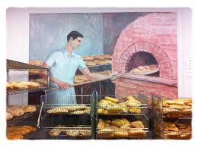
Heat and cold
Heat | Cold
Direct effects: Burns Heat exhaustion Heat stroke Heat cramps Indirect effects: Decreased efficiency Increased fatigue Increased accidents rates | Chilblains Erythrocyanosis Frostbite General hypothermia
Reasonable temperature must be maintained in each work room.

Slide 8
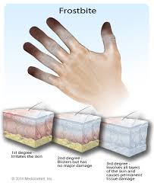
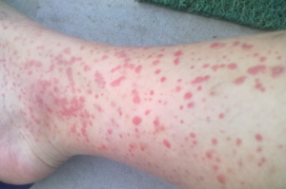
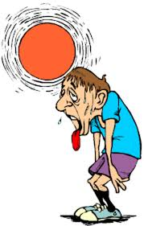
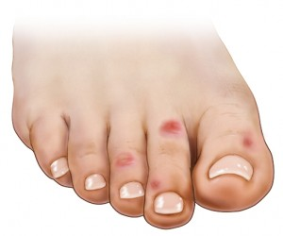

Slide 9
Light
Poor illumination | Excessive brightness
Acute effects: Eye strain Headache Eye pain Lachrymation Congestion around the cornea Eye fatigue Chronic effects: Miner's nystagmus | Discomfort, Annoyance and Visual fatigue Blurring of vision
Light should be sufficient and suitable, natural or artificial.

Slide 10
Noise
Auditory effects | Non-auditory effects
Temporary hearing loss Permanent hearing loss | Nervousness Fatigue Interference with communication by speech Decreased efficiency Annoyance
Factors affecting degree of injury: intensity and frequency range, duration of exposure and individual susceptibility.

Slide 11
Vibration
frequency range 10 to 500 Hz,
drills and hammers.
usually affects the hands and arms.
the fine blood vessels of the fingers may become increasingly sensitive to spasm (white fingers).
injuries of the joints of the hands, elbows and shoulders

Slide 12
Ultraviolet radiation
arc welding.
mainly affects the eyes:
intense conjunctivitis
keratitis (welder's flash).
Symptoms: pain and redness in eyes
usually disappear with no permanent effects

Slide 13
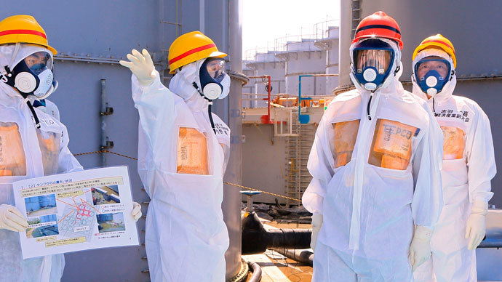
Ionizing radiation
e.g., X-rays and radio-active isotopes.
Some tissues are more sensitive than others.
Hazards: genetic changes, malformation, cancer, leukaemia, depilation, ulceration, death.
exposure at 5 rem per year to the whole body
Notes:
The International Commission of Radiological Protection has set the maximum permissible level of occupational exposure at 5 rem per year to the whole body

Slide 15
Chemical hazards
local action, absorption, inhalation and ingestion.
Effects depend on duration quantity of exposure, and individual susceptibility.

Slide 16
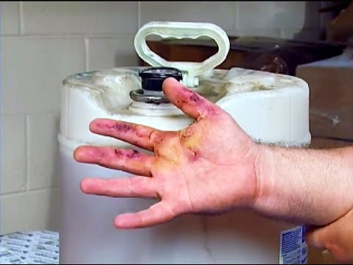
Local action
Irritation: allergic reactions, dermatitis, eczema, ulcers and cancer
Absorption: systemic effects.
Occupational dermatitis: machine oil, rubber, caustic alkalies and lime

Slide 17
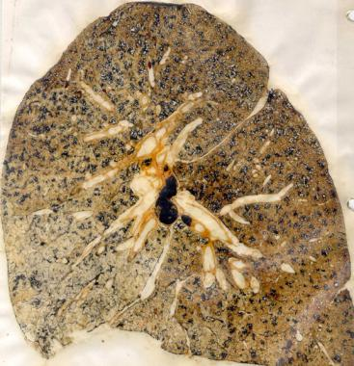
Inhalation
1-Dust:
0.1-150 microns
Organic (cotton), inorganic (silica, mica, coal, asbestos)
Soluble, insoluble
Pneumoconiosis: <5microns, insoluble dust
Example of dust disease: silicosis, anthracosis

Slide 18
Inhalation
2- Gases:
simple gases (e.g., oxygen, hydrogen),
asphyxiating gases (e.g. carbon monoxide, cyanide gas, sulphur dioxide, chlorine)
anaesthetic gases (e.g., chloroform, ether, trichlorethylene).

Slide 19
Inhalation
3- Metals and their compounds:
dust or fumes.
lead, antimony, arsenic, beryllium, cadmium, cobalt, manganese, mercury, phosphorus, chromium, zinc and others.
responds favorably to cessation and medical treatment.

Slide 20
Ingestion

Slide 21
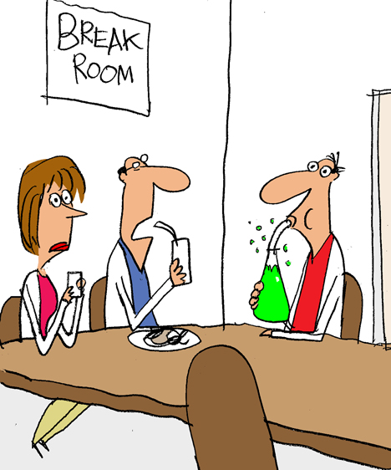
Ingestion
lead, mercury, arsenic, zinc, chromium, cadmium, phosphorus etc.
contaminated hands, food or cigarettes.
Most is excreted through feces and only a small proportion may reach the general blood circulation.

Slide 22
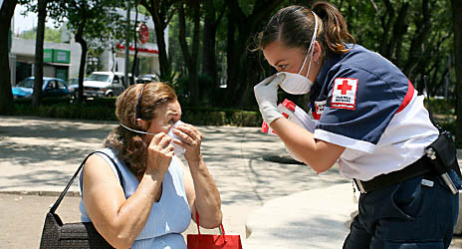
Biological hazards
Persons working in medical field, among animal products (e.g., hair, wool, hides) and agricultural workers are specially exposed to biological hazards.

Slide 23
Mechanical hazards
About 10 % of accidents in industry are due to mechanical causes.

Slide 24
Psychosocial hazards
Psychological and behavioral changes : hostility, aggressiveness, anxiety, depression, substance abuse, sickness, absenteeism
Psychosomatic ill-health : fatigue, headache; body pain, peptic ulcer, hypertension, heart disease and rapid aging.
Notes:
Frustration, lack of job satisfaction, insecurity, poor human relationships
capacity to adapt to different working environments is influenced by many factors such as education, cultural background, family life, social habits and expectations

Slide 25
Personal Protective Equipment (PPE)

Slide 26
References
Park,s Textbook of Preventive and Social Medicine

