Slide 1
Global Mental Health
Marwah Hassounah MPH-HCOM, MBBS
Community Medicine Unit Faculty
Family and Community Medicine Department- King Saud University
COMM 311
March 7th, 2019 10 -11 AM

Slide 2
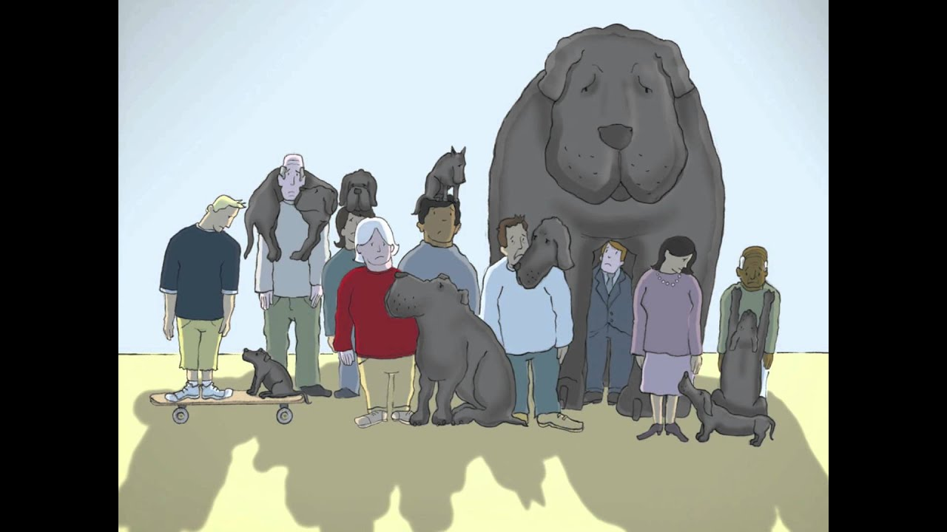
Notes:
https://www.youtube.com/watch?v=XiCrniLQGYc

Slide 3
Objectives
By the end of this lecture students should be able to:
Define mental health and its etiology
Discuss the global magnitude of mental illness based on the global burden of disease ( GBD)
List and classify the factors contributing to the occurrence of mental illness
Define stigma, and explain its consequences on mentally ill patients, their families and treatment outcome.
Discuss the principals of preventing mental illness.

Slide 4
Mental Health is ⁽¹⁾
“…the capacity in an individual to form harmonious relations with others, and to participate in, or contribute constructively to, changes in his social and physical environment.”
Notes:
-influenced by both biological and social factors
-not a static condition

Slide 5
The human lifecycle ⁽¹⁾
Human psychological needs differ in degree and qualitative importance at different ages.
Prenatal period
First 5 years of life
School child : https://www.youtube.com/watch?v=kmSinPMVU2U
Adolescence
Old age
Notes:
Needs:(1) the need for affection, (2) the need for belonging, (3) the need for independence, (4) the need for achievement, (5) the need for recognition or approval, (6) the need for a sense of personal worth and (7) the need for self-actualization.
The roots of mental health are in early childhood.
The programmes and practices of the school may satisfy or frustrate the emotional needs of the child. effectiveness in learning, proper teacher-pupil relationship and climate of the class room are very important
The basic needs of the adolescents are: (a) the need to be needed by others, (b) the need for increasing independence, (c) the need to achieve adequate adjustment to the opposite sex and (d) the need to rethink the cherished beliefs of one's elders. The failure to recognize and understand these basic needs may prevent sound mental development
The causes of mental illness in the aged are organic conditions of the brain, economic insecurity, lack of a home, poor status and insecurity.

Slide 6
Examples of Mental illness ⁽²⁾
Depression
bipolar affective disorder
schizophrenia and other psychoses
dementia
intellectual disabilities
developmental disorders including autism.

Slide 7
Causes and contributing factors
organic
Social
hereditary
environmental

Slide 8
Causes and contributing factors ⁽¹⁾
organic
Neoplasms
Neurological diseases
Hereditary
social
Emotional stress
Endocrine diseases
Environmental
Broken home
Economic insecurity
Toxic substances: lead compounds
Psychotropic drugs : barbiturates, alcohol
Trauma
Notes:
1- cerebral arteriosclerosis, neoplasms, metabolic diseases, neurological diseases, endocrine diseases and chronic diseases such as tuberculosis, leprosy, epilepsy, etc.
3-worries, anxieties, emotional stress, tension, frustration, unhappy marriages, broken homes, poverty, industrialization, urbanization, changing family structure, population mobility, economic insecurity, cruelty, rejection, neglect and the like.
4- (1) Toxic substances carbon disulfide, mercury, manganese, tin, lead compounds, etc. (2) Psychotropic drugs - barbiturates, alcohol, griseofulvin. (3) Nutritional factors deficiency of thiamine, pyridoxine. (4) Minerals deficiency of iodine. (5) Infective agents - infectious disease (e.g., measles, rubella) during the prenatal, perinatal and post-natal periods of life may have adverse effects on the brain's development and the integration of mental functions. (6) Traumatic factors - road and occupational accidents and (7) Radiation nervous system is most sensitive to radiation during the period of neural development.

Slide 9
Drug abuse and Dependence ⁽¹⁾
Drug abuse: “self administration of a drug for non-medical reasons, in quantities and frequencies which may impair an individual'. s ability to function effectively,…”
Drug dependence: "a state, psychic and sometimes also physical, resulting from the interaction between a living organism and a drug, characterized by behavioural and other responses that always include a compulsion to take the drug on a continuous or periodic basis in order to experience its psychic effects, and sometimes to avoid the discomfort of its absence. “

Slide 10
Drug abuse and Dependence ⁽¹⁾
Drug | Psychic dependence | Physical dependence
Amphetamines &Cocaine
Barbiturates
Cannabis
Heroin |  | fast
Lysergic Acid Diethylamide (LSD)
Alcohol |  | slowly
Tobacco
Notes:
Amphetamines- stimulant like adrenaline
Barbiturates – sleeping pills sedative
Cannabis –hasheesh/ marijuana
Heroin- narcotic analgesic
LSD – hallucinogenic drug

Slide 11
Objectives
By the end of this lecture students should be able to:
Define mental health and its etiology
Discuss the global magnitude of mental illness based on the global burden of disease ( GBD)
List and classify the factors contributing to the occurrence of mental illness
Define stigma, and explain its consequences on mentally ill patients, their families and treatment outcome.
Discuss the principals of preventing mental illness.

Slide 12
Mental Health Global burden (morbidity and mortality) ⁽³⁾
In 2004, mental disorders accounted for 13% of the global burden of disease
mental disorders accounted for 25.3% and 33.5% of all years lived with a disability in low- and middle-income countries, respectively
Notes:
defined as premature death combined with years lived with disability

Slide 13
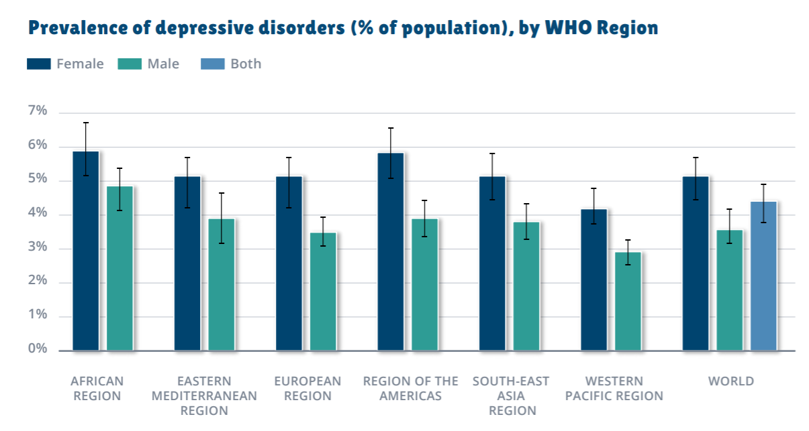

Slide 14
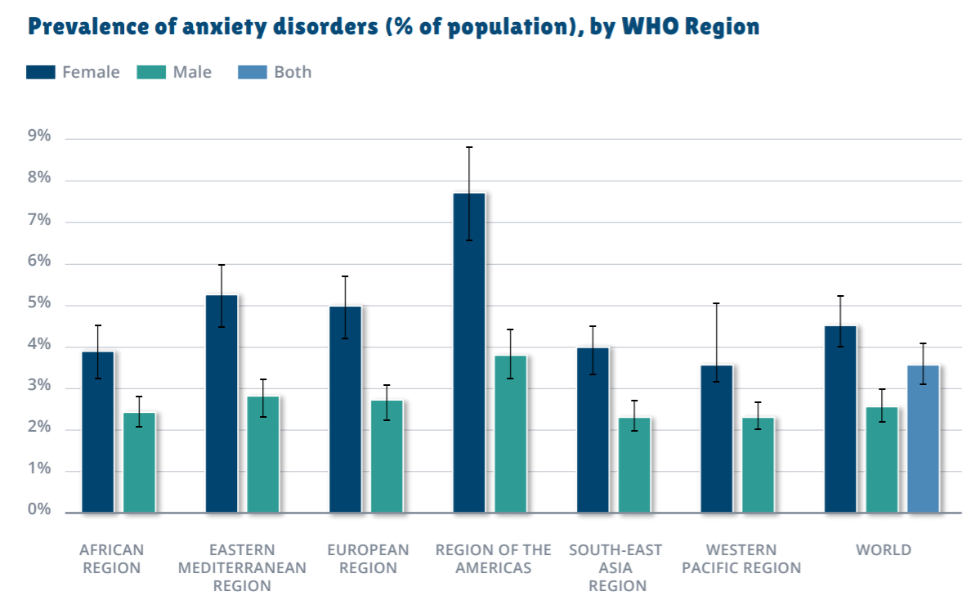

Slide 15
Mental Health Global burden (morbidity and mortality) ⁽³⁾
People with mental disorders experience disproportionately higher rates of disability and mortality
major depression and schizophrenia have a 40% to 60% greater chance of dying prematurely than the general population
Depression alone accounts for 4.3% of the global burden of disease
Notes:
, owing to physical health problems that are often left unattended [such as cancers, cardiovascular diseases, diabetes and HIV infection) and suicide
-and is among the largest single causes of disability worldwide [11 % of all years lived with disability globally], particularly for women. In 2004
How does this affect cost? Healthcare? Workforce? Income?

Slide 16
Objectives
By the end of this lecture students should be able to:
Define mental health and its etiology
Discuss the global magnitude of mental illness based on the global burden of disease ( GBD)
List and classify the factors contributing to the occurrence of mental illness
Define stigma, and explain its consequences on mentally ill patients, their families and treatment outcome.
Discuss the principals of preventing mental illness.

Slide 17
Stigma
A Social Experiment on Mental Health Stigma | Beyond the Label
https://www.youtube.com/watch?v=VQoiz4wfV_c

Slide 18
Stigma ⁽⁵⁾
“..a mark of shame, disgrace or disapproval which results in an individual being shunned or rejected by others. “
Notes:
The stigma associated with all forms of mental illness is strong but generally increases the more an individual's behaviour differs from that of the 'norm'.
A major cause of stigma associated with mental illness are the myths, misconceptions and negative stereotypes about mental illness held by many people in the community.

Slide 19
Stigma leads to ⁽⁵⁾
Rejection by friends, relatives, neighbors and employers
In-equal participation in family life, normal social networks, and productive employment;
detrimental effect on a mentally ill person's recovery, ability to find access to services, the type of treatment and level of support received and acceptance in the community;
family and caretakers isolation and humiliation
Notes:
often rejected by friends, relatives, neighbours and employers leading to aggravated feelings of rejection, loneliness and depression;
often denied equal participation in family life, normal social networks, and productive employment;
Stigma has a detrimental effect on a mentally ill person's recovery, ability to find access to services, the type of treatment and level of support received and acceptance in the community;
Rejection of people with mental illness also affects the family and caretakers of the mentally ill person and leads to isolation and humiliation; and
A major cause of stigma associated with mental illness are the myths, misconceptions and negative stereotypes about mental illness held by many people in the community.

Slide 20
How to reduce stigma? ⁽⁵⁾
openly talking about mental illness in the community;
providing accurate information
countering the negative stereotypes and misconceptions
providing support and treatment services
ensuring the existence of legislation to reduce discrimination in the workplace, in access to health and social community services.
Notes:
openly talking about mental illness in the community;
providing accurate information on the causes, prevalence, course and effects of mental illness;
countering the negative stereotypes and misconceptions surrounding mental illness;
providing support and treatment services that enable persons suffering from a mental illness to participate fully in all aspects of community life;
ensuring the existence of legislation to reduce discrimination in the workplace, in access to health and social community services.

Slide 21
Objectives
By the end of this lecture students should be able to:
Define mental health and its etiology
Discuss the global magnitude of mental illness based on the global burden of disease ( GBD)
List and classify the factors contributing to the occurrence of mental illness
Define stigma, and explain its consequences on mentally ill patients, their families and treatment outcome.
Discuss the principals of preventing mental illness.

Slide 22
Prevention
Tertiary
Secondary
primary
Notes:
Primary = preventing disease onset
Ex: vaccination
Secondary= early diagnosis and prompt treatment
Ex: Breast CA screening, BP for HTN
Tertiary prevention= rehabilition after severe illness, preventing the disease form getting worse and spreading on.

Slide 23
Primary prevention of mental illness ⁽¹⁾
Community based
Improving the:
Social environment
Living conditions
Health and welfare resources

Slide 24
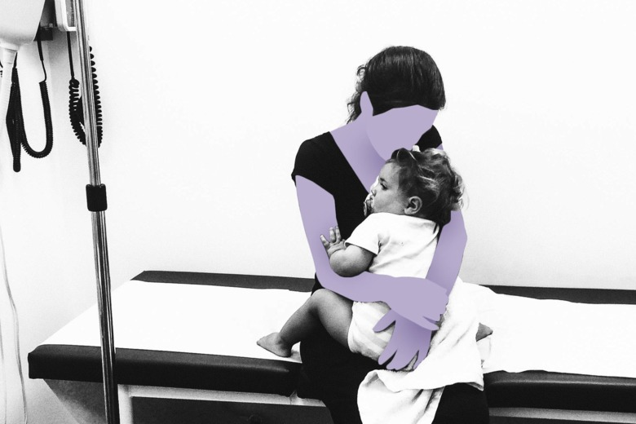
Secondary prevention of mental illness ⁽¹⁾
Screening programs in schools, universities, industry, recreation centers
Mental Health Screenings at Schools
https://www.youtube.com/watch?v=OgQx57os0UE

Slide 25
Tertiary prevention of mental illness ⁽¹⁾
seeks to reduce the duration of mental illness
prevent further break-down and disruption
Mental health services:
Diagnosis & treatment
Rehabilitation
Group &individual psychotherapy.
Mental health education.
psychoactive drugs
After-care services (ex: social care, employment services)

Slide 26
Global health systems and mental health⁽³⁾
76% - 85% of people with severe mental disorders receive no treatment (in low-income and middle-income countries)
VS.
35% - 50% in high income countries ( also high)
For those receiving treatment- poor quality of care

Slide 27
Global health systems and mental health⁽³⁾
annual spending on mental health is less than US$ 2 per person and less than US$ 0.25 per person in low-income countries
67% of these financial resources >>>>stand-alone mental hospitals
Half of the World's countries have 1 psychiatrist for each 200,000 persons. Psycho-social intervention professionals are even scarcer.
Notes:
2-despite their association with poor health outcomes and human rights violations

Slide 28
Global health systems and mental health ⁽³⁾
WHO recommends redirecting mental health funds to community-based services
integration of mental health into general health care settings
Improves access and cost-effectiveness
Notes:
2-despite their association with poor health outcomes and human rights violations

Slide 29
Objectives
By the end of this lecture residents should be able to:
Define mental health and its etiology
Discuss the global magnitude of mental illness based on the global burden of disease ( GBD)
List and classify the factors contributing to the occurrence of mental illness
Define stigma, and explain its consequences on mentally ill patients, their families and treatment outcome.
Discuss the principals of preventing mental illness.

Slide 30
References
Park’s Textbook of Preventive and Social Medicine. 23rd edition. CH17 (p 831-838).
Mental Disorders-Key Facts [webpage].9 April 2018. World Health Organization.URL: https://www.who.int/en/news-room/fact-sheets/detail/mental-disorders [Accessed March 7th, 2019]
Mental Health Action Plan 2013-2020[webpage].2013. World Health Organization.URL: https://apps.who.int/iris/bitstream/handle/10665/89966/9789241506021_eng.pdf?sequence=1 [Accessed March 7th, 2019]
Depression and Other Common Mental Disorders Global Health Estimates.2017. World Health Organization.URL: https://apps.who.int/iris/bitstream/handle/10665/254610/WHO-MSD-MER-2017.2-eng.pdf?sequence=1 [Accessed March 7th, 2019]
Mental health problems: the undefined and hidden burden [webpage].(n.d.). World Health Organization.URL: https://www.who.int/mediacentre/factsheets/fs218/en/ [Accessed March 7th, 2019]

Slide 31
mhassounah@ksu.edu.sa
Marwah Hassounah
Marwah Hassounah

Slide 32
Thank You

