Slide 1
Methods of prevention and control in NCDs
Dr Leena Baghdadi
MBBS, Master CliEpi, PhD ClinEpi
Assistant Professor & Epidemiologist | Family & Community Medicine| College of Medicine | KSU

Slide 2
Objectives
Epidemiology as a method to understand the nature, extent and causes of NCDs
Interventions for NCD control
Intrapersonal approaches for NCD control
Interpersonal approaches
Organizational level interventions
Community factors in NCD control
Health Policy and Legal Interventions

Slide 3
Nature, extent & causes of NCDs
There is much to learn about the cause of chronic diseases.
Whereas in some chronic diseases the cause is known (e.g., silica in silicosis, asbestos in mesothelioma), for many chronic diseases the causative agent is not known.
Multifactorial causation.
In the absence of a known agent, the term "risk factor(s)”is used.

Slide 4
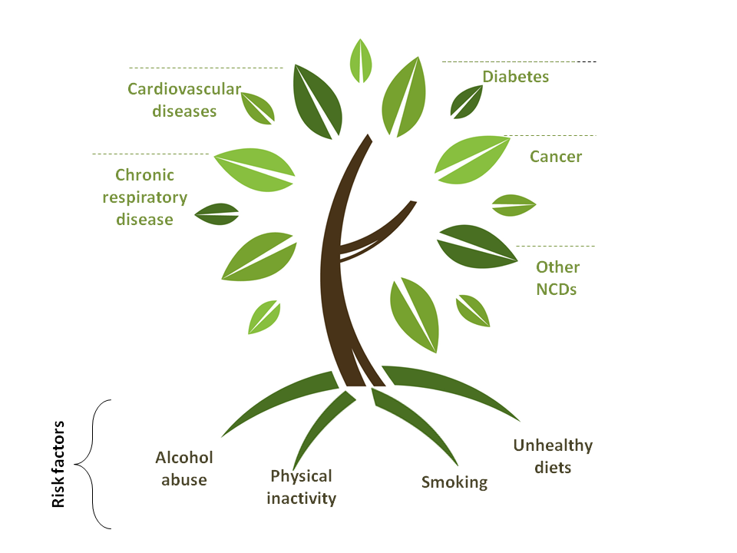
Behavioral
Multiple and interrelated causes
Source: http://emro.who.int

Slide 5
Chronic disease continuum
Continuum of Care is a concept involving a system that guides and tracks patients over time through a comprehensive array of health services spanning all levels and intensity of care.
- Developmental
- Social
- Environmental
- Genetic
Health risk
behaviors and
other factors
Chronic
conditions
Chronic
disease
Determinants

Slide 6
Chronic disease continuum
1. Descriptive epidemiology: Describing the distribution of the continuum in populations by time, person, and place
2. Analytic epidemiology: Discovering the causes of each of the factors along the continuum
3. Intervention and evaluation research: Finding programs that work along the continuum from primary to tertiary prevention
- Developmental
- Social
- Environmental
- Genetic
Health risk
behaviors and
other factors
Chronic
conditions
Chronic
disease
Determinants

Slide 7
Chronic disease continuum
- Developmental
- Social
- Environmental
- Genetic
Selected Risk Factors
- Tobacco Use
- Diet and Nutrition
- Physical Activity
- Alcohol Use
Major Conditions
- Obesity and overweight
- Diabetes
- High blood pressure
- High blood cholesterol
Major Diseases
- Cardiovascular disease
- Cancer
- Chronic Respiratory Diseases
- Mental Disorders
- Neurological Disorders
- Musculoskeletal Problems
- Arthritis
- Chronic Liver Disease
- Kidney Disease
Determinants

Slide 8
Epidemiology
The Centers for Disease Control and Prevention (CDC) currently defines epidemiology as “the study of the distribution and determinants of health-related states in specified populations, and the application of this study to control health problems.”

Slide 9
Epidemiology key words
Study - Epidemiology is a quantitative discipline based on principles of statistics and research methods.
Distribution - Epidemiologists study the “distribution” of health events within groups in a population, characterizing health events in terms of person, place, and time. This type of epidemiology is referred to as descriptive epidemiology.
Determinants - Epidemiologists also search for “determinants” (i.e., causes or factors) that are associated with increased risk or probability of disease. This type of epidemiology, where we move from questions of “who,” “what,” “where,” and “when” and start trying to answer “how” and “why,” is referred to as “analytical epidemiology.”

Slide 10
Epidemiology key words
Health-related states - Although infectious diseases were clearly the focus of much of the early epidemiological work, the field is no longer limited in this way. Epidemiology as it is practiced today is applied to the whole spectrum of health-related events, which includes NCDs, conditions, and risk factors.
Populations - One of the most important distinguishing characteristics of epidemiology is that it deals with groups of people rather than with individual patients.
Control - Epidemiological data and methods steer public health decision-making and aids in developing and evaluating interventions to control and prevent health problems. This is the primary function of applied, field, or consequential epidemiology.

Slide 13
Intervention Methods for NCD Control

Slide 14
Multiple Determinants of NCDs
Behavioral Determinants
Environmental Determinants
Social Determinants
Health Care Determinants

Slide 15
Multiple Determinants of NCDs
Behavioral Determinants
Poor diet, physical inactivity, and smoking
80% of heart disease and stroke
80% of type 2 diabetes
40% of cancers

Slide 16
Multiple Determinants of NCDs
2. Environmental Determinants
accessible and safe sidewalks
nearby parks,
bike trails
community swimming pools
multiple-television households,
desktop computers, and sophisticated video games
healthy menu choices in schools, restaurants, and work site cafeterias

Slide 17
Multiple Determinants of NCDs
3. Social Determinants
level of education
level of social or economic stressors
access to health care
transportation
housing
income inequality
social inclusion or exclusion stemming from sex, race, or age

Slide 18
Multiple Determinants of NCDs
4. Health Care Determinants
more funding on primary prevention
secondary prevention (e.g., screening for hypertension, hyperlipidemia, breast cancer)
tertiary prevention will minimize hospitalizations and provider visits

Slide 19
Evidence-based interventions
Environmental Health Sciences
Social and Behavioral Sciences
NCD control
Health Policy and Management
Epidemiology
Other

Slide 20
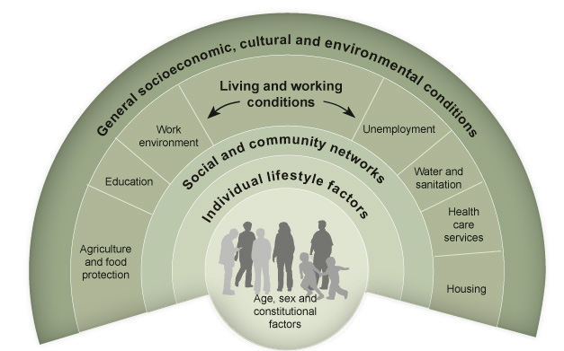
Levels of intervention: Ecological model of health
Source: Dahlgren & Whitehead 1991.

Slide 21
Levels of intervention: Ecological approach
Intrapersonal factors - altering knowledge, attitudes, skills, and future behavioral intentions at the level of the individual person.
Interpersonal factors - understanding and accessing the relationships that people have with other individuals in their social network such as friends, peers, and coworkers, family members, neighbors, and others from whom behavioral patterns and behavioral norms are acquired.

Slide 22
3. Organizational factors - using organizations such as schools, faith-based groups, work sites, or health care facilities to direct, influence, or support health behavior change and help to define health behavior norms.

Slide 23
4. Community factors - catalyzing interest within an area having geographic or political boundaries to leverage power structures to achieve a particular set of health objectives, perhaps to address the most serious health problems among persons typically in the weakest position to advocate on their own behalf (e.g., the rural poor, members of underrepresented minorities, less educated, physically or mentally disabled).

Slide 24
5. Policy factors - advocating for and organizing and analyzing policies and procedures, regulations, and laws that favorably influence the fight against chronic diseases.

Slide 25
Intrapersonal (Individual) Approaches
Source: http://inteligencia-intrapersonal2016iii.blogspot.com/2016/09/caracteristicas.html

Slide 26
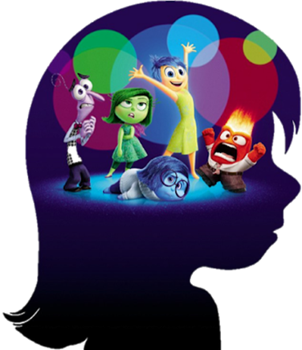
Intrapersonal (Individual) Approaches
Intrapersonal models or theoretical frameworks draw on the assumption that people can be motivated to take individual action that changes their health knowledge, attitudes, skills, behavioral intentions, and eventual behavior.

Slide 27
Health Believe model
Health Belief Model - The HBM suggests that a person's belief in a personal threat of an illness or disease together with a person's belief in the effectiveness of the recommended health behavior or action will predict the likelihood the person will adopt the behavior.

Slide 28
Health Believe model
A person is likely to change behavior if he/she experiences:
1. Perceived Susceptibility/Seriousness: believing he/she is at risk.
2. Perceived Benefits: believing that the behavior change will reduce risk.
3. Perceived Barriers: how one interprets the costs/barriers of the desired behavior.
4. Cues to Action: strategies to activate “readiness.”
5. Self-Efficacy: feeling confident in one’s ability to take action.

Slide 29
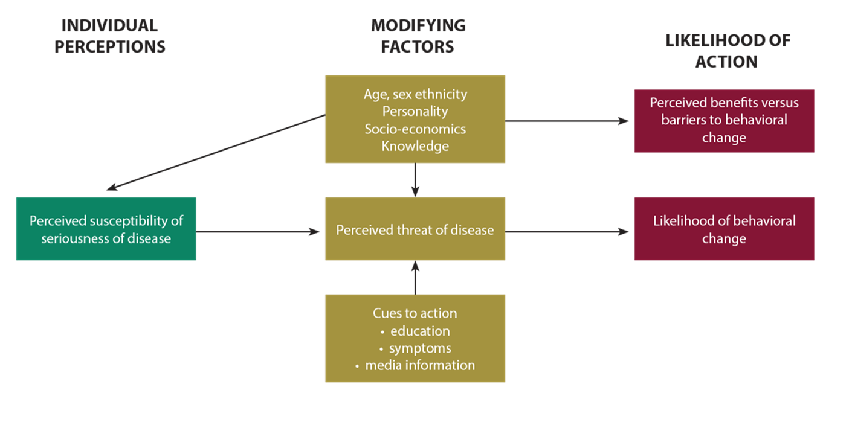
Health Believe model

Slide 30
Transtheoretical Model and Stages of Change
Transtheoretical Model and Stages of Change - The TTM operates on the assumption that people do not change behaviors quickly and decisively. Rather, change in behavior, especially habitual behavior, occurs continuously through a cyclical process.

Slide 31
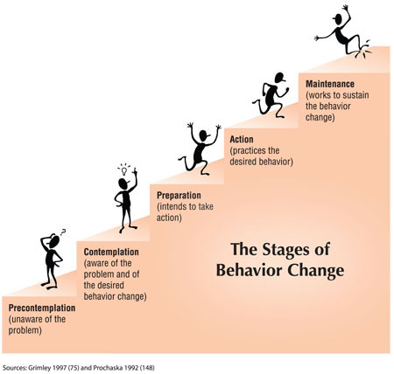
Transtheoretical Model and Stages of Change

Slide 32
Theory of Planned Behavior
Theory of Planned Behavior - The theory was intended to explain all behaviors over which people have the ability to exert self-control. The key component to this model is behavioral intent; behavioral intentions are influenced by the attitude about the likelihood that the behavior will have the expected outcome and the subjective evaluation of the risks and benefits of that outcome.

Slide 33
Theory of Planned Behavior
Behavior in this model is influenced by three elements:
Belief and Attitude: that the behavior will be beneficial to the individual.
Subjective Norms: the belief that other people think that the behavior is acceptable.
Perceived Ability: the belief that one has the skills and capability to change behavior.

Slide 34
Theory of Planned Behavior

Slide 35
Health Locus of Control Model
Health Locus of Control Model - who or what is responsible for that which happens to one’s health

Slide 36
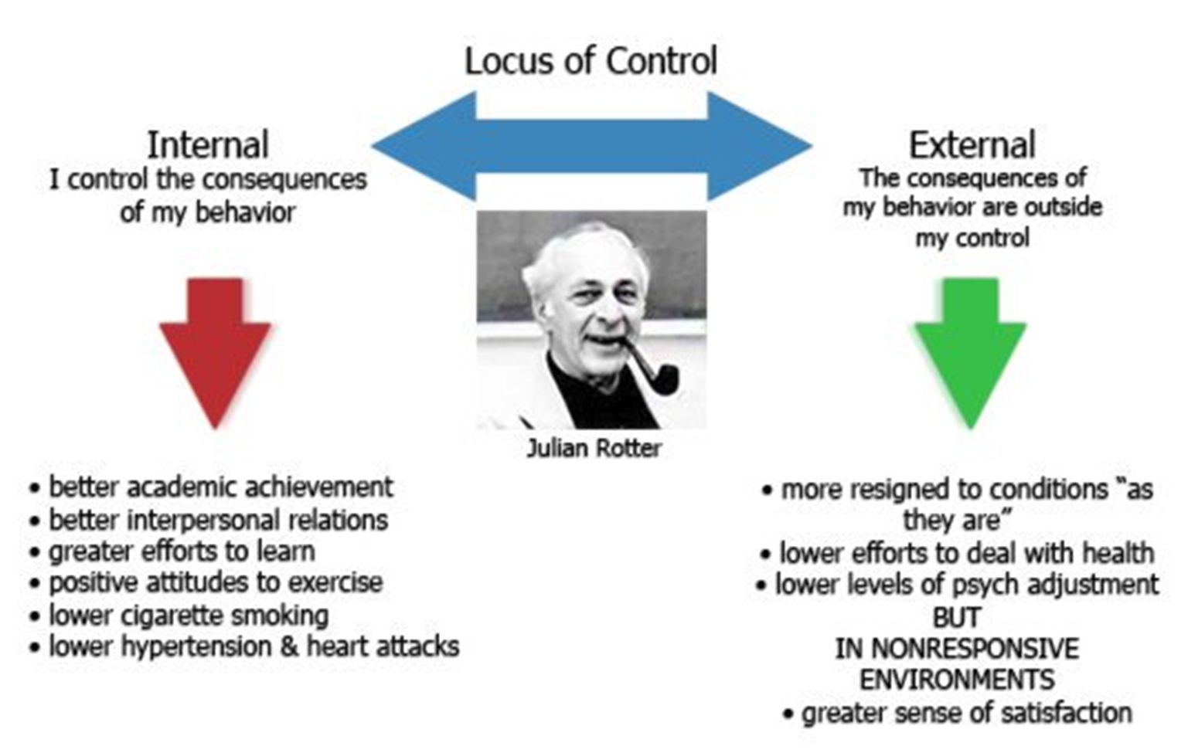
AP Psychology Review

Slide 37
Interpersonal Approaches
Source: https://jarvee.com/social-media-impact-interpersonal-relationships/

Slide 38
Interpersonal Approaches
Models of interpersonal health behavior assume that the interpersonal environment is one of the most powerful sources of influence for health-related behavior and health status.
“People’s environments provide the means, model, reinforcements, resources, and sources of influence from which people gain information, skills, self-confidence, self-management competencies, coping behavior, and support” (Glanz, Rimer, and Lewis 2002, p. 265).

Slide 39
Interpersonal Approaches
Social Cognitive Theory - learning occurs in a social context with a dynamic and reciprocal interaction of the person, environment, and behavior.
Family-Based Interventions - for example, family members have been trained to provide support to individuals who are in programs to stop smoking.

Slide 40
Interpersonal Approaches
Friends and Social Networks - developing new social network linkages through mentor programs, buddy systems, and self-help groups. Groups such as Alcoholics Anonymous, Overeaters Anonymous, and Weight Watchers.

Slide 41
Interpersonal Approaches
Social Support and Social Networks - impact of social relationships on health status, health behaviors, and health decisions has the potential to make important contributions to the design of effective interventions.
Natural Helpers - respected and trusted members of social networks to whom other network members turn for advice, support, and other types of aid

Slide 42
Organizational-Level Venues for Intervention

Slide 43
Organizational-Level Venues for Intervention
Health Care System and Clinical Services
Schools
Work Sites
Faith-Based Organizations

Slide 44
Health Care System and Clinical Services
Research has firmly established that physician advice given in the health care setting provides a powerful and motivational message for cardiovascular disease risk reduction, weight loss, dietary change, and physical activity improvement among adolescents, tobacco control and alcohol consumption.

Slide 45
Health Care System and Clinical Services
An intervention that has shown effectiveness without being especially burdensome on health care providers or patients is known as the “brief intervention.”
Brief interventions usually last for 5–60 minutes and consist of counseling and education.

Slide 46
Health Care System and Clinical Services
Sometimes, there are multiple sessions, perhaps initiated by a primary care provider, and then transitioned to a health education specialist to carry on the intervention.
However, a brief intervention can be as limited as 30 seconds and consist of just one “teachable moment” session conducted by an alert and opportunistic health care provider.
The content, duration, and number of sessions may depend on the provider, the patient’s receptivity and readiness to change, the setting, and previous patient–provider rapport.

Slide 47
Examples of Brief Interventions for Health Promotion
When taking a blood pressure reading, sharing information about the causes and problems of high blood pressure, talking about exercise and proper diet as ways to reduce blood pressure
Encouraging a patient at risk of developing diabetes to talk about the foods they eat, offering nutrition advice, talking about practical ways to shop for food and prepare healthy meals

Slide 48
Examples of Brief Interventions for Health Promotion
When treating an infant or child with a respiratory infection, talking to the mother who smokes to find out if she knows about passive smoking, recommending ways of reducing the child’s exposure to smoking, and asking if she is thinking about quitting

Slide 49
Coordinated school health program

Slide 50
Work site health promotion services
fitness centers
on-site exercise classes
weight loss programs
policies related to paid time to exercise at work
healthy vending and/or cafeteria choices

Slide 51
Benefits through workplace interventions
Improved employee productivity. Employees with multiple health risk factors have been found to be less productive than employees with fewer risk factors (Partnership for Prevention 2001).
Reduced absenteeism. In an analysis of the effects of work site wellness programs and employee absenteeism, it was determined that there was an average savings of $5.00 for every dollar spent on employee wellness.

Slide 52
Benefits through workplace interventions
Reduced health care costs. An analysis of eight work site wellness programs determined a reduction of health care expenses averaging $3.35 for every dollar spent on employee health promotion (Partnership for Prevention 2001).
Improved corporate image. Work site wellness programs offer further gains to employers by demonstrating social responsibility in addition to promoting the health of employees and their families in addition to retirees (Partnership for Prevention 2001).

Slide 53
Benefits through workplace interventions
Reduced employee health risks. For a cost of $32 per employee, the Coors Brewing Company “Lifecheck” program reduced employee risk for cardiovascular disease by decreasing high blood pressure, high cholesterol, and weight among its employees (Aldana 1998).

Slide 54
Community-Level Interventions

Slide 55
Community
Group’s members must share:
a sense of belonging
common symbols
norms and values
conditions and constraints
and mutual influence

Slide 56
Community interventions
Intervention strategies should be selected based on the needs and priorities of the specific population so as to identify appropriate interventions that are compatible with the population’s knowledge, attitudes, perceptions, and sociocultural and economic circumstances.
Chronic disease prevention and control programs will be more effective if the population of interest is actively involved in prioritizing, developing, and implementing all intervention activities.

Slide 57
Community interventions
Full partnership between public health professionals and local community members can lead to empowerment of individuals and groups and result in more effective management of health issues and economic, social, and political forces in the community.
Community coalitions are often initiated to assist communities in mobilizing resources and coordinating activities that improve the public’s health.
Media advocacy - “the strategic use of mass media in combination with community organizing to advance healthy public policies” .

Slide 58
Community interventions
Media advocacy differs from other uses of mass media in its attempt to shift power back to communities so they can change policies that affect their lives (i.e., addressing the power gap) rather than promote messages about the need for individual behavior change.
By learning to use media to address system-level factors, communities are empowered to participate in the political process.

Slide 59
Health Policy and Legal Interventions
Source: Hill Havurah, 2018

Slide 61
Source: World Health Organization, 2004

Slide 62
Conclusions
Epidemiology helps in searching for determinants of health and preventing chronic non-communicable diseases.
Health care continuum involves health care system and guides and tracks patients over time through a comprehensive array of health.
Many determents of health can be modified though behavioural change.
Behavioural change needs time and patient.

Slide 63
References
Remington PL, Brownson RC, Wegner MV. Chronic disease epidemiology and control - 3rd ed. Washington, DC: American Public Health Association; 2010.
LaMorte WW. Behavioral Change Models. Boston University School of Public Health; 2018. Available on: http://sphweb.bumc.bu.edu/otlt/MPH-Modules/SB/BehavioralChangeTheories/index.html
Key considerations for the use of law to prevent noncommunicable diseases in the WHO European Region. Report of an intensive legal training and capacity-building workshop on law and noncommunicable diseases. Moscow, 30 May–3 June 2016.

