Slide 1
The Social Determinants of Non-Communicable Diseases
Marwah Hassounah MPH-HCOM, MBBS
Community Medicine Unit Faculty
Family and Community Medicine Department- King Saud University
COMM 311 - Community Medicine Course
February 2nd,2019 9-10 A.M.

Slide 3
objectives
By the end of this session students should be able to:
Define the social determinants of NCDs
Discuss the significance, high risk groups and health consequences of social determinants of NCDs
Identify material conditions needed for individual and community well-being
Identify psychosocial risk factors influencing NCDs
Identify neighborhood factors influencing NCDs
Identify the relationship between SES and health-risk behaviors
Identify Evidence-based approaches to improving the social determinants of NCDs

Slide 4
“The social determinants of health refer to both specific features of and pathways by which societal conditions affect health and that potentially can be altered by informed action. “

Slide 5
Income
Public policies
Health services
Employment
Education
Housing
Transportation

Slide 6
Other examples of social determinants
Socio-economic status
Built environment
Community support networks
Health behavior and lifestyle

Slide 7
Social Determinants of Health ….
can influence health both directly and indirectly.
contribute to health inequalities between social groups.
are interconnected.
operate at different levels.
Notes:
While the precise pathways through which social determinants influence health are at an individual level – and not clear and are the subject of continuing research, it is important to note that:
Social determinants contribute to health inequalities between social groups. This is because the effects of social determinants of health are not distributed equally or fairly across society.
Social determinants can influence health both directly and indirectly. For example damp housing can directly contribute to respiratory disorders, while educational disadvantage can limit access to employment, raising the risk of poverty and its adverse impact on health.
Social determinants of health are interconnected. For example poverty is linked to poor housing, access to health services or diet, all of which are in turn linked to health.
Social determinants operate at different levels. Structural issues, such as socioeconomic policies or income inequality, are often termed ‘upstream’ factors. While ‘downstream’ factors like smoking or stress operate can be influenced by upstream factors.

Slide 8
Notes:
Figure 1 illustrates four layers of determinants of health, which function independently and collectively to impact health outcomes for individuals. The model indicates unequal individual genetic and lifestyle factors are the primary causes for inequality in health, though the wider determinants of health go beyond these. Individuals with their different characteristics such as sex, age, hereditary, and race are placed at the centre of the figure, but are influenced by social and community networks which were placed in the next layer. The third layer indicates that individual’s health is influenced by the broad health determinants factors such as the general socioeconomic, cultural and environmental conditions. For instance, individual living and working conditions, access to essential goods and services, which is largely determined by a country’s overall economic state, labour market conditions, cultural, environmental, and standard of living achieved in a society.

Slide 10
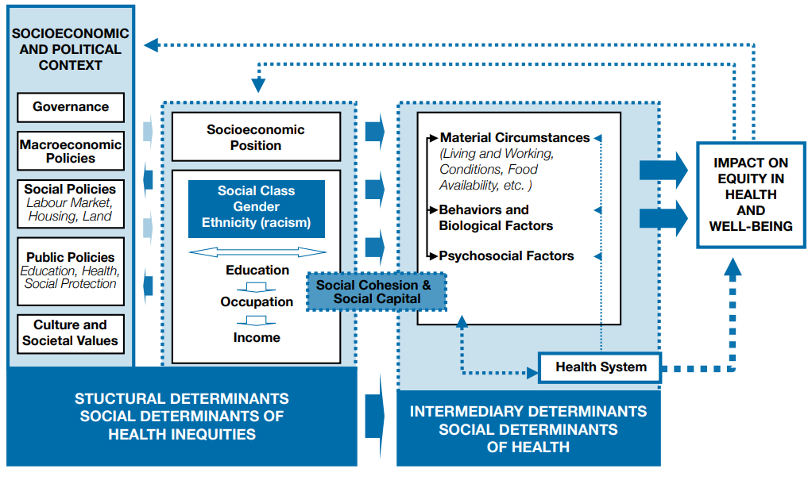
WHO conceptual framework for action on the social determinants of health-2010
Notes:
Read reference pgs [5-7], [25-40]
Structural determinants have the biggest impact on health and are a priority in health inequities.
structural determinants are those that generate or reinforce social stratification in the society and that define individual socioeconomic position. These mechanisms configure the health opportunities of social groups based on their placement within hierarchies of power, prestige and access to resources (economic status).
- Differential exposure to conditions that have more immediate effects on health, such as access to healthy foods, a safe and clean place to live, and the ability to get routine physical exercise.
- Those with less education and less income are more likely to smoke, less likely to engage in physical activity and less physically fit than their higher-income peers and are less likely to consume fiber and fresh fruits and vegetables.
- Education promotes knowledge and life skills, which increase access to information and resources that promote health In addition, education builds occupational opportunities and earning potential, which in turn can lead to better nutrition, housing, schooling, and recreation.
-material living conditions include:
Food
Shelter
Transportation
Health care
Safe environments

Slide 11
objectives
By the end of this session students should be able to:
Define the social determinants of NCDs
Discuss the significance, high risk groups and health consequences of social determinants of NCDs
Identify material conditions needed for individual and community well-being
Identify psychosocial risk factors influencing NCDs
Identify neighborhood factors influencing NCDs
Identify the relationship between SES and health-risk behaviors
Identify Evidence-based approaches to improving the social determinants of NCDs

Slide 12
WHO conceptual framework for action on the social determinants of health-2010
Notes:
Read reference pgs [5-7], [25-40]
Structural determinants have the biggest impact on health and are a priority in health inequities.
structural determinants are those that generate or reinforce social stratification in the society and that define individual socioeconomic position. These mechanisms configure the health opportunities of social groups based on their placement within hierarchies of power, prestige and access to resources (economic status).
- Differential exposure to conditions that have more immediate effects on health, such as access to healthy foods, a safe and clean place to live, and the ability to get routine physical exercise.
- Those with less education and less income are more likely to smoke, less likely to engage in physical activity and less physically fit than their higher-income peers and are less likely to consume fiber and fresh fruits and vegetables.
- Education promotes knowledge and life skills, which increase access to information and resources that promote health In addition, education builds occupational opportunities and earning potential, which in turn can lead to better nutrition, housing, schooling, and recreation.
-material living conditions include:
Food
Shelter
Transportation
Health care
Safe environments

Slide 13
High risk groups
Uneducated or low educational attainment
unemployed
Low income
low social status
Ethnic minorities
females

Slide 16
objectives
By the end of this session students should be able to:
Define the social determinants of NCDs
Discuss the significance, high risk groups and health consequences of social determinants of NCDs
Identify material conditions needed for individual and community well-being
Identify psychosocial risk factors influencing NCDs
Identify neighborhood factors influencing NCDs
Identify the relationship between SES and health-risk behaviors
Identify Evidence-based approaches to improving the social determinants of NCDs

Slide 17
WHO conceptual framework for action on the social determinants of health-2010
Notes:
Read reference pgs [5-7], [25-40]
Structural determinants have the biggest impact on health and are a priority in health inequities.
structural determinants are those that generate or reinforce social stratification in the society and that define individual socioeconomic position. These mechanisms configure the health opportunities of social groups based on their placement within hierarchies of power, prestige and access to resources (economic status).
- Differential exposure to conditions that have more immediate effects on health, such as access to healthy foods, a safe and clean place to live, and the ability to get routine physical exercise.
- Those with less education and less income are more likely to smoke, less likely to engage in physical activity and less physically fit than their higher-income peers and are less likely to consume fiber and fresh fruits and vegetables.
- Education promotes knowledge and life skills, which increase access to information and resources that promote health In addition, education builds occupational opportunities and earning potential, which in turn can lead to better nutrition, housing, schooling, and recreation.
-material living conditions include:
Food
Shelter
Transportation
Health care
Safe environments

Slide 18
Material & neighborhood factors
Housing
relating to both the dwelling itself and its location
Ex: access to hot and cold water in the house, having central heating and carpets, sole use of bathrooms and toilets, whether the toilet is inside or outside the home, and having a refrigerator, washing machine, or telephone, broken windows
consumption potential, i.e. the financial means to buy healthy food, warm clothing, etc.
the quality of physical working environment

Slide 19
Material & neighborhood factors
neighborhood environment:
abandoned cars, graffiti, trash and public school deterioration
water, air, and street and sidewalk conditions
level of risk in the environments in which people work, play, and rest
the quality of public and private services provided to residents, such as garbage removal, police protection, and social services
the reputation of a neighborhood
absence of grocery stores and the types of food available
individual characteristics of residents

Slide 20
Psychosocial Risk Factors
Stress (both acute and chronic)
Personality factors
traumatic life events
coping and resilience
self-efficacy
self-esteem
cynical hostility
Hopelessness
Social relationships
social support
social networks
sense of job control
experiences of discrimination
use of risky behaviors as a form of self-medication
Socioeconomic status
Risk Factors

Slide 21
objectives
By the end of this session students should be able to:
Define the social determinants of NCDs
Discuss the significance, high risk groups and health consequences of social determinants of NCDs
Identify material conditions needed for individual and community well-being
Identify psychosocial risk factors influencing NCDs
Identify neighborhood factors influencing NCDs
Identify the relationship between SES and health-risk behaviors
Identify Evidence-based approaches to improving the social determinants of NCDs

Slide 22
In-class stretching break

Slide 23
Reverse Causality
Socioeconomic position
NCDs
Socioeconomic position
NCDs
Notes:
……….based on their respective social status, individuals experience differences in exposure and vulnerability to health-compromising conditions. Illness can “feed back” on a given individual’s social position, e.g. by compromising employment opportunities and reducing income; certain epidemic diseases can similarly “feed back” to affect the functioning of social, economic and political institutions.
Differences correlated with people’s socioeconomic position are found for rates of mortality and morbidity from almost every disease and condition. SEP is also linked to prevalence and course of disease and self-rated health. p The magnitude of certain diseases can directly affect features of the socioeconomic and political context, through high prevalence rates and levels of mortality and morbidity.

Slide 24
Health-Risk Behaviors
Socioeconomic status
Tobacco use
Illicit drug use
Obesity
Physical inactivity
Sexual risk taking
Driving while intoxicated
Not wearing a helmet
others
Risky Behavior

Slide 25
objectives
By the end of this session students should be able to:
Define the social determinants of NCDs
Discuss the significance, high risk groups and health consequences of social determinants of NCDs
Identify material conditions needed for individual and community well-being
Identify psychosocial risk factors influencing NCDs
Identify neighborhood factors influencing NCDs
Identify the relationship between SES and health-risk behaviors
Identify Evidence-based approaches to improving the social determinants of NCDs

Slide 26
WHO conceptual framework for action on the social determinants of health-2010
Notes:
Read reference pgs [5-7], [25-40]
Structural determinants have the biggest impact on health and are a priority in health inequities.
structural determinants are those that generate or reinforce social stratification in the society and that define individual socioeconomic position. These mechanisms configure the health opportunities of social groups based on their placement within hierarchies of power, prestige and access to resources (economic status).
- Differential exposure to conditions that have more immediate effects on health, such as access to healthy foods, a safe and clean place to live, and the ability to get routine physical exercise.
- Those with less education and less income are more likely to smoke, less likely to engage in physical activity and less physically fit than their higher-income peers and are less likely to consume fiber and fresh fruits and vegetables.
- Education promotes knowledge and life skills, which increase access to information and resources that promote health In addition, education builds occupational opportunities and earning potential, which in turn can lead to better nutrition, housing, schooling, and recreation.
-material living conditions include:
Food
Shelter
Transportation
Health care
Safe environments

Slide 27
How to intervene?
Context strategies tackling structural and intermediary determinants
Intersectoral action
Social participation and empowerment ( informing, consulting, involving, collaborating, empowering)
Notes:
(with focus on structural socio-political context)1-

Slide 30
objectives
By the end of this session students should be able to:
Define the social determinants of NCDs
Discuss the significance, high risk groups and health consequences of social determinants of NCDs
Identify material conditions needed for individual and community well-being
Identify psychosocial risk factors influencing NCDs
Identify neighborhood factors influencing NCDs
Identify the relationship between SES and health-risk behaviors
Identify Evidence-based approaches to improving the social determinants of NCDs

Slide 31
objectives
By the end of this session students should be able to:
Define the social determinants of NCDs
Discuss the significance, high risk groups and health consequences of social determinants of NCDs
Identify material conditions needed for individual and community well-being
Identify psychosocial risk factors influencing NCDs
Identify neighborhood factors influencing NCDs
Identify the relationship between SES and health-risk behaviors
Identify Evidence-based approaches to improving the social determinants of NCDs

Slide 32
References
A Conceptual Framework for Action on the Social Determinants of Health Social Determinants of Health Discussion Paper 2. World Health Organization 2010. URL: https://www.who.int/sdhconference/resources/ConceptualframeworkforactiononSDH_eng.pdf. [accessed Feb 6th, 2019]
Social Determinants of Noncommunicable Diseases and Other Public Health Issues in Seychelles: Evidence and Implications.WHO Regional Office for Africa, 2014. URL:https://www.afro.who.int/sites/default/files/2017-05/social-determinants-of-ncd-and-other-publlic-health-issues-in-seychelles-who-published-2013.pdf. [Accessed 6th of February, 2019]
Dr. Armen Torchyan's COMM 311 course 2019 lecture slides titled-NCD social determinants

Slide 33
mhassounah@ksu.edu.sa
Marwah Hassounah
Marwah Hassounah

Slide 34
Thank You

