Slide 1

Cardiovascular Disease Epidemiology, Prevention & Control
Dr Leena Baghdadi
MBBS, Master CliEpi, PhD ClinEpi
Assistant Professor & Epidemiologist | Family & Community Medicine| College of Medicine | KSU

Slide 2



Objectives
Definition and public health significance of Cardiovascular Diseases (CVDs).
Risk factors, high risk groups and complications of CVDs
Descriptive CVD Epidemiology
Screening strategies for CVDs
CVDs Prevention and control measures globally and in the local context

Slide 3
Introduction
Cardiovascular diseases comprise especially the major disorders of the heart and the arterial circulation supplying the heart, brain, and peripheral tissues.
Evidence indicates that CVDs are already epidemic in low- and middle-income as well as high-income regions of the world and have become deep-rooted in most societies in recent decades.
CVDs are leading causes of morbidity and mortality burdens worldwide.

Slide 4
Public Health Significance
Significantly contributes to morbidity and mortality rates: potential life years lost, common cause of premature death, and labor force (economic costs)
According to the WHO, CVDs account for 31% of all global deaths.
A major impact on life expectancy
Contributes to deterioration of the quality of life
Leading cause of mortality in developed countries and a rising tendency in developing countries (disease of civilization)

Slide 5
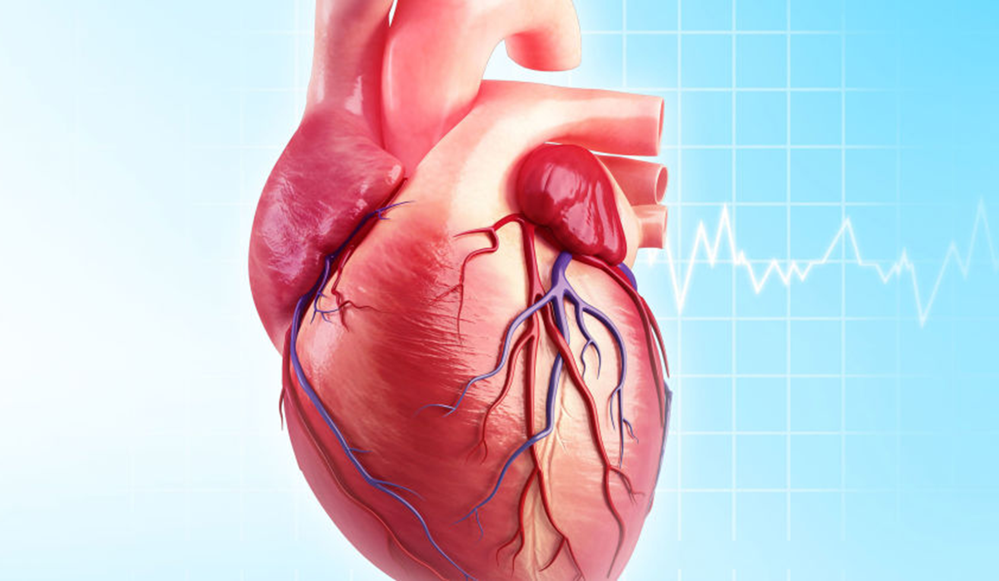
Types of Cardiovascular Diseases

Slide 6
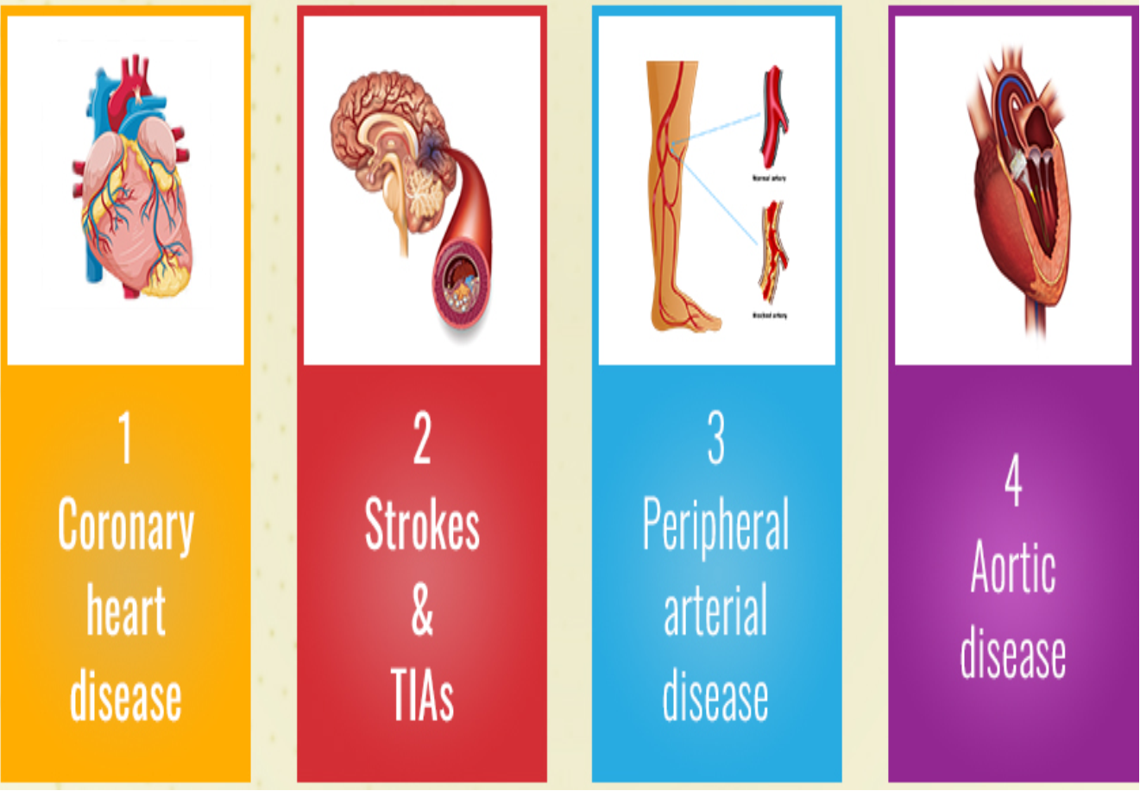
Types of CVDs

Slide 7
Types of CVDs
Coronary heart disease (CHD), manifested by myocardial infarction (MI), angina pectoris, heart failure, and coronary death.
Cerebrovascular disease, manifested by stroke and transient ischemic attack.
Peripheral artery disease, manifested by intermittent claudication.
Aortic atherosclerosis and thoracic or abdominal aortic aneurysm.

Slide 8
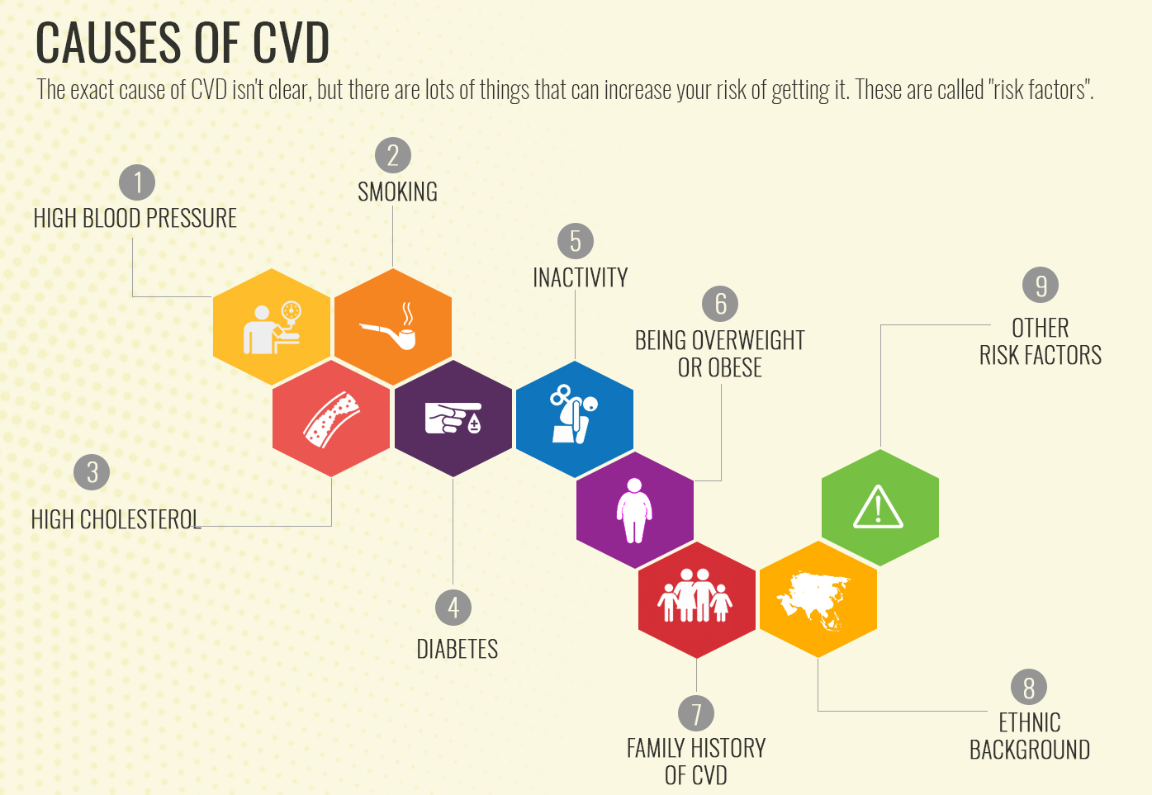
Causes of CVDs

Slide 9
Risk factors of CVDs
Risk factors fall into three broad categories:
1. Major risk factors – Research has shown that these factors significantly increase the risk of heart and blood vessel (cardiovascular) disease.
2. Modifiable risk factors – Some major risk factors can be modified, treated or controlled through medications or lifestyle change.
3. Contributing risk factors – These factors are associated with increased risk of cardiovascular disease, but their significance and prevalence haven’t yet been determined.

Slide 10
Major Risk Factors that can’t be Modified
1. Increasing Age
The majority of people who die of coronary heart disease are 65 or older. (Men > 45 and Females >55).
2. Male gender
Men have a greater risk of heart attack than women do, and men have attacks earlier in life.
3. Heredity (including race)
Children of parents with heart disease are more likely to develop heart disease themselves. family history of a premature MI (defined as MI before age 55 years in men and 65 years in women).

Slide 11
Major Risk Factors you can Modify, Treat or Control
1. Tobacco Smoke:
The risk that smokers will develop coronary heart disease is much higher than that for nonsmokers.
Cigarette smoking is a powerful independent risk factor for sudden cardiac death in patients with coronary heart disease.
Causing:
1. Mechanical damage of endothelium and atherosclerosis
2. Increase coagulability state as increase in fibrinogen level
3. Polythycaemia and so increase blood viscosity
4. Increase Low-density-lipoprotein (LDL), decrease high-density-lipoprotein (HDL) and increase triglycerides.

Slide 12
Major Risk Factors you can Modify, Treat or Control
2. High Blood Cholesterol
Low-density-lipoprotein (LDL) cholesterol = “bad” cholesterol
A low LDL cholesterol level is considered good. Lifestyle factors, such as a diet high in saturated and trans fats, can raise LDL cholesterol.
High-density-lipoprotein (HDL) cholesterol = “good” cholesterol
Higher levels are typically better. Low HDL cholesterol increases risk of heart disease. Genetic factors, Type 2 diabetes, smoking, being overweight and being sedentary can all result in lower HDL cholesterol.
Triglycerides
Triglycerides are the most common type of fat in the body. A high triglyceride level combined with low HDL cholesterol or high LDL cholesterol is associated with atherosclerosis, which is the buildup of fatty deposits inside artery walls that increases the risk for heart attack and stroke.

Slide 13
Major Risk Factors you can Modify, Treat or Control
3. Hypertension
High blood pressure increases the heart’s workload, causing the heart muscle to thicken and become stiffer.
Causing Mechanical damage of endothelium and atherosclerosis.
When high blood pressure is present alongside obesity, smoking, high blood cholesterol levels or diabetes, the risk of heart attack or stroke increases even more.
In patients <50 years of age, diastolic blood pressure was the strongest predictor of CHD risk.
In patients ≥60 years of age, systolic pressure (pulse pressure) was the strongest predictor.

Slide 14
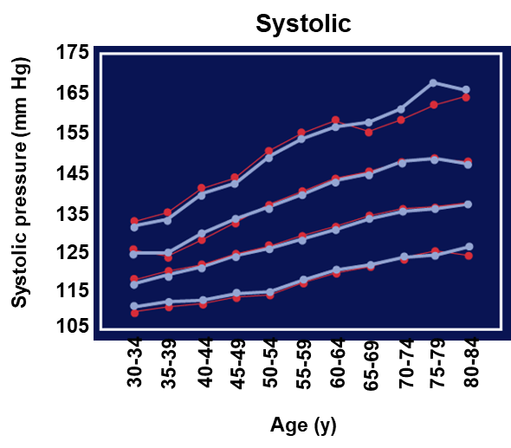
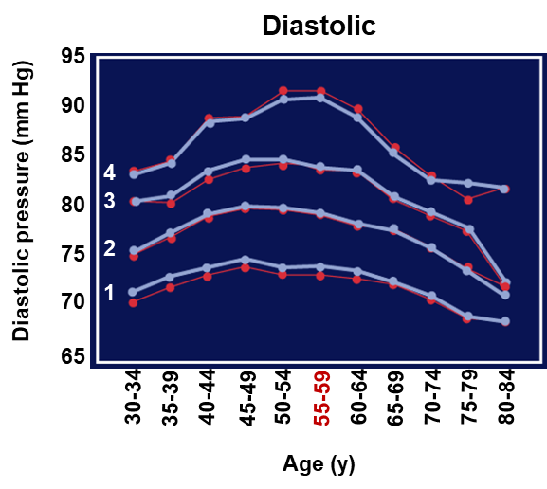
What happens to blood pressure with aging?
Systolic pressure increases with age
Diastolic pressure increases with age but peaks between 55 and 60 years then starts to decrease.
Arterial stiffness: cause of elevated systolic and lower diastolic pressure with aging.
Notes:
Franklin SS, Fustin W 4th, Wong ND, et al. Circulation. 1997;96:308-315.

Slide 15
Hypertension
Systolic blood pressure and isolated systolic hypertension are major CHD risk factors at all ages and in both genders.
The Framingham study found that the relative importance of systolic, diastolic, and pulse pressure (the difference between the systolic and diastolic blood pressures) changes with age.

Slide 16
Major Risk Factors you can Modify, Treat or Control
4. Physical Inactivity
An inactive lifestyle is a risk factor for coronary heart disease. Regular, moderate to vigorous physical activity helps reduce the risk of cardiovascular disease.
Physical activity can help control blood cholesterol, diabetes and obesity. It can also help to lower blood pressure in some people.

Slide 17
Major Risk Factors you can Modify, Treat or Control
4. Obesity
People who have excess body fat – especially if a lot of it is at the waist (central obesity) – are more likely to develop heart disease and stroke, even if those same people have no other risk factors.

Slide 18
Major Risk Factors you can Modify, Treat or Control
5. Diabetes
Diabetes seriously increases your risk of developing cardiovascular disease.
Even when glucose levels are under control, diabetes increases the risk of heart disease and stroke.
The risks are even greater if blood sugar is not well-controlled.

Slide 19
Contributing Factors to Heart Disease Risk
1. Stress
Individual response to stress may be a contributing factor for heart attacks. Increase in adrenaline and blood pressure.
2. Alcohol
Drinking too much alcohol can raise blood pressure, and increase your risk for cardiomyopathy, stroke, cancer and other diseases.
It can also contribute to high triglycerides, and produce irregular heartbeats.

Slide 20
Contributing Factors to Heart Disease Risk
3. Prothrombotic Markers
Homocystinaemia (more among smokers).
High fibrinogen (more among smokers).
4. Proinflammatory Markers
High sensitive C-Reactive Protein.

Slide 21
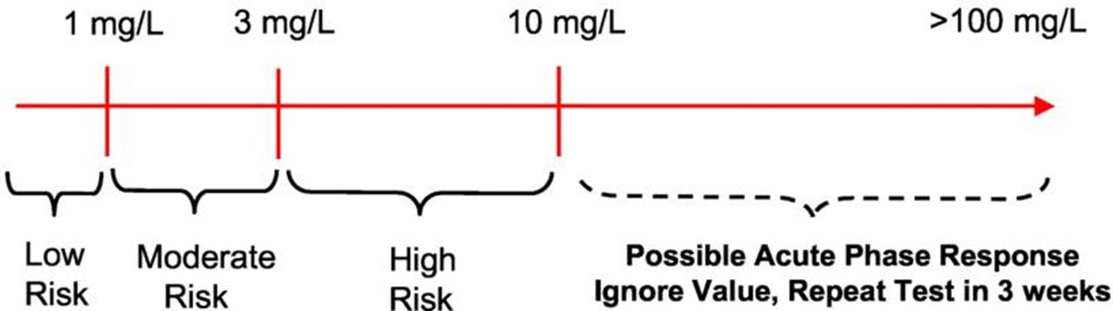
Clinical interpretation of hs-CRP for CV risk prediction
Notes:
Ridker P M Circulation 2003;108:e81-e85

Slide 22
Contributing Factors to Heart Disease Risk
5. Microalbuminuria
Microalbuminuria reflects vascular damage and appears to be a marker of early arterial disease.
Urinary albumin excretion (UAE) between the ranges of (30-300 mg/day) -- is an indication of increased cardiovascular risk and endothelial dysfunction, and an independent marker for cardiovascular morbidity and mortality in individuals with and without diabetes.

Slide 23

Cardiovascular Epidemiology

Slide 24

Cardiovascular Epidemiology
Descriptive epidemiology: Describing distribution of CVDs by PERSON (i.e., age, gender, ethnicity) TIME and PLACE
Analytic epidemiology: Analyzing relationships between CVDs and risk factors (which increase the probability of disease occurrence at population level), risk models, and multicausal developments
Experimental epidemiology/Interventions: Strategies of CVD prevention (primordial, primary, secondary, tertiary; individual vs community levels)

Slide 25
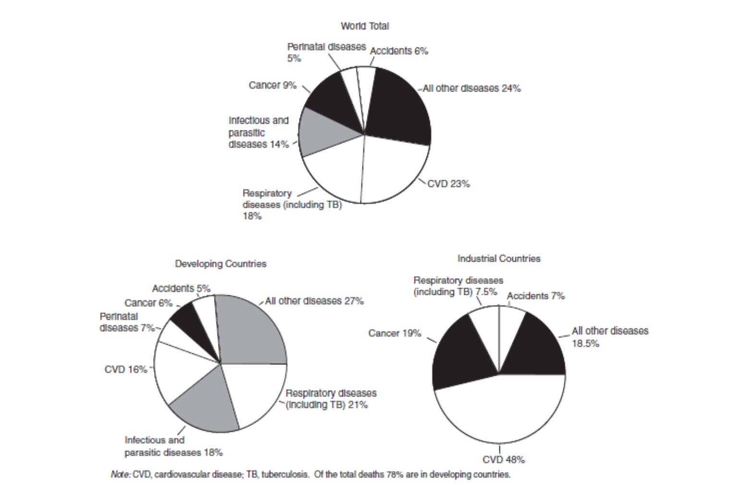
Descriptive Epidemiology
1980

Slide 26
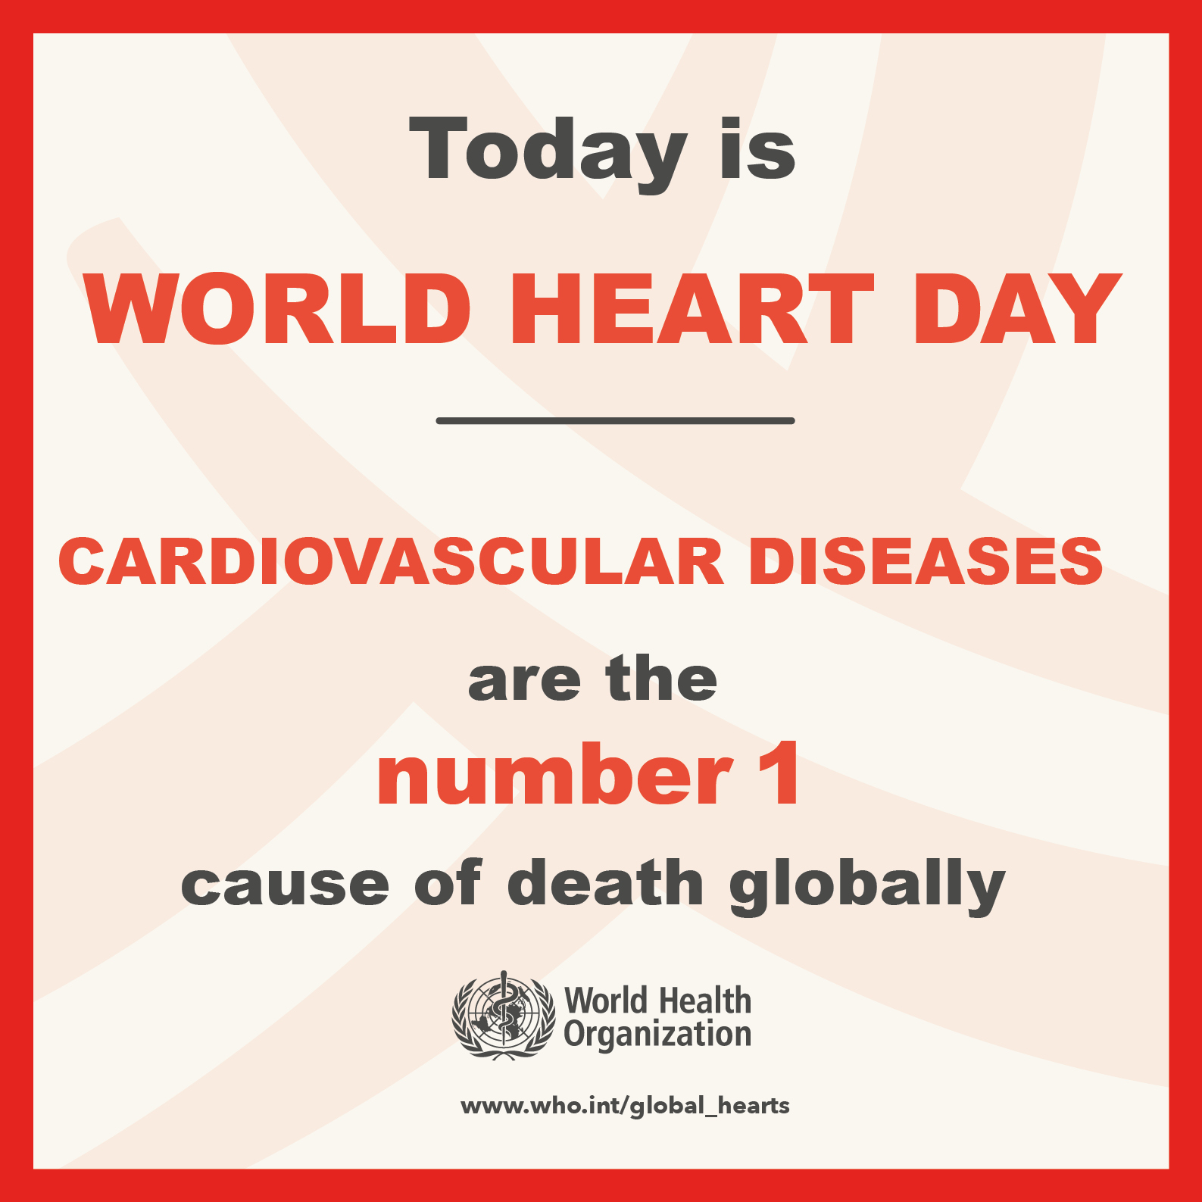
Descriptive Epidemiology
WHO 2019

Slide 27
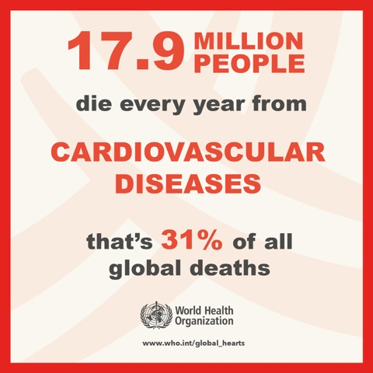
Descriptive Epidemiology
WHO 2019

Slide 28
Descriptive Epidemiology
WHO 2019

Slide 29
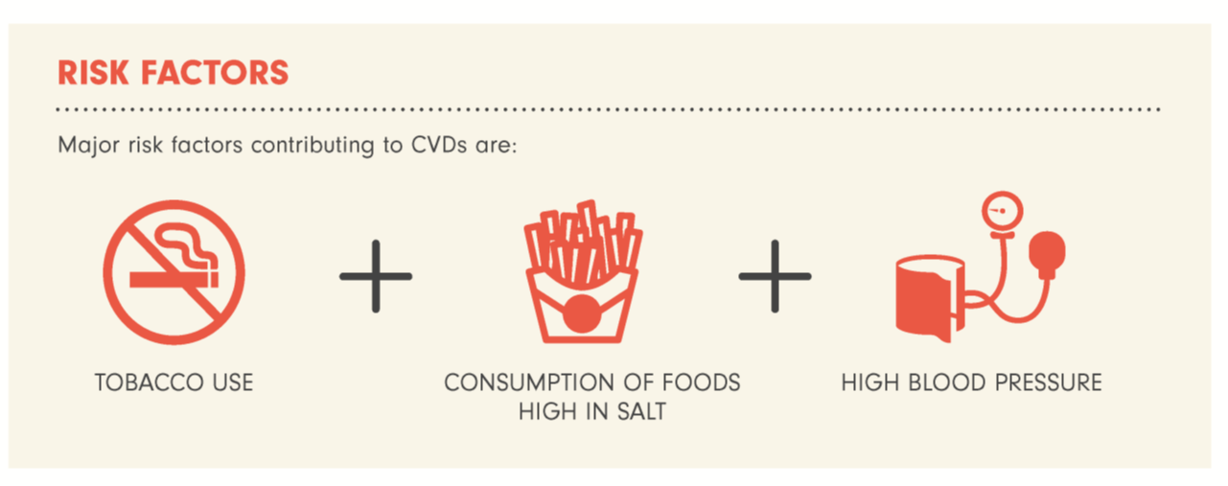
Descriptive Epidemiology
WHO 2019

Slide 30
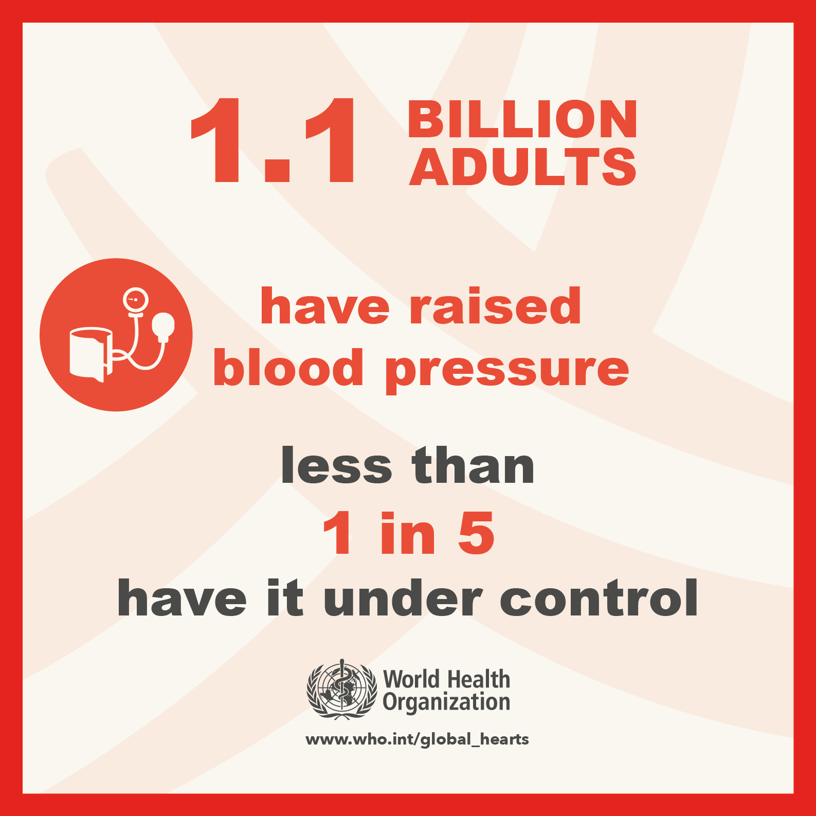
Descriptive Epidemiology
WHO 2019

Slide 31
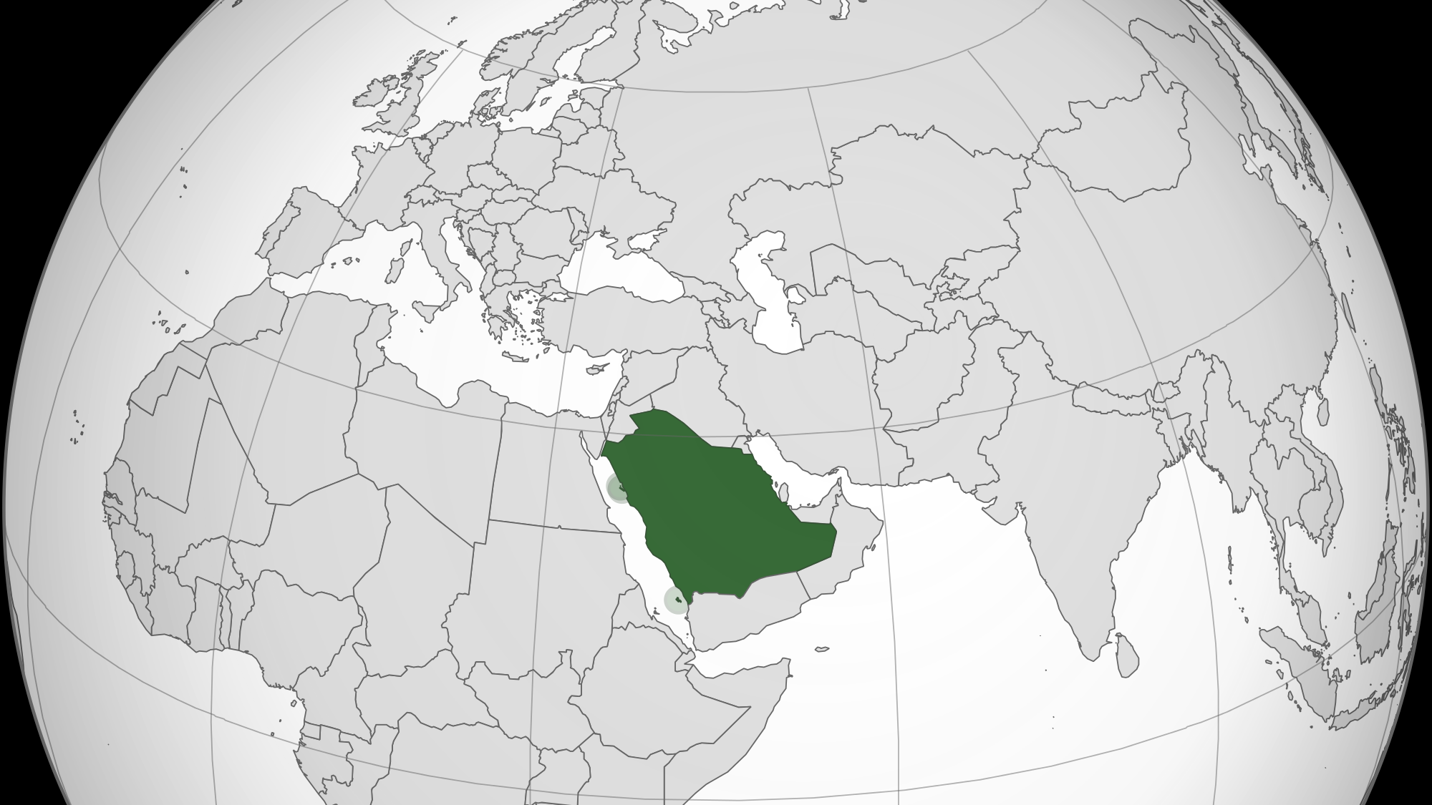
Saudi Arabia

Slide 32
Descriptive Epidemiology
Saudi Arabia
2018

Slide 33
Descriptive Epidemiology
Saudi Arabia
2018

Slide 34
Descriptive Epidemiology
Saudi Arabia
2018

Slide 35

Screening strategies for CVDs

Slide 36
CVD screening
The primary purpose of screening for CHD is to identify patients whose prognosis could be improved with an intervention (in this case, medical therapy for risk factors or coronary HD).
Screening for CHD should be distinguished from estimation of risk for CHD (or overall cardiovascular disease [CVD]).
By definition, both are performed in asymptomatic persons, and both aim to improve outcomes with interventions, if indicated.
However, screening for CHD (or CVD) identifies existing disease, while estimating the risk of CHD (or CVD) does not directly identify existing disease but rather the likelihood of any future event related to CHD (or CVD).

Slide 37
CVD screening
Usually, most asymptomatic adults are not screened for CHD. However, American Heart Association recommends nearly all patients aged 20 years or older without established CVD should undergo periodic cardiovascular risk assessment every three to five years.
(LDL) cholesterol and/or (HDL) cholesterol, glucose level, BP, life-style, …are required.

Slide 38
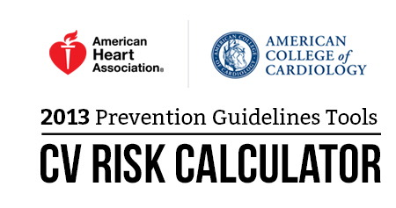
CVD screening
American Heart Association (AHA) and American College of Cardiology (ACC) pooled cohort hard CVD risk calculator (2013);
1. Age (validated only in patients 40 to 79 years of age)
2. Gender
3. Total cholesterol (mg/dL)
4. HDL cholesterol (mg/dL)
5. Systolic blood pressure (mmHg)
6. Blood pressure treatment (yes or no)
7. Diabetes mellitus (yes or no)
8. Current smoking (yes or no)

Slide 39
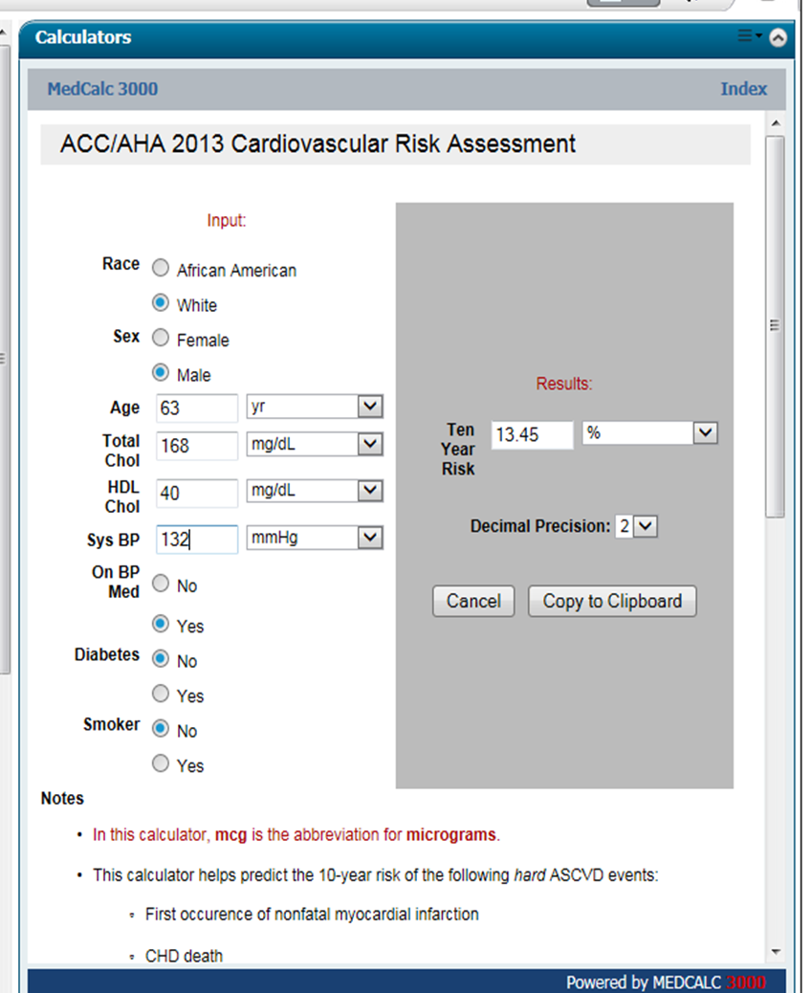
A 63-year-old man, known case of HTN, on medication. No history of Diabetes or smoking.
Risk assessment was done.
If Calculated Risk ≥7.5%
So considered high.
CV Risk Assessment:
10 year risk score is >7.5%, high due to ??

Slide 40
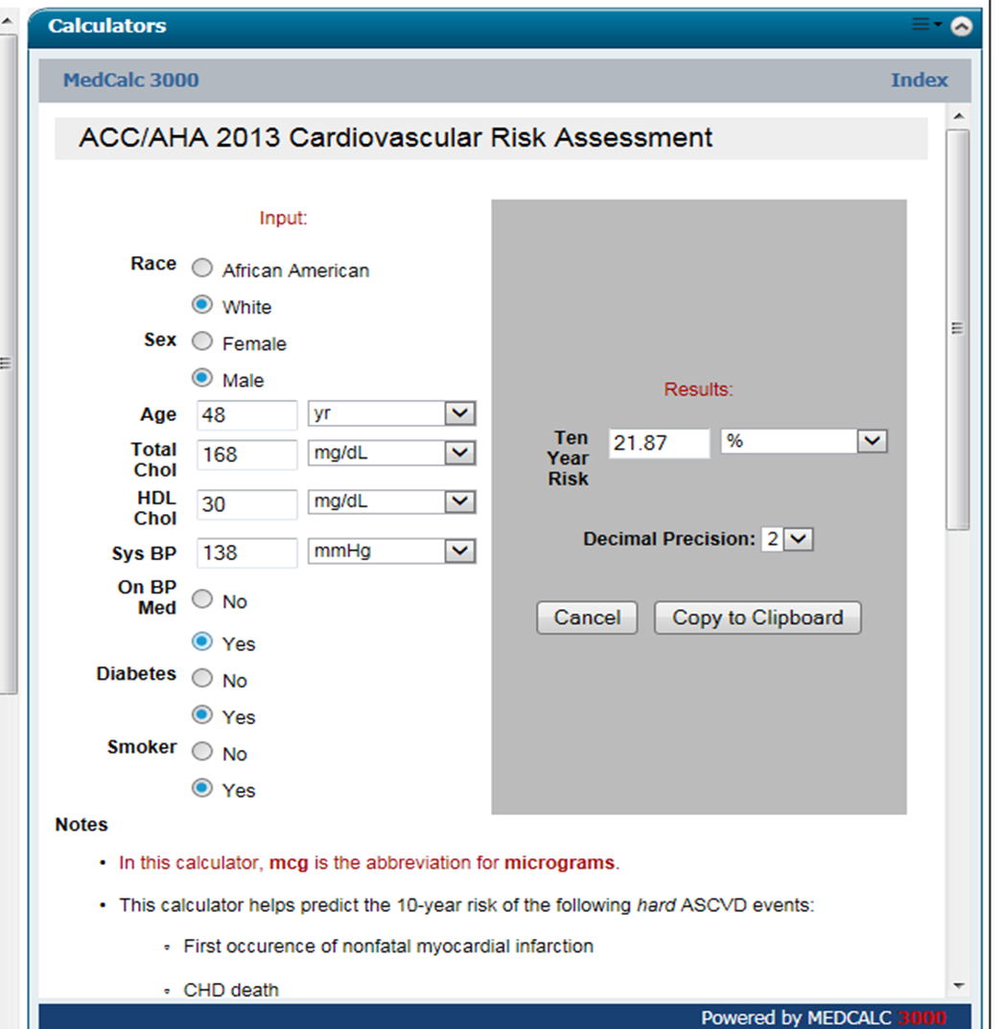
A 48-year-old man, known case of hypertension, diabetes and smoker.
10 year risk score is shown.
As it is high >7.5% even reaching higher levels.
This patient should be given high intensity statin and even Aspirin for primary prevention beside
Life style modification and stop smoking.

Slide 41
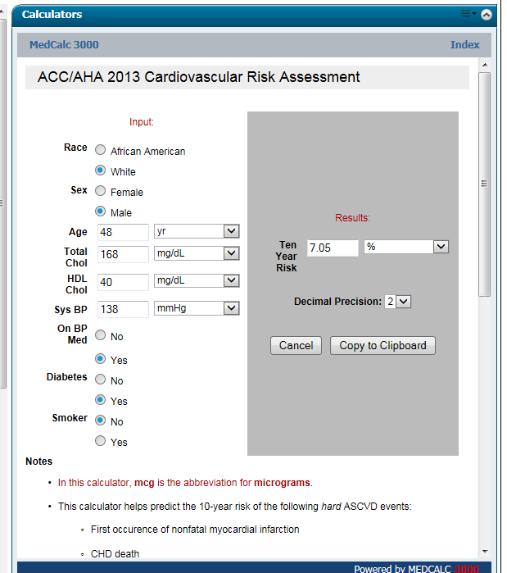
The same patient, if non-smoker and his HDL-C is within accepted range,
10 year risk score will drop from 21.87 to 7.05%

Slide 42
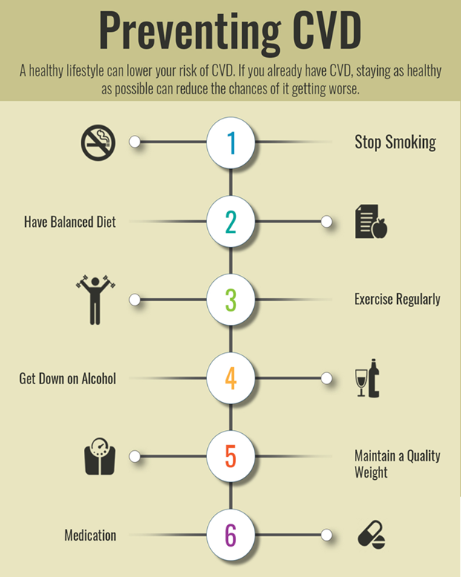
Cardiovascular Disease Prevention

Slide 43
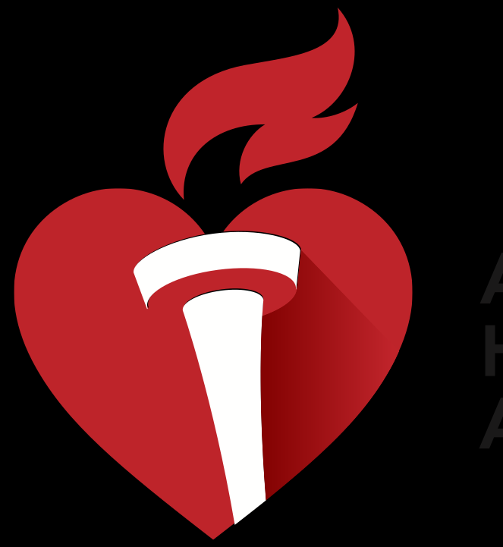
CVD prevention
Programs from the American Heart Association that promote seven ideal cardiovascular health metrics, including:
1. Not smoking
2. Being physically active
3. Having a normal blood pressure
4. Having a normal blood glucose level
5. Having a normal total cholesterol level
6. Being normal weight
7. Eating a healthy diet

Slide 44
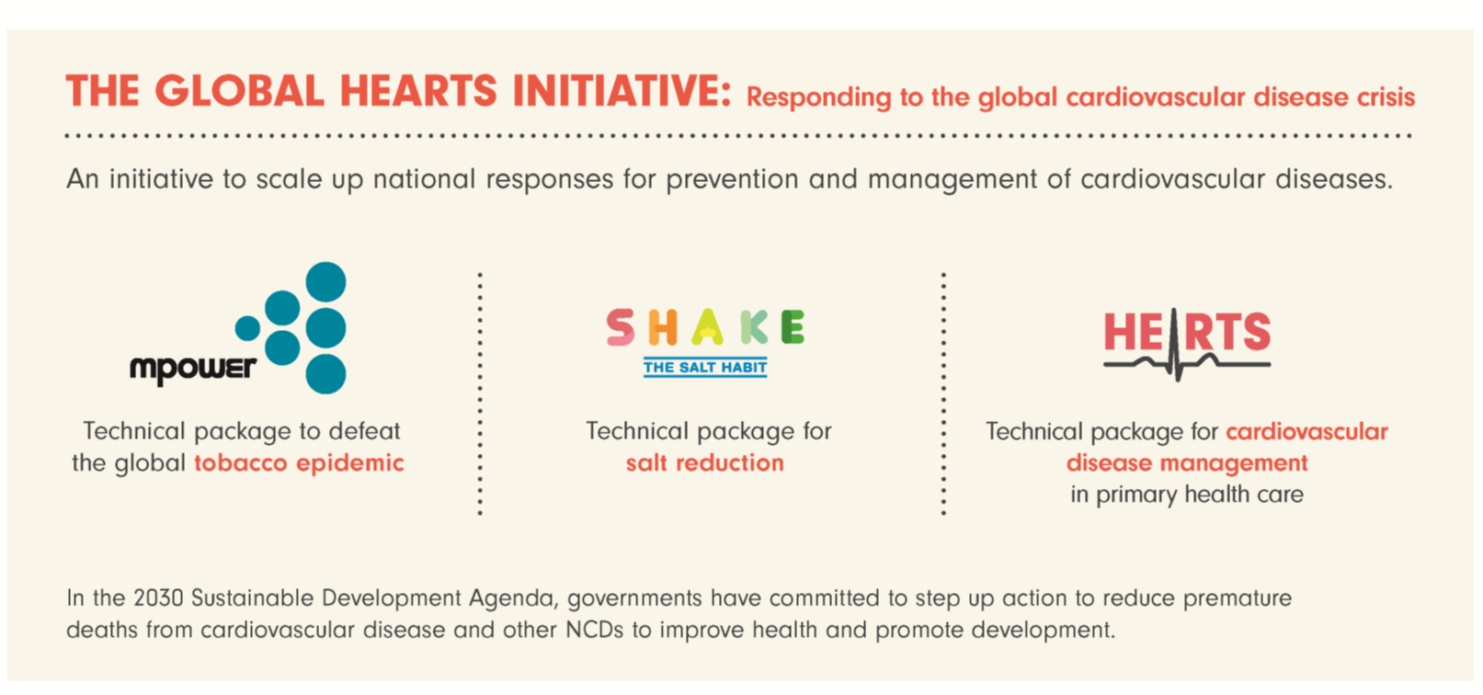

Slide 45

Counselling a patient at High Risk of CVD

Slide 46
Counselling
1. Start with estimating the risk of CVD
2. Ask about family history of premature CVD
3. Always consider LIFESTYLE MODIFICATION
Lifestyle modification including activities such as smoking cessation, increase in physical activity, or improvement in diet are of proven benefit and should be the primary interventions in all.

Slide 47
Counselling
3. Encourage Exercise
Even moderate degree has a protective effect against CHD and all-cause mortality.
150 minutes /week.
Exercise may have a variety of beneficial effects including an elevation in serum HDL cholesterol, a reduction in blood pressure, less insulin resistance, and weight loss.
Men who engaged in moderately vigorous sports activity have been reported to have a 23 % lower risk of death than those who were less active.

Slide 48
Counselling
4. Smoking Cessation
Always ask about history of smoking.
Offer counselling to quit smoking.

Slide 49
Counselling
5. Healthy Diet:
Fruits and vegetables – There is growing evidence suggesting that fruit and vegetable consumption is inversely related to the risk of CHD and stroke.
Higher intake of red meat and high-fat dairy products has also been associated with higher risks of CHD.
Fiber – High fiber intake is also associated with a reduction in the risk of CHD and stroke compared with low fiber intake.

Slide 50
Counselling
6. Use of Statins:
Due to the evidence of benefit from statin therapy across a broad range of risk, we believe it is reasonable to start statin therapy in patients whose 10-year risk of CVD ≥7.5 percent.
Statin therapy lowers the risk of death by 15 to 20 percent and lowers the risk of nonfatal cardiovascular events by an even greater degree.
The reduction in major vascular events with statin therapy is directly proportional to the absolute reduction in LDL-C.

Slide 51
Counselling
7. Control Blood Pressure
8. Control Diabetes
9. Reduction of weight among obese and overweight persons

Slide 52
Counselling
10. Antiplatelet therapy
For patients with established and stable atherosclerotic CVD, aspirin is recommended.
Long-term antiplatelet therapy with aspirin reduces the risk of subsequent myocardial infarction (MI), stroke, and cardiovascular death among patients with a wide range of manifestations of occlusive CVD.
In patients who are unable to take aspirin and in those with a history of gastrointestinal bleeding, clopidogrel is a reasonable alternative.

Slide 53
Counselling
11. Antioxidant vitamins
Antioxidant vitamins, the randomized evidence has not demonstrated clinical benefits on CVD in secondary or primary prevention regarding vitamin E and or vitamin C.

Slide 54

1. Risk factors for CVD:
Age, Gender, Smoking, Hypertension, Hypercholesterolaemia, Obesity, FH of premature CVD
2. Contributing factors: High levels of Homocystine, Fibrinogen, HS-CRP and Microalbuminuria
3. Prevention:
Dealing with risk factors and importantly Life Style Modification

