Slide 1
Injury Epidemiology
Dr. Afnan Younis, MBBS, MPH, SBCM
Assistant Professor, Community Medicine
ayounis@ksu.edu.sa
Afnan.younis@gmail.com

Slide 2
Scenario 1:
Ahmad and Lama spent their one-week vacation in a resort in Egypt with their 3-year old child (Khalid). While they were relaxing by the pool, Khalid fell in the pool. Khalid’s parents, the lifeguard and other residents tried to rescue Khalid.

Slide 3
Scenario 2:
Fatima is a 70-year old diabetic lady who is complaining of peripheral neuropathy and diabetic retinopathy (visual impairment). She was walking in her house and tripped over a loose carpet.

Slide 4
Scenario 3:
Majid was crossing the road on his way to grocery store. He was hit by a car driving on the wrong side of the road.
He was thrown about 10 feet into the air, landed on the car and suffered a severe brain injury.

Slide 5
Objectives
Describe the concepts of injuries, why do they occur and their epidemiology
Describe important differences between various types of injuries (intentional and unintentional)
Understand principles of injury prevention and control
Appreciate the burden of injury in KSA
Apply injury epidemiology principles to road traffic accidents

Slide 6
Injury
“Acute exposure to agents such as mechanical energy, heat, electricity, chemicals, and ionising radiation interacting with the body in amounts or at rates that exceed the threshold of human tolerance. In some cases, injuries result from the sudden lack of essential agents such as oxygen or heat.”
(Source: Gibson, 1961; Haddon, 1963)

Slide 7
Violence
“The intentional use of physical force or power, threatened or actual, against oneself, another person, or against a group or community, that either results in or has a high likelihood of resulting in injury, death, psychological harm, maldevelopment or deprivation”
(WHO, 1996)

Slide 8
Epidemiologic Triad of Injuries
Host: Human
Agent: Energy
Environment: vector / vehicle that conveys the agent / energy

Slide 9
Nature of Energy
Mechanical
Thermal / Chemical
Electrical
Asphyxiation

Slide 10
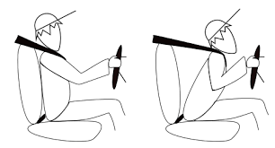
Mechanical energy
When a vehicle stops suddenly, the occupant will continue to move at the same speed and direction
Notes:
If a person must stop suddenly, as in a crash of a vehicle, that energy must be dissipated in the vehicle, environment, or individual’s tissues
When the vehicle stops, the occupant will continue to move at the pre-crash speed into interior structures, or into the materials in the exterior environment if ejected.

Slide 11
Mechanical energy
Stresses: contact with energy source generates forces counter to the load.
Types:
Tension
Compression
Shear

Slide 12
Mechanical energy
Strain: extent of deformation, resulting from tension, compression, shear
The shape and elasticity of the materials struck will determine the damage to the tissue.
Devices as seat-belts, air bags and child restraints reduce the severity of injury by reducing contact with less flexible structures (second collision)

Slide 13
Thermal and chemical energy
Fires, heat & smoke
As a result of ignition sources, flammable materials and of the heat and chemical energies

Slide 14
Thermal and chemical energy
Combustion varies by:
Concentration and type of heat source
Shape / size of a combustible
Oxygen concentration
Vaporization of gases
Presence or absence of catalysts

Slide 15
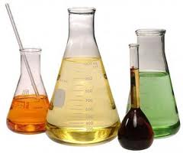
Thermal and chemical energy
Chemicals may be breathed / inhaled (as in a fire); ingested; injected; absorbed
Harms of chemicals are divided into 3 phases: exposure (poisoning); toxo-kinetic (chemical’s absorption through the organism’s membranes: GIT, lungs’ air sacs); toxo-dynamic (interaction of chemical with receptors in target tissues)

Slide 16
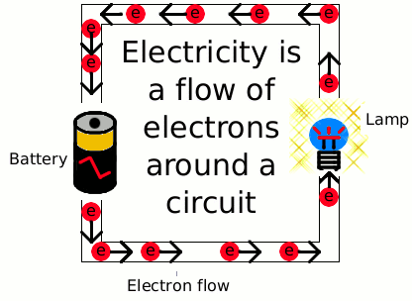
Electrical energy
The flow of electrons is
“electrical current”
The extent of damage of human contact with electrical energy increases with amperage.
Skin sensitivity varies 100-fold as a function of wetness (100,000 ohms when dry; 100 ohms when wet)

Slide 17
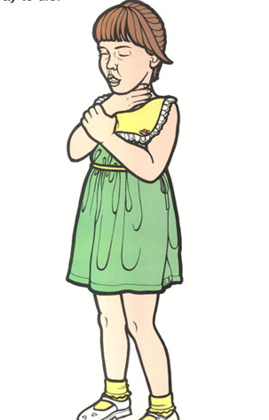
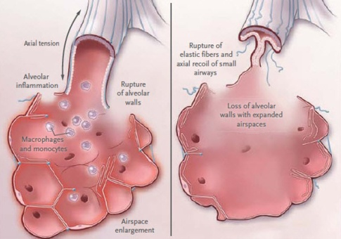
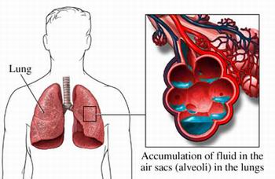
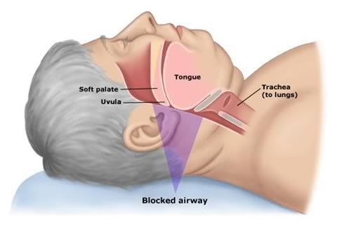
Asphyxiation
Asphyxiation: absence of oxygen to sustain endogenous energy conversion, which causes essential cells (in brain / heart) to be damaged within minutes
Possible causes: objects blocking nose / mouth / trachea; mechanical blow to the trachea; constriction of the trachea; lung obstruction; water in lungs (drowning); lung congestion (endogenous fluids as in pneumonia / congestive heart failure)

Slide 18
Types of Injuries
Intentional: e.g. violence, suicide, homicide, intentional fire-arm injuries, etc
Non-intentional (accidental): e.g. road-traffic injuries, fires, falls, poisoning, drowning-asphyxia, burns, sports, accidental fire-arm injuries, etc

Slide 19
Measuring the problem of accidents
Mortality
Morbidity
Disability

Slide 20
Mortality
Proportionate mortality rate
No. of deaths per million population
Death rate per 1000 registered vehicles per year
number of accidents or fatalities as a ratio of no. of vehicles per km or passengers per km
Notes:
Proportionate mortality rate: no. of deaths due to accidents out of 100 total deaths

Slide 21
Morbidity
In terms of :
Slight injuries
Serious injuries

Slide 22
Disability
Temporary or permanent
Partial or total
DALY, QALY…

Slide 23
MAGNITUDE OF THE PROBLEM

Slide 24
Every day,
more than 14 000 people die as a result of an injury
Every six seconds,
someone in the world dies as a result of an injury

Slide 25
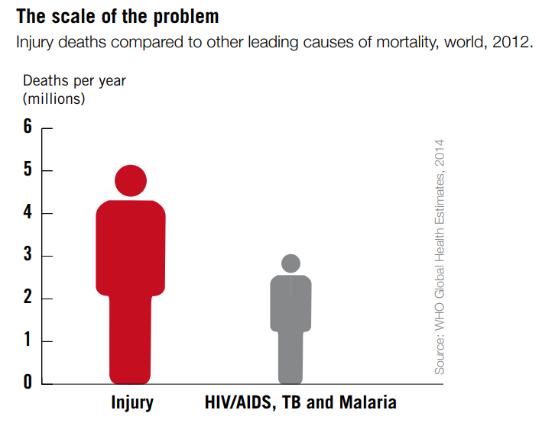

Slide 26
Global & Regional Burden
12% of global burden of disease
The most common cause of death among people 1- 44 years of age
In Eastern Mediterranean Region, injury is a leading cause of morbidity and mortality→ loss of productive years of life and effect on health care cost
Road traffic “incidents” are the leading cause of injury deaths worldwide, which strongly applies to GCC/KSA
More than 90% of injury deaths occur in low- and middle-income countries

Slide 27
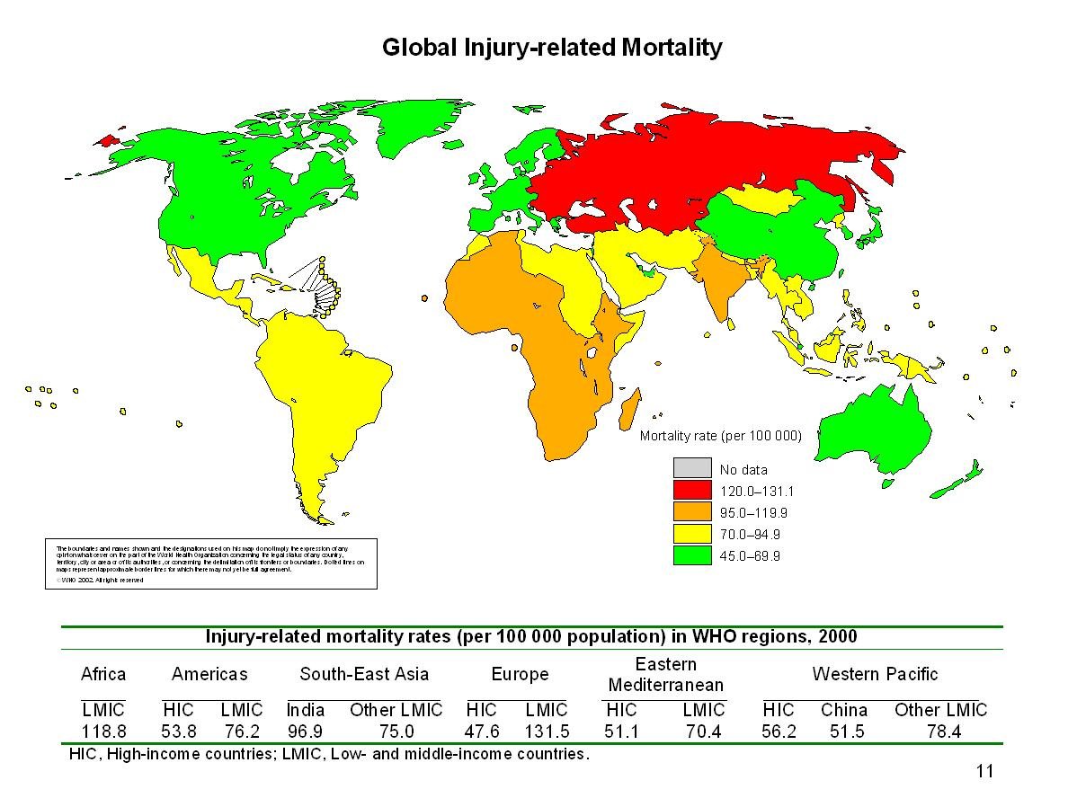
Injury from a Global Perspective
Each year > 5 million people die of injuries.
2/3 are males and the majority are young adults aged 15-44
RTA are the largest cause of injury death.

Slide 28
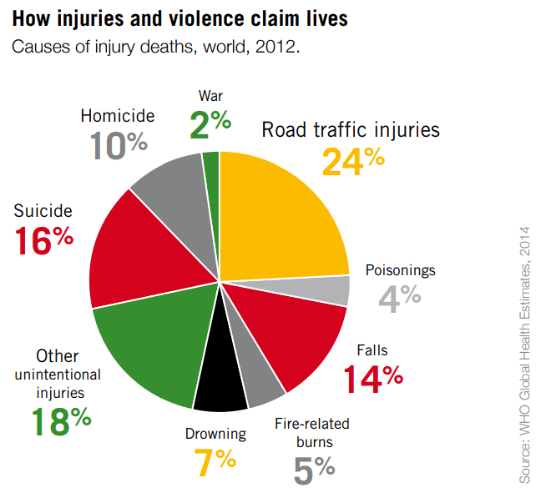

Slide 29
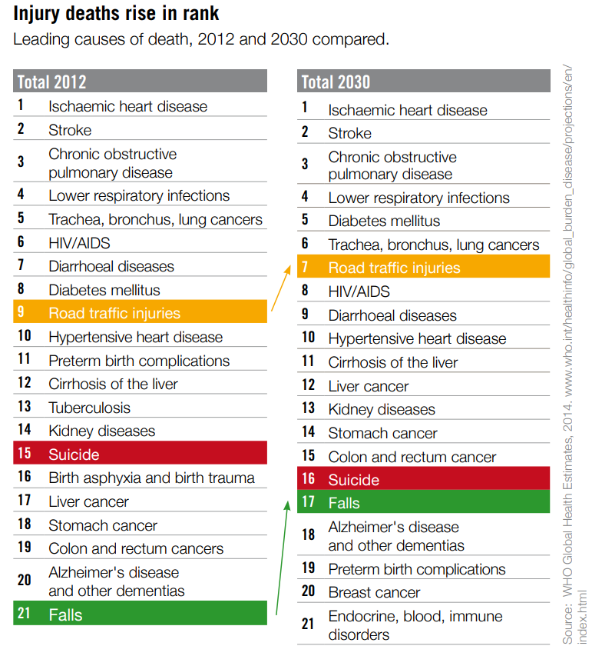

Slide 30
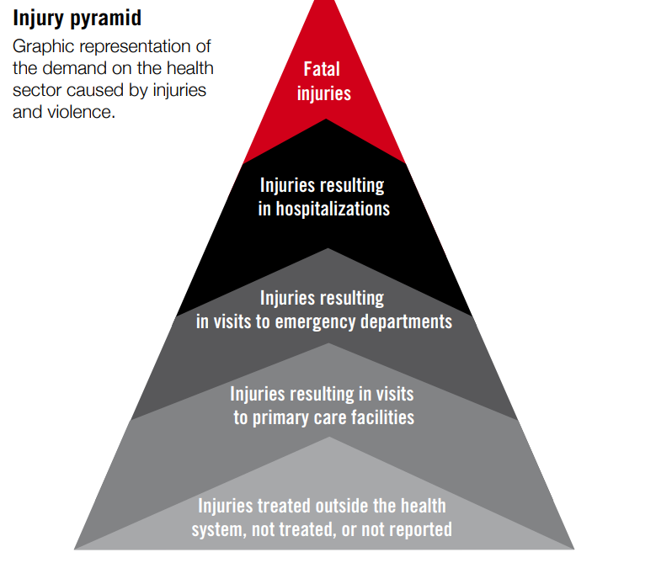
Source: WHO, 2014

Slide 31
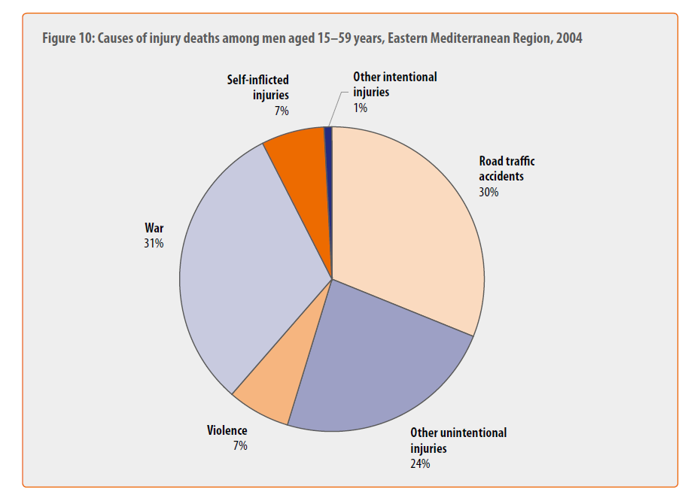

Slide 32
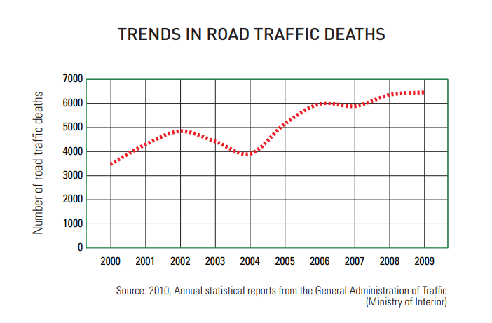
Saudi Arabia – RTA death numbers

Slide 33
Source: WHO, 2014

Slide 34
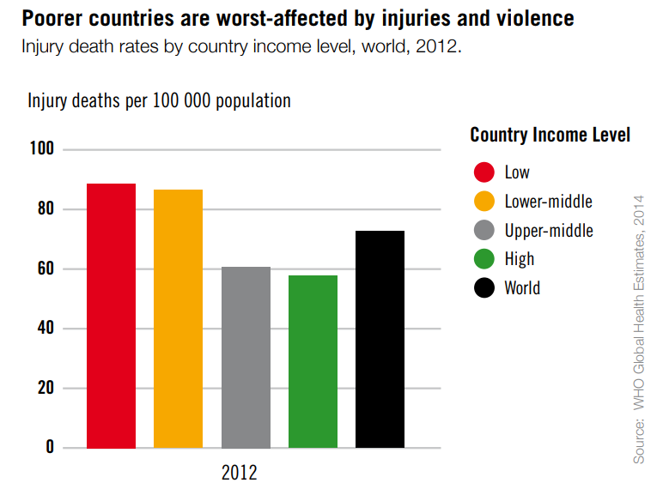
Notes:
Inequality

Slide 35
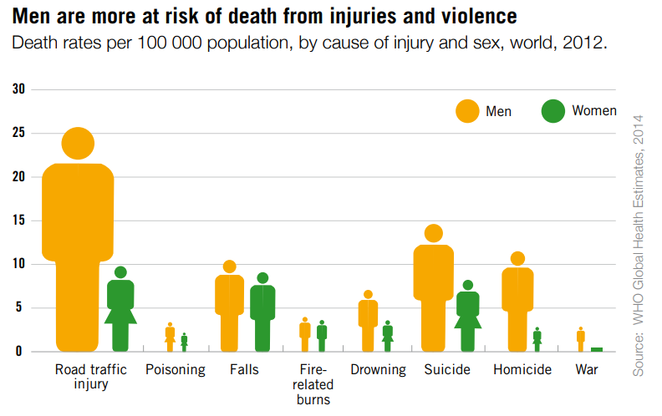

Slide 36
Haddon Phase-Factor Matrix
Phase | Host (Human) | Vector (Vehicle) | Physical Environment | Cultural Environment
Pre-Event
Event
Post-Event

Slide 37
Haddon Phase-Factor Matrix
Motor vehicle crash
Phase | Host (Human) | Vector (Vehicle) | Physical Environment | Cultural Environment
Pre-Event | Alcohol Experience Judgment | Brake status Tires | Nigh, Rain Icy road | Acceptance of Drinking and Driving
Event | No seat belt | No air bag Hardness of surfaces | Tree too close to road, No guard rail | Speed limits Enforcement of seat belt
Post-Event | Physical condition | Fuel system integrity Cell Phone | Distance of emergency response | Support for Trauma systems, EMS standard

Slide 38
Types of Data & Potential Sources of Information
Mortality
Death certificates
Reports from mortuaries
Morbidity and Health-related
Hospitals
Medical records
Self Reported
Surveys
Media

Slide 39
Community-based
Demographic records
Local government records
Law enforcement
Police records
Prison records
Economic-social
Institutional or agency records
Special studies
Source: adapted from Krug et al., eds., 2002

Slide 40
PREVENTION & CONTROL

Slide 41
Prevention
Primary prevention:
Raising awareness of the community, at its different levels, as to methods of avoiding injuries. This includes health promotion / health education activities and applying preventive measures accordingly
Secondary prevention:
Early detection, proper evaluation and management of injuries at different levels of healthcare delivery (primary, secondary and tertiary facilities)
Tertiary prevention:
Management of complications of injuries, especially disabilities, including rehabilitative measures and approaches, improvement of quality of life of injury victims, as well as palliative care, when needed

Slide 42
Prevention
Safety education
Promotion of safety measures
Primary care
Elimination of causative factors
Low enforcement
Rehabilitation
Research and data collection

Slide 43
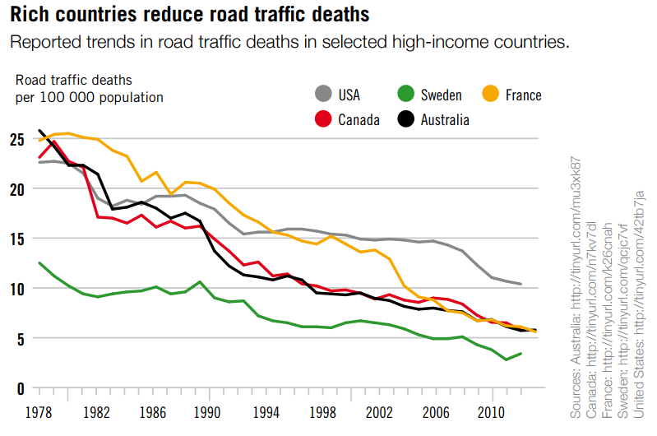

Slide 44
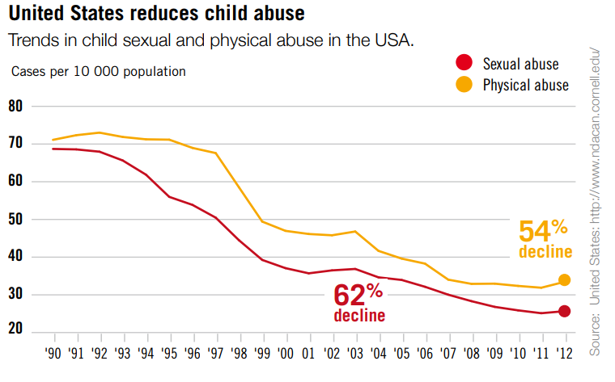

Slide 45
Source:WHO, 2014

Slide 46
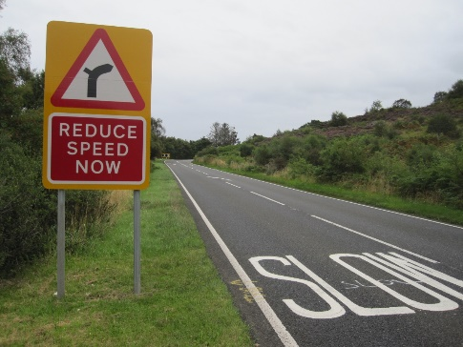
Measures - Road traffic crashes
• Setting and enforcing laws (speeding, drinking and
driving, motorcycle helmets, seat-belts, child restraints)
• Developing safer roadway infrastructure, including engineering measures to reduce speeds in urban areas and separate different types of road users
• Implementing vehicle and safety equipment standards
• Setting and enforcing laws on daytime running lights for motorcycles
• Introducing a graduated driver licensing system for novice drivers
Source: WHO, 2014

Slide 47
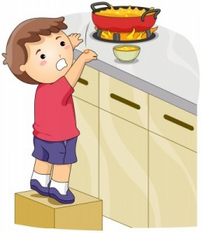
Measures - Burns
• Setting and enforcing laws on smoke detectors
• Setting and enforcing laws on hot tap water temperatures
• Developing and implementing a standard for child-resistant lighters
• Treating burns patients in a dedicated burns center
Source: WHO, 2014

Slide 48
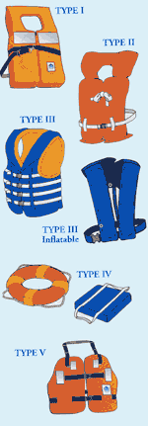
Measures - Drowning
• Installing barriers controlling access to water
• Providing capable child care for pre-school children in safe places away
from water
• Teaching school-age children basic swimming, water safety and safe rescue skills
• Training bystanders in safe rescue and resuscitation
• Wearing of personal flotation devices
Source: WHO, 2014

Slide 49
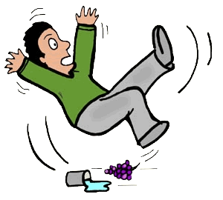
Measures - Falls
• Setting and enforcing laws requiring window guards for tall buildings
• Redesigning furniture and other products
• Establishing standards for playground equipment
Source: WHO, 2014

Slide 50
Measures - Poisoning
• Setting and enforcing laws for child resistant packaging of medicines and poisons
• Removing toxic products
• Packaging drugs in non-lethal quantities
• Establishing poison-control centers
Source: WHO, 2014

Slide 51
Measures – Interpersonal violence
• Developing safe, stable and nurturing relationships between children and their parents or caregivers
• Developing life skills in children and adolescents
• Reducing the availability and harmful use of alcohol
• Reducing access to guns and knives
• Changing cultural and social norms that support violence
• Reducing violence through victim identification, care and support programs
Source: WHO, 2014

Slide 52
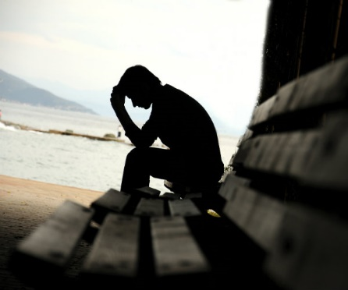
Measures - Suicide
• Reducing access to common means, such as firearms, pesticides and certain medications
• Implementing policies and interventions to reduce the harmful use of alcohol
• Ensuring early detection and effective treatment of mental disorders, particularly depression and alcohol use disorders
• Ensuring management of people who have attempted suicide or are at risk, including assessment and appropriate follow-up
• Training primary health care workers and other ‘gatekeepers’ who are likely to interact with people at risk of suicide
• Adoption of responsible reporting of suicide by the media
Source: WHO, 2014

Slide 53
Proven Injury Prevention Interventions
Car safety seats and belts
Air bags
Motorcycle helmets
Bicycle helmets
Child resistant packaging
Swimming pool fencing
Smoke detectors
Self extinguishing cigarettes

Slide 54
KSA EFFORTS

Slide 55
http://moh-ncd.gov.sa/injury/index.php

Slide 56
Surveillance System
Education
Capacity Building

Slide 57
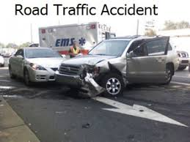
Application to Road Traffic Accidents

Slide 58
Application to RTI
Host: victim: e.g. driver, passenger, pedestrian, etc
Agent: mechanical / thermal energy
Environment: vehicle(s) of incident

Slide 59
Application to RTI
If a person must stop suddenly, as in a crash of a vehicle, that energy must be dissipated in the vehicle, environment, or individual’s tissues
When the vehicle stops, the occupant will continue to move at the pre-crash speed into interior structures, or into the materials in the exterior environment if ejected.
Stresses: contact with energy source generates forces counter to the load. Types: tension (pulling molecules apart), compression (pushing molecules together), shear (from a tangential force)

Slide 60
Application to RTI
Strain: extent of deformation, resulting from tension, compression, shear
The shape and elasticity of the materials struck will determine the damage to the tissue.
Devices as seat-belts, air bags and child restraints reduce the severity of injury by reducing contact with less flexible structures (second collision)

Slide 61
Application to RTI
Primary prevention:
Raising awareness of the community, at its different levels, as to methods of avoiding RTI. This includes legislations, health promotion activities and applying preventive measures (seat-belts, child restraints, air-bags, good roads, following traffic rules, etc)
Secondary prevention:
Early detection, proper evaluation and management of RTI at different levels of healthcare delivery (especially tertiary facilities: e.g. emergency / trauma facilities and related services)
Tertiary prevention:
Management of complications of RTI, especially disabilities, on medical / social / economic levels, including rehabilitative and physiotherapy measures

Slide 62
National strategic plan to reduce RTI:
National strategic plan that covers the 4Es:
Education: annual traffic weeks.
Saudi Society Organization for Traffic Safety
http://www.salamh.org.sa
Engineering: road infrastructure and vehicles
Enforcement: seatbelt rule, speed limit law
Emergency: Saudi Red Crescent Society (SRCS)
Epidemiology

Slide 64
“Education is the Vaccine for the Disease of Injury”

Slide 65
References
Robertson LS. Injury epidemiology. Research & control strategies. 3rd edition. Oxford, New York: Oxford University Press, 2007
WHO. World report on violence and health. Geneva: World Health Organization, 2002
Rivara FP. Injury control: a guide to research and program evaluation. Cambridge, New York: Cambridge University Press, 2001
WHO Global Consultation on Violence and Health, Violence: a public health priority. Geneva: World Health Organization, 1996

