Slide 1
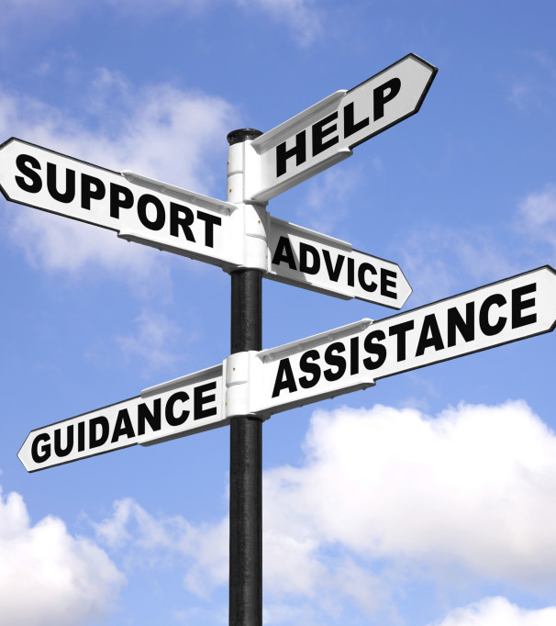
Tutorial: Communication & Counseling in Clinical Setting
Dr. Leena Baghdadi
MBBS, Master CliEpi, PhD CliEpi
Assistant Professor & Clinical Epidemiologist | Family & Community Medicine| College of Medicine | KSU

Slide 2
Objectives:
To understand the concepts of communication and counseling
To learn why are communication& counseling skills important ?
To learn the theories and stages of counseling
What are the possible barriers ?
Discuss one practical example of counselling

Slide 3
Why Communication & Counseling Skills?
When doctors use consultation & counseling skills effectively:
Patients’ problems identified more accurately
Patients more satisfied with their care
Patients more likely to comply with treatment
Patients’ distress & vulnerability to anxiety & depression are lessened

Slide 4
Why Communication/ Counseling Skills?
When doctors use consultation skills effectively
Doctors’ and patients wellbeing is improved
Few clinical errors are made
Patients are less likely to complain
Reduced likelihood of doctors being sued

Slide 5
Communication Skills
You often need to be bearers of the worst imaginable news
You have to arrange complex and often uncertain information into something understandable
You have to respond to differing needs of a hugely diverse range of patients and their families
And you have to do much of this when you are busy and under pressure

Slide 6
What is Counseling?
It is the skilled and principled use of relationship to help the patient develop self-knowledge, emotional acceptance and growth including personal resources
Counselors who offer warmth and empathy are more effective

Slide 7
It is an opportunity to talk to a person in non-judgmental and supportive way.
To better understand his/her current problems
To identifies strategies to help problem solve.

Slide 8
Aims of counseling
To help people accept and come to terms with their difficulties and identify ways of coping more effectively and resourcefully
The counselor listens and asks questions until both counselor and client understand the way the client sees things
The counselor enables the client to clarify thoughts and feelings for better understanding of the problem

Slide 9
Stages of Counseling
Exploration: Enabling the patient to explore the problem himself and then focus on specific concerns
New understanding: To see both, themselves and their situation in new perspectives and how to cope more effectively
Goal setting
Action: Possible ways to act ; costs/consequences, planning, implementation and evaluation ; creative thinking, problem solving and decision making

Slide 10
Deficiencies in Communication &Counseling
Doctors may not obtain enough information about patients’ perspective
Provide information in inflexible way
Pay little attention in checking how well patients have understood
Less than half of patients’ psychological morbidity is recognized

Slide 11
Reasons for patients not disclosing problems
Belief that nothing can be done
Reluctance to burden the Doctor
Desire not to appear pathetic or ungrateful
Concern that it is not legitimate to mention them
Doctors’ blocking behavior
Worry that their fears about what is wrong with
them will be confirmed
Lack of confidentiality and trust

Slide 12
The Evidence Base
54% of patient’s problems & concerns not elicited (Stewart et al, 1979).
Doctors frequently interrupted their patients soon after their opening statement (mean time 18 seconds) so patients subsequently failed to disclose significant (Beckman and Frankel, 1984).
Failing to discover the patients feelings and concerns led to dysfunctional consultations and counselling (Byrne and Long, 1976).

Slide 13
What is a failed communication/ Counseling?
No rapport
Using medical jargon
Not exploring the patients agenda
Not eliciting the actual problem
No contingency plan
No summarization
Failing to clarify
Not exploring in socio-cultural & economic context

Slide 14
Problems & Limitations in Communication & Counseling:
Shortage of time
Language barrier – low literacy
Firm misconceptions and myths
Lack of awareness
Not ready to take responsibility for own illness
Socio-cultural, economic barriers
Fatalistic attitude (It’s God’s will)

Slide 15
Barriers to Communication/Counseling in Clinical Practice
Personal Barriers
Lack of training: undergraduate/postgraduate
Undervaluing importance of communication
Focus only on treating diseases
Personal Limitations
Organizational Barriers
Lack of time
Pressure of work
Interruptions

Slide 16
Good communication & counseling is good for doctors
good for patients and
good for the health service

Slide 17
Example 1

Slide 18
Smoking Cessation Counselling
Domains to be assessed:
A. Professional Behavior
B. Data Gathering
C. Management

Slide 19
Professional Behavior
Building Rapport
Showing empathy
Good posture
Appropriate body language
Avoids interruptions

Slide 20
Data Gathering
Exploring Smoking History :
Number if cigarettes
First cigarettes time
Previous attempts to quit
Motivation
Smokers around the patients?

Slide 21
Data Gathering
General Health issues:
Cardiovascular diseases
Chronic cough
Depression
Any suicidal ideations, etc …
Opportunistic Screening:
Blood Pressure, obesity, adolescent issues, stress, depression etc…

Slide 22
Data Gathering
Exploring ICE :
Idea: want to give up, any options available around ??
Concern: fear of lung cancer.
Expectation: I might get some prescription to quit smoking

Slide 23
Management
Discuss different pharmacological and non- pharmacological issues
Patient’s ideas regarding medications
Offering choices of Nicotine Replacement Therapy e.g. patches and gums
Any cost issues to buy this treatment
Agree on quit date
Respect his treatment choice
Involvement of smoking cessation clinics (with patient agreement)
Follow up in 2 weeks after quit date

Slide 24
Competencies to cover

Slide 25
Example 2

Slide 26
A 20 years old college student visits the health center for concerns over her increasing weight. You see that her BMI is greater than 30.
How will you approach this student, within context of the 5A approach to counselling?
Please use the attached file to answer the question.
https://onlinelibrary.wiley.com/doi/full/10.3322/caac.21394

Slide 27
Thank you

