Slide 1
PBL guidelines
Max: 2 minutes, entire case / problem
Font size: 32
Line spacing: 1.5
Max: 5 lines on slides 2-4
Max: 8 phrases on each line

Slide 2
5 slides
Slide 1: group ID (3 seconds)
Slide 2: picture or video (10 seconds)
Slide 3: case scenario (45 seconds)
Slide 4: discussion (60 seconds)
Slide 5: references (2 seconds)

Slide 3
PBL Slide 1: group ID

Slide 4
[1st slide: Your identity] (3 seconds)
University - College
Course and date
Supervisor
Group name
Presenters

Slide 5
2nd slide
2nd, 3rd slide: “case” →case scenario or “problem”
Picture (news clip)
Video
Other
(10 seconds)

Slide 6
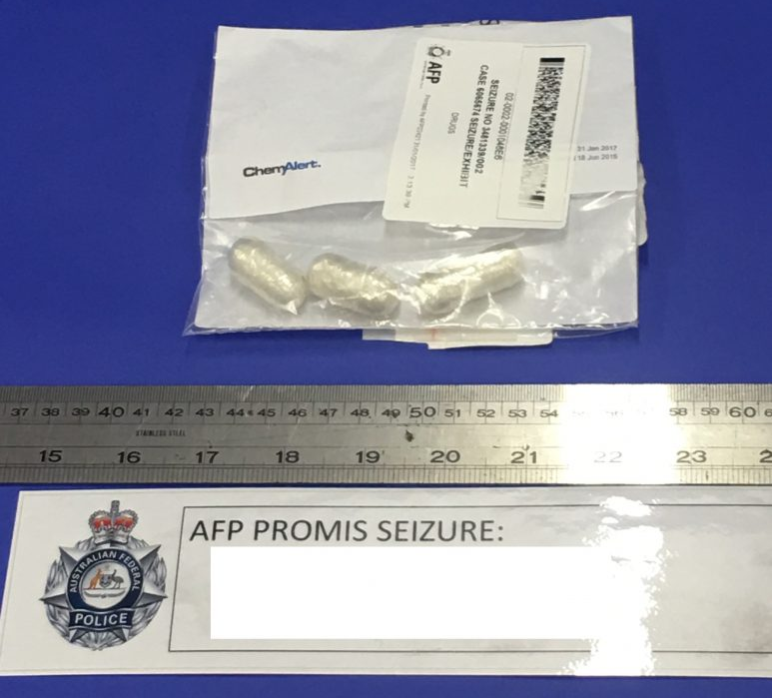
[Slide 2: Case/ problem: picture or video ] (10 seconds)
Notes:
http://www.dailymail.co.uk/travel/travel_news/article-3616375/Emirates-flight-forced-land-suspected-cocaine-smuggler.html http://metro.co.uk/2017/02/06/peru-two-drug-mule-michaella-mccollum-describes-long-ride-to-freedom-6429485/ http://www.mygc.com.au/drug-mule-busted-sydney-airport-swallowing-74-pellets-cocaine/

Slide 7
[Slide 3: case scenario ]
Case scenario
History (witnesses, news reporter, police, fire department, emergency physician, EMS, family doctor)
Examination
Other

Slide 8
4th slide: Discuss important point/points
Involve each of the other groups
Identify leaders and subleaders of other groups
Ask them to answer or discuss
Ask if anyone has any questions

Slide 9
[Slide 4: discussion ] (60 seconds) - One or All
Authority (ID, human, dead/alive, system)
History
Examination
Scene investigation
Postmortem changes
COD (Dx disease: natural, trauma, toxicologic)
Scientists or physicians: roles?
Recommendations: preventing disease, injury and death

Slide 10
Slide 5
Scientific references, such as:
Simpson's Forensic Medicine 13th ed. - J. Payne-James, et. al. (Hodder-Arnold, 2011)
http://www.medscape.com
http://scholar.google.com/
http://www.ncbi.nlm.nih.gov/pubmed/
Also, the reference of your case, problem or story:
Newspaper, website, journal

Slide 11
[5th slide: references] (time: 2 seconds)
Simpson's Forensic Medicine 13th ed. - J. Payne-James, et. al. (Hodder-Arnold, 2011)
http://www.medscape.com
http://scholar.google.com/
http://www.ncbi.nlm.nih.gov/pubmed/
http://www.dailymail.co.uk/travel/travel_news/article-3616375/Emirates-flight-forced-land-suspected-cocaine-smuggler.html
http://metro.co.uk/2017/02/06/peru-two-drug-mule-michaella-mccollum-describes-long-ride-to-freedom-6429485/
http://www.mygc.com.au/drug-mule-busted-sydney-airport-swallowing-74-pellets-cocaine/

Slide 12
PBL Example
Understand what chapters are covered
Session 1:
Principles in Forensics and the autopsy: Chapter 1, 23-24, Appendix 1
Ethics and Legal, COD, DC: Chapter 2, 3
Natural death, SUD: chapter 6-7
What are the session objectives?
cont’d next

Slide 13
PBL example cont’d
Read, understand and discuss session objectives
Given the objectives:
Scan chapters, go over titles, tables, graphs, figures, scan chapter
Search for an appropriate case or problem:
journal case report, web or news.
Cont’d next

Slide 14
PBL cont’d
Choose a picture or video to set the “history”
Choose questions/MCQs to ask/discuss with other groups
Review this presentation again to see if you have missed anything

Slide 15
[1st slide: Your identity] (3 seconds)
King Saud University – College Of Medicine
Course: Forensic medicine, Session #, Date
Supervisor: Khaldoon Aljerian
Group name: Ibn Sina
Presenters: [your Group’s name]

Slide 16
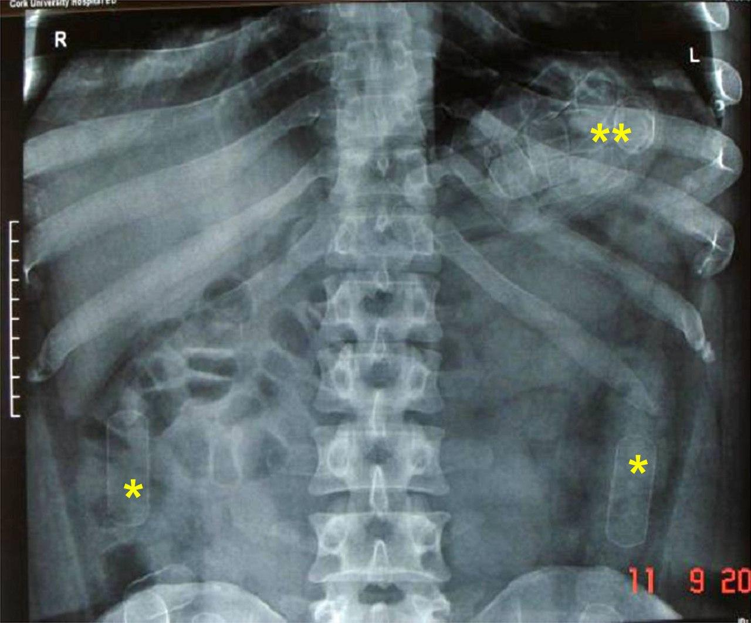
[Slide 2: Case/ problem: picture or video ] (10 seconds)
Notes:
http://www.dailymail.co.uk/travel/travel_news/article-3616375/Emirates-flight-forced-land-suspected-cocaine-smuggler.html http://metro.co.uk/2017/02/06/peru-two-drug-mule-michaella-mccollum-describes-long-ride-to-freedom-6429485/ http://www.mygc.com.au/drug-mule-busted-sydney-airport-swallowing-74-pellets-cocaine/

Slide 17
[Slide 3: case scenario ]
Case scenario: Airport – Confiscation of bowel content
History: irritable and restless → abd pain
Examination: tender abd
Other: XR

Slide 18
[Slide 4: discussion ] (60 seconds)
Authority (how, who will ID? dead/alive? what system)
History: where to get Hx?
Examination: what to examine? How?
Scene investigation: who, what?
Postmortem changes: what changes?
COD (Dx disease: natural, trauma, toxicologic) if dies…Dx, COD, Manner
Scientists or physicians: roles?
Recommendations: preventing disease, injury and death…?

Slide 19
[5th slide: references] (time: 2 seconds)
Simpson's Forensic Medicine 13th ed. - J. Payne-James, et. al. (Hodder-Arnold, 2011)
http://www.medscape.com
http://scholar.google.com/
http://www.ncbi.nlm.nih.gov/pubmed/
http://www.dailymail.co.uk/travel/travel_news/article-3616375/Emirates-flight-forced-land-suspected-cocaine-smuggler.html
http://metro.co.uk/2017/02/06/peru-two-drug-mule-michaella-mccollum-describes-long-ride-to-freedom-6429485/
http://www.mygc.com.au/drug-mule-busted-sydney-airport-swallowing-74-pellets-cocaine/

