Slide 1
MALARIA & TRAVEL MEDICINE
Awadh R. Alanazi M.D
King Saud University
College Of Medicine
1440--2019

Slide 2
EDUCATIONAL OBJECTIVES
At the end of this lecture students are expected to know:
Epidemiology & Etiology.
Clinical presentation.
Risk to travelers.
Malaria and pregnancy.
Diagnostic work up.
Treatment & prophylaxis.

Slide 3
MALARIA EPIDEMIOLOGY
In 2017, an estimated 219 million cases of malaria occurred worldwide, compared with 239 million cases in 2010 and 217 million cases in 2016.
Most malaria cases in 2017 were in the WHO African Region (200 million or 92%), followed by the WHO South-East Asia Region with 5% of the cases and the WHO Eastern Mediterranean Region with 2%.
Fifteen countries in sub-Saharan Africa and India carried almost 80% of the global malaria burden. Five countries accounted for nearly half of all malaria cases worldwide: Nigeria (25%), Democratic Republic of the Congo (11%), Mozambique (5%), India (4%) and Uganda (4%).

Slide 4
MALARIA EPIDEMIOLOGY
The 10 highest burden countries in Africa reported increases in cases of malaria in 2017 compared with 2016. Of these, Nigeria, Madagascar and the Democratic Republic of the Congo had the highest estimated increases, all greater than half a million cases. In contrast, India reported 3 million fewer cases in the same period, a 24% decrease compared with 2016.
The incidence rate of malaria declined globally between 2010 and 2017, from 72 to 59 cases per 1000 population at risk. Although this represents an 18% reduction over the period, the number of cases per 1000 population at risk has stood at 59 for the past 3 years.
Plasmodium falciparum is the most prevalent malaria parasite in the WHO African Region, accounting for 99.7% of estimated malaria cases in 2017, as well as in the WHO regions of South-East Asia (62.8%), the Eastern Mediterranean (69%) and the Western Pacific (71.9%). P. vivax is the predominant parasite in the WHO Region of the Americas, representing 74.1% of malaria cases.

Slide 5
MALARIA EPIDEMIOLOGY
In 2017, there were an estimated 435 000 deaths from malaria globally, compared with 451 000 estimated deaths in 2016, and 607 000 in 2010.
Children aged under 5 years are the most vulnerable group affected by malaria. In 2017, they accounted for 61% (266 000) of all malaria deaths worldwide.

Slide 6
ETIOLOGY
Malaria is caused by the Plasmodium parasite. The parasite can be spread to humans through the bites of infected mosquitoes (female Anopheles mosquitoes). There are many different types of plasmodium parasite, but only 5 types cause malaria in humans.
Plasmodium falciparum – mainly found in Africa, it's the most common type of malaria parasite and is responsible for most malaria deaths worldwide.
Plasmodium vivax – mainly found in Asia and South America, this parasite causes milder symptoms than Plasmodium falciparum, but it can stay in the liver for up to 3 years, which can result in relapses.
Plasmodium ovale – fairly uncommon and usually found in West Africa, it can remain in your liver for several years without producing symptoms.
Plasmodium malariae – this is quite rare and usually only found in Africa.
Plasmodium knowlesi – this is very rare and found in parts of southeast Asia.

Slide 7
PATHOGENESIS
P.F. invades RBC at all ages.
P. Mal: only old RBC.
P. ovale and P. vivax invade young RBC’s.
Microvascular pathology: secondary Ischemia Adherence of Non-deformable parasitized RBC to endothelium
Renal failure: hemolysis, Ischemia secondary microvascular pathology
Deep Coma: hypoglycemia, microvascular adherent parasitized RBC
Pulmonary edema; 2 o: Capillary leak Synd (without C.C.F.)
Immune complex Neph. Syndrome 2 o P. Malariae.

Slide 8
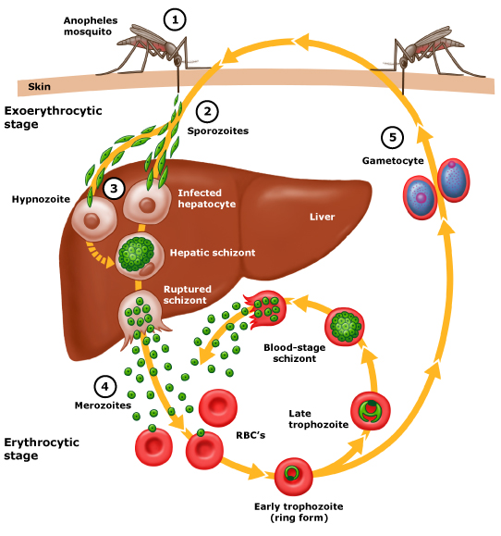
INCUBATION PERIOD
Sporozoites reach the liver within 1-2 hours following female Anopheles mosquito bite.
Patients are asymptomatic for 12-35 days until RBCs stage of parasite life cycle.

Slide 10
CLINICAL FEATURES
Clinical features vary with:
Geography.
Epidemiology.
Age.
High risk population includes:
Children.
Pregnant women.
Non-immune travelers to malaria endemic areas.

Slide 11
CLINICAL FEATURES
Major features:
Recurring fevers
Chills (Assoc. RBC lyses – mature zchisonts)
Periodicity S/O
48 hours: P. Vivax & Ovale
72 hours: P. Malaria
Non-regular/hectic in P.F. especially in non- immune
Patients (who are at highest risk of complications and death)

Slide 12
MALARIA PAROXYSM
Paroxysms associated with synchrony of merozoite release
Between paroxysms temperature is normal and patient feels well
Falciparum may not exhibit classic paroxysms (continuous fever)

Slide 13
CLINICAL FEATURES
Severe: P.F. (> 10 parasite/ mcl) AC Complications:
Renal failure
Coma 2 o: hypoglc; TNF, or microvascular pathology
Pulmonary Edema
Thrombocytopenia
G. Enteritis – especially diarrhea.
Chronic P. Falciparum infection:
Splenomegaly typically resolves after treatment with anti-malarial medications (6-12 months).
P. Malariae associated Immune compl. N. Synd.
P. Vivax – late splenic rupture with trauma 1-3 mon. after initial infection.

Slide 14
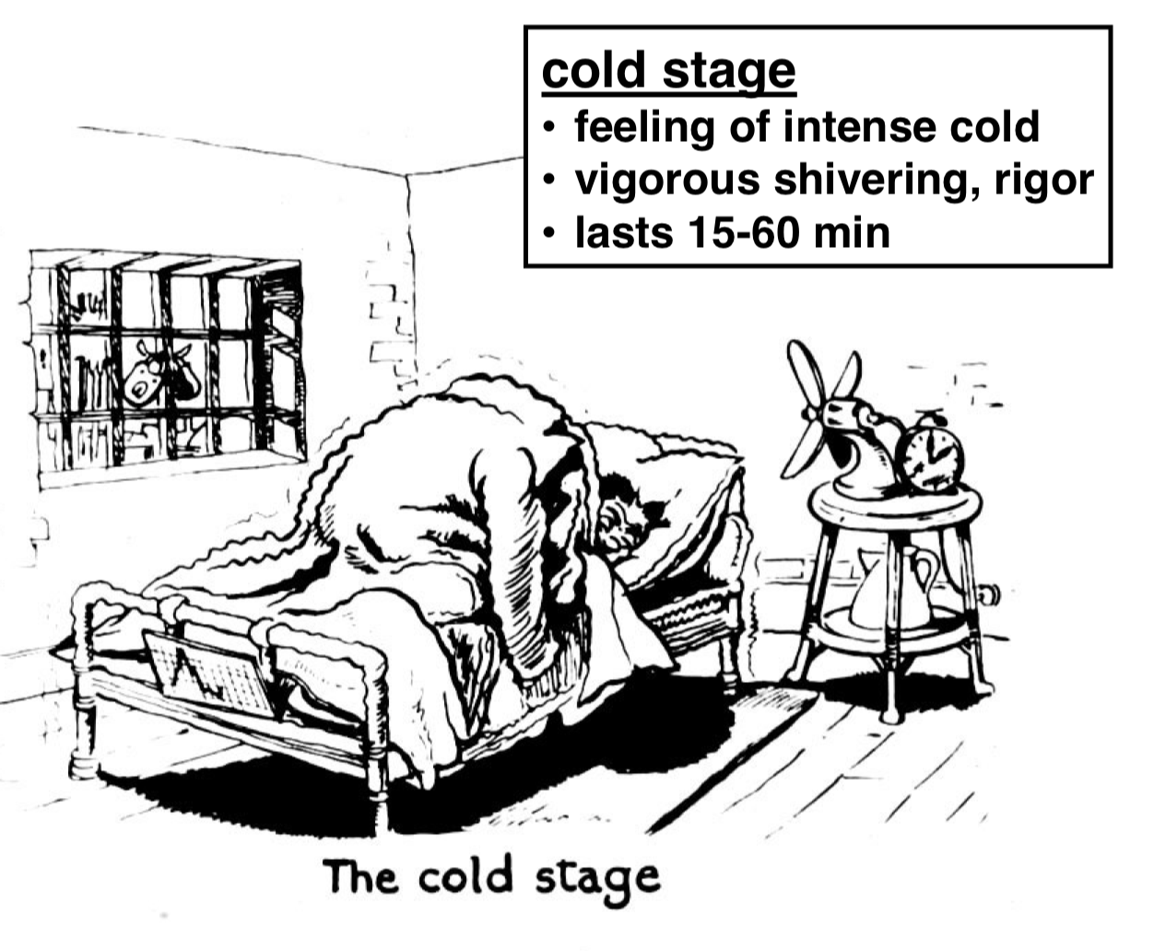
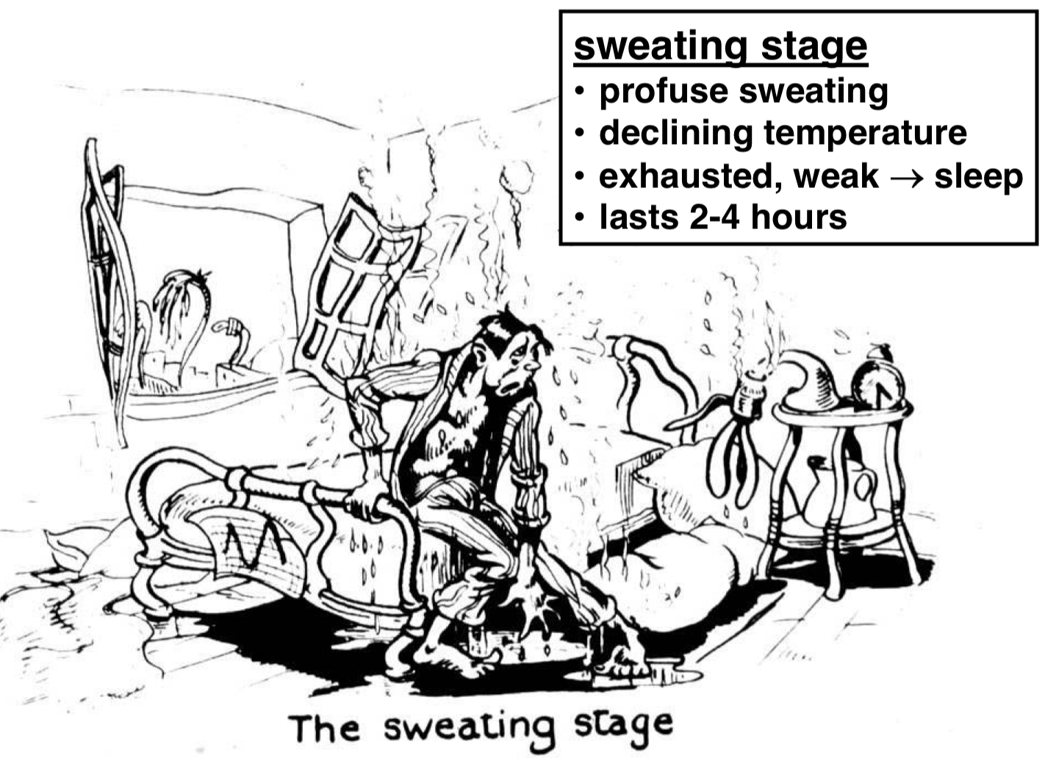
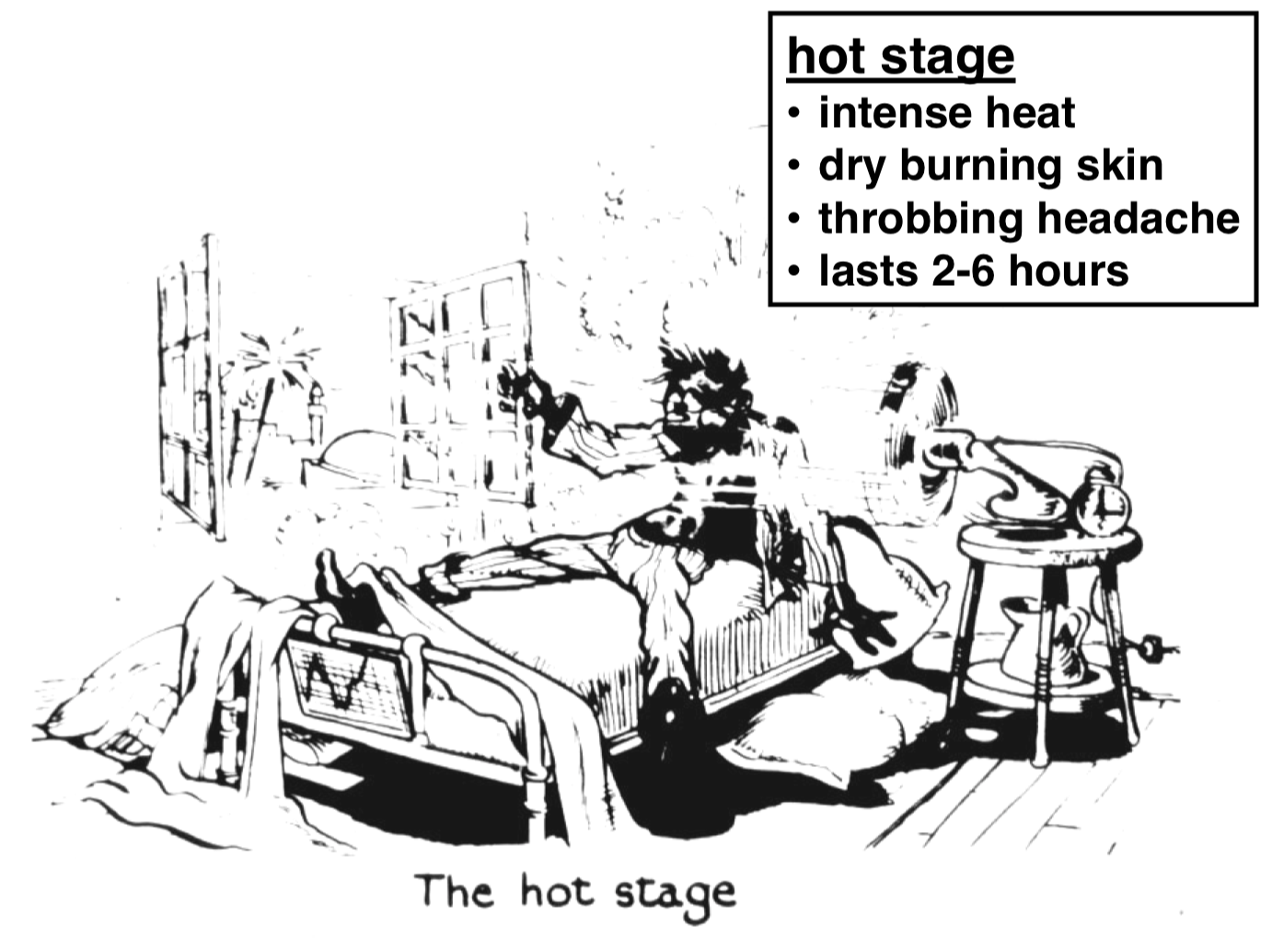
MALARIA FEVER PAROXYSMS
Rigors, headache
associated with pale cold skin
(1-2 hours)
Delirium, Tachypnoea,
Hot Skin
(Several hours)
Fever
Marked sweating and fatigue
Patient often symptoms free between paroxysms

Slide 15
DIAGNOSIS
Detailed targeted history including travel hx and clinical examination together with:
High Index of Suspicion (HIS)

Slide 16
DX: BLOOD FILM
Giemsa stain or wright’s stain.
Correct identification of malarial Species is essential for treatment because of P. Falciparum is risitant to Chloroquine & others.
On Giemsa stain – Cytoplasm: light blue, nucleus: dark blue
In P.F
(a) only ring stage a sexual parasite and gametocytes seen in periph. blood.
(b) While RBC with Trophozoites or Schizonts stage – sequestered in peripheral, Microvasculature, and NOT circulating P-blood.
All asexual erythrocytic stages of P. Vivax, Ovale & malariae circulate in peripheral blood, thus seen on Blood Smear
Acutely ill patients
DDX: P.F. vs P. Vivax, because
(a) P. Ovale – Vivax – clinical, morphological
(b) P. malariae - ch. Infeciton

Slide 17
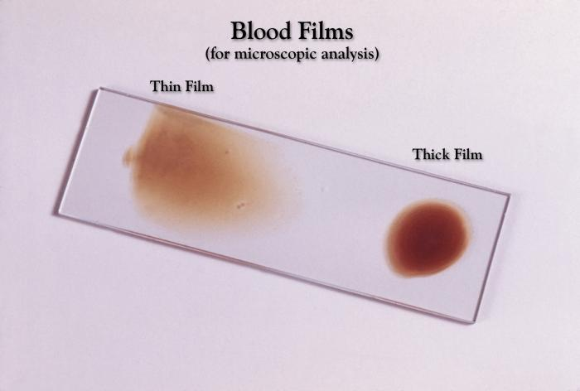

Slide 18
THIN VS. THICK BLOOD FILM
Thin blood film: RBC morphology preserved:
P. Vivax; infected RBC
RBC enlargement with parasite maturation.
Scuffner’s dots (eosinophilic dots in RBC cyto.)
May see Maurer’s clots in RBC ectoplasm
Infection with more than one parasite spp: 5-7%
Thick blood film: RBC’S are lysed:
You may examine 10X. Blood more than in thin film.
More diagnostic in lower degree of parasitemias.
Serology: not useful in managing acutely ill patient.
DNA probe: similar thick film sensitivity.

Slide 20
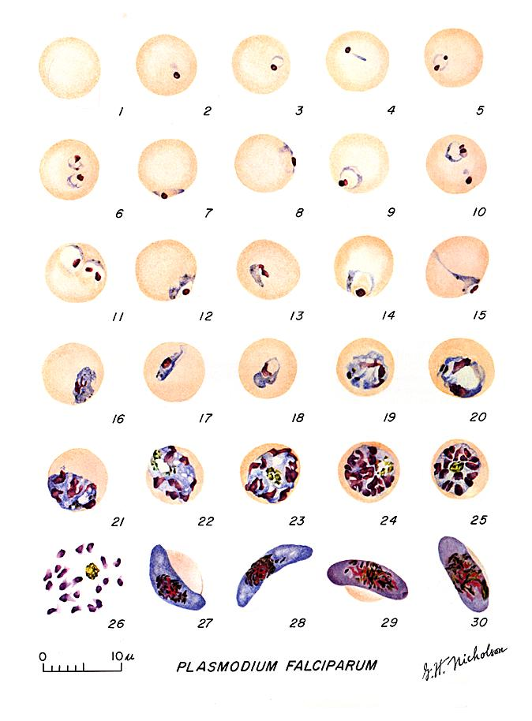
PLASMODIUM FALCIPARUM: BLOOD STAGE PARASITES THIN BLOOD SMEARS
1: Normal red cell.
2-18: Trophozoites
( 2-10: ring-stage trophozoites).
19-26: Schizonts ( 26 is a ruptured
schizont).
27, 28: Mature macrogametocytes
(female).
29, 30: Mature microgametocytes
(male).

Slide 21
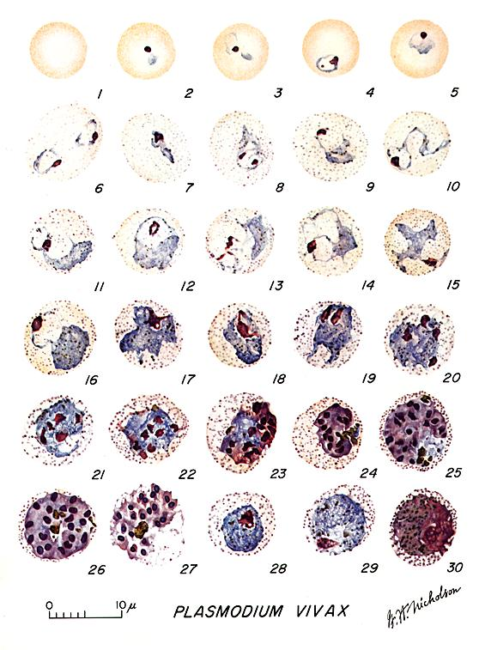
PLASMODIUM VIVAX: BLOOD STAGE PARASITES THIN BLOOD SMEARS
1: Normal red cell.
2-6: Young trophozoites (ring stage parasites).
7-18: Trophozoites.
19-27: Schizonts.
28,29: Macrogametocytes (female).
30: Microgametocyte (male).

Slide 22
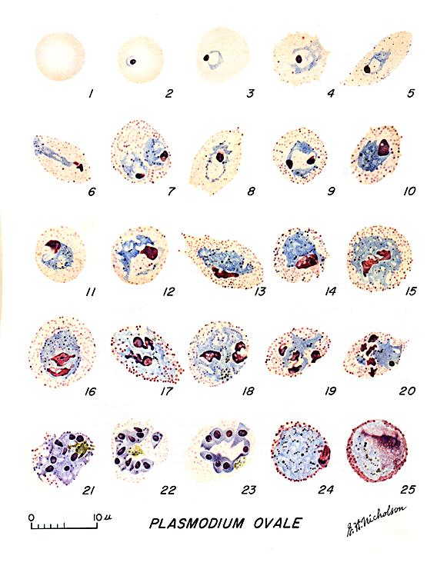
PLASMODIUM OVALE: BLOOD STAGE PARASITES THIN BLOOD SMEARS
1: Normal red cell.
2-5: Young trophozoites.
6-15: Trophozoites.
16-23: Schizonts.
24: Macrogametocytes (female).
25: Microgametocyte (male).

Slide 23
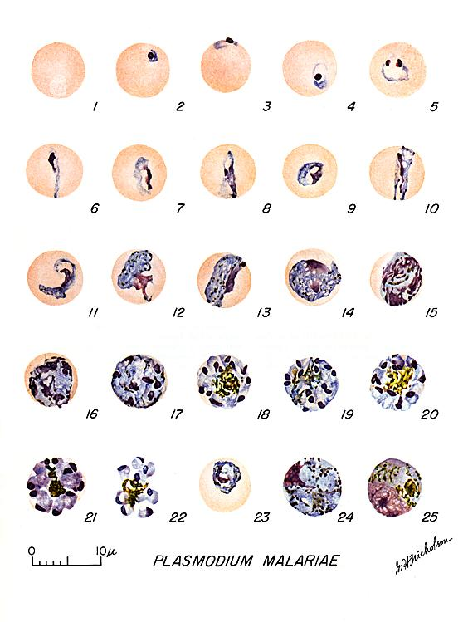
PLASMODIUM MALARIAE: BLOOD STAGE PARASITES THIN BLOOD SMEARS
1: Normal red cell.
2-5: Young trophozoites (rings).
6-13: Trophozoites.
14-22: Schizonts.
23: Developing gametocyte.
24: Macrogametocyte (female).
25: Microgametocyte (male).

Slide 24
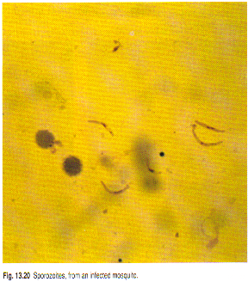
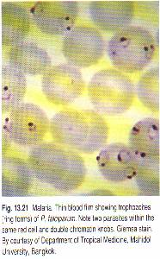

Slide 25
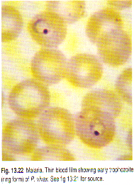
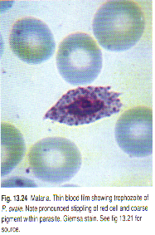

Slide 26
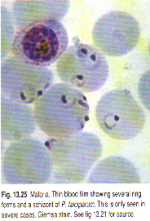
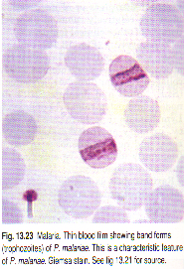

Slide 27
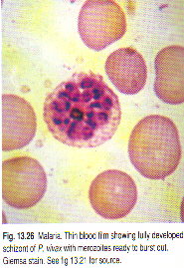
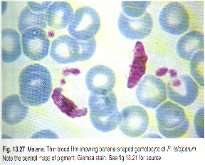

Slide 28
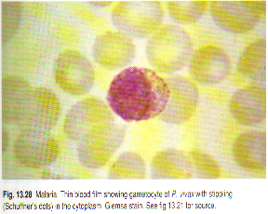
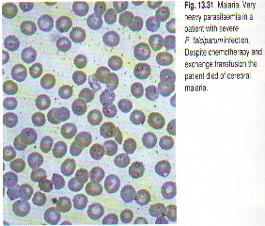

Slide 29
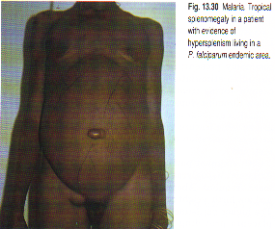
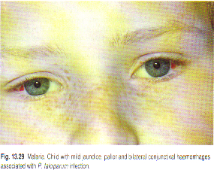

Slide 30
DIFFERENTIAL DIAGNOSIS OF MALARIA IN ACUTELY III PATIENTS BASED ON P.B. SMEAR
 | P. FALCIPARUM | P. VIVAD & P. OVALE
Multiple infected RBCs | Common | Rare
Mature (trophozoite and schizont) parasites | Absent | Common
RBC enlargement with later parasite stages | Absent | Common
Mature (trophozoites & schizont) stage P. falciparum. Typically sequestered in the peripheral microvasculature.
RBC enlargement in P. vivax typically occurs with later stage parasites that do not circulate in P. falciparum infection.

Slide 31
MALARIA COMPLICATIONS
Depth of coma.
Temp.
Vomiting.
Seizures. Do not modify outcome
Parasite load.
Anemia.
HIV infection did not affect clinical or biological presentation of cerebral malaria and appears not to affect outcome.
(Niyongabo et al, Acta Tropica Apr 1994)

Slide 32
RISK FACTORS FOR POOR PROGNOSIS IN CEREBRAL MALARIA
High bilirubin.
High creatinine.
Hight lactase.

Slide 33
MALARIA COMPLICATIONS
Major clinical features of malaria are those of the complications.
Majority of complications (apart from anemia) associated with P. Falciparum.

Slide 34
MALARIA COMPLICATIONS
Majority of complications (apart from anemia) associated with P. falciparum
*Anemia: presents in most severe infections and parallels parasitemia.
Hemolysis of infected RBC.
Delayed retics. release from BM.
Immune – mediated hemolysis of non-infected RBC.

Slide 35
MALARIA COMPLICATIONS
Majority of complications (apart from anemia) associated with P. falciparum
Non-immune: (primary infection).
Hemoglobinuria.
Black water fever .
Exaggerated hemolytic response to quinine – sensitized RBC.

Slide 36
MALARIA COMPLICATIONS
Mild unconjugated jaundice common, and parallels hemolysis. Hepatocellular dysfunction may contribute to jaundice.
Tissue hypoxia related complications:
Hypoxia results from altered microcirculation + anemia.
Maturation of erythrocyte schizonts in P. falciparum takes place in tissue capillaries and venules.
P. falciparum parasitized RBC sequestered in micro circulation because:
Altered deformability of parasitized RBC.
Adhesion involving parasite – derived proteins within RBC and glycoproteins on vascular endothelium.

Slide 37
MALARIA COMPLICATIONS
Cerebral Malaria: Most severe common complication
Renal Failure: Most severe common complication
ATN.
Dehydration.
Hypotension.
Hypervescosity.
Pulmonary Edema:
ARDS – may complicate acute phase of severe malaise. Fluid overload may contribute.

Slide 38
MALARIA COMPLICATIONS
Hypoglycemia:
Glucose consumption.
Lactic acidosis.
Quinine/quinidine --- increase insulin secretion.
Bleeding:
Thrombocytopenia.
Consumption coagulopathy.
Shock: Endotoxemia.
Diarrhea.
Hyponatremia (? SIADH).

Slide 39
LATE COMPLICATIONS
Tropical splenomegaly in P. Falciparum endemic areas.
N. syndrome with P. malariae.
Burkett’s lymphoma (PF - EBV)

Slide 40
MALARIA & PREGNANCY
Mortality.
Anemia, hypoglycemia, pulmonary edema: > common.
Abortion.
Stillbirth.
Premature delivery high infant mortality.
LB wt.
Placental insufficiency.
High parasitemia ? placenta favorable site for P. falciparum.

Slide 41
CONGENITAL MALARIA
Transplacental infection:
Can be all 4 species.
Commonly P.v. and P.f. in endemic areas.
P.m. infections in nonendemic areas due to long persistence of species.
Neonate can be diagnosed with parasitemia within 7 days of birth or longer if no other risk factors for malaria (mosquito exposure, blood transfusion).
Fever, irritability, feeding problems, anemia, hepatosplenomegaly, and jaundice.
Be mindful of this problem even if mother has not been in malarious area for years before delivery.

Slide 42
MALARIA AND HEMOGLOBINOPATHIES
Heterozygous sickle cell train children less likely to contract P. falciparum.
C.S. disease: no such protection, rather mortality is higher > normal.
Thalassemics: partially protected (? Fetal Hb)
G-6-phosphatase RBC : less prone to P. falciparum.

Slide 43
PRINCIPLES OF TREATMENT
Treatment should be guided by three main factors (CDC):
The infecting Plasmodium species.
The clinical status of the patient.
The drug susceptibility of the infecting parasites as determined by the geographic area where the infection was acquired and the previous use of antimalarial medicines.

Slide 44
PRINCIPLES OF TREATMENT
If treatment must be initiated before the species is known treat as P .falciparum.
P falciparum should be presumed to be chloroquine resistant, except in a few areas of Central America and the Middle East.
Primaquine should be given if Plasmodium vivax or Plasmodium ovale is likely.

Slide 45
RESISTANCE PATTERNS
Chloroquine-resistant P falciparum:
Eastern Hemisphere: All of sub-Saharan Africa, Saudi Arabia, Yemen, Iran, Pakistan, Afghanistan, China, Nepal, and all of Southeast Asia .
Western Hemisphere: Panama, Haiti, Brazil, Peru, Bolivia, Colombia, Venezuela, Ecuador, French Guiana, Guyana, and Suriname.
Chloroquine-sensitive P falciparum:
Eastern Hemisphere: Turkey, Iraq, Syria, Georgia, Azerbaijan, Tajikistan, Turkmenistan, and Kyrgyzstan.
Western Hemisphere: Argentina, Paraguay, Mexico, Guatemala, Costa Rica, Honduras, Nicaragua, El Salvador, and Dominican Republic.

Slide 46
RESISTANCE PATTERNS CONT.
Mefloquine-resistant P falciparum:
Southeast Asia: Regions of Vietnam, Laos, Thailand, Burma, and Cambodia.
Chloroquine-resistant P vivax:
Papua New Guinea and Indonesia.

Slide 47
TREATMENT
Uncomplicated P falciparum infection :
Artemether-Lumefantrine or,
Atovaquone-proguanil or,
Quinine or,
Mefloquine.
Uncomplicated Plasmodium malariae, Plasmodium knowlesi, or chloroquine-sensitive P falciparum infection:
Chloroquine phosphate or,
Hydroxychloroquine.
Uncomplicated P vivax or P ovale infection, expected to be chloroquine-susceptible:
Chloroquine phosphate or,
Hydroxychloroquine.

Slide 48
TREATMENT
Uncomplicated P vivax infection, expected to be chloroquine-resistant:
Quinine or,
Atovaquone-proguanil or,
Mefloquine or,
Amodiaquine.

Slide 49
COMPLICATED MALARIA
Quinidine gluconate 10 mg/kg loading dose over 1-2h, then 1.2 mg/kg/h for at least 24h.
Once parasitemia is < 1% and patient can take oral medication, switch to quinine 650 mg PO TID to complete 3-d course (7-d course if malaria was acquired in southern Asia).
In addition, give doxycycline 100 mg IV or PO BID for 7d.
For pregnant women, instead of doxycycline, give clindamycin 20 mg base/kg/day PO divided TID for 7d.

Slide 50
CHEMOPROPHYLAXIS
Atovaquone-proguanil or,
Chloroquine phosphate or,
Doxycycline or,
Mefloquine or,
Primaquine.

Slide 53
ADDITIONAL SUPPORTIVE MEASURES
Blood Tx / Exchange Tx.
Hypoglycemia treatment and prophylaxis especially in pregnant women.
Avoidance of IVF overload.
Dialysis.
Heparin for consumption coagulation.
Pregnant woman should receive prophylaxis.
Non-immune travelers.

Slide 54
OTHER MEASURES IN TREATING SEVERE MALARIA
Antibodies against TNF - α
They DECREASE fever but no effect on mortality & morbidity
? Reason
Effects of other cytokines as IL – 1, TNF- β.
On pathogenesis of complicated severe malaria.

Slide 55
OTHER MEASURES IN TREATING SEVERE MALARIA
Steroids
Harmful by controlled trials.
Dexamethasone longer duration of coma + worse outcomes than patient receiving quinine alone.
(NEWJ 1982, Warrel et al)
Reducing mosquito – human contact.
Malaria vaccine.

Slide 56
FUTURE PERSPECTIVE
Success to control or eradicate malaria faced by obstacles:
Increasing drug resistance in P. falciparum and appearing ( R ) in P. vivax.
Basis of protection against infection and disease not understood.
Biologic basis of vector capacity responsible for mosquito-born malaria transmission is unknown.
Increasing anopheline mosquito resistance to insecticide.

Slide 57
FURTHER EXTRA READING
The following are for interested readers

Slide 58
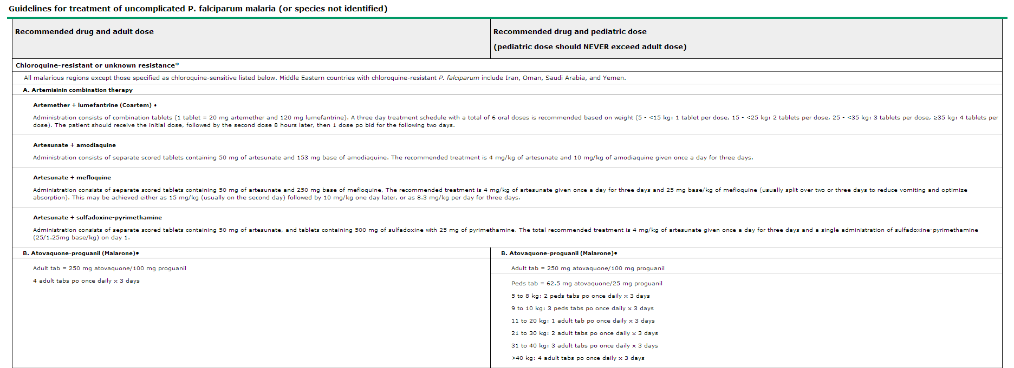

Slide 60
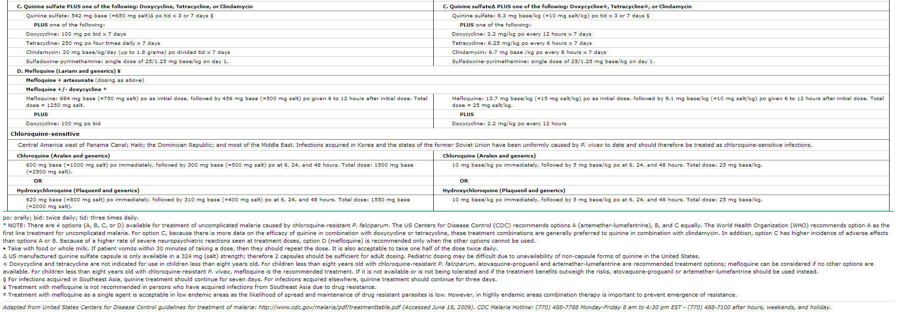

Slide 61
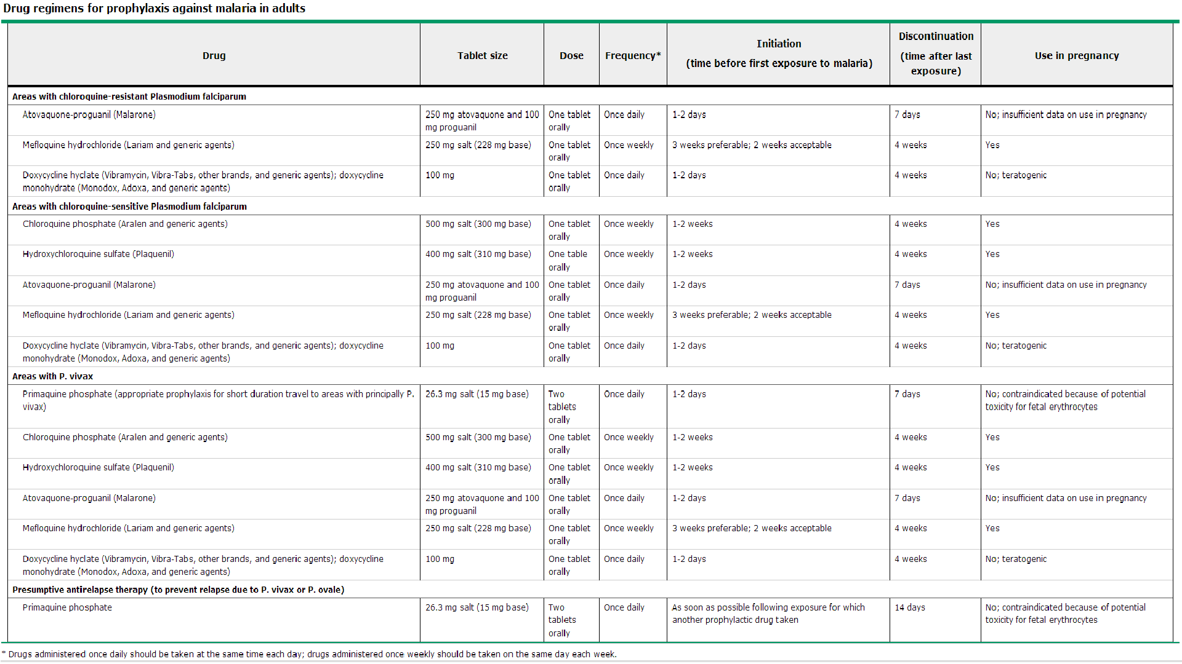

Slide 62
THANK YOU

