Slide 1
Neuromuscular Junction Disorders
Dr. Hana Albulaihe
Consultant Neurologist

Slide 2
Outline:
Anatomy and physiology of neuromuscular junction.
Classifications of NMJ disorders
Myasthenia gravis.
Lambert eaton myasthenic syndrome.
Other neuromuscular junction disorders (toxins).

Slide 3
Anatomical Description of a NMJ
Each neuromuscular junction consists of the axon terminal of a motor neuron and the motor end plate of a muscle fibre.
The Motor Neuron Part: - The axon of a motor neuron enters the structure of skeletal muscle and forms many branches called axon terminals.
- There is a swelling called a synaptic end bulb at the end of each axon terminal.
- Each synaptic end bulb contains many synaptic vesicles each of which contains an important neurotransmitter called acetylcholine.

Slide 4
Anatomical Description of a NMJ
The Muscle Fiber Part:
The part of the sarcolemma of the muscle cell that is in closest proximity to the synaptic end bulb is called the motor end plate.

Slide 5
Anatomical Description of a NMJ
The Synapse or Neuromuscular Junction (NMJ):
The area between the axon terminal and the sarcolemma is called the 'synaptic cleft'.

Slide 7
Neuromuscular junction physiology
Release of Ach:
- When a nerve pulse reaches a synaptic end bulb, it triggers release of the neurotransmitter acetylcholine (ACh) from synaptic vesicles that contain acetylcholine (ACh).
- ACh then diffuses across the synaptic cleft between the motor neurone and the motor end plate.

Slide 8
Activation of ACh receptors:
- The motor end plate contains receptors onto which the free ACh binds after diffusing across the synaptic cleft.
- This binding of ACh to ACh receptors in the motor end plate causes ion channels to open & so allow the sodium (Na+) ions to flow across the membrane into the muscle cell.

Slide 9
Neuromuscular junction physiology
Generation of muscle action potential:
- The flow of sodium (Na+) ions across the membrane into the muscle cell generates a muscle action potential.
- This action potential then travels along the sarcolemma.

Slide 10
Neuromuscular junction physiology
Breakdown of Ach:
The ACh that is released is only available to take part for a short time before it is broken down by an enzyeme called acetylcholinesterase (AChE). This breakdown of ACh occurs within the synaptic cleft.

Slide 11
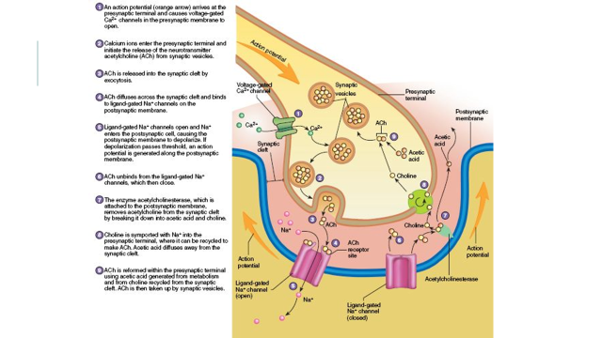

Slide 12
video

Slide 13
Classification of NMJ DISORDERS
According to the mechanism of action or etiology:
Immune-mediated disease.
Toxic/metabolic.
Congenital syndromes.

Slide 14
Classification
Immune-mediated
Myasthenia gravis, and Lambert-Eaton syndrome
Toxic/metabolic
Include snake venom poisoning, botulism, arthropod poisoning, organophosphates and hypermagnesemia
Congenital
Congenital myasthenic syndromes

Slide 15
Classification
According to the location of their disruption:
Presynaptic membrane of the motor neuron.
The synapse.
Postsynaptic membrane (the muscle fiber).

Slide 16
Classification
Presynaptic
Different mechanisms.
Most often this causes a decrease in the release of acetylcholine.
Mechanism of action can also impair the calcium channels that induce exocytosis of the vesicles.
Other ion channels can also be disrupted, such as the potassium channels causing inefficient repolarization at the presynaptic membrane as in neuromyotonia.
Examples: autoimmune neuromyotonia, Lambert-Eaton syndrome, congenital myasthenia gravis and botulism

Slide 17
Classification
Postsynaptic
The highest number of diseases affect the neuromuscular junction postsynaptically.
Immune mediated Myasthenia Gravis is the most common.
All the diseases that affect the postsynaptic membrane are forms of myasthenia gravis. Examples includes: Neonatal Myasthenia Gravis, Drug Induced Myasthenia Gravis and several types of Congenital myasthenia.

Slide 18
Myasthenia Gravis
Myasthenia gravis is the most common disorder of neuromuscular transmission.
The hallmark of the disorder is a fluctuating degree and variable combination of weakness in ocular, bulbar, limb, and respiratory muscles.

Slide 19
There are two clinical forms of myasthenia gravis: ocular and generalized.
●Ocular myasthenia: the weakness is limited to the eyelids and extraocular muscles.
●Generalized disease, the weakness commonly affects ocular muscles, but it also involves a variable combination of bulbar, limb, and respiratory muscles.

Slide 20
Myasthenia Gravis
EPIDEMIOLOGY :
Myasthenia gravis is a relatively uncommon disorder with an annual incidence of approximately 7 to 23 new cases per million.
Myasthenia gravis occurs at any age, but there is a bimodal distribution to the age of onset:
-Early peak in the second and third decades (female predominance)
-Late peak in the sixth to eighth decade (male predominance).

Slide 21
Pathophysiology of mg
- With every nerve impulse, the amount of ACh released by the presynaptic motor neuron normally decreases because of a temporary depletion of the presynaptic ACh stores (a phenomenon referred to as presynaptic rundown).
- In MG, there is a reduction in the number of AChRs available at the muscle endplate and flattening of the postsynaptic folds.
- Even if a normal amount of ACh is released, fewer endplate potentials will be produced, and they may fall below the threshold value for generation of an action potential. The end result of this process is inefficient neuromuscular transmission.

Slide 22
Pathophysiology of mg
- Inefficient neuromuscular transmission together with the normally present presynaptic rundown phenomenon results in a progressive decrease in the amount of muscle fibers being activated by successive nerve fiber impulses. This explains the fatigability seen in MG patients
- Patients become symptomatic once the number of AChRs is reduced to approximately 30% of normal.

Slide 23
Pathophysiology of mg
- The cholinergic receptors of smooth and cardiac muscle have a different antigenicity than skeletal muscle and usually are not affected by the disease
- The decrease in the number of postsynaptic AChRs is believed to be due to an autoimmune process whereby anti-AChR antibodies are produced and block the target receptors, cause an increase the turnover of the receptors, and damage the postsynaptic membrane in a complement-mediated manner.

Slide 24
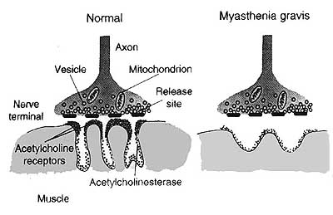

Slide 25
Clinical features of mg
- >50% of patients present with ocular symptoms of ptosis and/or diplopia.
- Of those who present with ocular manifestations, about half will develop generalized disease within two years.
- 15% of patients present with bulbar symptoms. These include dysarthria, dysphagia, and fatigable chewing.
-<5% present with proximal limb weakness alone.

Slide 26
Clinical features of mg
Ocular muscles:
Weakness of the eyelid muscles can lead to ptosis (flactuating).
The ptosis may start bilaterally and improve in one eye, resulting in unilateral ptosis or alternate.
Variable severity
Extraocular muscles involvement( binocular diplopia). It may be horizontal or vertical.

Slide 27
Clinical features of mg
Bulbar muscles
Muscles of jaw closure (fatigable chewing).
Oropharyngeal muscle weakness produces dysarthria and dysphagia.
Palatal muscles weakness causing nasal speech.
Nasal regurgitation, particularly of liquids, may occur due to palatal weakness

Slide 28
Clinical features of mg
Facial muscles
Frequently involved and causing expressionless face.
Transverse smile may be evident on examination "myasthenic sneer," where the mid-lip rises but the outer corners of the mouth fail to move.
Orbicularis oculi weakness.

Slide 29
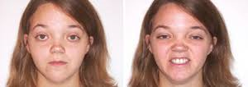

Slide 30
Neck and limb muscles :
Neck extensor and flexor muscles are commonly affected.
Dropped head syndrome.
Proximal limb weakness (the arms > the legs).
Wrist and finger extensors and foot dorsiflexors.

Slide 31
Clinical features of mg
Respiratory muscles :
Respiratory muscle weakness can leads to respiratory insufficiency and pending respiratory failure "myasthenic crisis.“
It may occur spontaneously during an active phase of the disease or may be precipitated by a variety of factors including surgery, infections, certain medications, or tapering of immunotherapy.

Slide 32
Diagnosis of mg
BEDSIDE TESTS:
Ice pack test:
It can be used in patients with ptosis.
A bag (or surgical glove) is filled with ice and placed on the closed lid for two minutes. The ice is then removed and the extent of ptosis is immediately assessed.
The sensitivity appears to be about 80%.

Slide 34
Diagnosis of mg
Edrophonium(Tensilon) test:
It should be used only in those patients with obvious ptosis or ophthalmoparesis, in whom improvement after infusion of the drug can easily be observed.
Edrophonium chloride is an acetylcholinesterase inhibitor with rapid onset (30 to 45 seconds) and short duration of action (5 to 10 minutes).
It prolongs the presence of acetylcholine in the neuromuscular junction and results in an immediate increase in muscle strength in many of the affected muscles.

Slide 35
Diagnosis of mg
SEROLOGIC TESTING :
- Acetylcholine receptor binding antibodies found in in 80-90% of those with generalized disease and in 40-55% of those with ocular myasthenia
- MuSK antibodies are present in 38-50% of those with generalized myasthenia gravis who are AChR-Ab negative

Slide 36
Diagnosis of mg
ELECTROPHYSIOLOGIC CONFIRMATION
Repetitive nerve stimulation:
The nerve is electrically stimulated 6 to 10 times at low rates (2 or 3 Hertz). The compound muscle action potential (CMAP) amplitude is recorded from the electrodes over the muscle after electrical stimulation of the nerve.
In normal muscles, there is no change in CMAP amplitude with repetitive nerve stimulation.
In myasthenia there may be a progressive decline in the CMAP amplitude with the first four to five stimuli

Slide 37
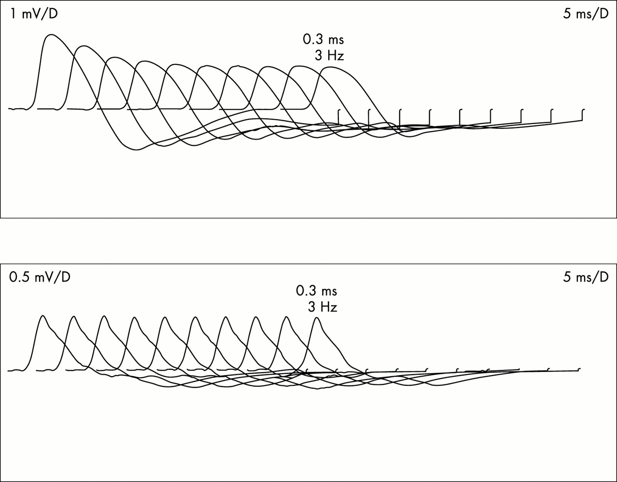

Slide 38
Diagnosis of mg
An RNS study is considered positive (abnormal) if the decrement is greater than 10 %
RNS studies are positive in more than 75% of patients with generalized myasthenia.

Slide 39
Single fiber electromyography:
It is positive in greater than 90% of those with generalized myasthenia.

Slide 40
Diagnosis of mg
CT Mediastinum:
In AChR antibody positive myasthenia gravis,>75% of patients have thymic abnormalities.
Thymic hyperplasia is most common 85%.
Thymic tumors (primarily thymoma) in up to 15%.

Slide 41
Diagnosis of mg
Autoimmune disorders:
Autoimmune thyroid disease is common (3-8%) in patients with myasthenia.
Screening for thyroid abnormalities should also be part of the initial evaluation.

Slide 42
Treatment of mg
Symptomatic treatments (anticholinesterase agents)
Chronic immunotherapies (glucocorticoids/immunosuppressive drugs).
Rapid immunotherapies (plasma exchange and intravenous immune globulin [IVIG]).
Thymectomy.

Slide 43
Lambert eaton syndrome
Lambert-Eaton myasthenic syndrome (LEMS) is a rare presynaptic disorder of neuromuscular transmission in which quantal release of acetylcholine (ACh) is impaired.

Slide 44
Pathophysiology of lems
An autoimmune attack directed against the voltage-gated calcium channels (VGCCs) on the presynaptic motor nerve terminal results in a loss of functional VGCCs at the motor nerve terminals.
The number of quanta released by a nerve impulse is diminished.
Because presynaptic stores of ACh and the postsynaptic response to ACh remain intact, rapid repetitive stimulation or voluntary activation that aids in the release of quanta will raise the endplate potential above threshold and permit generation of muscle action potential.

Slide 45
Pathophysiology of lems
Clinically, this phenomenon is noted by the appearance of previously absent tendon reflexes following a short period of strong muscle contraction by the patient.
Parasympathetic, sympathetic, and enteric neurons are all affected

Slide 46
Etiology of lems
Autoimmune:
Antibodies directed against the voltage-gated calcium channel (VGCC).
These antibodies interfere with the normal calcium flux required for the release of acetylcholine.
Paraneoplastic:
The expression of functional VGCCs in the surface membrane of small cell lung cancer (SCLC) cells (among numerous other neural antigens) is responsible for most cases of paraneoplastic LEMS.

Slide 47
Epidemiology of lems
The true incidence of LEMS is unknown, but the condition is uncommon and occurs much less frequently than myasthenia gravis
approximately 1/2 of LEMS cases are associated with a malignancy, mainly small cell lung cancer (SCLC)
The incidence and prevalence of LEMS in patients with SCLC are estimated to be approximately 3%
The other tumors associated with LEMS are lymphoproliferative disorders (Hodgkin lymphoma).

Slide 48
Clinical manifestation of lems:
Most patients with LEMS present with slowly progressive proximal muscle weakness, particularly involving the legs.
Deep tendon reflexes are typically depressed or absent
Dry mouth is the most common autonomic symptom, while erectile dysfunction is common in men
Ocular symptoms, especially ptosis and diplopia, may occur with LEMS but are rarely the presenting or dominant feature of the illness.

Slide 49
Clinical manifestation of lems
Most patients do not have significant respiratory muscle weakness
Recovery of lost deep tendon reflexes or improvement in muscle strength with vigorous, brief muscle activation is a unique aspect of LEMS

Slide 50
Diagnosis of lems :
The diagnosis of LEMS is usually made on clinical grounds and confirmed by the presence of antibodies to voltage-gated calcium channel (VGCC) and by electrodiagnostic studies
Antibodies against the P/Q-type VGCC are present in approximately 85-95% of patients with LEMS
high frequency (10 to 50 Hz) repetitive nerve stimulation (RNS) or brief (eg, 10 seconds) maximal isometric muscle activation result in significant increment with a marked increase in the CMAP amplitude

Slide 51
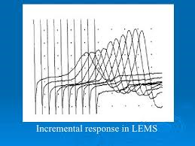

Slide 52
Treatment of lems:
Search for and treat a primary underlying malignancy in patients with any risk factors for small cell lung cancer.
Symptomatic therapies for LEMS include medications that increase the amount of acetylcholine available at the postsynaptic membrane.
These are guanidine, aminopyridines such as 3,4-diaminopyridine (3,4-DAP), and acetylcholinesterase inhibitors such as pyridostigmine

Slide 53
Treatment of lems:
Immunologic therapies include intravenous immune globulin (IVIG), oral immunosuppressive agents.

Slide 54
Other neuromuscular junction disorders

Slide 55
botulism
It is an uncommon and life-threatening disease caused by bacteria in the Clostridium family.
The botulinum neurotoxin is considered the most potent lethal substance known. In high enough doses
Organisms of the Clostridium genus are commonly found in soil and include C. botulinum, C baratii, and C butyricum.
They are all gram-positive, anaerobic, spore-forming rods, which have evolved to produce a potent neurotoxin

Slide 56
botulism
It occurs in 4 forms, differentiated by the mode of acquisition:
●Food borne botulism occurs after ingestion of food contaminated by preformed botulinum toxin
●Infant botulism occurs after the ingestion of clostridial spores that then colonize the host's gastrointestinal (GI) tract and release toxin produced in vivo
●Wound botulism occurs after infection of a wound by Clostridium botulinum with subsequent in vivo production of neurotoxin
●Adult enteric infectious botulism or adult infectious botulism of unknown source is similar to infant botulism in that toxin is produced in vivo in the GI tract of an infected adult host

Slide 57
botulism
An average of 110 cases of botulism is reported each year in the United States.
Approximately 72% of these cases are infant botulism, 25% are food borne botulism, and 3% are wound botulism.

Slide 58
Clinical manifestation of botulism:
- It is described as the acute onset of bilateral cranial neuropathies associated with symmetric descending weakness.
- Key features of the botulism syndrome (US CDC):
●Absence of fever
●Symmetric neurologic deficits
●The patient remains responsive
●Normal or slow heart rate and normal blood pressure
●No sensory deficits with the exception of blurred vision

Slide 59
Diagnosis of botulism:
The diagnosis is usually clinical as routine lab tests are nonspecific and specific laboratory confirmation may take up to days.
Electrodiagnostic studies are helpful in diagnosis of botulism.
Repetitive nerve stimulation (RNS) at low frequencies of 2 to 5 Hz causes decremental response.
RNS at high frequenciesstimulation or exercise causes incremental response, or postactivation facilitation ( in 60% of adult botulis).
The amount of facilitation seen with botulism (40-100%) is usually less than that seen in Lambert-Eaton myasthenic syndrome (200%).

Slide 60
Treatment of botulism:
Any patient with clinical signs, symptoms, or history suspicious for botulism should be hospitalized immediately and monitored for signs of respiratory failure.
There are two botulism antitoxin therapies available.
Equine serum heptavalent botulism antitoxin is used to treat children older than one year of age and adults.
Human-derived botulism immune globulin is used for infants less than one year of age

Slide 61
Treatment of botulism
Antibiotics are recommended for wound botulism after antitoxin has been administered.
Penicillin G (3 million units intravenously [IV] every four hours in adults) provides effective coverage of other clostridial species and is frequently used.
Metronidazole (500 mg IV every eight hours) is a possible alternative for penicillin-allergic patients.

Slide 62
Tick paralysis:
Several tick species produce a toxin that inhibits transmission at the neuromuscular junction by blocking influx of sodium ions.
This prevents presynaptic terminal axon depolarization and inhibits release of acetylcholine at the nerve terminal.
The ticks primarily responsible include the Rocky Mountain wood tick (Dermacentor andersoni), the American dog tick (Dermacentor variabilis), the Lone Star tick (Amblyomma americanum), the black-legged tick (Ixodes scapularis).

Slide 63
Tick paralysis:
Symptoms include anorexia, lethargy, muscle weakness, nystagmus, and an ascending flaccid paralysis.
Symptom onset occurs three to seven days after attachment of the tick.
The diagnosis of tick paralysis usually relies on the finding of a tick attached to the patient.
Unexposed areas such as the scalp, genitalia, and external meatus should be inspected carefully.
Removal of the tick is the primary treatment of tick paralysis.

Slide 64
Snake venom:
The toxins produced affect either the presynaptic or postsynaptic junction
Toxins affecting the presynaptic junction include beta-bungarotoxin (krait), notexin (tiger snake), taipoxin (Taipan), and crotoxin (Brazilian rattlesnake).
The exact mechanism of toxicity is undefined, but initial fusion of synaptic vesicles with the presynaptic membrane is induced, followed by inhibited reformation of the vesicles after exocytosis. Further neurotransmitter release is therefore prevented

Slide 65
Snake venom
The postsynaptic-acting toxins bind irreversibly to the acetylcholine receptor site, and prevent the opening of the associated sodium channel (an example is alpha-bungarotoxin).

Slide 66
Snake venom
Snake venom neurotoxins affect the cranial nerves first, resulting in ptosis, ophthalmoplegia, dysarthria, dysphagia, and drooling. This progresses to weakness of limb muscles.
Clotting time is also increased.
The postsynaptic toxins produce findings on electrodiagnostic studies identical to those seen in myasthenia gravis, since the mechanism of disease is similar.
Repetitive nerve stimulation produces a decremental response

Slide 67
Snake venom
Antivenom is available and effective for postsynaptic neurotoxins. It accelerates dissociation of the toxin from the postsynaptic receptor.
Presynaptic toxins have no response to antivenom.

Slide 68
ORGANOPHOSPHATE AND CARBAMATE TOXICITY
Organophosphates and carbamates are potent inhibitors of acetylcholinesterase, causing excess acetylcholine concentrations in the synapse.
Commonly used as pesticides.
Exposure routes include oral ingestion, inhalation, or dermal contact.

Slide 69
Clinical manifestation:
Both sympathetic and parasympathetic systems are involved.
Symptoms of organophosphate and carbamate poisoning include typical muscarinic signs (lacrimation, bradycardia, bronchospasm) and nicotinic signs (mydriasis, tachycardia, weakness, hypertension).
Increased depolarization at nicotinic neuromuscular synapses results in muscle weakness and flaccid paralysis.

Slide 70
Clinical manifestation:
Central nervous system symptoms may be present, with suppression of central medullary centers resulting in anxiety, confusion, seizures, and coma
10-40%of patients develop a distinct neurologic disorder 24-96 hours after organophosphorus agent poisoning, referred to as the "intermediate syndrome."

Slide 71
Diagnosis:
The diagnosis of organophosphate or carbamate poisoning is made on clinical grounds; the clinical features of cholinergic excess should indicate the possibility of organophosphate poisoning

Slide 72
Treatment
Emergency management of organophosphate or carbamate poisoning often requires endotracheal intubation and volume resuscitation.
All cases require aggressive decontamination with complete removal of the patient's clothes and vigorous irrigation of the affected areas
Atropine is used for symptomatic relief of muscarinic symptoms.
It does not reverse the paralysis caused by neuromuscular blockade that results from nicotinic receptor stimulation.
Atropine dosing should be titrated to the therapeutic end point of the clearing of respiratory secretions and the cessation of bronchoconstriction

Slide 73
HYPERMAGNESEMIA/HYPOCALCEMIA
Causes inhibition of acetylcholine release
Magnesium has a calcium channel blocking effect that decreases entry of calcium into cells. It also decreases the amount of acetylcholine released and depresses the excitability of the muscle membrane.
This produces proximal muscle weakness, which may progress to respiratory insufficiency. Ocular muscles are generally spared

Slide 74
The diagnosis of hypermagnesemia or hypocalcemia is generally made by demonstrating elevated serum magnesium levels or decreased calcium levels.
Observing clinical improvement as levels normalize.

Slide 75
Thank you

