Slide 1

Osteoarthritis
RIZWAN MANSOOR M.D. CONSULTANT RHEUMATOLOGIST

Slide 2
OA - Definition
◆ Heterogeneous group of conditions resulting in common histopathologic
and radiologic changes involving
◆ Entire joint organ, including:
◆ the articular cartilage
◆ the subchondral bone and
◆ the synovium.

Slide 3
Epidemiology
◆ Internationally, osteoarthritis is the most common articular disease.
Estimates of its frequency vary across different populations.
◆ 80-90% of individuals older than 65 years have evidence of radiographic osteoarthritis.
◆ the prevalence of osteoarthritis is higher among women than among men.
◆ Interethnic differences in the prevalence of osteoarthritis have been
noted.

Slide 4
Involved joints
Weight-bearing joints, including:
the knees the hips
cervical and lumbosacral spine feet.
Non weight bearing joints:
the(DIP), the(PIP), and the(CMC) joints.

Slide 5
Joint classification
◆ Functional:
Synarthroses (immovable)(Skull)
Amphiarthroses (slightly moveable)(symphysis pubis, verebral) Diarthroses (freely moveable)

Slide 6
Joint Classification
◆ Structural
Synovial Fibrous Cartilaginous

Slide 7
Synovial Joints
◆ Articular cartilage
◆ Subchondral bone
◆ Synovial membrane
◆ Synovial fluid
◆ Joint capsule

Slide 8



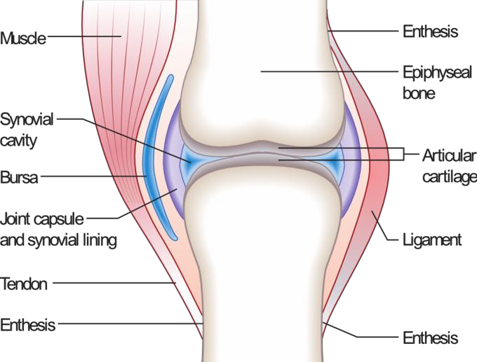

Synovial joint anatomy

Slide 9
The normal articular surface of synovial joints
◆ articular cartilage ( chondrocytes) surrounded by extracellular matrix
includes
◆ proteoglycans and collagen. The cartilage facilitates joint function and protects the underlying subchondral bone by
◆ distributing large loads,
◆ maintaining low contact stresses, and
◆ reducing friction at the joint.

Slide 10
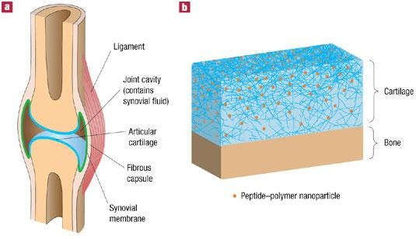
Synovial cartilage

Slide 11
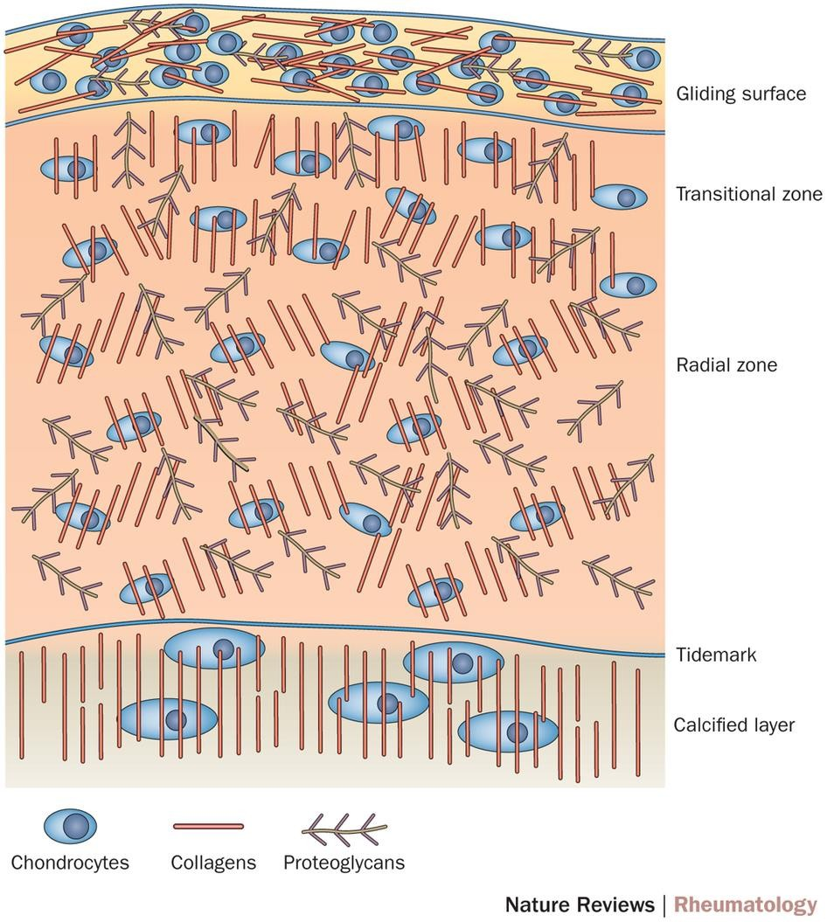
Synovial cartilage

Slide 12
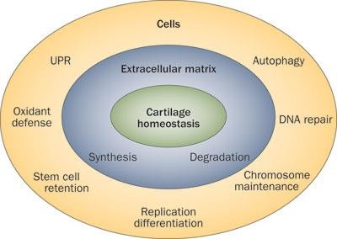
Cartilage homeostasis

Slide 13
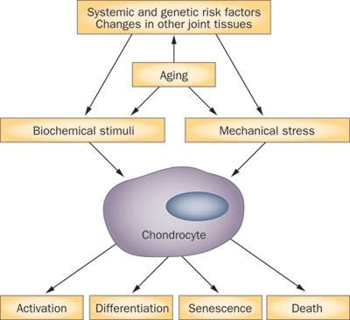
Pathogenesis Pathways in OA

Slide 14
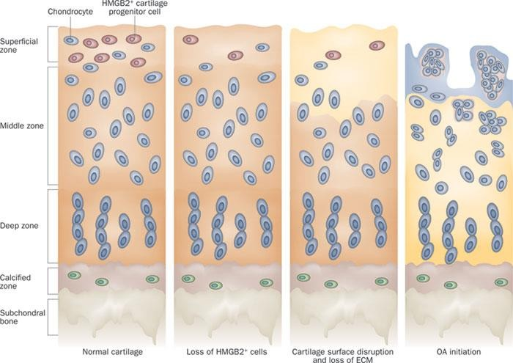
Cartilage Disruption

Slide 15
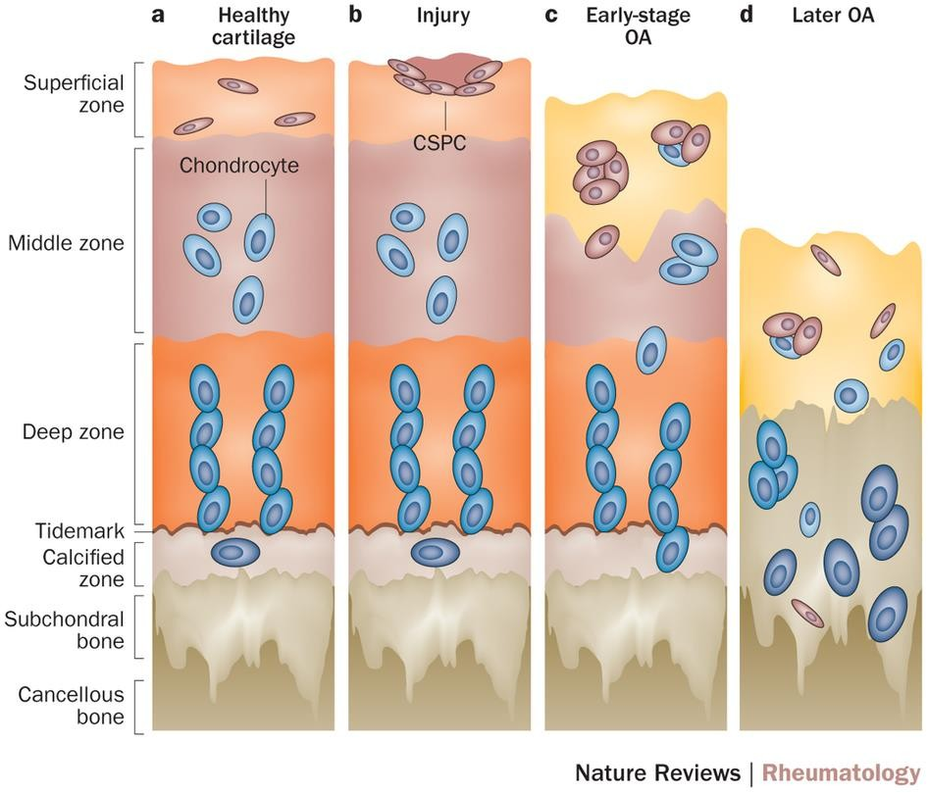
CSPC distribution in normal articular cartilage and, OA pathogenesis.

Slide 16
Synovial Fluid
◆ Synovial fluid is formed by (synoviocytes).
◆ Synovial cells also manufacture hyaluronic acid (HA, also known as hyaluronate), a glycosaminoglycan that is the major noncellular component of synovial fluid.
◆ Synovial fluid supplies nutrients to the avascular articular cartilage; it also
◆ provides the viscosity needed to absorb shock from slow movements
◆ provides elasticity required to absorb shock from rapid movements.

Slide 17
There is Inflammation in OA
◆ Inflammation occurs as cytokines and metalloproteinases are released into the joint. These agents are involved in the excessive matrix degradation that characterizes cartilage degeneration in osteoarthritis.

Slide 18
Pathogenesis
◆ Swelling of the cartilage usually occurs
◆ the level of proteoglycans eventually drops very low, the cartilage softens and lose elasticity and compromising joint surface integrity.
◆ Flaking and fibrillations (vertical clefts) develop along on the surface of an osteoarthritic joint. Over time, the loss of cartilage results in loss of joint space.
◆ a greater loss of joint space occurs at those areas experiencing the highest loads.

Slide 19
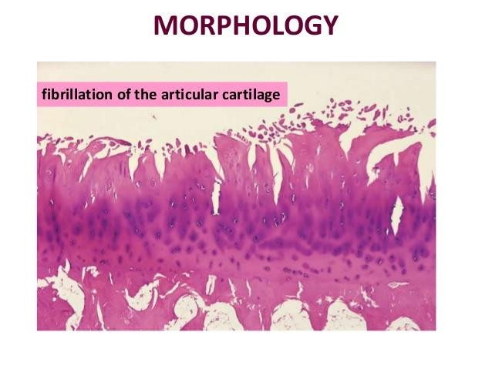
Cartilage changes

Slide 20
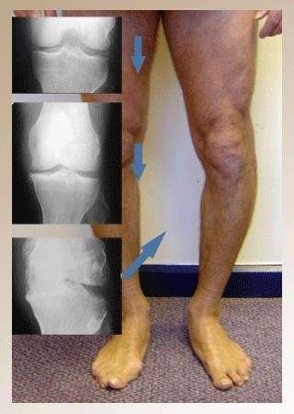
Clinical and Radiological

Slide 21
Bone changes
◆ Bone denuded of its protective cartilage continues to articulate with the
opposing surface.
◆ Eventually, the increasing stresses exceed the biomechanical yield strength of the bone.
◆ The subchondral bone responds with vascular invasion and increased cellularity, becoming thickened and dense (a process known as eburnation) at areas of pressure.

Slide 22
Bone changes
◆ subchondral bone undergo cystic degeneration.
◆ Osteoarthritic cysts are also referred to as subchondral cysts, pseudocysts, or geodes and may range from 2 to 20 mm in diameter.
◆ Osteoarthritic cysts in the acetabulum are termed Egger cysts.

Slide 23
Joint changes
◆ vascularization of subchondral marrow,
◆ osseous metaplasia of synovial connective tissue, and
◆ ossifying cartilaginous protrusions lead to irregular outgrowth of new bone (osteophytes).
◆ Fragmentation of these osteophytes or of the articular cartilage itself results in the presence of intra-articular loose bodies (joint mice).

Slide 24
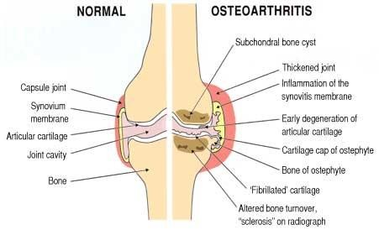
Joint changes

Slide 25
Etiology
◆ Risk factors-
◆ Age, obesity,trauma, genetics, hypogonadism, muscle weakness, repetitive use, Infection, crystal deposition, acromegaly, previous inflammatory arthritis (burnt-out rheumatoid arthritis)
◆ Heritable metabolic causes (alkaptonuria, hemochromatosis, Wilson disease)Hemoglobinopathies (sickle cell disease and thalassemia)Neuropathic disorders leading to a Charcot joint (syringomyelia, tabes dorsalis, and diabetes)Underlying morphologic risk factors (congenital hip dislocation and slipped femoral capital epiphysis)
◆ Disorders of bone (Paget disease and avascular necrosis)Previous surgical procedures (meniscectomy)Diabetes mellitus ^{[44]}

Slide 26
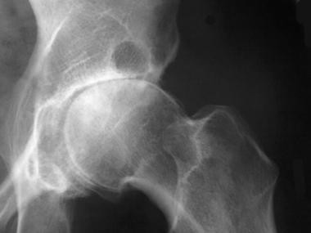
Radiographic changes

Slide 27
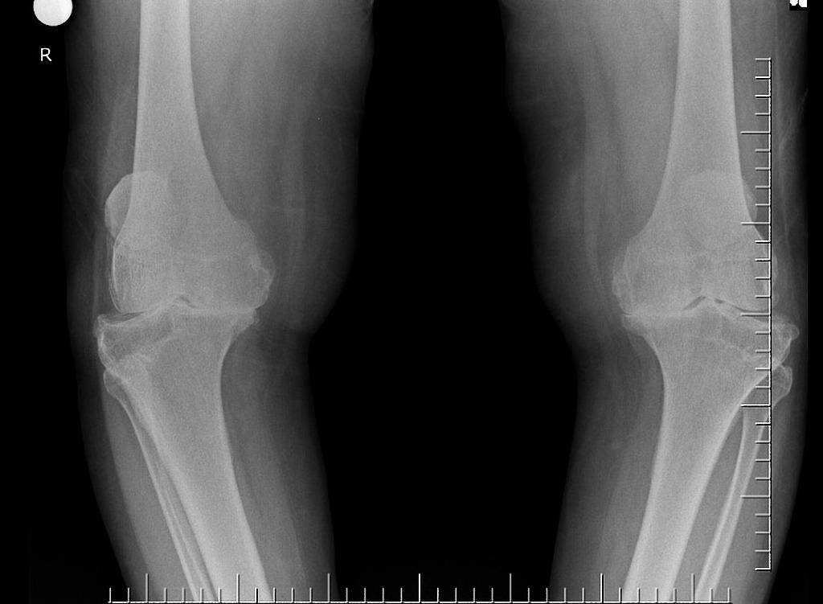
Radiological changes

Slide 28
Osteoarthritis Progression
◆ Stage 1- breakdown of the cartilage matrix occurs.
◆ Stage 2 - involves the fibrillation and erosion of the cartilage surface
◆ Stage 3 - a chronic inflammatory response in the synovium.
◆ Further Progression - the above events alter the joint architecture, compensatory bone overgrowth occurs. joint architecture is changed mechanical and inflammatory stress occurs on the articular surfaces, the disease progresses unchecked.

Slide 29
Primary Osteoarthritis
Three subtypes
◆ Primary generalized OA
◆ Erosive osteoarthritis
◆ Chondromalacia Patellae

Slide 30
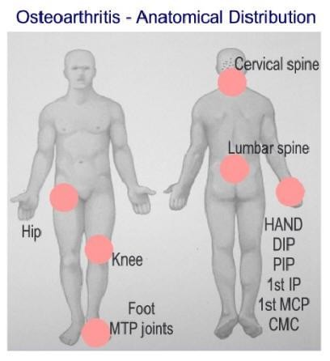
PGOA

Slide 31
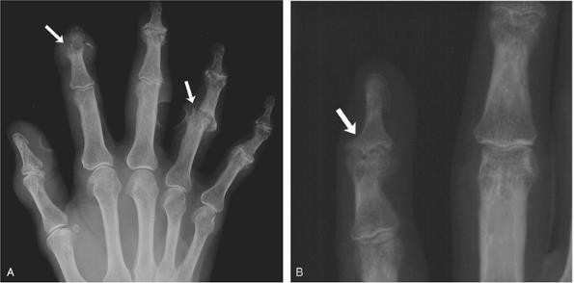
Erosive OA

Slide 32
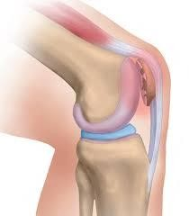
Chonromalcia Patellae

Slide 33
Differential Diagnosis
◆ Crystalline arthropathies (ie, gout and pseudogout)
◆ Inflammatory arthritis (eg, rheumatoid arthritis)
◆ Seronegative spondyloarthropathies (eg, psoriatic arthritis and reactive arthritis)
◆ Septic arthritis or postinfectious arthropathy
◆ Fibromyalgia
◆ Tendonitis

Slide 34
Work Up
◆ Laboratory
◆ Plain Radiography
◆ CT scan, MRI scan, ultrasonography
◆ Bone scintigraphy
◆ Arthrocentesis

Slide 35
Treatment
◆ Non pharmacologic-
Life style modification, physical and rehab therapy
◆ Pharmacotherapy Arthroscopy Osteotomy Arthroplasty
Fusion and joint Lavage Stem cell therapy

Slide 36
References
1.1.Hunter, W. Of the structure and diseases of articulating cartilages. Phil. Trans. Royal Soc. 470, 514–521 (1743).
2.2.National Collaborating Centre for Chronic Conditions (UK).
3.National Clinical Guideline for Care and Management in Adults(Royal College of Physicians of London, 2008). 3.3.Felson, D. T. An update on the pathogenesis and epidemiology of osteoarthritis. Radiol. Clin. North Am. 42, 1–9 (2004).
4.4.WHO. The World Health Report 2002: reducing risks, promoting healthy life (WHO, 2002).
5.5.Centers for Disease Control and Prevention (CDC). Prevalence of doctor-diagnosed arthritis and
arthritis-attributable activity limitation—United States, 2010–2012. MMWR Morb. Mortal. Wkly Rep. 62, 869–873 (2013).

