Slide 1

“CLOSER LOOK AT SpA”
Dr. Mohamed Bedaiwi
Consultant Rheumatologist Rheumatology Unit - KKUH

Slide 2


Slide 3
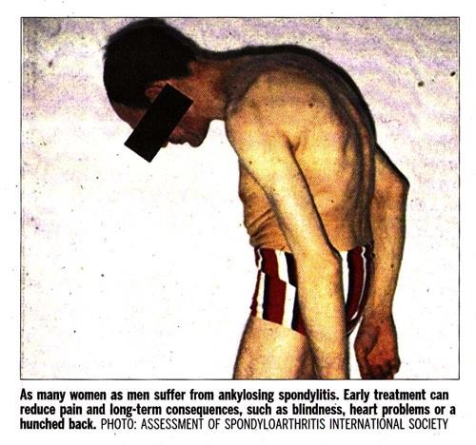

Slide 4

Closer look at SpA
Categories
SIGN & SYMPTOMS
X-RAY
MRI
V. MANAGMENT

Slide 5
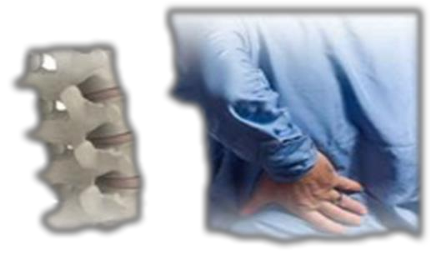



Spondyloarthritis (SpA) diseases:???
What are they?
Ankylosing spondylitis (AS)
Non-radiographic axial spondyloarthritis (nr- axSpA
PsA
IBD related arthritis
ReA
Undifferentiated Peripheral SpA
●
●
●
●

Slide 6
Spondyloarthritis (SpA) diseases:???
What are they?
Ankylosing spondylitis (AS)
Non-radiographic axial spondyloarthritis (nr- axSpA
PsA
IBD related arthritis
ReA
Undifferentiated Peripheral SpA
●
●
●
●

Slide 7


2 Broad Overlapping Categories
Complex disease
Axial Spondyloarthritis
Peripheral Spondyloarthritis
PsA
ReA
nr-axSpA
AS
IBD-SpA
Undifferentiated
Periphere SpA
●
●
●
●

Slide 8
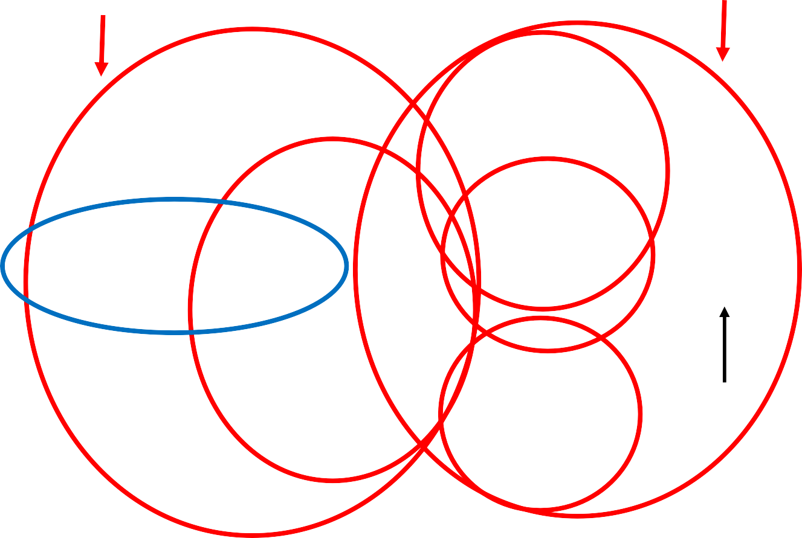
2 Broad Overlapping Categories
Complex disease
Axial Spondyloarthritis
Periphere Spondyloarthritis
PsA
ReA
nr-axSpA
AS
IBD-SpA
Undifferentiated
Periphere SpA
●
●
●
●

Slide 9
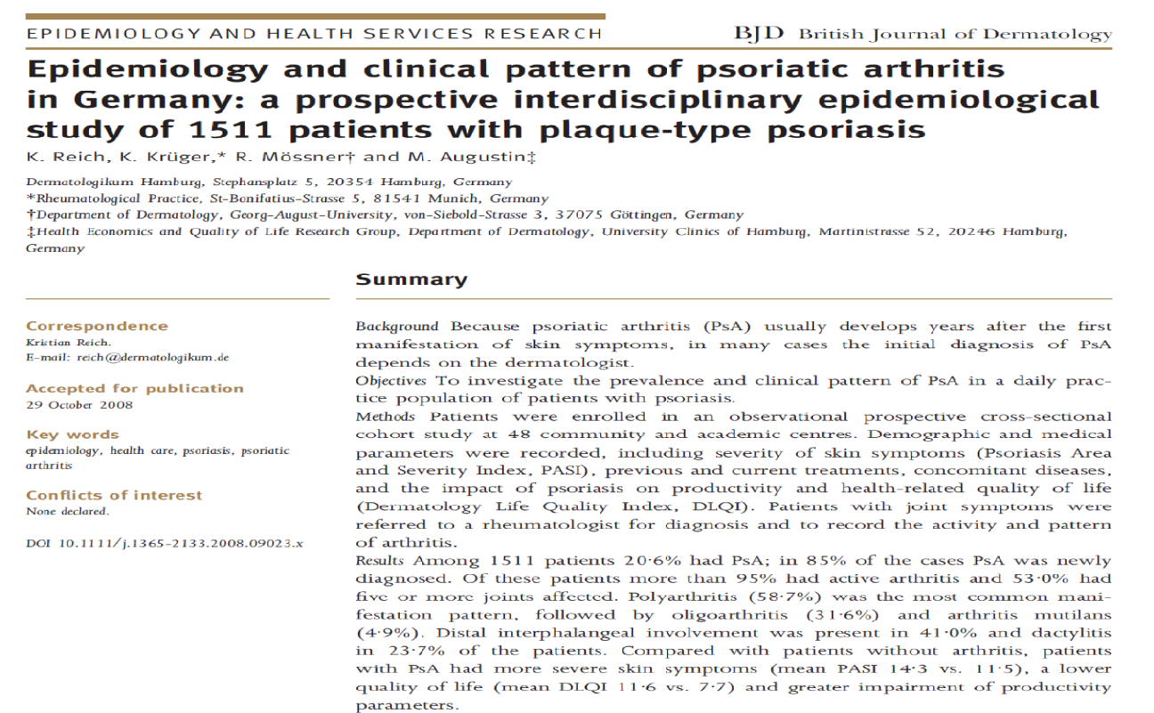
SpA IS MISSED
Observational prospective cross- sectional cohort study at 48 community and academic centres in Germany
1511 patients with psoriasis
Patients with joint symptoms were referred to a rheumatologist
Among 1511 patients 20.6% had PsA → 85% newly Dx

Slide 10
Ankylosing spondylitis
Family medicine practice
MRI?? → is very valuable

Slide 11
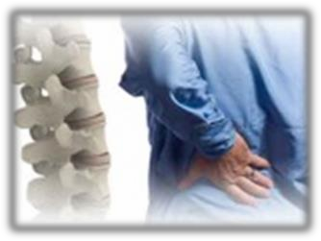



Good response
to NSAIDs
Tips
Symptoms
Patient History
Lab
Genetics Imaging
Dealing with a Solvable Problem
●
●
●
●

Slide 12
Back Pain
80% of the population will experience back pain during their lifetime.
More than 85% cannot attribute it to a specific disease or spinal abnormality.
Up to one third (1/3) of patients report persistent back pain of at least moderate intensity 1 year after an acute episode.
●
●
●
●

Slide 13
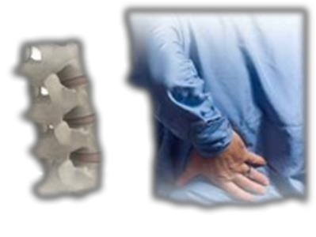



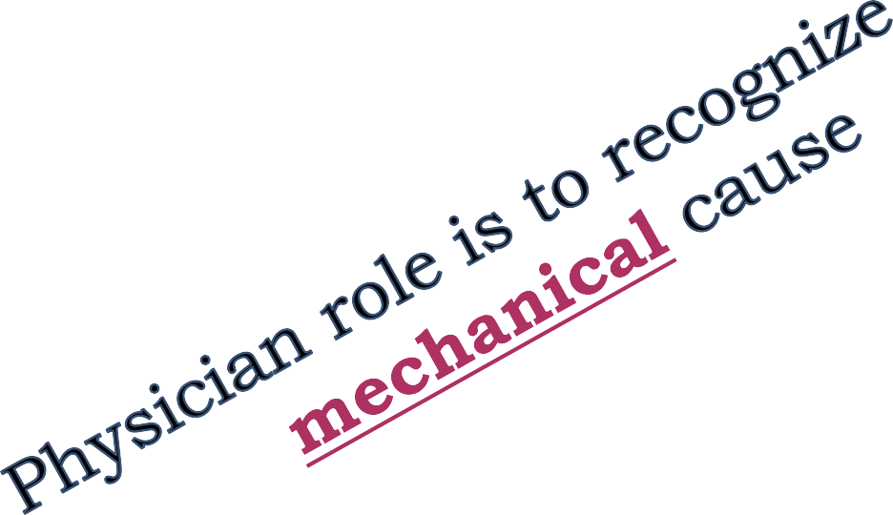



Low Back Pain is caused by a specific disorder:
Compression fracture
Symptomatic herniated disc
Spinal stenosis
Ankylosing spondylitis (3%)
Cancer
Spinal infection
●
●
●
●

Slide 14
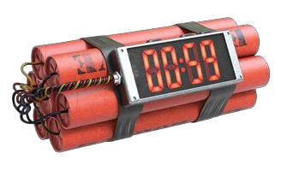



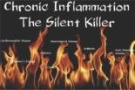
�Inflammation is bad
Inflammation is treatable
�Inflammation x Time = Damage
●
●
●
●

Slide 15
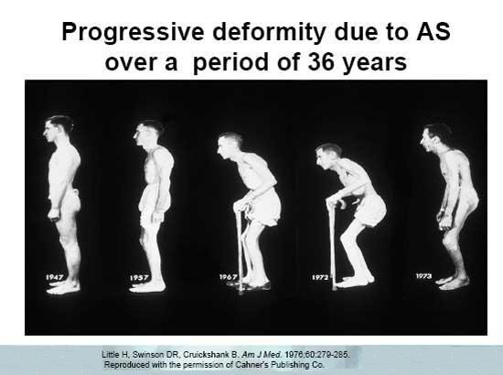
AS is progressive disease
●
●
●
●

Slide 16
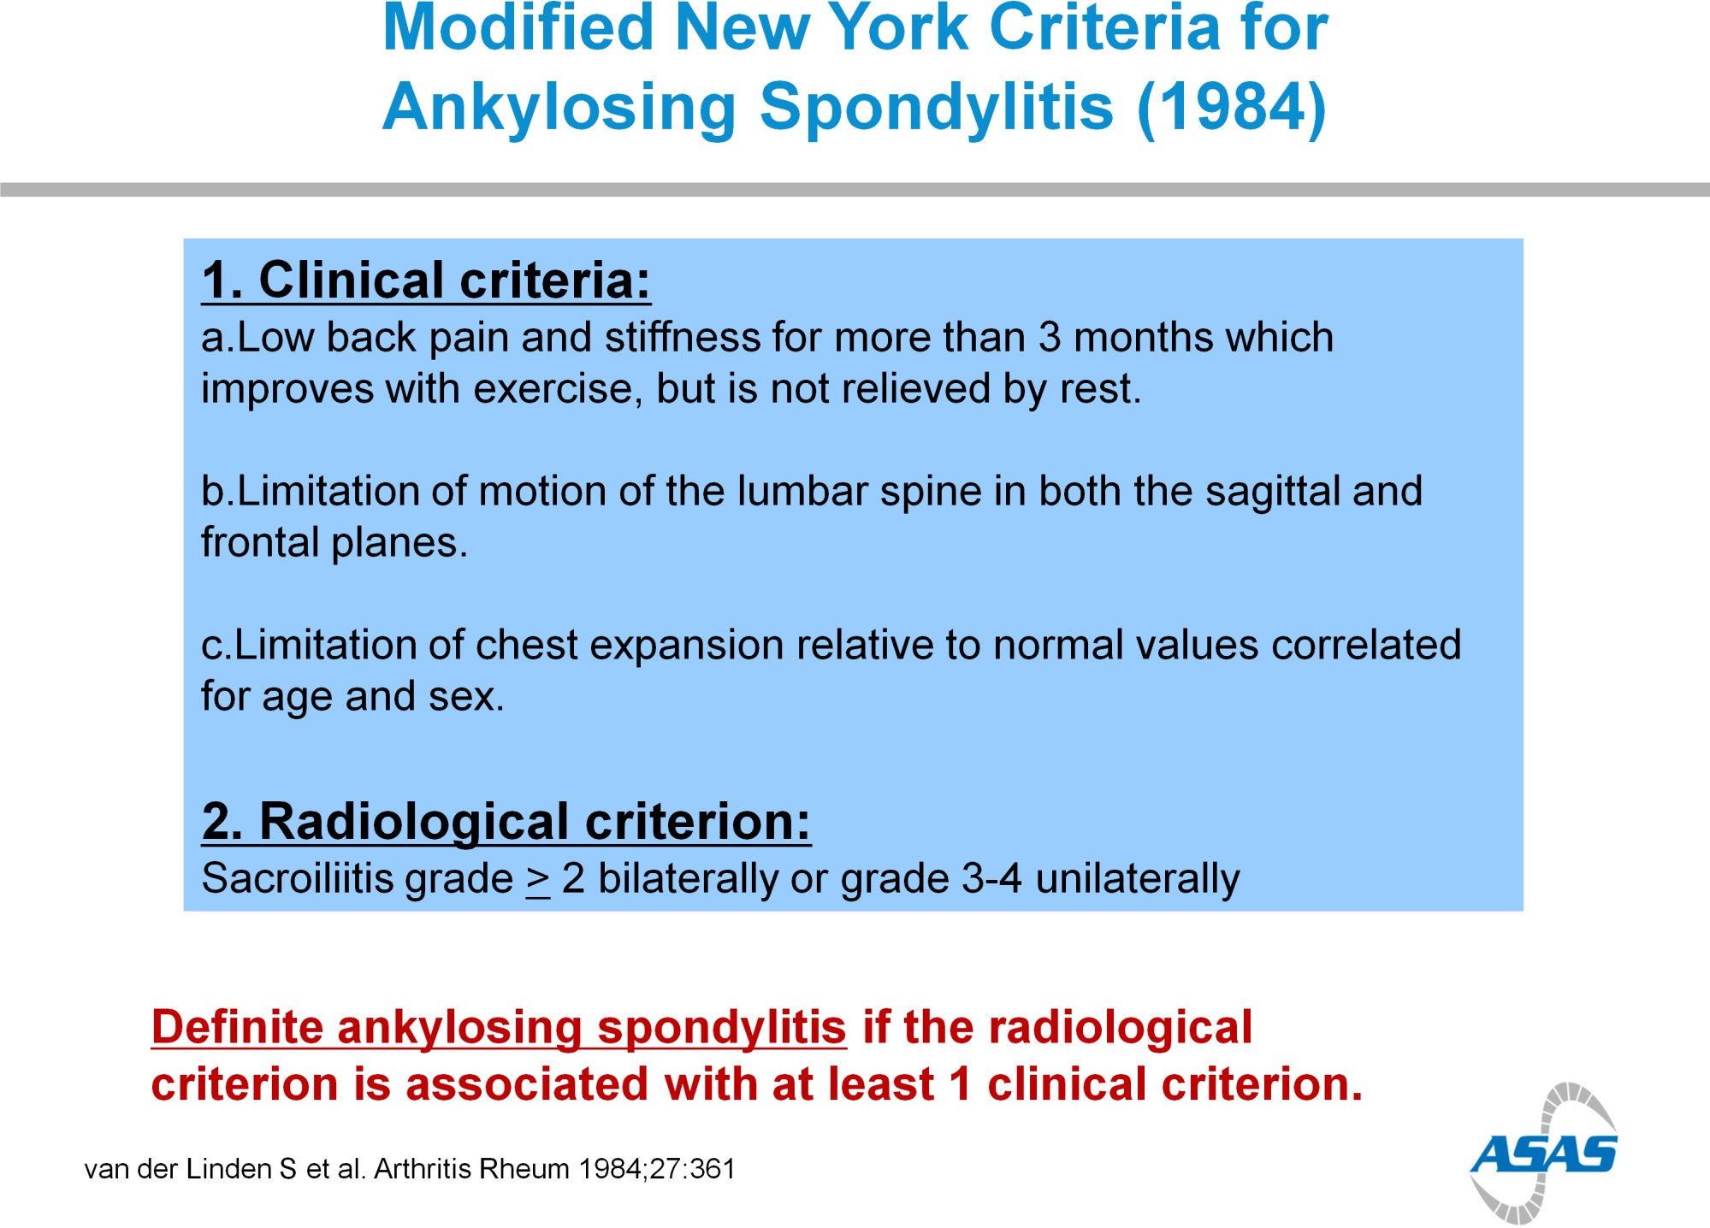

Slide 17
NEW YORK CRITERIA
MRI??
Extra-articular features??
HLA-B27

Slide 18
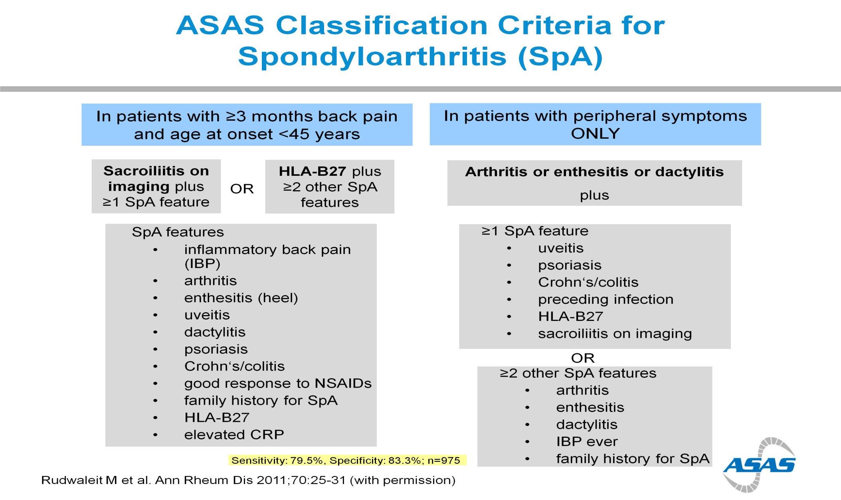

Slide 19
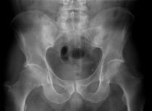
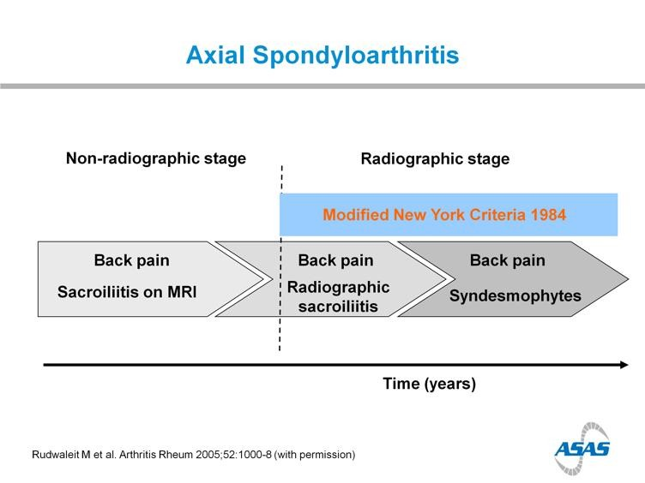
●
●
●
●

Slide 20
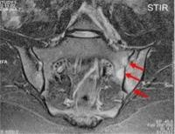
●
●
●
●

Slide 21
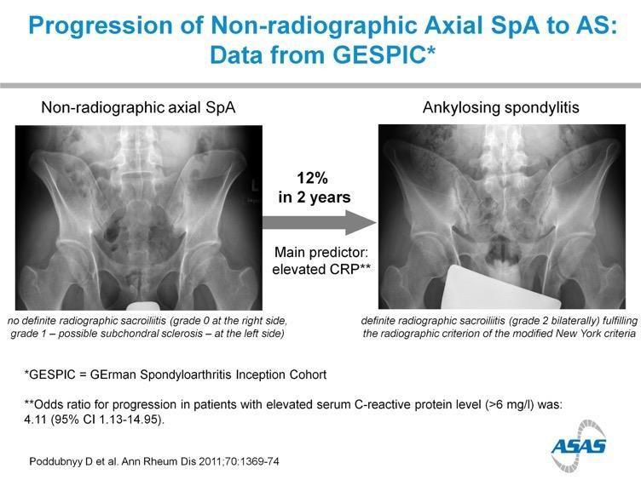
●
●
●
●

Slide 22
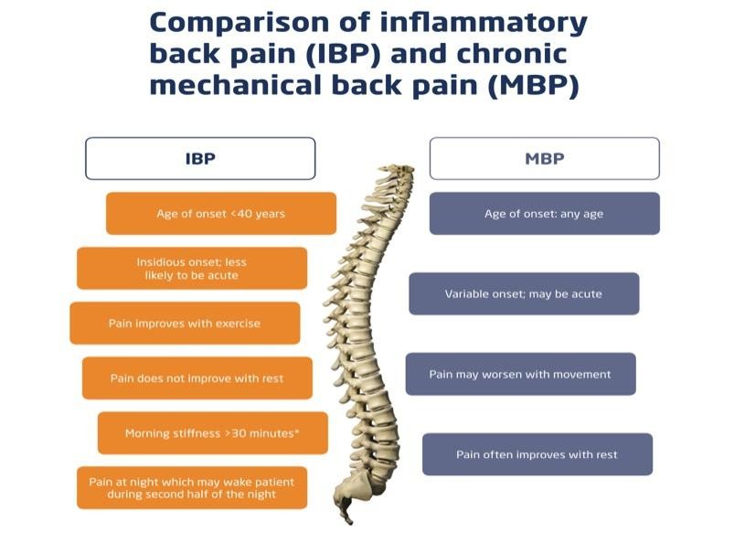
Back Pain
●
●
●
●
This Back in Focus resource was developed in collaboration with Claire Harris, Susan Gurden, Dr Jane Martindale, Claire Je ries and organized and funded by AbbVie.
Date of Preparation: August 2015 Job Code: AXHUR150732

Slide 23
M vs F

Slide 24
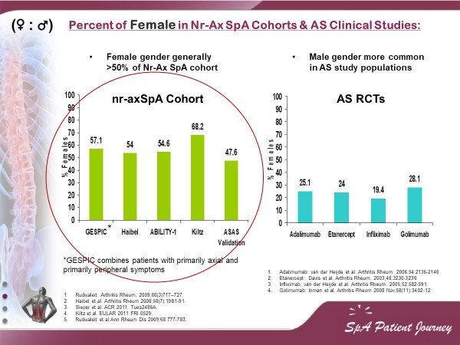

Slide 25
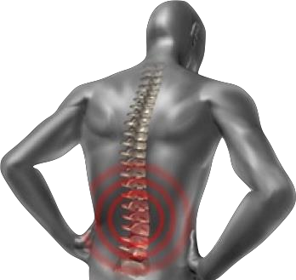

Spondyloarthropathies – SpA
Is it only SPINE?
●
●
●
●

Slide 26
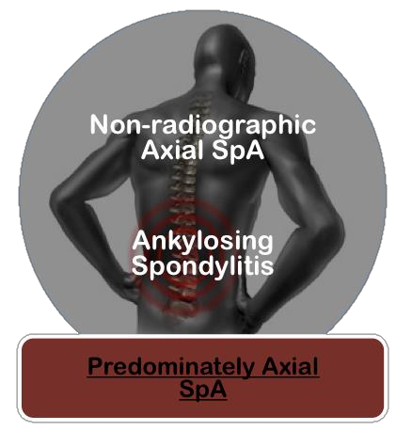
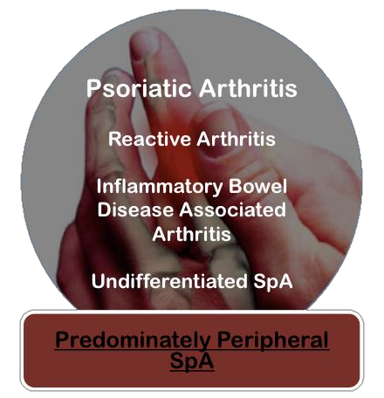
Updated ASAS Concept of Spondyloarthritis (SpA)
Groups Diseases into 2 Broad Overlapping Categories
●
●
n A
●
I
U iffe Perip
van den Berg R, et al. Polskie Archiwum Medycyny Wewnętrznej. 2010;120(11):452-457.

Slide 27
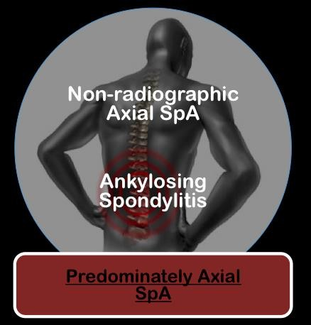
●
●
●
●

Slide 28


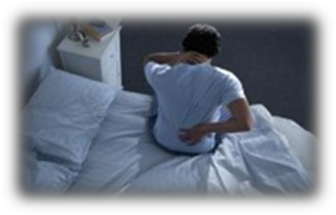


Inflammatory Back Pain
In patients with chronic back pain (>3 months), IBP criteria are fulfilled if at least 4 out of 5 parameters are present:
Tips
Symptoms
I
P
A
I
N
Patient History
Lab
Genetics
Insidious onset
No improvement with rest
Imaging
Pain at night
Improvement with exercise
●
●
●
●
Age at onset <45 years
An insidious disease is any disease that comes on slowly and does not have obvious symptoms at first. The person is not aware of it developing.

Slide 29
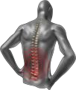
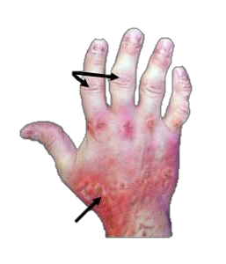
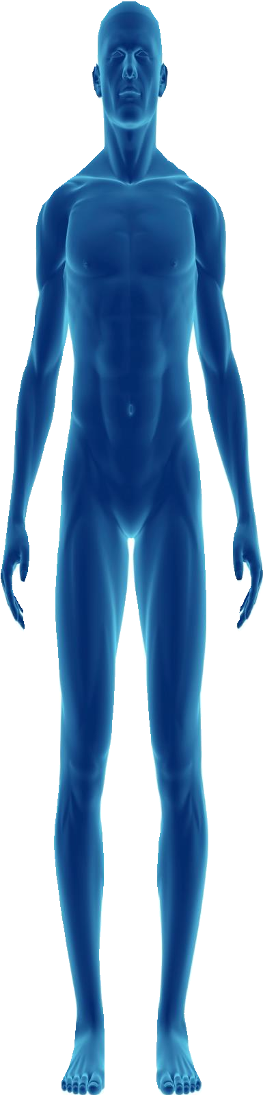








Extra-articular Manifestations
Uveitis
25-40% of patients affected
Uveitis
25% of patients affected
Psoriasis
16% of patients affected
Axial Disease
40% of patients affected
Inflammatory bowel Disease (IBD)
10% of patients affected (UC & CD)
Nail Psoriasis
80-90% of patients affected at some point
Dactylitis
21.5% of patients affected
Synovial joint involvement
Enthesitis
25-58% of patients affected
Enthesitis
20% of patients affected
●
●
●
●

Slide 30
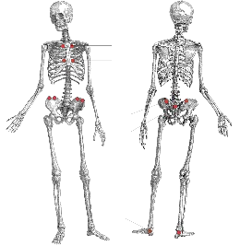
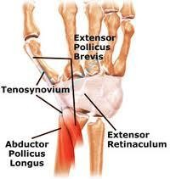
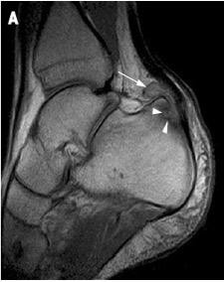
Heel Pain - Enthesitis
Tips
Enthesitis is inflammation of Entheses.
  Entheses are sites where tendons, ligaments, joint capsules, or fascia attach to bone.
Symptoms
Heel Enthesitis is most common.
Patient History
Tenosynovitis
Enthesitis
Achilles heel
Enthesitis
Lab
Genetics
Imaging
●
●
●
●
Eshed I, et al. Ann Rheum Dis 2007;66:1553–9

Slide 31
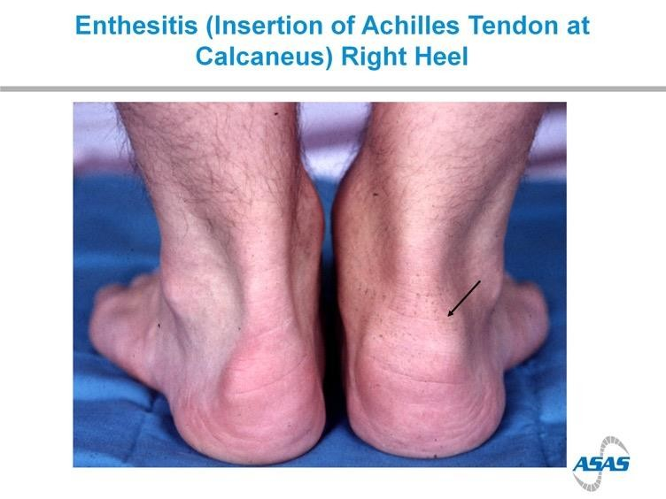
Tips
Symptoms
Patient History
Lab
Genetics Imaging
●
●
25-58% of patients affected
●
●

Slide 32
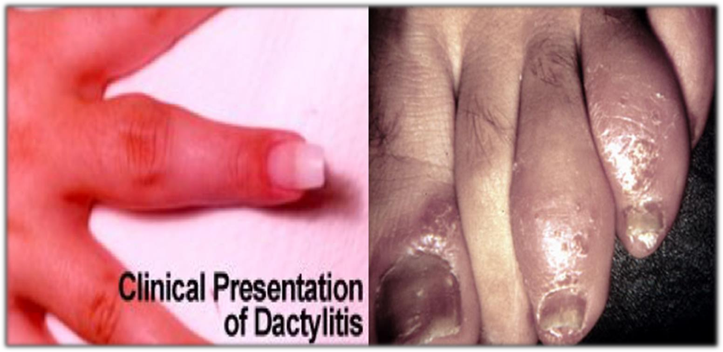
Dactylitis
Tips
Symptoms
Patient History
Lab
Genetics Imaging
●
●
21.5% of patients affected
●
●

Slide 33
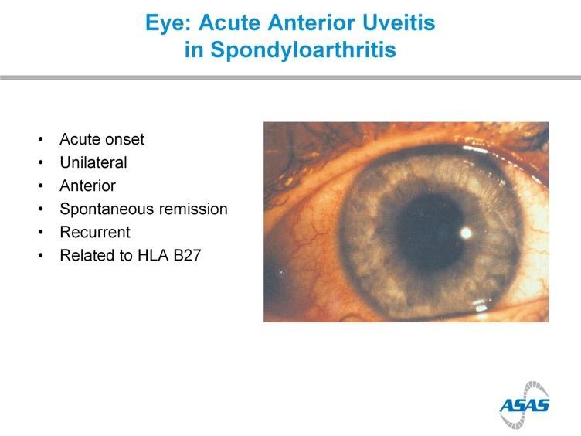
Tips
Symptoms
Patient History
Lab
Genetics Imaging
●
●
●
●
25-40% of patients affected

Slide 34
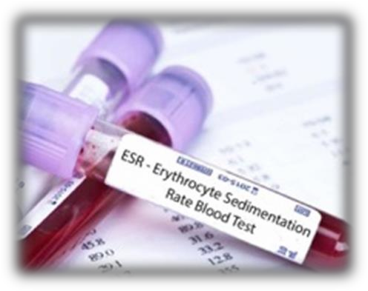
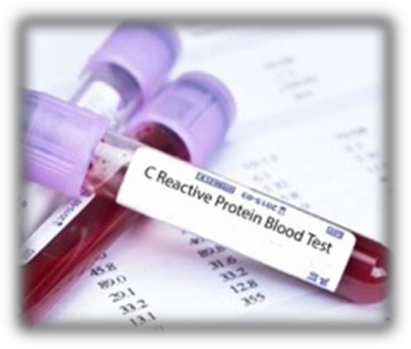

ESR & C-reactive protein
Tips
Symptoms
Levels are increased up to 70% in most As. Patient.
No relation with disease activity.
If ESR or CRP is normal this doesn’t reflect that there is no AS.
Patient History
Lab
Genetics
Imaging
●
●
●
●

Slide 35
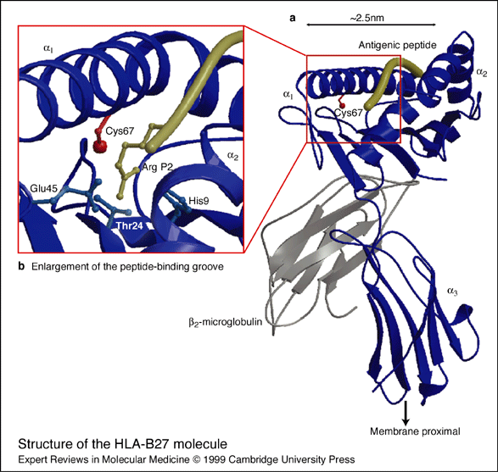
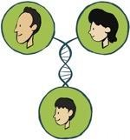
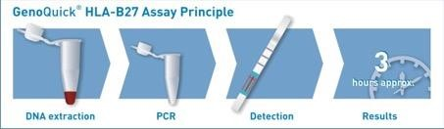
HLA-B27
Tips
Symptoms
Patient History
90% to 95% of AS patient.
Is neither necessary nor sufficient for the diagnosis of patient that their history and physical examination suggest AS.
If the radiographic finding is not clear the lab, Test may be confirmatory.
Lab
Genetics
Imaging
●
●
●
●

Slide 36
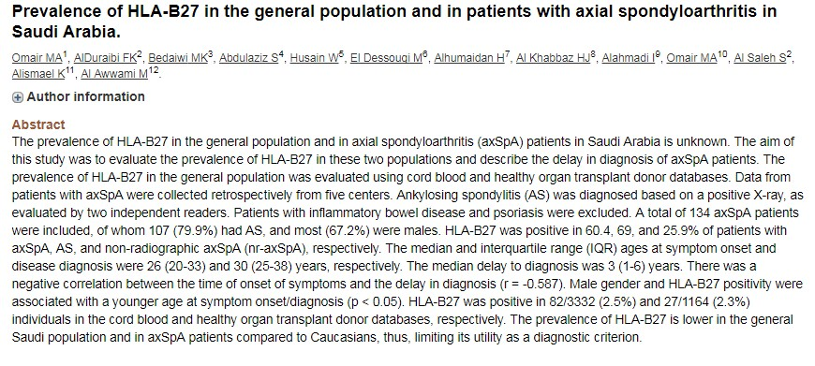
HLA-B27
Tips
Symptoms
Patient History
Lab
Genetics
Imaging
●
●
●
●

Slide 38
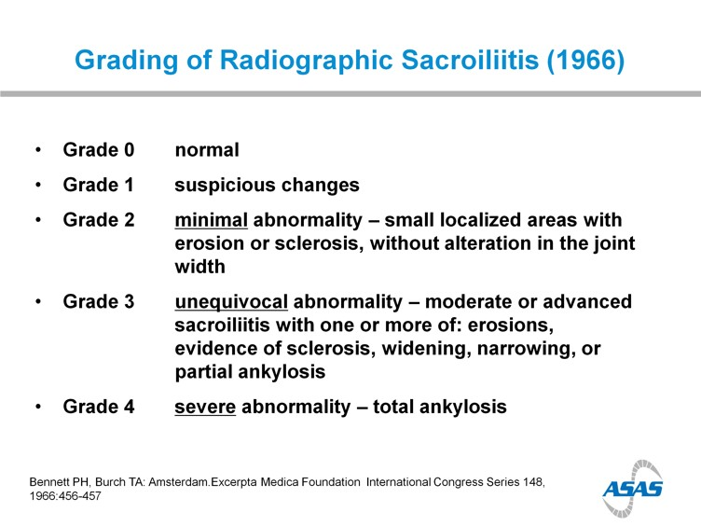
Tips
Symptoms
Patient History
Lab
Genetics
Imaging
●
●
●
●

Slide 39
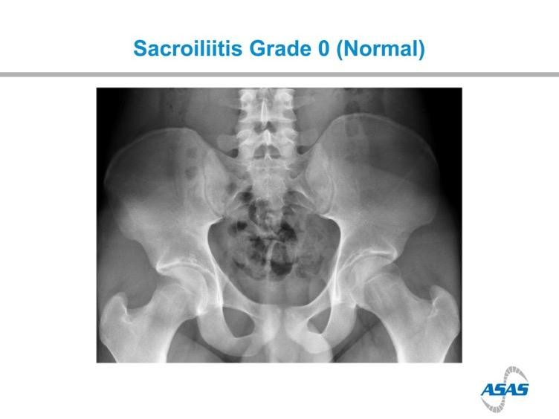
Tips
Symptoms
Patient History
Lab
Genetics
Imaging
●
●
●
●

Slide 40
Tips
Symptoms
Patient History
Lab
Genetics
Imaging
●
●
●
●

Slide 41
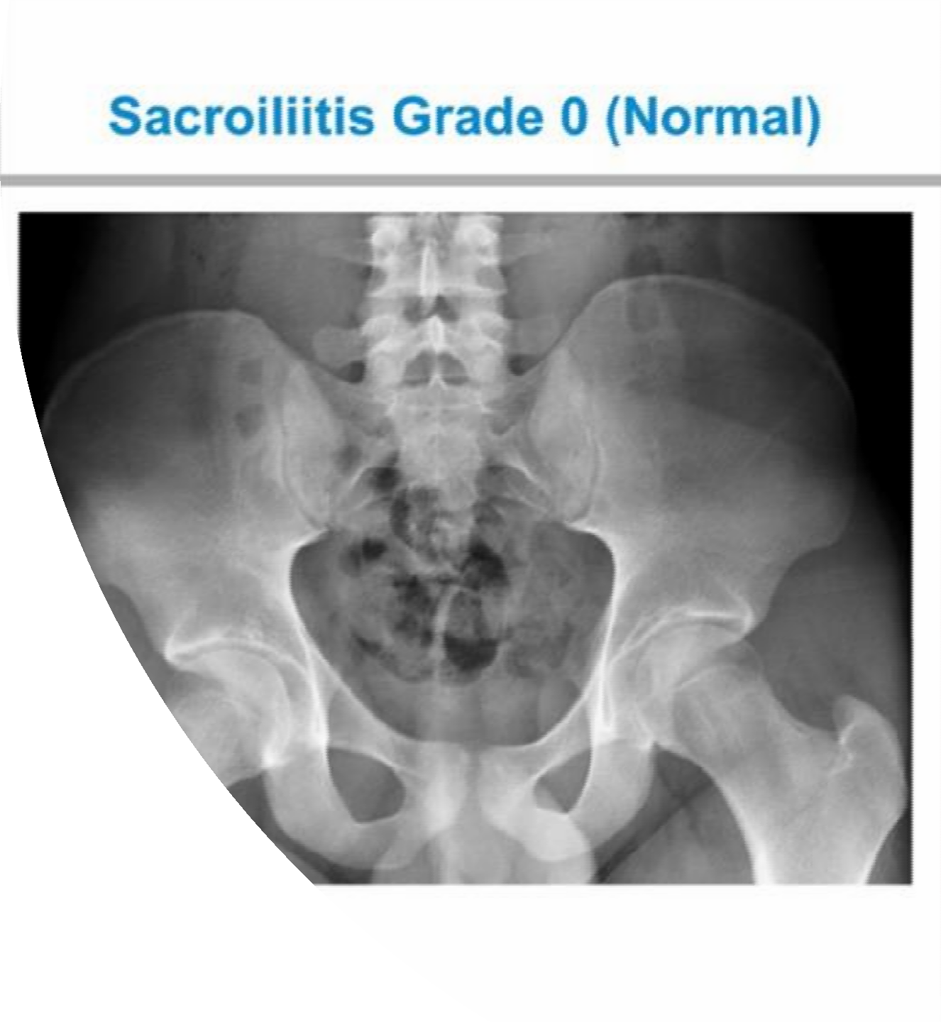
Q
22 y.o male.
Inflammatory back pain for a year.
Recurrent iritis.
Family Hx of SpA
Good response to NSAIDs
What's the diagnosis
Whats the next step?

Slide 42


Slide 43
Tips
Symptoms
Patient History
Lab
Genetics
Imaging
●
●
●
●

Slide 44
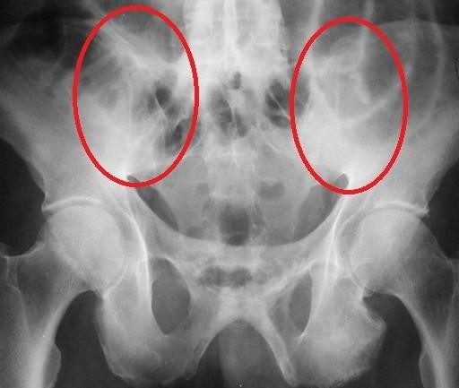
Tips
Symptoms
Patient History
Lab
Genetics
Imaging
●
●
●
●

Slide 45


Bilateral Grade 3 Radiographic Sacroiliitis:
Bony Changes Inflammation is not Visible on Plain X-ray
Tips
Symptoms
Patient History
Arrows point to sacroiliac (SI) joints
Lab
*Note loss of the clear SI joint line and “fluffy” white area surrounding both SI joints
Genetics
Imaging
●
●
●
●

Slide 46
Bilateral Grade 3 Radiographic Sacroiliitis:
Bony Changes Inflammation is not Visible on Plain X-ray
Tips
Symptoms
Patient History
Arrows point to sacroiliac (SI) joints
Lab
*Note loss of the clear SI joint line and “fluffy” white area surrounding both SI joints
Genetics
Imaging
●
●
●
●

Slide 47
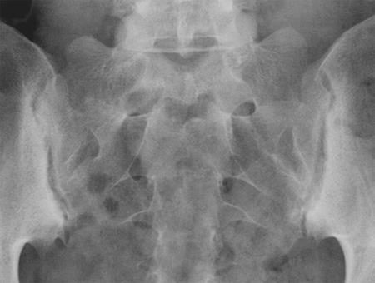
Bilateral Grade Radiographic Sacroiliitis:
Bony Changes
Tips
Symptoms
Patient History
Lab
Genetics
Imaging
●
●
●
●

Slide 48
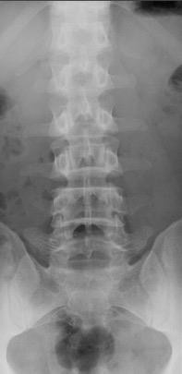
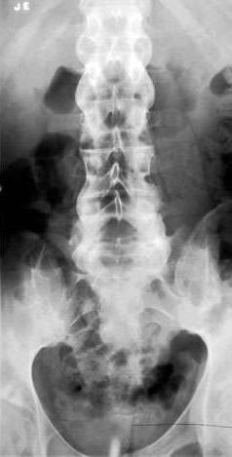
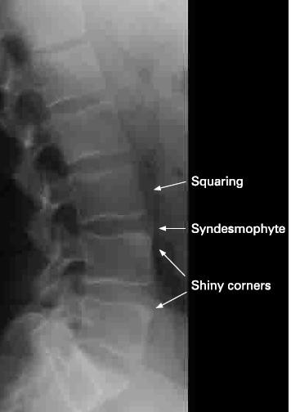
Spondylitis
Tips
Symptoms
Patient History
Lab
Genetics
Imaging
Normal
Ankylosing Spondylitis: Bamboo Spine, Lumbar Vertebrae
●
●
●
●
Rheumatology Image Bank 2011 ACR AS Bamboo Spine Image 99-07-0044 Kelley’s Textbook of Rheumatology. 2009:813.: Figure 53-58. Radiopaedia.org

Slide 49
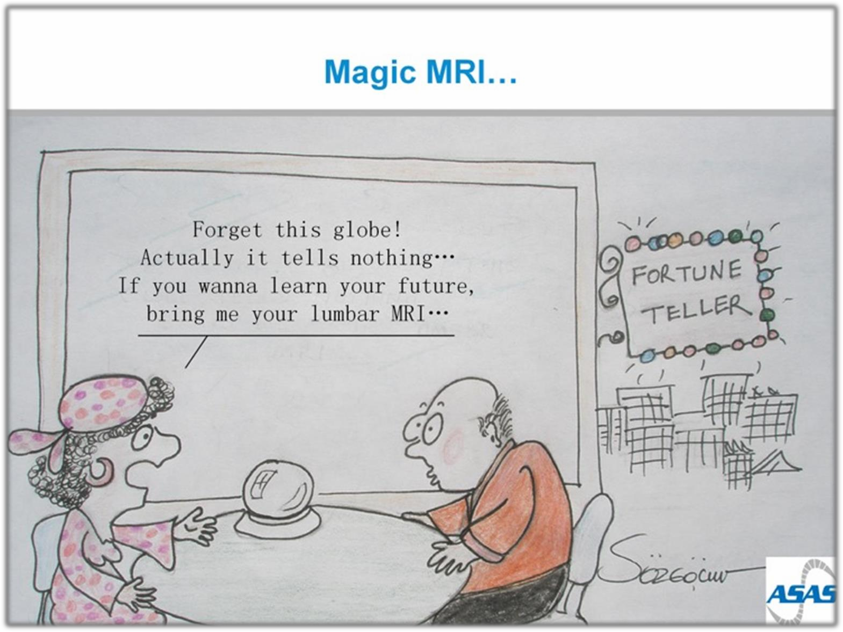
“Ask Your Patients to bring their lumber MRI"
●
●
●
●

Slide 50
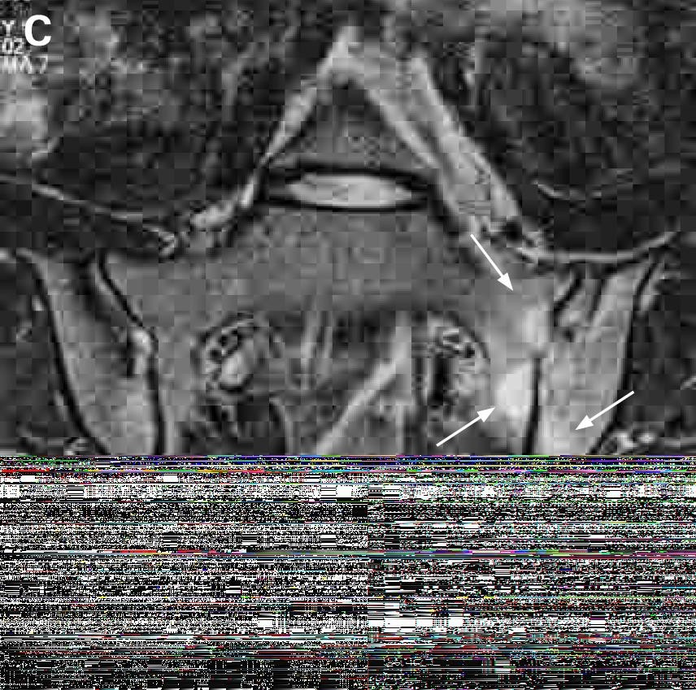
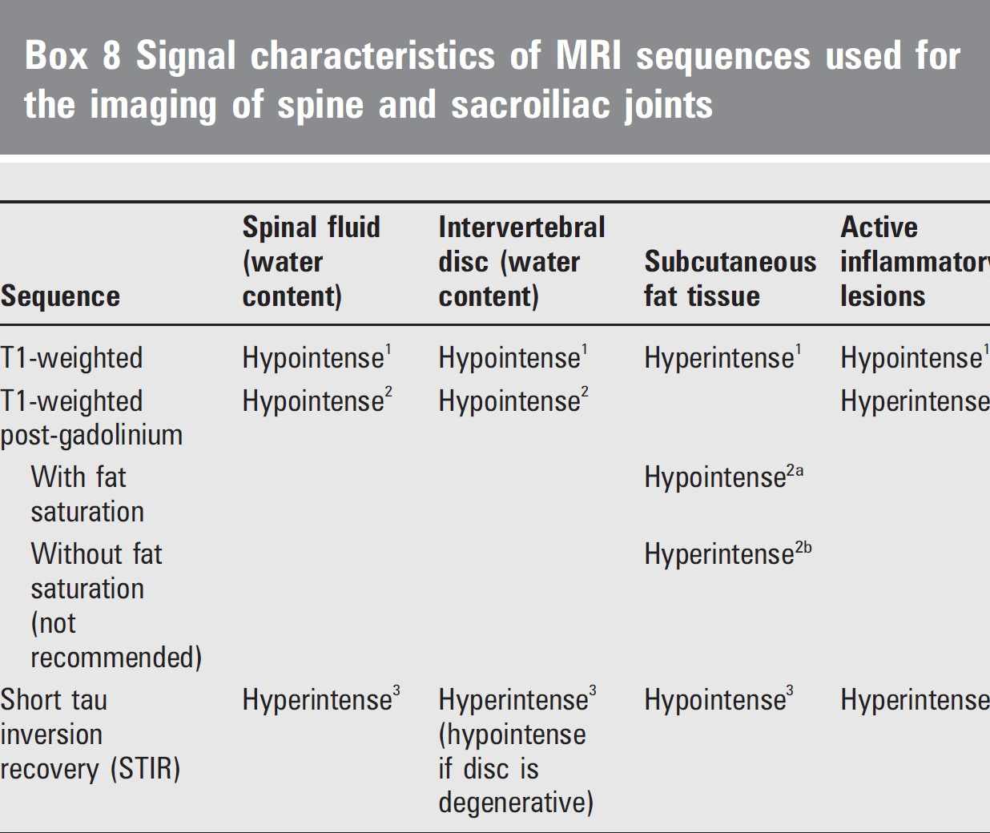

Slide 51
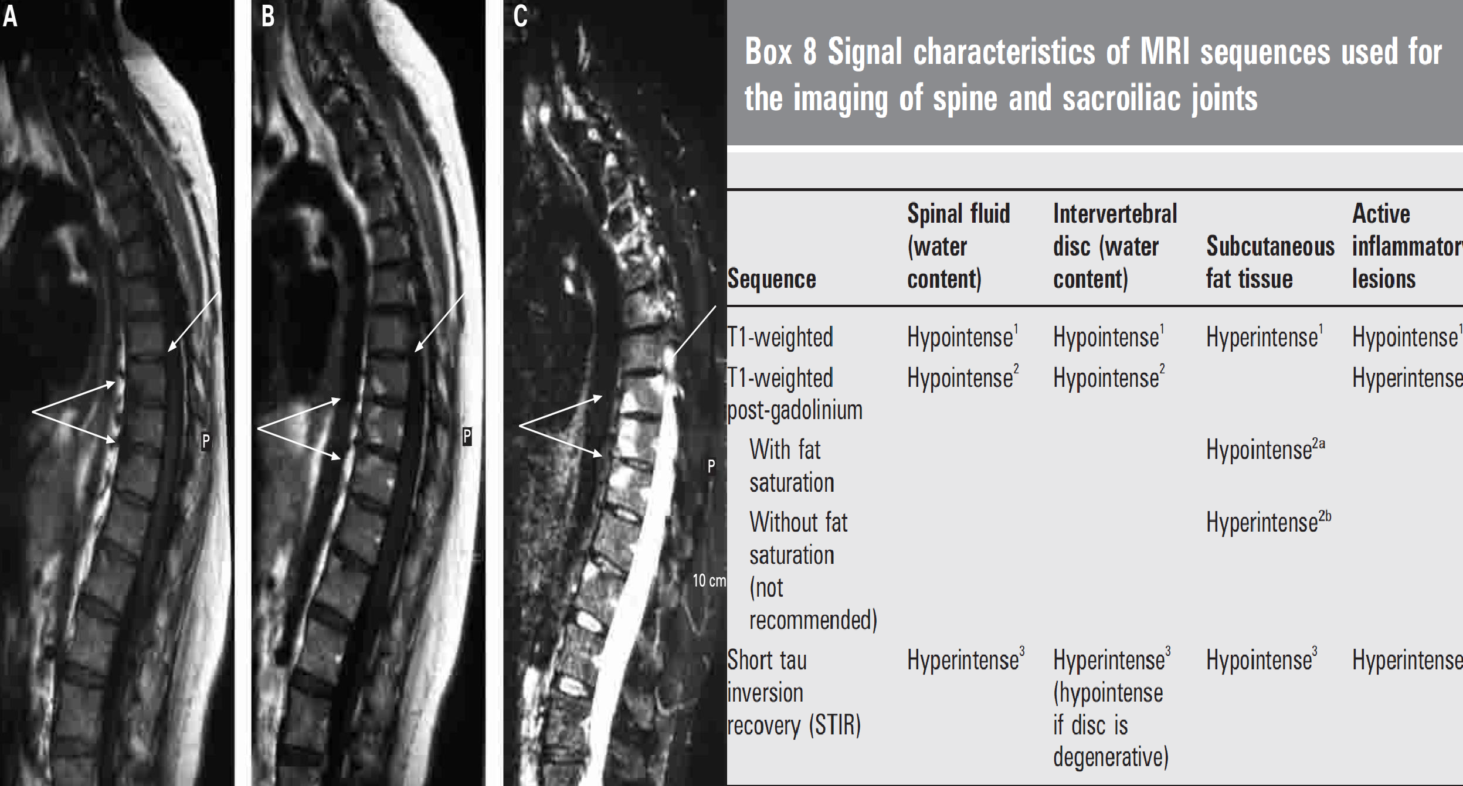
MRI

Slide 52

MRI

Slide 53
MRI

Slide 54


Slide 55




Complex disease
SpA - Complex Overlapping diseases
Axial Spondyloarthritis
Periphere Spondyloarthritis
PsA
ReA
nr-axSpA
AS
IBD-SpA
Undifferentiated Periphere SpA
●
●
●
●

Slide 56

Updated ASAS Concept of Spondyloarthritis (SpA)
Groups Diseases into 2 Categories
●
●
●
●
Axial Spondyloarthritis
Periphere Spondyloarthritis
PsA
nr-axSpA
AS
ReA
IBD-SpA ^{Undifferentiated}
Periphere SpA
van den Berg R, et al. Polskie Archiwum Medycyny Wewnętrznej. 2010;120(11):452-457.

Slide 57
Tips
Patterns
Pathogene
sis
Morbidity
●
●
●
●

Slide 58





PsA is a chronic progressive disease
Skin changes
Swelling
Affected nails
Mutations
Time/Years
●
●
●
●
Psoriatic arthritis: Pictures of symptoms and progression
https://www.medicalnewstoday.com/articles/316877.php

Slide 59

PsA
Arthritis associated with psoriasis,
Tips
(a scaly rash, most frequently occurring on the elbows, knees, and scalp)
Patterns
Identifying features
Pathogene
sis
Psoriasis
Morbidity
Other manifestations such as:
  peripheral arthritis, spondylitis, tenosynovitis, enthesitis, dactylitis.
●
●
Olivieri I, et al. Imaging of psoriatic arthritis Reumatismo. 2007;59 Suppl 1:73-6
Khan MA. Ann Intern Med. 2002 Update on Spondyloarthropathies Page 900
Kelley’s Textbook of Rheumatology, 8th ed, 2009:685–686

Slide 60


PsA
Psoriatic plaques typically precede development of the arthritic component.
  7–42% of psoriasis (Ps) patients (in patient populations with severe
Ps) may develop PsA.
  No correlation between the severity of psoriatic plaques and PsA has been identified.
Tips
Patterns
Pathogene
sis
Equal gender distribution. (♂ : ♀)
Morbidity
Peak years of onset typically between the ages of 20 and 40
●
●
Kelley’s Textbook of Rheumatology. 2009, Page 1201-1204
Moll JM, et al Semin Arthritis Rheum 1973;3:55–78;
Kelley’s Textbook of Rheumatology, 8th ed, 2009:1201–1206

Slide 61
Patterns in PsA
Pattern | Features | Rate
Asymmetrical | Usually involves small joints, less frequently involves large joints Normally oligoarthritis (≤4 joints) | ~ 47%
Symmetrical | Involves small joints and large joints May be RF positive (clinically similar to RA) Arthritis may develop concurrently with psoriasis | ~ 25%
Spondylitis | SIJ and vertebrae affected asymmetrically More common in men May coexist with peripheral PsA Enthesitis prevalent | ~ 23%
DIP synovitis | Restricted to only DIP joints
Arthritis mutilans | Joint lysis Telescoping movement
Tips
Patterns
Pathogene
sis
Morbidity
●
●
●
●
SIJ: sacroiliac joint
Gottlieb AB. Dermatol Nurs 2003;15:107–10; Harrison’s Principles of Internal Medicine, 15th ed, 2001:2003–5

Slide 62



Patterns in PsA
Some features are common to nearly all patterns of PsA:
Tips
Morning stiffness
Nail disease
Joint pain
Patterns
Pathogene
sis
Morbidity
●
●
●
●
Harrison’s Principles of Internal Medicine, 15th ed, 2001:2003–5

Slide 63

Asymmetric Psoriatic Arthritis
Asymmetric psoriatic arthritis typically involves one to three joints in the body -- large or small -- such as the knee, hip, or one or several fingers.
Tips
Patterns
Pathogene
sis
Asymmetric psoriatic arthritis does not affect matching pairs of joints on opposite sides of the body.
Morbidity
●
●
●
●

Slide 64

Symmetric Psoriatic Arthritis
Symmetric psoriatic arthritis affects the same joints -- usually in multiple matching pairs -- on opposite sides of the body.
Tips
Patterns
Symmetric psoriatic arthritis can be disabling, causing varying degrees of progressive, destructive disease and loss of function in 50% of people with this type of arthritis.
Pathogene
sis
Morbidity
Symmetric psoriatic arthritis resembles rheumatoid arthritis.
●
●
●
●

Slide 65

Distal Interphalangeal Predominant (DIP)
Distal interphalangeal predominant psoriatic arthritis involves primarily the small joints in the fingers and toes closest to the nail.
Tips
Patterns
Pathogene
sis
DIP psoriatic arthritis is sometimes confused with osteoarthritis, a chronic disease that causes the deterioration of joint cartilage and bone at the joints.
Morbidity
●
●
●
●

Slide 66

Arthritis Mutilans
Arthritis mutilans is a severe, deforming, and destructive form of psoriatic arthritis that primarily affects the small joints in the fingers and toes closest to the nail. This leads to loss of function of the involved joints.
Tips
Patterns
Pathogene
sis
Fortunately, this severe type of psoriatic arthritis is rare.
Morbidity
●
●
●
●

Slide 67
Pathogenesis of PsA
Synovial hyperplasia and cellular infiltration.
  Pannus formation
  Cartilage erosion
  Prominent role for cytotoxic (CD8+) T cells
Tips
Patterns
Pathogene
sis
Increased levels of TNFα found in joint.
  Pro-inflammatory effect
  Stimulation of proteases
Morbidity
Associated enthesitis present.
●
●
●
●
Veale DJ, et al. Ann Rheum Dis 2005;64(suppl 2):ii26–9 Gladman DD. Rheum Dis Clin North Am 1998;24:829–44

Slide 68
TNFα Levels in Psoriatic skin blister fluids
In a clinical trial, TNFα levels in psoriatic skin blister fluids were found to be much greater than in healthy control subjects
Tips
160
140
120
100
80
60
40
20
0
Control (normal skin blister fluids)
Psoriatic involved skin blister fluids
145
Patterns
Median blister TNFα (pg/ml)
Pathogene
sis
×36
Morbidity
N = 30
(P = 0.0001)
4
Bonifati, 384/2/Table 1
and 384/1/2
●
●
●
●
Bonifati C, et al. Clin Exp Dermatol. 1994;19:383-387.

Slide 69
Morbidity Associated With PsA
40–57% of patients have deforming erosive arthropathy*
Tips
Patterns
16% of patients with at least five deformed joints*
Pathogene
sis
Morbidity
11–19% of patients with disability*
*Data published in 1987 and 1991. These data may not accurately reflect current morbidity trends following recent medical advances
●
●
●
●
Torre Alonso JC, et al. Br J Rheumatol 1991;30:245–50 Gladman DD, et al. Q J Med 1987;62:127–41

Slide 70












Diagnosis of PsA Patients
Subclinical
Clinical Imaging Criteria
●
●
●
●

Slide 71


Arthritis in the presence of psoriasis is the key to clinical diagnosis.
Subclinical
The onset depends on the subtype:
Clinical
Delayed after psoriasis onset:
  asymmetrical, spondylitis.
Imaging
Concurrent with psoriasis:
  symmetrical.
Criteria
Diagnosis is clinical and radiographic.
●
●
●
●
Harrison's Principles of Internal Medicine, 15th ed, 2001:2003–5
Gladman DD, et al. Q J Med 1987;62:127–41

Slide 72

Clinical Features of PsA
Clinical feature | Patients (%)
Actively inflamed joints | 97
Plaque psoriasis | 94
Nail lesions | 83
DIP joint disease | 54
Morning stiffness | 52
Deformities: ≥1 / ≥5 | 43 / 16
Skin and joints flaring simultaneously | 35
Dactylitis | 33
Inflammatory neck pain and stiffness | 23
Inflammatory back pain and stiffness | 19
ACR functional class III/IV | 11
Sacroiliac stress pain | 10
Iritis | 7
Subclinical
Clinical Imaging Criteria
●
●
●
●
ACR: American College of Rheumatology
Gladman DD, et al. Q J Med 1987;62:127–41

Slide 73


Actively inflamed joints
97% of patients affected
Subclinical
Clinical
Imaging
Plaque psoriasis
Criteria
94% of patients affected
●
scaly rash, most frequently occurring on
●
●
●
ACR: American College of Rheumatology Gladman DD, et al. Q J Med 1987;62:127–41
the scalp, elbows and knees

Slide 74


Nails
Subclinical
Clinical
Imaging Criteria
83% of patients affected
●
Fingernail pitting
●
●
●
ACR: American College of Rheumatology Gladman DD, et al. Q J Med 1987;62:127–41

Slide 75



PIP and DIP synovitis
Subclinical
Clinical Imaging Criteria
PIP = proximal interphalangeal. DIP = distal interphalangeal.
54% of patients affected
●
●
●
●
Kelley’s Textbook of Rheumatology, 8th ed, 2009:1087–1102
ACR: American College of Rheumatology Gladman DD, et al. Q J Med 1987;62:127–41

Slide 76



Morning stiffness
52% of patients affected
Subclinical
Clinical
Inflammatory neck
pain and stiffness
Imaging
Criteria
23% of patients affected
Inflammatory back
pain and stiffness
●
●
●
●
ACR: American College of Rheumatology Gladman DD, et al. Q J Med 1987;62:127–41
19% of patients affected

Slide 77

Subclinical
Clinical Imaging Criteria
●
●
●
●
ACR: American College of Rheumatology Gladman DD, et al. Q J Med 1987;62:127–41

Slide 78
Dactylitis
Subclinical
Clinical Imaging Criteria
●
●
●
●
33% of patients affected
ACR: American College of Rheumatology Gladman DD, et al. Q J Med 1987;62:127–41

Slide 79
Heel Pain - Enthesitis
Enthesitis is inflammation of Entheses.
  Entheses are sites where tendons, ligaments, joint capsules, or fascia attach to bone.
Subclinical
Heel Enthesitis is most common.
Clinical
Tenosynovitis
Enthesitis
Achilles heel
Enthesitis
Imaging
Criteria
●
●
●
●
Eshed I, et al. Ann Rheum Dis 2007;66:1553–9

Slide 80
Subclinical
Clinical Imaging Criteria
●
●
●
●
20% of patients affected

Slide 81
Subclinical
Clinical Imaging Criteria
●
●
●
●
25% of patients affected

Slide 82




PsA Radiologic Features
Subclinical
Characteristic peripheral joint destruction progresses
to cause a “pencil in cup”
appearance.
Clinical
Imaging
Criteria
In spondylitis subtype, may also see sacroiliitis and changes in the spine.
●
●
●
●
Mease, P.J., et al. J Am Acad Dermatol 2005;52:1–19
Kelley’s Textbook of Rheumatology, 8th ed, 2009:1207: Figure 72-5

Slide 83

Symptoms at presentation determine which pathway
Subclinical
Axial ± peripheral symptoms at time of presentation
Purely peripheral symptoms at time of presentation*
Clinical
Imaging
Criteria
●
●
●
●
*Past inflammatory back pain allowed
¹Rudwaleit et al. Ann Rheum Dis 2009;68:777-783. ²Rudwaleit et al. Ann Rheum Dis 2011;70:25-31.

Slide 84

Subclinical
✅
Clinical
Imaging
Criteria
●
●
●
●

Slide 85











PsA Patient
Equal gender distribution (♂ : ♀)
Age at onset 20-40 years
Neck Pain & Stiffness
Eye inflammation
Inflammatory Back Pain (IBP)
Plaque psoriasis
(a scaly rash, most frequently occurring on the elbows, knees, and scalp)
Crohn’s/ Colitis
DIP joint disease
Joints Arthritis
Nail lesions
or pitting
Tenosynovitis
(inflammation of the synovium that surrounds a tendon, typically leading to joint pain, swelling, and stiffness. It can be either infectious or noninfectious)
Dactylitis
Enthesitis
●
●
●
●
Morning stiffness
Deformities
Family History of SpA
• +ve HLA-B27

Slide 86






Axial-SpA Patient Journey
Derma Clinic
7–42% of psoriasis (Ps) patients may develop PsA.
Ophtha Clinic
25% of patients may have uveitis
No correlation between the severity of psoriatic plaques and PsA has been identified.
Pain Clinic
Family Medicine
Clinic
●
●
●
●

Slide 87






Derma Clinic
Ophtha Clinic
Family Medicine Clinic
Pain Clinic
ESR,CRP, HLA-B27
●
●
●
●

Slide 88















Arthritis | Dactylitis or or | Enthesitis
Age at onset 20-40 years old
Psoriasis
Uveitis
IBP
Crohn’s/ Colitis
Family History
or
or
or
or
Yes
“Start confirmation”
Connect to Rheumatologist
-Involved joints X-ray
●
●
●
●
-HLA – B27

Slide 89

EULAR Treatment Algorithm for PsA
Phase I
Adverse prognostic factors
Clinical diagnosis of active psoriatic arthritis
Major skin involvement
(± major skin involvement)
(also in phase II–IV)
Go directly to phase II
Start NSAIDS ± local glucocorticoid injections
Consider consulting
a dermatologist
Failure phase I: go to phase II
No
Achieve target within 3–6 months
Yes
Continue
Recommendation
Phase II
Contraindication for methotrexate
Lack of efficacy and/or toxicity in phase I
(or adverse prognostic factors)
Algorithm
Predominantly axial disease
or severe enthesitis
Start leflunomide or sulfasalazine (or cyclosporine A)
Start methotrexate (consider appropriate dosage)
Go directly to phase III
Failure phase II: go to phase III
No
Achieve target within 3–6 months
Yes
Continue
●
●
●
●
Gossec L et al., Ann Rheum Dis. 2012 Jan;71(1):4-12

Slide 90
EULAR Treatment Algorithm for PsA
Phase III
Lack of efficacy and/or toxicity in phase II
Arthritis with adverse
Arthritis without adverse
prognostic factors
prognostic factors
Predominant axial disease or enthesis
Start a second synthetic DMARD
Leflunomide, Sulfasalazine,
MTX, or Cyclosporine A
(or combination therapy)
Start a TNF-inhibitor (± DMARD)
Achieve target
within 3–6 months
No
Recommendation
Failure phase III: go to phase IV
No
Achieve target within 3–6 months
Yes
Continue
Algorithm
Lack of efficacy and/or toxicity in phase III
Phase IV
Change the biologic treatment. Switch to a second TNF-blocking drug (± DMARD)
●
No
Achieve target within 3–6 months
Yes
Continue
●
●
●
Gossec L et al., Ann Rheum Dis. 2012 Jan;71(1):4-12

Slide 91
GRAPPA Treatment Recommendations for PsA (2009)
Establish diagnosis of PsA
Peripheral arthritis |  |  | Skin and nail disease
Axial disease
Dactylitis
Enthesitis
Recommendation
Initiate therapy:
NSAIDs
IA steroids DMARDs ((MTX, CsA, SSZ, LEF)
Biologics (anti-TNFs)
Initiate therapy: Topicals PUVA/UVB
Systemics (MTX, CsA, etc.)
Biologics
(anti-TNFs)
Initiate therapy: NSAID
Physiotherapy Biologics
(anti-TNFs)
Initiate therapy: NSAID
Injection Biologics (anti-TNFs)
Initiate therapy: NSAID
Injection Biologics (anti-TNFs)
Algorithm
Reassess response to therapy and toxicity
●
●
●
●
Ritchlin C, et al. ARD 2009; 68:1387-1394

Slide 92
Reactive arthritis
Reactive arthritis is a rare disease even among rheumatology practices.
Reactive arthritis has been defined by consensus as a form of arthritis that is associated with a coexisting extraarticular infection.

Slide 93
Reactive arthritis
Only certain enteric and genitourinary pathogens are conventionally accepted as capable of causing reactive arthritis.
  Chlamydia trachomatis,
  Yersinia,
  Salmonella,
  Shigella,
  Campylobacter,
  Clostridioides (formerly Clostridium) difficile, and
  Chlamydia pneumoniae.

Slide 94
Reactive arthritis
Musculoskeletal features of reactive arthritis typically develop one to four weeks following an acute infection with one of the triggering organisms.
At least one of the following is seen in all patients with this condition:
  asymmetric oligoarthritis (often affecting the lower extremities)
  enthesitis
  dactylitis
  inflammatory back pain.

Slide 95
Extraarticular manifestations occur in some patients, but none are specific for reactive arthritis.
These include eye involvement, most often with
  conjunctivitis, but infrequently with
  anterior uveitis
  genitourinary tract symptoms
  oral mucosal ulcers
  cutaneous manifestations such as keratoderma blennorrhagica, circinate balanitis, and psoriasis-like nail changes.

Slide 96
Laboratory findings may include
  evidence of the infection,
  elevated acute phase reactants, and
  findings of inflammatory joint fluid in patients with arthritis.

Slide 97
Antibiotic therapy should be used for treatment of active Chlamydia trachomatis infection, if present. In general, antibiotics are not indicated for uncomplicated enteric infections or for treatment of the arthritis itself.
We suggest treatment of arthritis in most patients initially with nonsteroidal antiinflammatory drugs (NSAIDs)
In patients who do not respond adequately to NSAIDs, we suggest intraarticular glucocorticoids, rather than initiating therapy with daily oral glucocorticoids or a DMARD.

Slide 98
In patients who do not respond adequately to NSAIDs and intraarticular glucocorticoid injections, we suggest low to moderate doses of systemic glucocorticoids, rather than initiating treatment with a DMARD.
A typical dose would be prednisone, 20 mg daily, titrated to the lowest dose required to control symptoms

Slide 99
In patients who have not responded adequately to NSAIDs over at least four weeks and who require ongoing therapy with more than 7.5 mg of prednisone or equivalent for more than three to six months we suggest a trial of a nonbiologic DMARD, rather than continuing moderate to high dose glucocorticoids without a DMARD.
We usually prescribe sulfasalazine.
Methotrexate is an alternative to SSZ.

Slide 100
The prognosis is good in the majority of patients, with spontaneous remission within 6 to 12 months of onset of arthritis.
However, some patients have persistent but mild musculoskeletal symptoms, and others develop radiologic evidence of joint injury and evolve to a more chronic form of SpA.

