Slide 1
Approach to patient with headache
Dr. Hana Albulaihe
Consultant Neurologist

Slide 2
Objectives
Pain sensitive structures in the head
Classification of headache
Most common primary headaches
Most common secondary headaches
Approach to patient with headache
Management of common headache types

Slide 3
Headache is pain in any part of the head, including the scalp, face, orbitotemporal area and interior of the head.
Headache is one of the most common reasons patients seek medical attention.
It is due to activation of pain-sensitive structures in or around the brain, skull, face, sinuses, or teeth.

Slide 4
Pain Sensitive structures in Brain :
Intracranial :
1. Cranial venous sinuses with afferent veins
2. Arteries at base of brain and arteries of dura including middle meningeal artery
3. Dura around venous sinuses and vessels
4. Falx cerebri

Slide 5
Extracranial :
1. Skin
2. Scalp appendages
3. Periosteum
4. Muscles
5. Arteries
6. Mucosa

Slide 6
Nerves :
1. Trigeminal (Fifth cranial nerve)
2. Facial (seventh cranial nerve)
3. Vagal (Tenth cranial nerve)
4. Glossopharyngeal (Ninth cranial nerve)
5. Second and Third cranial nerves

Slide 7
Classification
Primary headache.
Secondary headache.

Slide 8
Classification
Primary headache disorders:
Migraine.
Cluster headache.
Chronic paroxysmal hemicrania.
Hemicrania continua.
Tension-type headache.

Slide 9
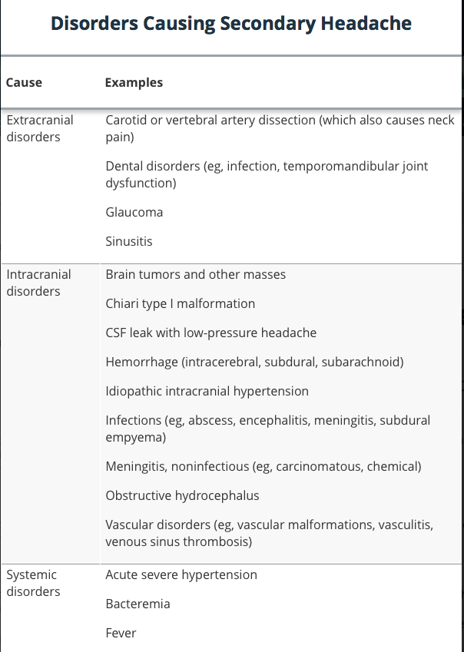

Slide 10
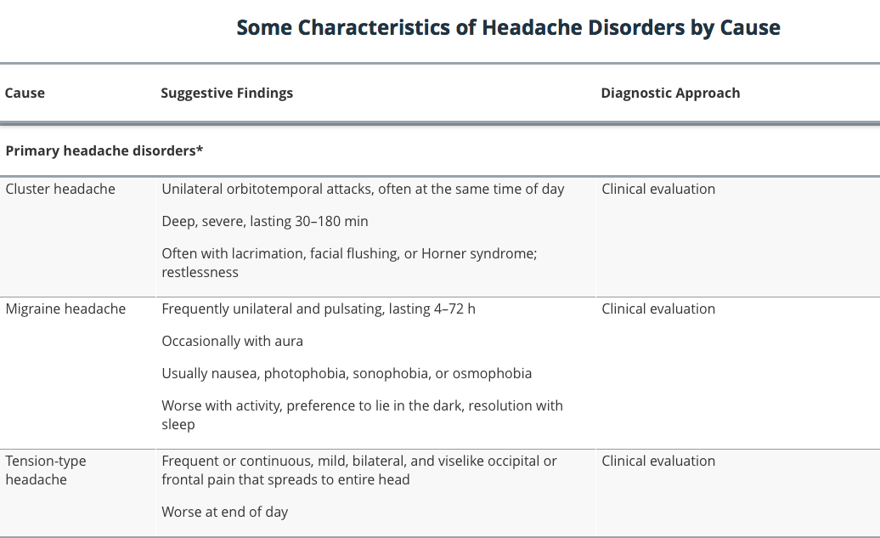

Slide 11
Evaluation
Determining whether a secondary headache is present.
Check for symptoms that suggest a serious cause.
If no cause or serious symptoms are identified, evaluation focuses on diagnosing primary headache disorders.

Slide 12
History
History of present illness:
Headache location.
Duration.
Severity.
Onset.
Quality ( throbbing, constant, intermittent, pressure-like).
Exacerbating and remitting factors ( head position, time of day, sleep, light, sounds, physical activity, odors, chewing).

Slide 13
History
History of present illness:
Previous or recurrent headaches.
The previous diagnosis (if any).
Whether the current headache is similar or different.
For recurrent headaches, age at onset, frequency of episodes, temporal pattern (including any relationship to phase of menstrual cycle), and response to treatments (including OTC treatments).

Slide 14
History
Headaches that have recurred since childhood or young adulthood suggest a primary headache disorder.
If headache type or pattern clearly changes in patients with a known primary headache disorder, secondary headache should be considered.

Slide 15
History
Review of systems:
Vomiting: Migraine or increased intracranial pressure
Fever: Infection (eg, encephalitis, meningitis, sinusitis)
Red eye and/or visual symptoms (halos, blurring): Acute angle-closure glaucoma
Visual field deficits, diplopia, or blurring vision: Ocular migraine, brain mass lesion, or idiopathic intracranial hypertension
Lacrimation and facial flushing: Cluster headache
Rhinorrhea: Sinusitis
Pulsatile tinnitus: Idiopathic intracranial hypertension

Slide 16
History
Review of systems:
Preceding aura: Migraine.
Focal neurologic deficit: Encephalitis, meningitis, intracerebral hemorrhage, subdural hematoma, tumor, or other mass lesion.
Seizures: Encephalitis, tumor, or other mass lesion.
Syncope at headache onset: Subarachnoid hemorrhage.
Myalgias and/or vision changes (in people > 55 yr): Giant cell arteritis.

Slide 17
History
Past medical history:
exposure to drugs, substances (particularly caffeine), and toxins
recent lumbar puncture;
immunosuppressive disorders or
IV drug use (risk of infection);

Slide 18
History
Past medical history:
Hypertension (risk of brain hemorrhage).
Cancer (risk of brain metastases).
Trauma, coagulopathy, or use of anticoagulants or ethanol (risk of subdural hematoma).
Family and social history of headaches, particularly because migraine headache may be undiagnosed in family members.

Slide 19
Physical examination
Vital signs, including temperature.
General appearance (eg, whether restless or calm in a dark room) is noted.
Full neurologic examination are done.
The scalp is examined for areas of swelling and tenderness.
The ipsilateral temporal artery is palpated.
Temporomandibular joints are palpated for tenderness and crepitance while the patient opens and closes the jaw.

Slide 20
Physical examination
The eyes and periorbital area ( lacrimation, flushing, and conjunctival injection.
Pupillary size and light responses, extraocular movements, and visual fields.
The fundi for evidence of papilledema. If patients have vision-related symptoms or eye abnormalities.
visual acuity.
The oropharynx for swellings, and the teeth for tenderness.
Neck flexion to detect discomfort or stiffness indicating meningismus.
The cervical spine for tenderness.

Slide 21
Red flags
Neurologic symptoms or signs ( altered mental status, weakness, diplopia, papilledema, focal neurologic deficits)
Immunosuppression or cancer.
Meningismus.
Onset of headache after age 50.
Thunderclap headache (severe headache that peaks within a few seconds)

Slide 22
Red flags
Symptoms of giant cell arteritis ( visual disturbances, jaw claudication, fever, weight loss, temporal artery tenderness, proximal myalgias).
Systemic symptoms ( fever, weight loss).
Progressively worsening headache.
Red eye and halos around lights.

Slide 23
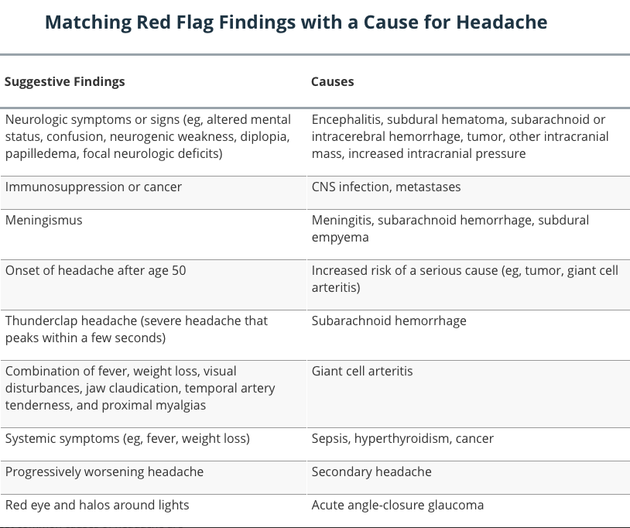

Slide 24
Diagnosis
Most patients can be diagnosed without testing. However, some serious disorders may require urgent or immediate testing.
CT or MRI should be done in patients with any of the following findings:
Age > 50 yr
Weight loss
Cancer
Change in an established headache pattern
Diplopia

Slide 25
Diagnosis
Thunderclap headache.
Altered mental status.
Meningismus.
Papilledema.
Signs of sepsis (eg, rash, shock).
Acute focal neurologic deficit.
Severe hypertension (eg, systolic > 220 mm Hg or diastolic > 120 mm Hg on consecutive readings).

Slide 26
Diagnosis
Lumbar puncture and CSF analysis should be done if
* CNS infection ( meningitis, encephalitis).
* Subarachnoid hemorrhage.
* Headache is progressive and findings suggest idiopathic intracranial hypertension (transient obscuration of vision, diplopia, pulsatile tinnitus).
Tonometry should be done if findings suggest acute narrow-angle glaucoma (eg, visual halos, nausea, corneal edema).

Slide 27
ESR (old age, visual symptoms, jaw claudication, temporal artery signs).
CT of the paranasal sinuses is done to rule out complicated sinusitis if patients have a moderately severe systemic illness (eg, high fever, dehydration, prostration, tachycardia) and findings suggesting sinusitis (eg, frontal, positional headache, epistaxis, purulent rhinorrhea).

Slide 28
Case 1

Slide 29
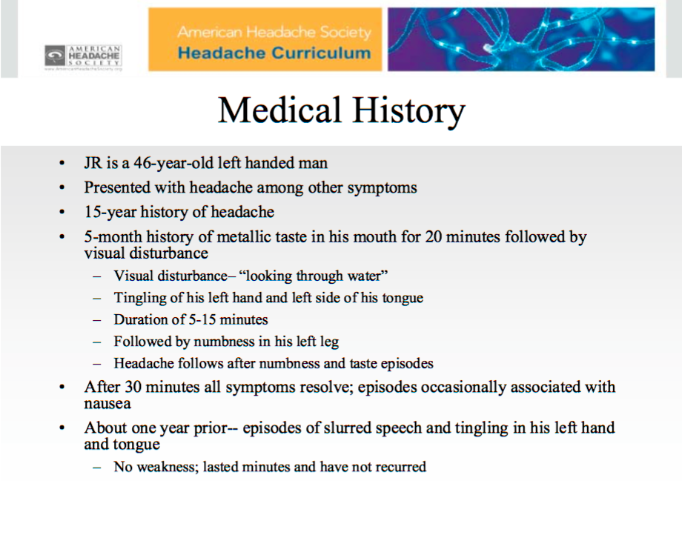

Slide 30
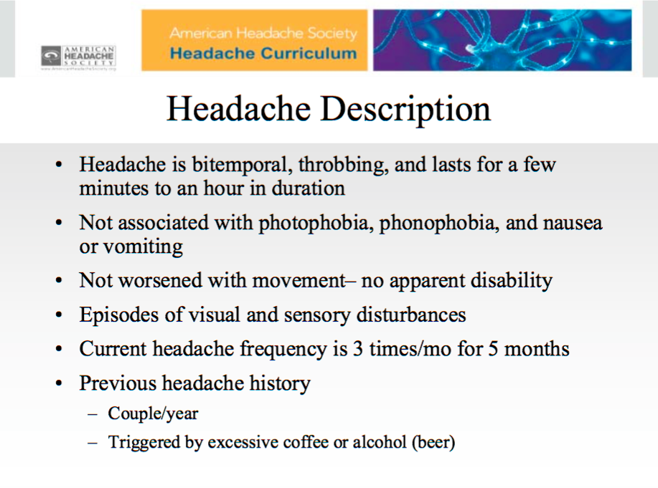

Slide 31
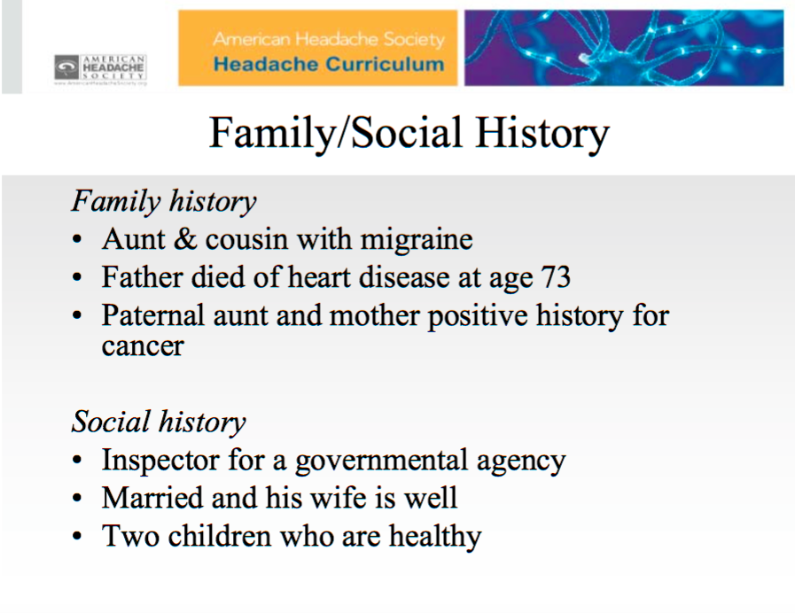

Slide 32
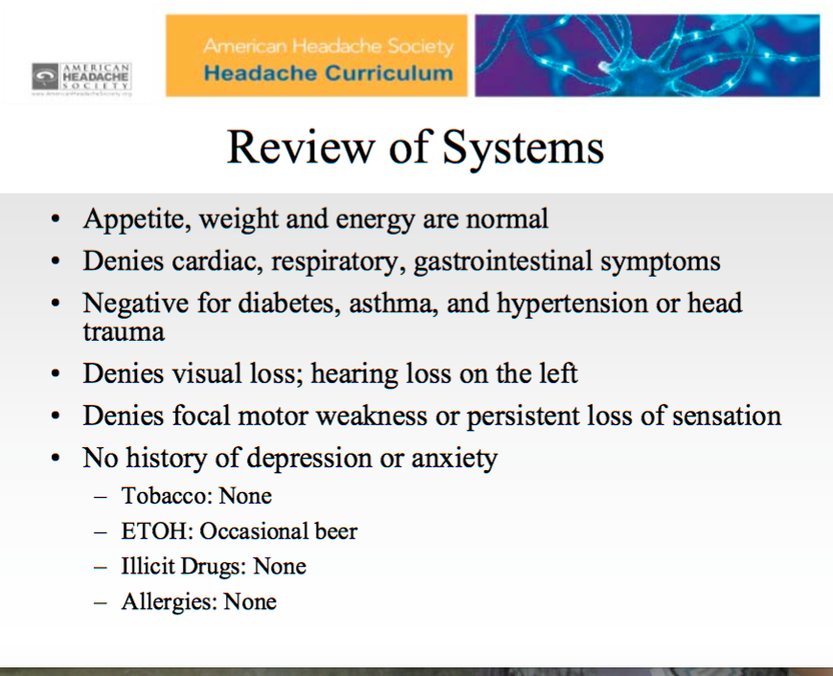

Slide 33
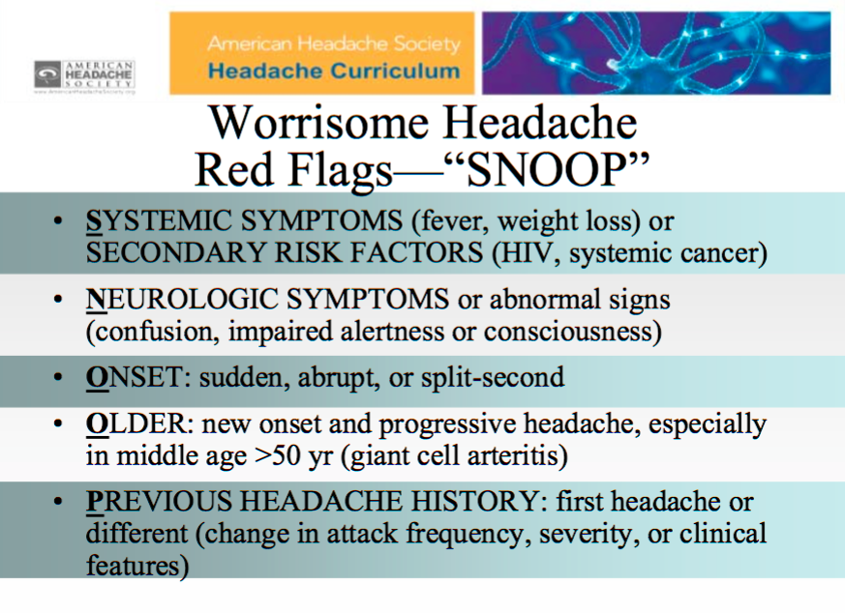

Slide 34
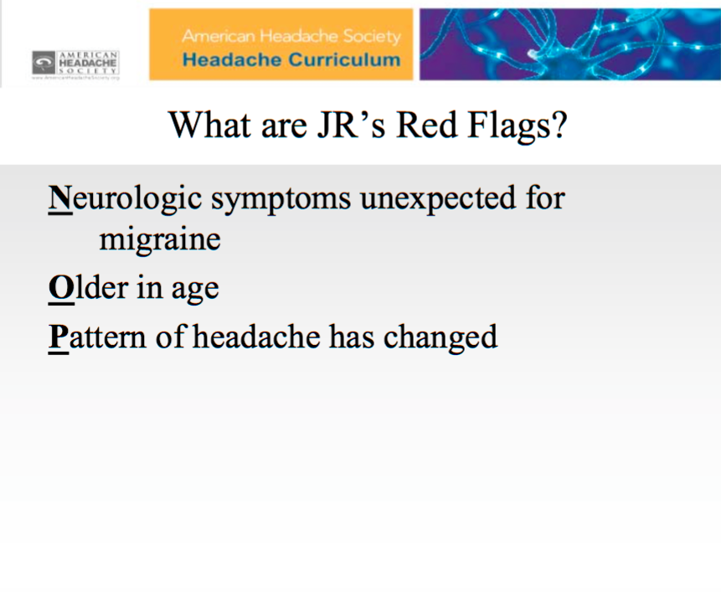

Slide 35
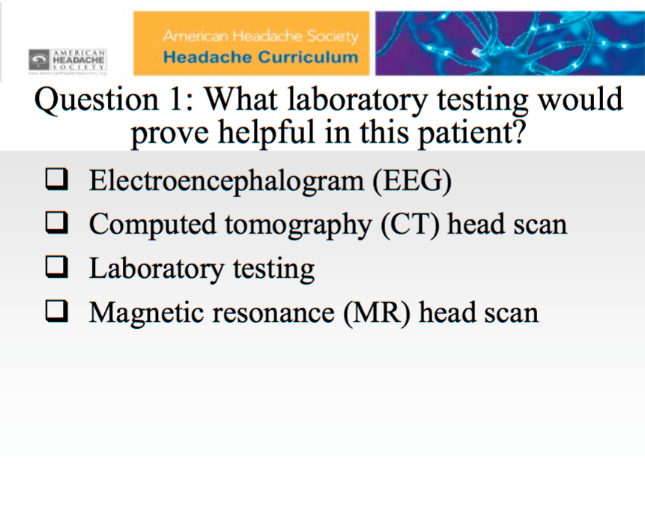

Slide 36
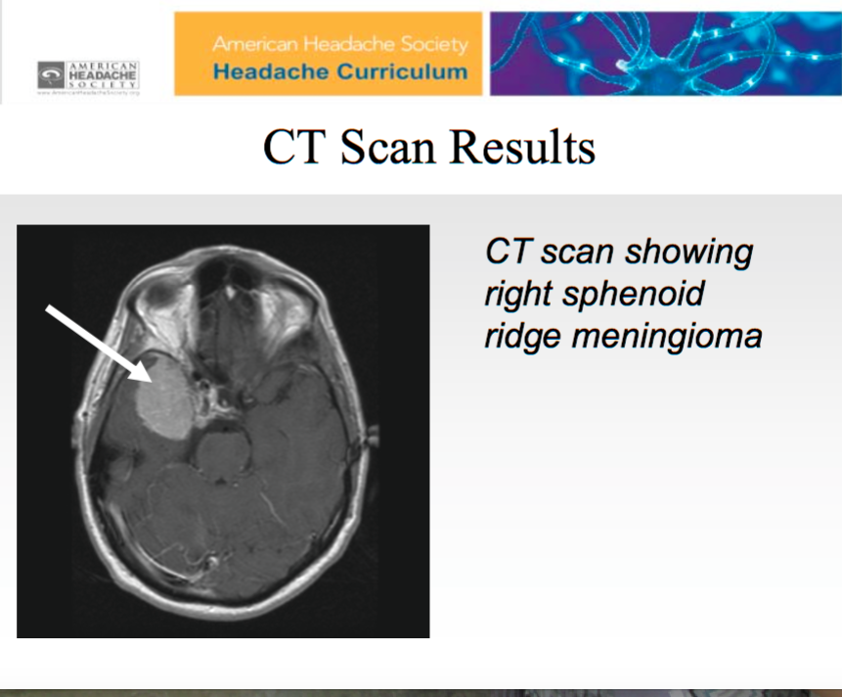

Slide 37
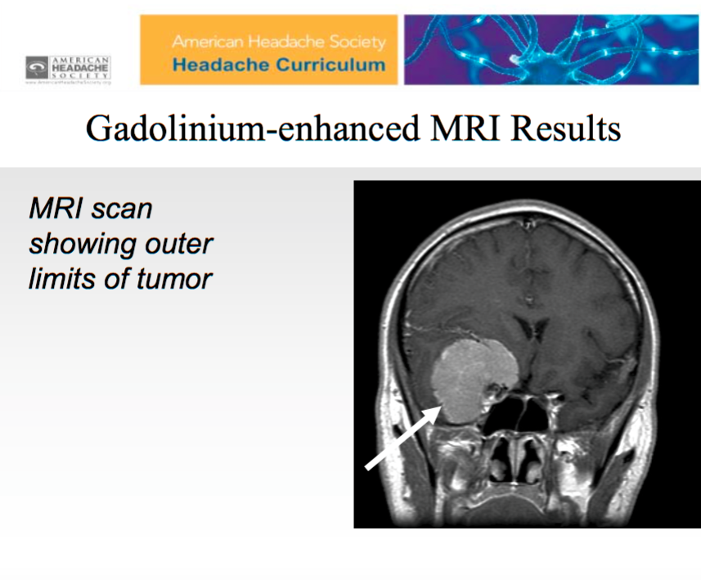

Slide 38
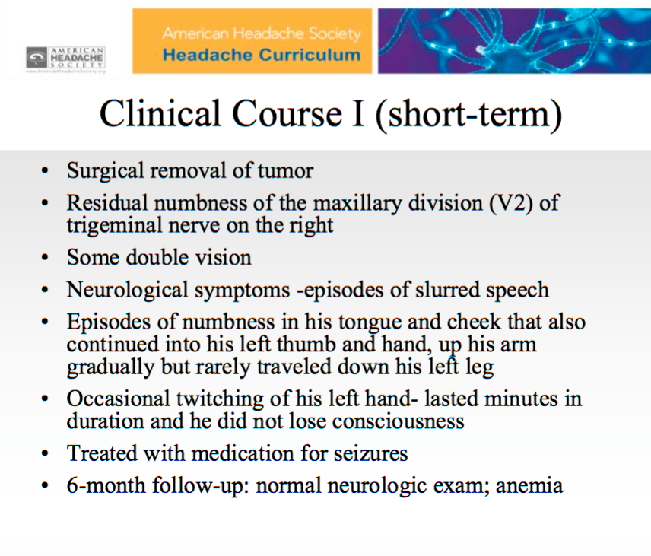

Slide 39
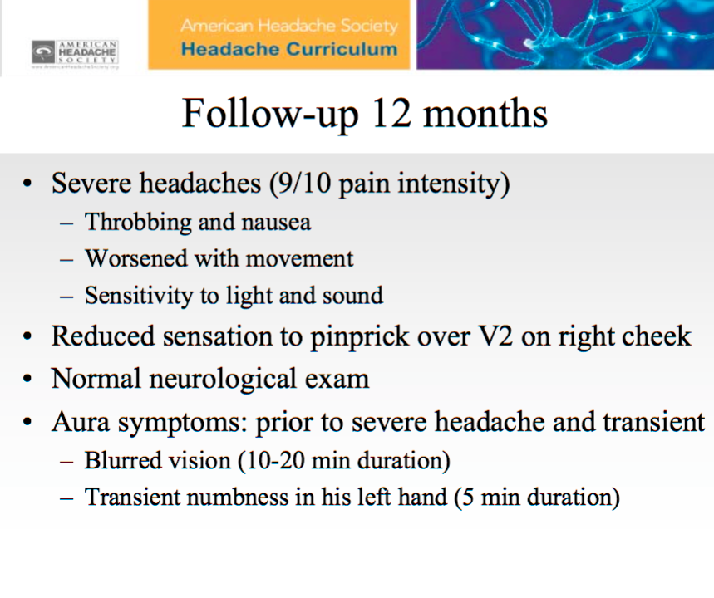

Slide 40
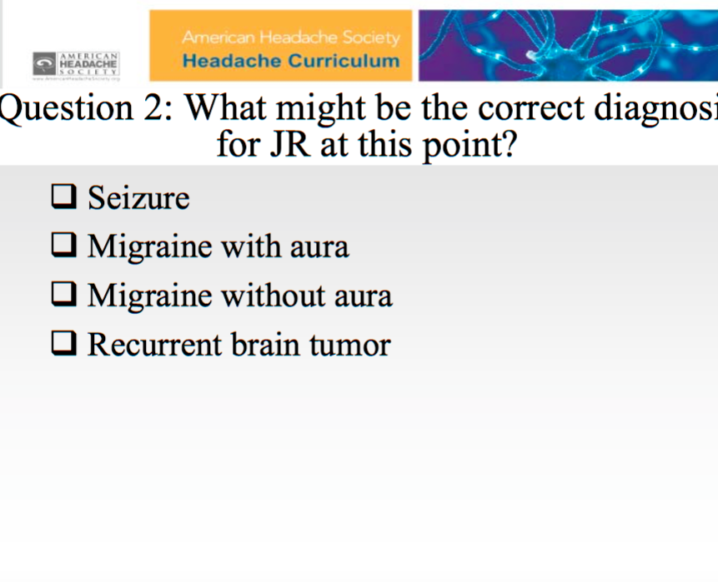

Slide 41
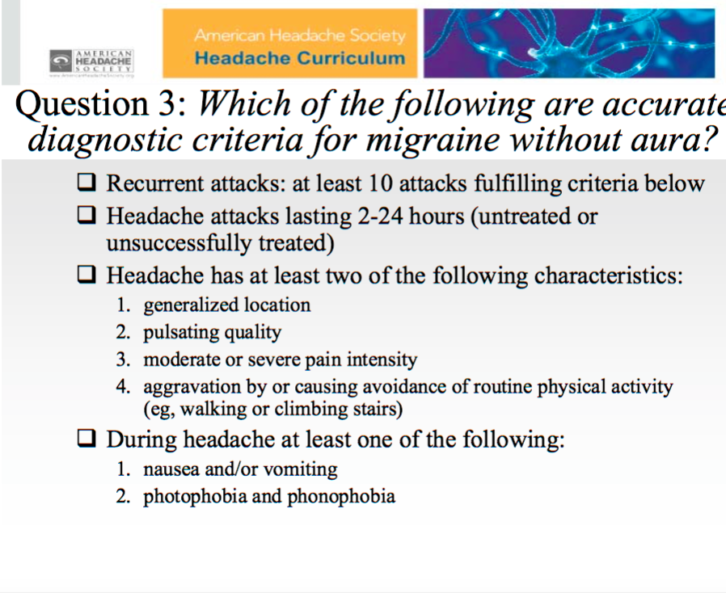

Slide 42
Case 2

Slide 43
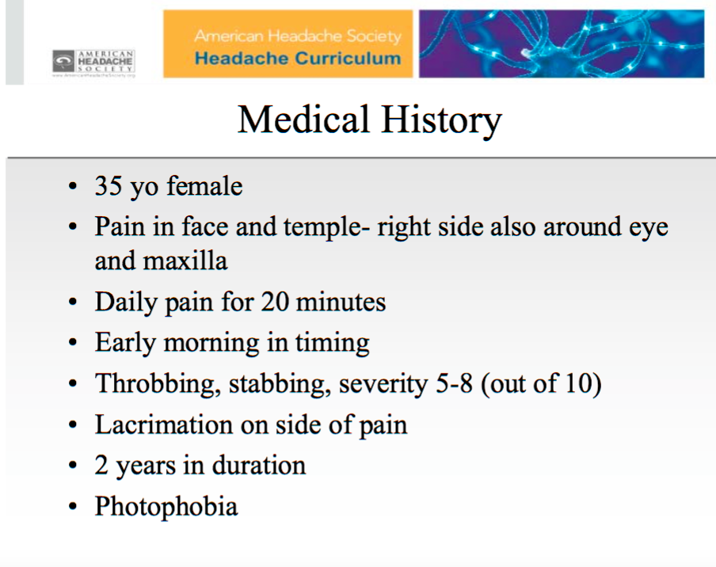

Slide 44
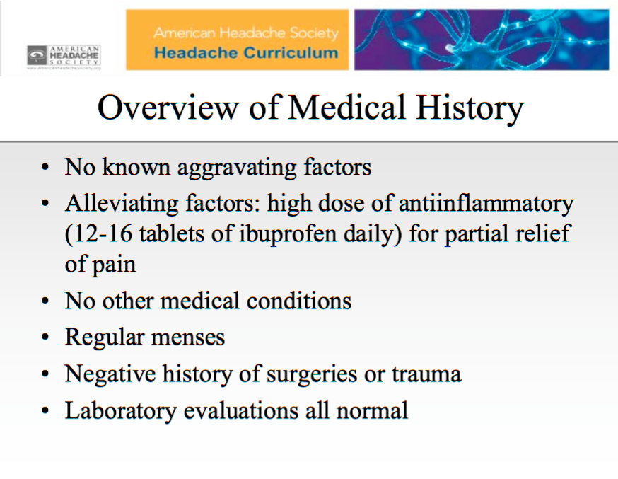

Slide 45
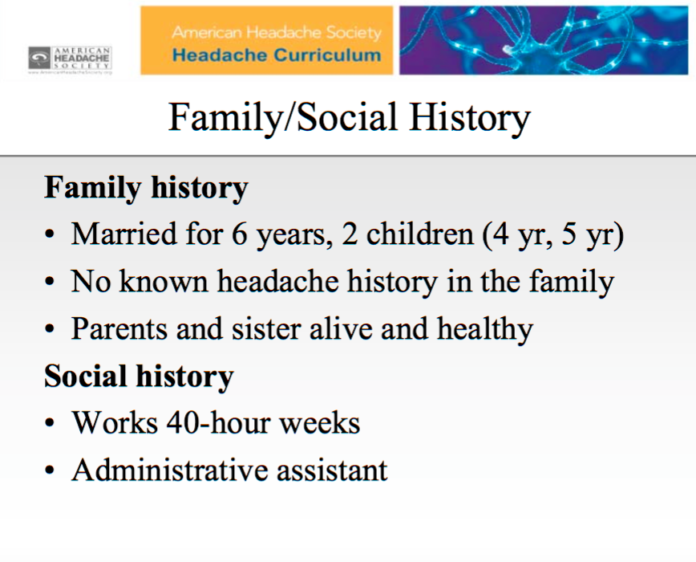

Slide 46
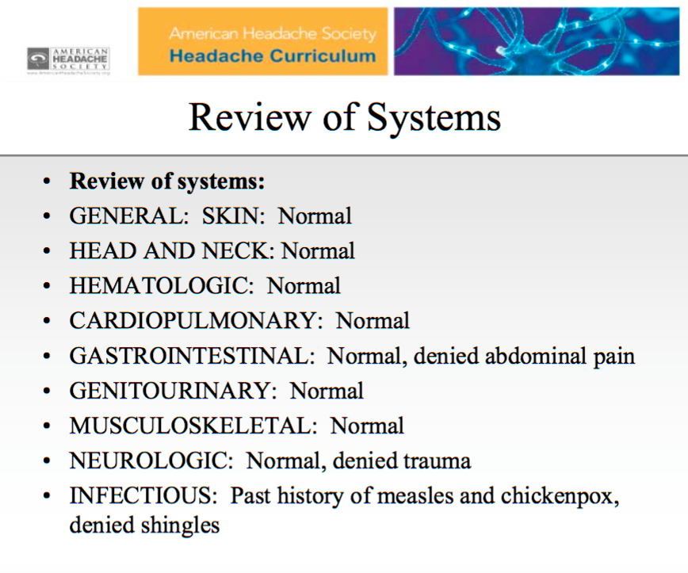

Slide 47
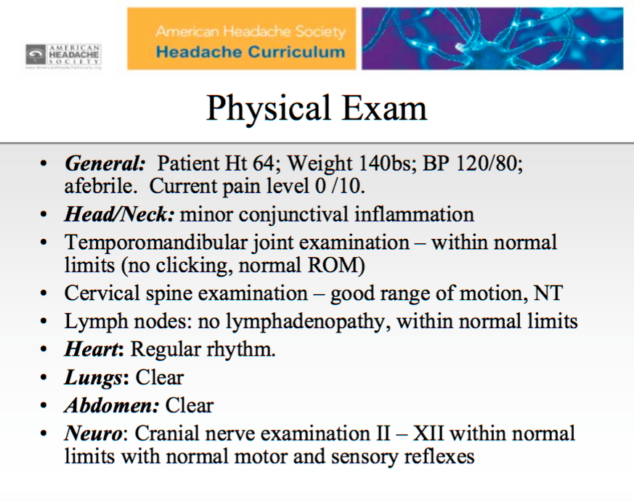

Slide 48
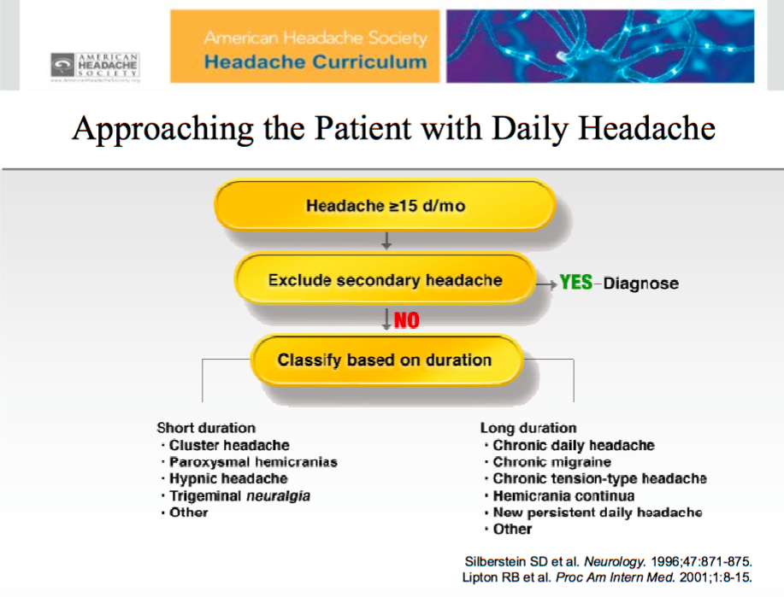

Slide 49
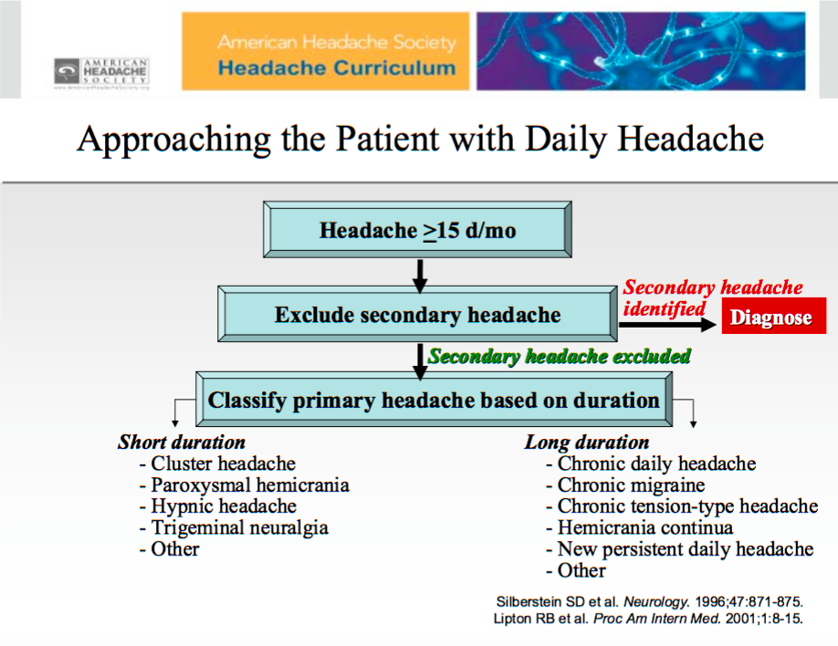

Slide 50
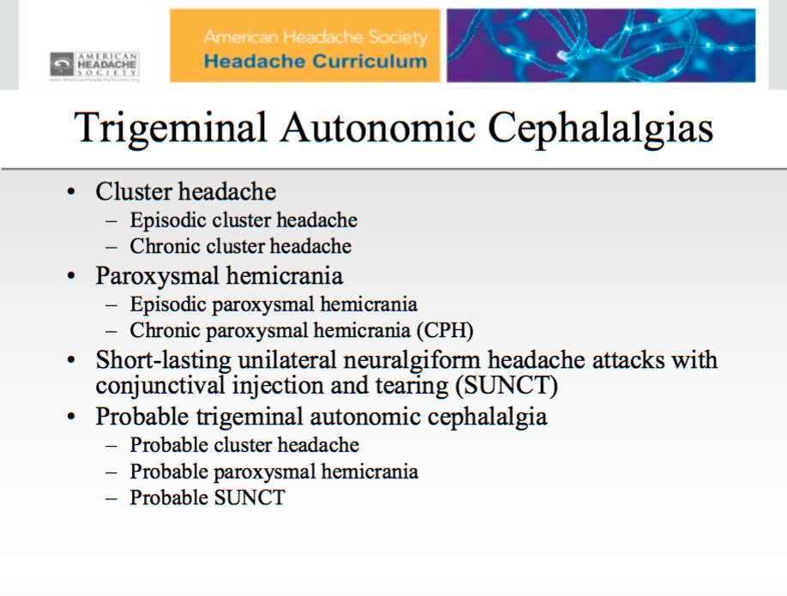

Slide 51
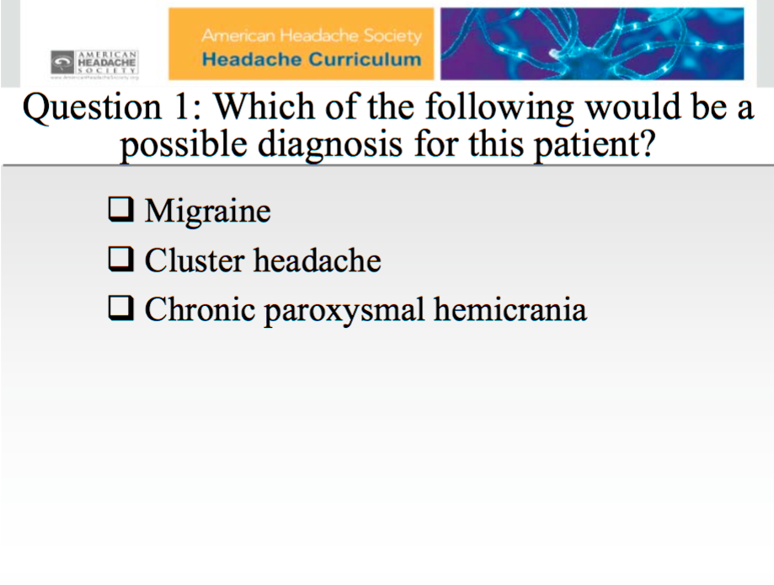

Slide 52
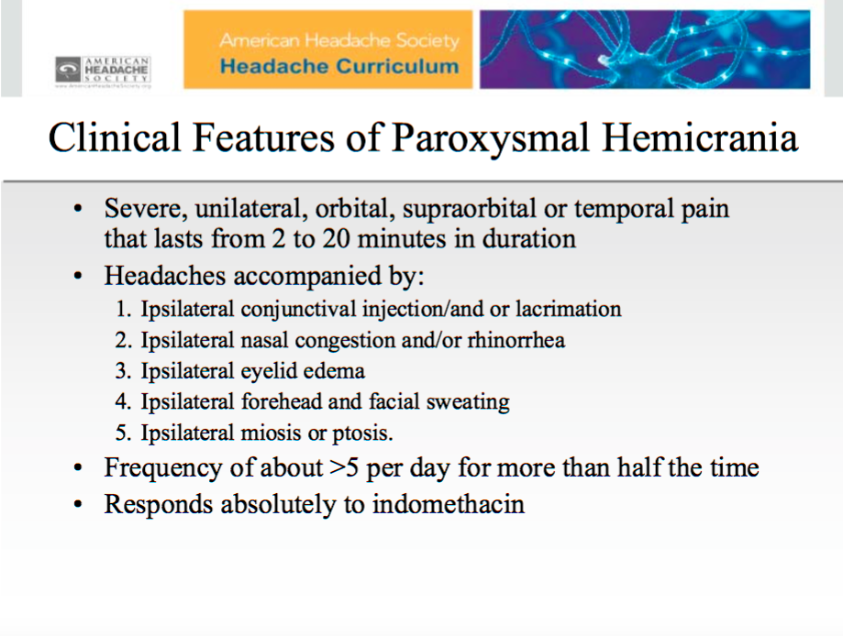

Slide 53
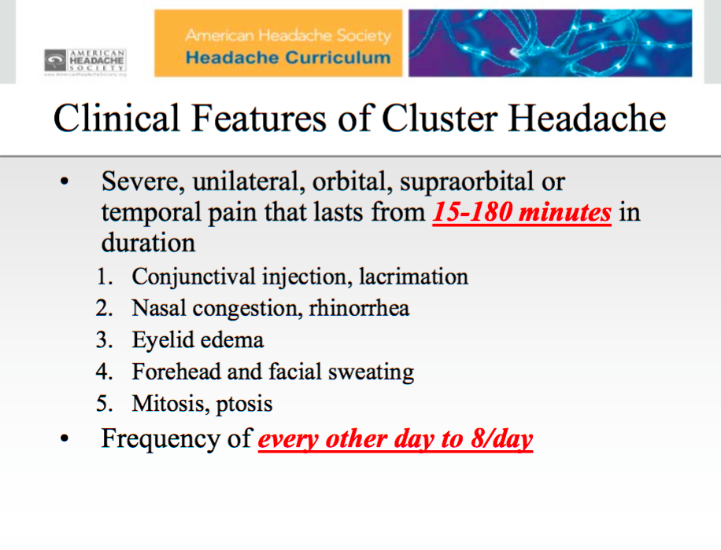

Slide 54
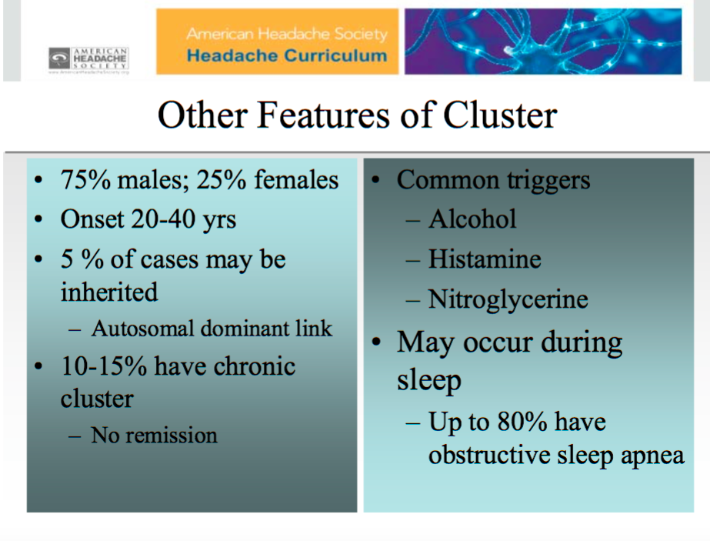

Slide 55
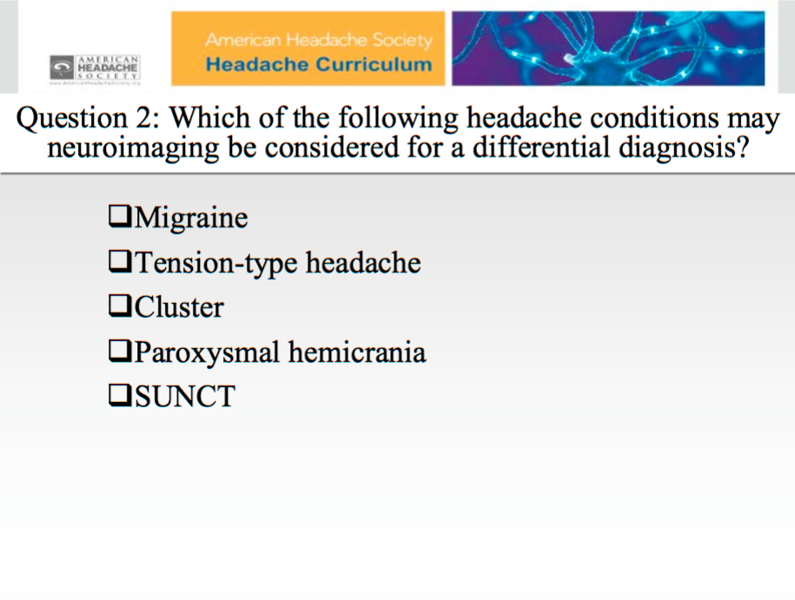

Slide 56
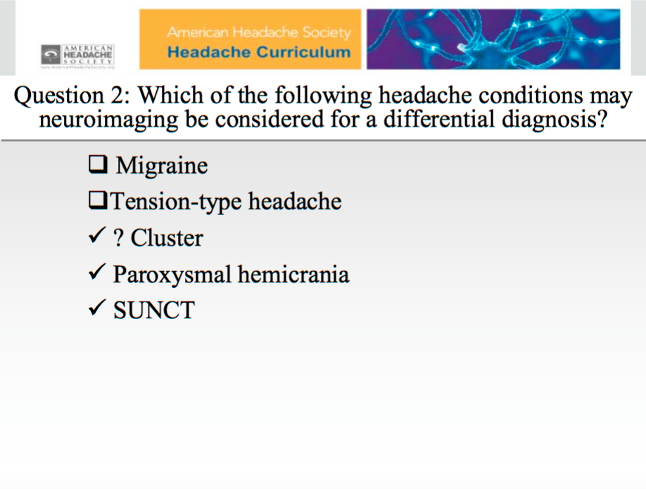

Slide 57
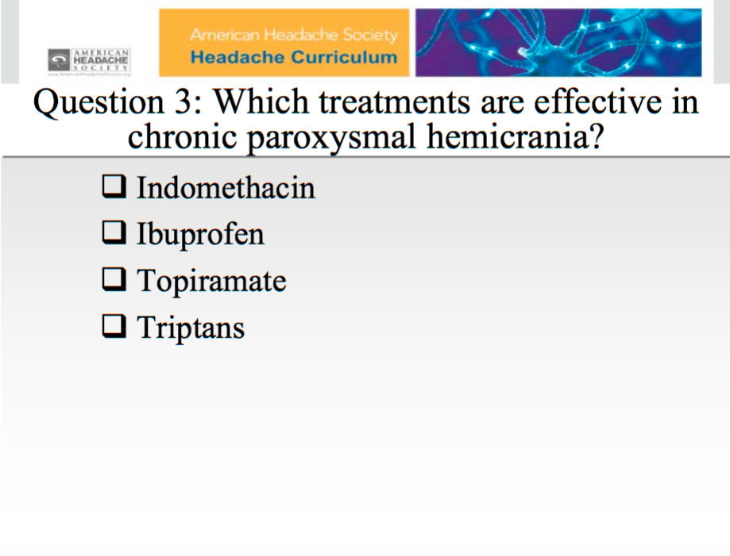

Slide 58
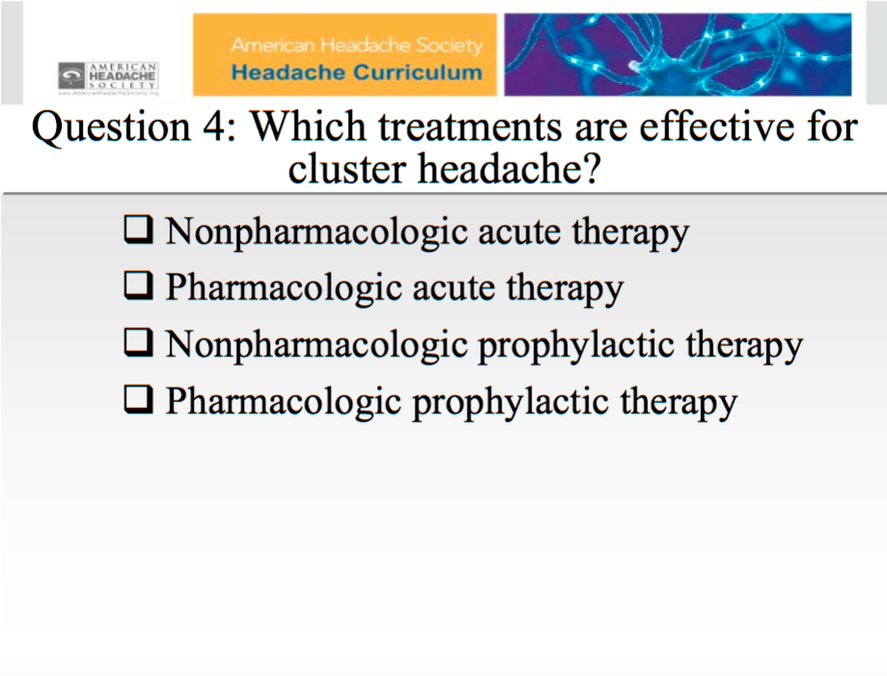

Slide 59
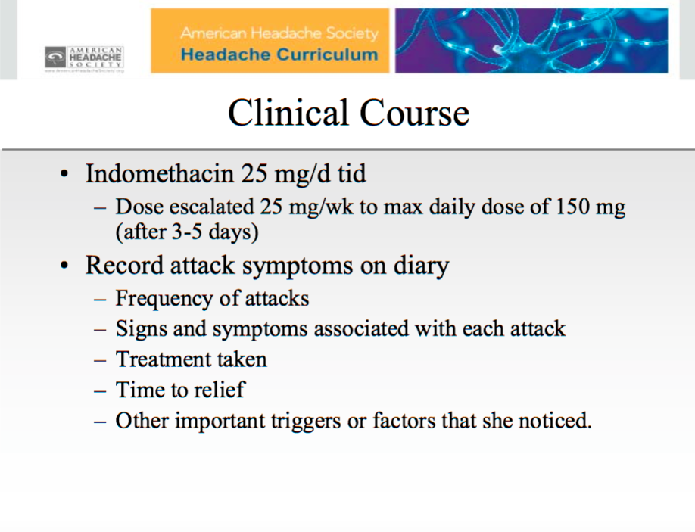

Slide 60
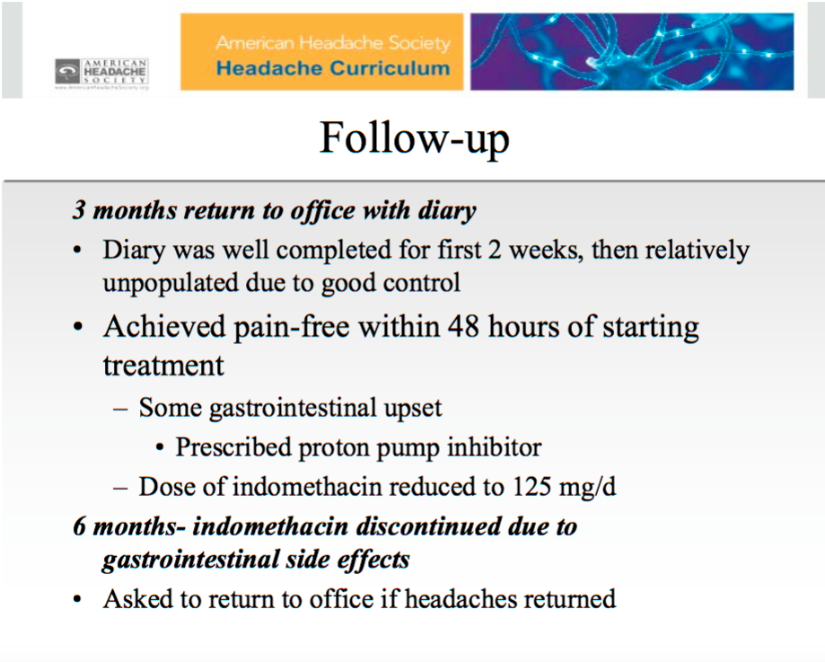

Slide 61
Thank You

