Slide 1
Localization in Neurology
Dr. Hana Albulaihe
Consultant Neurologist

Slide 2
Objectives
Neuroaxis structures.
Central vs. peripheral nervous system.
UMN & LMN signs.
Functions of the brain lobes.
Brain stem and spinal cord anatomy and functions.
Cases.

Slide 3
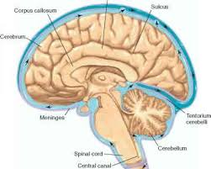

Slide 4
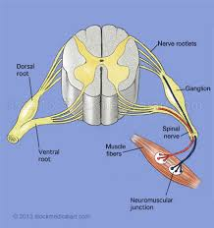

Slide 5
Brain
Brain stem.
Spinal cord.
Anterior horn cells.
Nerve root.
Plexus.
Peripheral nerve.
Neuromuscular junction.
Muscle.

Slide 6
UPPER MOTOR NEURON SIGNS
Indicate that the lesion is above the anterior horn cell (spinal cord, brain stem, brain).
increased muscle tone (spasticity).
weakness (flexors weaker than extensors in the legs and the reverse in the arms - pyramidal pattern of weakness).
increased reflexes.
up-going plantar response.
sustained clonus.

Slide 7
LOWER MOTOR NEURON SIGNS
Indicate that the lesion is distal to the anterior horn cell (root, plexus, peripheral nerve, NMJ, muscle).
decreased muscle tone.
weakness and wasting.
areflexia.

Slide 8
Brain :
Frontal lobe.
Temporal lobe.
Parietal lobe.
Occipital lobe.

Slide 9
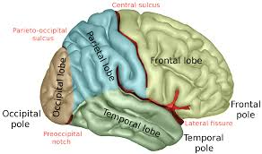

Slide 10
Frontal lobe
Essential for planning and executing learned and purposeful behaviors.
Primary motor cortex controls all motor functions on the contralateral side of the body .
90 % of motor fibers from each hemisphere cross the midline in the lower medulla.

Slide 11
The medial frontal cortex is important in arousal and motivation. lesions in this area the patients become apathetic, inattentive, and markedly slow to respond.
The orbital frontal cortex modulates social behavior. lesions in this area cause emotional labilty and disinhibition.

Slide 12
The left posteroinferior frontal cortex ( Broca area) controls expressive language function. Lesions in this area cause expressive aphasia.
The dorsolateral frontal cortex manipulates very recently acquired information ( working memory). Lesions in this area can impair the ability to retain information and process it in real time (eg, to spell words backwards or to alternate between letters and numbers).

Slide 13
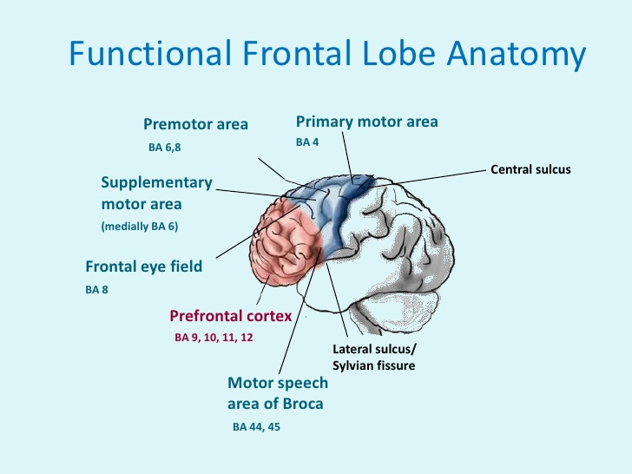

Slide 14
Parietal lobe
The primary somatosensory cortex integrates sensory stimuli for recognition and recall of form, texture, and weight. The primary somatosensory cortex on one side receives all somatosensory input from the contralateral side of the body. Lesions in this area result in inability to recognize objects by touch (astereognosis).
Areas posterolateral to the postcentral gyrus generate visual-spatial relationships and awareness of moving objects.

Slide 15
Parts of the parietal lobe of the dominant hemisphere are involved in abilities such as calculation, writing, left-right orientation, and finger recognition. Lesions in the angular gyrus can cause deficits in writing, calculating, left-right disorientation, and finger-naming (Gerstmann syndrome).

Slide 16
The nondominant parietal lobe integrates the contralateral side of the body with its environment, enabling people to be aware of this environmental space.
Acute injury to the nondominant parietal lobe may cause neglect of the contralateral side (usually the left), resulting in decreased awareness of that part of the body, its environment, and any associated injury to that side (anosognosia). For example, patients with large right parietal lesions may deny the existence of left-sided paralysis.

Slide 17
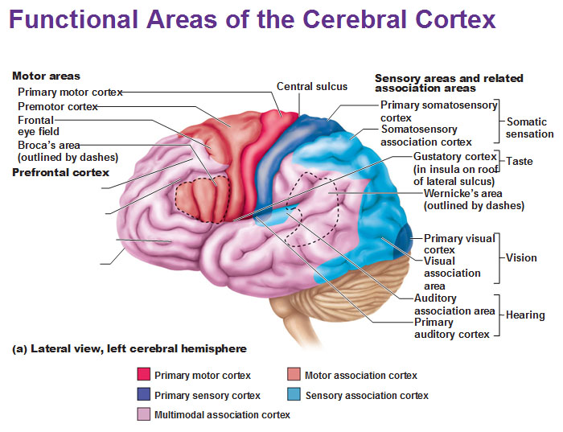

Slide 18
Temporal lobe
The temporal lobes are integral to auditory perception, receptive components of language, memory and emotion.
Lesions in the posterior third of the sup. Tempral gyrus result in wernicke aphasia.

Slide 19
Occipital lobes
The primary visual cortex
Visual association areas

Slide 20
Sub cortical areas.
Internal capsule.
Thalamus.

Slide 21
Brain stem
Lesions of the brain stem can result to abnormalities in the function of cranial nerves which may lead to visual disturbances, pupil abnormalities, changes in sensation, weakness, hearing problems, vertigo, swallowing and speech difficulty, voice change, and coordination problems.
Crossed signs.

Slide 22
Cerebellum:
  Hemispheric:
  Nystagmus.
  Dysarthria with "scanning" speech.
  Ipsilateral UE dysmetria.
  Dysdiadochokinesia.
  Ataxia.
  Intention tremor.
  Impaired heel-to-shin test.
  Vermis lesions cause truncal ataxia and unsteadiness.

Slide 23
Spinal cord
Contains ascending and descending tracts.
Ascending tracts are sensory.
Descending tracts are motor.

Slide 24
General arrangement of both tracts
1st order neuron
2nd order neuron
3rd order neuron

Slide 25
Decussation is the cross-over of the tract from one side to the other.
Decussation occurs at different locations for each tracts.

Slide 26
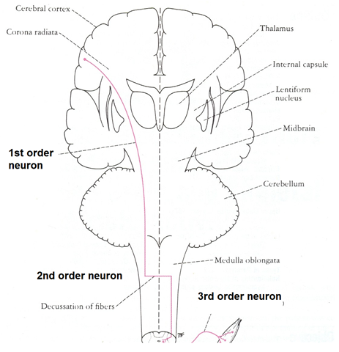
Descending tracts (Motor)

Slide 27
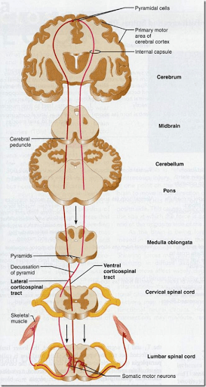

Slide 28
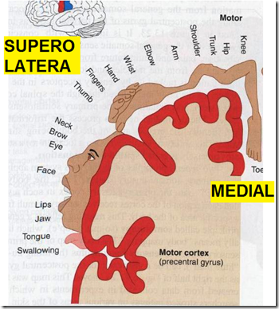

Slide 29
Ascending tracts (sensory)
Types of ascending tracts:
Spinothalamic tracts
Lateral
  pain & temperature
Anterior
  light touch & pressure
Dorsal column tract
deep touch & pressure
proprioception
vibration sensation
Spinocerrebellar tract
posture & coordination

Slide 30
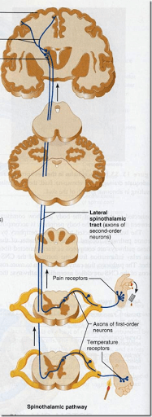

Slide 31
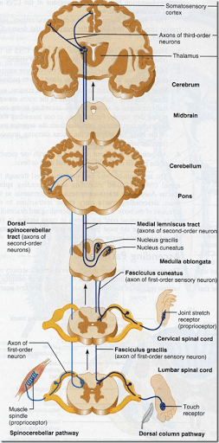

Slide 32


Slide 33
Spinal Cord:
Complete transection:
sensory level.
upper motor lower limbs weakness.
spinal tenderness.
bowel/bladder dysfunction.

Slide 34
Hemisection of the spinal cord:
Ipsilateral upper motor neuron weakness.
Ipsilateral loss of vibration and proprioception.
Contalateral loss of pain and temperature.

Slide 35
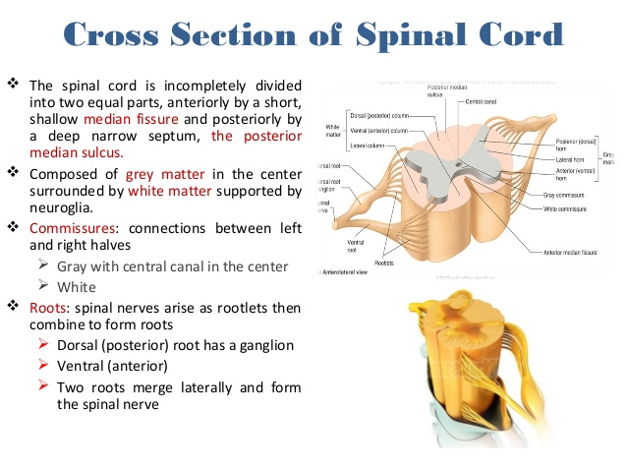

Slide 36
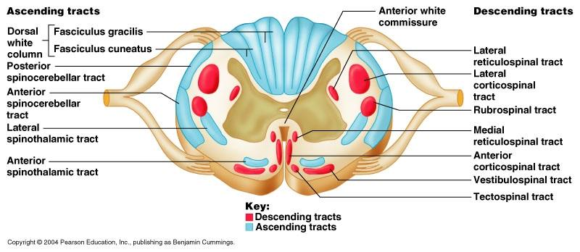

Slide 37
Anterior Horn Cells:
Weakness.
Fasciculations.
Wasting.
Spasticity.
Hyperreflexia.
No sensory loss.

Slide 38
Peripheral nervous system:
Root (radiculopathy):
Pain, focal weakness and wasting, sensory loss along a dermatomal distribution, history of back pain.
mononeuropathy:
findings along a particular nerve distribution

Slide 39
Peripheral polyneuropathy:
glove and stocking" distribution, pain and paresthesias of toes,fingers, +/-loss of distal DTR'S,+/- loss of vibration and proprioception,+/-weakness
polyradiculoneuropathy:
ascending weakness, +/- sensory loss and pain. Wasting in chronic form.

Slide 40
Neuromuscular junction:
fluctuating weakness, wasting.
Myopathy:
sensory usually not involved, although may have pain. Weakness .

Slide 41
To localize a lesion:
Step 1:
Is it UMN or LMN?

Slide 42
Step 2:
If UMN:
1. Brain (including brainstem).
2. Spinal cord.

Slide 43
If LMN:
Nerve root.
Nerve.
Neuromuscular Junction (NMJ).
Muscle.

Slide 44
Case 1
A 72-year-old woman with a history of diabetes and hypertension suddenly awakens with deviation of her mouth angle to the left, weakness of the right arm and leg. On examination, she has upper motor neuron weakness of the right face, arm and leg associated with brisk reflexes on the right and a right extensor plantar response.

Slide 45
Case 2
A 35 year-old woman known to have breast cancer with metastasis to the liver presented with progressive weakness of both legs for 3 days. On exam she has bilateral lower extremity hyperreflexia and clonus.

Slide 46
Case 3
26 year old motorcyclist was received by the trauma team in the emergency department after being involved in MVA. Initial neurological examination found him alert and orientated with a Glasgow Coma Score of 15. Full neurological examination demonstrated reduced motor power on the left side. Shoulder abduction and elbow flexion was diminished but movement was absent or reduced to a flicker for elbow extension, wrist flexion and extension, finger extension and flexion, and all muscle groups in the lower limb.

Slide 47
Right sided motor function was normal. Sensation was abnormal below C6 with absent pinprick sensation on the right side and abnormal light touch and proprioception sensation on the left side. Reflexes were all reduced on the left side.

Slide 48
Case 4
A 60 year old man with hypertension wakes one morning with trouble walking. He is feeling dizzy. His wife gets him into the car and brings him to the emergency room where you are asked to evaluate him. On the way to the emergency room his wife noted that his face seemed to be drooping on the right.

Slide 49
On examination you find that the man is quite uncomfortable and prefers to be lying still rather than trying to cooperate with the exam. His mental status is appropriate. His pupillary exam is normal but he cannot look to the right with either the left or the right eye. The corneal reflex is abnormal on the right. Although he feels the cornea being touched he does not close his right eye. His left eye does close to right corneal stimulation. The right side of his face is weak and he has marked loss of right sided hearing. His gag reflex is intact. He is unable to walk and has right upper extremity intention tremor. When you sit him up he falls to the right. His reflexes and strength are intact in all limbs.

Slide 50
Case 5
A 37-year-old male presented to a chiropractic office complaining about recent onset of tingling and numbness in both hands. He also complained about his feet which he described as "feeling sleepy." His symptoms began slowly following an upper respiratory tract infection that he had about 14 days prior. No history of trauma was reported nor had he ever complained of the current symptoms.

Slide 51
Examination of this man revealed a healthy person in other- wise good condition. Generalized weakness of the lower ex tremities was noted when testing the quadriceps, hamstrings and the gastrocnemius-soleus muscle groups.Sensory loss was variable in both his hands and feet. Deep tendon reflexes are not obtainable.

Slide 52
Thank you

