Slide 1
















AHMAD AMER Al-BOUKAI
Clinical Associate Professor & Senior Consultant Radiologist
Radiology & Medical Imaging Department
King Saud University Medical city
A A Al-BOUKAI-1

Slide 2


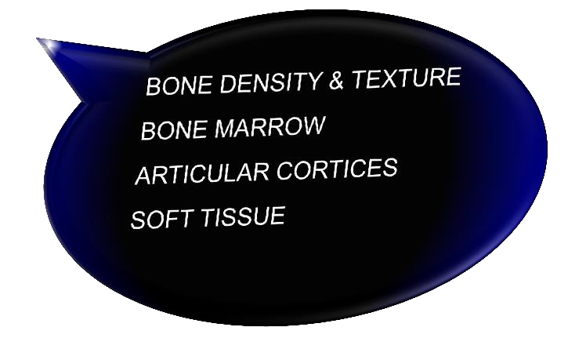

Increase level of confidence in looking at different radiology images Learn to be competent in interpreting findings
Understanding basics of image formation and anatomical land marks
Developing system of analyzing findings
“Where to look & What to look for”
Recognizing imaging features axial spondyloarthritis
A A Al-BOUKAI-2

Slide 3


Introduce the different imaging modalities utilized in imaging MSK system
Define Imaging anatomical landmarks seen in each modality
Introduce simplified approach to the interpretation of image findings
Identify Imaging findings, importance and correlation in different pathology, trauma
Identify Imaging findings, importance and correlation in different pathology, arthritis
Identify Imaging findings, importance and correlation in different pathology, metabolic
Identify Imaging findings, importance and correlation in different pathology, neoplastic
A A Al-BOUKAI-3

Slide 4


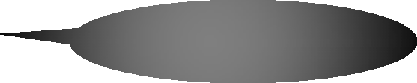

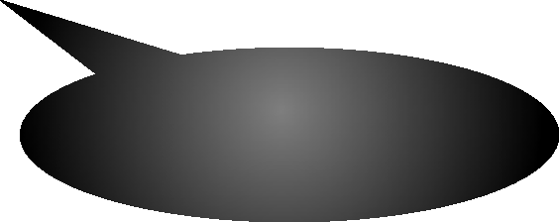


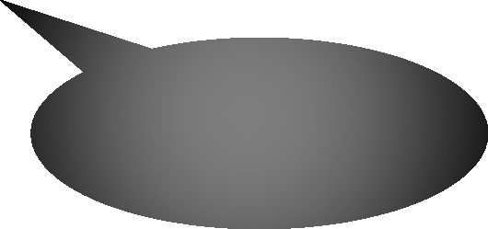
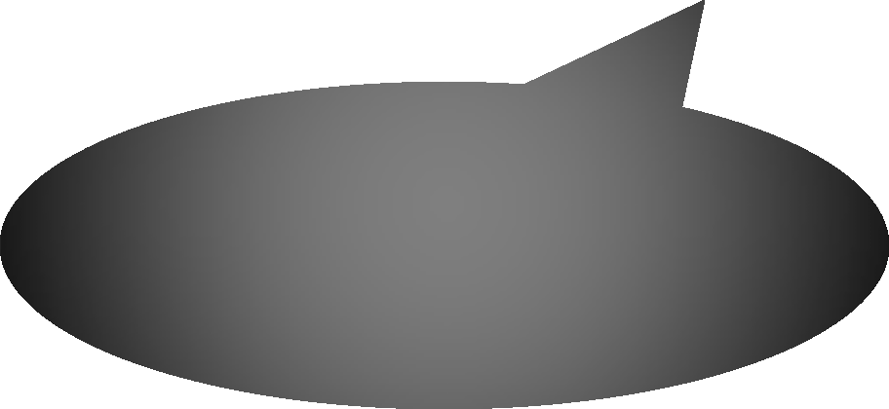

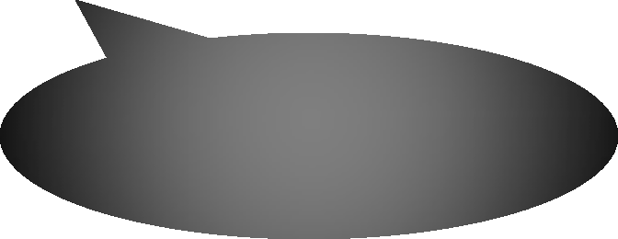







CONVENTIONAL RADIOGRAPHY
Corner Stone
COMPUTED TOMOGRAPHY
MAGNATIC RESONANCE IMAGING^{Useful in evaluating}
ULTRASOUND NUCLEAR MEDICINE
Tendons/ligaments/muscles.
Detect fluid collections around joints or within muscles.
Soft tissue masses and cysts.
bone texture
Useful in bone marrow and soft tissue
bone scan is very sensitive but is relatively non-specific
A A Al-BOUKAI-4

Slide 5


A A Al-BOUKAI-5

Slide 6
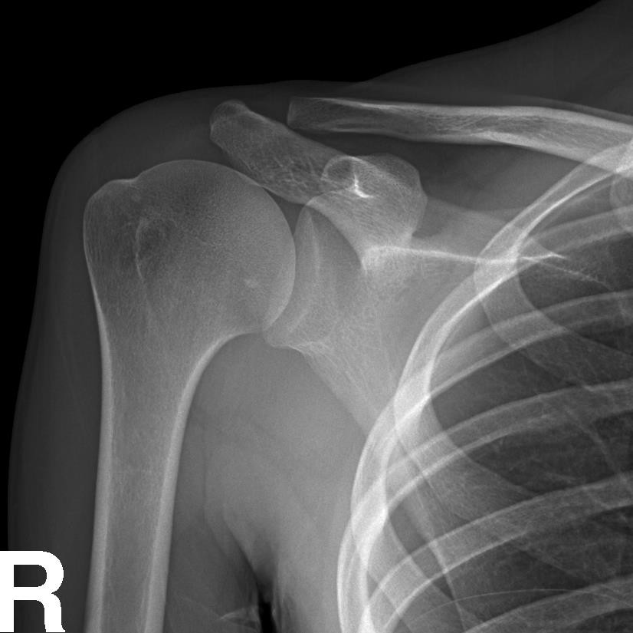
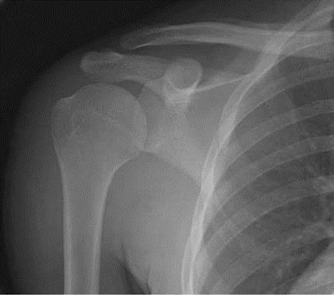
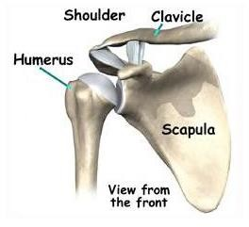

A
A
1
2 ₃
4
5
B
1
2
3
5
4
B
A- Acromio-Clavicular joint B- Gleno-Humeral joint
Clavicle
Acromiom process
Coracoid process
Glenoid process
Humerus
A A Al-BOUKAI-6

Slide 7
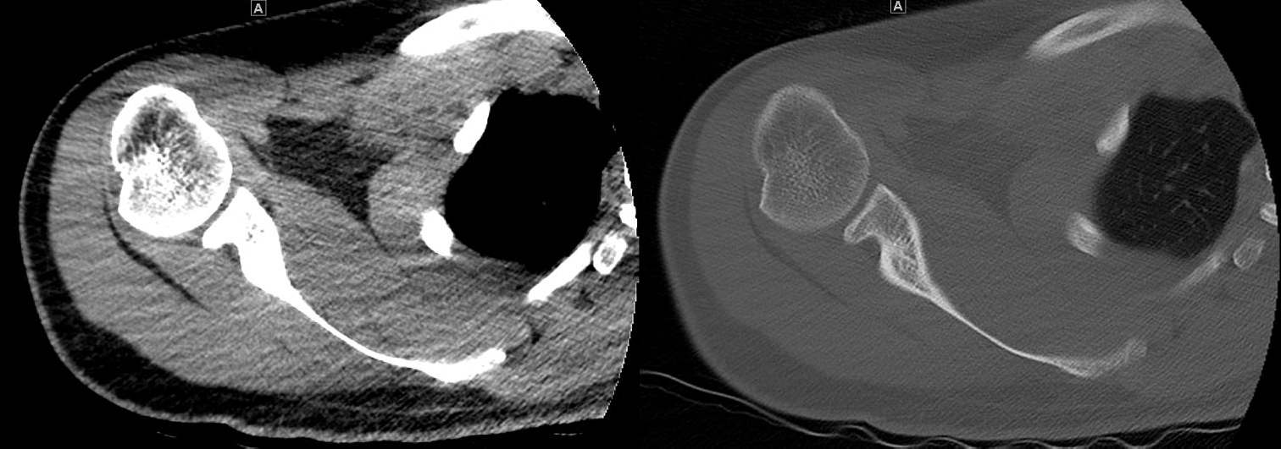
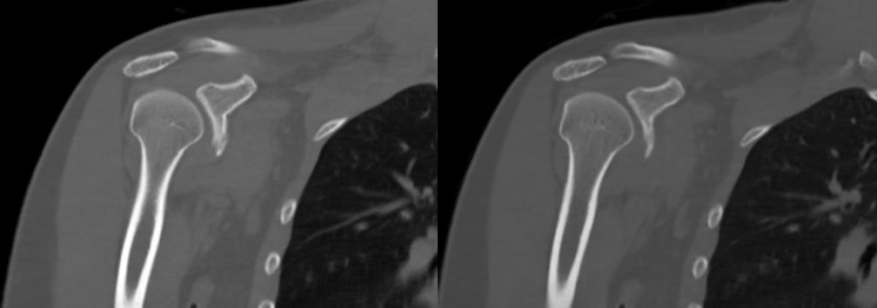
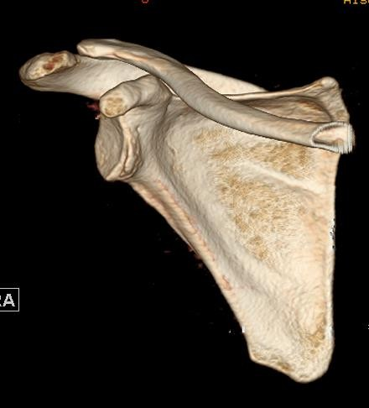

Clavicle
Humerus
ISM
SSC
Scapula
DM
Clavicle
Acromion process
Humerus
COMPUTED TOMOGRAPHY
A A Al-BOUKAI-7

Slide 8
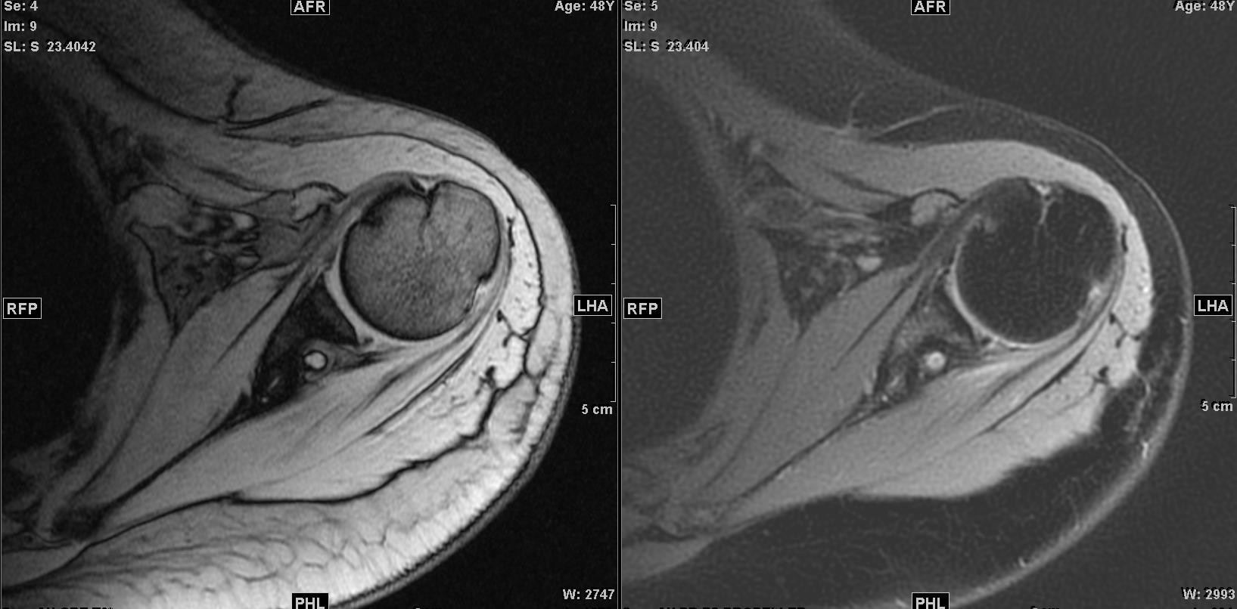
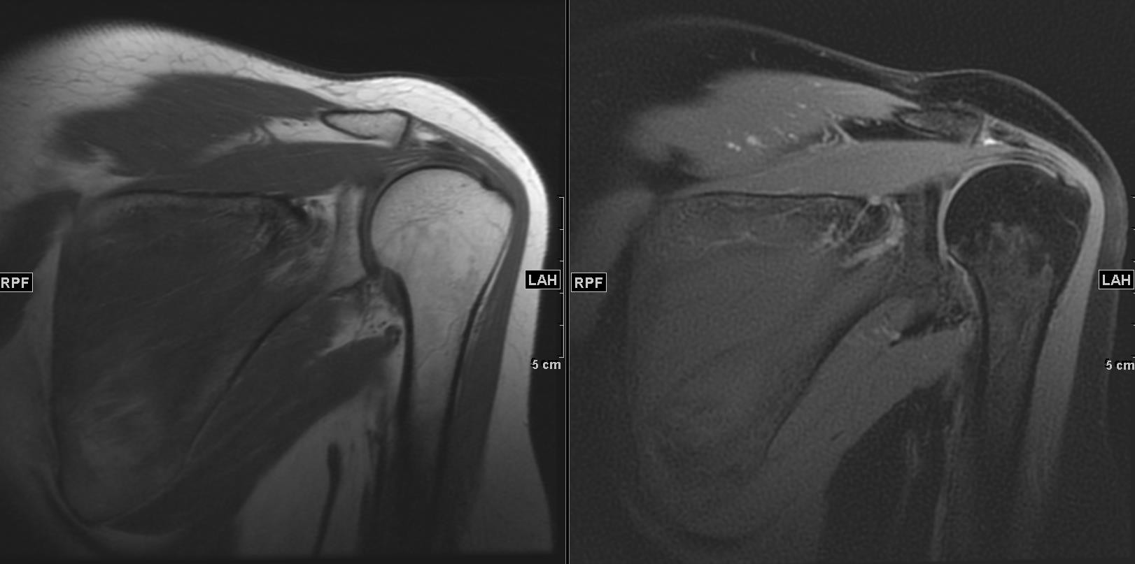
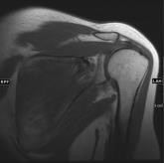
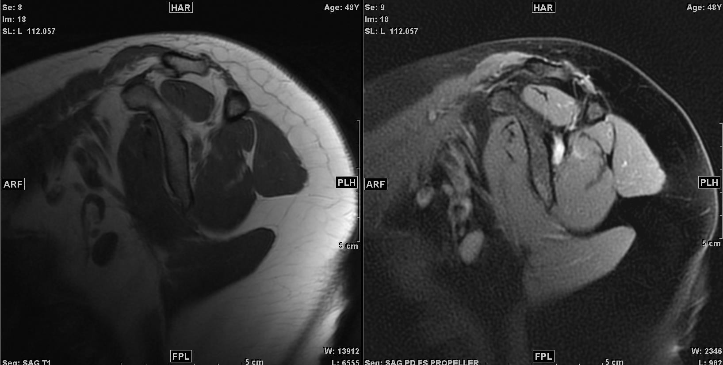
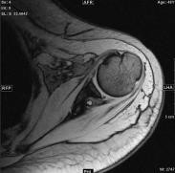


AXIAL PLANE
T₁WI
CORONAL PLANE
T₂ FSWI
AXIAL PLANE
MAGNATIC RESONANCE IMAGING
A A Al-BOUKAI-8

Slide 9

T₁WI
CORONAL PLANE
T₂ FSWI
MAGNATIC RESONANCE IMAGING
A A Al-BOUKAI-9

Slide 10
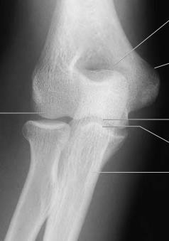
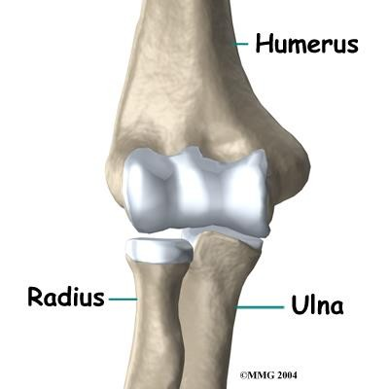






3
4
1
2
5
6
7
1- Lateral Epicondyle
2- Capitulum
3- Olecranon Fossa
4- Medial Epicondyle
5- Trochlea
6- Coronoid Process
7- Radius Head

Slide 11
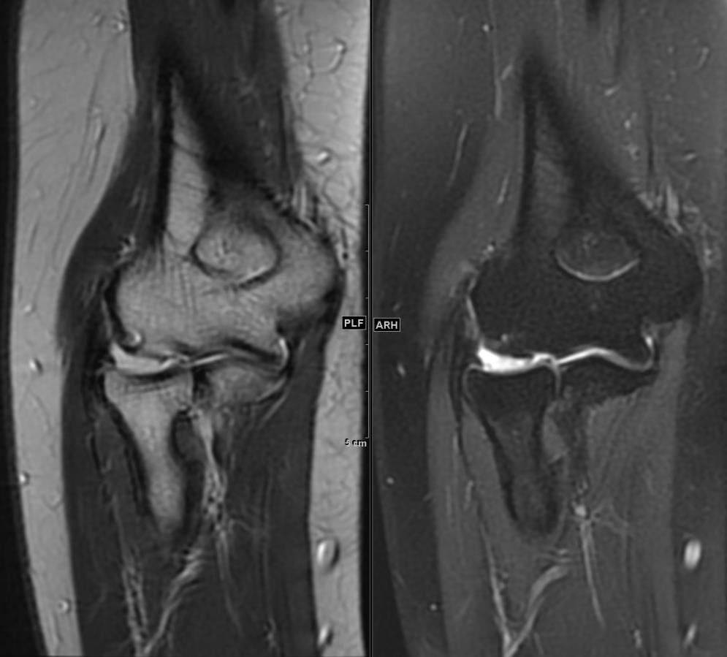

CORONAL PLANE
3
T₂WI
T₂ FSWI
4
1
3
4
2
5
6
7
1
2
5
6
7
1- Lateral Epicondyle
2- Capitulum
3- Olecranon Fossa
4- Medial Epicondyle
5- Trochlea
6- Coronoid Process
7- Radius Head

Slide 12
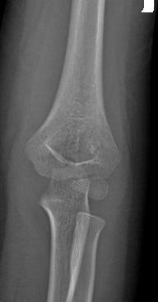
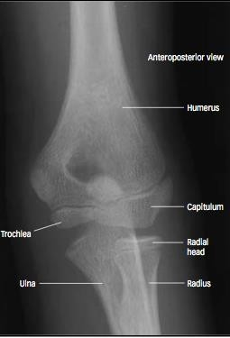
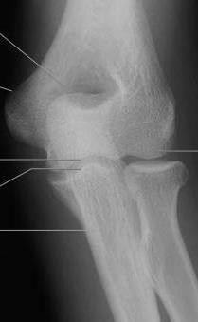

Child 5-Year old
Child 11-Year old
Adult

Slide 13
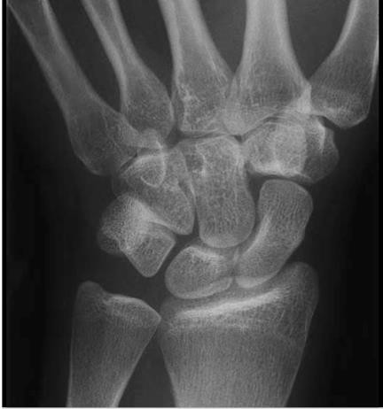
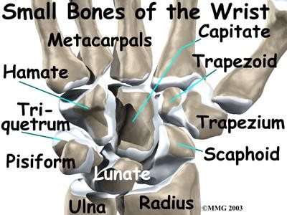


Slide 14
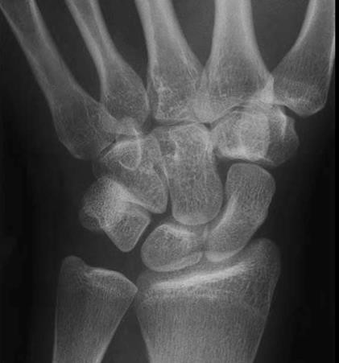


Ulna
Radius
Scaphoid
Lunate
Triquetrum
Pisiform
Trapezium
Trapezoid
Capitate
8
7
10
9
6
3
5
4
10- Hamate
1
2

Slide 15

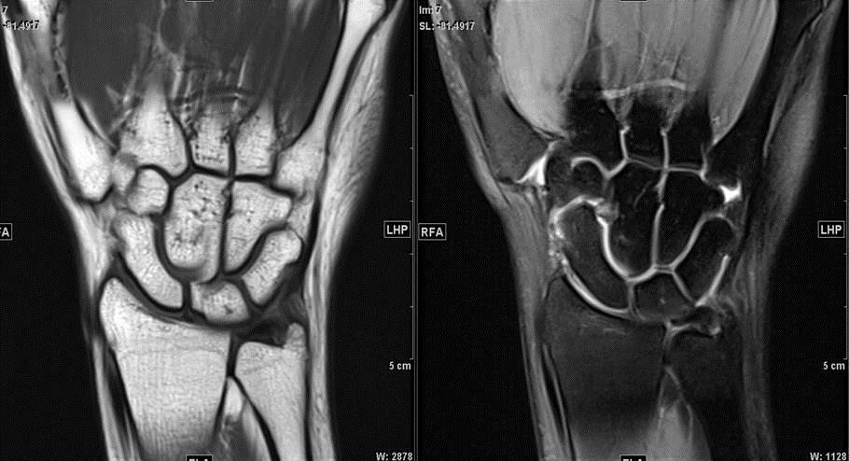

Ulna
Radius
Scaphoid
4-
5-
6-
7-
8-
9-
Lunate
T₁WI
T₂ FSWI
Triquetrum
Pisiform
Trapezium
Trapezoid
MC₂
MC₃
Capitate
MC
1
MC
4
10- Hamate
7
MC
5
8
9
10
3
6
5
4
2
1
CORONAL PLANE

Slide 16
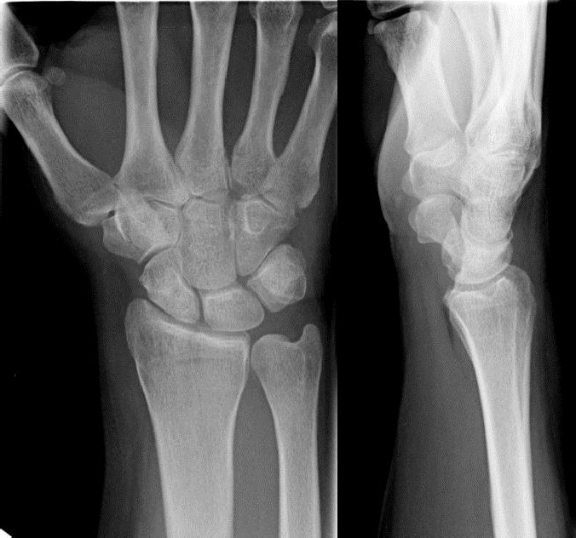
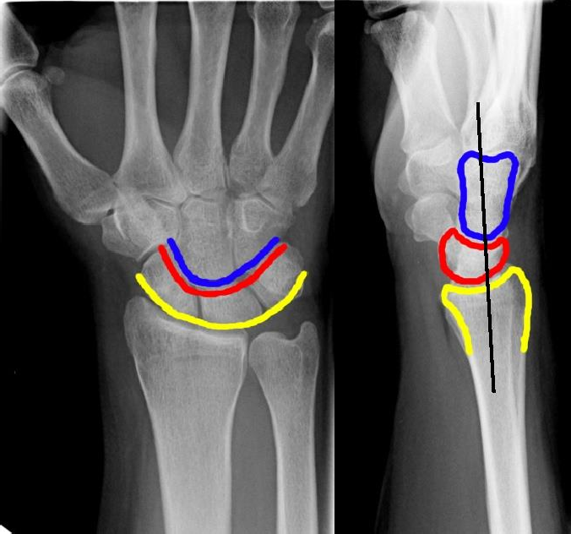


Three carpal arcs should be traced:
along the proximal row of carpal bones; proximal aspect.
along the proximal row of carpal bones; distal aspect.
along the capitate and hamate proximally.
These three lines should remain unbroken

Slide 17
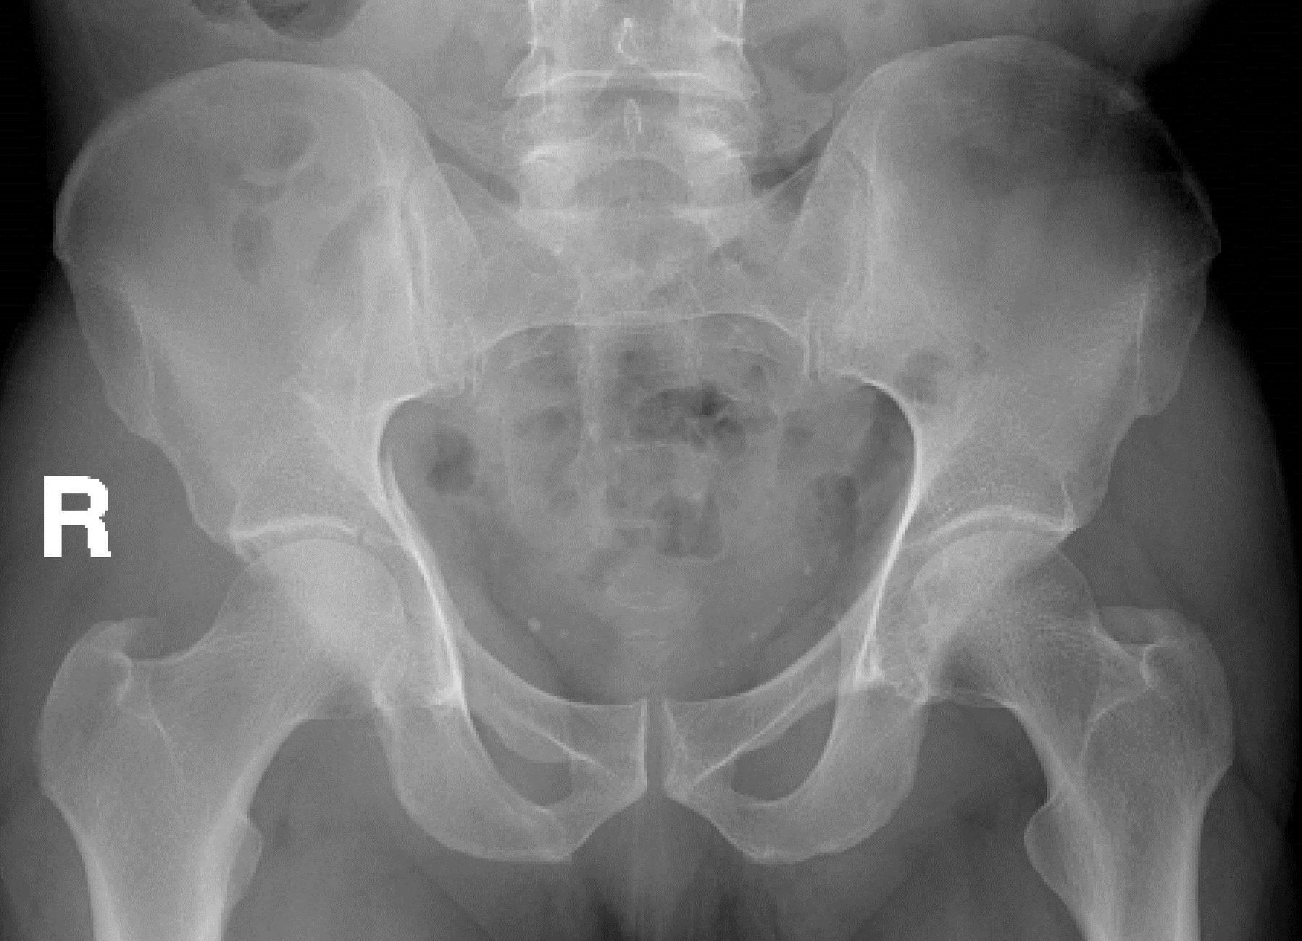
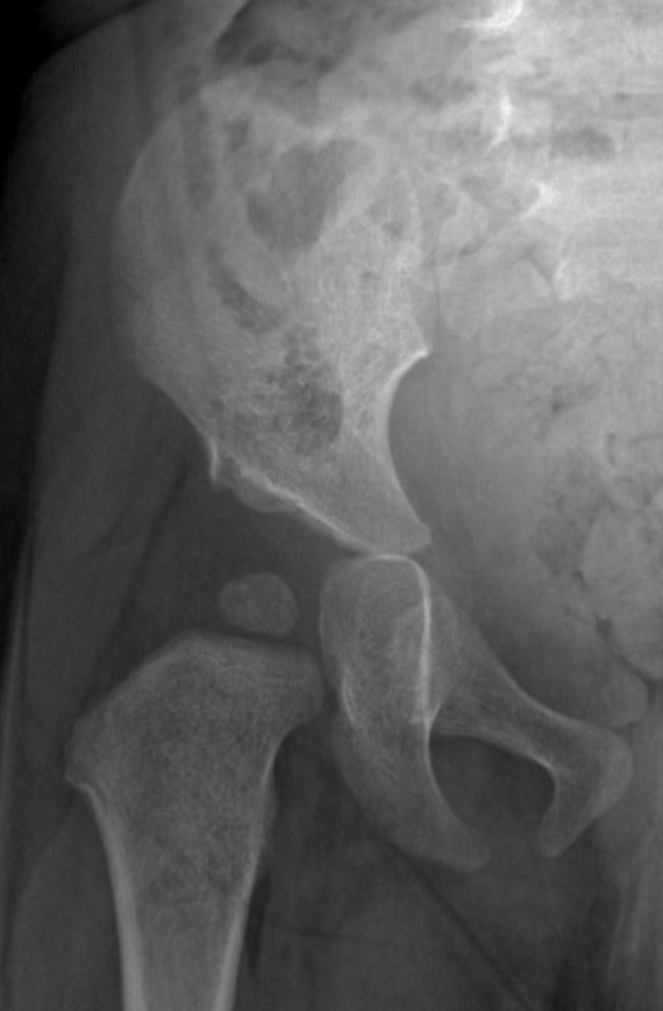

A
6

Slide 18
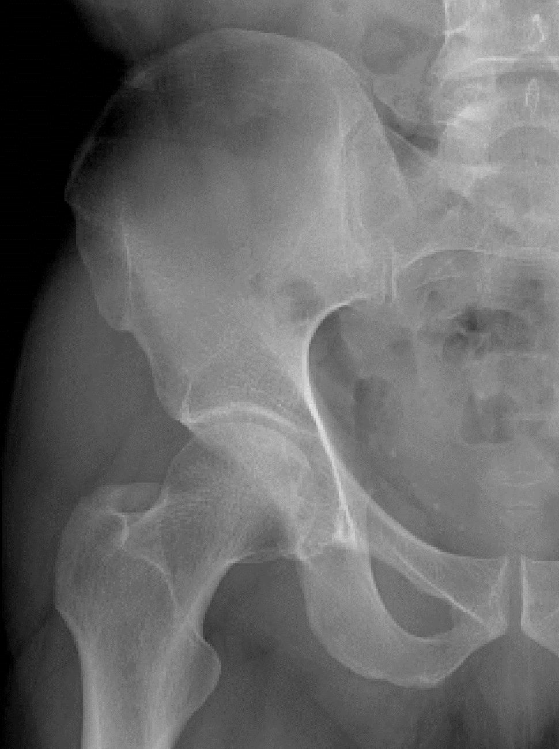
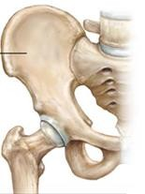


A
1
2
3
4
A-Sacro-iliac Joint B-Symphysis Pubis
1- Superior Anterior Iliac Spine 2- Inferior Anterior Iliac Spine 3- Femur Head
Femur Neck
Greater Trochanter
Lesser Trochanter
Ischium
Superior Pubic Ramus
5
8
7
6
B
A A Al-BOUKAI-18

Slide 19






A
1
ILIAC BONE
2
3
4
A-Sacro-iliac Joint B-Symphysis Pubis
1- Superior Anterior Iliac Spine 2- Inferior Anterior Iliac Spine 3- Femur Head
Femur Neck
Greater Trochanter
Lesser Trochanter
Ischium
Superior Pubic Ramus
5
PUBIC
8
ISCHIUM
7
6
B
A A Al-BOUKAI-19

Slide 20
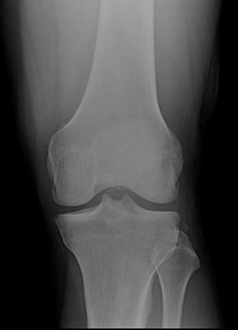
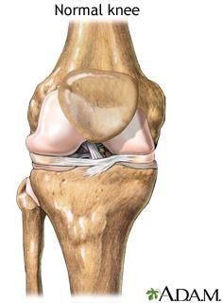






8
Patella
Lateral condyle
Medial condyle
4-
5-
6-
7-
8-
9-
1
Lateral tibial plateau
Medial tibial plateau Tibial eminence Fibula
Femur Tibia
3
2
5
4
4
9
7
A A Al-BOUKAI-20

Slide 21
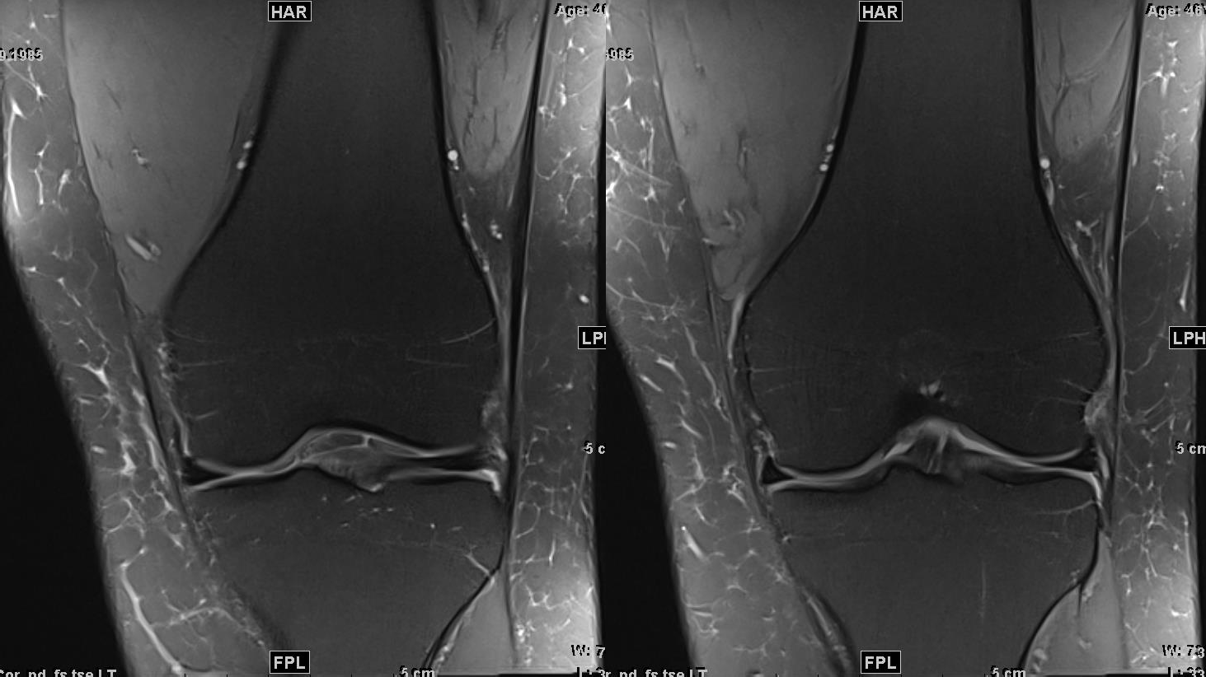
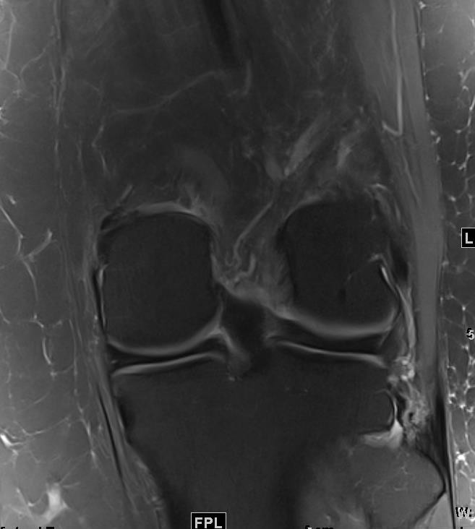
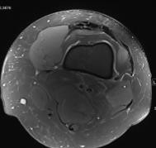

PDFSWI
7
Lateral condyle
Medial condyle
1
2
4 3
3- Lateral tibial plateau 4- Medial tibial plateau 5- Tibial eminence
Fibula
Femur
Tibia
5
8
8
6
CORONAL PLANE
A A Al-BOUKAI-20

Slide 22
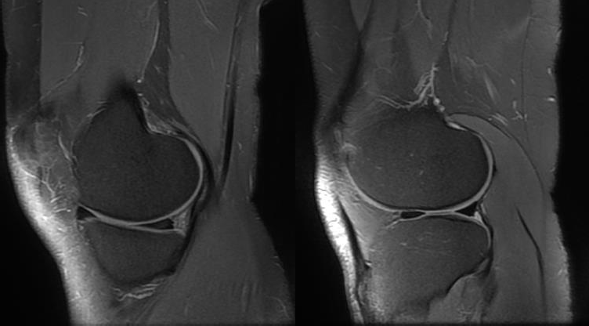
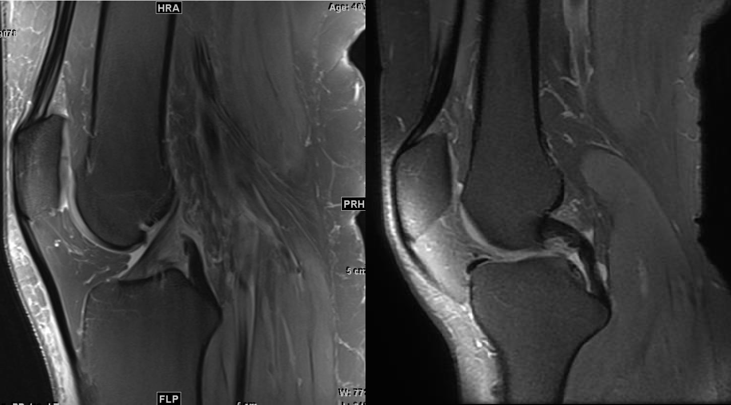

7
PDFSWI
2
1
Patella
Femur
Tibia
4
5
ACL
PCL
3
NORMAL MEDIAL MENISCUS
NORMAL LATERAL MENISCUS
SAGITTAL PLANE

Slide 23
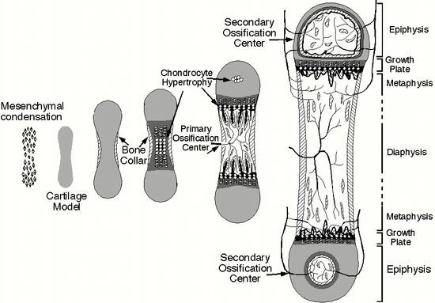
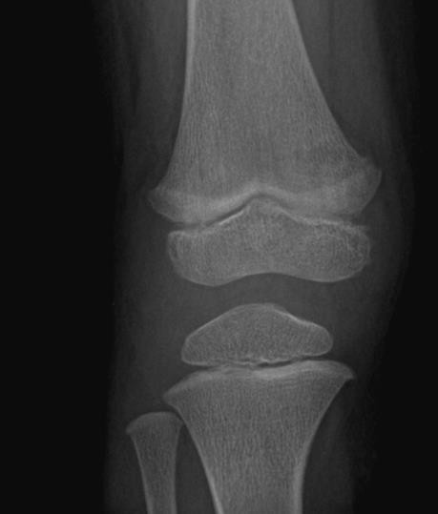
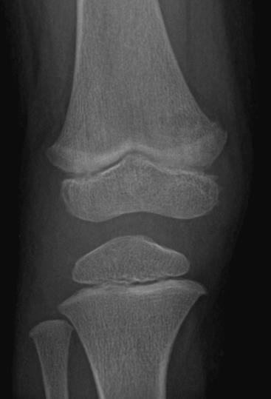
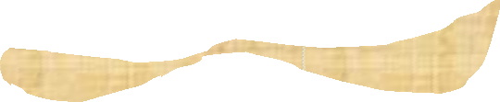
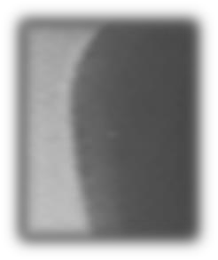


Diaphysis
Metaphysis
Epiphysis
Growth Plate

Slide 24

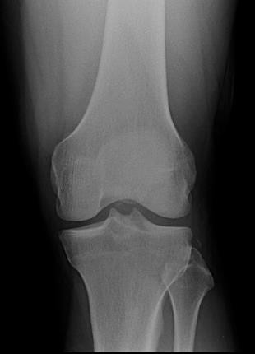
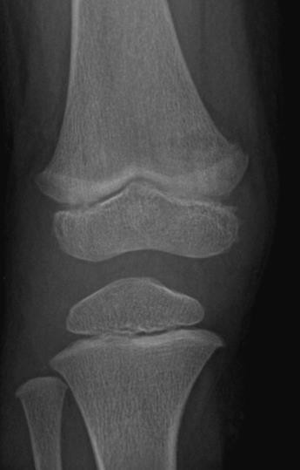

Diaphysis
Metaphysis
Pediatric
Adult

Slide 25
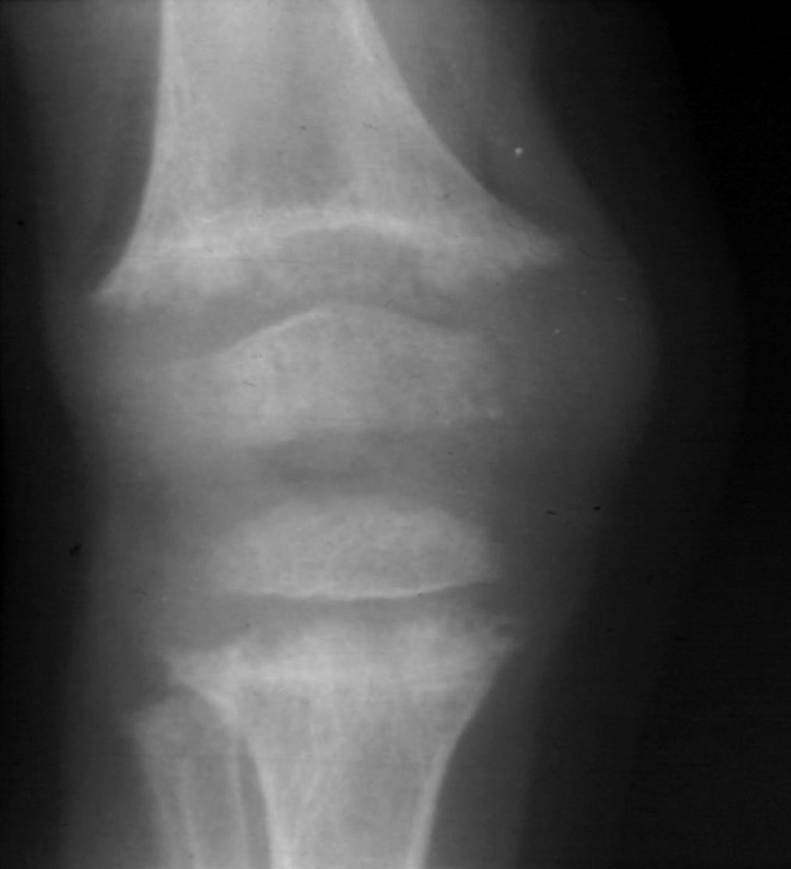
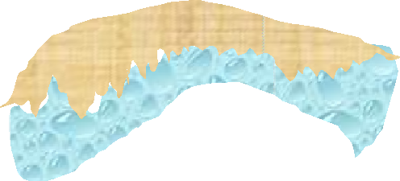




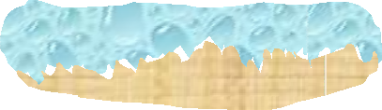

Normal
Rickets
Diaphysis
Metaphysis Epiphysis
Plate
“Where to look & What to look for”
Cupping
Widening of
^{Fraying} Growth Plate
Cupping
Growth
IMPORTANT SITES
BONE DENSITY
BONE TEXTURE
DISTORTION / DISPLACEMENT OF NORMAL STRUCTURES
A A Al-BOUKAI-24

Slide 26

Normal
Rickets
Diaphysis
Metaphysis Epiphysis
Plate
“Where to look & What to look for”
Cupping
Widening of
^{Fraying} Growth Plate
Cupping
Growth
IMPORTANT SITES
BONE DENSITY
BONE TEXTURE
DISTORTION / DISPLACEMENT OF NORMAL STRUCTURES
A A Al-BOUKAI-24

Slide 27
Normal
_{Diaphysis}“Where to look & What to look for”
Rickets
Cupping
Metaphysis
Epiphysis
Widening of Growth Plate
Fraying
Growth
Plate
IMPORTANT SITES
BONE DENSITY
BONE TEXTURE
DISTORTION / DISPLACEMENT OF NORMAL STRUCTURES
Cupping
A A Al-BOUKAI-24

Slide 28
Diaphysis
Diaphysis
Metaphysis
Metaphysis
Epiphysis
Growth Plate
Epiphysis
Growth Plate
A A Al-BOUKAI-23

Slide 29



“Where to look & What to look for”
H Y P E R P A R A T H Y R O I D I S M
N O R M A L

Slide 30



Normal
Fracture
•
•
•
•
IMPORTANT SITES
BONE DENSITY BONE TEXTURE
DISTORTION / DISPLACEMENT OF NORMAL STRUCTURES
A A Al-BOUKAI-26

Slide 31


Normal
Old Fracture & Dislocation
•
•
•
•
IMPORTANT SITES
BONE DENSITY BONE TEXTURE
DISTORTION / DISPLACEMENT OF NORMAL STRUCTURES
A A Al-BOUKAI-26

Slide 32







Old Fracture & Dislocation

Slide 33





