Slide 1
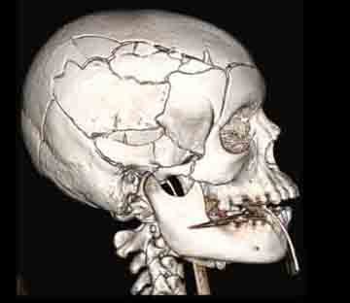
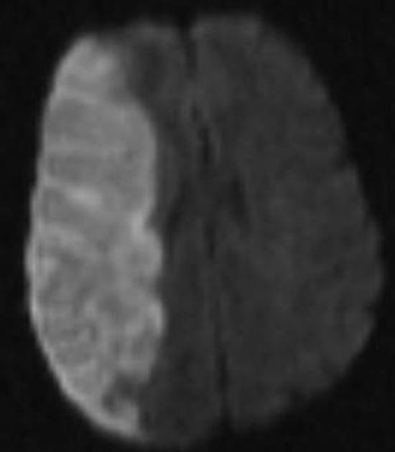
Radiology of Common Brain Diseases (RAD366)
Fahad Essbaiheen, MBBS, FRCPC, DABR
Interventional & Diagnostic Neuroradiologist
King Saud University Medical City

Slide 2
Objectives
Learn about:
Intracranial hemorrhage.
Brain ischemia.
Intracranial tumors.
Intracranial infections.

Slide 3
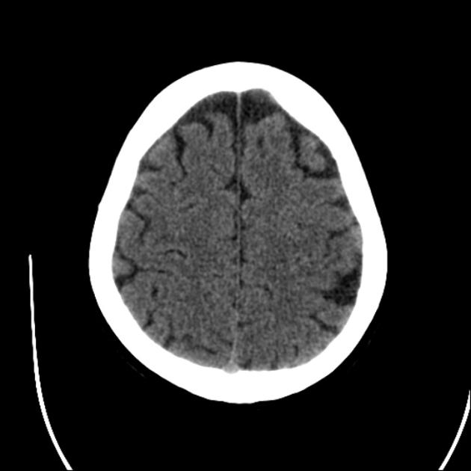
Anatomy:
Gyrus
Frontal lobe
Cerebral sulci
Parietal lobe

Slide 4
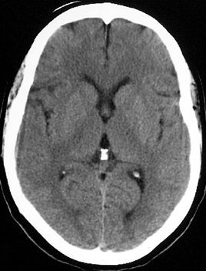
Anatomy:
Frontal lobe
Temporal lobe
Occipital lobe

Slide 5
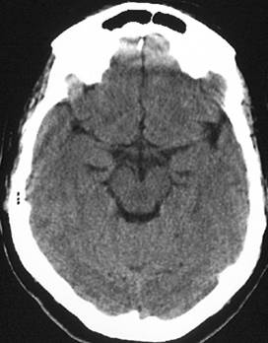
Anatomy:
Midbrain
Basal cistern
Cerebellum (vermis)

Slide 6
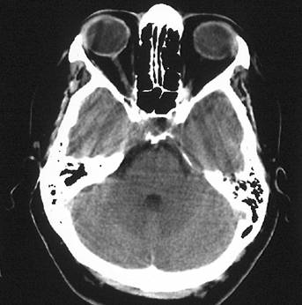
Anatomy:
Pons
Cerebellum

Slide 7
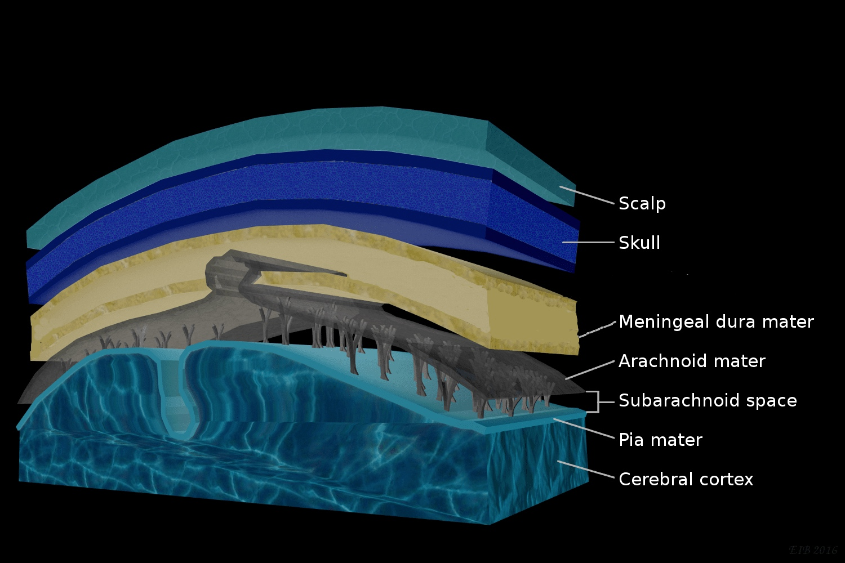
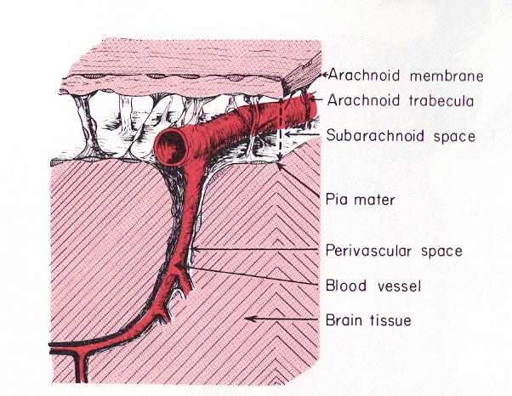
Anatomy:

Slide 8
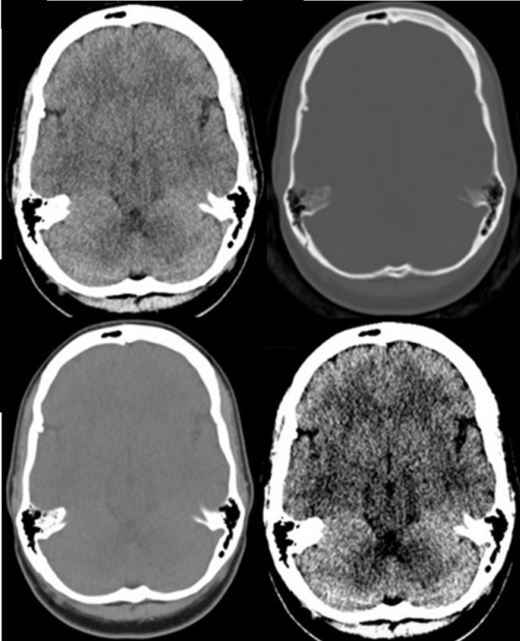
Windowing:
Brain window
(W 80, L 40)
Bone window
(W 3000, L 500)
Subdural / soft tissue window
(W 260, L 80)
Stroke window
(W 40, L 40)

Slide 9
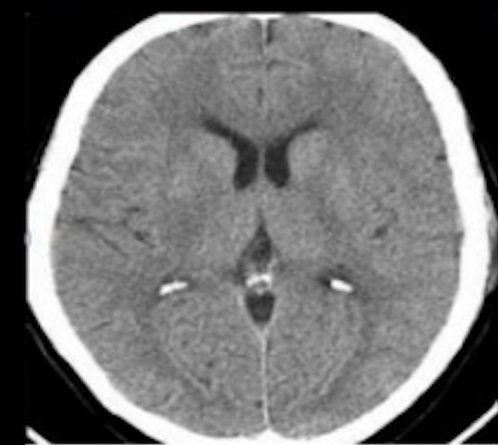
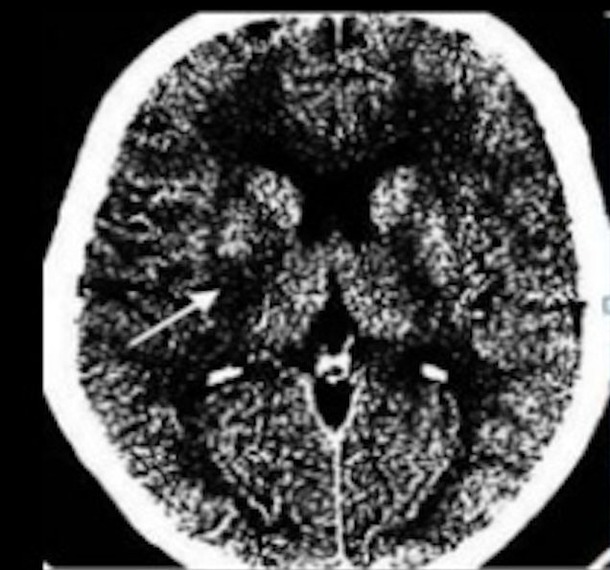
Windowing:
Stroke window
Brain window
Infarct

Slide 10
Windowing:
Brain window
Bone window
Fracture
Acute epidural hemorrhage

Slide 11
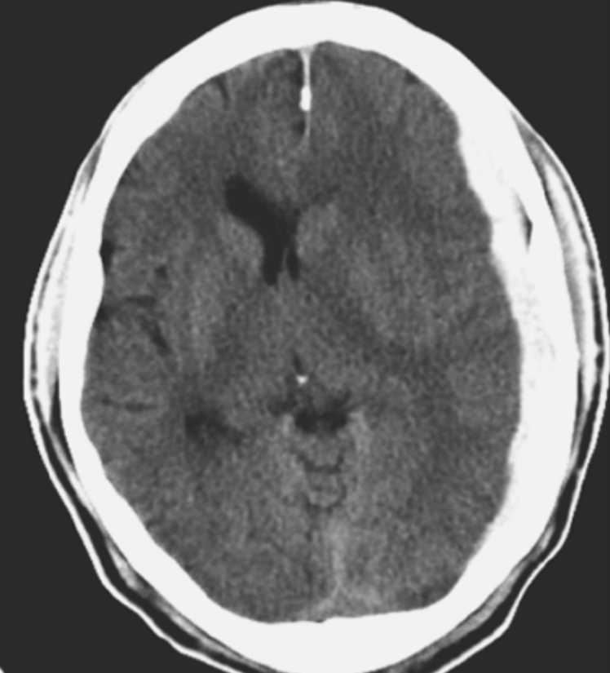
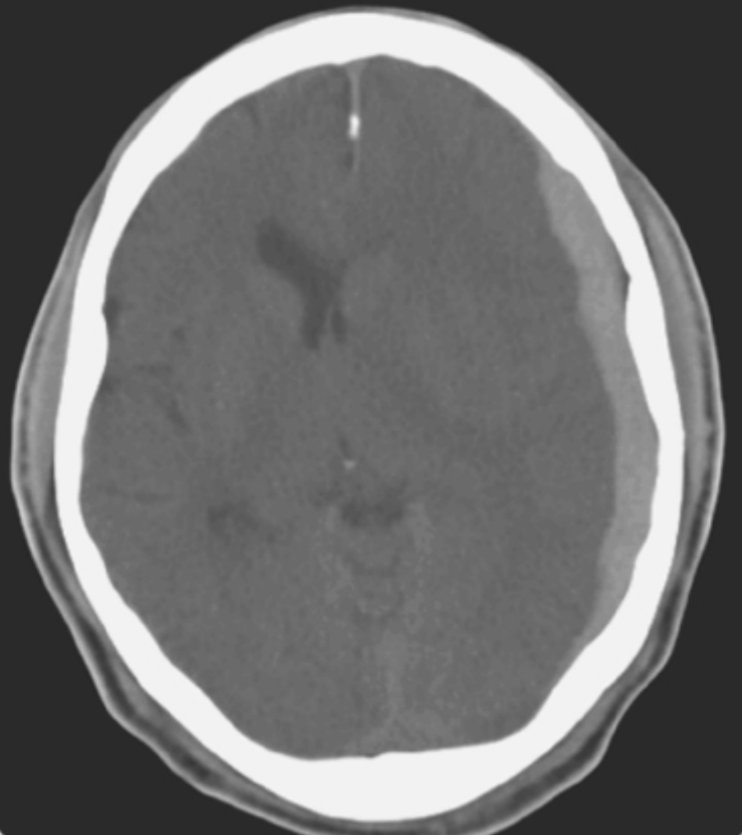
Windowing:
SDH
Brain window
Subdural / soft tissue window

Slide 12
Intracranial Hemorrhage

Slide 13
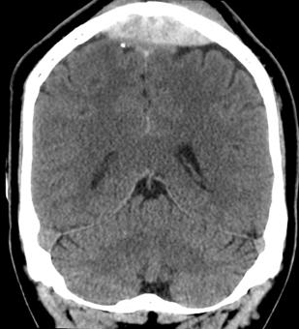
Intracranial Hemorrhage
Epidural hematoma:
Lentiform collection between the dura and skull.
Almost always traumatic.
Associated with skull fracture.
Typically arterial in nature, MMA mostly but could be from venous sinuses.
It doesn’t crosses sutures but crosses midline.

Slide 14
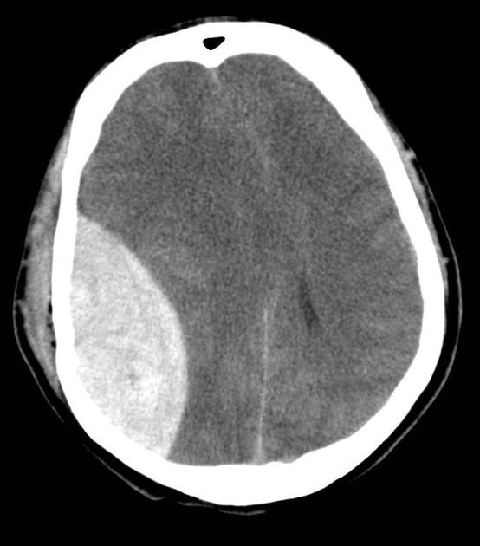
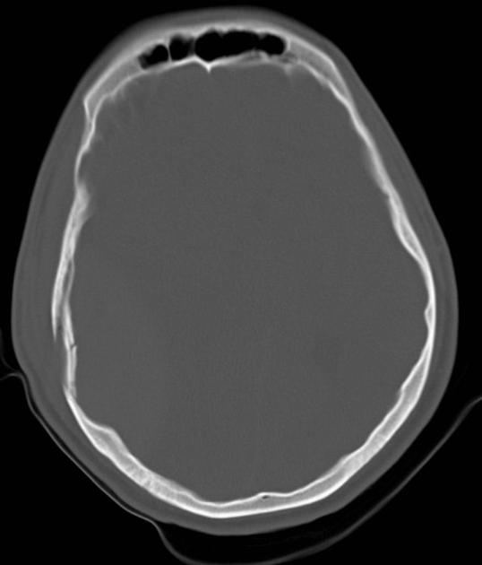
EDH
Skull fracture
Acute epidural hematoma

Slide 15
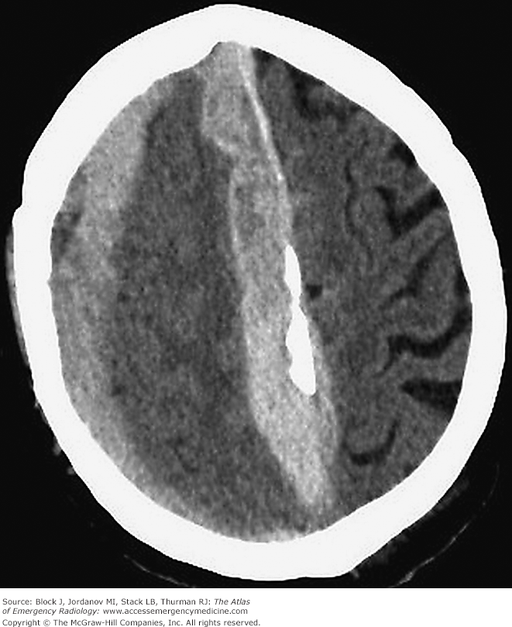
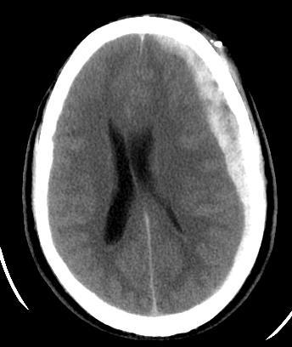
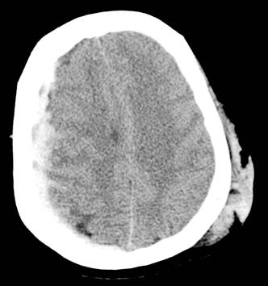
Intracranial Hemorrhage
Subdural hematoma:
Crescentic collection between the dura and arachnoid.
Usually caused by trauma.
Typically venous in nature.
It does not cross midline.
Acute SDH

Slide 16
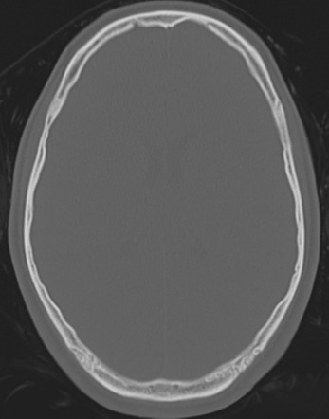
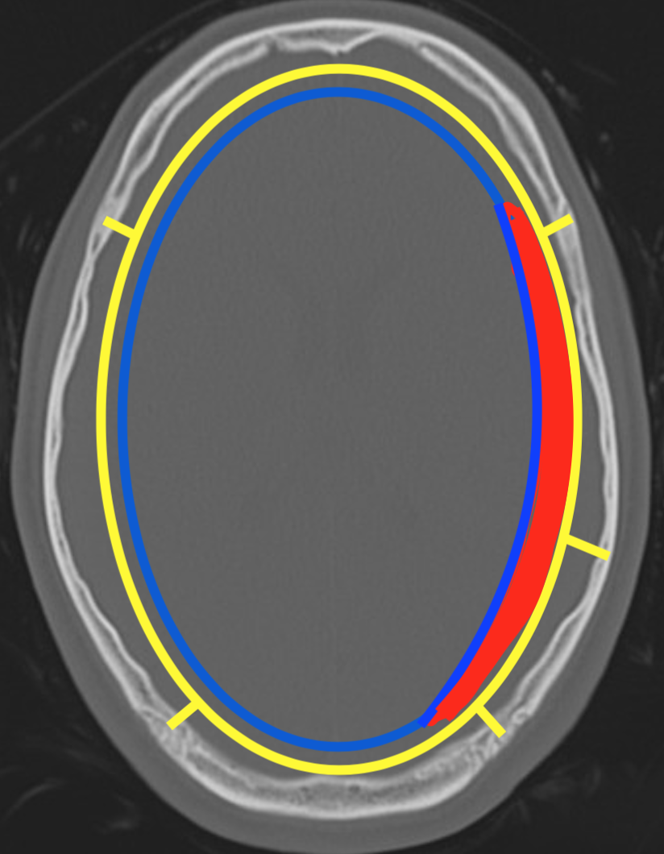
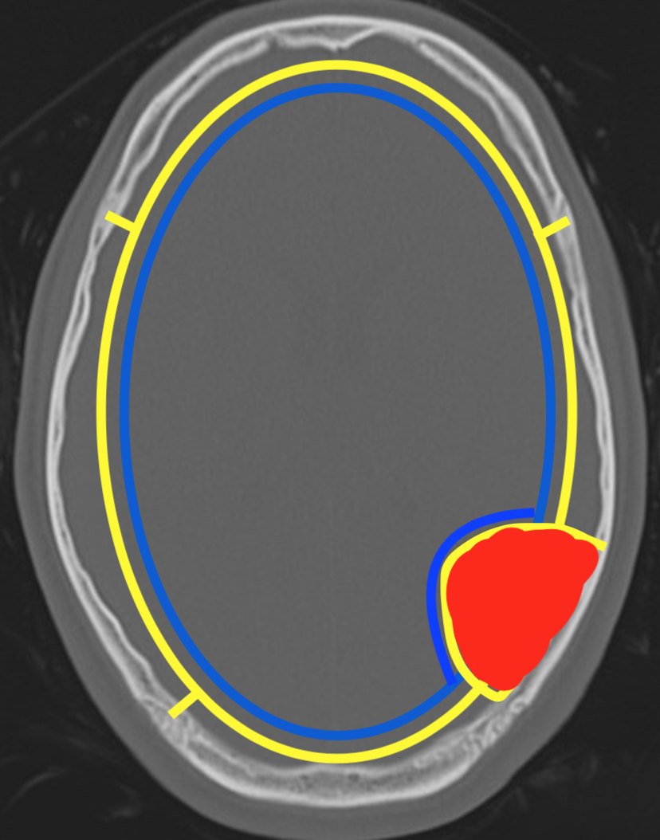
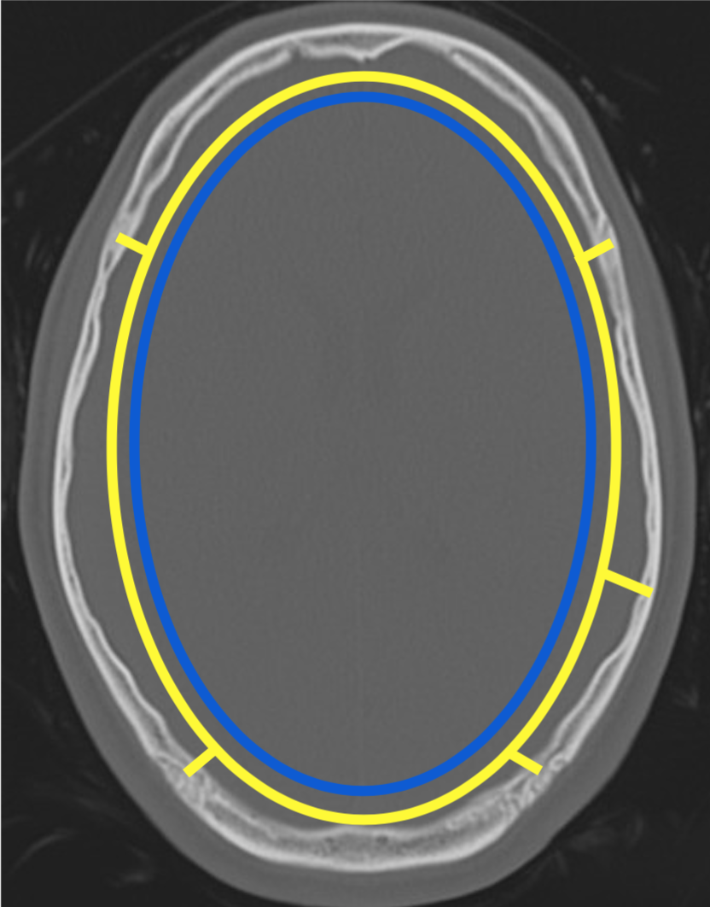
SDH vs EDH
DURA
ARACHNOID

Slide 17
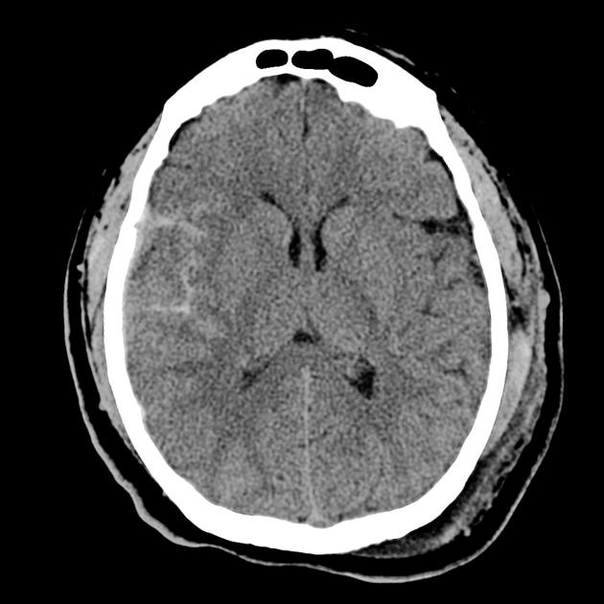
Intracranial Hemorrhage
Subarachnoid hemorrhage:
Collects between the arachnoid and pia.
Trauma is the most common cause of subarachnoid hemorrhage (SAH).
Aneurysm rupture is the most common cause of non-traumatic SAH.
No cause of SAH is seen in up to 20% of cases.
Clinically, non-traumatic SAH presents with thunderclap headache and meningismus.

Slide 18
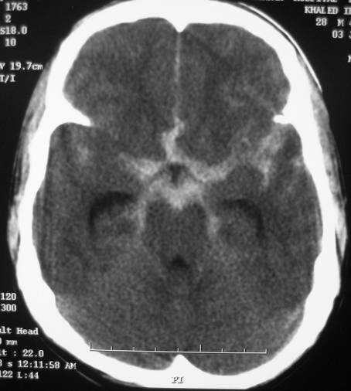
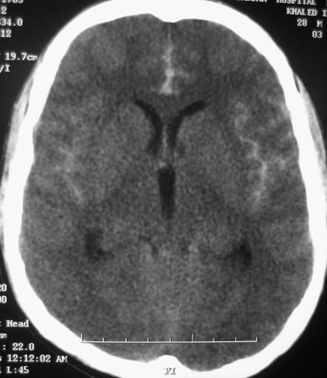
SAH

Slide 19
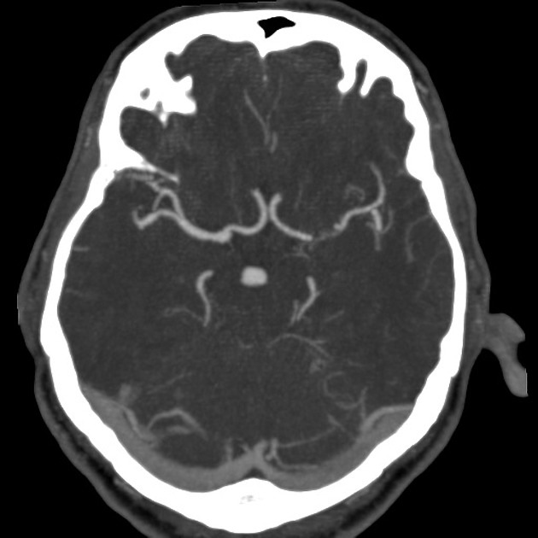
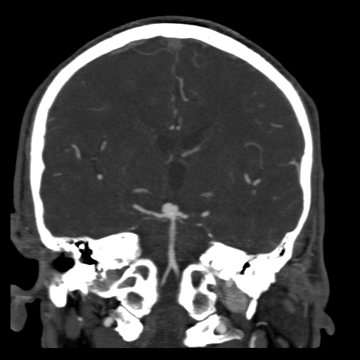
Aneurysmal SAH
Basilar tip aneurysm (5% of aneurysms)

Slide 20
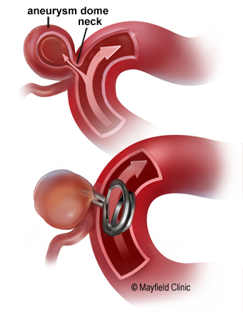
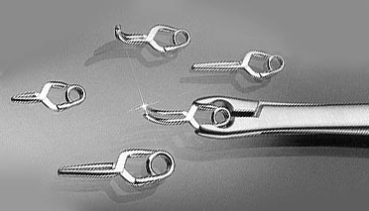
Aneurysmal SAH
Treatment of intracranial aneurysms
Surgical clipping

Slide 21
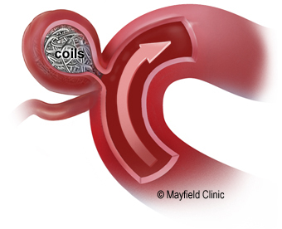
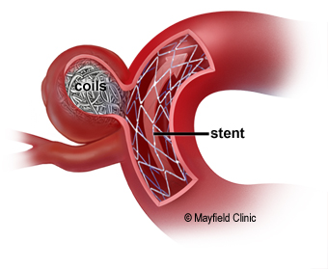
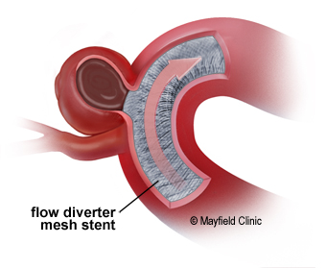
Aneurysmal SAH
Endovascular treatment of intracranial aneurysms
Stent-assisted coiling
Flow diverter stenting
Coiling

Slide 22
Aneurysmal SAH
Endovascular treatment of intracranial aneurysms
Before
During
After

Slide 23
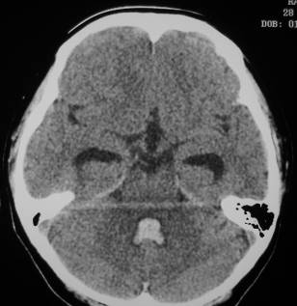
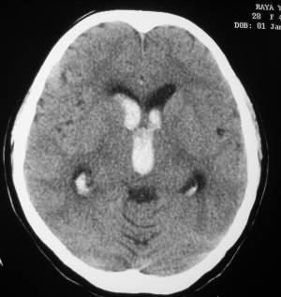
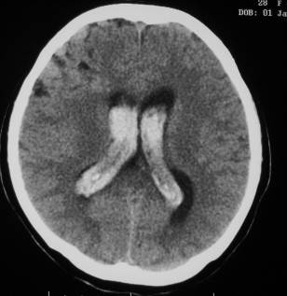
Intraventricular hemorrhage

Slide 24
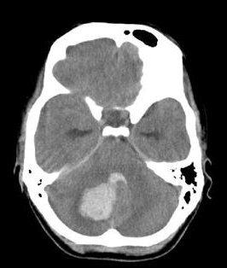
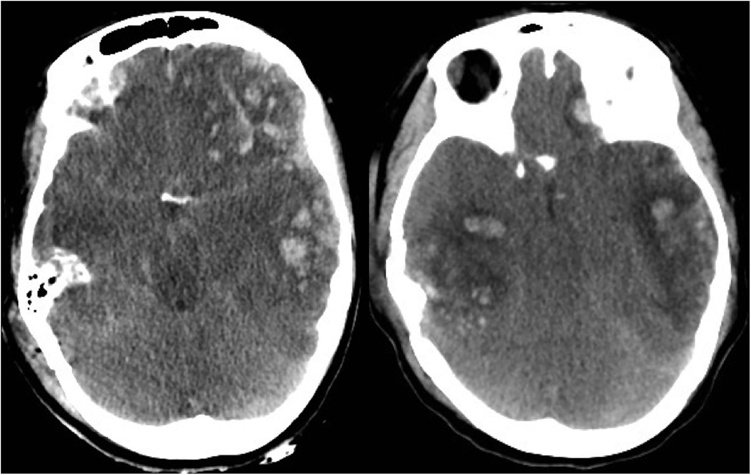
Parenchymal hemorrhage
Can be caused by trauma
Other causes include:
Hypertension.
AVM malformations.
Cerebral amyloid angiopathy.

Slide 25
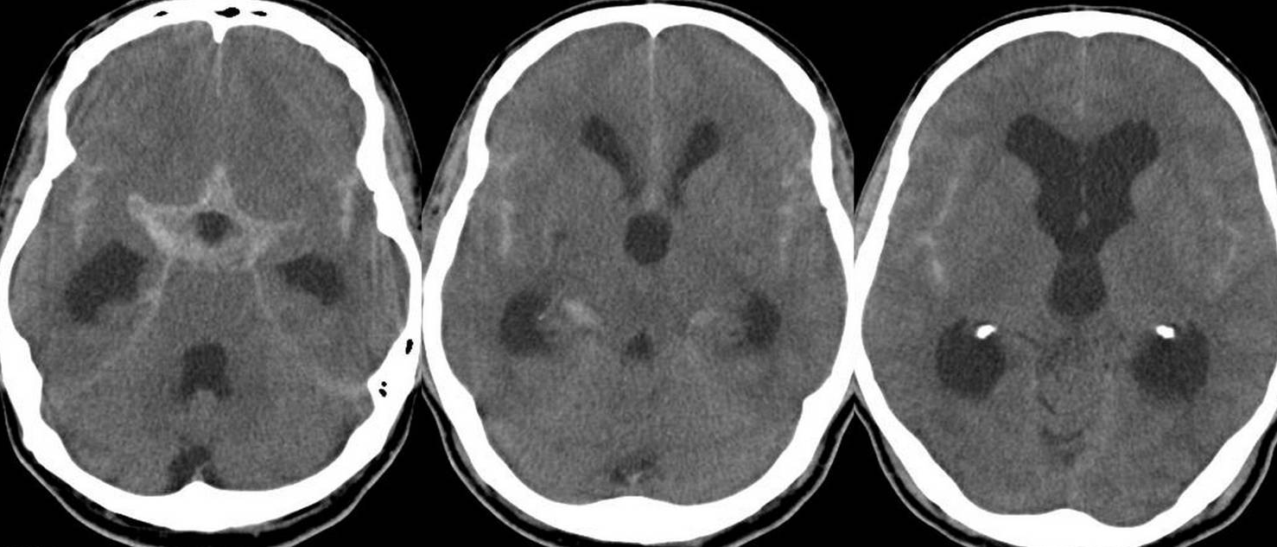
Intracranial Hemorrhage
Complication:
Acute hydrocephalus

Slide 26
Brain Ischemia

Slide 27
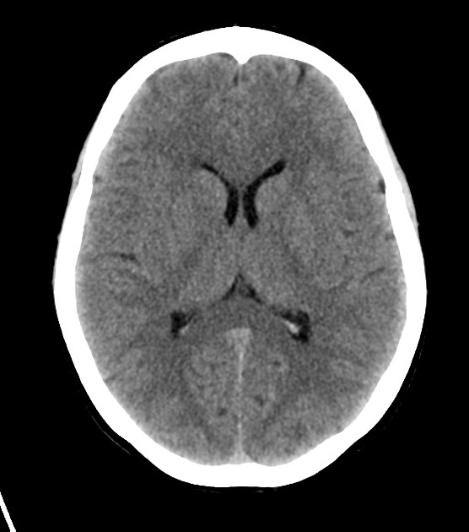
Ischemic stroke
What will you see on head CT immediately after and ischemic stroke?
Normal head CT

Slide 28
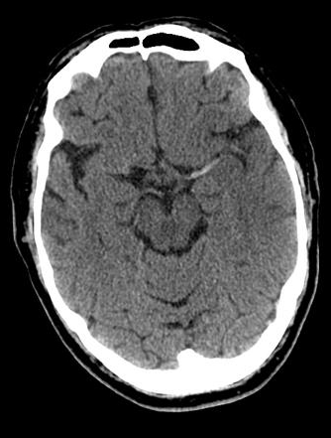
Ischemic stroke
What will you see on head CT in the HYPERACUTE phase?
Hyperdense sign

Slide 29
Ischemic stroke
Middle cerebral artery
Notes:
Rule out ICH and large stroke

Slide 30
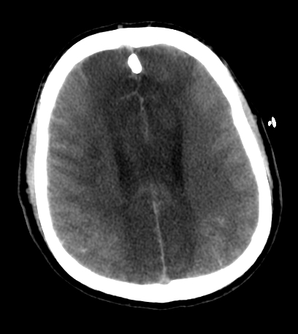
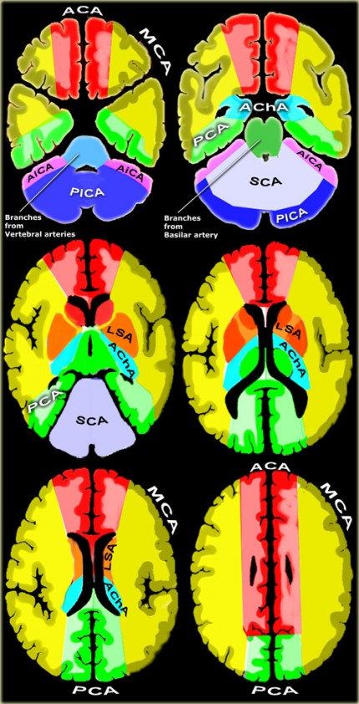
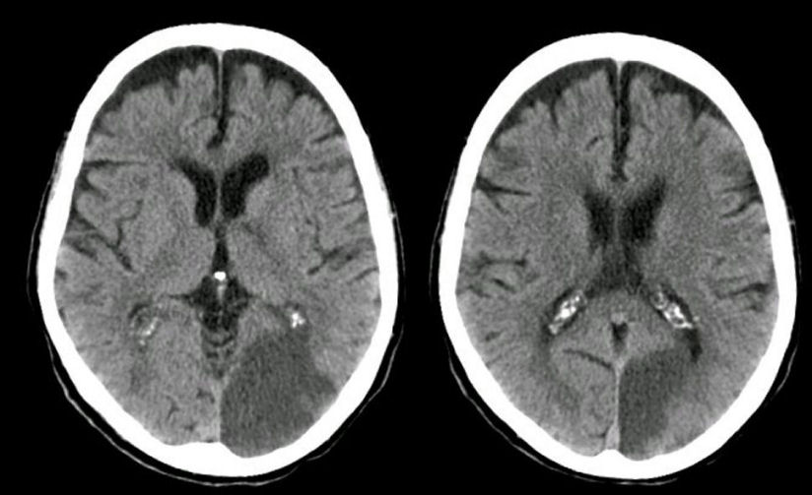
Ischemic stroke
ACA
PCA
http://www.radiologyassistant.nl

Slide 31
Ischemic stroke
Where is the stroke?
CT
MRI

Slide 32
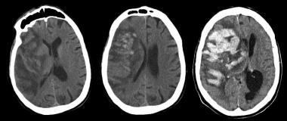
Ischemic stroke
Complications:
Hemorrhagic transformation
24 hours after onset
Next day
A few hours after

Slide 33
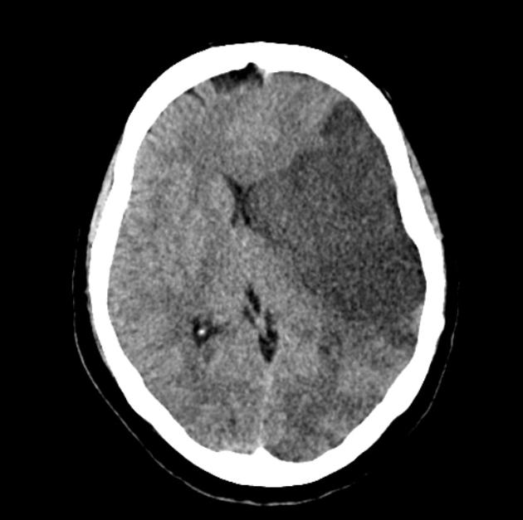
Ischemic stroke
Complications:
Malignant stroke
Decompressive craniectomy

Slide 34
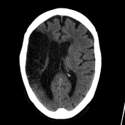
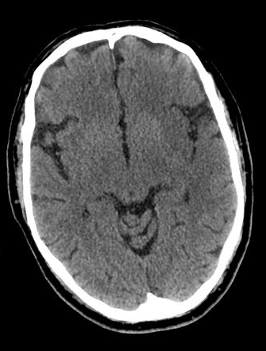
Ischemic stroke
3 Hrs
12 Hrs
3 Days
3 months

Slide 35
Intracranial Tumors

Slide 36
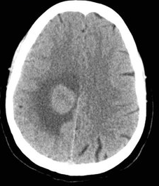
Intracranial Tumors
Extra-axial
Intra-axial

Slide 37
Intracranial Tumors
Extra-axial masses:
Meningioma.
Cranial nerve schwannoma.
Metastasis.
Intra-axial masses:
Metastasis.
Glioblastoma.
Astrocytoma.

Slide 38
Intracranial Infections

Slide 39
Intracranial Infections
Headache, fever and neck stiffness.
Enhancing meninges.
Bacterial meningitis.

Slide 40
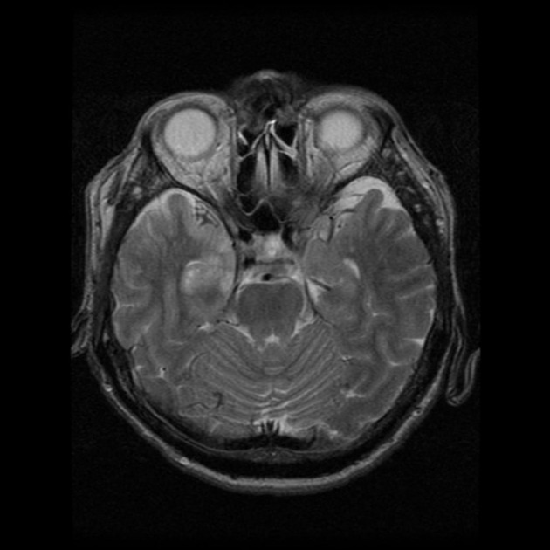
Intracranial Infections
Headache, fever and decreased level of consciousness.
Abnormal signal in the temporal lobe.
Herpes Encephalitis

Slide 41
Intracranial Infections
Headache and fever.
Ring-enhancing lesion.
Brain Abscess

Slide 42
Questions?

Slide 43
Thank you!

