Slide 1
Interactive Lecture
of Nervous System

Slide 2
Name the normal anatomical area

Slide 5
Where is the infarction area?

Slide 6
Old CT
Recent CT

Slide 7
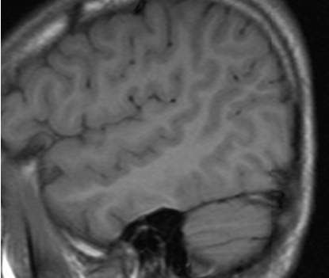
Inferior frontal gyrus
Pars opercularis,
Pars triangularis,
Pars orbitalis.
S
M
Sylvian fissure
I
Superior temporal sulcus
transverse Temporal gyri
Parieto-occipital sulcus

Slide 8
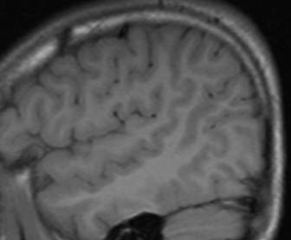
Paracentral lobule
Parieto occipital sulcus
Subcentral
Lobule
Supramarginal gyrus
Angular gyrua
Inferior parietal lobule

Slide 9
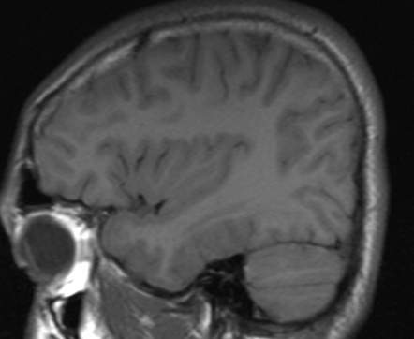
Insular cortex

Slide 10
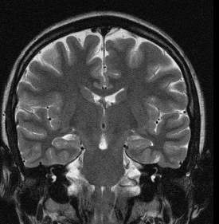
insula
Hippocampus
Parahippocampus
Lateral occipito-temporal gyrus
S;M;I,temporal gyri

Slide 11
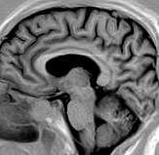
Superior frontal gyrus
Cingulate gyrus
Middle frontal gyrus
Cingulate sulcus
Callosal sulcus
Parieto occipital sulcus
Calcarine sulcus
Gyrus rectus
Striate Cortex
Medial occipitotemporal gyrus

Slide 13
Approach
to
brain
mass
Location
Pattern
Age / sex
Clinical
data
Pathological
entity

Slide 17
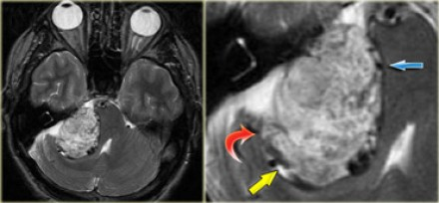

Slide 20
Arachnoid cyst low on T1WI AND HIGH ON T2WI , WITHOUT restriction on DWI

Slide 22
Epidermoid

Slide 23
Epidermoid
HIGH ON T2WI , WITH restriction on DWI

Slide 24
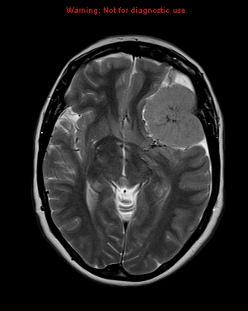

Slide 25
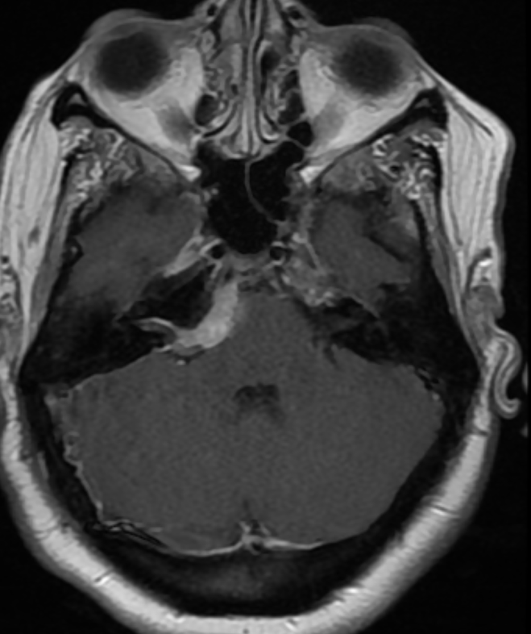
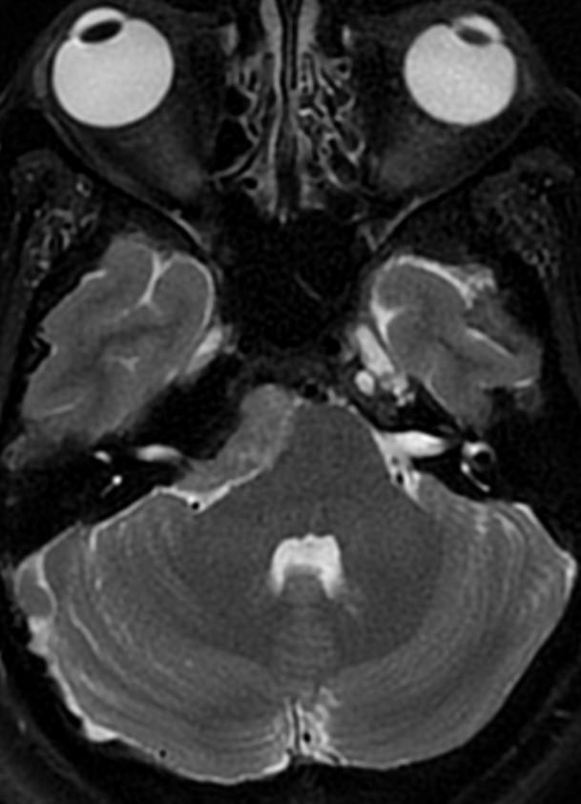

Slide 26
Glioblastoma
•
•
WHO grade IV
Most common 1ry brain
tumor and most
malignant
Can occur at any age even
neonates and infants
Cerebral hemisphere
(subcortical,
periventricular and across
compact tract. Basal
ganglia and thalamus.
•
•
•
•

Slide 27
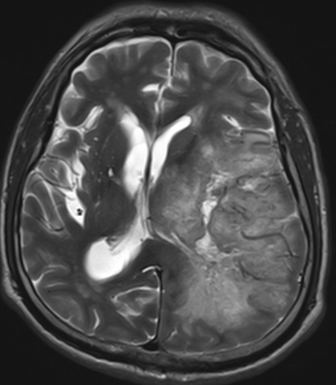
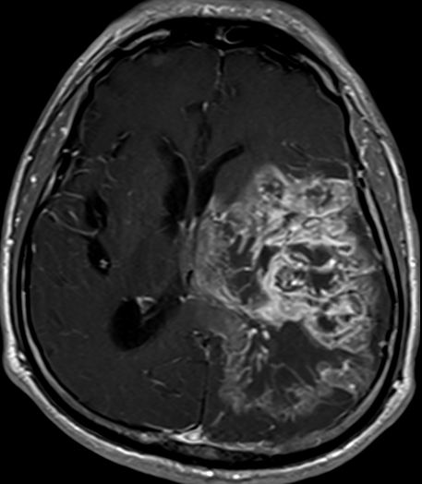

Slide 28
GBM

Slide 29
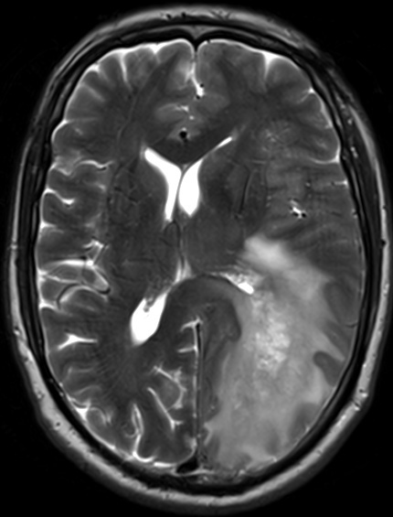
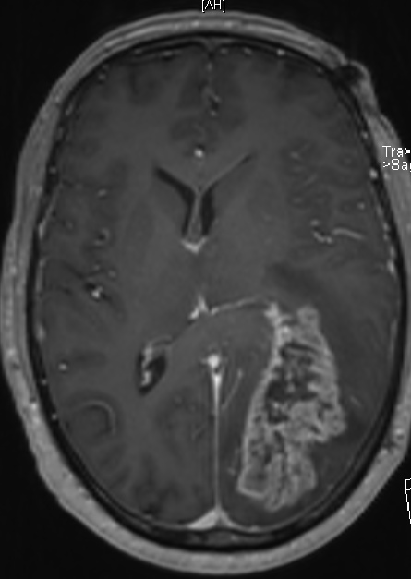
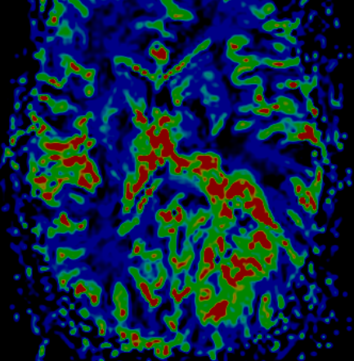

Slide 30
Linear nodular central areas of enhancement with thicker peripheral enhancement
Very high rCBV values on perfusion MRI in enhancing part with intermediate perfusion values in immediate surrounding non-enhancing areas indicating tumor infiltration
Also look for diffusion restricted areas corresponding to enhancement

Slide 36
Brain abscess

Slide 39
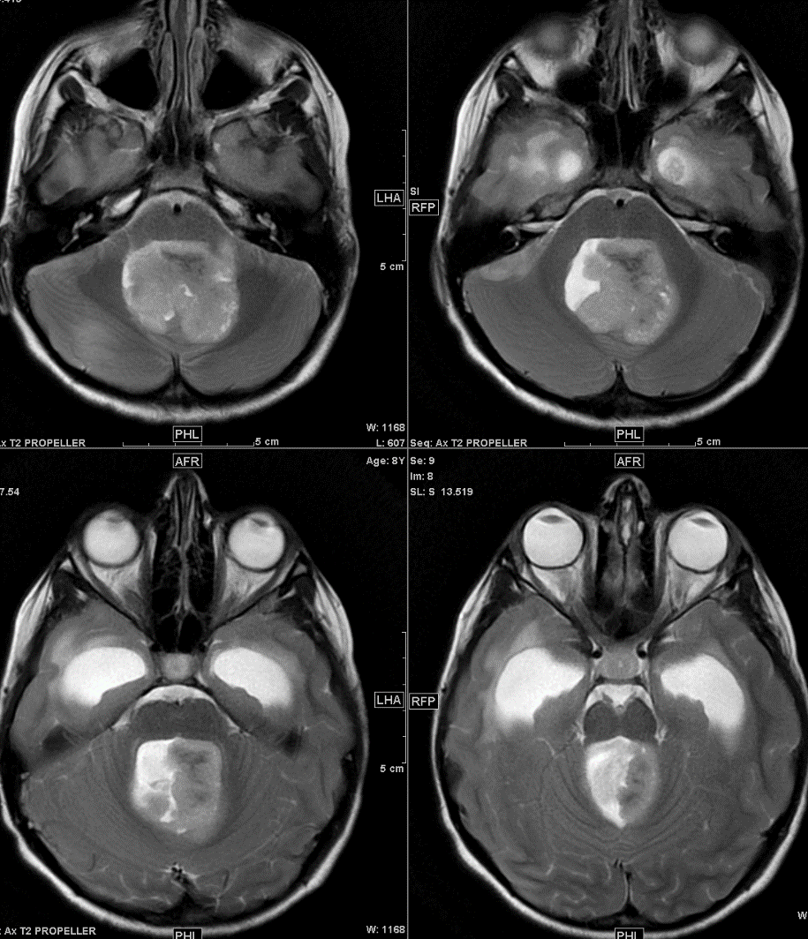
Medullobalstoma
Medulloblastomas are the most common malignant brain tumor of childhood. They most commonly present as midline masses in the roof of the 4th ventricle with associated mass effect and hydrocephalus.

Slide 40
Medullobalstoma
Medulloblastomas
On CT, medulloblastomas often appear as a mass arising from the vermis, resulting in effacement of the fourth ventricle / basal cisterns and obstructive hydrocephalus. They can also occur more laterally in the cerebellum.

Slide 41
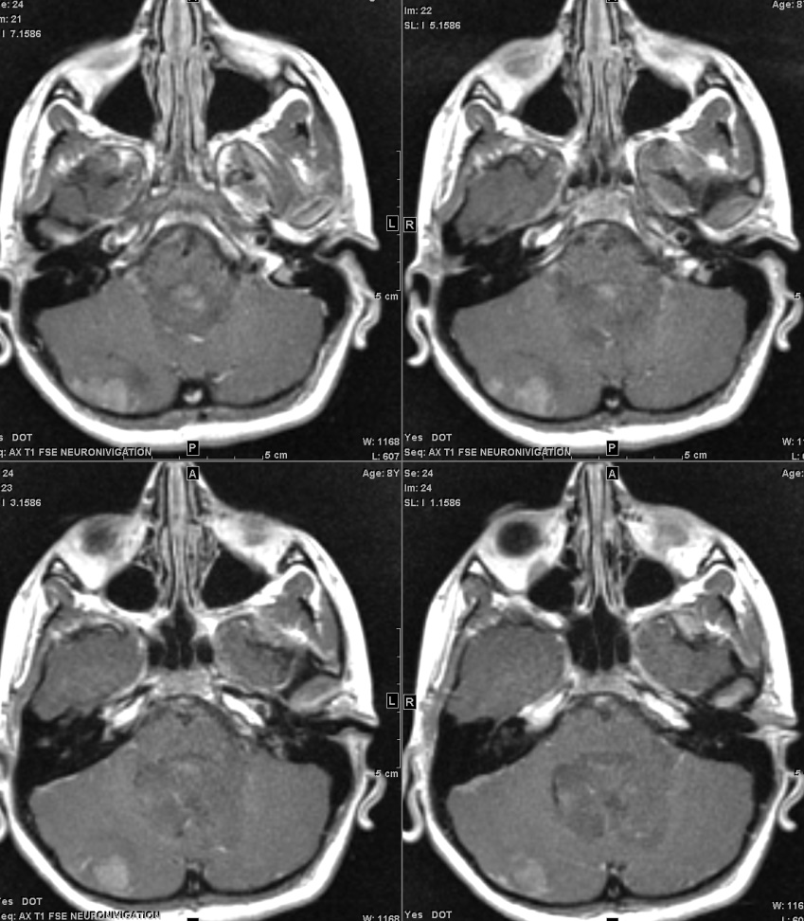
Treatment typically consists of surgical resection, radiation therapy, and chemotherapy. In general, the tumors are quite radiosensitive.

Slide 42
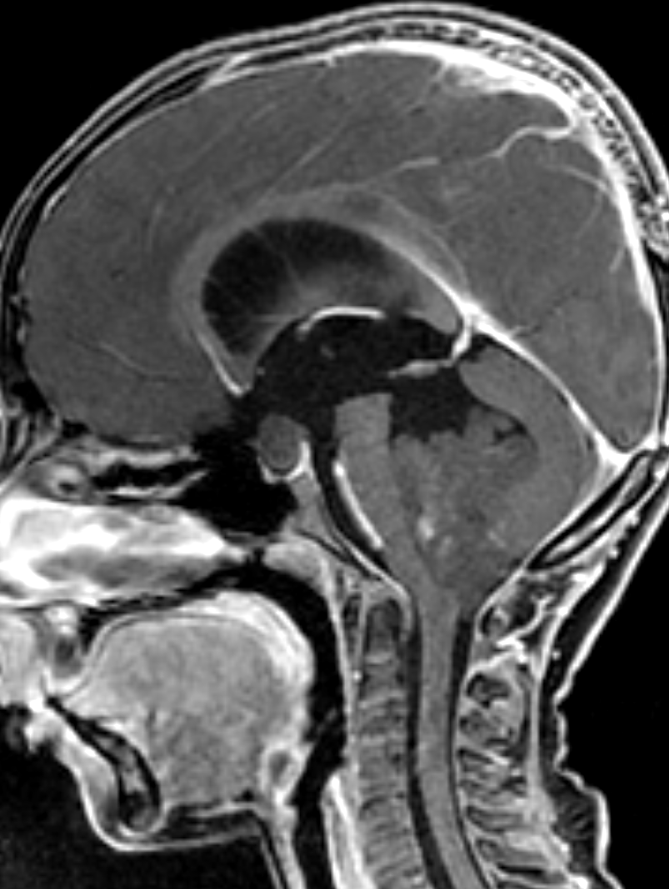

Slide 43
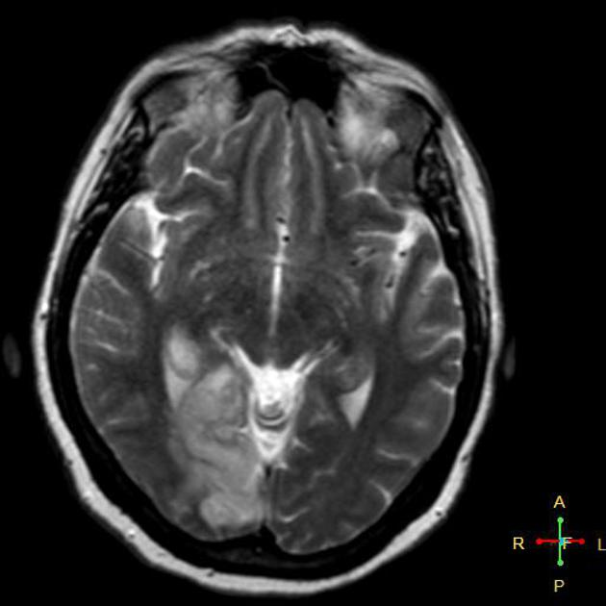
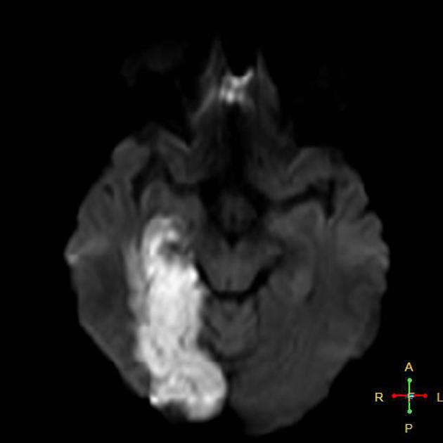

Slide 44
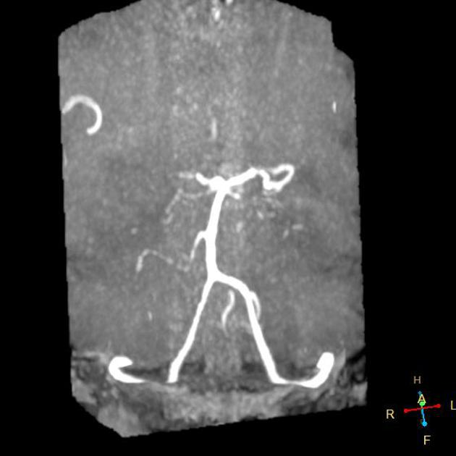
Acute PCA territory cerebral infarction

Slide 45
Right occipital gyral swelling and altered signal in cortical and subcortical area exhibiting restricted diffusion in DWI, bright signal in T2.
MRA reveals occluded P1 segment of right PCA.
Diagnosis: Right PCA territory acute cerebral infarction.

Slide 46
The abnormalities on this MRI are due to:

Slide 47
The abnormalities on this MRI are due to:
Multiple sclerosis → not corrected because in this image
most of the abnormality is seen in gray matter and MS is a
white matter disease.
Brain tumor: no the lesion is bilateral and cortical
Meningitis, no the lesion cortical

Slide 48
Herptic encephalitis

