Slide 1
Breast disease
Dr.Amal Al-Abdulkareem

Slide 2
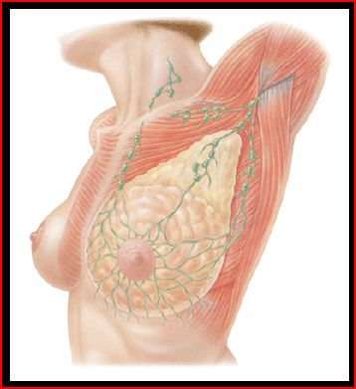
Breast Modified Sebaceous Glands
Upper border
- Clavicle
Lower border. - 6th or 7th rib.
Inner Border - Edge of sternum.
Outer border
- Mid-axillary line.

Slide 3
External Anatomy of the Breast
Nipple -Pigmented, Cylindrical -4th inter-costal space * at age 18
Areola -Pigmented area surrounding nipple
Glands of Montgomery -Sebaceous glands within the areola -Lubricate nipple during lactation

Slide 4
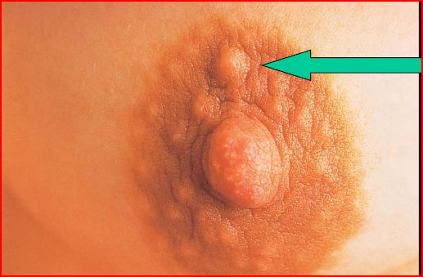
Montgomery’s Tubercles
Blocked Montgomery Tubercle

Slide 5
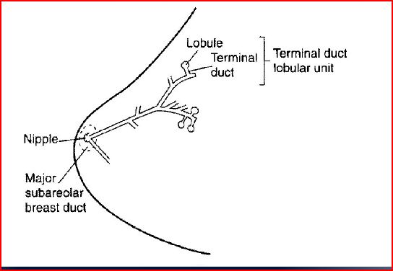
Terminal Lobular Unit and Branching Systems of Ducts

Slide 6
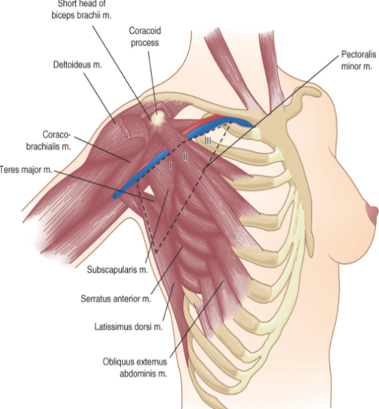
Anatomy
Axillary lymph nodes defined by pectoralis minor muscle:
- Level 1 – lateral - Level 2 – posterior - Level 3 – medial
Long Thoracic Nerve
- Serratus anterior
Thoracodorsal Nerve
- Latissimus Dorsi
Intercostalbrachial Nerve
- Lateral cutaneous - Sensory to medial arm & axilla

Slide 7
Tissue Types
Glandular Tissue - Milk producing tissue
Fibrous. connective Tissue
Fatty Tissue

Slide 8
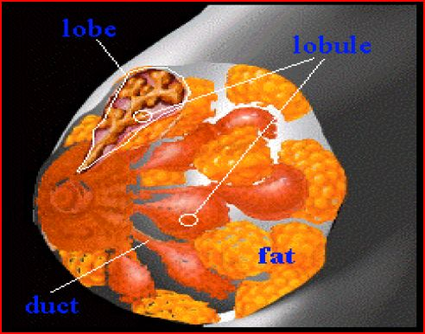
Internal Anatomy of the Breast

Slide 9
Fibrous Tissue
Cooper’s Ligaments -Suspensor ligaments
- Extending through the breast to underlying muscle - Benign or malignant lesions may affect these ligament - Skin retraction or dimpling

Slide 10
Fatty Tissue
Subcutaneous and retro-mammary fat
Bulk of breast.
No fat beneath areola and nipple

Slide 11
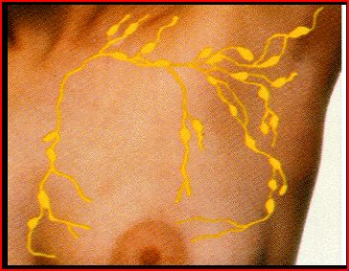
Lymph Nodes
Most drain towards axilla.
Superficial lymphatic nodes drain skin .
Deep lymphatic nodes drain mammary lobules

Slide 12
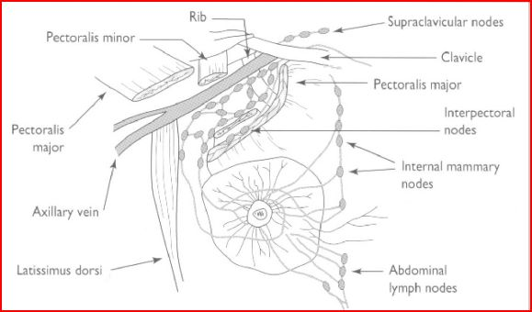
Lymph Drainage of Breast

Slide 13
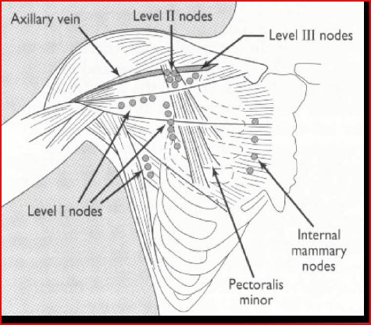
Levels of Axillary Nodes

Slide 14
Lymph Nodes
Palpate ALL nodes
Axillary
Supraclavicular
Infra-clavicular
Nodes deep in the chest or abdomen

Slide 15
Clinical Breast Exam

Slide 16
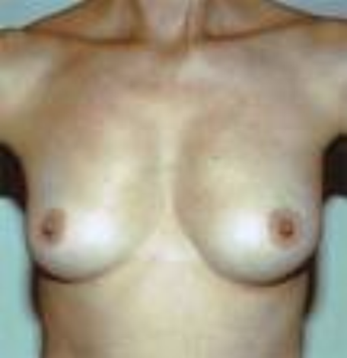
Clinical Exam
Inspection
Skin
Symmetry
Masses
- contour
Palpable
Gland
Axilla, Supraclavicular spaces
Nipple-areola complex

Slide 17
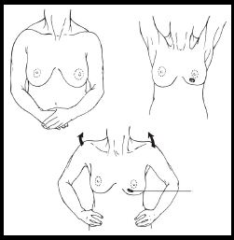
Inspect Both Breasts

Slide 18
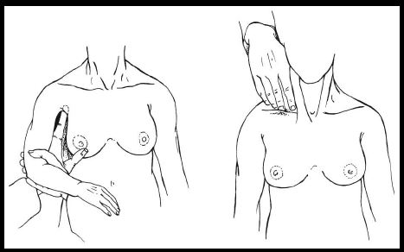
Palpate Axilla and Clavicular Nodes

Slide 19
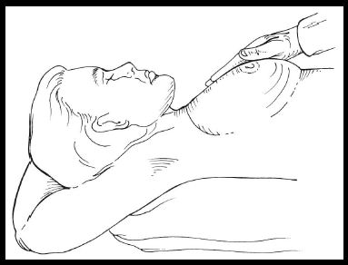
Breast Palpation

Slide 20
Normal Variations of Breast
Accessory breast tissue.
Supernumerary nipples.
Hair
Lifelong Asymmetry

Slide 21
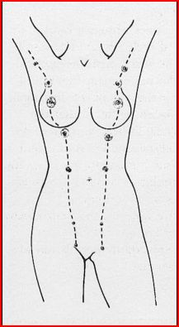
Milk Lines Sites of Accessory Nipples and Breasts

Slide 22
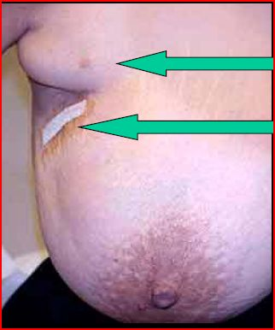
Accessory Beast Tissue
Accessory Tissue
Biopsy

Slide 23
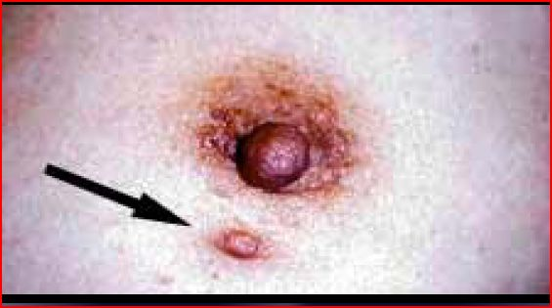
Accessory Nipple

Slide 24
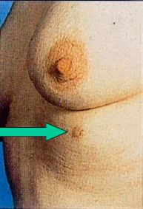
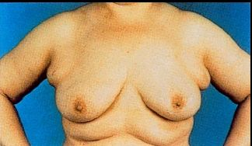
Accessory Nipple and Bilateral Accessory Breasts

Slide 25
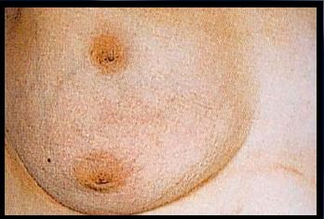
Breast with Two Nipples

Slide 26
Breast Hair

Slide 27
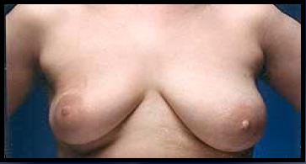
Breast Asymmetry

Slide 28
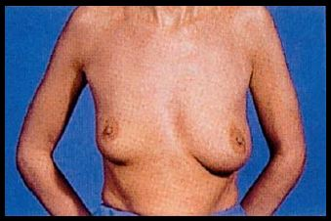
Breast Asymmetry

Slide 29
Skin Dimpling and Change in Contour
Dimpling due to Carcinoma
Change in contour due to carcinoma

Slide 30
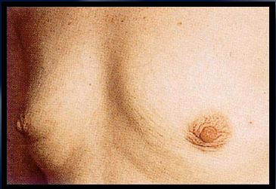
Skin Dimpling Both Breasts Involution Due to Aging

Slide 31
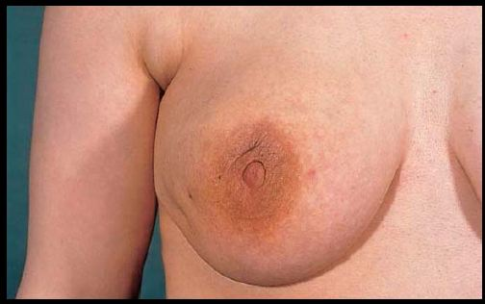
Skin Dimpling Breast Infection

Slide 32
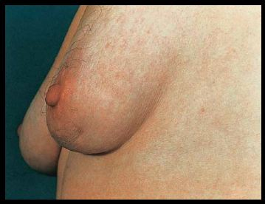
Skin Dimpling Previous Breast Surgery

Slide 33
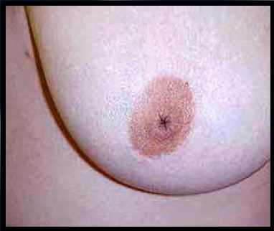
Inverted Nipple Since Puberty

Slide 34
Common Benign Breast Disorders

Slide 35
Common Benign Breast Disorders
Fibrocystic changes
Fibroadenoma
Intraductal papilloma
Mammary duct ectasia
Mastitis. Breast abscess
galactocele
Fat necrosis
cyst simple or complicated
Phylloides tumor
Male gynecomastia

Slide 36
Benign breast disease
Breast adenoma
Lipoma
Sebaceous cyst
Skin papilloma

Slide 37
Fibrocystic Changes
Lumpy breasts
Pain is common complain
Age 30-40
Caused by hormonal changes prior to menses

Slide 38
Fibrocystic Disease
Histology
Adenosis
Apocrine metaplasia
Fibrosis
Duct ectasia

Slide 39
Signs and Symptoms
Cysts with well-defined margins
Singular or multiple
May be symmetrical
Upper outer quadrant

Slide 40
Signs and Symptoms
Pain and tenderness
Cysts may appear quickly and decrease in size
Lasts half of a menstrual cycle
Subside after menopause

Slide 41
Breast Mass
Breast Cysts
Fluid-filled
50% multiple and recurrent
-ultrasound is diagnostic
Hormonally influenced
Needle aspirated

Slide 42
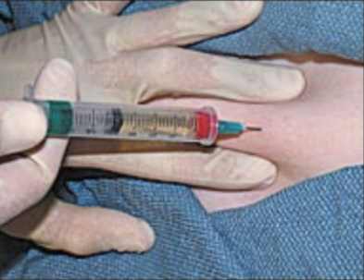
Breast Mass

Slide 43
Treatment
Aspirate cyst fluid
Treatment based on symptoms
Reassure
‘’Atypical Hyperplasia’’ on pathology report indicates increased risk of breast cancer

Slide 44
Breast Pain
Cyclical pain – hormonal
Dull, diffuse and bilateral
Treatment: Reassurance, NSAIDS,
Non-cyclical pain
Non-breast vs breast
Imaging
Treatment: Reassurance, NSAIDS,

Slide 45
Fibroadenoma
Second most common breast condition
Late teens to early adulthood
Rare after menopause

Slide 46
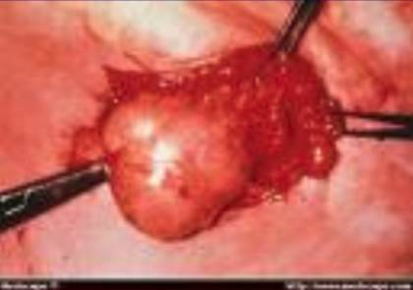
Fibroadenoma

Slide 47
Signs and Symptoms
Firm, rubbery, round, mobile mass
Painless, non-tender
Solitary can be multiple
Well circumscribed
Upper-outer quadrant
1-5 cm or larger

Slide 48
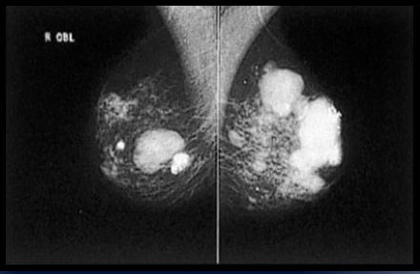
Mammogram Multiple Calcified Fibroadenomas

Slide 49
Indication for surgery
1-more than 4 cm
2- phylloides
3- painful
4- un usull age
5- unclear pathology
6- +VE family history
7-no access for medical follow up
8-giant fibroadenoma

Slide 50
Intraductal Papilloma
Slow-growing
Overgrowth of ductal epithelial tissue
Usually not palpable
Most common cause of bloody nipple discharge
40-50 years of age

Slide 51
Signs and Symptoms
Watery, serous, serosanguinous, or bloody discharge
Spontaneous discharge
Usually unilateral
Often from single duct - Pressure elicits discharge from single duct
50% no mass palpated

Slide 52
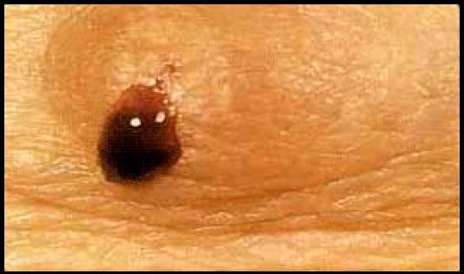
Bloody Breast Discharge

Slide 53
Treatment
Test for occult blood
Ductogram
Biopsy
Excision of involved duct

Slide 54
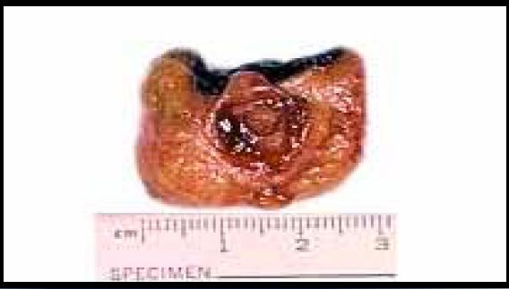
Intraductal Papilloma

Slide 55
Mammary Duct Ectasia
Inflammation and dilation of sub-areolar ducts
behind nipples
May result in palpable mass
Greatest incidence after menopause
Etiology Unclear - Ducts become distended with cellular debris causing obstruction

Slide 56
Mammary Duct Ectasia versus Breast Cancer
Left breast – slit-like nipple characteristic of mammary duct eclasia
Right breast – nipple retraction from carcinoma

Slide 57
Signs and symptoms
Multi-colored discharge - Thick, pasty (like toothpaste) - White, green, greenish-brown or serosanguinous
Intermittent, no pattern
Bilaterally from multiple ducts
Nipple itching

Slide 58
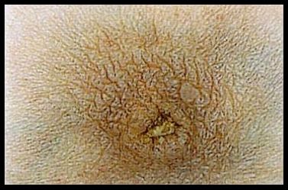
Dried Secretions from Mammary Duct Ectasia

Slide 59
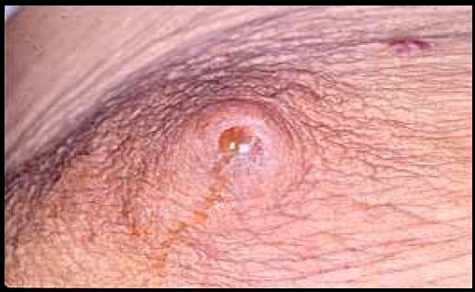
Yellow Breast Discharge Duct Ectasia

Slide 60
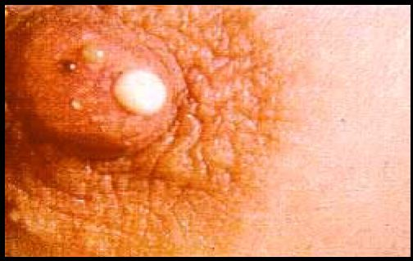
Multi-colored Breast Discharge

Slide 61
Treatment
Test for occult blood
Imaging - Mammogram - Sonogram
Antibiotics if there is infection

Slide 62
Mastitis
Breast infection when bacteria enter the breast via the nipple
Ducts infected
Fluid stagnates in lobules
Usually during lactation
Staphylococcus common cause

Slide 63
Mastitis
Treatment
Antibiotics
Continue breast feeding
Close follow-up

Slide 64
Puerperal Mastitis

Slide 65
Puerperal Mastitis Left Breast

Slide 66
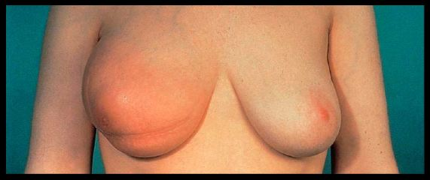
Inflammatory Carcinoma
Erythema and peau d’orange

Slide 67
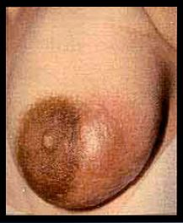
Signs and Symptoms of abscess
Pain
Nipple discharge
Localized induration
Fever
Breast Abscess

Slide 69
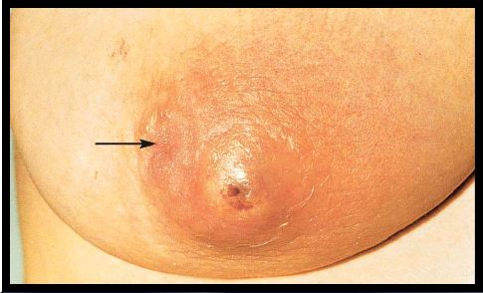
Non-Lactating Breast Abscess
Arrow points to inverted nipple

Slide 70
Breast Abscess
Treatment
Antibiotics
Needle aspiration
Incision and drainage

Slide 72
Puerperal Breast Abscess
Before treatment
Local anesthetic
After treatment
Abscess occurred during lactation

Slide 73
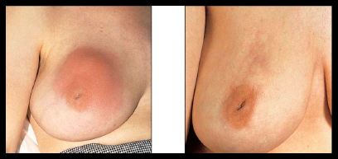
Breast Abscess
Left – before management
Right – after recurrent aspiration and antibiotics

Slide 74
Fat Necrosis
Cause - Trauma to breast - Surgery
Necrosis of adipose tissue
Pain or mass - Usually non-mobile mass - Resolves over time without treatment -may be excised

Slide 75
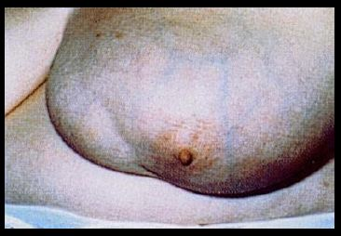
Fat Necrosis
Seat Belt Trauma

Slide 76
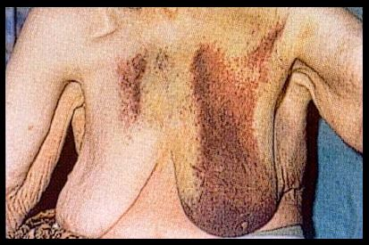
Breast Hematoma

Slide 77
Phylloides Tumor
Giant fibroadenoma with rapid growth
Malignant potential
Often occurs in women aged 40+
Treatment - Excision

Slide 78
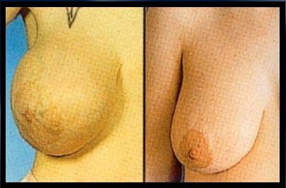
Giant Fibroadenoma
Before Surgery
After Surgery

Slide 79
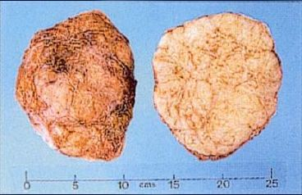
Cross Section of Giant Fibroadenoma

Slide 80
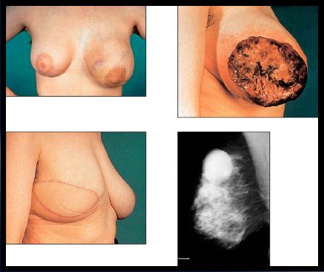
Malignant Phylloides Tumor

Slide 81
galactocele
Galactocele is a cyst containing milk
There is pain but no fever
Ultrasound is diagnostic
Needle aspiration

Slide 82
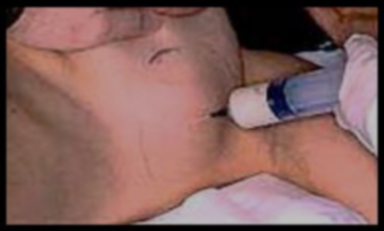
Draining Breast Abscess

Slide 83
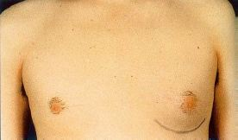
Left-Sided Gynecomastia

Slide 84
Treatment
If pre-puberty - Wait to see if it resolves
Change medication
Treat underlying illness
Occurs in families with genetic mutation - Colon, prostate cancer

Slide 85
Differential Diagnosis of Nipple Discharge
Common causes in non-pregnant women
Carcinoma
Intraductal papilloma
Fibrocystic changes
Duct ectasia
Hypothyroid
Pituitary adenoma

Slide 86
Galactorrhea

Slide 87
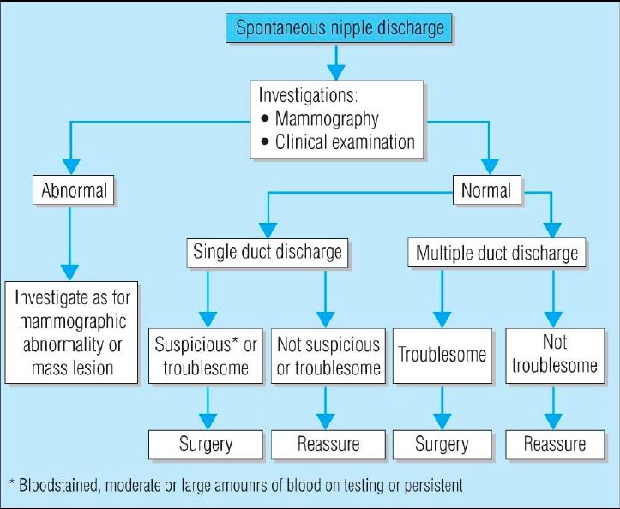

Slide 88
Clinical Characteristic
Physiologic - Usually bilateral - Multiple ducts - by squeezing the nipple

Slide 89
Physiological Breast Discharge

Slide 90
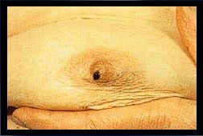
Clinical Characteristic
Pathologic discharge - Spontaneous - Unilateral - Single duct - Discolored discharge
Bloody discharge

Slide 91
Bloody Nipple Discharge

Slide 92
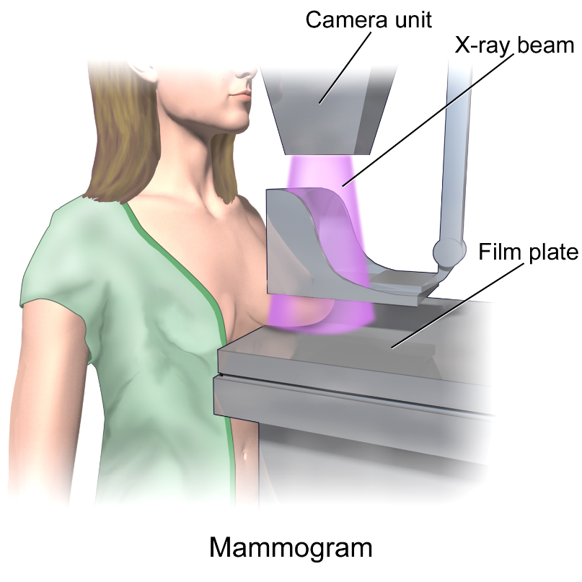
Mammography
Screening tool - Age of 40
Estimated reduction in mortality 15 – 25%
Densities and calcification

Slide 93
Calcification
Macrocalcifications - Large white dots - Almost always non-cancerous and require no further follow-up
Microcalcifications
- Very fine white specks - Usually non-cancerous but can sometimes be a sign of cancer
- Size, shape and pattern

Slide 97
BI-RADS Classification | Features
0 | Need additional imaging
1 | Negative – routine in 1 year
2 | Benign finding – routine in 1 year
3 | Probably benign – 6 month follow-up
4 | Suspicious abnormality – biopsy recommended
5 | Highly suggestive of malignancy – appropriate action must be taken

Slide 98
Ultrasound
Benign | Malignant
Pure hyperechoic | Hypoechoic, spiculated
Elliptical shape (wider than tall) | Taller than wide
Lobulated | Duct extension
Complete tine capsule | Microlobulation

Slide 99
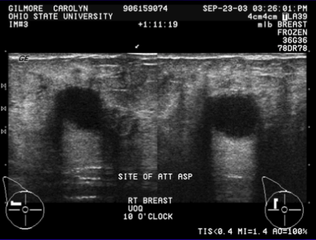
Ultrasound

Slide 100
MRI
High risk patients - History of breast cancer - LCIS, atypia - 1st degree relative with breast cancer - Very dense breast
High sensitivity

Slide 101
Diagnosis
Fine needle aspiration - Cytology
Core biopsy
- Image guided - Stereotactic
Excisional biopsy - Needle localization

Slide 102
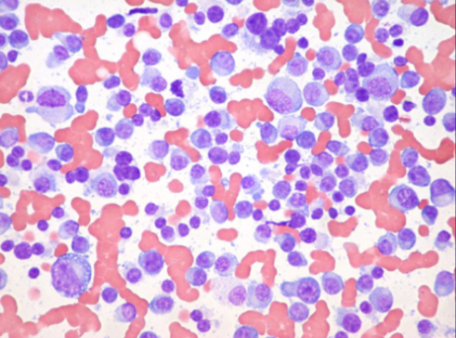
Fine Needle Aspiration
Fast, inexpensive
96% accuracy
Institution dependent
Unable to differentiate between in-situ vs CA

Slide 103
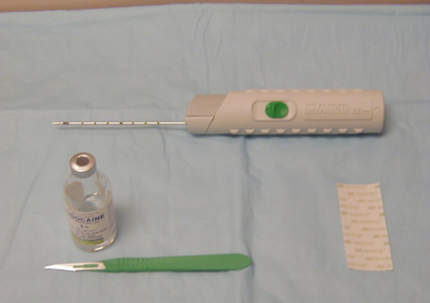
Core Needle Biopsy
14 – 18 gauge spring loaded needle
Tissue
Multiple

Slide 104
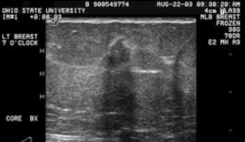

Slide 105
Large Core Biopsy
6 – 14 gauge core
Large Samples
Single insertion

Slide 106
Core Biopsy Vacuum Assisted

Slide 107
Stereotactic Biopsy
Suspicious mammographic abnormalities
Patients lay prone

Slide 110
Excisional Biopsy
Atypical lesions
LCIS
Radial scar
Atypical papillary lesions
Phyllodes
Inadequate tissue

Slide 112
Screening
Prior breast cancer or atypia - Annual mammography
Family Hx
- 10 years younger than relative’s diagnosis
BRCA - 25 y.o, annual mammography

Slide 113
Genetics
Early age of onset
2 breast primaries or breast & ovarian CA
Clustering of breast CA with: - Male breast CA - Thyroid CA - Sarcoma - Adrenocortical CA - Pancreatic CA - Leukemia/Lymphoma on same side of family
Family member with BRCA gene
Male breast CA
Ovarian CA

Slide 114
BRCA
Account for 25% of early-onset breast cancers
36 - 85% lifetime risk of breast cancer
16 – 60% lifetime risk of ovarian cancer

Slide 115
BRCA Management
Monthly BSE – 18 y.o
6 month CBE & annual mammo – 25 y.o
Discuss risk reducing options
Prophylactic Mastectomies
Salpingo-oophorectomy upon completion of child bearing
6 month transvaginal US & CA125 – 35. y.o

Slide 118
Carcinoma breast
Type
Ductal carcinoma
1-non invasive (DCIS)
2-invasiveductal carcinoma
LOBULAR Carcinoma
1-invacive
2-non invasive(LCIS)
Pages disease of the nipple
Sarcoma

Slide 136
Any Questions?

