Slide 1
Introduction to Toxicology
Dr Abdulaziz Alrabiah, MD
Assistant Professor
Department of Emergency Medicine
King Saud university Medical City
College of Medicine, KSU

Slide 2
Topics
Definition
Terminology
Classification of Toxic agents
assessment
history
Examination
investigation
Management
Disposition
Poison center No.

Slide 3
Definition
a science that deals with the adverse effects of chemicals on living organisms and assesses the probability of their occurrence

Slide 4
Why people get toxic?
intentional i.e. suicide
wrong dose (i.e. Insulin)
symptoms control (i.e. paracetamol for pain)
exposure i.e. radiation, organophosphate
bite i.e. snake bite

Slide 5
what are the routes of exposure?
inhalation (i.e. Nitrous oxide, CO)
skin or eye absorption (i.e. organophosphate)
ingestion : major one (i.e. paracetamol….etc)
injection (i.e. Opioids, insulin)

Slide 6
Assessment

Slide 7
History
may be unclear
substance
dose
rout of exposure
collateral Hx (i.e. family, friends, medical records)
Prehospital medical staff (i..e empty containers)
other (i..e hobbies, occupation, suicide note, change in behaviour recently)

Slide 8
Examination
Organ system | example of finding
General appearance | Malnurished (IV drug user, HIV infection)
CNS | Miosis (Opioids, organophsophate) Nystagmus/ataxia (ethanol)
CVS | Murmur (Endocarditis/IV drug user)
Respiratory system | Bronchorrhea/crepitations/hypoxia ( Organophosphate)

Slide 9
Examination
Organ system | Example of finding
GIT | oral cavity burns ( corrosive ingestion hyper salivation (cholinergic toxidrome
Urology | urinary retention ( anticholinergic toxicity)
Peripheral nerves | tremor (Lithium) Lead pipe rigidity (NMS) clonus/hyperreflexia (serotonin toxicity)
Dermal | bruising (anticoagulant) flush, dry skin(anticholinergic toxicity) warm, moist skin(sympathomimetic toxicity)

Slide 10
Do not forget …!
examine skin folds, clothes and bags for retained tablets or substances

Slide 12
Toxidrome
Cluster of symptoms and signs
enabling the identification of potential toxins when a clear history is unavailable

Slide 13
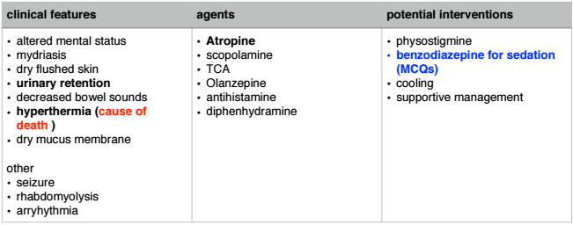
Anticholinergic = Antimuscarinic

Slide 14
Anti-cholinergic

Slide 15
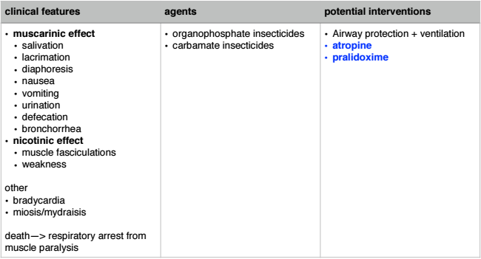
Cholinergic = Muscarinic

Slide 16
Cholinergic

Slide 17
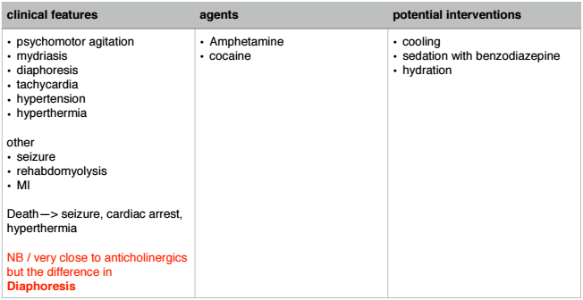
Sympathomimetics

Slide 18
Opioid

Slide 19
Sedative-hypnotic

Slide 20
Hallucinogenic

Slide 21
Other toxidromes
Toxidrome | Examination finding
Hypoglycemic(i.e.insulin) | altered mental status, diaphoresis, tachycardia, HT
Serotonin (i.e.SSRIs) | altered mental status, hyperreflexia, hypertonia(LL>UL), clonus, tachycardia
Neuromuscular Malignant(i.e.antipsychotics) | sever muscle rigidity, hyperpyrexia, altered mental status
Extrapyramidal (i.e.haloperidol) | Dystonia, torticollis, muscle rigidity
Ethanol | CNS depression, ataxia, dysartheria, smell of ethanol
Salicylate(i.e. Aspirin) | AMS, Resp Alkalosis, Metabolic Acidosis, Tinnitus, Tachypnoea, Tachycardia, diaphoresis, nausea vomiting

Slide 22
Diagnostic tests
Bedside :
Blood Glucose level : hypoglycaemia
ECG: Arrhythmias
VBG: i.e. metabolic acidosis —> paracetamol

Slide 23
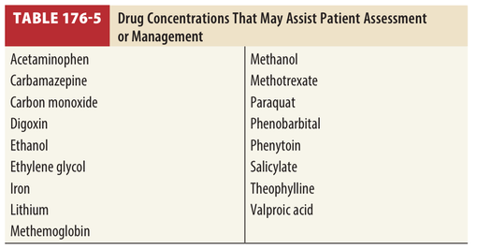
Diagnostic tests
Laboratory:
blood / urine drug level

Slide 24
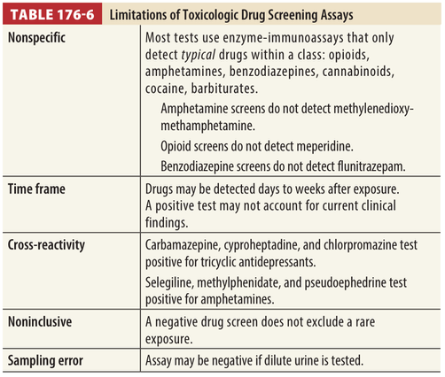
Diagnostic tests
what are the limitation of Drug screening assays?

Slide 25
Diagnostic tests
Electrolytes:
K level : i.e. hyperkalemia in digoxin overdose
LFT:
elevated liver enzymes in Paracetamol toxicity

Slide 26
Management:

Slide 27
Resuscitation
Airway:
intubation: if compromised
Breathing:
O2 administration, if hypoxic (i.e. O2sat <94%)
mechanical ventilation if intubated
Circulation :
hypotension
IV fluid ( 10-20ml /Kg ) , avoid excess fluid administration
specific antidote
inotropic support ( i.e.Adrenaline infusion)
aim : systolic BP > 90mmHg or MAP >65 mmHg

Slide 28
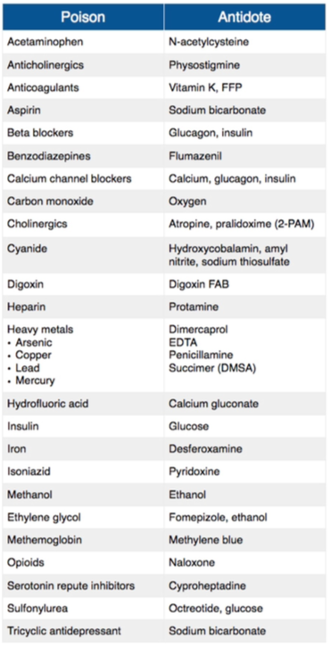
Resuscitation
Antidotes list

Slide 29
Resuscitation
some specific presentations

Slide 30
Hypoglycemia
BGL : < 4mmol
give IV dextrose (Glucose)

Slide 31
Cardiac Arrhythmias
Anti-arrythmic drugs are not first line treatment in toxin induced arrhythmias
treatment:
O2 sat
antidote (i.e. digoxin Fab in digoxin overdose)

Slide 32
Seizure
treatment
1st : IV benzodiazepine ( except in Isoniazed toxicity —> Pyridoxine)
2nd: Barbiturates
treat hypoglycaemia and hyponatremia
No rule for Phenytoin in toxin induced seizure

Slide 33
Agitation
1st line treatment : benzodiazepine
2nd line treatment : antipsychotic agents

Slide 34
Hyperthermia and hypothermia
core temperature > 39* —> aggressive cooling
core temperature <32* —> aggressive rewarming

Slide 35
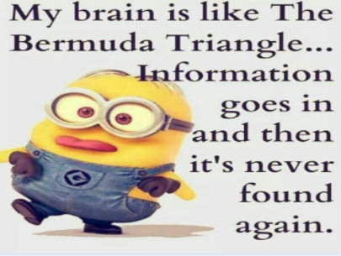

Slide 36
Decontamination
two ways
GIT Decontamination
Enhanced Elimination

Slide 37
GIT decontamination
Activated Charcoal
whole bowel irrigation (WBI)
Gastric lavage
Induced emesis ( Syrup or Ipecac)

Slide 38
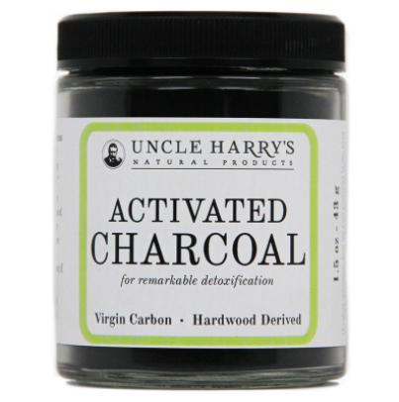
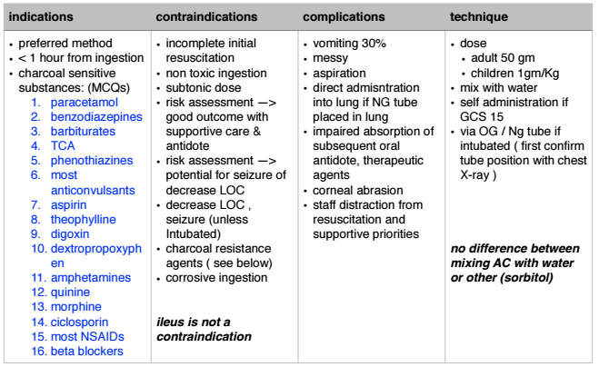
Activated Charcoal (single dose)

Slide 39
Activated Charcoal (single dose)

Slide 40
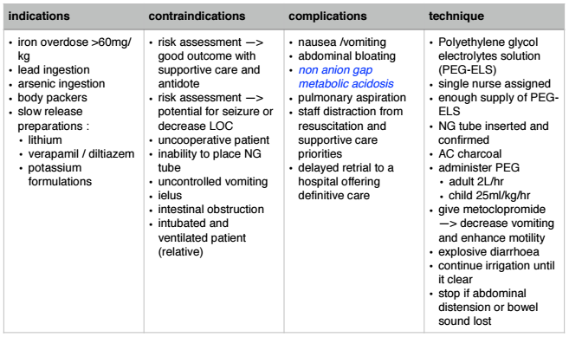
whole bowel irrigation

Slide 41
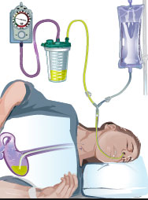
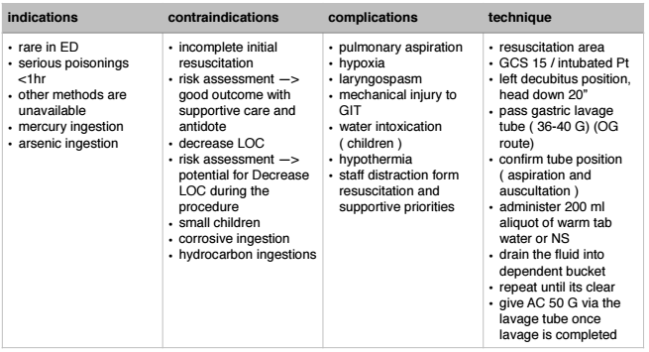
Gastric Lavage

Slide 42
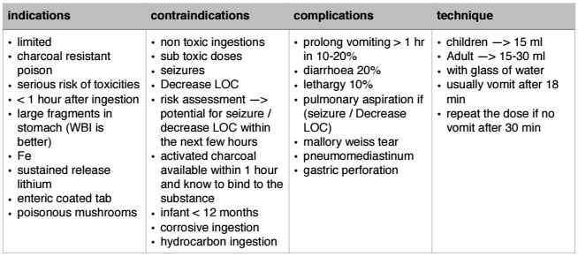
Induced emesis (Syrup or Ipecac)

Slide 43
Enhanced Elimination
Multiple dose activated charcoal
urine alkalisation
extracorporeal technique of elimination
harm-dialysis and haemofiltration
charcoal haemoperfusion

Slide 44
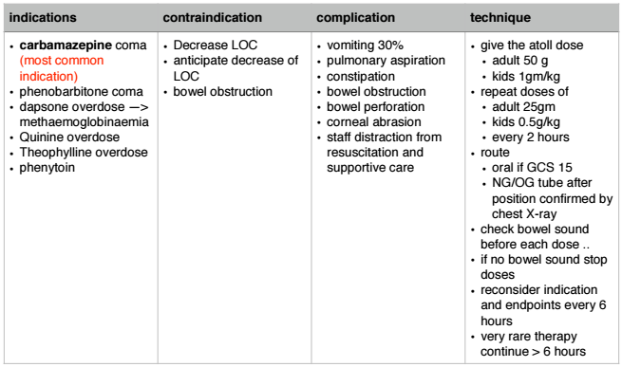
Multiple doses of AC

Slide 45
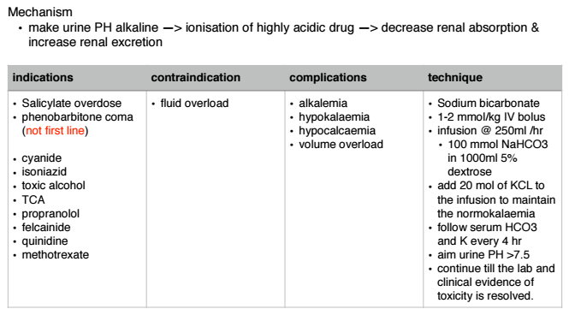
Urinary Alkalinisation

Slide 46
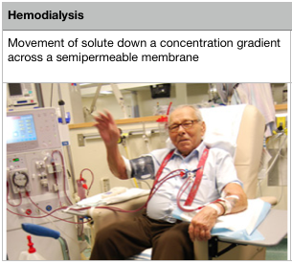
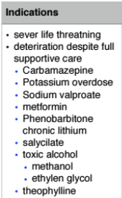
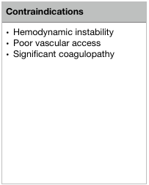
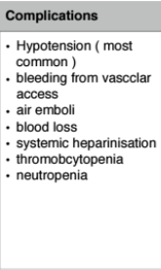
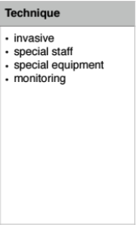
Extracorporeal technique of elimination

Slide 47
Disposition
if asymptomatic for 6 hours in ED —> discharge
otherwise admission to hospital is required

Slide 48
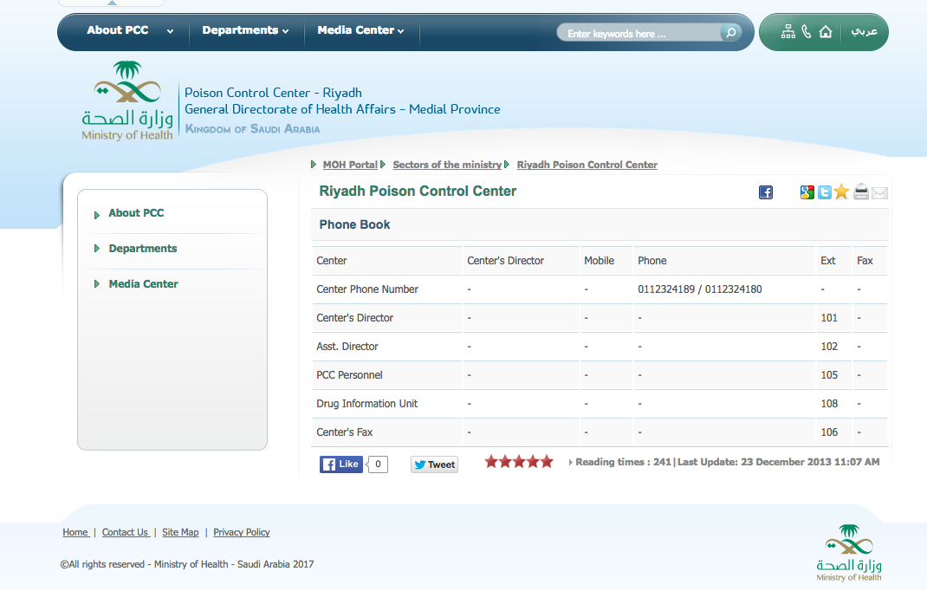

Slide 49
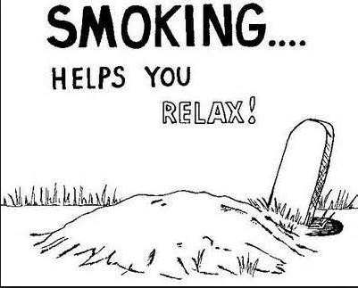
Thank You
All the best !

