Slide 1
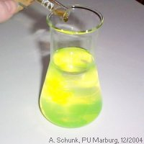
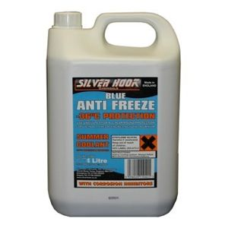
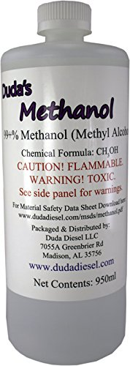
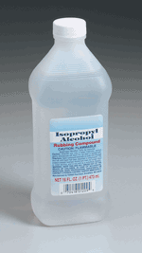
Toxic Alcohols
Badr Aldawood, FRCPC
March, 2019

Slide 2
Outline
Biochemistry
Ethanol
Methanol
Ethylene Glycol
Isopropanol

Slide 3
Alcohols molecular structure?

Slide 4
Alcohols: R-OH
OH
H
H
H-C-H
H-C-OH
H-C-OH
H-C-H
H-C-OH
H
H
H
Methanol
1C
Ethanol
2C
Ethylene Glycol
2C

Slide 5
Alcohols: R-OH
H
H
H
H-C-H
H-C-OH
H-C-OH
H-C-OH
H-C-OH
H-C-H
H-C-H
H
H
Isopropanol
3C
Propylene Glycol
3C
Benzyl Alcohol

Slide 6
Ethanol Metabolism ?

Slide 7
Ethanol Metabolism ?
OH
O
O
H-C-H
ADH
C-H
ALDH
C-OH
H-C-H
H-C-H
H-C-H
H
H
H
Ethanol
Acetaldehyde
Acetic Acid
ADH = Alcohol Dehydrogenase
ALDH = Aldehyde Dehydrogenase

Slide 8
Ethanol Toxicity
Most commonly abused drug in the world
Majority of morbidity and mortality is due to trauma owing to impaired cognitive function
Rate of metabolism 20 mg/dL/h

Slide 9
Which one will get intoxicated from one can of beer?
Blood ethanol levels correlate poorly with the degree of intoxication (Tolerance)

Slide 10
Ethanol Toxicity clinical presentation ?

Slide 11
Ethanol Toxicity clinical presentation ?
Disinhibited behavior
Slurred speech
Impaired coordination
Later: Respiratory and (CNS) depression

Slide 12
Ethanol Toxicity work up?
Ethanol levels
ABG/VBG
Renal profile/Lytes
Don’t miss possible injuries (TRAUMA)

Slide 13
Ethanol Toxicity Treatment?
Observation
IV Fluid Hydration (?Alcoholic Ketoacidosis)
Thiamine ?
Discharge the patient once sober

Slide 14
Methanol
Molecular weight 32
Low freezing point
Highly volatile
H
H-C-OH
H
Methanol

Slide 15
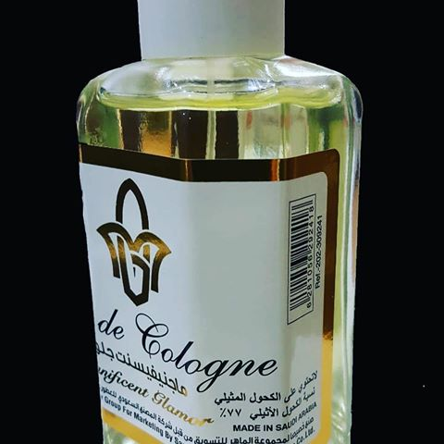
Methanol containing products?

Slide 16

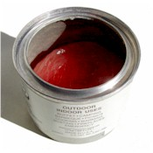
Methanol containing products?
Gas Line Antifreeze 100%
Windshield washer fluid 30%
Varnish removers
Fuel for food warming 3-70%
Industrial uses

Slide 17
Methanol Metabolism?

Slide 18
Methanol Metabolism
H
O
O
ADH
ALDH
H-C-OH
H-C-H
H-C-OH
H
H
H
Methanol
Formaldehyde
Formic Acid
ADH: Alcohol Dehydrogenase
ALDH: Aldehyde Dehydrogenase

Slide 19
Methanol Toxicity ?

Slide 20
Methanol Toxicity
Delayed onset (8-12hrs)
CNS depression, Ataxia, Confusion
Abdominal pain
Multisystem organ failure

Slide 22
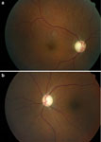
Methanol Toxicity
Visual complaints
  Retinal damage
  “Snow storm”
Anion gap acidosis
  Tachypnea
Yang CS et al Eye 2005;19:806-809
Notes:
Optic atrophy with cupping 2 months after surviving
Pt with non-reactive pupils and min light perception

Slide 23
Methanol work up?

Slide 24
Methanol work up?
ABG/VBG
Osmolality
Serum levels
Lactate
Renal profile
Ethanol level

Slide 25
Ethylene Glycol (EG)
Low Volatility
Low freezing point
High boiling point
H
H-C-OH
H-C-OH
H
Ethylene Glycol

Slide 26
Ethylene Glycol containing products?

Slide 27
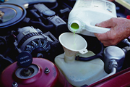
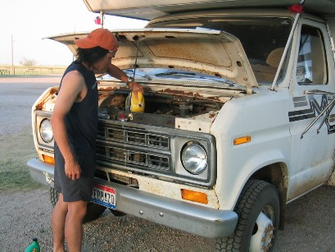
Ethylene Glycol
Coolant/Antifreeze
Solvents
Notes:
Sweet flavor

Slide 28
Ethylene Glycol Metabolism?

Slide 29
Ethylene Glycol Metabolism
H
O
O
H-C-OH
C-H
C-OH
ADH
ALDH
H-C-OH
H-C-OH
H-C-OH
H
H
H
Ethylene Glycol
Glycoaldehyde
Glycolic Acid
ADH = Alcohol dehydrogenase
ALDH = Aldehyde dehydrogenase

Slide 30
Ethylene Glycol Metabolism
O
O
O
C-OH
LDH
C-OH
C-OH
H-C-OH
H-C-H
H-C-OH
H
O
O
Glycolic Acid
Glyoxylic Acid
Oxalic Acid
B₁, Mg²⁺ B₆
α-OH-β Ketoadipic Acid Glycine + Benzoic Acid
LDH = Lactate dehydrogenase

Slide 31
Ethylene Glycol Toxicity ?

Slide 32
Ethylene Glycol Toxicity
Onset 4-6 hours
Anion gap acidosis
  Tachypnea

Slide 33

Ethylene Glycol Toxicity
Abdominal pain
Hypocalcemia ?
Calcium oxalate crystals in urine
Renal failure (Calcium Oxalate)
Notes:
Sweet tasting, occasional fluorescein

Slide 34
Toxicity tests
Methanol/EG
Ethylene glycol:
  Limited utility of fluorescence of urine
  May note crystals in urine using Woods lamp
Methanol
  Hyperemic retina or visual complaints

Slide 35
Identifying Patients for Treatment: Methanol/EG
Serum ethylene glycol or methanol level
Action level for treatment:
  Methanol / EG > 25 mg/dL
  Any level with acidosis
Notes:
Outbreak 323 persons in orison?
R
Or any level with an acidosis

Slide 36
Limits of Serum Levels
Useful prior to onset of acidosis or in massive overdoses
Parent compound not directly toxic
Levels not universally available
EG or Methanol
Anion Gap
Time
Notes:
No good test for rapid quatification of metabolites

Slide 37
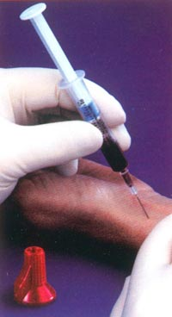
Arterial Blood Gas/Lactate
Acidosis indicates advanced poisoning
Lactate usually low*
Patients with acidosis should receive treatment

Slide 38
Osmol Gap ?

Slide 39
Osmol Gap ?
Osmol Gap = Measured Osmols - Calculated Osmols
Calculated:
  2 Na + BUN + Glucose + 1.25 Ethanol
Lab Measurement

Slide 40
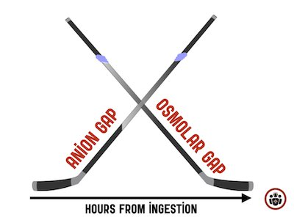

Slide 41
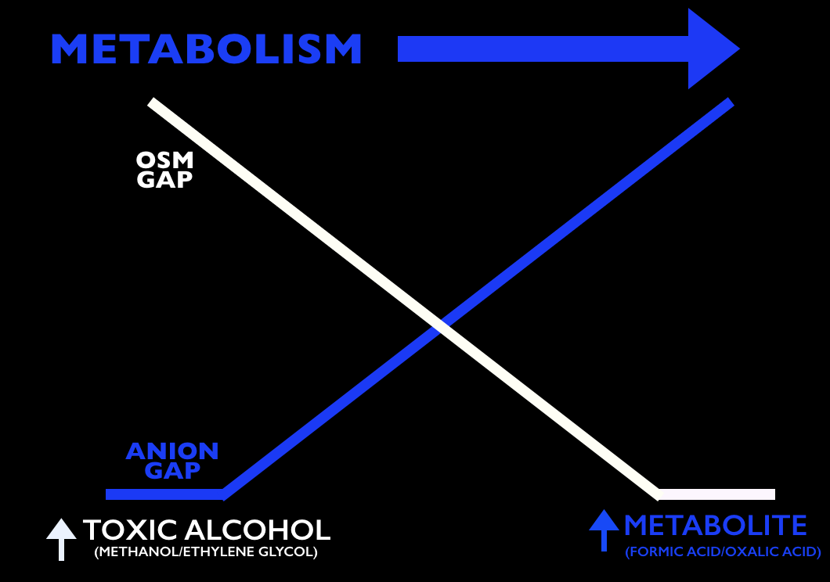

Slide 42
Osmol Gap: Limitations
Roughly the gap should be < 10
Normal Osmol Gap in setting of poisoning does not rule out a treatable level
Osmol Gap diminishes as parent compound is metabolized
Osmol Gap
Anion Gap
Time
Notes:
If late in poisoning, patient requires treatment regardless
Only parent compound is osmotically active
Other conditions can cause osmol gap

Slide 43
Treatment

Slide 44
Treatment
Limit absorption:
Prevent metabolism of parent compound to toxic metabolite
Enhance elimination
  Parent
  Metabolites
Correct Derangements
NG Tube Suction
ADH Inhibition
Substrates/Other
Hemodialysis

Slide 45
Antidotal Therapy

Slide 46
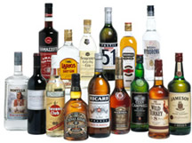
Antidotal Therapy: Ethanol
Serum ethanol inhibits metabolism:
    EG
    Methanol
Onset of toxicity EG/Methanol may be delayed
Notes:
In a pateitn with undifferentiated anion gap metabolic acidosis and high ethanol level, the diagnosis of a toxic alcohol should be questioned
The only setting in which this may occur is a patient with advanced poisoning who ingests ethanol after acidosis develops, highly unlike;y

Slide 47
Treatment
Methanol
Ethanol
Ethylene Glycol
ADH
ALDH
Aldehyde
Acid
Ethanol more avid for ADH
  6-8 X more avid than ethylene glycol
  4 X more avid than methanol

Slide 48
Ethanol Infusion: Management
Serial ethanol levels
Watch glucose* and sodium*
Observe for respiratory status*
* Especially in children

Slide 49
1st line Antidote Fomepizole
A blocker of alcohol dehydrogenase
Has replaced ethanol as the agent of choice in known or suspected exposures
Minimal adverse effects
Notes:
Advantage: pediatrics where one sip of 100% methanol can be toxic
Can initatiate therapy and wait for level

Slide 50
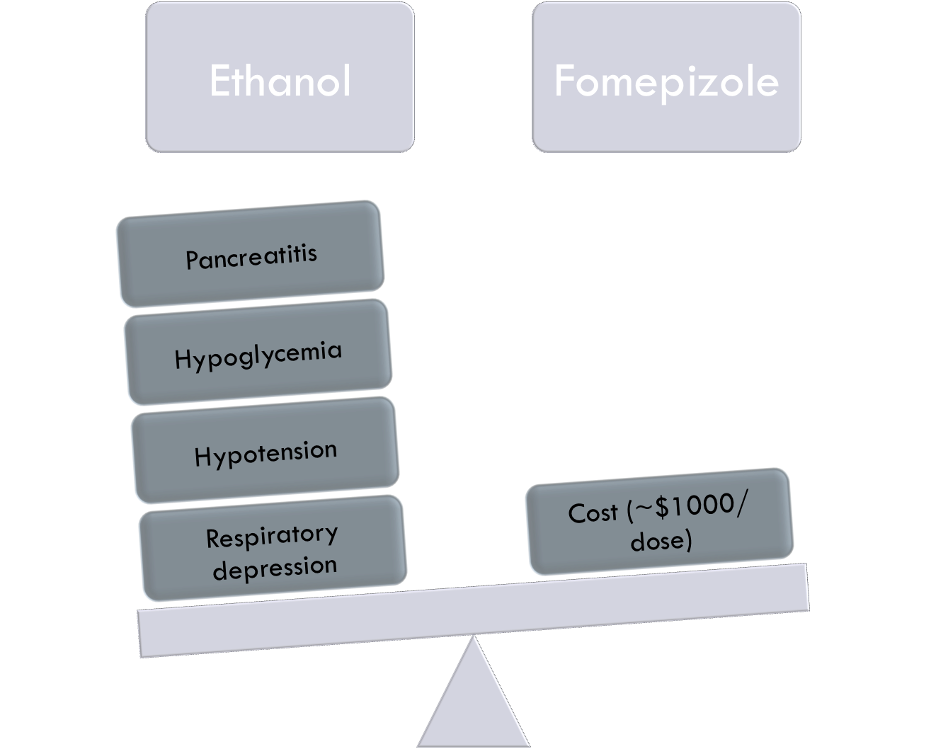

Slide 51
Hemodialysis ??

Slide 52
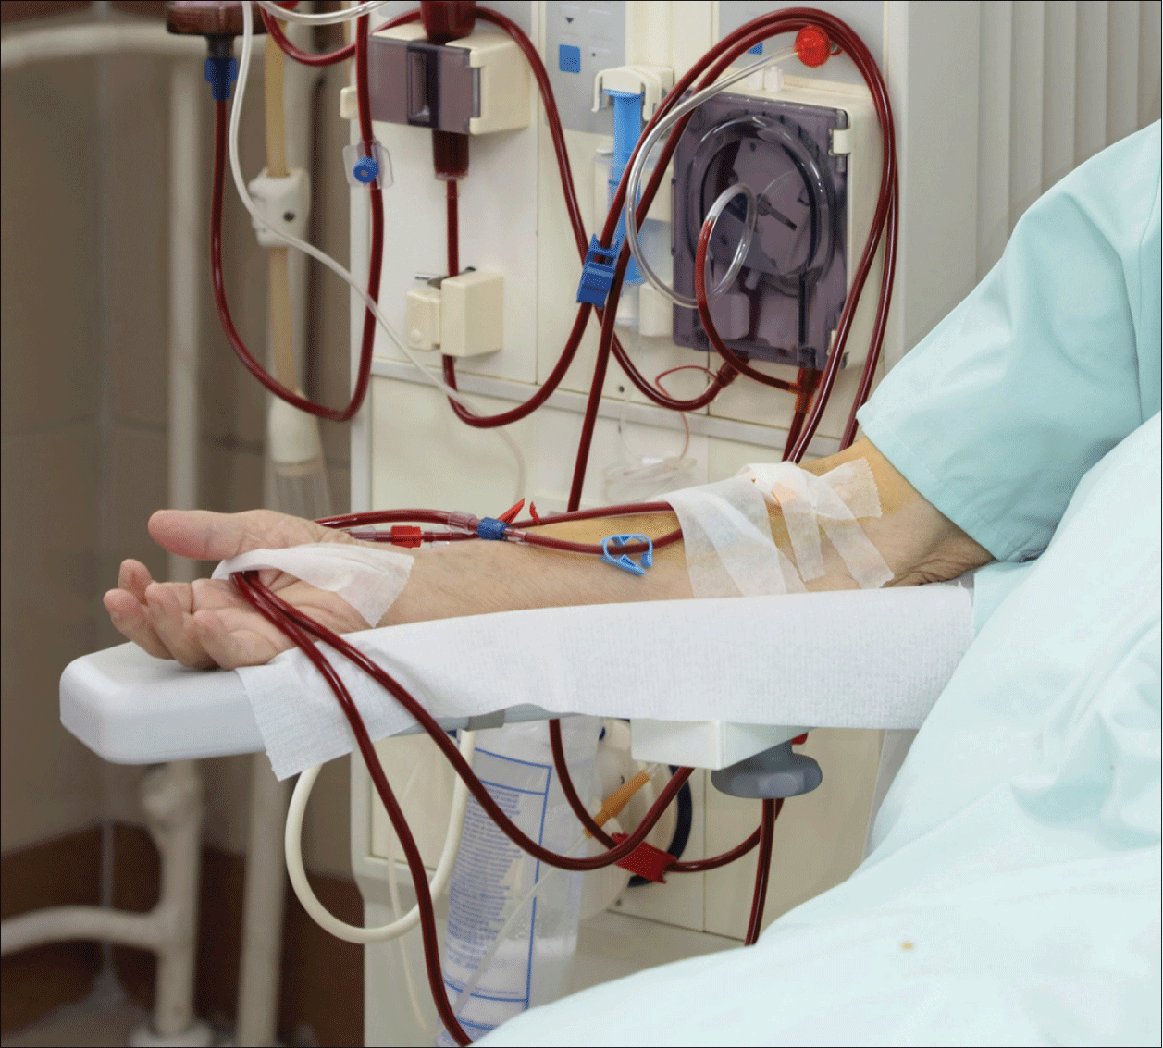
Hemodialysis
Consult nephrology early in acidemic patients
Levels toxic alcohol ≥ 25 mg/dL

Slide 53
Adjuncts for Methanol Poisoning
Sodium bicarbonate
  pH < 7.30
  Can ion trap formic acid in urine and enhance elimination
Folate administration
  Facilitates conversion of one carbon fragments to CO₂
Notes:
For acidemic patients with methanol
N ot necessarily helpful in EG
1-2mEq/kg followed by an isotonic drip
Observe potassium
Animal models suggest folate minimizes formic acid half-life,

Slide 54
Adjuncts for Ethylene Glycol Poisoning
O
O
O
C-OH
LDH
C-OH
C-OH
H-C-OH
H-C-H
H-C-OH
H
O
O
Glycolic Acid
Glyoxylic Acid
Oxalic Acid
B₁, Mg²⁺ B₆
α-OH-β Ketoadipic Acid Glycine + Benzoic Acid
LDH = Lactate dehydrogenase

Slide 55
Adjuncts for Ethylene Glycol Poisoning
To enhance metabolism away from oxalates*
  Thiamine (B1)
  Pyridoxine (B6)
Notes:
But benign intervention

Slide 56
Isopropanol
Metabolized to :
  Acetone
Acidosis: NO
Osmol Gap: YES
Supportive care
H
H-C-H
H-C-OH
H-C-H
H
Isopropanol
3C

Slide 58
Summary
For Methanol&EG Poisoning
  Get early Level, VBG, Lactate, Ethanol level
  Caution when using osmol gap
  Antidote: 1st line Fomepizole
  Hemodialysis is very useful in elimination.

