Slide 1
Aspirin & NSAID

Slide 2
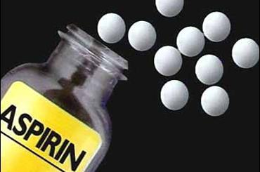

Slide 3
Pathophysiology
Peak level = 18-24 hrs.
Acidemia = non-inoized ASA = cross BBB
ASA = early stimulate respiratory center

Slide 4
Pathophysiology
ASA = increased pulmonary vascular permeability
Reversible sensorineural hearing loss correlates ASA concentrations.

Slide 5
Pharmacokinetics
rapidly absorbed from GI tract within 30 minutes.
Two thirds of a therapeutic dose is absorbed in 1 hour.
peak levels occur in 2 to 4 hours.
Large ingestions ,,,
Delay gastric emptying ,,,
Prolonged absorption ,,,
Rising serum levels for 12 hours or more
Free salicylate and its conjugates are eliminated by renal excretion.

Slide 6
When the metabolic pathways become saturated, urinary excretion of salicylic acid determines the half-life, which becomes prolonged and may approach 15 to 30 hours with toxic doses.
At therapeutic salicylate concentrations, elimination follows first order kinetics, and excretion is proportional to salicylate concentration.
When serum salicylate concentrations are greater than 30 mg/dL, however, elimination follows zero order kinetics, and the metabolic rate is constant.

Slide 7
Children Clinical feature
Primarily = metabolic acidosis and acidemia (<4 years old
If >4 years of age its just like adult
Presenting signs fever, hyperventilation, and altered mental status with volume depletion, acidosis, and severe hypokalemia.
Poor prognosis = hyperpyrexia
Chronic higher mortality

Slide 8
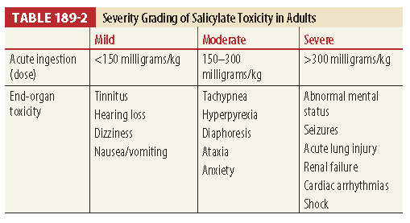
Toxic dose of aspirin is 200 to 300 mg/kg, and ingestion of 500 mg/kg is potentially lethal.
Five mL of oil of wintergreen contains 7 g of aspirin and can be deadly to a toddler

Slide 9
Diagnosis
Don’t use single level
obtain serial serum salicylate concentrations initially every 1 to 2 hours until level declined then every 4-6 hrs

Slide 10
Treatment of ASA overdose
Treat dehydration; maintain urine output at 2 to 3 mL/kg/hr.
Correct potassium depletion with goal serum level of 4.5 mEq/L.
Consider activated charcoal (AC); 25 grams every 2 to 4 hours for two to four doses if tolerated.
Alkalinize urine with goal urine pH of 7.5 to 8.0.
Infuse bicarbonate drip: 132 to 150 mEq (three 50-mL ampules) of 7.5% or 8.4% sodium bicarbonate (NaHCO3) in 1 L of dextrose 5% in water (D5W) + 40 mEq of potassium chloride (KCl) running at 2 to 3 mL/kg/hr.
Allow serum pH up to 7.55.
Do not attempt forced diuresis.

Slide 11
Initiate hemodialysis if any of the following occur:
Altered mental status, coma, seizure
Renal failure
Hepatic failure
Pulmonary edema or respiratory failure Severe acid-base imbalance (pH <7.1 to 7.2)
Deterioration in condition
Failure of urine alkalinization
Rapidly rising salicylate level
Serum salicylate concentration ≥100 mg/dL after acute ingestion
Serum salicylate concentration ≥40 mg/dL after chronic ingestion
Intubation

Slide 12
Administer intravenous (IV) dextrose 0.5 to 1 g/kg IV for any central nervous system (CNS) abnormalities (altered mental status, coma, agitation, seizure)

Slide 13
Disposition
A patient may be discharged from the ED if serial declining salicylate levels.
Hospital admission is required for pulmonary edema, CNS symptoms, seizures, acidosis, electrolyte disorders, dehydration, renal insufficiency, or increasing serum levels during serial testing.
Overdosed of enteric-coated or modified-release preparations of aspirin should be treated and observed for approximately 24 hours, with serial serum salicylate concentrations.

Slide 14
CONT…
Consultation with a clinical toxicologist is recommended.
The mortality rate for chronic salicylate intoxication is 25%, compared with a mortality rate of 1% after acute salicylate intoxication.
With any case of intentional overdose, psychiatric evaluation is essential.

