Slide 1
Opioids & Sedatives
Toxicity
Aref Melibary MD, FRCPC, ABEM
Assistant Professor of Emergency Medicine
Consultant Emergency Medicine & Critical Care Medicine
Dept. of Emergency Medicine
King Saud University Medical City
dr_aref@hotmail.com

Slide 2
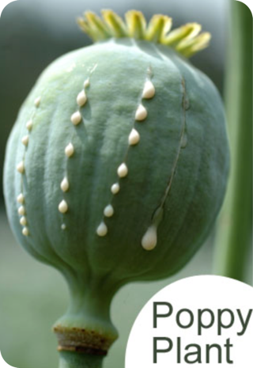
What Are Opioids?

Slide 3
Exudate of the opium poppy (Papaver somniferum)
Known to relieve pain, diarrhea, produce euphoria
Addiction to opium became commonplace
Opioid vs Opiate vs Narcotic?

Slide 4
Examples of Opioids
Morphine
Heroin
Codeine
Fentanyl
Meperidine
Methadone

Slide 5
On What Receptors do Opioids work on?

Slide 6
Mu (μ)
Located at supraspinal and spinal sites
Analgesia and respiratory depression
Mioisis, euphoria, reduced GI motility
Kappa (κ)
Dorsal horn of spinal cord and brain stem
Analgesia, miosis, sedation
Delta (δ)
Binding sites for endogenous peptides
Analgesia, dysphoria, delusions, hallucinations

Slide 7
WHAT IS THE TOXIDROME
OF OPIOID TOXICITY?

Slide 8
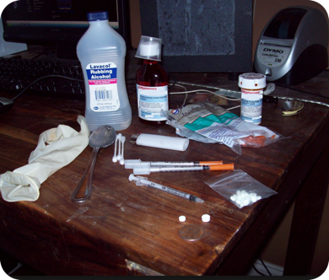
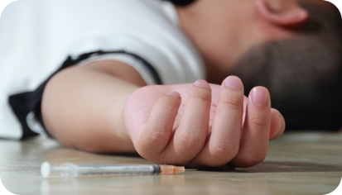
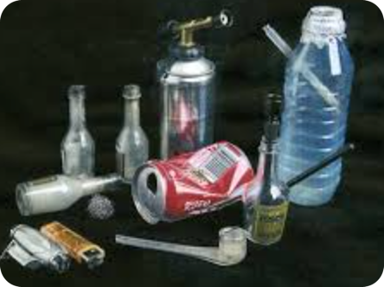
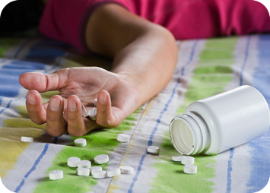

Slide 9
The Opioid Toxidrome
CNS depression
Respiratory depression
Miosis

Slide 10
Other Opioid Effects
Sensorineural hearing loss
Mild hypotension (Histamine release) and Bradycardia
Nausea & Vomiting (watch out for ileus)
Urinary Retention
Pruritus/ Urticaria and Flushing

Slide 11
Management
ABC’s and Supportive therapy
Antidote

Slide 12
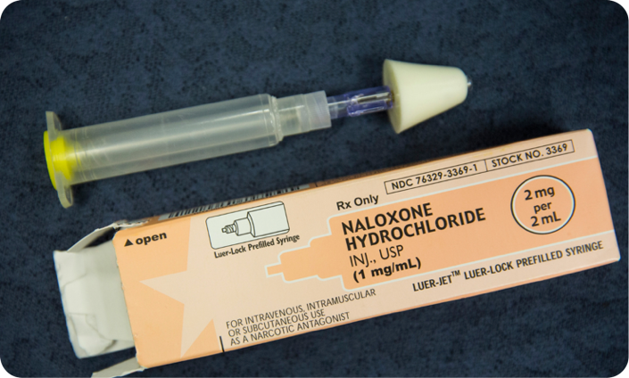

Slide 13
Pure Opioid antagonist
Routes?
Competitively bind opioid receptors and reverses all opioid mediated action
Dose ?
Half Life? Why is it important??

Slide 14
Naloxone 1/2 life is 1 -2 hours
Morphine 1/2 life approx. 2 hours
The duration of action of many opioids, especially after overdose, is significantly longer than that of naloxone. Patients responsive to naloxone should be observed for recurrence of opioid toxicity after the effect of naloxone has resolved.

Slide 15
Opioid Withdrawal

Slide 16
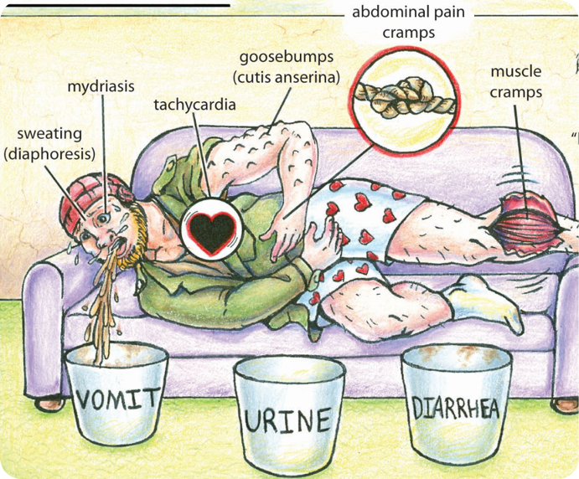
NOT LIFE THREATENING!

Slide 17
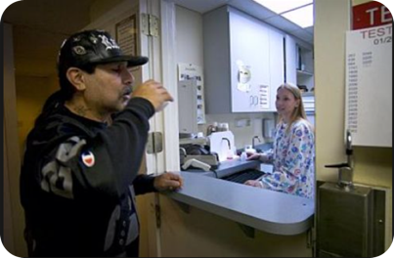

Slide 18
Methadone
Long half life
Requires a dose every 24hrs

Slide 19
Benzodiazepine Toxicity

Slide 20
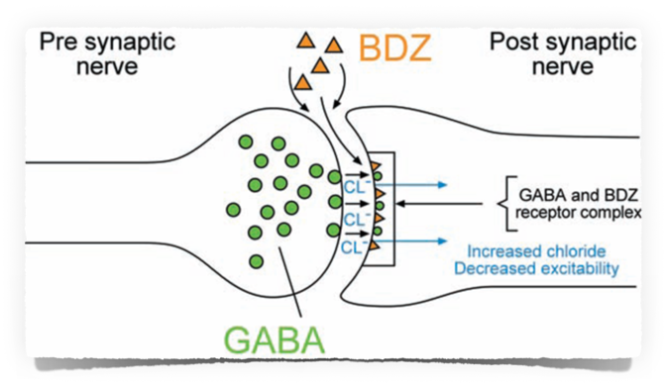
Mechanism of Action
Benzodiazepine bind to benzodiazepine receptor & potentiates GABA effects on the chloride channel —> increasing intracellular flux of CL ions & hyperpolarizing the cell
The net effect is a diminished ability of the nerve cell to initiate an action potential, inhibiting neural transmission!

Slide 21
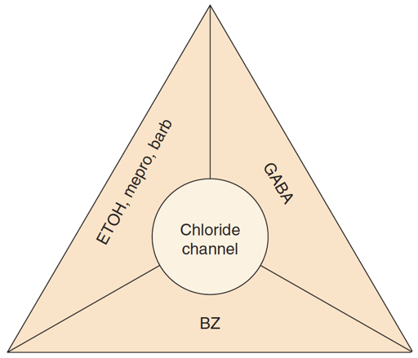

Slide 22
Clinical Effects
Sedative
Hypnotic
Anxiolytic
Anticonvulsant

Slide 23
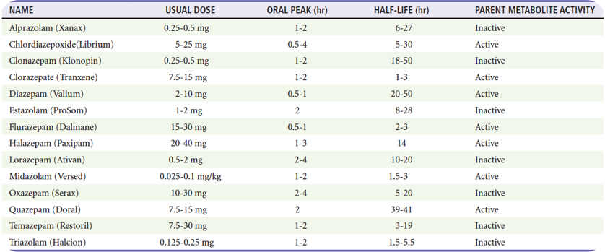

Slide 24
Clinical Features of Benzo Poisoning
CNS depression (spectrum)
Resp. depression (non central)
Hypotension (uncommon)
Potentail complications: Aspiration - Pressure sores

Slide 25
Why do they get HAGMA ACIDOSIS?

Slide 26
How to Diagnose?
Differential Diagnosis?

Slide 27
Management
Supportive
Antidote

Slide 28
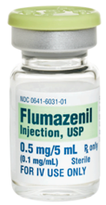
Flumazenil
Nonspecific competitive antagonist of the benzo receptor
Reverse benzodiazepine-induced sedation after GA, PSA, & confirmed benzodiazepine overdose
Not recommended for the routine reversal of sedative overdose in the ED

Slide 29
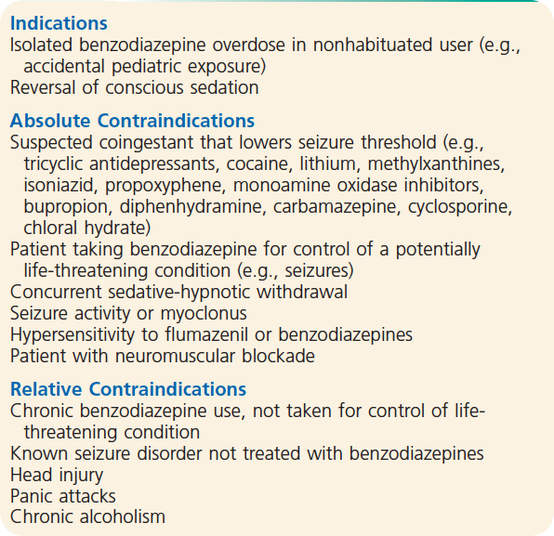

Slide 30
Complications
Seizures
Dysrhythmia
Reported mortalities
Precipitate withdrawal

Slide 31
Withdrawal

Slide 32
QUESTIONS?
dr_aref@hotmail.com

